Slide 1
Tumbling of JLab-2
Status

Slide 2
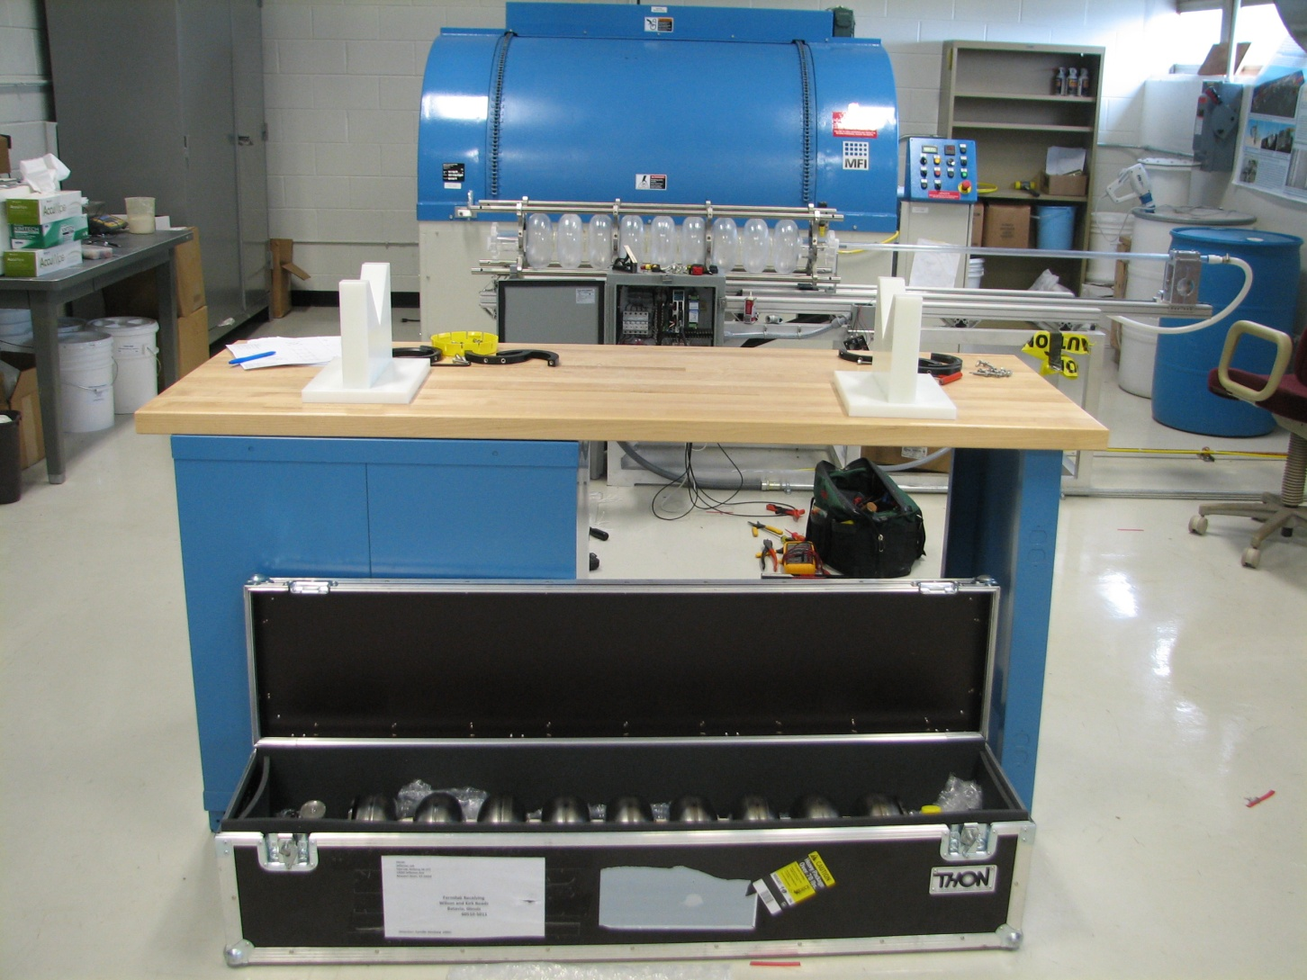
Tumbling Prep Process – Unloading Cavity

Slide 3
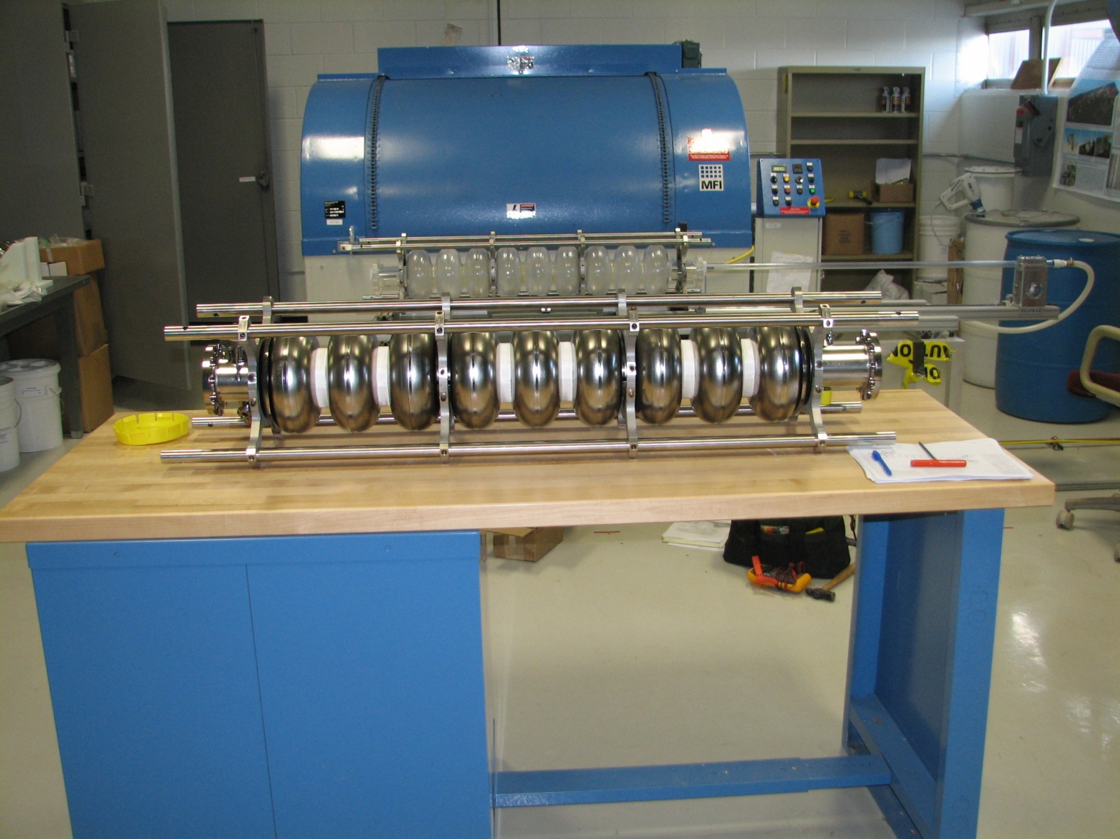
Tumbling Prep Process – Frame Around Cavity

Slide 4
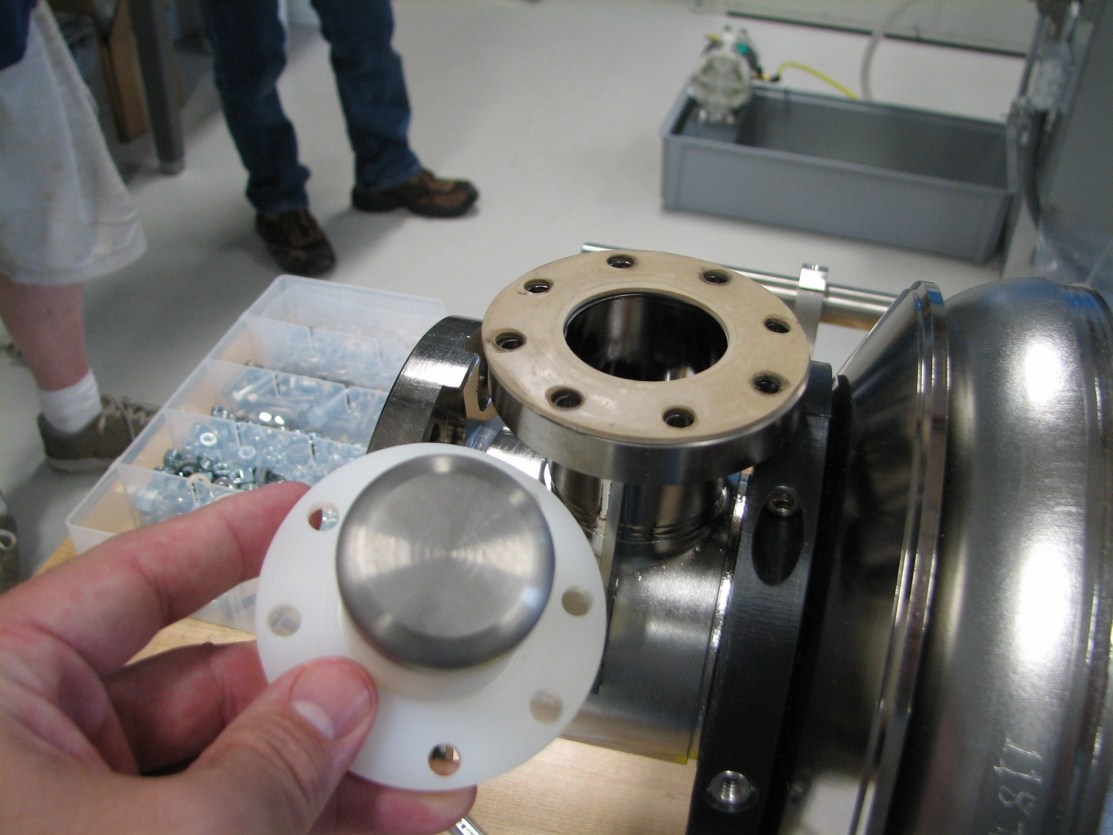
Tumbling Prep Process – Input Coupler

Slide 5
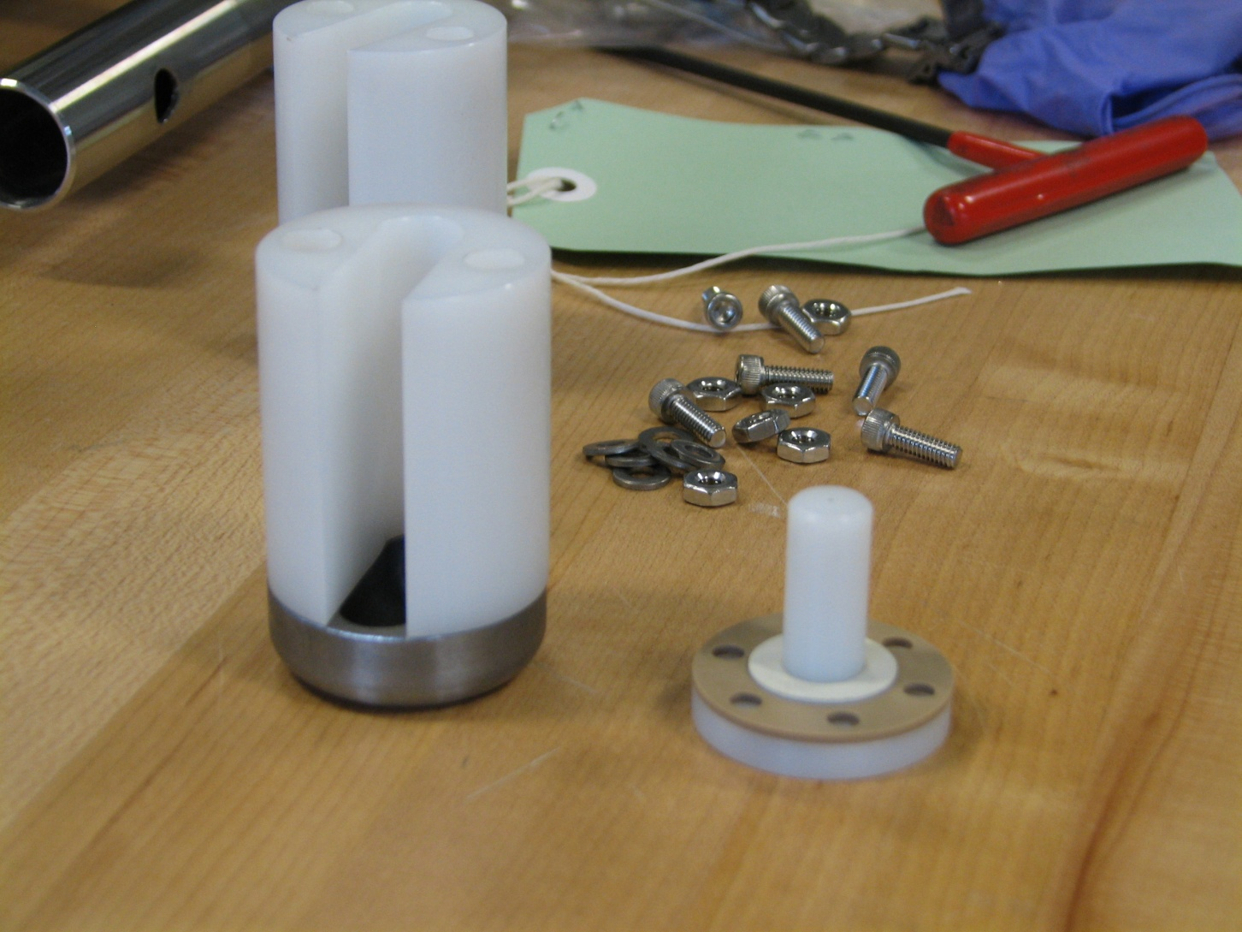
Tumbling Prep Process – HOM Can

Slide 6
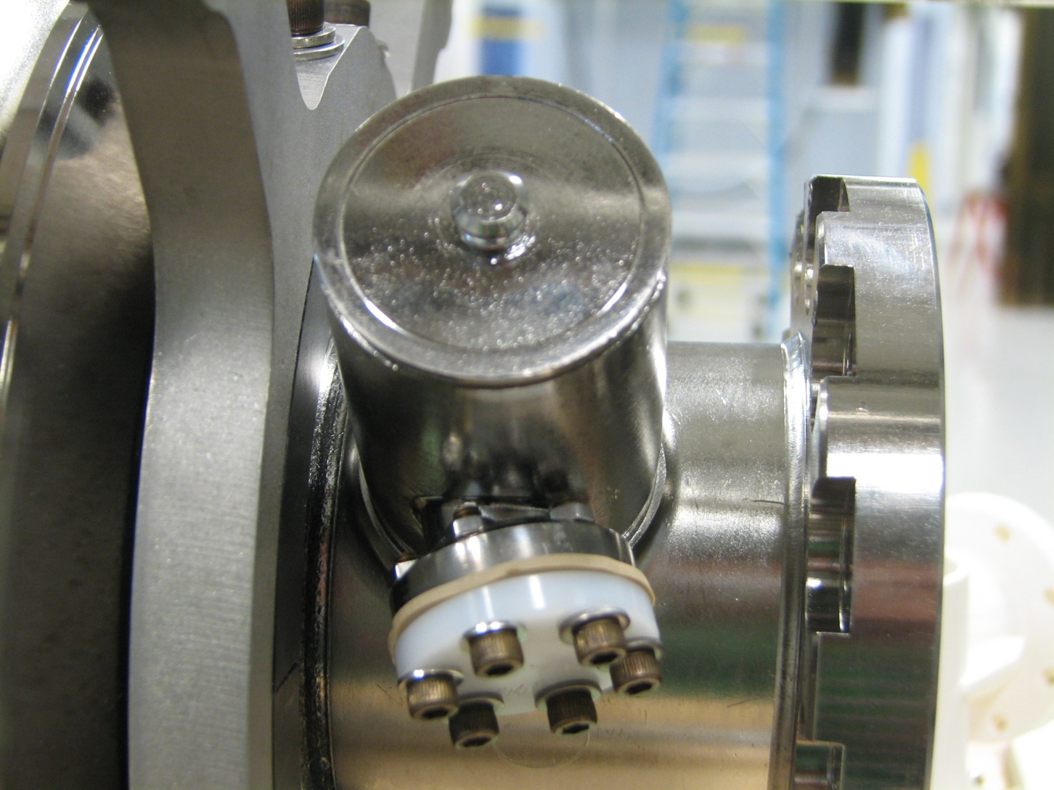
Tumbling Prep Process – HOM Can

Slide 7
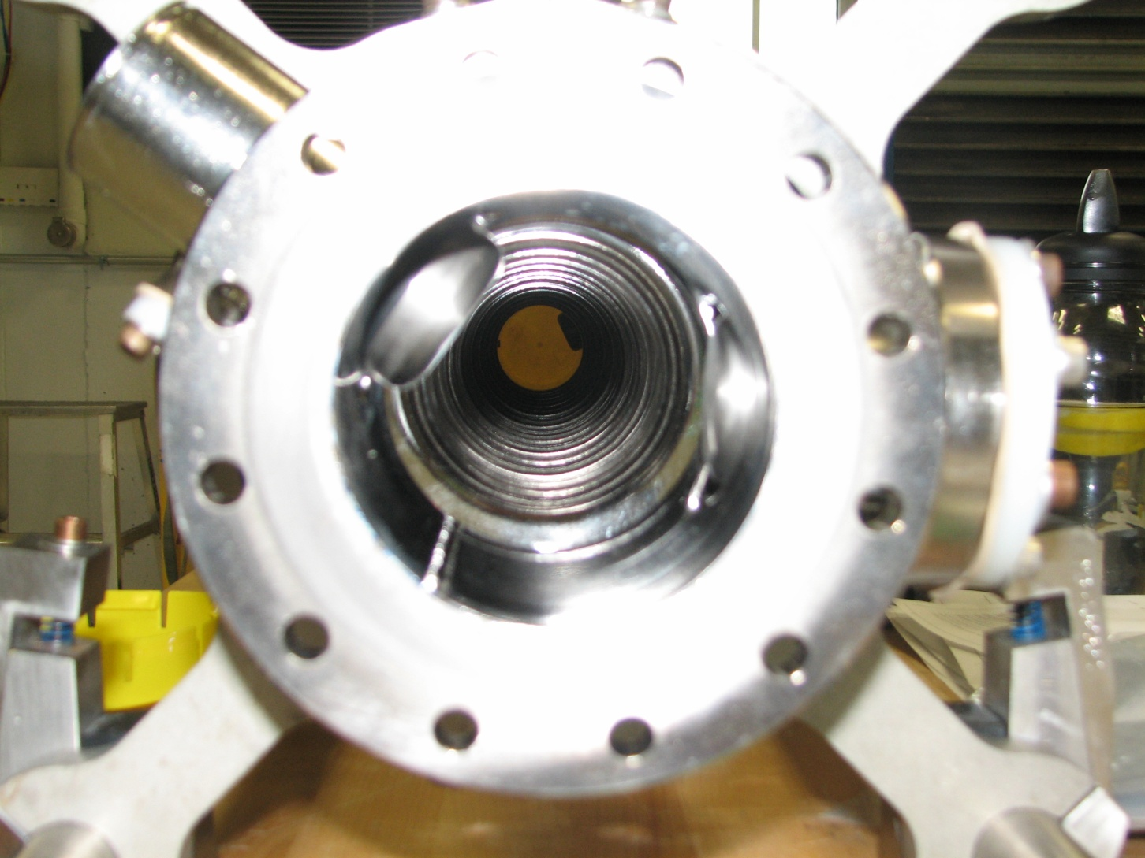
Tumbling Prep Process - Plugs

Slide 8
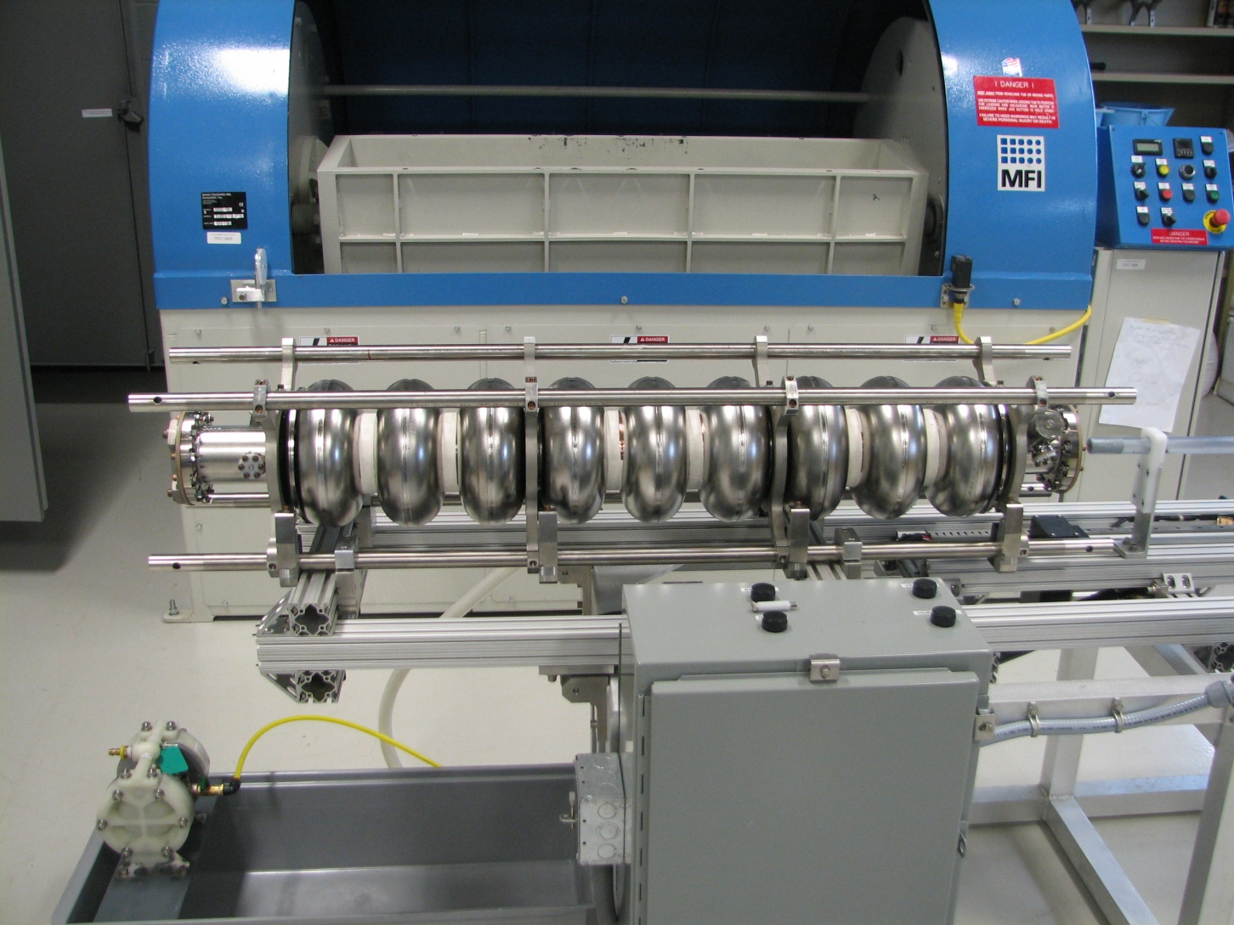
Tumbling Prep Process – Rinse Station

Slide 9
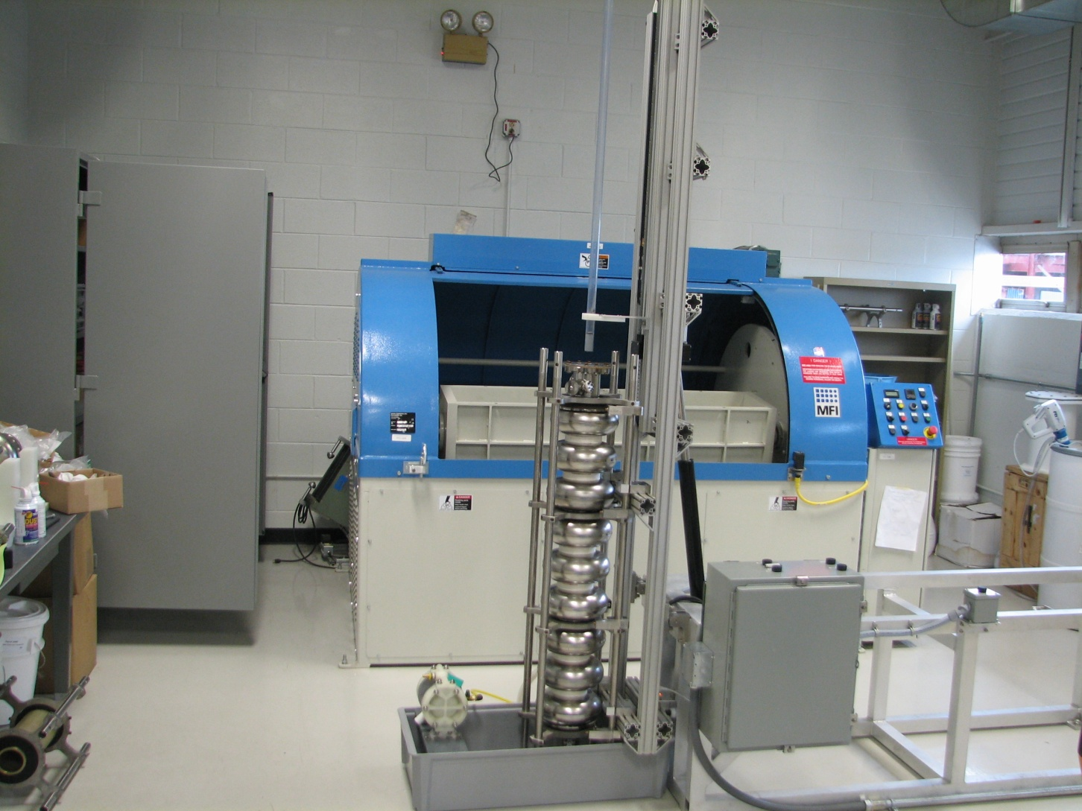
Tumbling Prep Process – Load Media

Slide 10
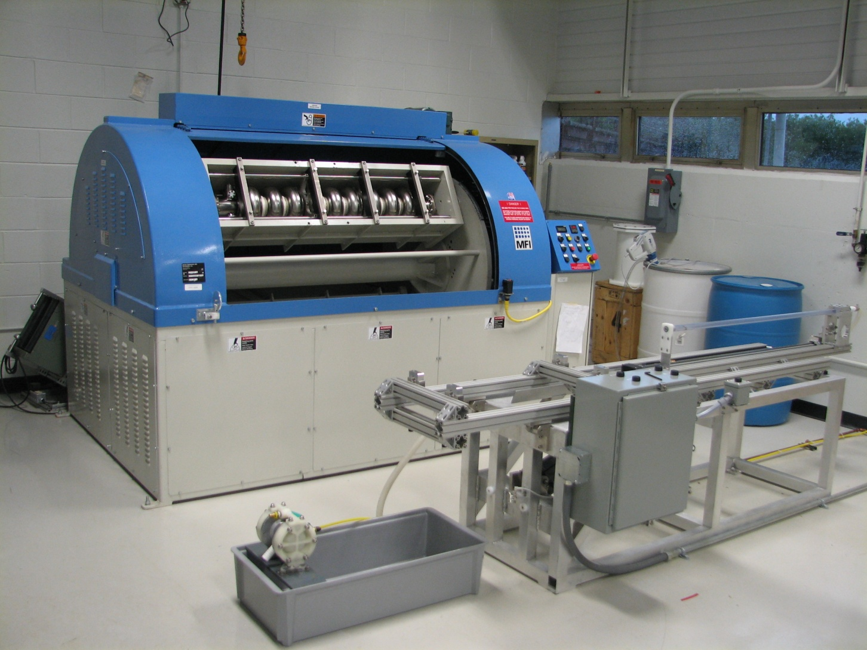
Tumble

Slide 11
Tumbled
Cavity previously processed with bulk EP and 2 light EPs. Max performance around 31 MV/m. Has a mode mixing problem.
Tumbled for 5 hours with cutting media (3/8 inch oblong ceramic pyramid)
Removed 40 microns from equator and 10 microns from beam tube. Unknown removal rate on iris.
Tumbling process went well in general but 3 general problems found.
  Plugs Stuck – New Design Being Implemented
  Rinse Wand Had Poor Coverage – New Design Implemented
  Cavity got hot during tumbling (estimated 50°C)

Slide 12
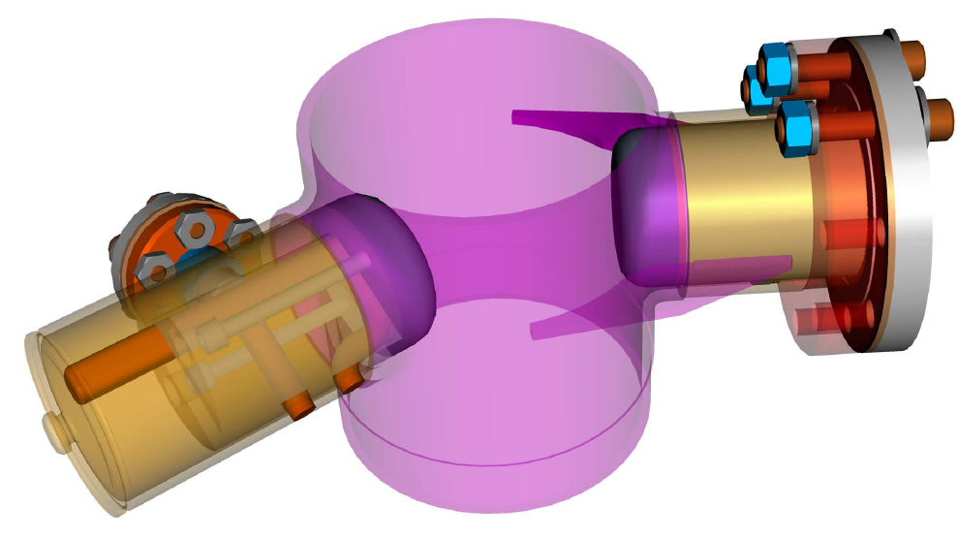
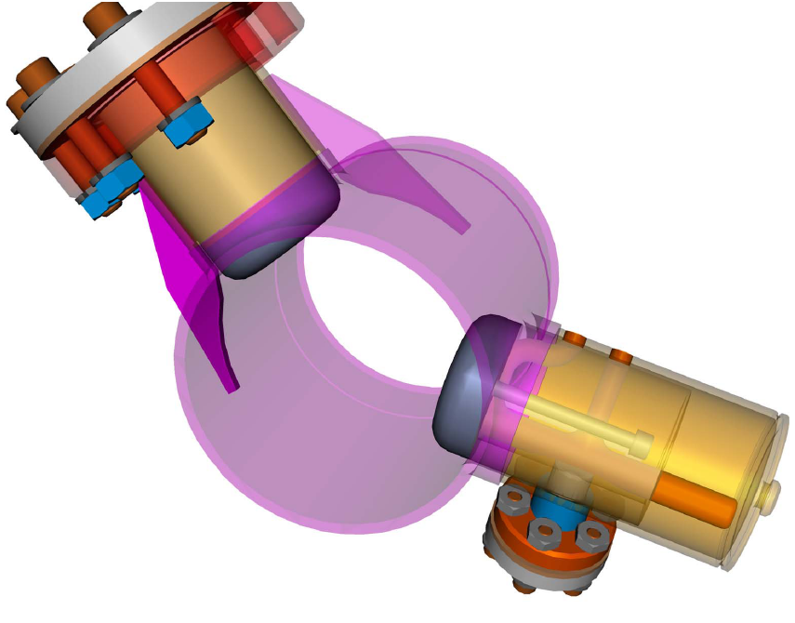

Slide 13
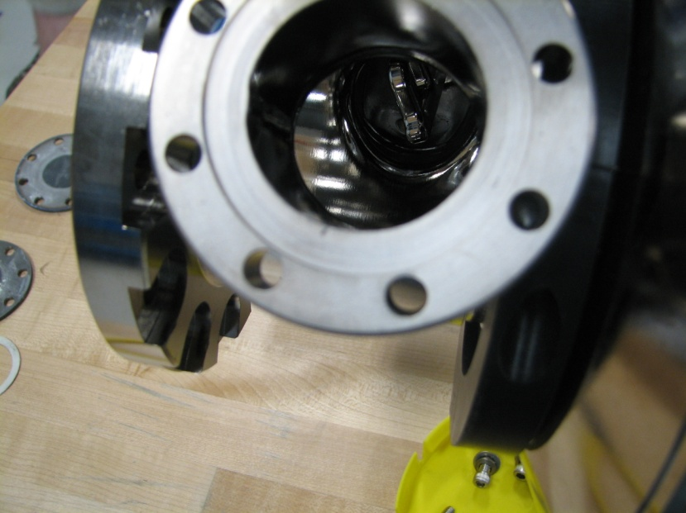
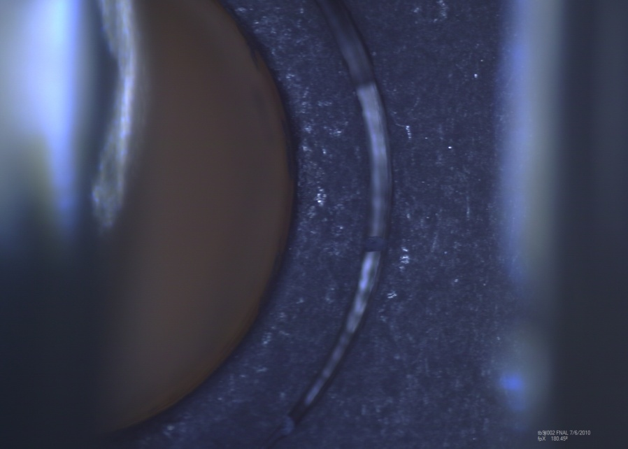
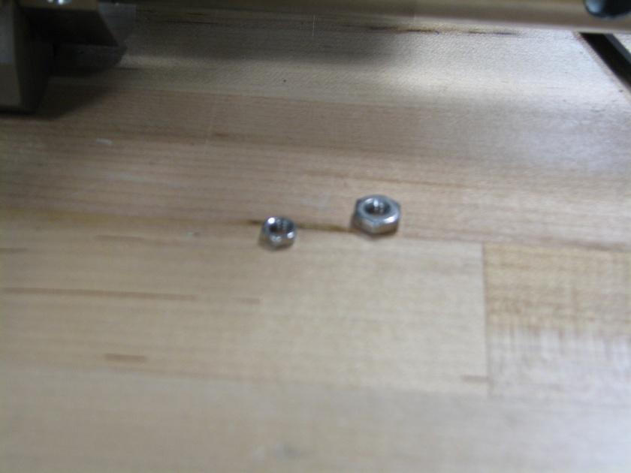
Cavity Defects
Pit on Input Coupler Sealing Surface
Scratch on Sealing Surface on Field Probe Side HOM Can Flange
Bad etching on inside and outside of HOM cans
HOM Can ID too big.
Clearance between HOM can flange and beam tube too small.
Field Probe weld not full penetration

Slide 14
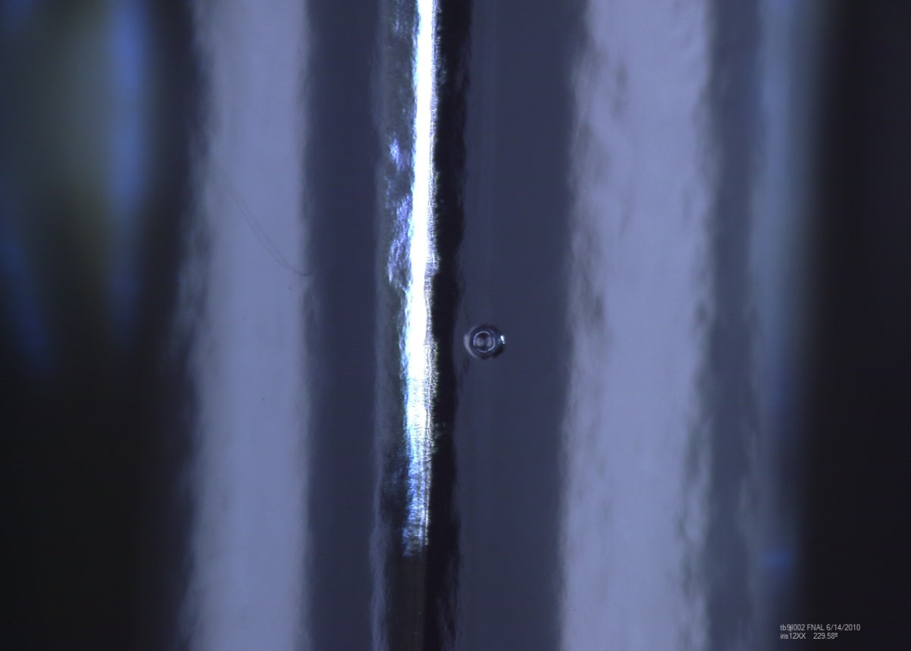
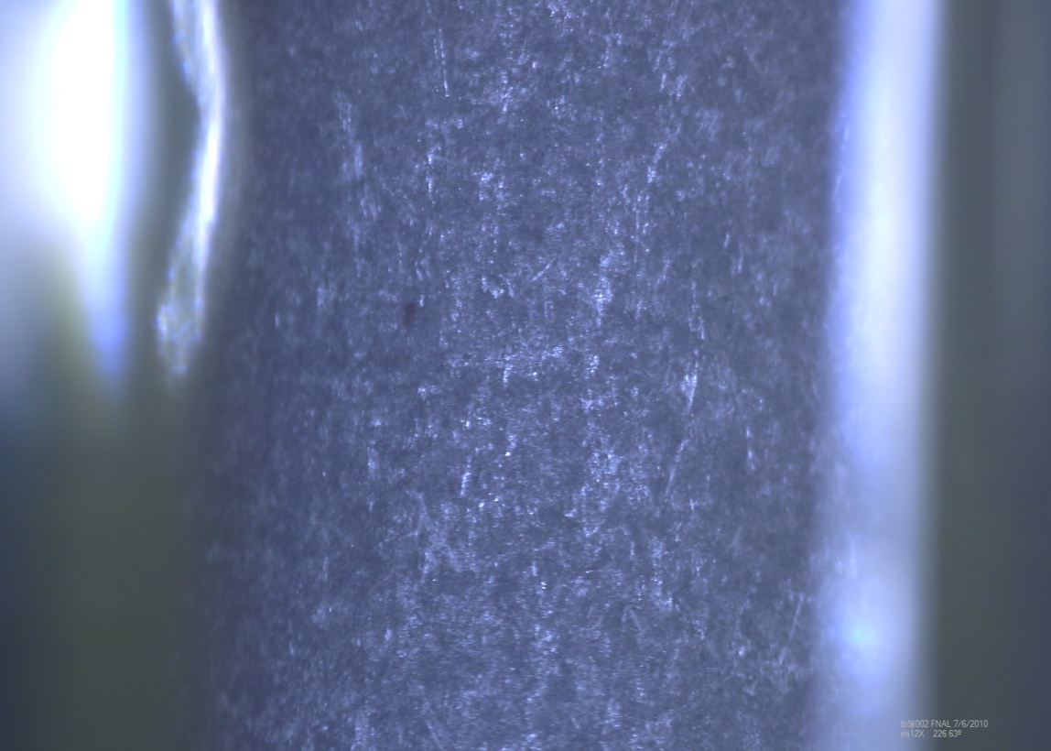
Iris 1-2

Slide 15
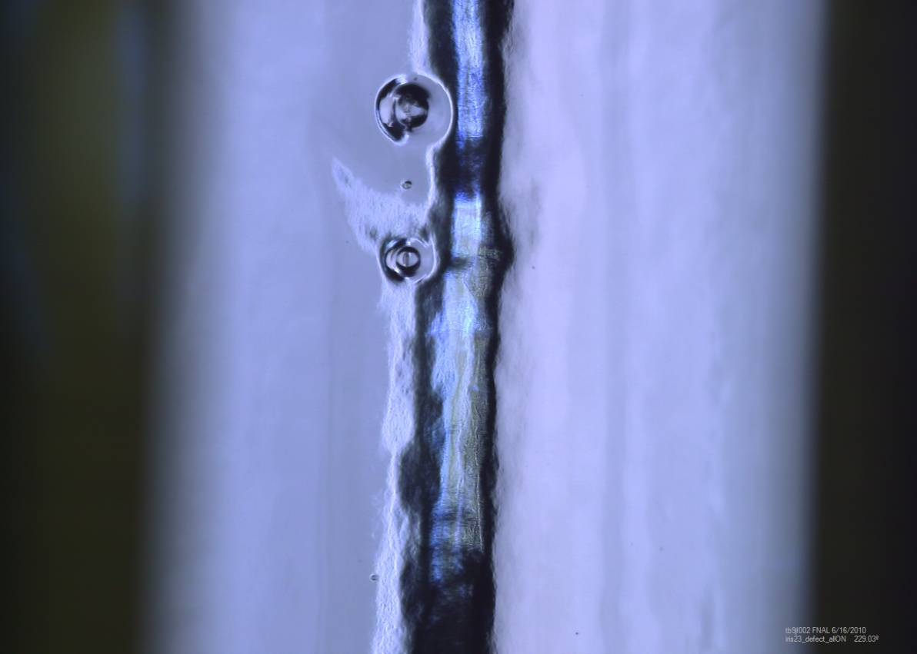
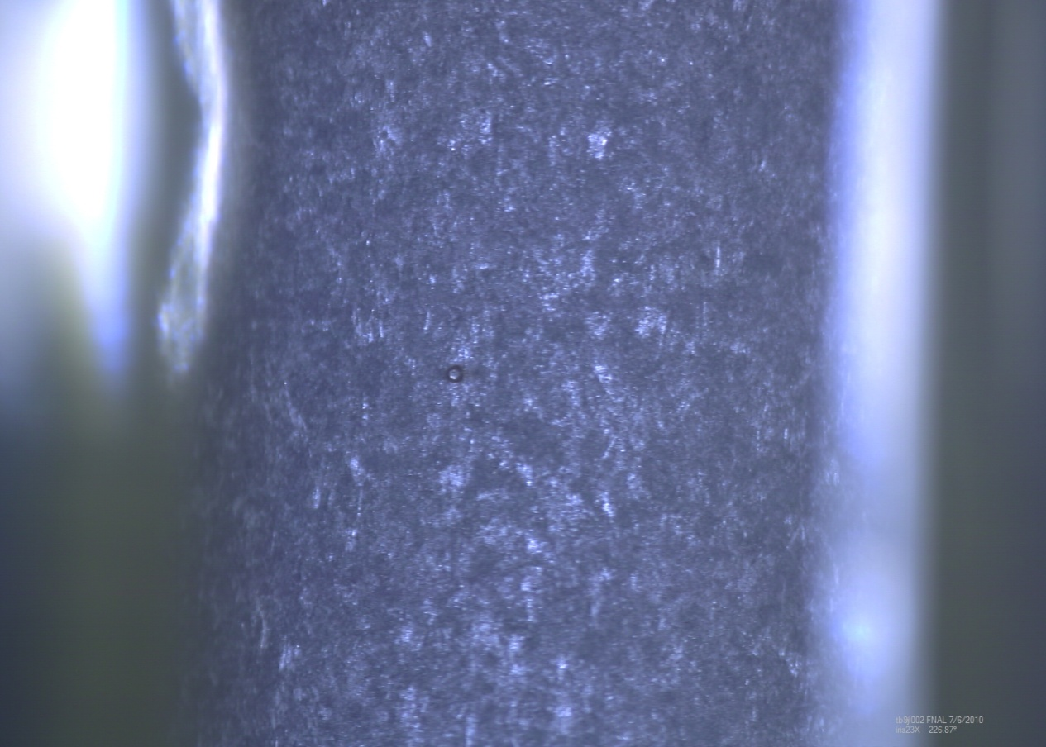
Iris 2-3

Slide 16
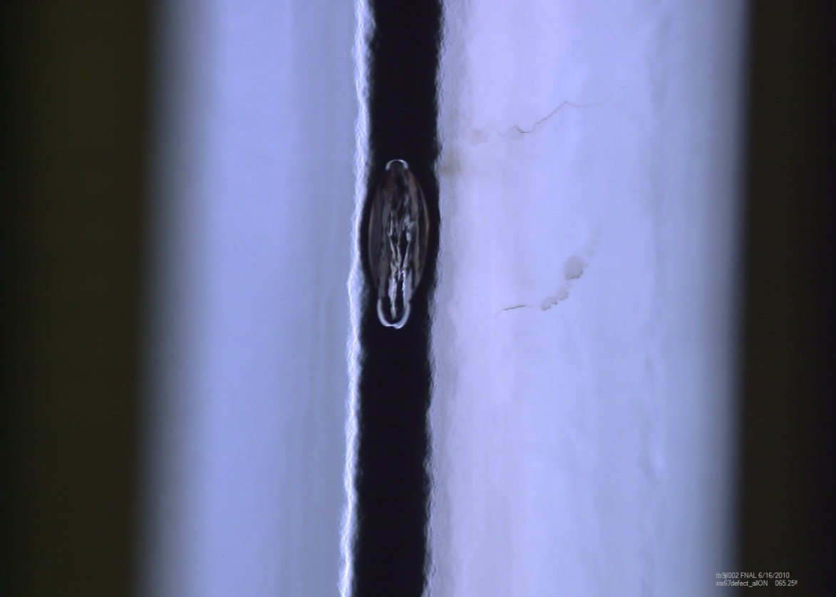
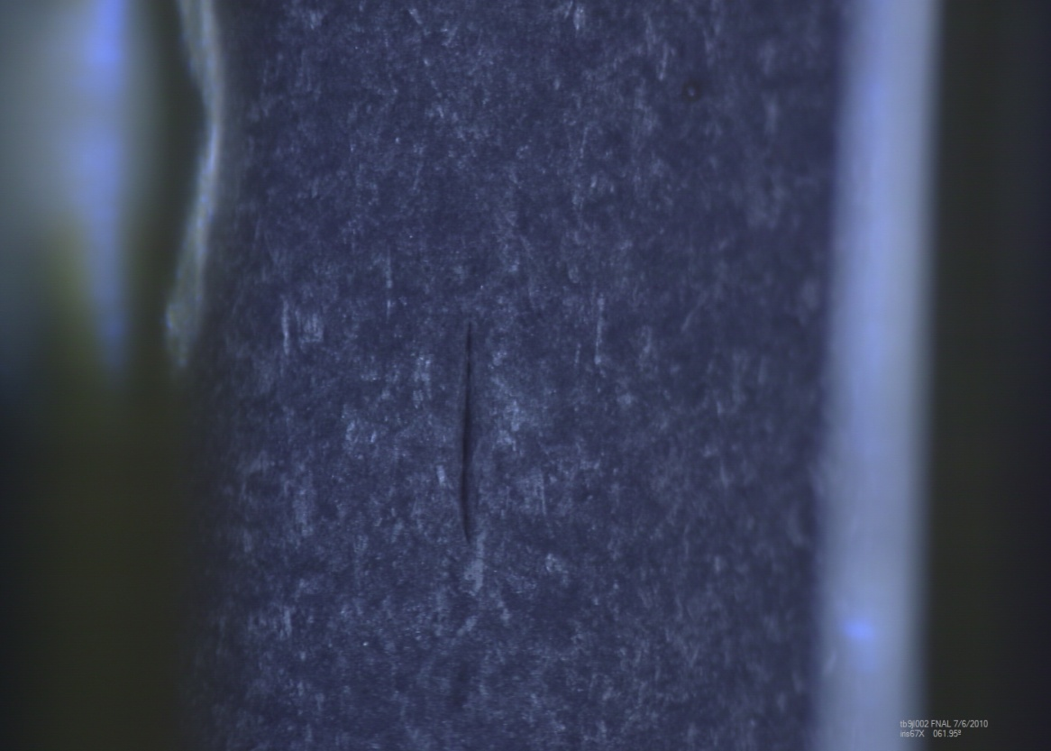
Iris 6-7

Slide 17
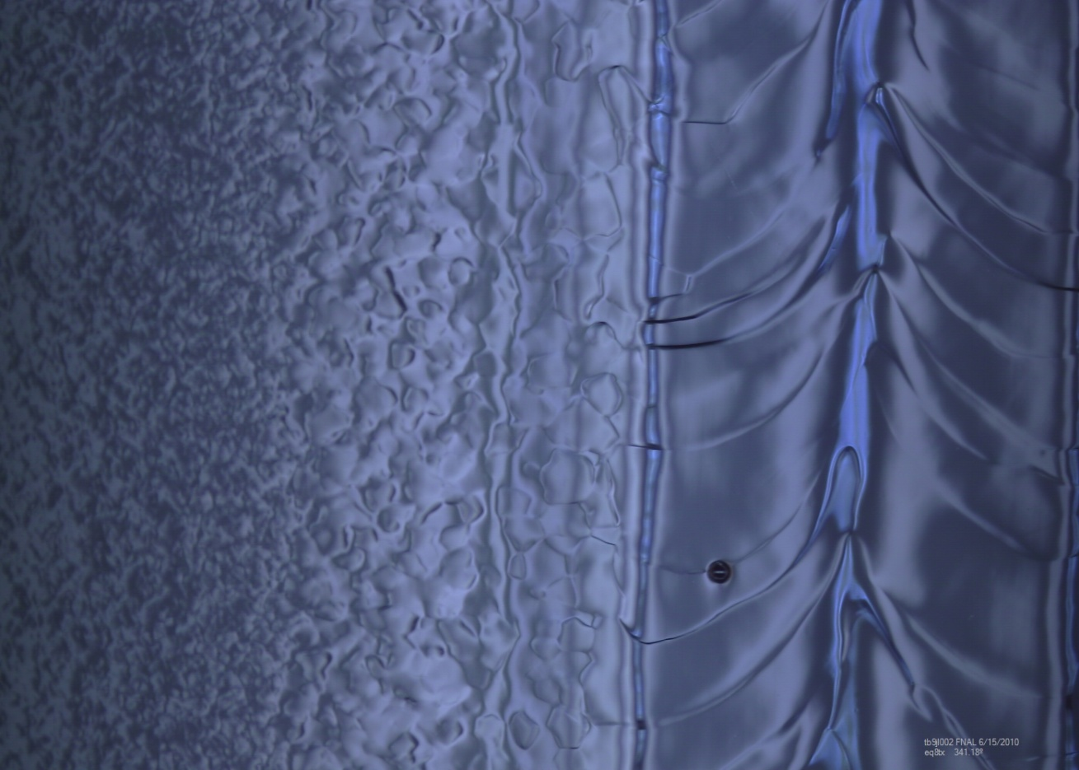
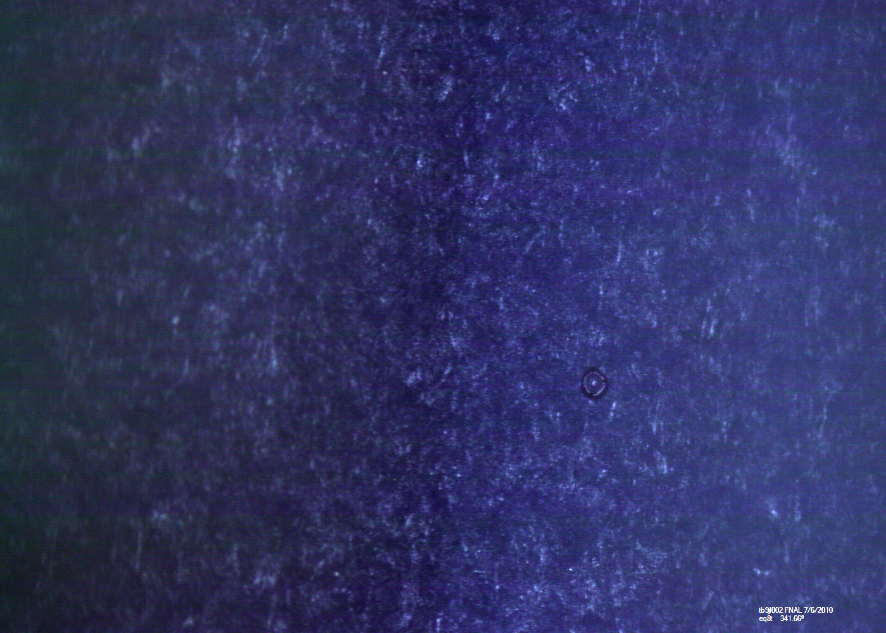
Equator 8

Slide 18
Next Steps
Finish modifying HOM Can Plug
Tumble 3 more steps – polishing
  ½ inch plastic cone
  2 mm silicon carbide
  1200 grit alumina
Ultrasonic Degrease/ 20 micron EP at Argonne

