Slide 1
ICPA Status
Lance Cooley
July 12, 2010
Monday SRF Meeting

Slide 2
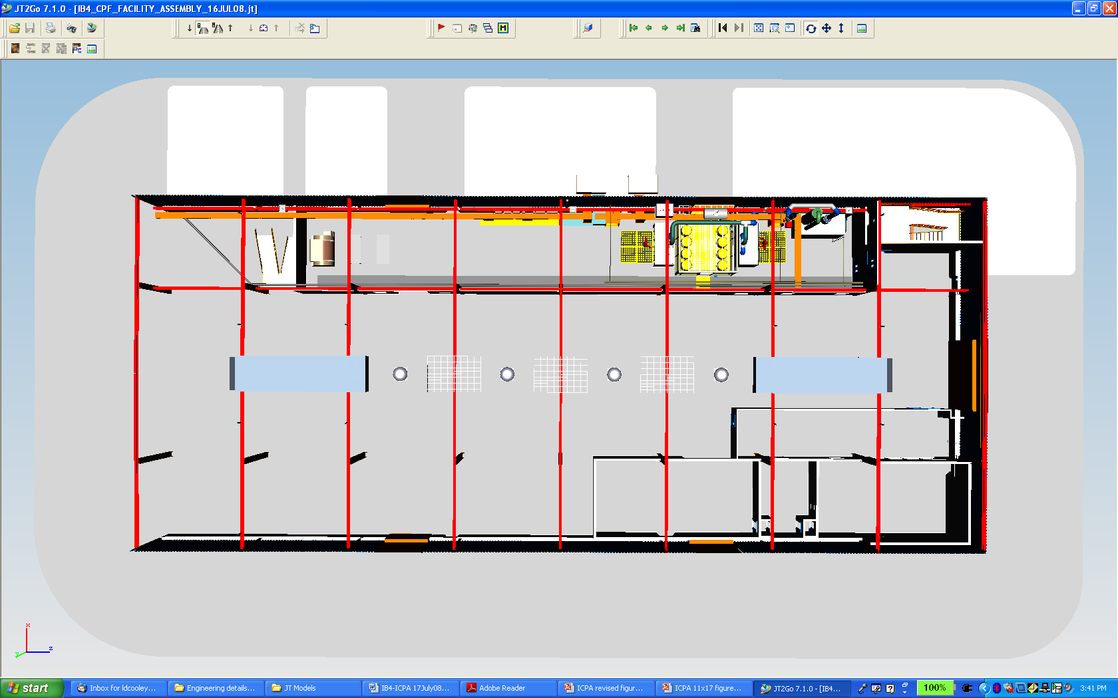
ICPA Map
Industrial Building 4
North
Lab Area
Chemistry Area
D
B
C
A
Clean Area
To ICB
Figure 4‑2. Route map of ICPA activities.

Slide 3
The journey up to now…
June 2007 – New TD project, Concepts for a “cavity processing facility”
Nov. 2007 – Scope defined: 1-cell facility, design work begins
Jan. 2008 – “Facility” is an “Apparatus”
June 2008 – Conceptual design finished
July 21, 2008 – Independent panel reviews and approves design
Aug. 2008 to May 2009 – procurement of major equipment
Nov. 08 to June 09 – Installation of class 10 module clean room, most UPW items except buffer tank
Aug. 08 to May 09 – Preparation of environmental permits
Sept. 23, 2009 – Wastewater pre-treatment permit awarded
October 5, 2009 – Air emissions permit (Labwide) awarded
Nov. 09 – Mar. 2010 – Final installation of UPW system (FNAL completed work under vendor cure order)
Jan. 2010 – June 2010 – Chemistry area renovation and construction
June 2010 – HPR tool begins ORC

Slide 4
Present status
Chemistry
Chemistry area construction and installation of major items is 99% complete
  Air flow tests, balancing will occur ~this week
  Minor finishing work remains on acid work enclosure
Electropolishing tool assembly is beginning (Target: 30 Sept)
  Unique, FNAL-designed item
  Modifications to include water cooling
EP controls development is in process (Target: 30 Sept)
ORC issues under development (Target: 1 Jan 2011)
HPR and Clean Room
HPR system in ORC phase (Target ops: 1 October)
  Pressure test this week, followed by shake-down per ANL procedures
  After TD shake-down, formal procedures go to review committee

Slide 5
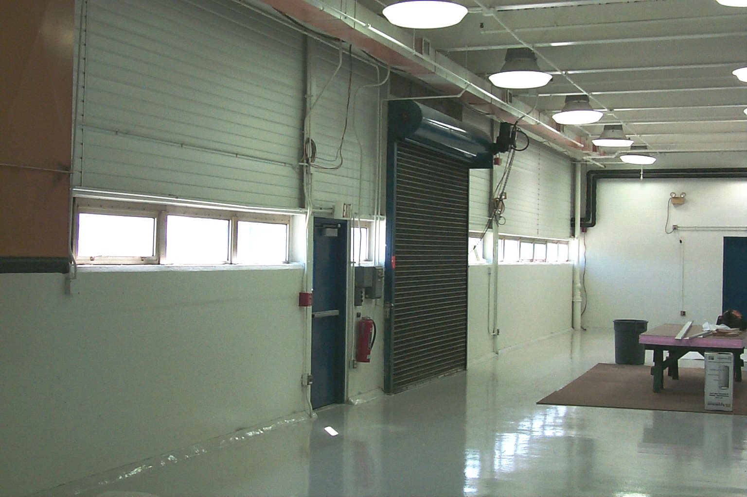
June 2009 – chemistry area

Slide 6
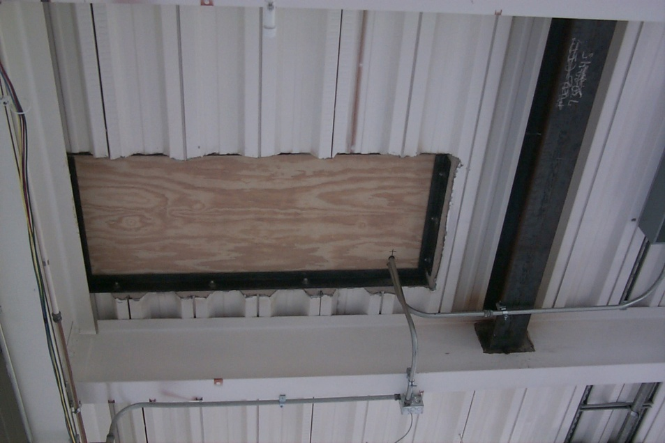
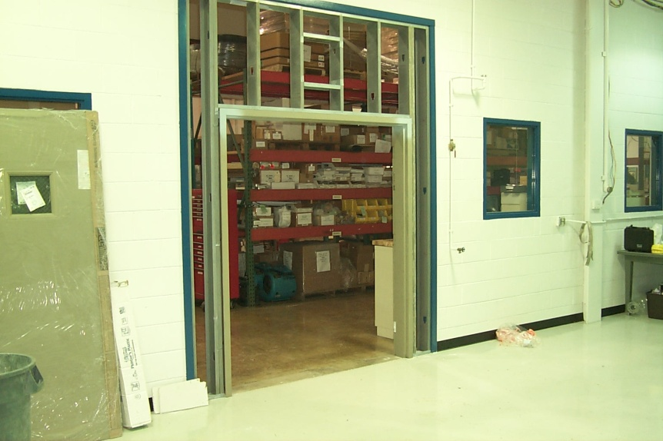
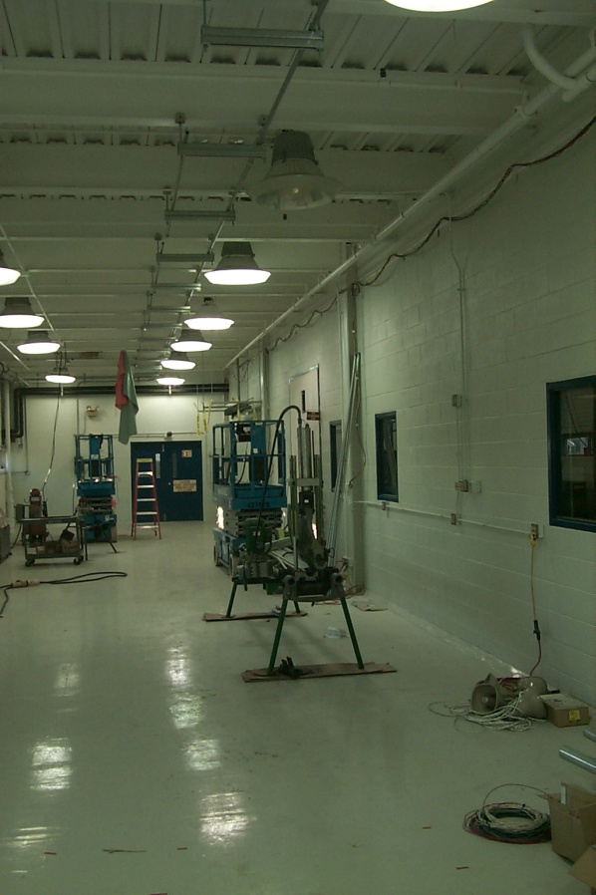
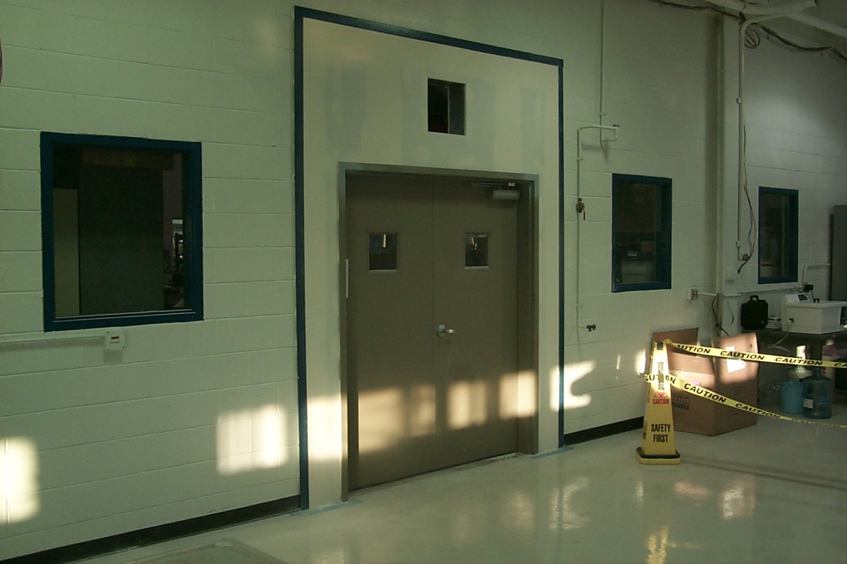
Jan. 2010

Slide 7
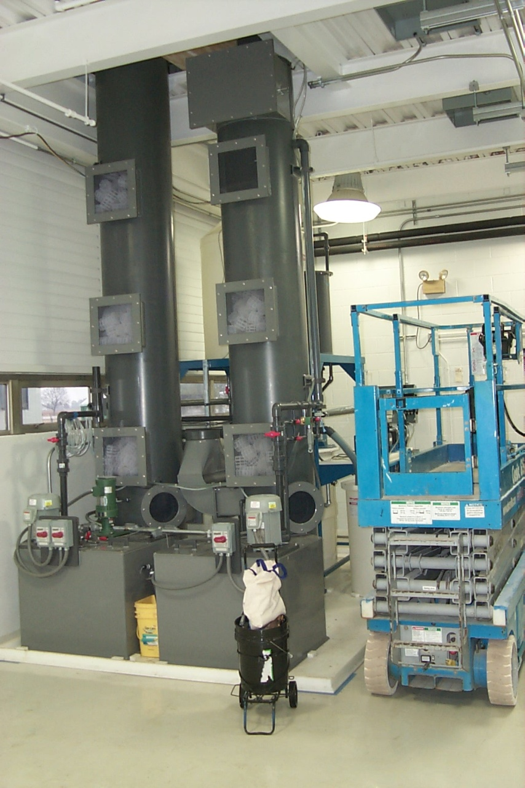
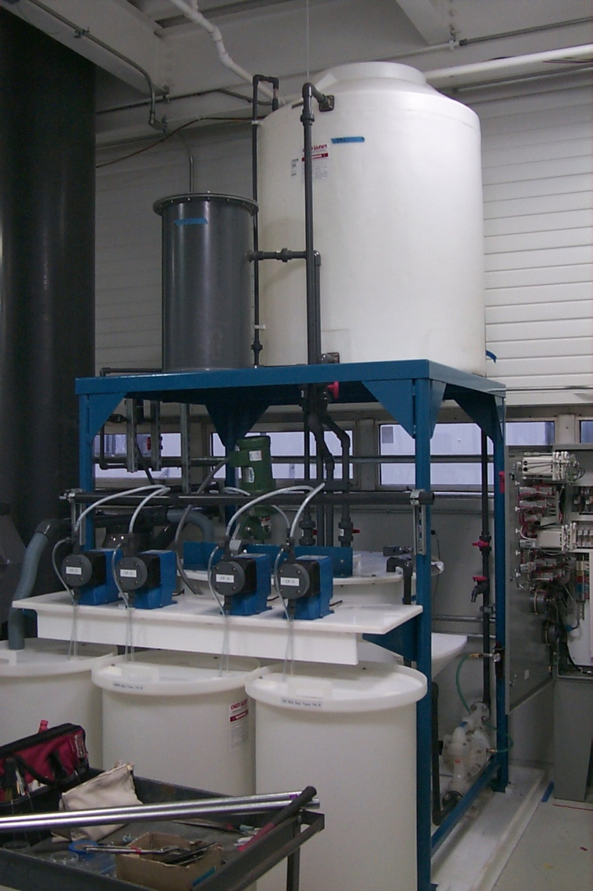
Scrubber arrives

Slide 8
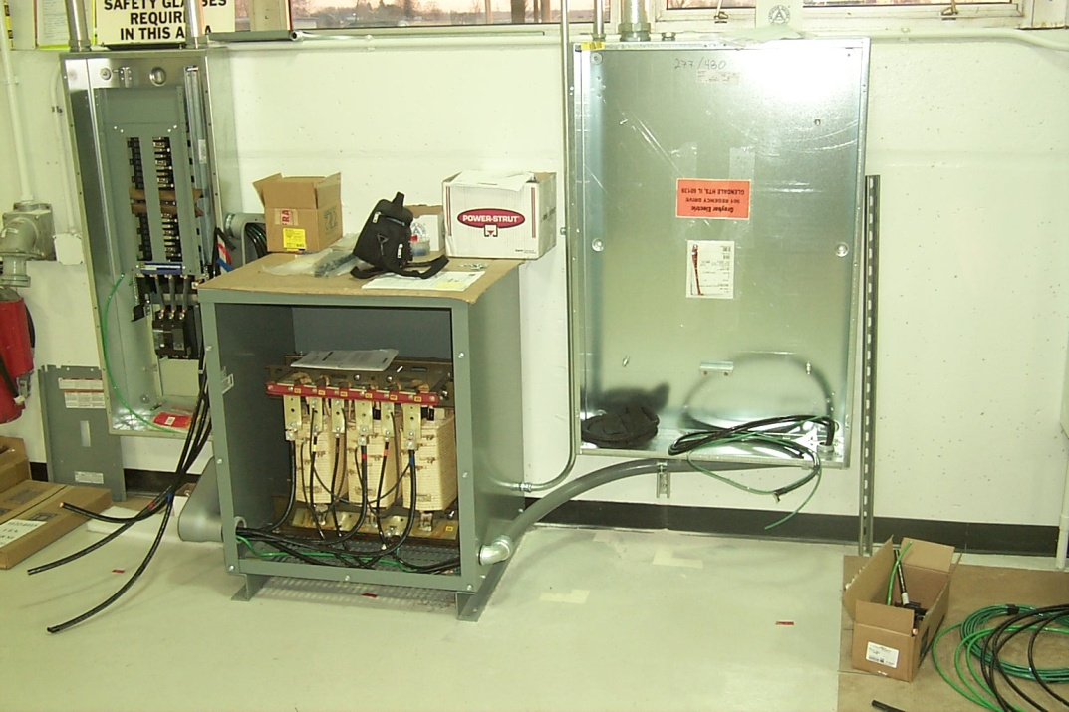
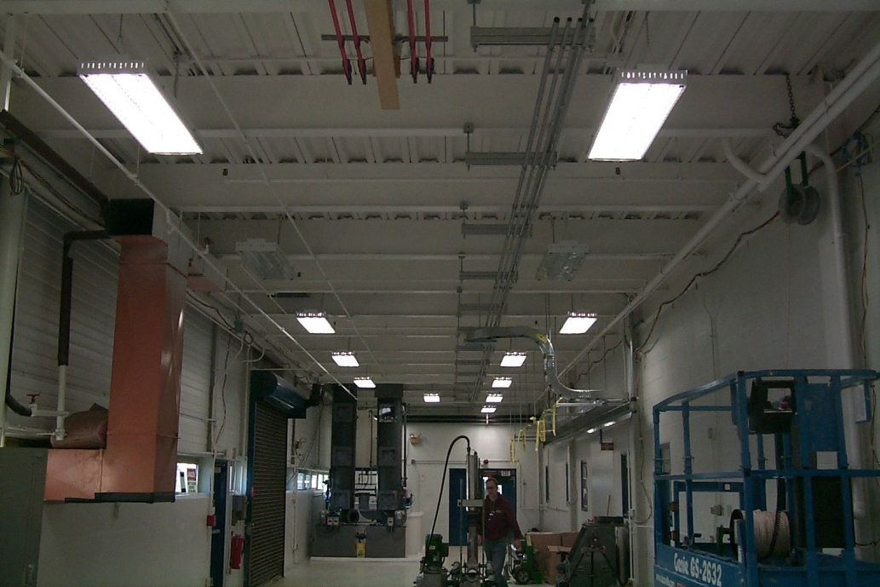
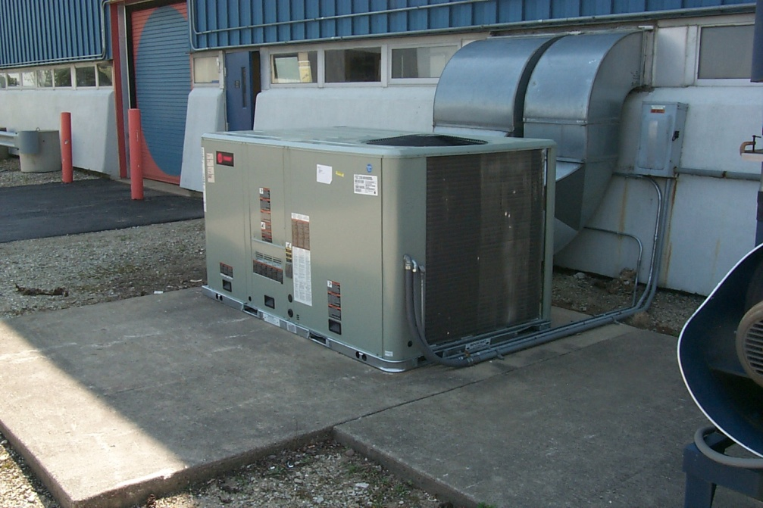
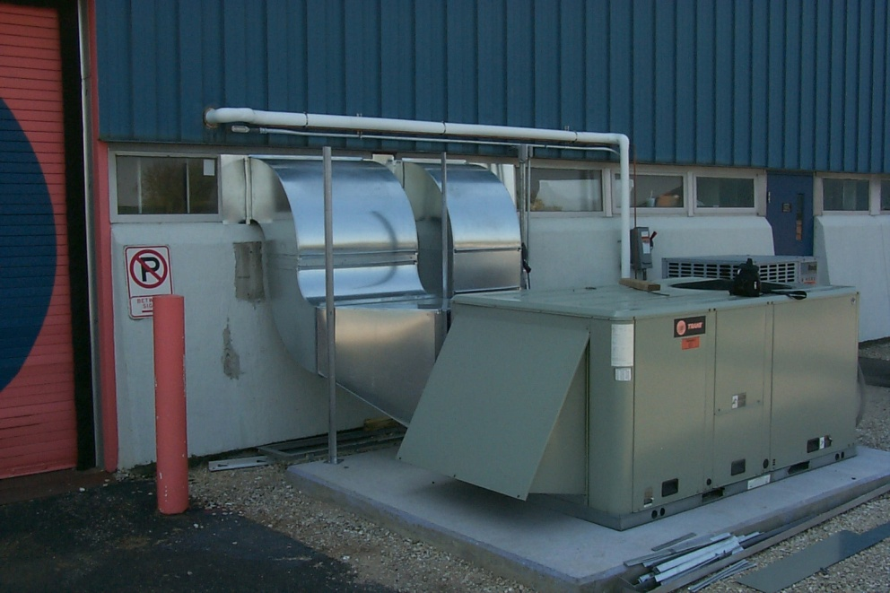
Electricity, Lights, HVAC

Slide 9
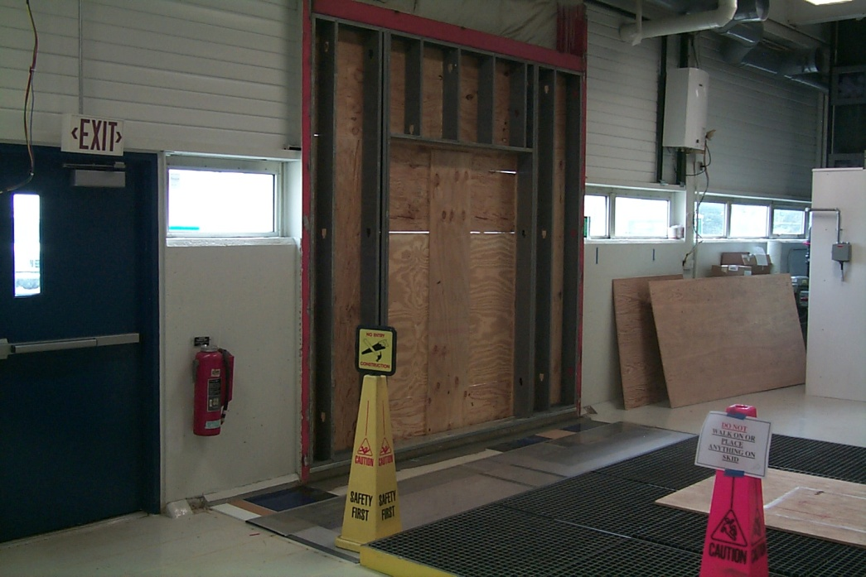
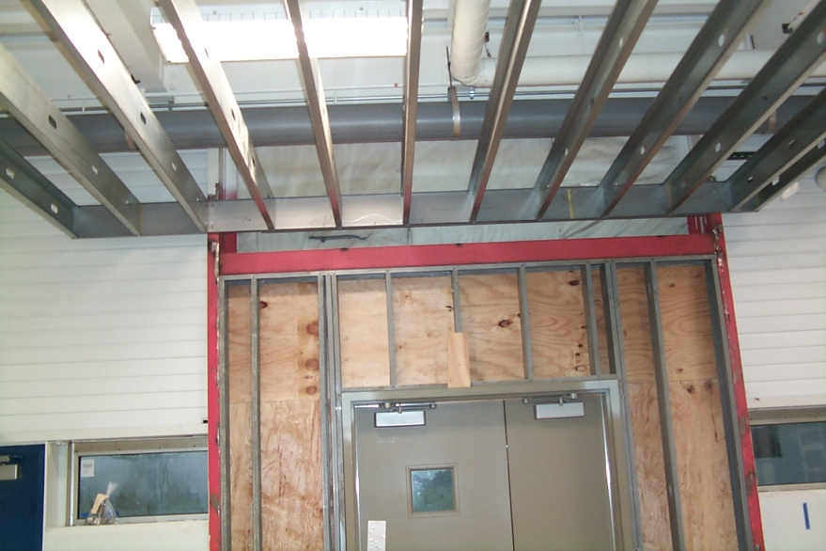
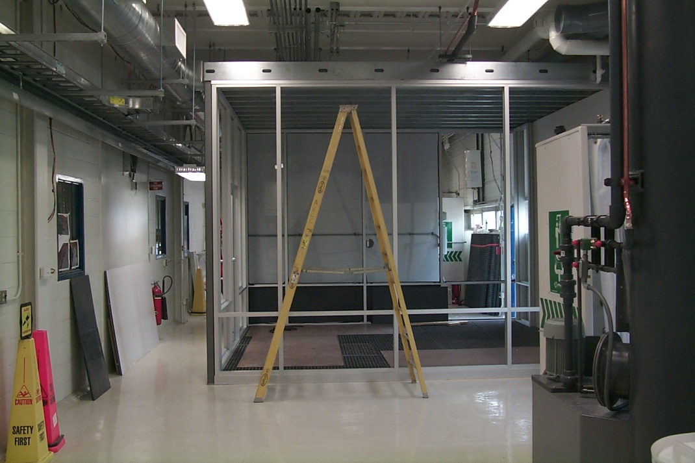
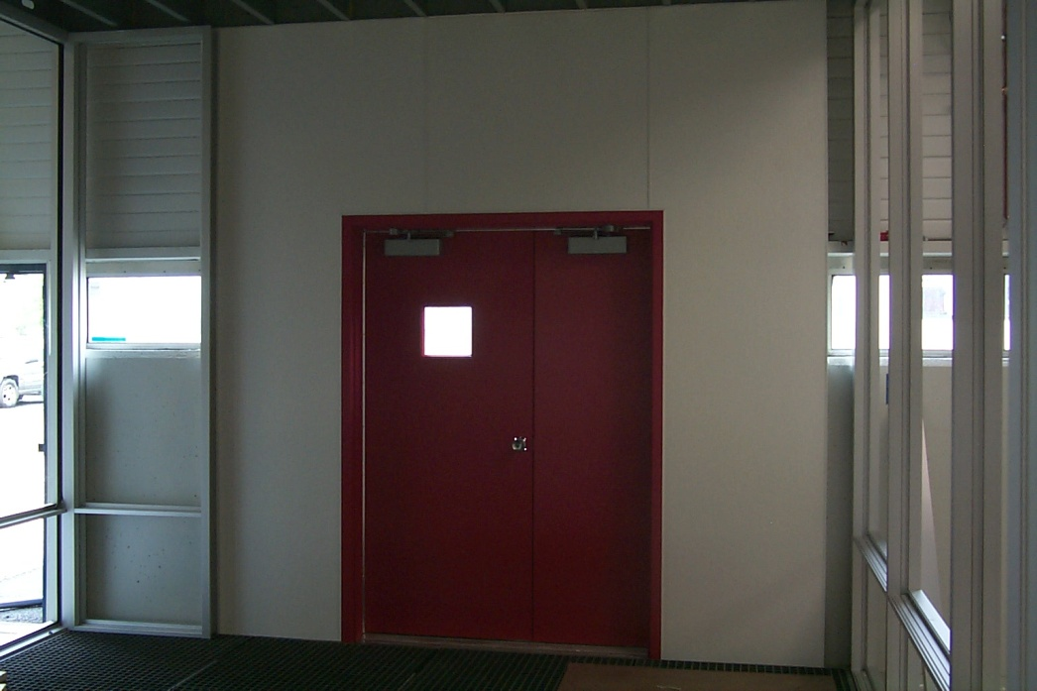
Acid storage area

Slide 10
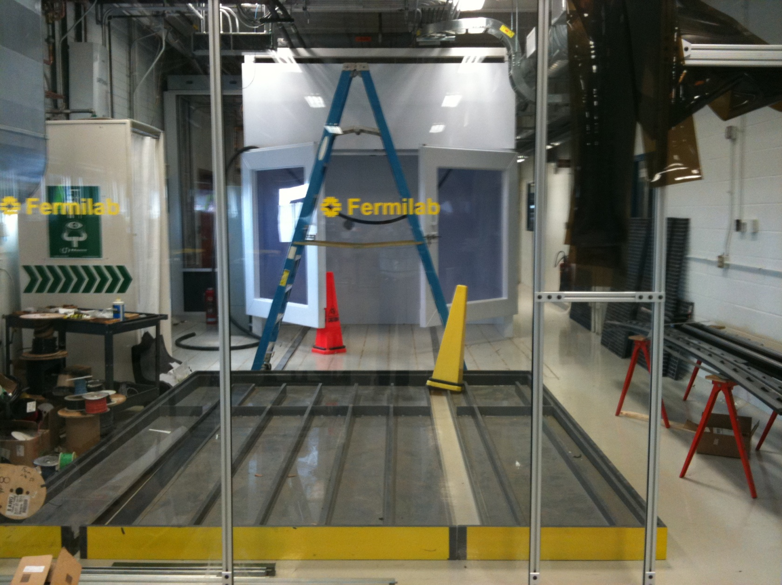
Acid work enclosure

Slide 11
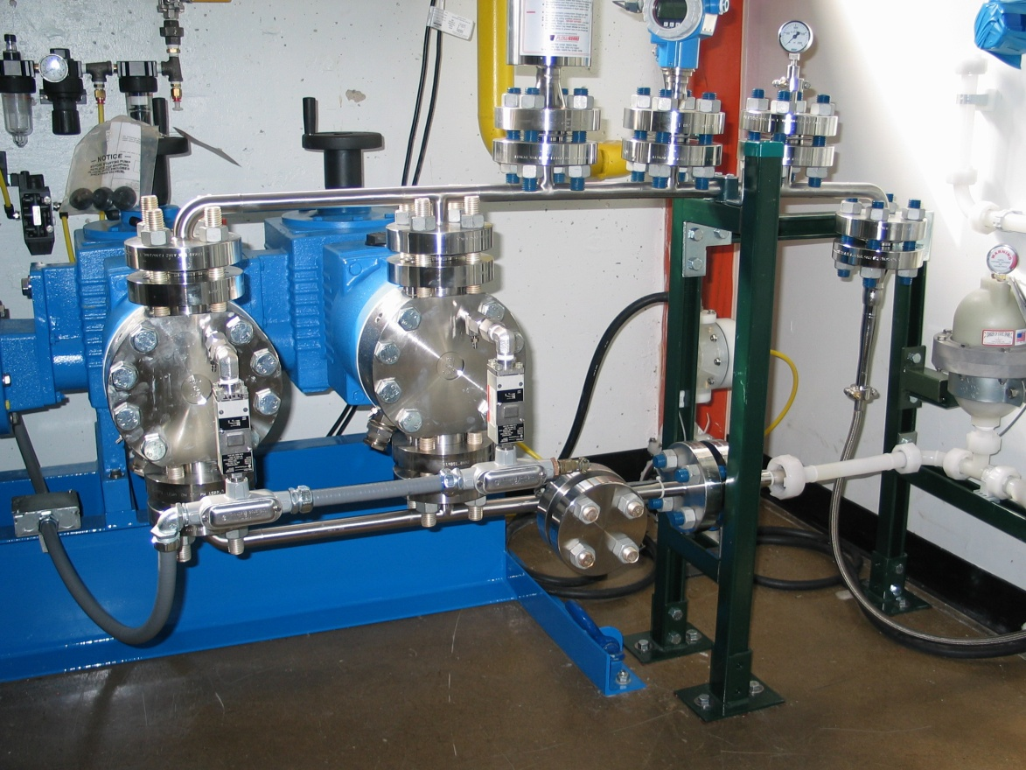
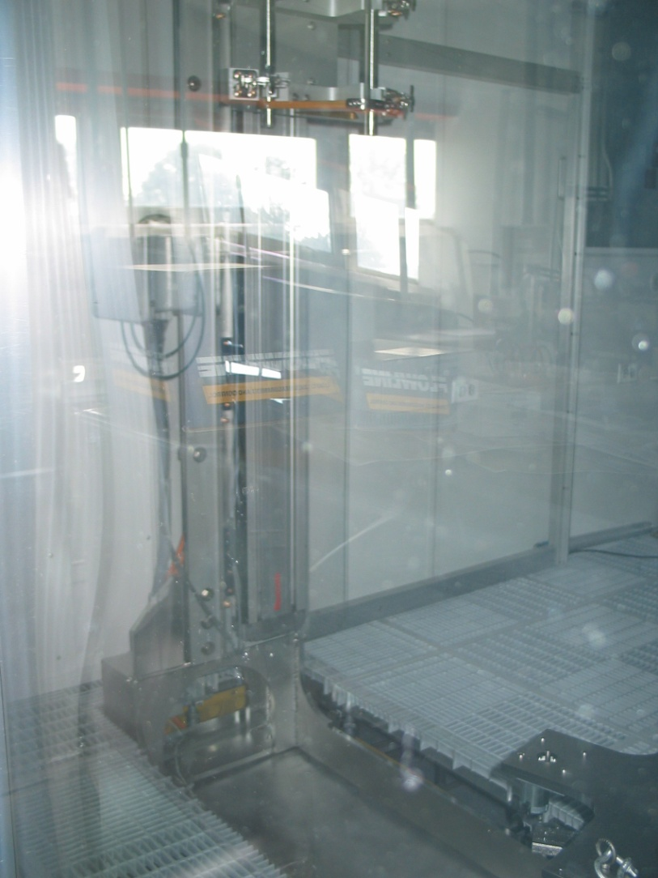
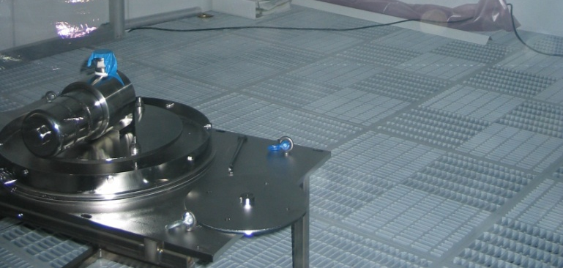
HPR

Slide 12
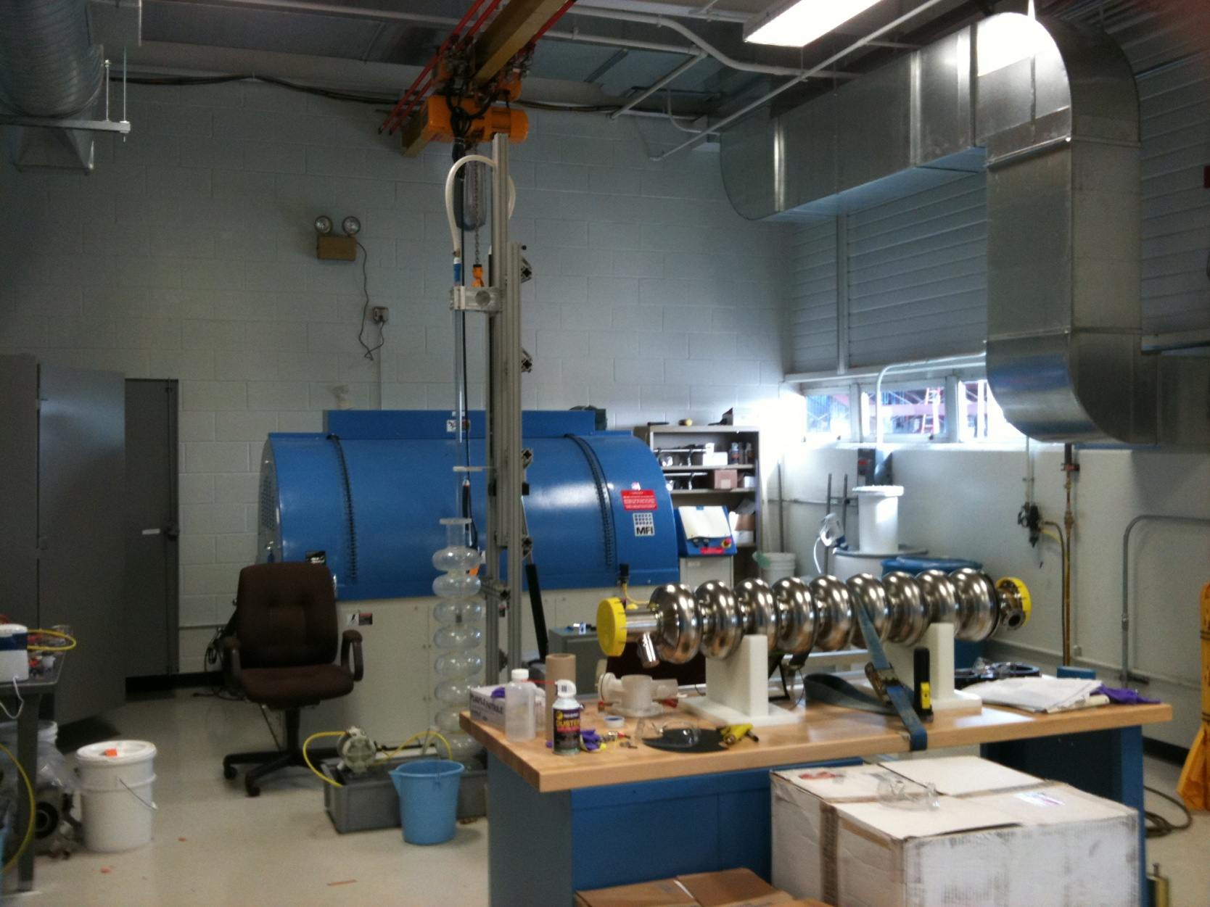
Tumbling is active, by the way

