Slide 1
2010.07.20: Hayano
Cavity status; recent KEK activities
(1) HIT-001, TOS-001,IHEP_01 ; no HOM 9 cell cavities field measurements
HIT-001: 1st VT 35MV/m @ Q0=0.65E10 June 24,2010
TOS-001: 1st VT 8.6MV/m @ Q0=0.41E10 July 08,2010
IHEP_01: 1st VT 20MV/m @ Q0=0.16E10 July 01,2010
(2) KEK-JLAB collaboration; JLAB LG-01 for local grinding
2nd local grinding and 30um EP finish were over.
Then molding again and found that it became more smooth & better surface.
After several 5um EP & water rinse study,
brown stain problems has been suppressed.
(Later, I will summarize the rinsing study for suppression of brown stains in 9-cell cavity.)
The cavity was sent back to JLAB, now in Narita airport.
(3) KEK-FNAL collaboration; on RI-026 and AES-001
These cavities were borrowed for the tuning machine commissioning, and
local grinding studies.
The cavities were arrived at STF in last week,
and under preparation of surface inspection as received state.

Slide 3
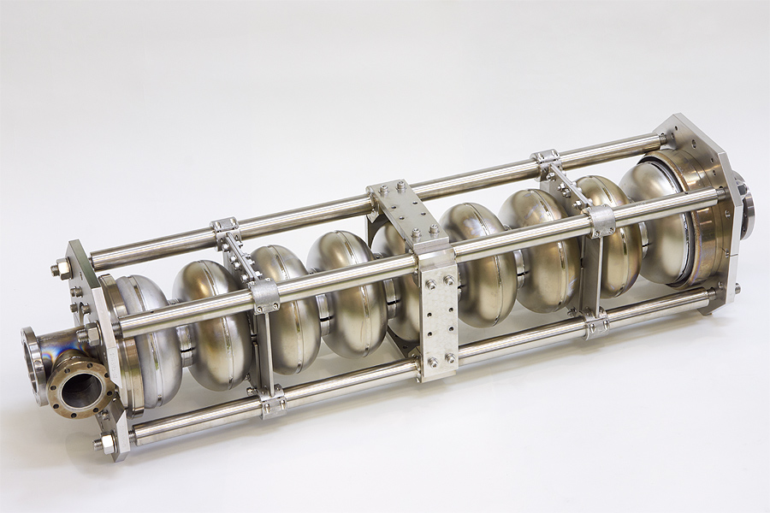

Slide 4
CBP, anneal, BCP, pre-tuning
at IHEP,
degreasing, HPR, baking
at KEK,

