Slide 1
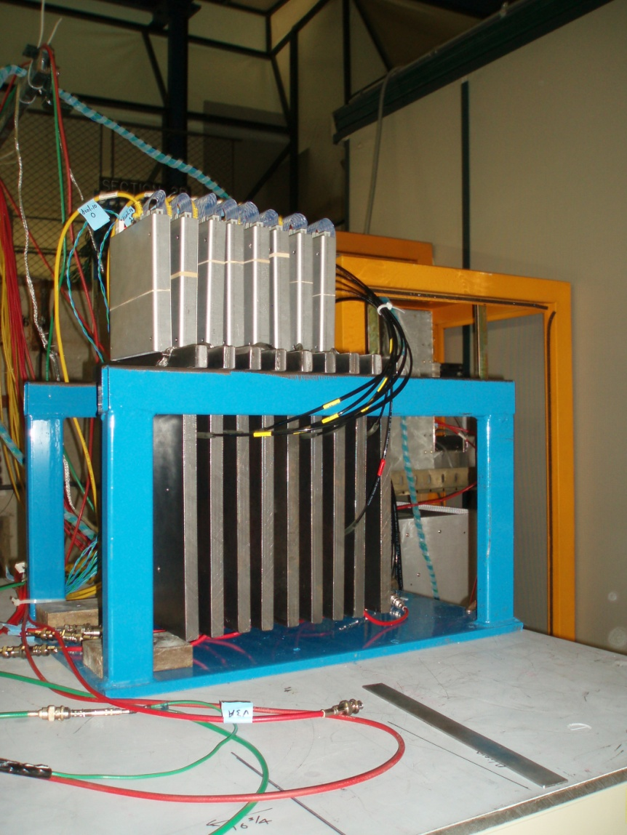



Simulation of the RPC Response
José Repond
Argonne National Laboratory
SiD Calorimeter Meeting, by phone
July 15, 2010

Slide 2
Simulation Strategy
Experimental set-up
Beam (E,particle,x,y,x’,y’)
Measured signal Q distribution
Points (E depositions in
gas gap: x,y,z)
GEANT4
RPC response simulation
Hits
Parameters
Exponential slope a
Threshold T
Distance cut d_{cut}
Charge adjustment Q₀
Hits
Comparison
DATA
With muons – tune a, T, (d_{cut}), and Q₀
With positrons – tune d_{cut}
Pions – no additional tuning

Slide 3
RPC_sim
Language: Fortran 77
276 lines of code
(I think it is well documented)
Input: ASCII file
-1 IL -1 -1 -1 Nevt = 1
LN x y
LN x y
…
-1 IL -1 -1 -1 Nevt = 2
LN x y
LN x y
…
Output: ASCII file
EV IL -1 -1
EV x y LN
EV x y LN
…
EV IL -1 -1
EV x y LN
EV x y LN
…
GEANT4
RPC_sim
Same format as
ASCII output of event builder
IL … true interaction layer
LN … layer number
EV … event number

Slide 4
RPC_sim: Step I
Discard close-by hits
RPCs do not generate multiple avalanches very close by
Check distance d between all pairs of points
If d < dist_cut, discard one of the points

Slide 5
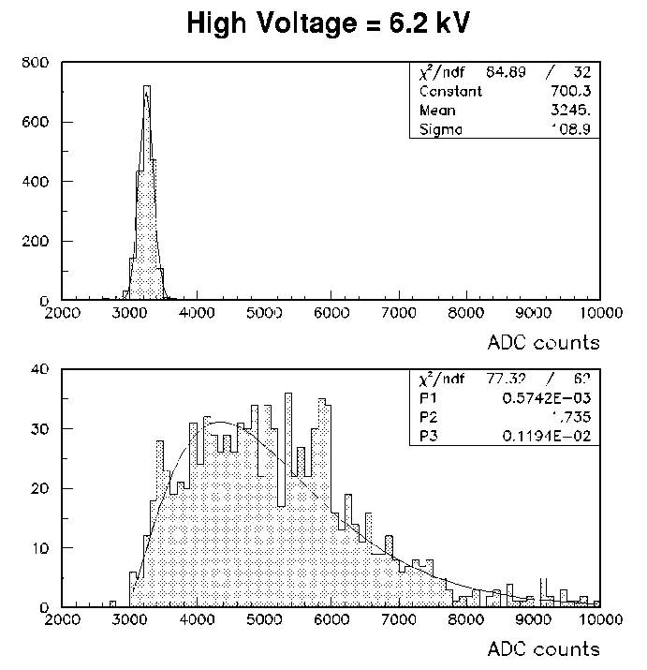
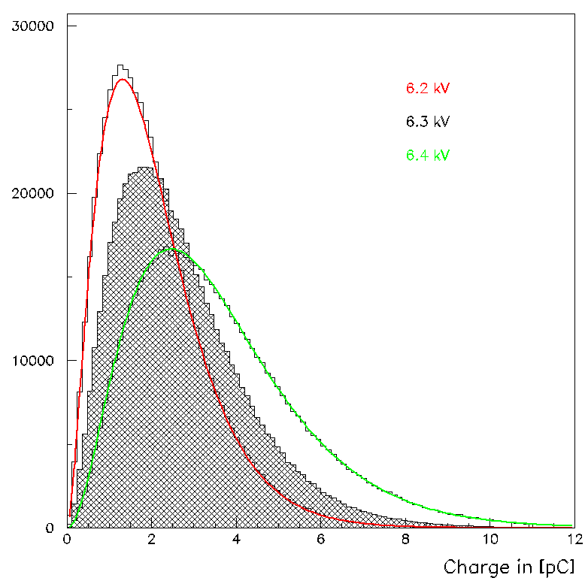
RPC_sim: Step II
Generate overall charge
Measured charge distribution
for HV = 6.2 kV
Generated charge distributions
for different HV settings
Allow for shift of Q spectrum by Q₀
Fit to y = α (x-2900)^{β} e^{-γ(x-2900)}

Slide 6
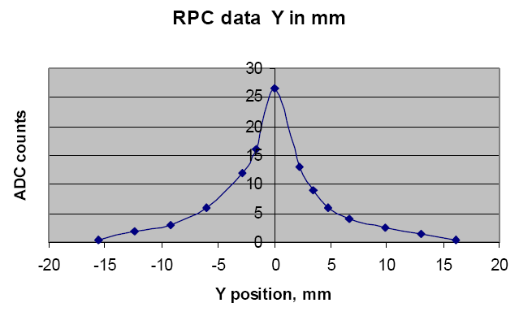
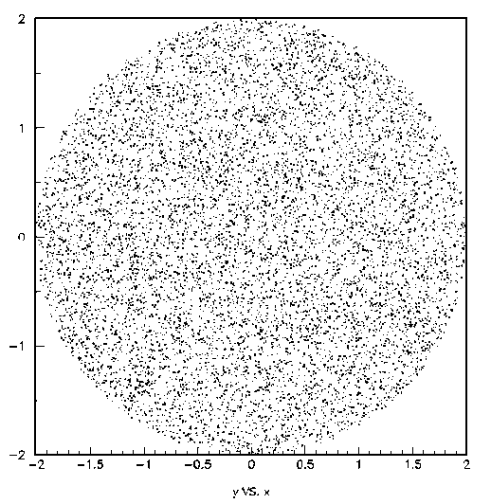
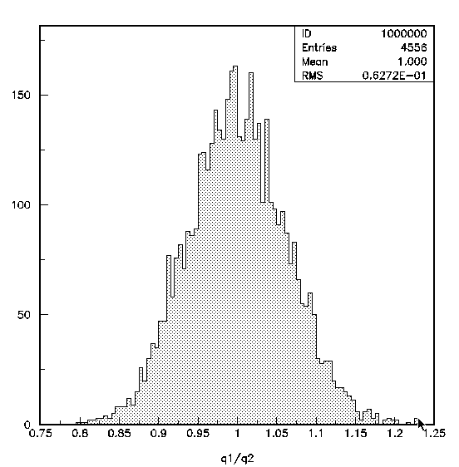
RPC_sim: Step III
Distribute charge over pads
Assume exponential dependence on distance from avalanche
Measured charge distribution as
function of y in the pick-up plane
Throw 10,000 points in x,y plane within radius R₀ of avalanche
Calculate charge Q(r)
Sum up charge on 1 x 1 cm² pads
Cross check:
sum of charges on pads
D.Underwood et al.
Exponential with slope a

Slide 7
RPC_sim: Step IV
Identify hits
Pad identified as hit if Q_{pad} > T
Note:
This procedure reproduces the average efficiency and pad multiplicity of RPCs for
single tracks (muons)
It deals properly with the overlap of avalanches within a shower or from
different particles
It does not deal with the effect of particles crossing the chambers at an angle
(we know that the efficiency (pad multiplicity) is slightly (somewhat) dependent
on the angle of incidence).

Slide 8
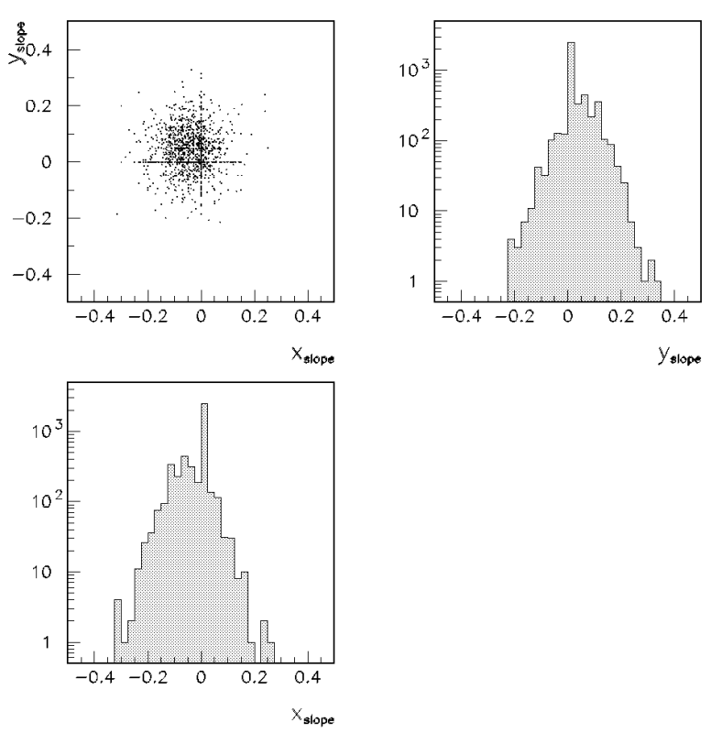
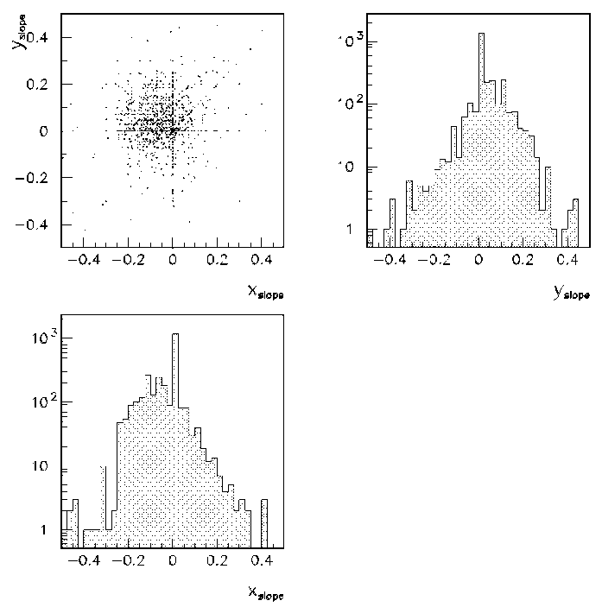
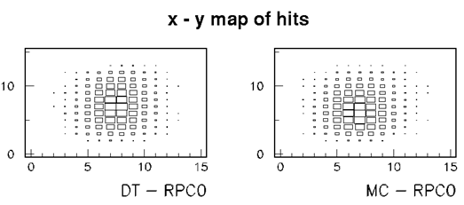
RPC_sim: Tuning I
Location and angle of particles
Procedure
Cluster hits in each layer
Fit straight line to clusters
Compare MC and data:
Clusters in first layer
Slopes of straight lines
Adjust MC to reproduce data
Simulation
Data

Slide 9
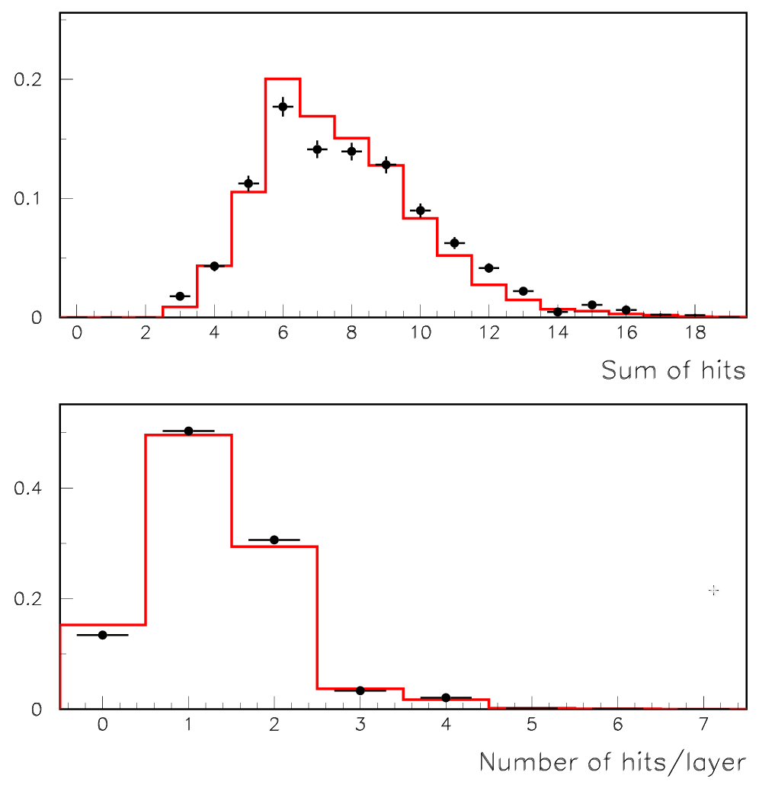
RPC_sim: Tuning II
Tune parameters Q₀, a, and T
Broadband muons
from FNAL test beam (with 3 m Fe blocker)
Tune
slope a
threshold T
charge adjustment Q₀
(Muon data not sensitive to dist_cut)
→ reproduce the distributions of the sum of hits and hits/layer
Data
Simulation

Slide 10
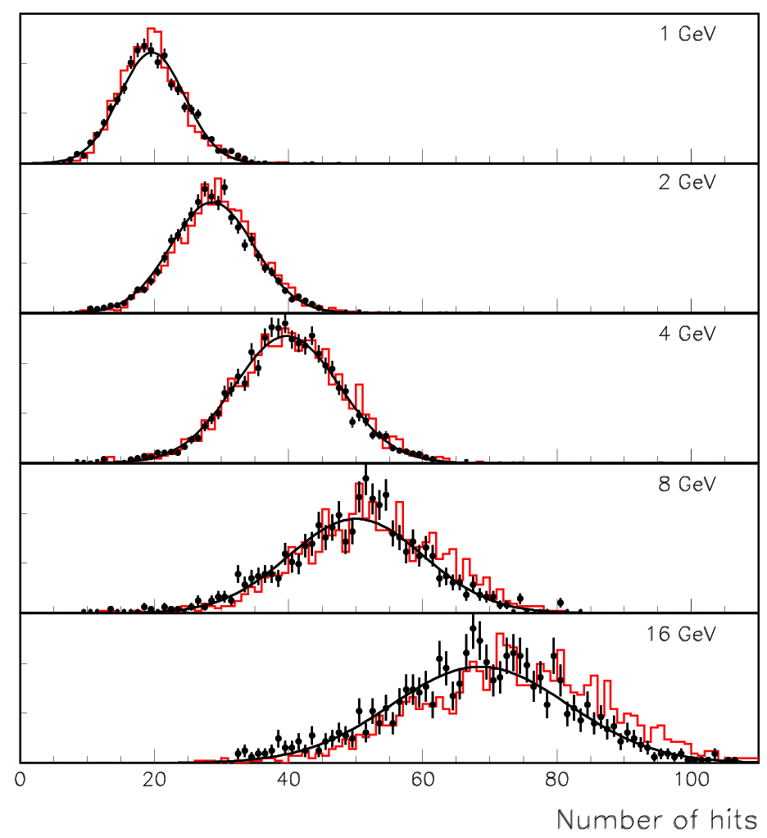
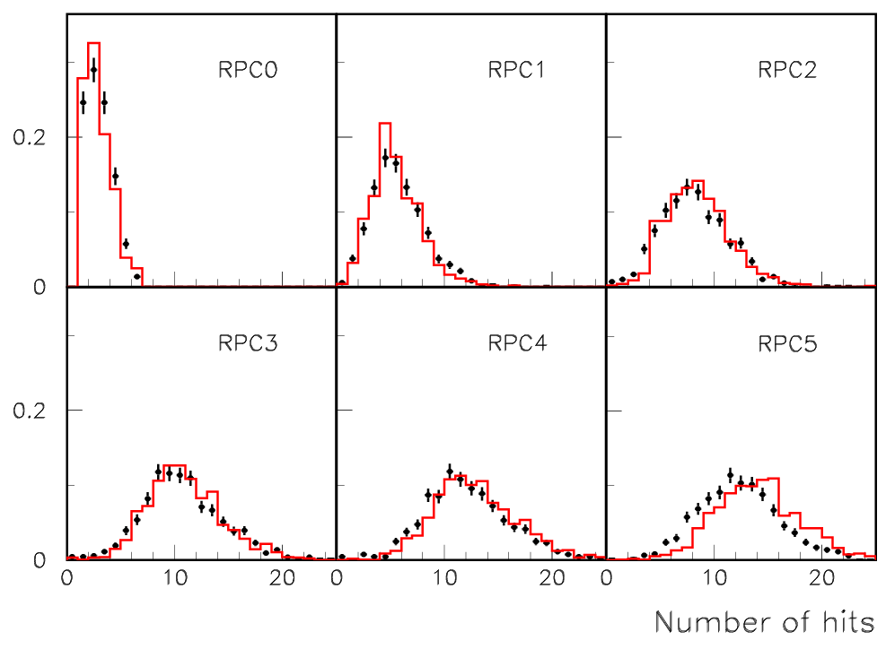
RPC_sim: Tuning III
Tune parameter dist_cut
Adjust dist_cut to reproduce Σ_{hits} for 4 GeV positrons
8 GeV Positrons

Slide 11
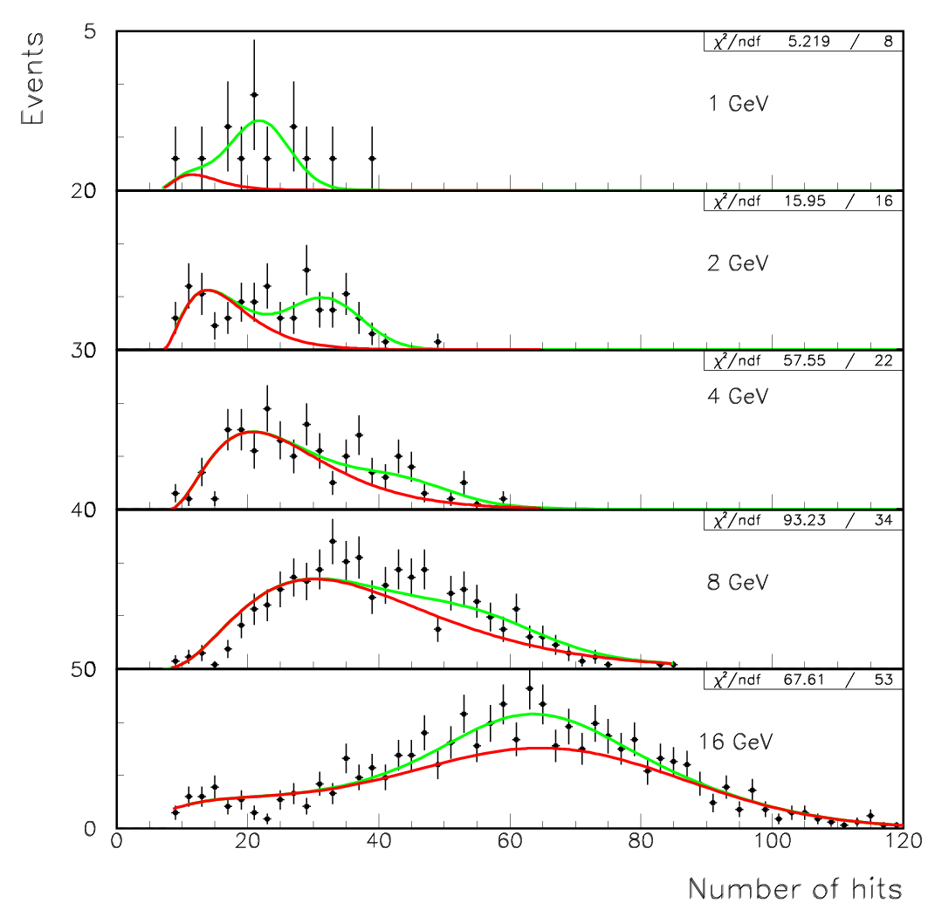
RPC_sim: Tuning IV
Cross – check with pions
Fit to 2 components
- Pions (from MC)
- Positrons (from MC)
Note
MC curves = absolute predictions,
apart from general scaling due
to efficiency problems (rate) at
16 GeV (-9%)

Slide 12
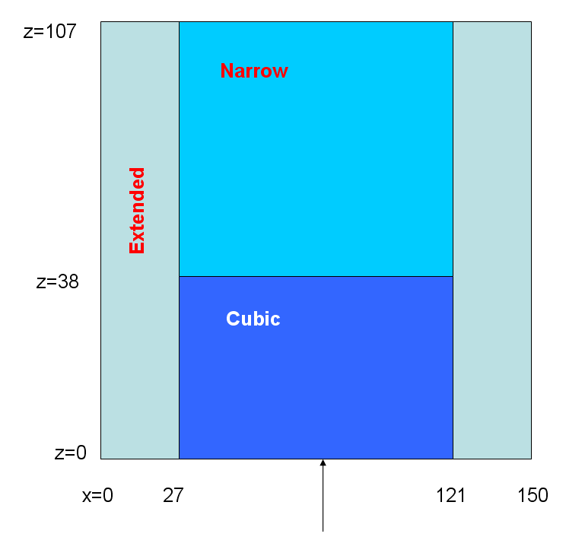
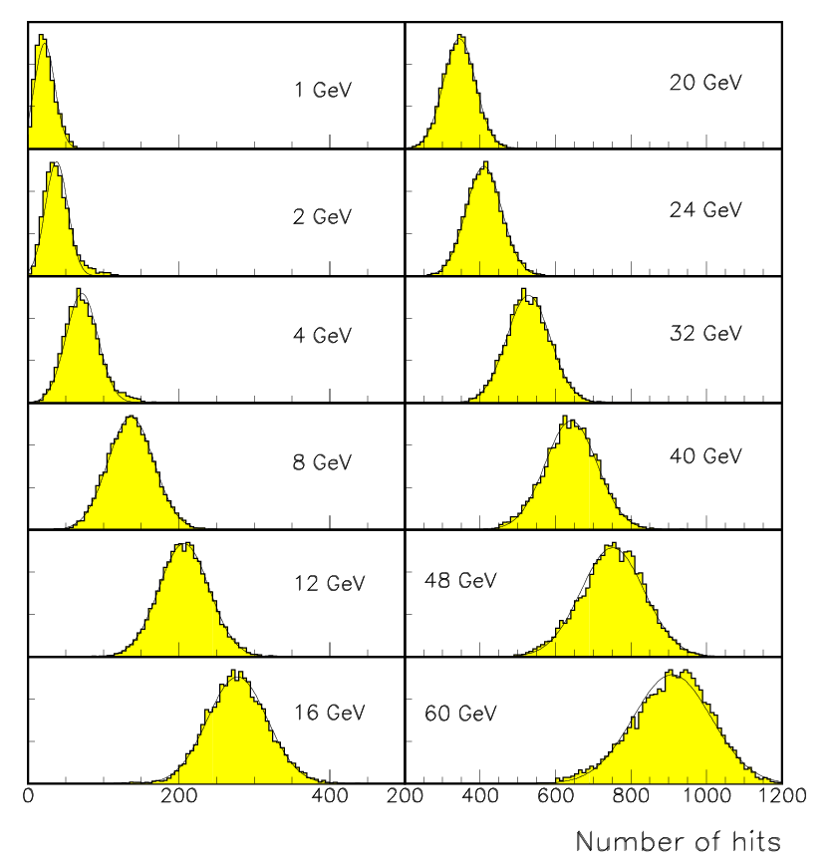
RPC_sim: Predictions I
Response curves
107 layers (minimal leakage)
Each 1.5 x 1.5 m²
Reasonable Gaussian fits for E > 2 GeV

Slide 13
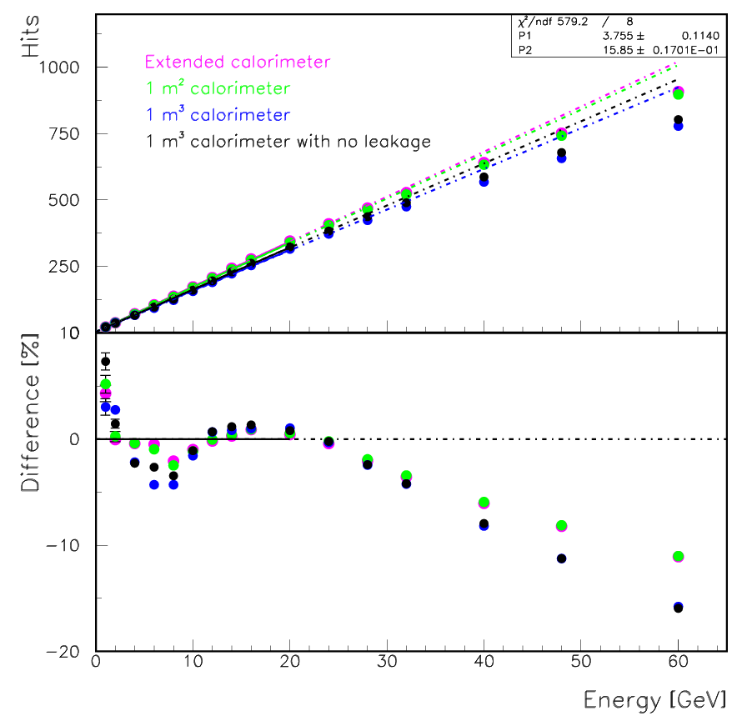
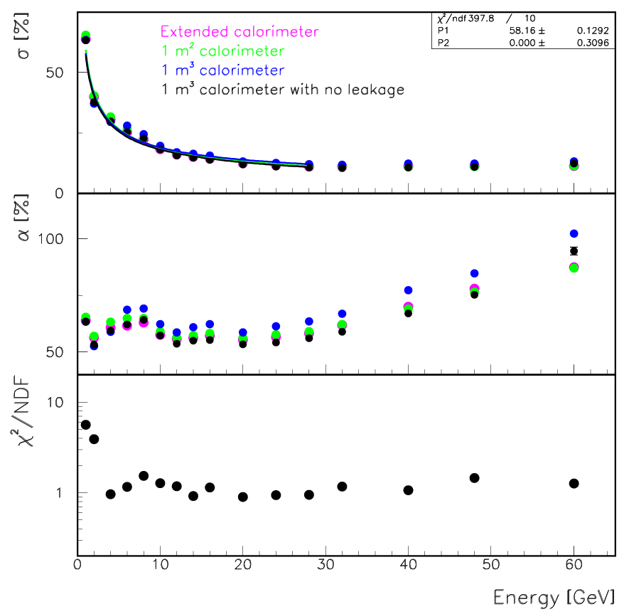
RPC_sim: Predictions II
Linearity and resolution
Reasonable Gaussian fits for E > 2 GeV
Discontinuity at E ~ 8 GeV (surprising, changes with physics list)
Non-linearity above E ~ 20 GeV (saturation)
Resolution ~ 58%/√E(GeV) (for E < 28 GeV)
Resolution degrades above 28 GeV (saturation)
Resolution of 1m³ with containment cut somewhat better than for extended calorimeter

Slide 14
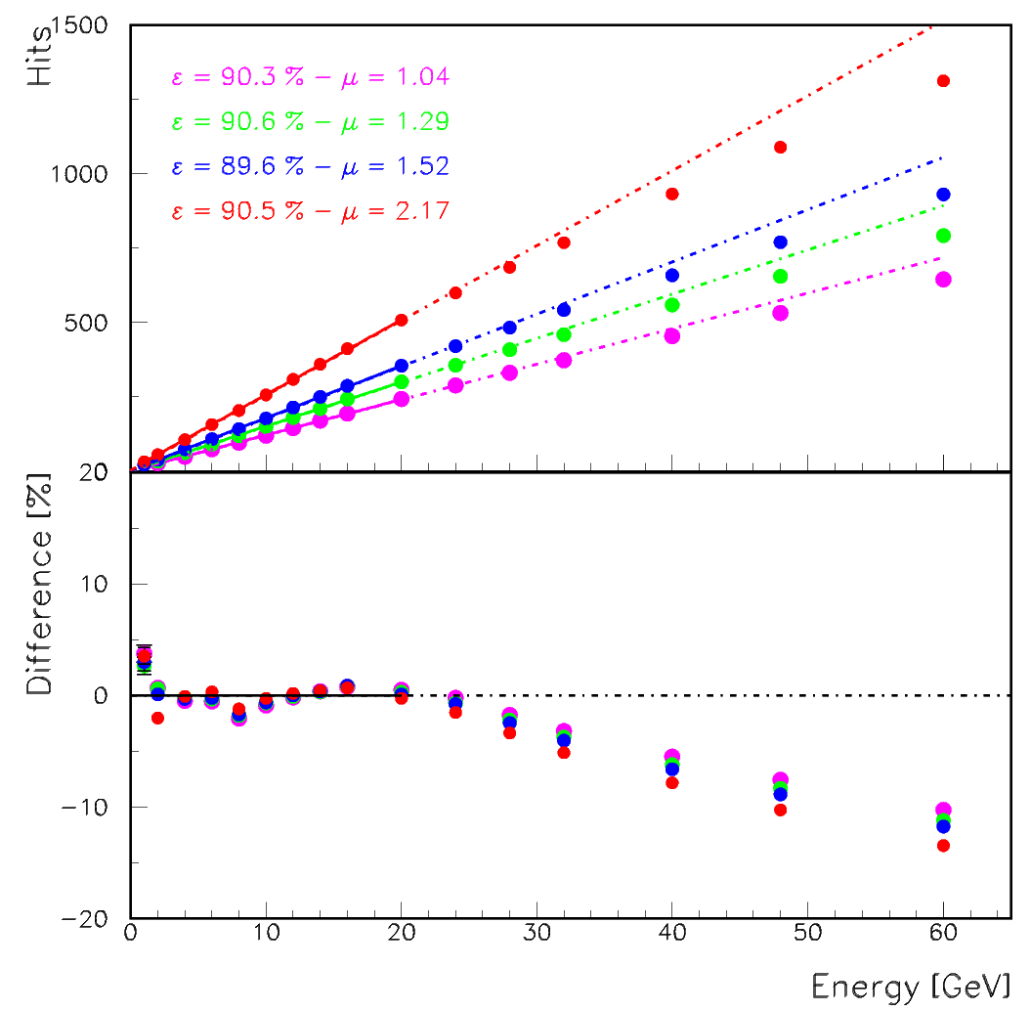
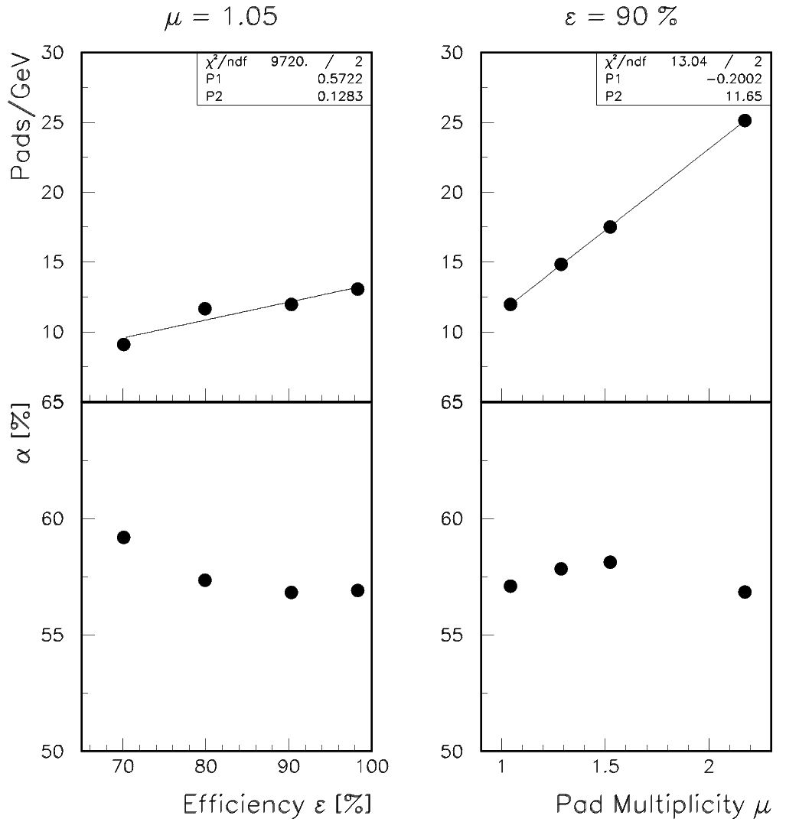
RPC_sim: Predictions III
Dependence on ε and μ
Efficiency and pad multiplicity have
only minor effect on resolution
(Large ε/small μ might be desirable for PFAs)
However values need to be known (calibration)
Note: Linear calibration corrections for ε,μ will work (P₁ ~ 0)

Slide 15
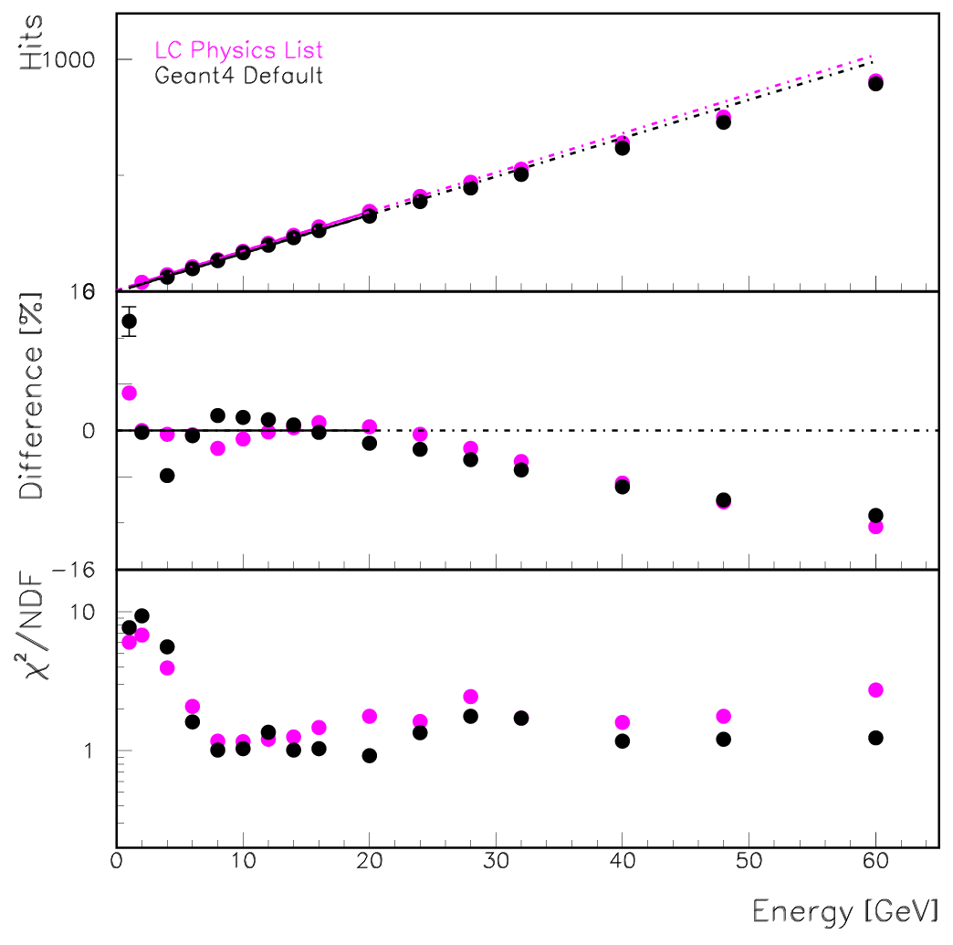
RPC_sim: Predictions IV
Different physics lists
Discontinuity seems
to move from 8 to 4 GeV
Discontinuity due to transition
in hadron showering models
These physics lists obsolete
by now

Slide 16
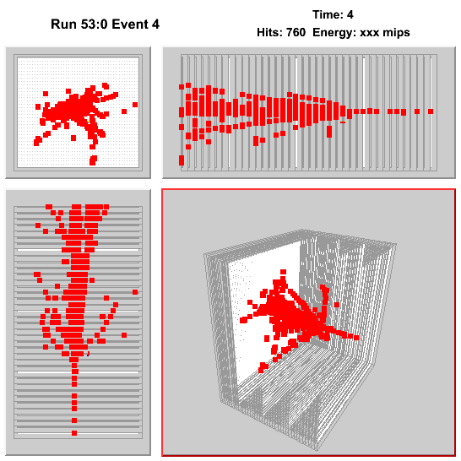
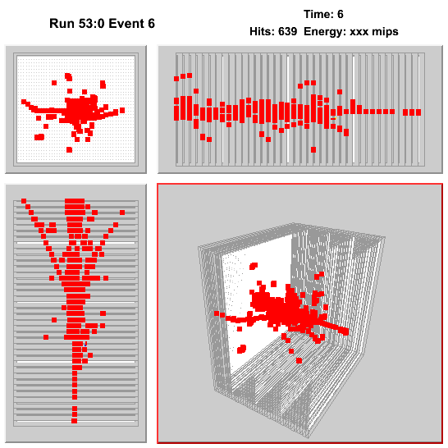
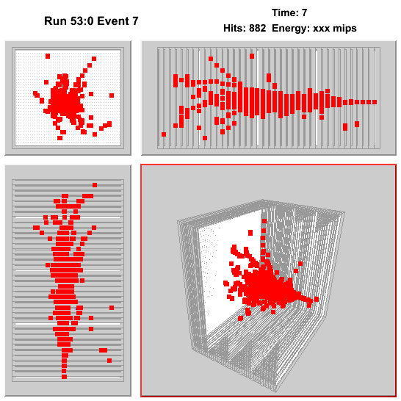
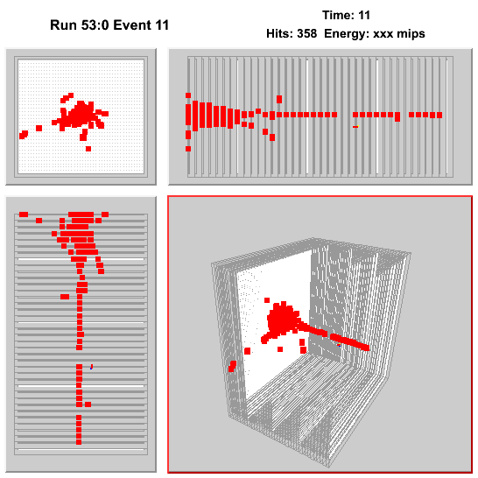
RPC_sim: Predictions V
Event displays
60 GeV Pions
GEANT4 simulation +
RPC response simulation

