Slide 1
CM2 Tuner Testing in HTS
Yuriy Pischalnikov
Warren Schappert
Serena Barbannoti

Slide 2
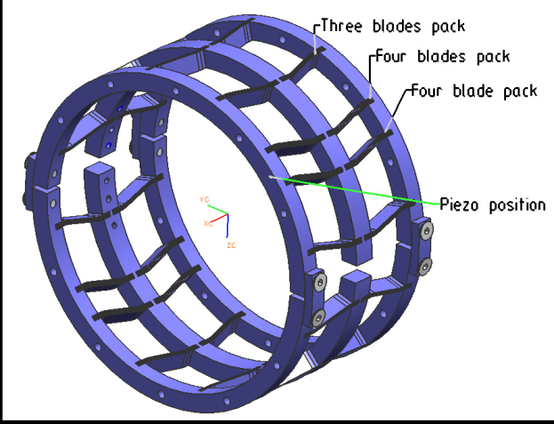
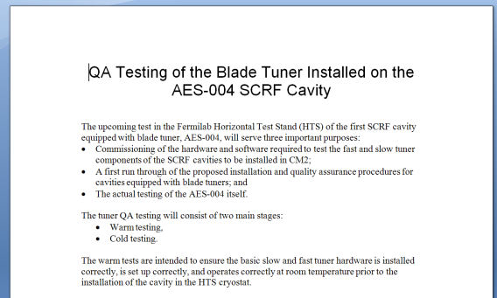
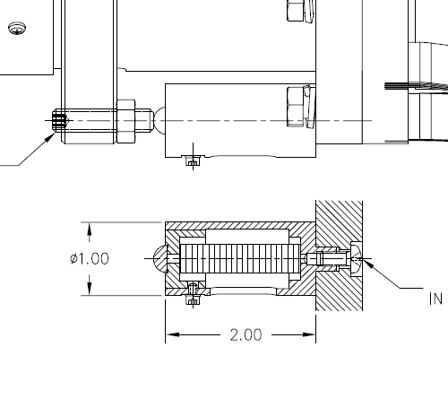
QA Testing of CM2 Tuners
CM2 cavities will be equipped with a coaxial blade tuner to limit Lorentz Force Detuning at high gradients
  Tuner developed by INFN/Milan
  Piezo mounts modified by FNAL

Slide 3
Cavities Tested
Total of 3 CM2 cavities tested to date
All used same piezos and piezo holders
Cavity | Tuner | Tested | Comments
ACC013 | Tuner 01 | February | Piezos unseated
AES009 | Tuner 11 | April | Loctite
ACC008 | Tuner 11 | May
ACC013 | Tuner 01 | June? | Not tested yet
AES010 | Tuner 03 | August? | Planned

Slide 4
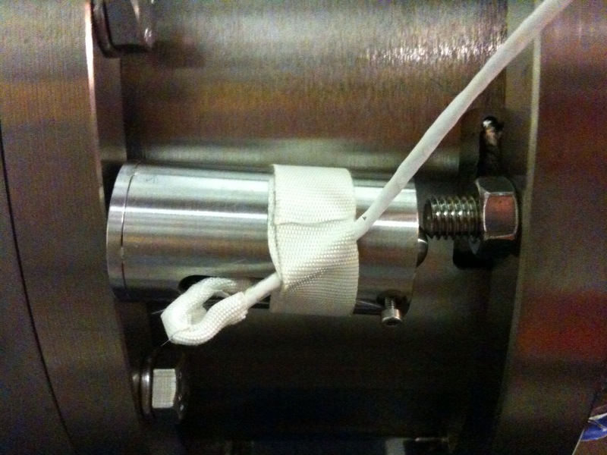
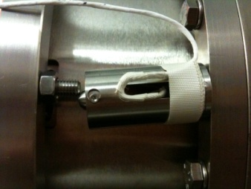
ACC013 (February)
Successfully controlled LFD at gradients of up to 35 MV/m
When the cavity was removed from the HTS piezo holders were not seated properly
  Holder retaining screws had not been installed because of time constraints

Slide 5
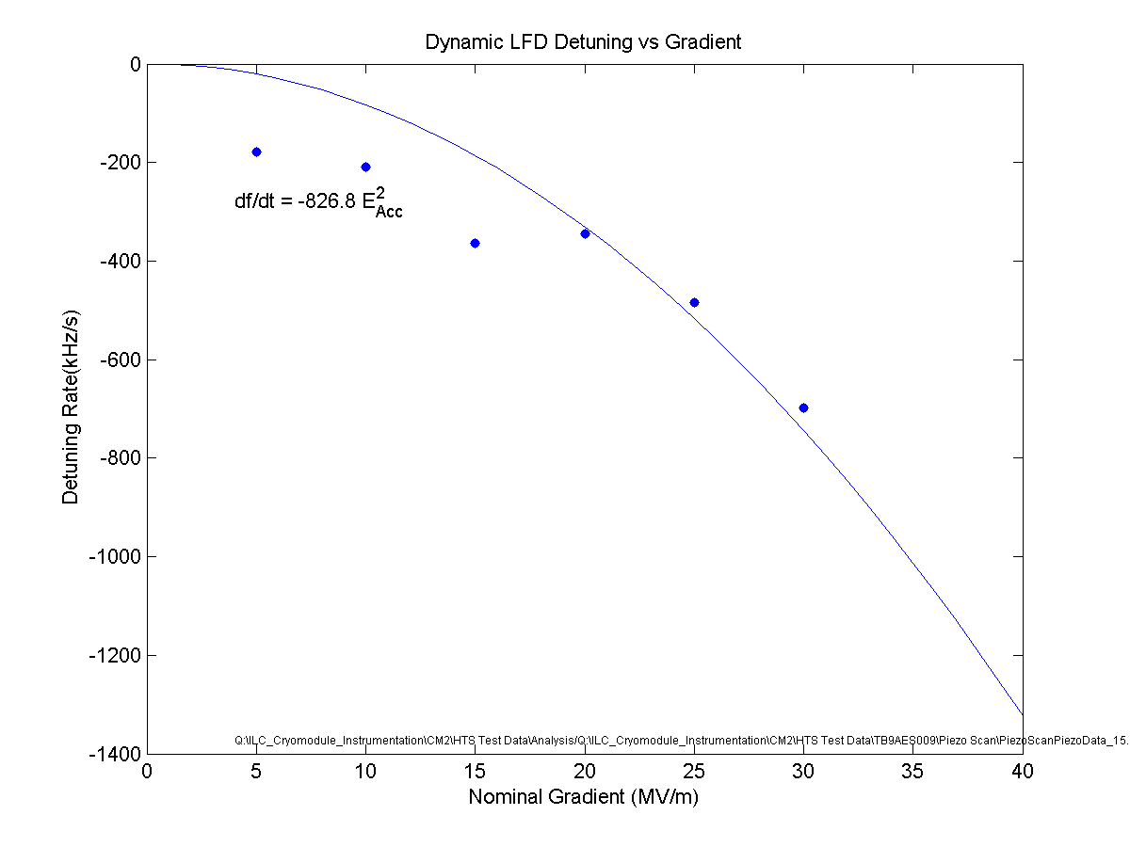
AES009 (April)
Sensitivity to piezo expected (~ 3Hz/V vs ~ 8 Hz/V)
Only able to compensate LFD at gradients below ~25 MV/m.
Post-mortem
  Loctite applied to retaining screws had seeped between the base of the piezo holder and the tuner ring

Slide 6
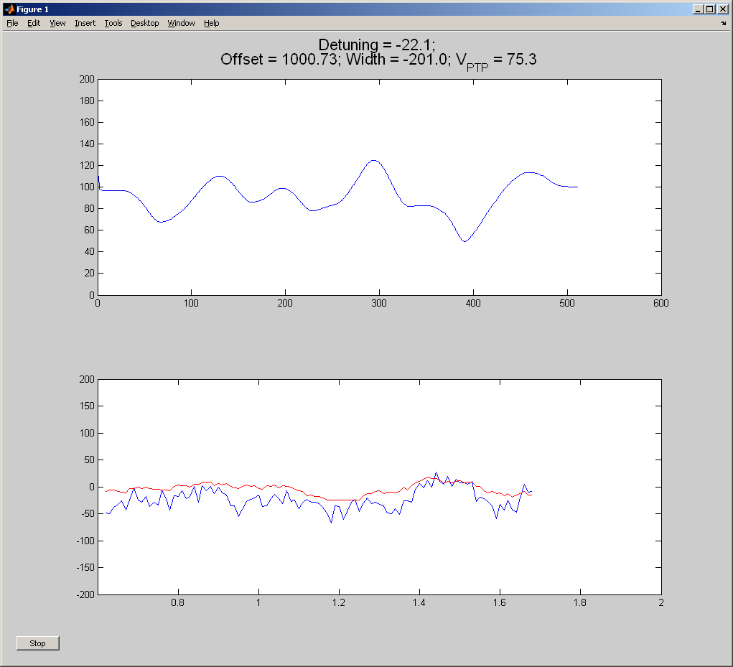
ACC008 (May)
Successfully controlled LFD up to 27 MV/m
Piezo sensitivity as expected
  Retaining screws installed without Loctite

Slide 7
Current Status
Three CM2 cavities tested thus far with mixed results
  Problems with retaining screws and Loctite may be resolved
Testing and analysis of data from individual tests now relatively routine
Still need to systematically compare tests to each other and to Milan design goals

