Slide 1
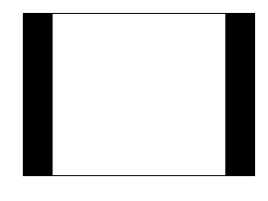
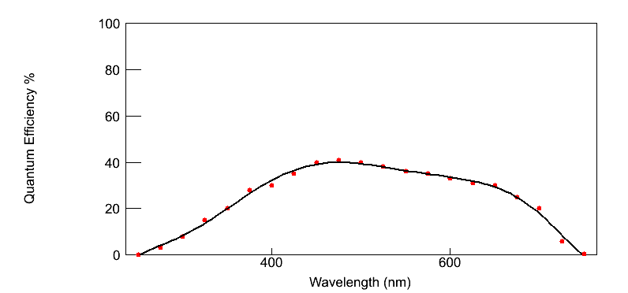
x
Simulation Setup
Cube: 2x2x2 cm³
2 Sens. Det. (x=-1,x=1)
Crystal: BGO
Surface: Polished
Particle Gun Position
Det.0
x = 0
Det.1
Quantum Efficiency
Makris Yiannis
Kyriacou Savvas

Slide 2
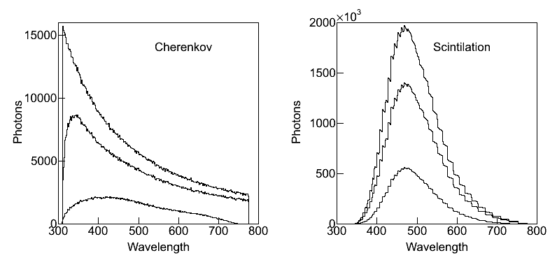
Wavelength distribution for Cherenkov –Scintillation photons

Slide 3
Approximation on photon yield to x by angle calculation
x
θ
φ
particle perpendicular trajectory

Slide 4
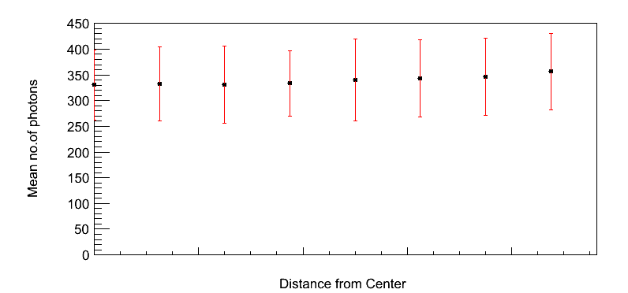

Slide 5
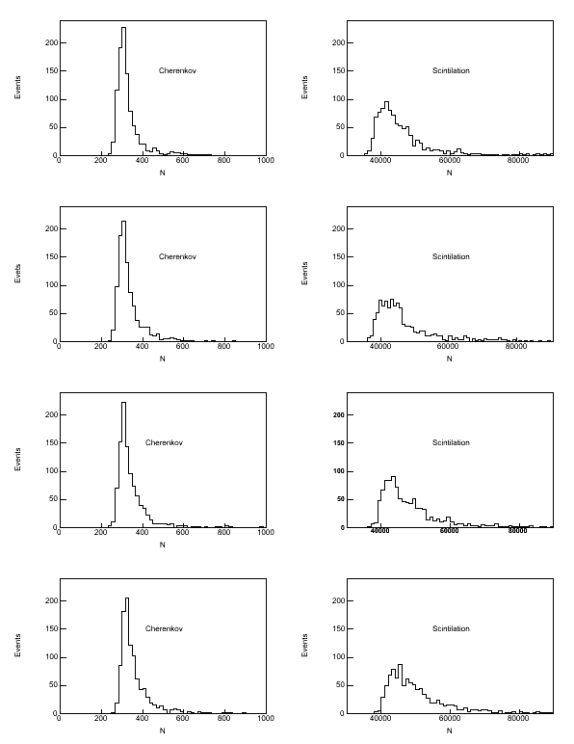
x=0mm
x=3.75mm
x=6.25mm
x=8.75mm

Slide 6
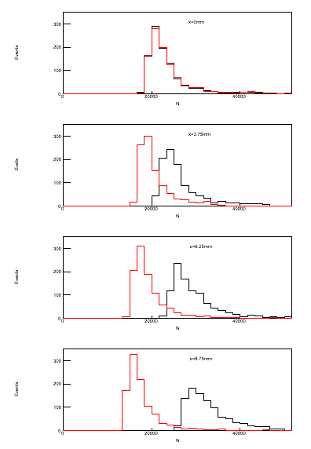
 | Detector 0 | Detector 1 | Ratio
Cerenkov | Mean:166 RMS: 43.8 | Mean:166.3 RMS:41.3 | 1.002
Total | Mean: 2.37x10⁴ RMS: 0.58x10⁴ | Mean: 2.37x10⁴ RMS: 0.57x10⁴ | 1
 | Detector 0 | Detector 1 | Ratio
Cerenkov | Mean:185 RMS: 40.8 | Mean:148.6 RMS:32.4 | 0.799
Total | Mean: 2.69x10⁴ RMS: 0.62x10⁴ | Mean: 2.09x10⁴ RMS: 0.49x10⁴ | 0.778
 | Detector 0 | Detector 1 | Ratio
Cerenkov | Mean:204 RMS: 45.6 | Mean:138.9 RMS:32.5 | 0.681
Total | Mean: 3.01x10⁴ RMS: 0.71x10⁴ | Mean: 1.96x10⁴ RMS: 0.48x10⁴ | 0.651
 | Detector 0 | Detector 1 | Ratio
Cerenkov | Mean:227.2 RMS: 47.8 | Mean:129.8 RMS:30.1 | 0.571
Total | Mean: 3.39x10⁴ RMS: 0.76x10⁴ | Mean: 1.79x10⁴ RMS: 0.46x10⁴ | 0.465

