Slide 1
SCRF Monthly WebEx Meeting
July 28, 2010
Agenda
Report from PMs (5 min.)
General Report from GLs (15 min.)
Special Discussions (40 min.)
  BAW-1 Preparation
  ILC-CLIC ws at CERN

Slide 2

TDP R&D Plan Rel-5: Draft
Notes:
Leaving PIP aside for the moment – however this is an important TDR deliverable. How does it integrate with the above?
R&D should feature more prevalently: TDR will contain quite some detail on the results and achievements of the R&D programme
Need better word than ‘Remaining’ – motivation for further work, not a sense of ‘OK we are done’.

Slide 3
Draft: TDP-R&D Plan (Release 5)

Slide 4
Preparation for BAW-1 and Requests for
Conveners and Key-contributors
Akira Yamamoto
To be discussed in SCRF webex meeting,
on July 28, 2010

Slide 5
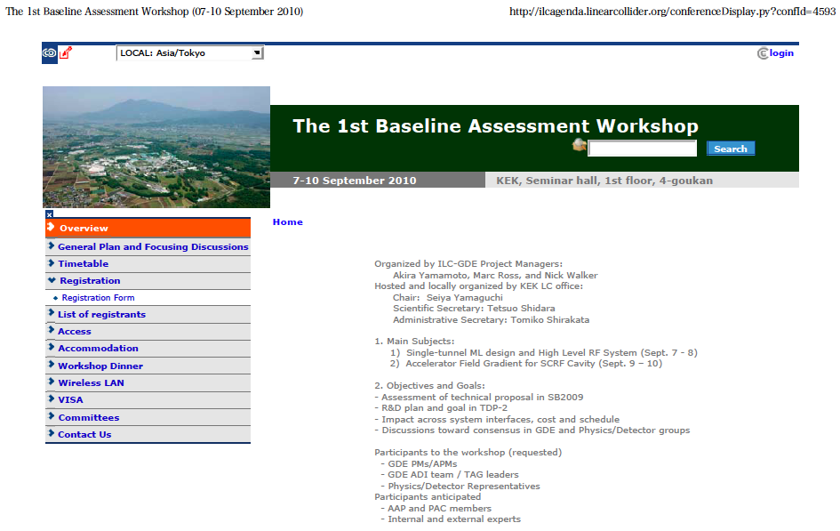
The 1st BAW Announcement http://ilcagenda.linearcollider.org/conferenceDisplay.py?confId=4593

Slide 6
Time-Table / Agenda (Plan: Sept. 7)
Day | Am/pm | Subject | Convener Session Chair/- presenter
9/7 |  | Single Tunnel ML Design and HLRF -1 | S. Fukuda / C. Nantista
 | am-1 | Opening and Introduction Opening Opening address Report and advice from AAP BAW1 objectives and goal | S. Yamaguchi S. Yamaguchi A. Suzuki/K. Oide E. Elsen A. Yamamoto
 | am-2 | Single tunnel CF design and HLRF design Single tunnel ML design overview Single tunnel CF design status General HLRF design in SB2009 | V. Kuchler C. Adolphsen A. Enomoto S. Fukuda
 | pm-1 | HLRF KCS-1 KCS design and R&D issues | S. Fukuda C. Nantista TBD
 | pm-2 | HLRF KCS-2 Operation, control, and tolerance Others Discussion | S. Fukuda TBD TBD ALL

Slide 7
Time-Table / Agenda (Plan: Sept. 8)
Day | Am/pm | Subject | Convener Session Chair/- presenter
9/8 |  | Single Tunnel ML Design and HLRF -2 | S. Fukuda / C. Nantista
 | am-1 | DRFS - 1 DRFS design DRFS R&D status and plan | C. Nantista S. Fukuda TBD
 | am-2 | DRFS-2 Assembly, sorting, installation strategy others | C. Nantista - TBD TBD
 | pm-1 | HLRF and LLRF LLRF requirements/issues for KCS LLRF requiremetns/issues for DRFS | C. Adolphsen TBD S. Michizono
 | pm-2 | Discussions and Recommendations General discussions Summary and recommendations | S. Fukuda TBD ALL

Slide 8
Discussion Topics: Single-tunnel HLRF system in the 1st BAW, Sept. 7-8, 2010
KCS: (Convener: Chris Nantista)
  RF power margin required for cluster operation, including gradient spread, as consistent with cavity production strategy,
  Tuning and control strategy, including impact on high gradient operation and required gradient operational margin
  RF amplitude and phase performance tolerance within a cluster; allowed common-mode and normal-mode fluctuations,
  R&D required, including demonstrations of component performance and demonstrations with small clusters
DRFS: (Convener: Shigeki Fukuda)
  Cavity and klystron sorting and resulting required RF power margins
  Installation strategy; needed tunnel infrastructure and access
  RF amplitude and phase performance tolerances, including gradient spread, as consistent with cavity production strategy,
  R&D required in the remaining half of the TDP (and beyond) including radiation shielding, klystron lifetime, redundancy strategies
Backups: (Convener: Shigeki Fukuda, as SCRF HLRF GL)
  Original RF system in RDR, in single tunnel, just in case, as a backup,

Slide 9
Time-Table / Agenda (Plan: Sept. 9)
Day | Am/pm | Subject | Convener Session Chair/- presenter
9/9 |  | Cavity: Gradient R&D | R. Geng
 | am-1 | Cavity Gradient R&D - 1 Technical address for the 2nd part of WS Overview Progress of cavity gradient data-base/yield | H. Hayano A. Yamamoto R. Geng C. Ginsburg
 | am-2 | Cavity gradient R&D – 2 Regional R&D status and further plan | E. Kako - TBD, from Europe M. Champion, from AMs H. Hayano, from Asia
 | pm-1 | Strategy for cavity gradient improvement Near-future R&D in TDP-2 Long-term R&D scoping TeV collider | E. Elsen TBD TBD
 | pm-2 | R&D plan and discussion General discussions Summary and recommendations | R. Geng TBD ALL

Slide 10
Time-Table / Agenda (Plan: Sept. 10)
Day | Am/pm | Subject | Convener Session Chair/- presenter
9/10 |  | ILC accelerator gradient and operational margin | A. Yamamoto and J. Kerby
 | am-1 | ILC Accelerator Gradient Overview on ILC gradient specification Observation on average and spread Operational experience | C. Adolphsen - A. Yamamoto - J. Kerby - TBD
 | am-2 | Cryomodule operational margin Operational experience Requirements from cavity-string operation Discussions | M. Ross TBD TBD
 | pm-1 | Accelerator/beam operational margin Operational experience in accelerators Requirements from accelerator tuning/op. Discussions | N. Walker - TBD TBD
 | pm-2 | Genearl Discussion and recommendation General discussions Summary and recommendations | A. Yamamoto TBD All

Slide 11
Discussion Topics: Accelerating Gradient
1st BAW, KEK, Sept. 9-10, 2010
Gradient Improvement Studies: (Convener: Rongli Geng)
  Material/fabrication, surface processing, instrumentation and repair
  Strategy to overcome ‘quench’, and ‘field emission’ and to maintain moderate cryogenic load,
  Strategy to define and specify ‘Emitted Radiation’, (Radiation that may result in increased cryogenic-load and usable gradient limitations),
  Improvement of gradient and achievement of adequate yield,
Strategy for Accelerating Gradient in the ILC: (Convener: Akira Yamamoto)
  Overview and scope of ‘production yield’ progress and expectations for TDP, including acceptable spread of the gradient needed to achieve the specified average gradient,
  Specifications of Gradient, Q0, and Emitted Radiation in vertical test, including the spread and yield,
  Specifications of Gradient, Cryogenic-load and Radiation, including the gradient spread and operational margin with nominal controls, in cryomodule test,
  Specifications of Gradient, Cryogenic-load and Radiation, including the gradient spread and the operational margin with nominal controls in beam acceleration test,
  Impact on other accelerator systems: CFS, HLRF, LLRF, Cryogenics, and overall costs.

Slide 12
Requests for Conveners and
Key-contributors
Communicate with experts and establish the agenda to be reported and discussed,
Prepare for ‘text’ documents on the reports and discussions by end of August, prior to the BAW-1 workshop,
Report the progress and plan for the above preparation in the SCRF webex meeting, on July 28.
Your cooperation will be much appreciated.

Slide 13
Preparation for the 1st BAW
May 7: SCRF webex meeting and homework assignment
May 26: AD&I meeting
June 2: SCRF webex meeting and progress report from each collaborator,
June 23: AD&I meeting
June 30: SCRF webex meeting and preliminary draft report to be distributed >>> in progress, assuming R&D plan draft can be partly used.
July 21: AD&I meeting
July 28: SCRF meeting and draft report to be distributed,
Aug. 25: SCRF meeting, the report prior to the 1st BAW to be complete.

