Slide 1
ILC Cavity Performance Evaluation
TDP/R&D plan (Rel-5) and BAW-1
Originally reported by
C.M. Ginsburg
On behalf of the ILC Database Group
At SCRF WebEx meeting, June 20, 2010, and
A few slides added by
A.Yamamoto
For SCRF WebEx Meeting
July 28, 2010

Slide 2
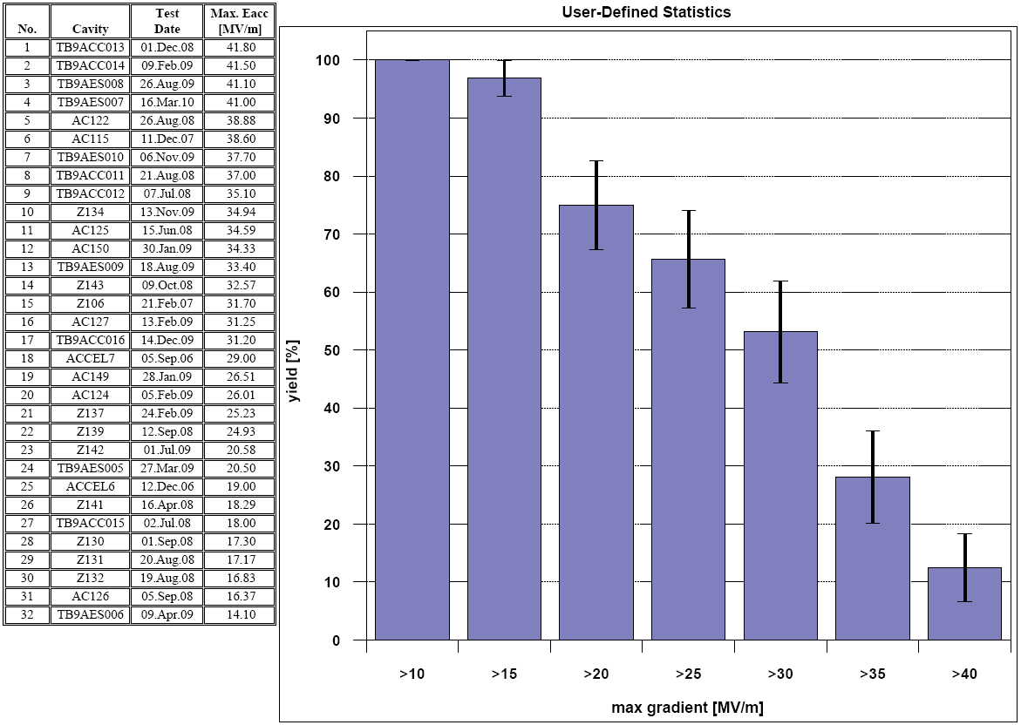
1st pass
LCWS2010
First-pass cavity yield at >25 MV/m is (66 +- 8) %
(66 +- 8) %
>35 MV/m is (28 +- 8) %
(29 +- 8) %

Slide 3
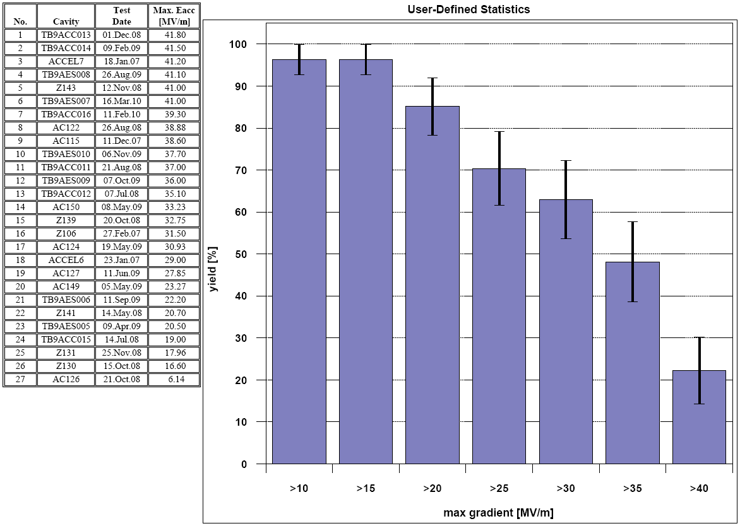
2nd pass
LCWS2010
First-pass cavity yield at >25 MV/m is (70 +- 9) %
(74 +- 8) %
>35 MV/m is (48 +- 10) %
(56 +- 10) %

Slide 4
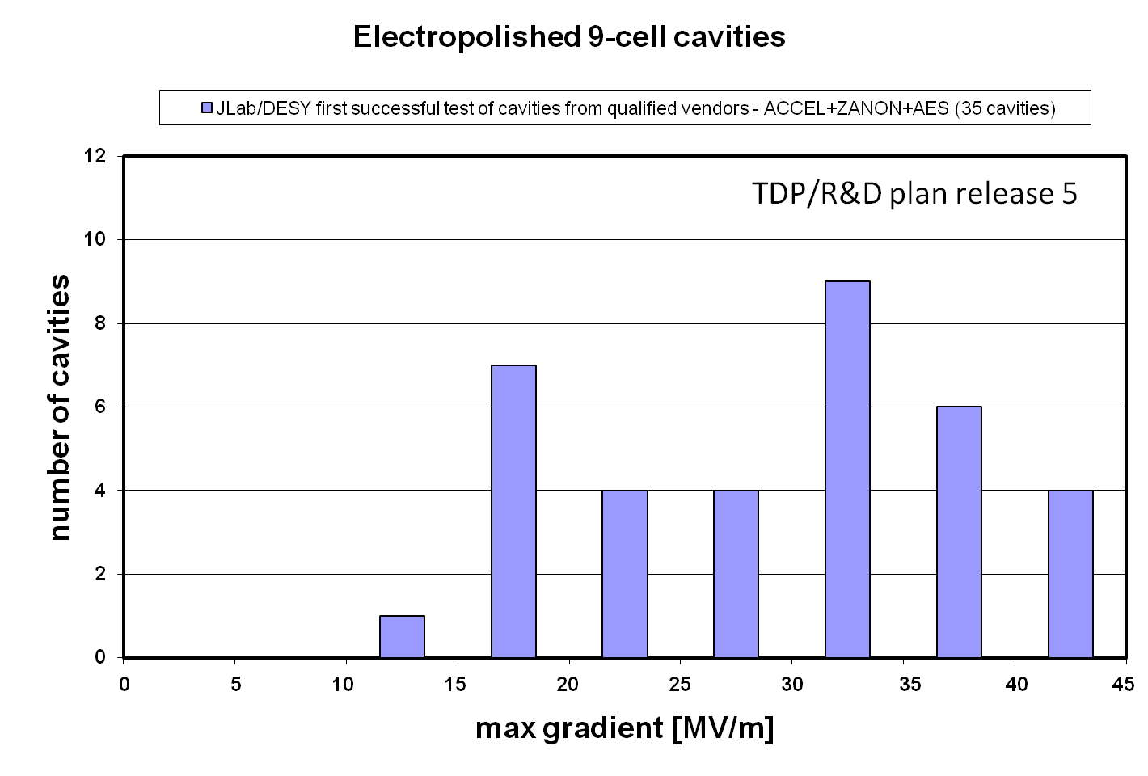
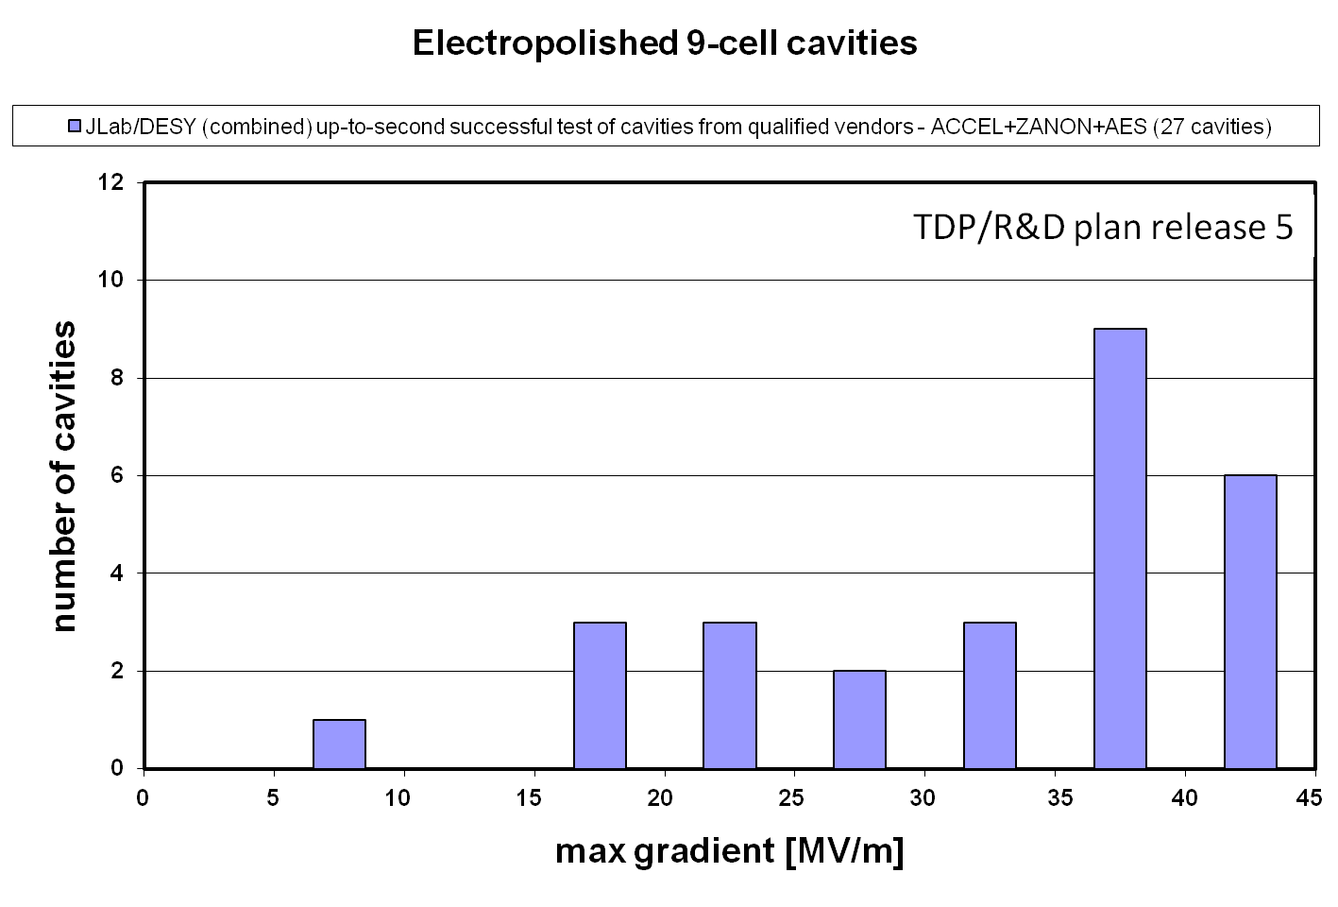
More plots for the document

Slide 5
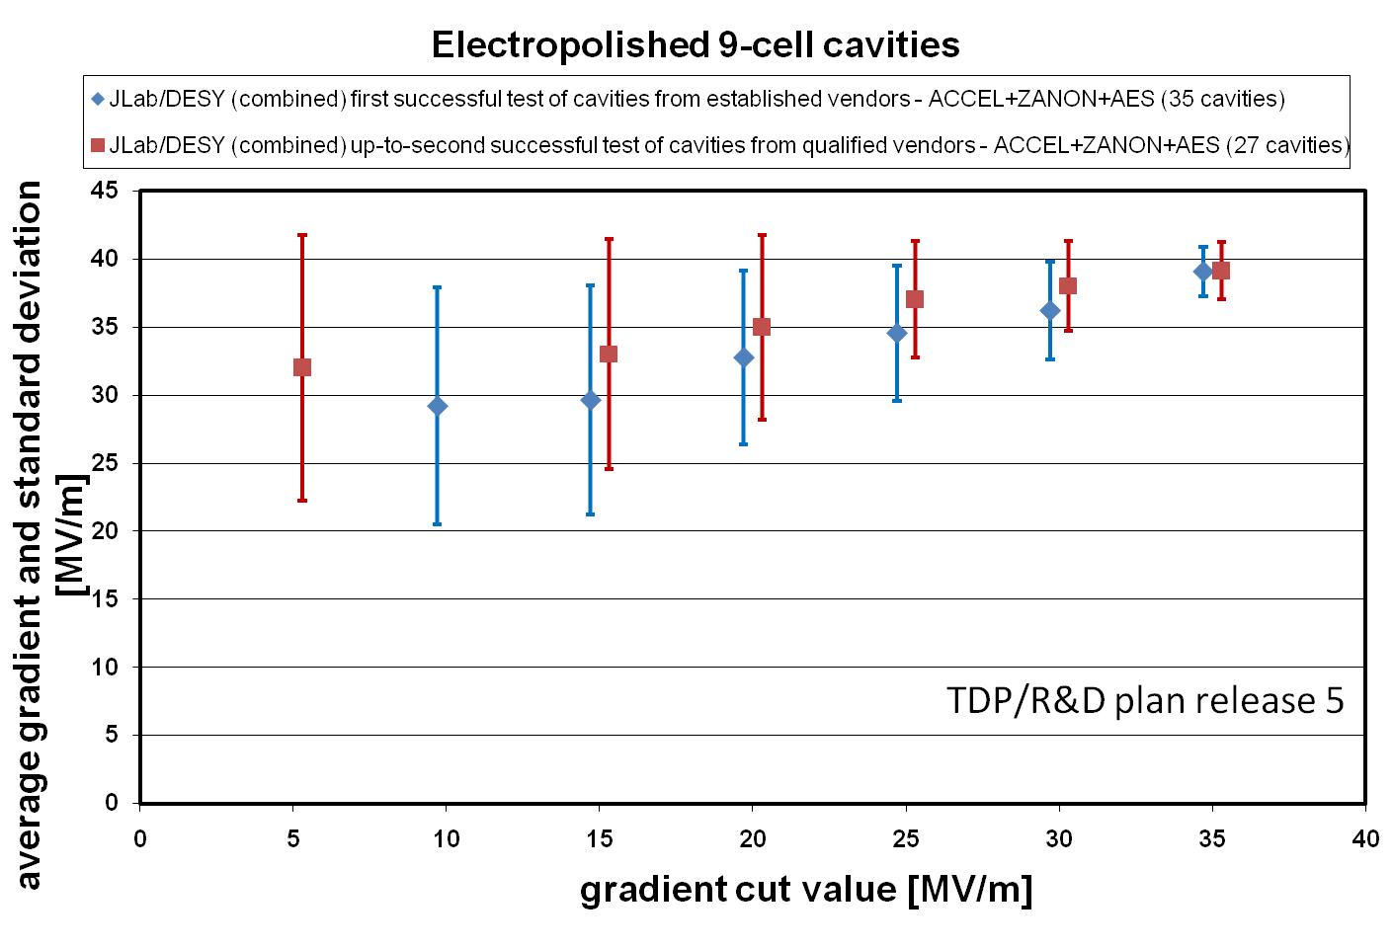
More plots for the document

Slide 6
Comments on the plots
In LCWS2010 plots, two cavity tests were mistakenly included in the 2nd pass plots which shouldn’t have been
  Z106 and AC149 had no surface treatment in between 1st and falsely-labeled 2nd passes
  automation is an excellent thing
For TDP/R&D plan release 5, three additional new cavities are included: TB9RI018 and TB9RI019 from JLab (1st and 2nd pass plots, but see note below), and AC146 from DESY (1st pass only)
  35 cavities for 1st pass, 27 cavities for 2nd pass
Within the database group we are discussing how best to include one of the cavities (TB9RI018)
  The standard EP process at JLab was known to have poor temperature stability, suspect water introduced in the acid mixture during mixing; Rongli specified “do not include”
    "Do not include" normally means system limitation implies could not determine cavity limitation from test, and test to be repeated w/o additional surface preparation
    If process was non-standard, the cavity would not be included in any plots
      Problem in standard process, not new process
      From R&D perspective, it is interesting to have the cause and effect of
      such a deviation from normal performance understood
    From an earlier email exchange, I believe Rongli wants this cavity included in the plots
    Opinion from the database group is mixed, and clearly Rongli’s specific input is needed
  Next steps
    I changed the status in the database to “include” for the purposes of making the plots in this talk, then changed it back
    The contributing institution specifies the “include” flag, therefore this requires Rongli’s confirmation about the preferred specification of the cavity in the database

Slide 7
Further To Do List for BAW-1
The key issues to address for the cavity performance evaluation are:
  Reduction in the horizontal bin size, if justified by the gradient measurement error
  Cavity performance tracks/changes from vertical test to horizontal test to cryomodule test in current data samples
  Cavity performance evaluation to be extended to 3rd pass process, if a sufficiently useful data set become available
  Radiation emission to be added as further quantitative evaluation of the cavity performance.
The primary tasks planned for completion by September 2010 are:
  To create a standard plot tracking cavity performance for new vendors if there are new data available.
  To study Q₀ at the 31.5 MV/m operating gradient and Q₀ at the 35 MV/m vertical qualification gradient for data in the first- and second-pass data selections, for cavities which reach these gradients. This requires the adoption of a common algorithm to interpolate between measurements. As a later step, we will include this information in the ILC database.
  To evaluate annual progress of the maximum field gradient, at least, at the first-pass evaluation, which can be widely and easily applied to cavity production in various projects (e.g. XFEL, Project-X) in a consistent fashion with the ILC R&D cavities.

