Slide 1
ILC Accelerator Operational Gradient
Akira Yamamoto:
SCRF Webex Meeting, July 28, 2010

Slide 2
ILC Accelerator, Operational Gradient
Strategy for Average Accelerating Gradient in the ILC operation:
  Overview and scope of 'production yield' progress and expectations for TDP,
    including acceptable spread of the gradient needed to achieve the specified average gradient,
  Cavity
    Gradient, Q0, and Emitted Radiation in vertical test, including the spread and yield,
  Cryomodule
    Gradient, Cryogenic-load and Radiation, including the gradient spread and operational margin with nominal controls,
  ILC Accelerator
    Gradient, Cryogenic-load and Radiation, including the gradient spread and the operational margin with nominal controls
  Strategy for tuning and control,
    including feedback, control of ‘Lorentz force detuning’, tolerances and availability margin,
  Impact on other accelerator systems: CFS, HLRF, LLRF, Cryogenics, and overall costs.

Slide 3
Short and Long Term R&Ds
Priority | Subjects | R&D themes | Actions planned
Highest | Fabrication | Forming/machining EBW, Improve tools for QC in mass production | Cost effective fabrication R&D with Pilot Plant (KEK) Destructible bare 9-cell cavities, (FNAL/JLAB/Cornell/Industry) Bare 9-cell cavities w/ in-house welder (JLAB) XFEL and HighGrade Project (DESY)
High. | Mechanical polishing prior to heavy EP | Eliminates weld irregularities, Reduce surface removal by heavy EP | Raw 9-cell mechanical polishing before chemistry (FNAL) 9-cell tumbling for cavity recover (Cornell)
Mid, | Large-grain and direct slicing | Eliminate rolling | Large-grain cavities and multi-wire slicing (KEK), Processing and evaluation of 8 existing 9-cell large grain cavities,
High | Seamless cavity | Eliminate weld prep machining and EBW | Hydroform and test muti-cell cavities, (DESY-JLab) Hydroform and test multi-cell cavities (FNAL/Ind.)
Mid. | Material improvement | Nb with low Ta concentration | Material characterization and 1-cell cavity testing (FNAL) Material characterization and 1-cell testing (JLab)
High | Post vertical test local treatment | Rapid quench limit improvement with small incremental cost | Local grinding (KEK) Local re-melting with laser beam (FNAL) Local treatment/re-melting with electron beam (JLab)
Highest | Field emission quantified | Additional information than unloaded quality factor | Correlation of vertical test FE with horizonatal test FE as well as dark current in linac beam operation, Comparison across facilities world-wide,

Slide 4
R&D Milestone in RDR revised in Rel-5
Stage | Subjects | Milestones to be achieved | Year
S0 | 9-cell cavity | 35 MV/m, max., at Q0 ≥ 8E9, with a production yield of 50% in TDP1, and 90% in TDP2 ^{1), 2)} | 2010/ 2012
S1 | Cavity-string | 31.5 MV/m, in average, at Q0 ≥ 1E10, in one cryomodule, including a global effort | 2010
S2 | Cryomodule-string | 31.5 MV/m, in average, with full-beam loading and acceleration | 2012

Slide 5
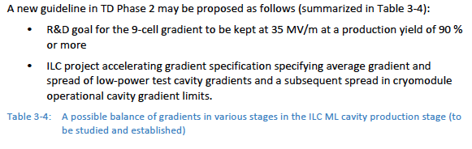
A possible balance in
ILC Accelerator Cavity Specification
Single 9-cell cavity gradient | String Cavity gradient in cryomodule w/o beam | String cryomodule gradient in accelerator with beam
35 MV/m, on average w/ spread above a threshold | 33 MV/m, on average (or to be further optimized) | 31.5 MV/m, on average (or to be further optimized)

Slide 6
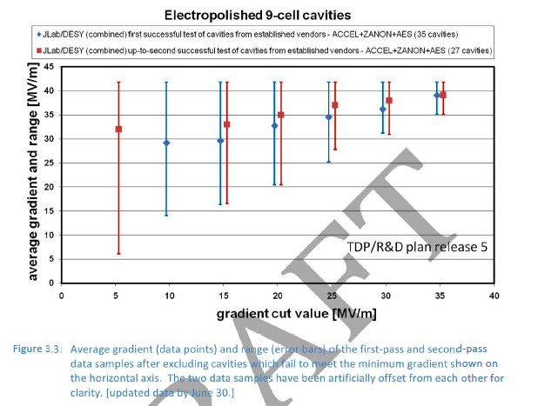

Slide 7
Subjects to be further studied in
TDP-2
Further Studied in TDP-2
  How wide cavity gradient spread may be acceptable in balance of HLRF power source capacity and efficiency?
  How large operational margin required in cryomodule and accelerator operation?

Slide 8
backup

Slide 9
Discussion Topics: Single-tunnel HLRF system in the 1st BAW, Sept. 7-8, 2010
KCS:
  RF power margin required for cluster operation, including gradient spread, as consistent with cavity production strategy,
  Tuning and control strategy, including impact on high gradient operation and required gradient operational margin
  RF amplitude and phase performance tolerance within a cluster; allowed common-mode and normal-mode fluctuations,
  R&D required, including demonstrations of component performance and demonstrations with small clusters
DRFS:
  Cavity and klystron sorting and resulting required RF power margins
  Installation strategy; needed tunnel infrastructure and access
  RF amplitude and phase performance tolerances, including gradient spread, as consistent with cavity production strategy,
  R&D required in the remaining half of the TDP (and beyond) including radiation shielding, klystron lifetime, redundancy strategies
Backups:
  Original RF system in RDR, in single tunnel, just in case, as a backup,

Slide 10
Preparation for the 1st BAW
May 7: SCRF webex meeting and homework assignment
May 26: AD&I meeting
June 2: SCRF webex meeting and progress report from each collaborator,
June 23: AD&I meeting
June 30: SCRF webex meeting and preliminary draft report to be distributed >>> in progress, assuming R&D plan draft can be partly used.
July 21: AD&I meeting
July 28: SCRF meeting and draft report to be distributed,
Aug. 25: SCRF meeting and the final report (prior to the 1st BAW) to be distributed

Slide 11
Discussion Topics: Accelerating Gradient
1st BAW, KEK, Sept. 9-10, 2010
Gradient Improvement Studies: (Convener: Rongli Geng)
  Material/fabrication, surface processing, instrumentation and repair
  Strategy to overcome ‘quench’, and ‘field emission’ and to maintain moderate cryogenic load,
  Strategy to define and specify ‘Emitted Radiation’, (Radiation that may result in increased cryogenic-load and usable gradient limitations),
  Improvement of gradient and achievement of adequate yield,
Strategy for Accelerating Gradient in the ILC: (Convener: Akira Yamamoto)
  Overview and scope of ‘production yield’ progress and expectations for TDP, including acceptable spread of the gradient needed to achieve the specified average gradient,
  Cavity: Specifications of Gradient, Q0, and Emitted Radiation in vertical test, including the spread and yield,
  Cryomodue: Specifications of Gradient, Cryogenic-load and Radiation, including the gradient spread and operational margin with nominal controls, in cryomodule test,
  ILC Accelerator: Specifications of Gradient, Cryogenic-load and Radiation, including the gradient spread and the operational margin with nominal controls in beam acceleration test,
  Impact on other accelerator systems: CFS, HLRF, LLRF, Cryogenics, and overall costs.

Slide 12
Time-Table / Agenda (Plan: Sept. 10)
Day | Am/pm | Subject | Convener Session Chair/- presenter
9/10 |  | ILC accelerator gradient and operational margin | A. Yamamoto and J. Kerby
 | am-1 | ILC Accelerator Gradient Overview on ILC gradient specification Observation on average and spread Operational experience | C. Adolphsen - A. Yamamoto - J. Kerby - TBD
 | am-2 | Cryomodule operational margin Operational experience Requirements from cavity-string operation Discussions | M. Ross TBD TBD
 | pm-1 | Accelerator/beam operational margin Operational experience in accelerators Requirements from accelerator tuning/op. Discussions | N. Walker - TBD TBD
 | pm-2 | Genearl Discussion and recommendation General discussions Summary and recommendations | A. Yamamoto TBD All

Slide 13
Cavity Gradient R&D Goals
 | Consideration in RDR/SB2009 | Re-optimization required in TD Phase 2
R&D goal: S0 - 9-cell cavity gradient | 35 MV/m (≥ 90%) | 35 MV/m (≥ 90 %): kept for forward looking
R&D goal: S1 - Cryomodule gradient w/o beam | 31.5 MV/m in average | 31.5 MV/m in average or higher to be optimized for reasonable cryomodule operational margin, inclusive
R&D goal: S2 Cryomodules gradient with beam acceleration | Not specified | Likely to be the same as ILC operational gradient
ILC-ML design value: - Accelerating gradient | 31.5 MV/m in average | 31.5 MV/m in average or lower to be optimized for reasonable accelerator operational margin, inclusive

