Slide 1
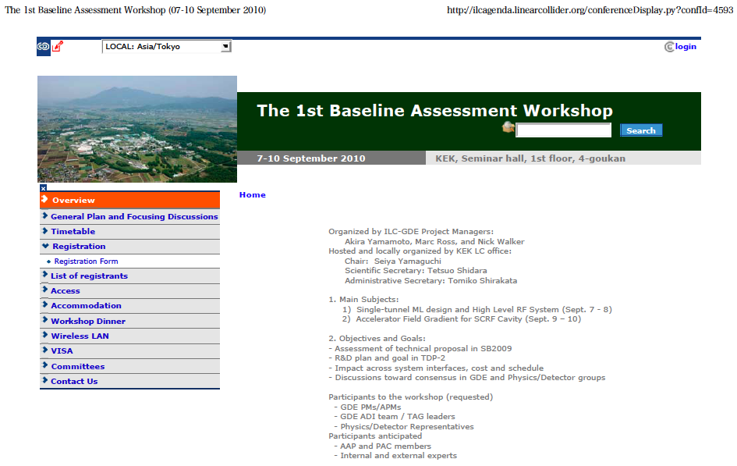
The 1st BAW Announcement http://ilcagenda.linearcollider.org/conferenceDisplay.py?confId=4593

Slide 2
Time-Table / Agenda (Sept. 9)
Day | Am/pm | Subject | Convener/presenter
9/9 |  | Cavity: Gradient R&D and ML Cavity Gradient | R. Geng/A. Yamamoto
 | 9:00 | Introduction and Current Status Technical address for the 2nd part of WS Overview from RDR to R&D Plan 5 Progress of cavity gradient data-base/yield | Chair: M. Ross A. Yamamoto R. Geng C. Ginsburg
 | 10:45 | R&D Status and further R&D specification Fabrication, testing, & acceptance for XFEL/HG R&D expected in cooperation w/ vendors R&D w/ a pilot plant w/ vendor participation | Chair: E. Kako - E. Elsen M. Champion H. Hayano
 | 13:30 | Short-tem R&D and Specification Field emission and strategy to settle … Gradient, Spread, Q0, Radiation: R&D specification, standardization | Chair: R. Geng H. Hayano
 | pm-2 | Long-term R&D ACD subjects and goals Seamless/hydro-forming, Cavity shape variation, VEP, Thin Film, Large-grain, .. | Chair: R. Geng (Rongli to propose)

Slide 3
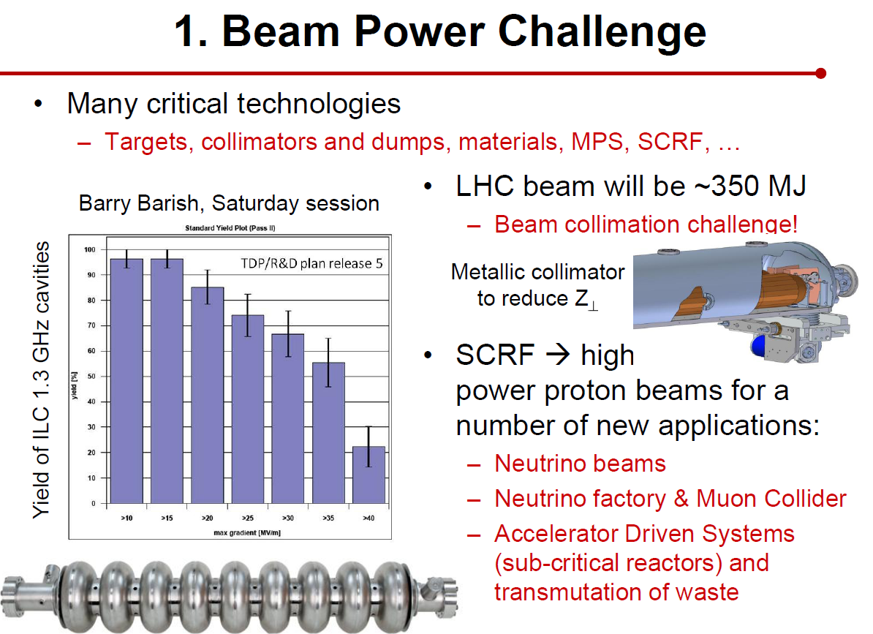
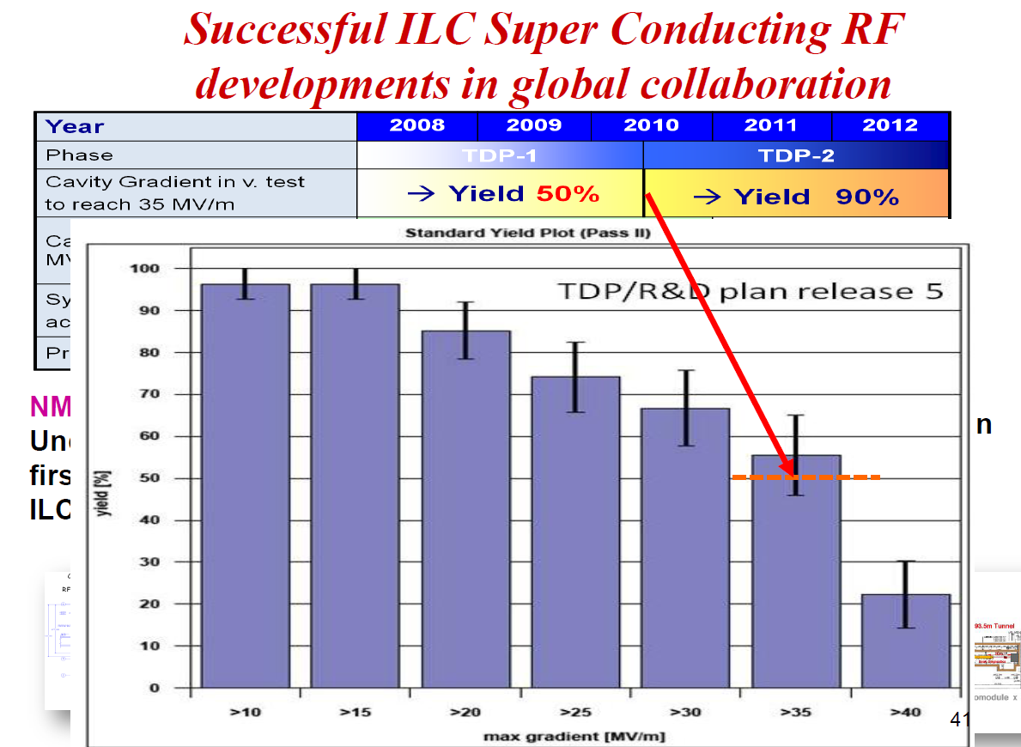
Gradient Progress Reported by Barry at ICHEP2010 Well Received by Community
Now the challenge is 90% yield by 2012
Tor Raubenheimer, ICHEP2010
J.P.Delahaye, ICHEP2010

Slide 4
Gradient Improvement Plan
Based on Recent Understanding due to Globally Coordinated S0 Program
Highest priority is to push yield up near 20 MV/m – the yield drop due to local (geometrical) defects near equator weld.
  Fab. QA/QC
  Mechanical polish prior to heavy EP
  Post-VT local targeted repair
  Seamless cavity
  Large-grain mat. From ingot slicing
  Fine grain mat. Optimization
Also high priority is to suppress field emission at high gradient (up to 42 MV/m) – and quantify its effect on cryogenic loss and dark current.
Remove local
defect (comp.)
and field emitter
Eliminate Local defect
(geo.) near equator weld

Slide 5
Time-Table / Agenda (Sept. 7) updated: August 27
Day | Am/pm | Subject | Chair/presenter
9/7 |  | Single Tunnel ML Design and HLRF -1 | S. Fukuda / C. Nantista
 | 9:00 | Opening and Introduction Opening address Report from AAP BAW1 objectives and goals | Chair: S. Yamaguchi A. Suzuki (KEK-DG) E. Elsen A. Yamamoto (GDE-PM)
 | 10:45 | Single tunnel CF design and HLRF design Single tunnel CF design status General HLRF design in SB2009 | Chair: T. Shidara - A. Enomoto S. Fukuda
 | 13:30 | HLRF KCS KCS design and R&D status Demonstration of feasibility | Chair: S. Fukuda C. Nantista C. Adolphsen
 | 15:45 | HLRF: general Experience from XFEL RDR configuration (as backup) Discussion | Chair: M. Ross W. Bia S. Fukuda ALL

Slide 6
Time-Table / Agenda (Sept. 8)
Day | Am/pm | Subject | Convener/presenter
9/8 |  | Single Tunnel ML Design and HLRF -2 | S. Fukuda / C. Nantista
 | 9:00 | DRFS DRFS design and R&D status Installation strategy | Chair: C. Nantista S. Fukuda S. Fukuda
 | 10:45 | HLRF and LLRF LLRF requirements/issues for KCS LLRF requirements/issues for DRFS Requirements from Beam Dynamics | Chair: T. Shidara C. Adolphsen S. Michizono K. Kubo
 | 13:30 | Operational consideration Sorting cavities in relation with HLRF Gradient and RF Power Overhead | Chair: C. Adolphsen S. Noguchi J. Cawardine
 | 15:45 | Discussions and Recommendations General discussions and questions Summary and recommendations | Chair: A. Yamamoto TBD ALL

Slide 7
Time-Table / Agenda (Sept. 10)
Day | Am/pm | Subject | Convener/presenter
9/10 |  | ILC accelerator gradient and operational margin | A. Yamamoto and J. Kerby
 | am-1 | Gradients from VTS to Operation Overview on ILC gradient specification at each testing / operation step Differences in test / operation cycles | Nick Walker - A. Yamamoto -TBD
 | am-2 | Gradient Comparisons Gradient and Cavity Tilts; Other ‘uses’ of margin Gradients in VTS, HTS, Cryomodules, Beam Ops | K. Kubo? E. Elsen, E. Kako?
 | pm-1 | Cost Impacts List of systems / technical components affected by gradient specification change Reminder on cost effects | A.Y. & J. K. J. Kerby P. Garbincius
 | pm-2 | General Discussion and recommendation General discussions Summary and recommendations | PMs (AY, MR, NW) All

Slide 8
Discussion Topics: Single-tunnel HLRF system in the 1st BAW, Sept. 7-8, 2010
KCS: (Convener: Chris Nantista)
  RF power margin required for cluster operation, including gradient spread, as consistent with cavity production strategy,
  Tuning and control strategy, including impact on high gradient operation and required gradient operational margin
  RF amplitude and phase performance tolerance within a cluster; allowed common-mode and normal-mode fluctuations,
  R&D required, including demonstrations of component performance and demonstrations with small clusters
DRFS: (Convener: Shigeki Fukuda)
  Cavity and klystron sorting and resulting required RF power margins
  Installation strategy; needed tunnel infrastructure and access
  RF amplitude and phase performance tolerances, including gradient spread, as consistent with cavity production strategy,
  R&D required in the remaining half of the TDP (and beyond) including radiation shielding, klystron lifetime, redundancy strategies
Backups: (Convener: Shigeki Fukuda, as SCRF HLRF GL)
  Original RF system in RDR, in single tunnel, just in case, as a backup,

Slide 9
Discussion Topics: Accelerating Gradient
1st BAW, KEK, Sept. 9-10, 2010
Gradient Improvement Studies: (Convener: Rongli Geng)
  Material/fabrication, surface processing, instrumentation and repair
  Strategy to overcome ‘quench’, and ‘field emission’ and to maintain moderate cryogenic load,
  Strategy to define and specify ‘Emitted Radiation’, (Radiation that may result in increased cryogenic-load and usable gradient limitations),
  Improvement of gradient and achievement of adequate yield,
Strategy for Accelerating Gradient in the ILC: (Convener: Akira Yamamoto)
  Overview and scope of ‘production yield’ progress and expectations for TDP, including acceptable spread of the gradient needed to achieve the specified average gradient,
  Specifications of Gradient, Q0, and Emitted Radiation in vertical test, including the spread and yield,
  Specifications of Gradient, Cryogenic-load and Radiation, including the gradient spread and operational margin with nominal controls, in cryomodule test,
  Specifications of Gradient, Cryogenic-load and Radiation, including the gradient spread and the operational margin with nominal controls in beam acceleration test,
  Impact on other accelerator systems: CFS, HLRF, LLRF, Cryogenics, and overall costs.

