Slide 1
Americas Region Update
C.M. Ginsburg (Fermilab)
S0 Meeting - WebEx
August 24, 2010

Slide 2
JLab Update
RG
ILC Cavity Group Meeting
August 24, 2010

Slide 3
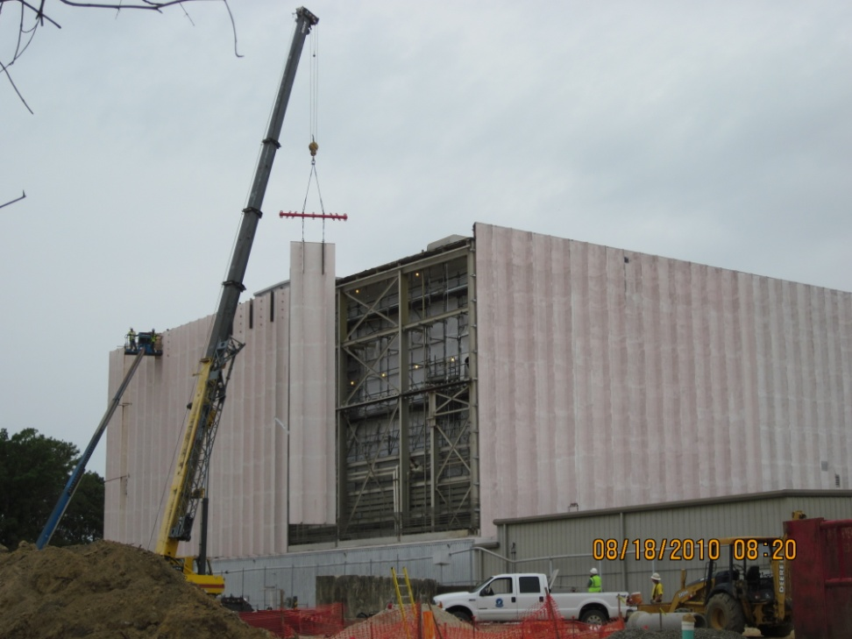
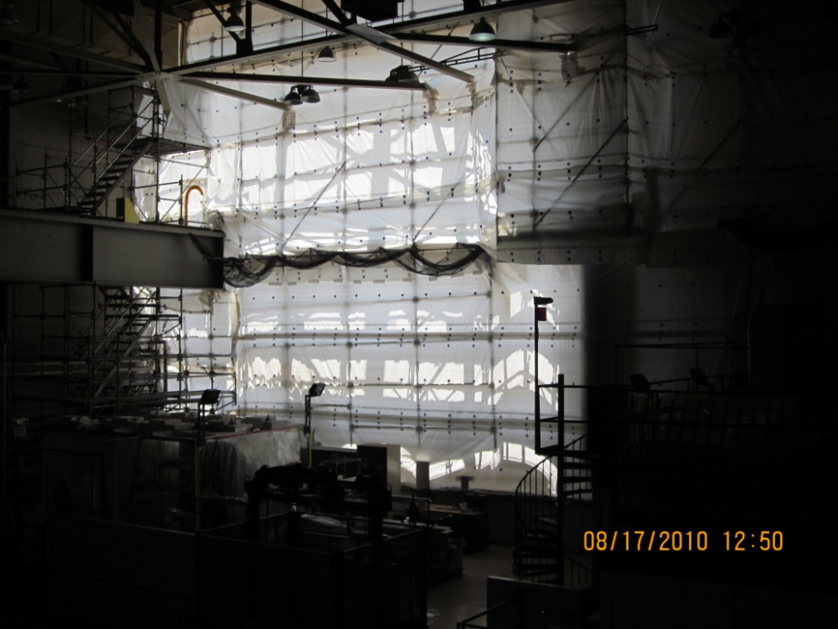
Facilities Down for 2 Weeks due to TDEF
Vacuum furnace
EP machine, HPR machine, clean room,
vacuum furnace and tuning machine are not accessible from 8/13-31. VTA is also down.
Test Lab south wall being torn down
for new extension

Slide 4
TB9RI027 & TB9RI028
TB9RI027 and TB9RI028, the remaining two new RI cavities, received for processing and testing at JLab
Goal is to complete first-pass testing by end of FY10
TB9RI027
  Heavy EP, 800Cx2hr, tuning, light EP, initial HPR and clean room assembly done. Now parked in clean room.
  Final HPR and clean room assembly will resume September 1 when facility is up and RF testing follows.
TB9RI028
  Heavy EP done.
  Issue of insufficient removal due to software problem.
  Will re-EP in early September and standard steps to follow.

Slide 5
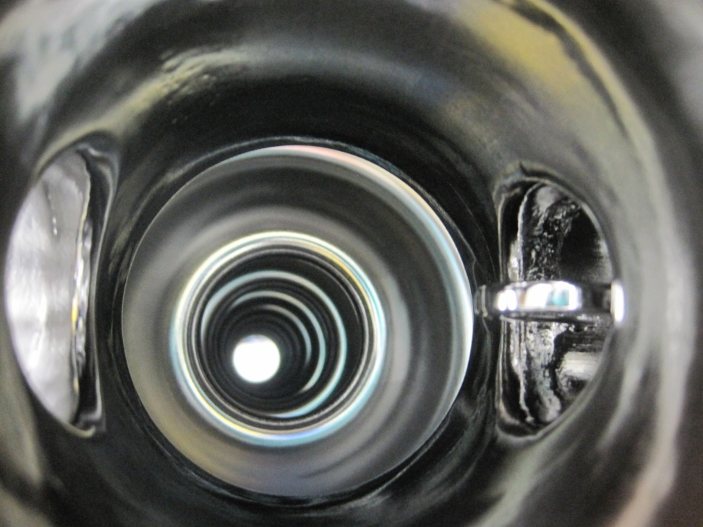
KEK ICHIRO7 9-Cell Cavity S0 Studies at JLab
Ichiro7 has Low-loss cavity shape - Ultimate gradient potential > 50 MV/m
Single cell demonstration of > 50 MV/m already done by KEK
Low-loss shape is among ACD shapes for ILC TeV upgrade
Near term gradient goal of this KEK/JLAB study is 9-cell demonstration of >= 45 MV/m
2 EP & vertical test cycles completed
KEK scientist Fumio Furuta visited JLab for 2 months working together with JLab scientists
Gradient performance improved over baseline
Pi mode max. Eacc 27 MV/m
Pass-band measurements indicate individual cells reaching surface field of Pi-mode equivalent of 34-48 MV/m
Data still under analysis
Photo credit: F. Furuta

Slide 6
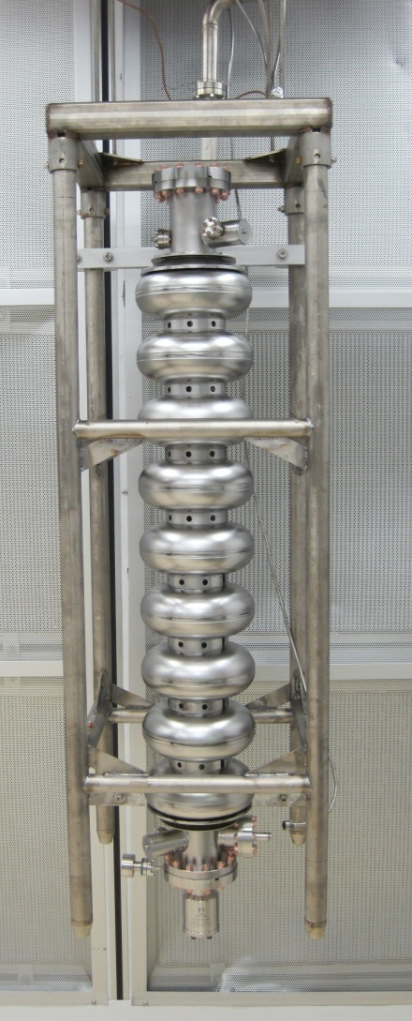
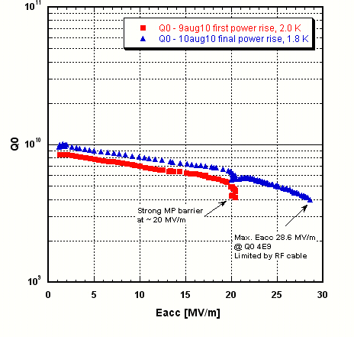
Peking University 9-cell Cavity w/ End Group PKU3 After Standard ILC Processing at JLab
PKU3 is the 3rd 9-cell cavity built by Peking University SRF Group since 2008

Slide 7
Cornell ILC Program
Cornell SRF
Status as of 24aug10
Cavities
  TB9AES005, ACCEL9 and TB9ACC010 have been tumbled and electropolished at Cornell
  These cavities were then shipped to JLab
  TB9AES005 and TB9ACC010 have been degassed and tuned for field flatness at JLab
  ACCEL9 will be degassed and tuned for field flatness when the furnace is re-commissioned at JLab. Estimated completion: mid September
  TB9ACC010 is on its way back to Cornell for high pressure rinse, bake and test.
  TB9AES005 will be high pressure rinsed, baked and tested at JLab in September
ACrawford 24aug10

Slide 8
Cornell ILC Program
Cornell SRF
Status as of 24aug10
Test Facility
  A new ILC cavity vertical test Dewar has been installed
    Reduced Dewar LHe volume and improved magnetic shielding
  The Cornell ILC test stand is being prepared to receive cavity TB9ACC010
  Estimated date for readiness for first test is 15sep10.
ACrawford 24aug10

Slide 9
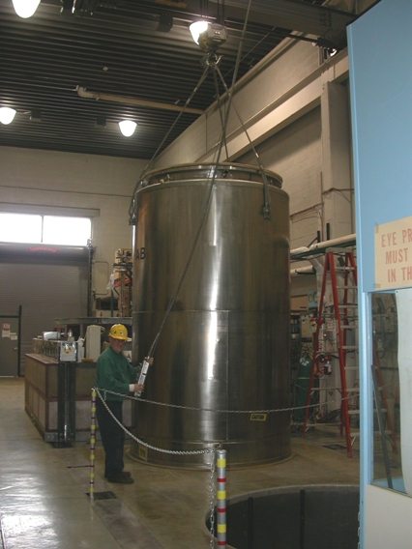
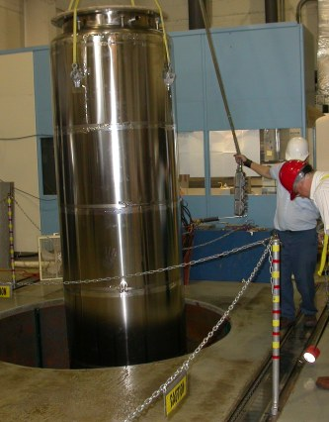
Cornell ILC Program
Cornell SRF
8000 Liter Dewar removal
ILC Cavity Dewar installation
ACrawford 24aug10

Slide 10
Production Cavities for CM2
Cryomodule 2
Cavity ID | CM2 candidate | Vertical Test | He vessel? | Horizontal Test | cryomodule ready?
TB9AES009 | 1 | 36 MV/m | dressed | 35 MV/m | yes
TB9AES010 | 2 | 38 MV/m | dressed | >35 MV/m (admin) | yes
TB9AES008 | 3 | 41 MV/m | dressed | ongoing
TB9ACC016 | 4 | 39 MV/m | dressed
TB9AES007 | 5 | 42 MV/m | dressed
TB9RI029 | 6 | 35 MV/m | dressed
TB9RI018 | 7 | 39 MV/m | dressed
TB9RI019 | 8 | 38 MV/m
ACCEL8 | backup | 31 MV/m | dressed | 31 MV/m | yes
TB9ACC013 | backup | 38 MV/m | dressed | 35 MV/m; FE limit | no
Vast majority of cavities vertically qualified at JLab
TB9ACC013 performance was degraded after a FE incident in horizontal test; future cavities will not be pushed past 35 MV/m in horizontal test; cavity to be dressed-EP’d within a few months
TB9AES010 horizontal test went smoothly (see later…)
TB9RI019 was vertically tested at FNAL before dressing; with nearly identical results to JLab (see later…)
TB9AES008 to be installed at HTS late this week, cold test to start next week

Slide 11
Fermilab Update
High-temperature furnace (currently all hydrogen degassing done at JLab)
  received from vendor two weeks ago in FNAL/IB4
  installation in FNAL/IB4, and final acceptance test by mid-September
  cavity commissioning complete by mid-October
Tuning machine was relocated from FNAL/ICB to FNAL/IB4 end-July with relatively painless two-week downtime
Final two RI cavities from 12-cavity order at JLab for std process/test [S0]
Six cavity order from Niowave-Roark [new vendor qualification]
    TB9NR001: JLab standard process/test path
    TB9NR002: FNAL/ANL standard process/test path
Six cavity order from AES [experienced vendor; cavities partially for S0]
  all six are fabricated and received or will receive 10 um internal BCP at vendor
  delivery of first cavity TB9AES011 due tomorrow 8/25
  remainder to be delivered with few-day periodicity
24 August 2010
CM Ginsburg S0 Mtg
11
Notes:
11

Slide 12
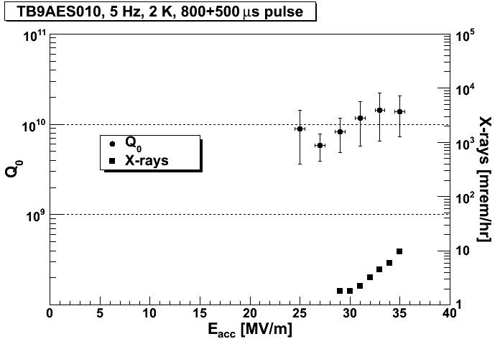
Fermilab Update: Horizontal Test of TB9AES010
Cavity reached 35 MV/m (policy limit); low FE; qualified for CM2

Slide 13
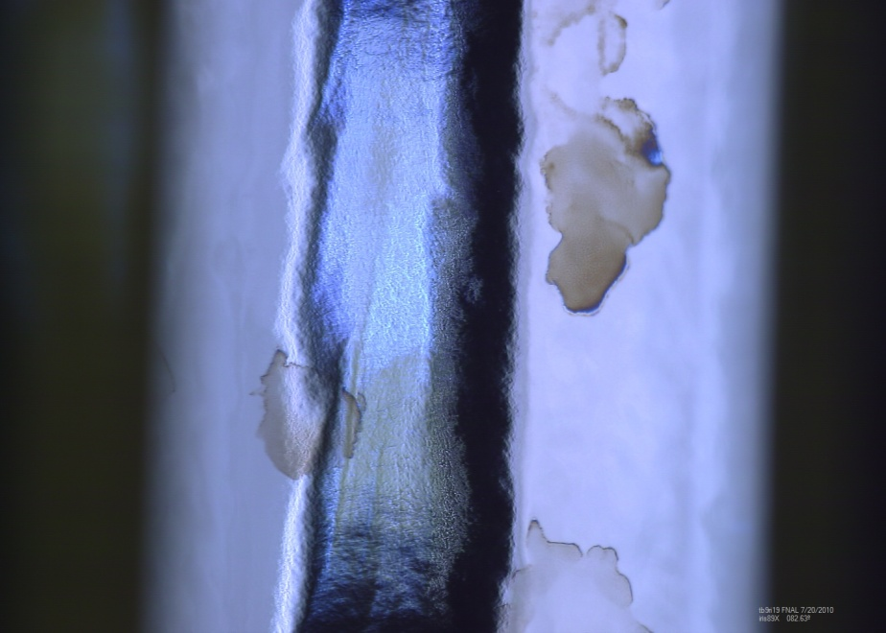
TB9RI019 for CM2
Sent to FNAL from JLab after qualification vertical test
  38 MV/m, Q0>1E10
  blanked off at atmospheric pressure before shipment
Optical inspection, HPR/assembly at FNAL/ANL before FNAL vertical test
Tested Friday 8/20 at FNAL
  compare JLab/FNAL data…
Iris 8-9; Upon receipt from JLab

Slide 14
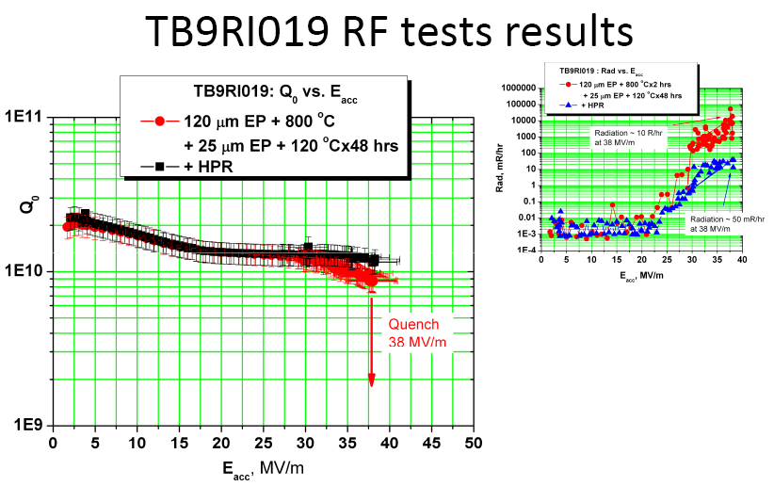
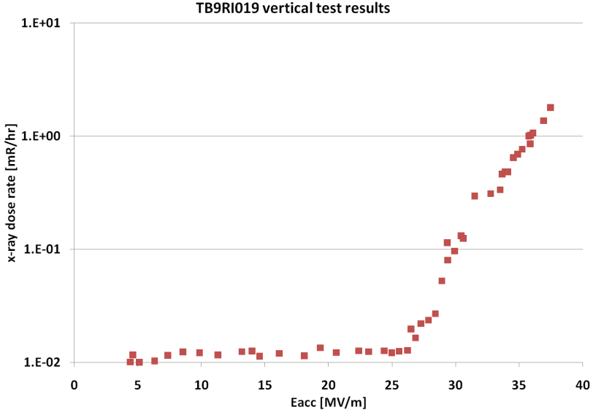
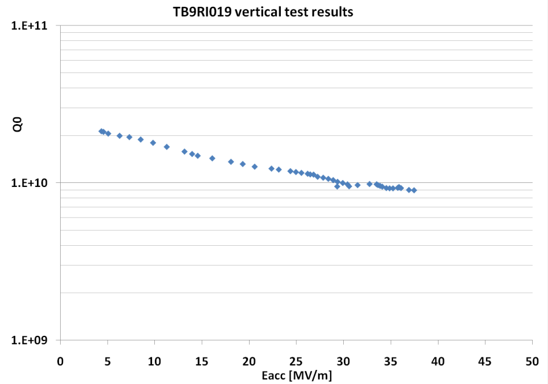
TB9RI019 JLab/FNAL data
JLab
X-ray dose rate ~1.8 mR/hr at 38 MV/m
Quench ~38 MV/m
FNAL

Slide 15
TB9RI019 JLab/FNAL data (cont.)
Key points:
Quench gradient agrees well, JLab very slightly higher
Low-field Q0 agrees well, JLab very slightly higher
High-field Q0 is higher at JLab
X-ray dose rate is a factor ~25 higher at JLab than FNAL; onset ~3 MV/m higher at FNAL
We also saw excitation of 7pi/9 mode, developing over several seconds; we do not normally monitor excitation of other modes, and would not have seen it if we had not been explicitly looking
Bottom line:
Good agreement between JLab/FNAL test data sets
Cavity will be dressed and horizontally tested

Slide 16
ANL EP Parameters
M. Kelly, T. Reid et al. at ANL
Several changes to ANL EP starting ~March based on discussion w/ FNAL, JLab, KEK etc in an attempt to bring some (not all) of the details of the ANL
process in line with what is current practice at JLab and KEK
Mar 2010: 9:1 EP electrolyte solution rather than the 85:10 Siemens recipe
Apr 2010: Lower anode/cathode voltage AND lower acid temperature
  18 V -> 14.5 V
  35C -> 25-30C, as measured on cavity external surface
Apr 2010: Additional water rinsing during disassembly to keep the cavity wet
  spray down interior at 5 minute intervals with DI water before cavity sent to clean room for US cleaning
  spray 1-2 times for single cells and 3-4 times for 9-cell
May 2010: rotated the cathode so the holes went from spraying the acid down to up

Slide 17
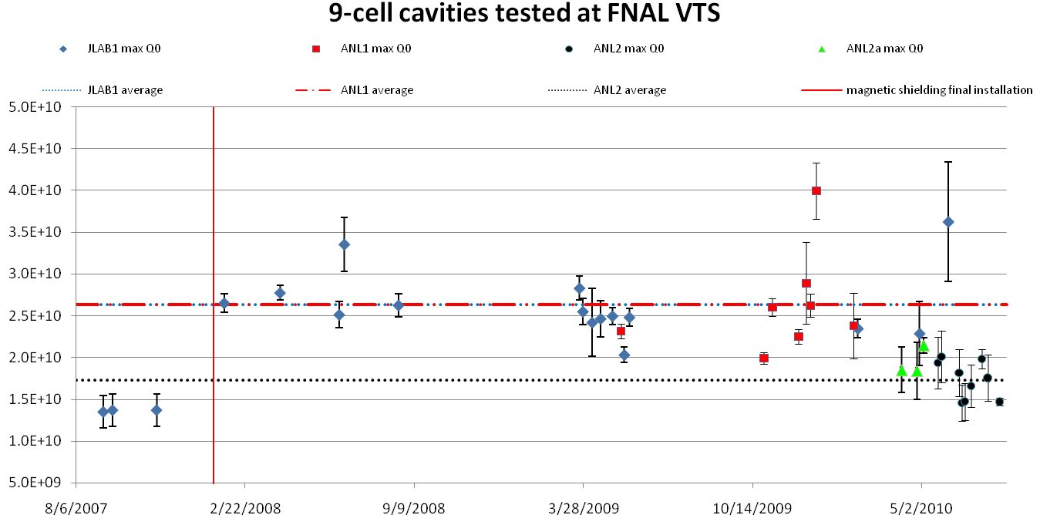
ANL EP Parameters
Averages:
JLab1: 2.63E10 (no early mag shield data)
ANL1: 2.63E10 (old parameters pre March)
ANL2a: (new acid mixture, post-EP rinse)
ANL2: 1.73E10 (low-T, low-V parameters)
Strictly max Q0; 1.95<T<2.05K;
fluctuations systematically upward; some
data points have unphysically small error
bars; all tests included whether or not
additional EP took place

Slide 18
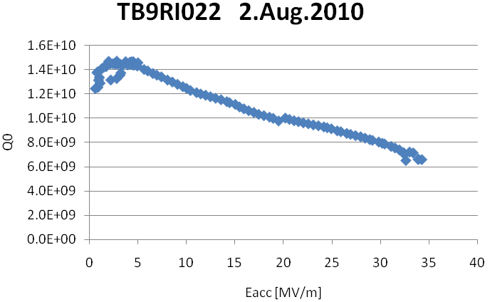
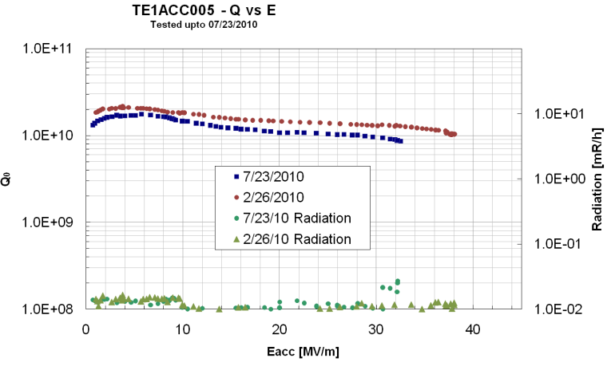
ANL EP Parameters
The low-field Q0 is lower than it used to be and lower than we want for 9-cells
  At least one cavity would have likely
  satisfied the ILC spec, except Q0 was
  too low
  Effect on 1-cells clear between ANL1
  and ANL2 but no EPs during ANL2a
The 9:1 mixture is standard for ongoing 9-cell work and we've verified DESY and KEK are still using this
  Do not want to change the mixture back to 85:10 or adopt 10:1
Mike proposes for the next single cell EP's:
  Keep HF(48%):H₂SO₄ (96%) in the ratio 9:1
  Keep low temp acid (~25 C)
  Go back to 18 V
Two single cells modified-EP ongoing, to
be tested within next two weeks before trying
a 9-cell

