Slide 1
PFA Studies:
Reconstruction of the charged energy
Remi Zaidan

Slide 2
Introduction
The idea:
  Factorize the study of the PFA performance.
  Start by studying the performance of the PFA on events with purely charged energy.
The implementation:
  Wrote a hit filter which remove hits generated by neutral particles (photons and hadrons).
  The reconstruction then runs on the filtered hit container.
The studies:
  Look at Energy/Momentum balance at event level.
  Look at a random selection of event displays (~100 events) and identify common features.
  Study in particular the cone algorithms (first and second) and the “jet” merging.

Slide 3
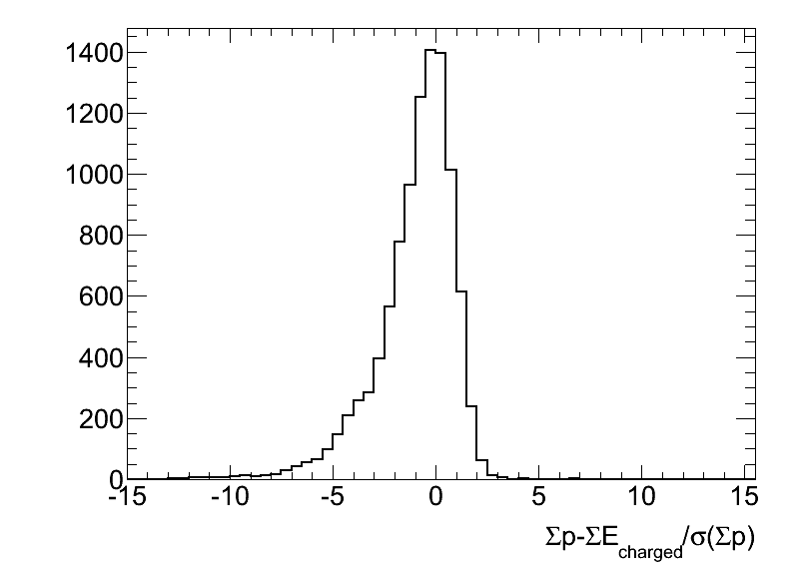
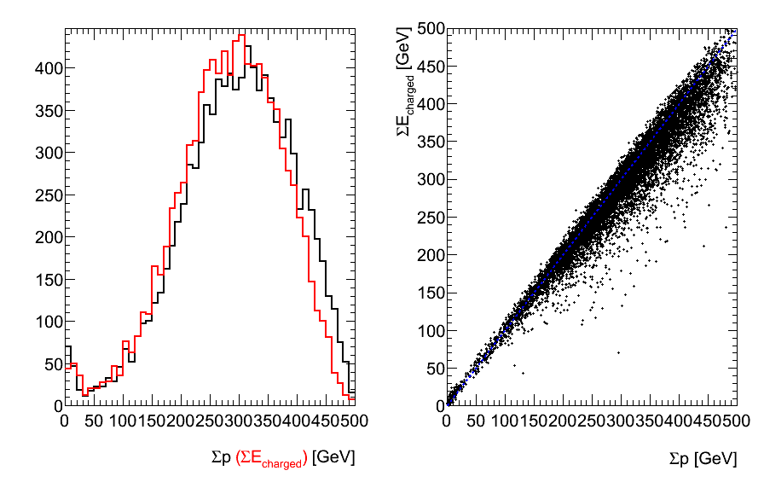
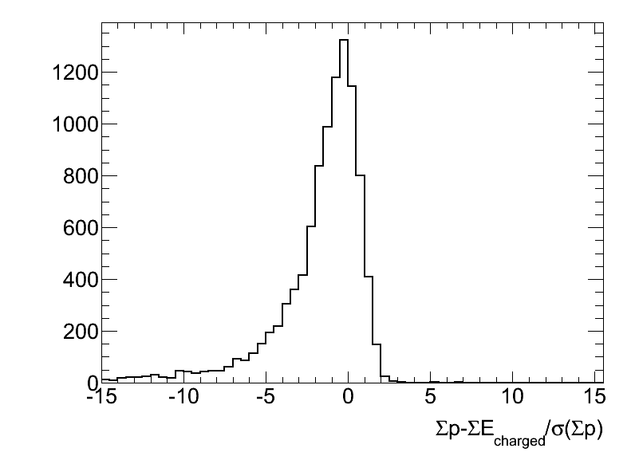
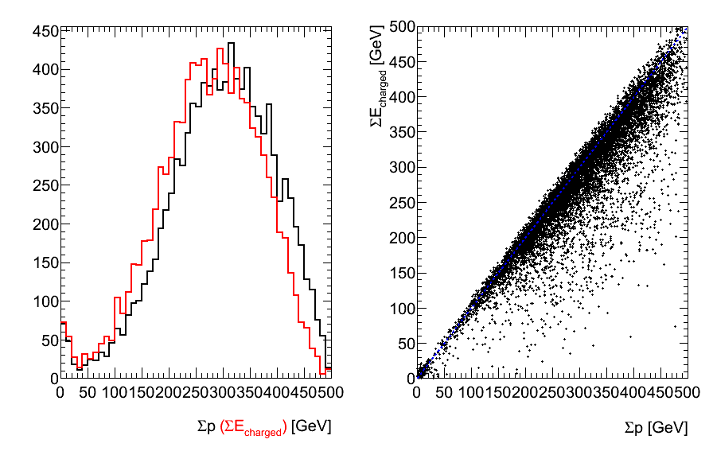
Event energy reconstruction
Compare total momentum to total reconstructed charged shower energy:
  Would expect in the ideal case to have same distribution except for calorimeter resolution.
Reconstructed energy is systematically lower:
  Charged → Neutral confusion.
  Leakage.
  Worse when not applying the cone algorithms.
Baseline
No cone Algs

Slide 4
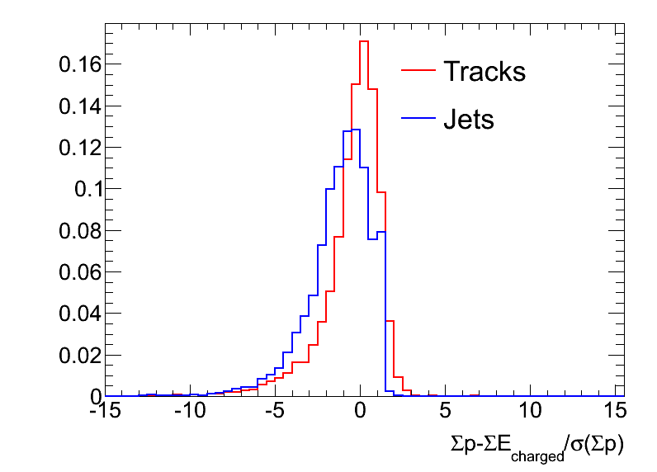
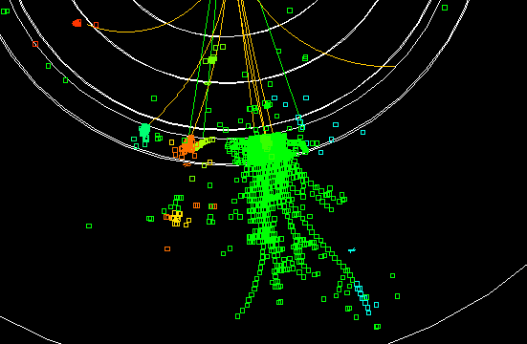
Jet Merging
Tracks that are close enough so that the shower pieces overlap, are merged into “Jets”:
  “Jets” are almost always associated with mistakes.
  Left-over pieces gets reconstructed as neutral particles.
The causes that lead to jet merging are not always proximity of the tracks!

Slide 5
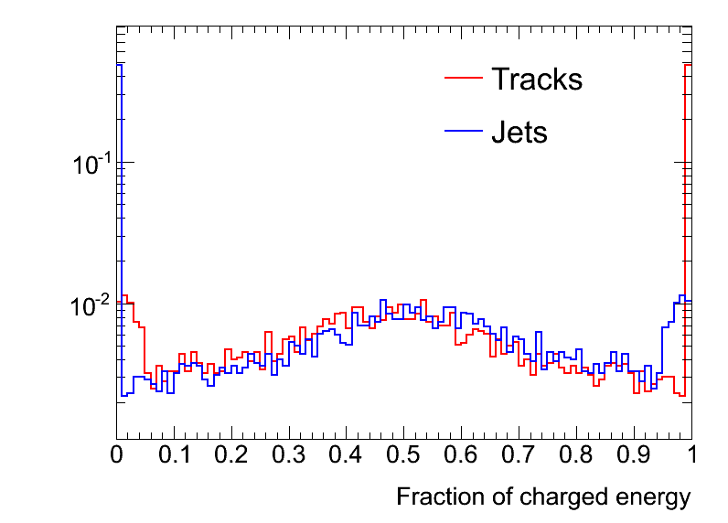
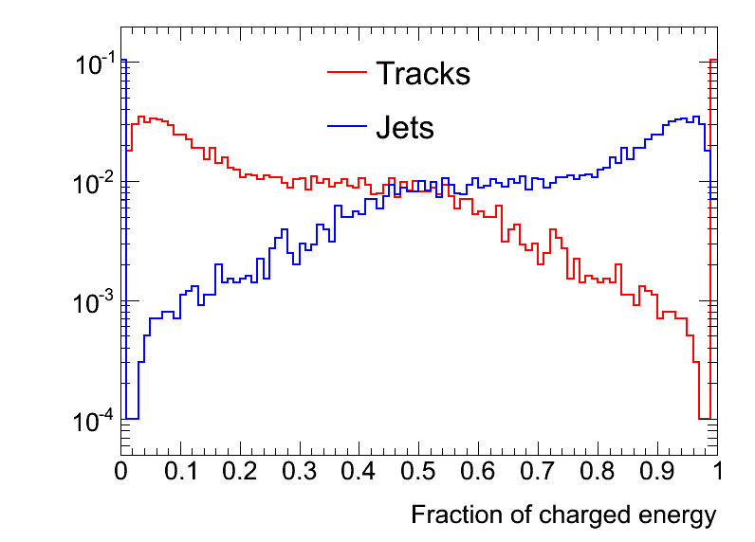
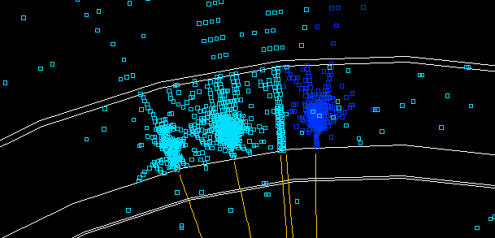
Jet Merging vs First Cone Alg.
When turning off the first cone algorithm, “Jet” merging is almost the rule!!
Most common cause: Tracks that start their shower very early in the Ecal have very short seeds (< 4 hits).
➔ Score calculation to link a cluster to the seed is affected
➔ The PFA find a track with too low energy and tries to fix by merging it with nearby tracks
The first cone algorithm updates the score which actually hides this problem!
Baseline
No cone Algs

Slide 6
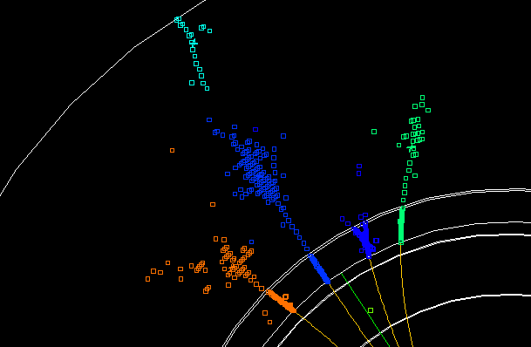
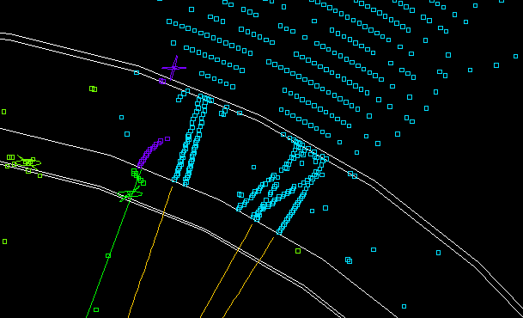
Other mistakes…
Recurrent
cases
Detached pieces of shower essentially from secondary neutrals:
  Fixed by the first cone algorithm.
  This is not the main problem that appear when we turn off the cone algorithm!!!
Tracking failure:
  Triggers “Jet” merging, probably because the extra energy tend to become more tolerable when merging into a “jet”.
  Rare cases, not the first thing to try to fix!
rare cases

Slide 7
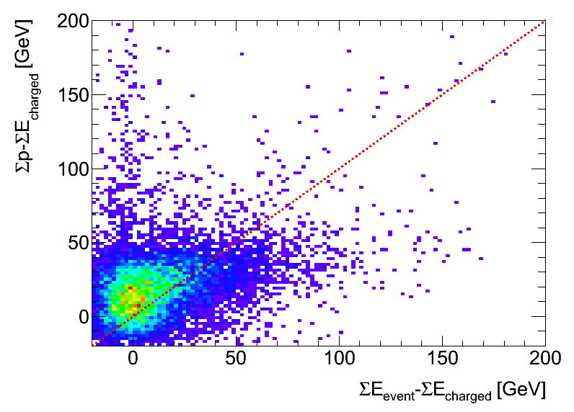
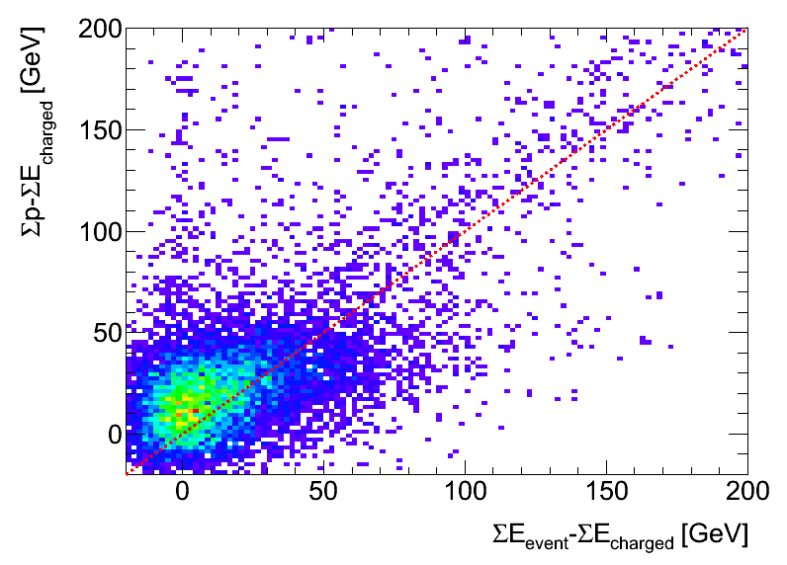
Trying to quantify different effects
Baseline
Plot the momentum/charged energy balance vs. total/charged energy balance:
  Total event energy is computed from hits while charged energy is computed from showers ➔ Different calibration!
  Different components show up in different regions of the plot.
Resolution
Mistakes
Leakage
Calibration?!?
No cone Algs

Slide 8
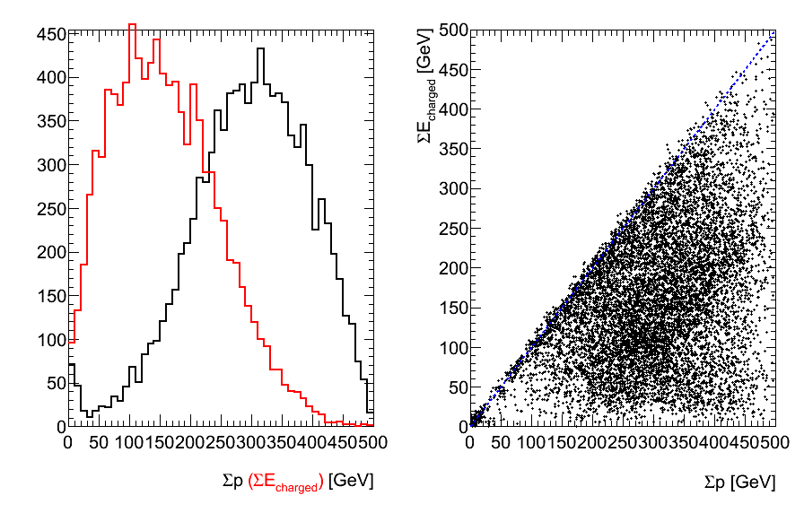
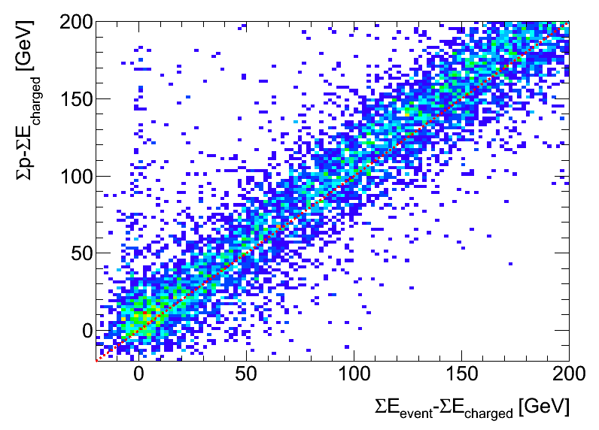
What if we turned off both Cone algorithms and Jet merging?
Real catastrophe!!!
This is a problem in my opinion since both the “jet” merging and the cone algorithms were created to fix rather secondary problems!!

Slide 9
Conclusion
The PFA is doing mistakes even when no neutral energy is present in the event.
I have spent some time to spot problems and do a diagnostic of the causes.
Cone Algorithm and Jet merging are hiding (and not fixing) the real problems of the PFA.
Next step is to start implementing and testing solutions:
  I am now working of modifying the score calculations for the cases where the seed is too small to have a reliable directional information:
    The idea is to use track direction at the Ecal entrance instead of the seed direction when the shower point is in the first few layers of the Ecal.

