Slide 1
Status of GEM DHCAL
Jae Yu
For GEM-TGEM/DHCAL Group
Sept. 24, 2010
CALICE Collaboration Meeting
Univ. Hassan II, Casablanca
Introduction
What has been done?
2D readout with KPiX chip
TGEM Beam Test at CERN
Large GEM Foil Certification
Large Chamber Mechanics Design
Summary

Slide 2
Why GEM?
Flexible configurations: allows small anode pads for high granularity
Robust: survives ~10¹² particles/mm² with no performance degradations
Based on electron collection, ~few ns rise time
Short recovery time ➔ can handle high rates
Uses simple gas (Ar/CO₂) – no long-term issues
Runs at relatively low HV ( ~400V across a foil)
Stable operations

Slide 3
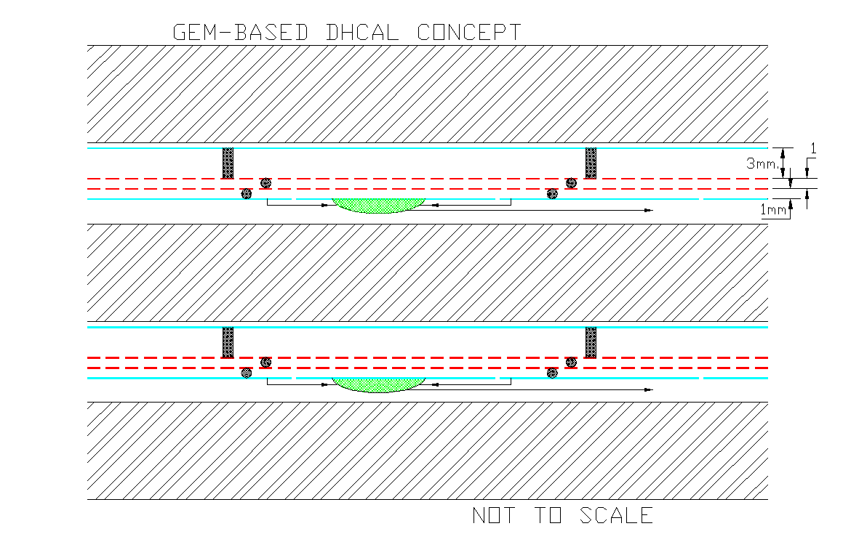
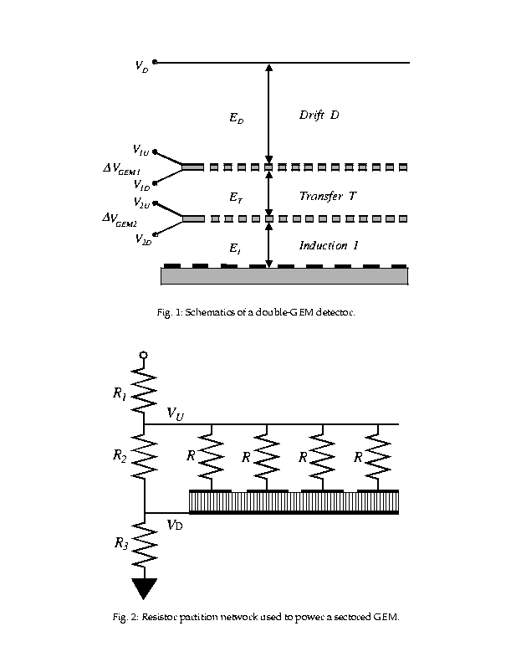
GEM-based Digital Calorimeter Concept
Use Double GEM layers
{
-2100V
~6.5mm
∆V ~400V
∆V ~400V
0V

Slide 4
What have been done so far?
Bench tested with various source and cosmic ray
  Used QPA02 chip based preamp
  Verified the signal shape, responses and gain
Took a beam test at a high flux electron beam
  Prototype chamber built with 3M’s 30cmx30cm GEM
  Used QPA02 chip based preamp
  Verified that the chamber can survive
Took two beam tests at FNAL’s MTBF
  Used QPA02 chip based preamp
  8 GeV pion beams and 120GeV proton beams
  Measured chamber responses, efficiencies and gain

Slide 5
KPiX Analog Readout for GEM DHCAL
Dynamic gain select (GEM/Si)
13 bit A/D
DHCAL anode pad
Storage until end of train.
Pipeline depth presently is 4
Leakage current subtraction
New version equipped with self and ext. trigger
Event triggered by the ILC clock
calibration
1024 channel 13 bit ADC chip
Developed for Si/W ECAL@ SLAC
Notes:
5

Slide 6
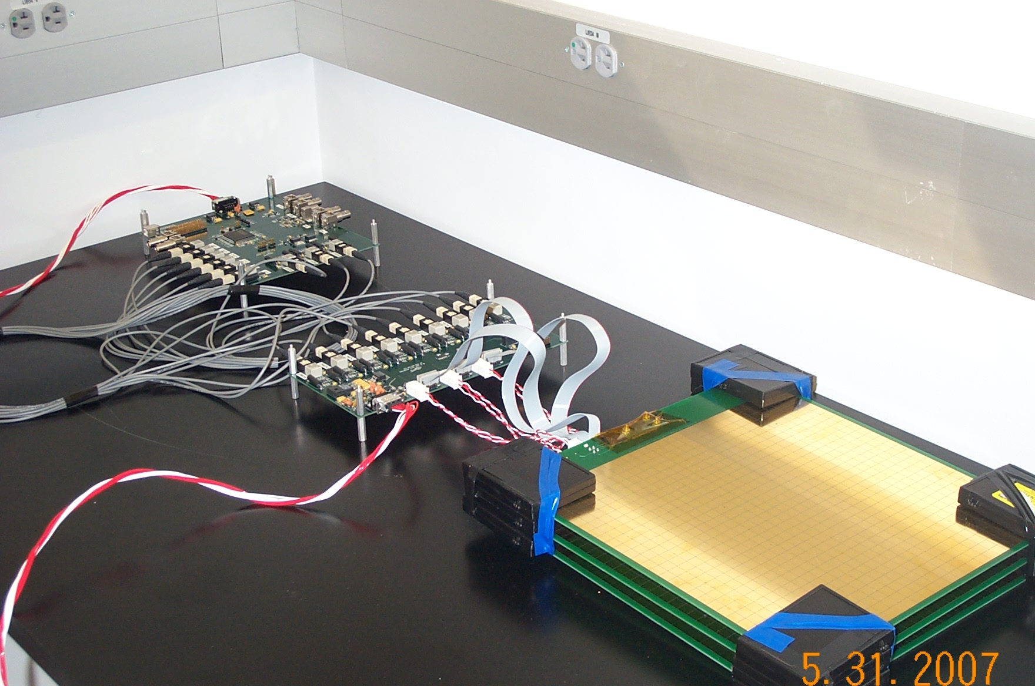
GEM-DHCAL/KPiX boards with Interface and FPGA boards

Slide 7
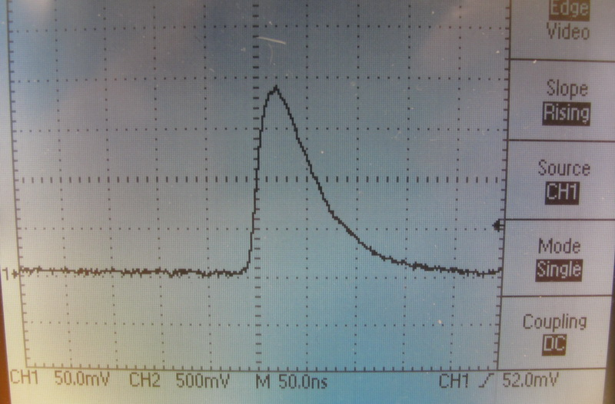
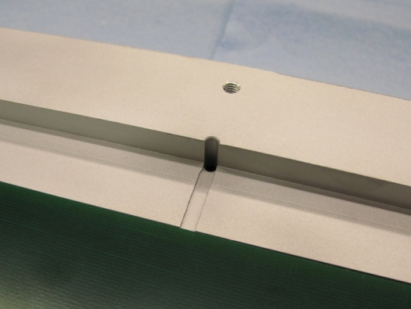
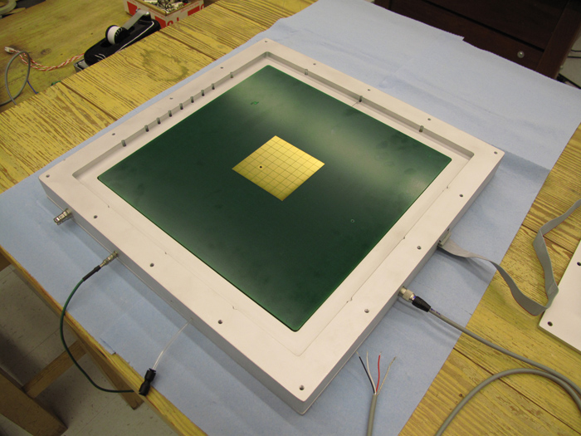
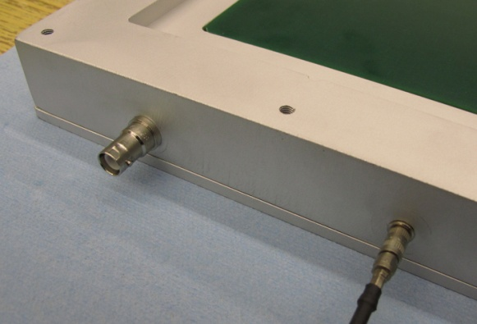
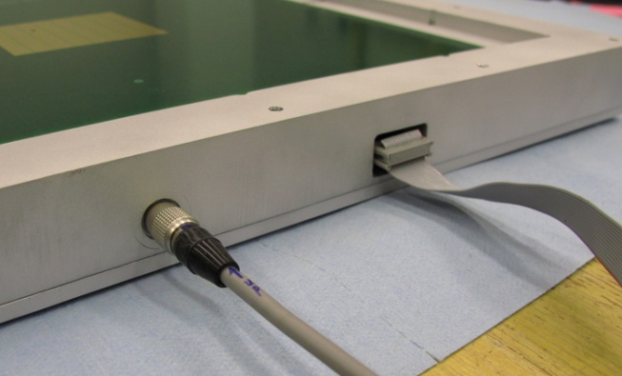
Fe55 Source Signal
Gas outlet
Top side
Data cable
HV power
Analog signal
LV power

Slide 8
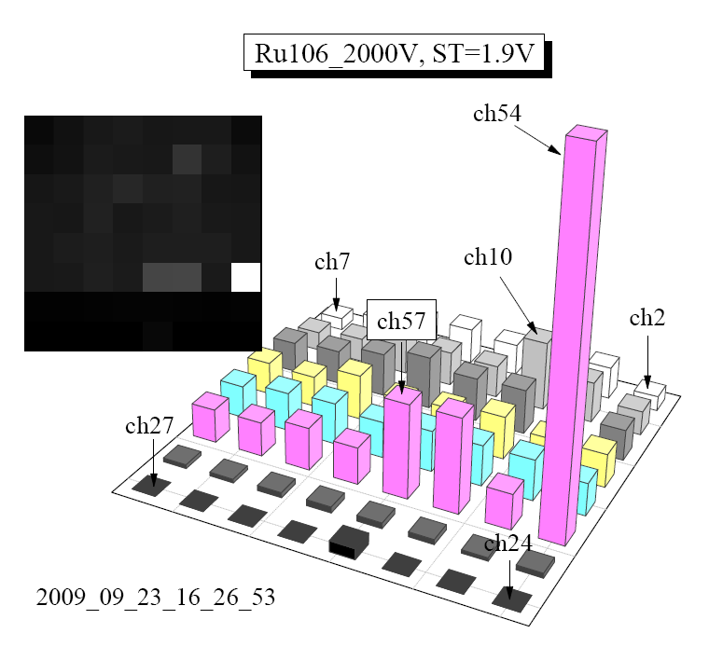
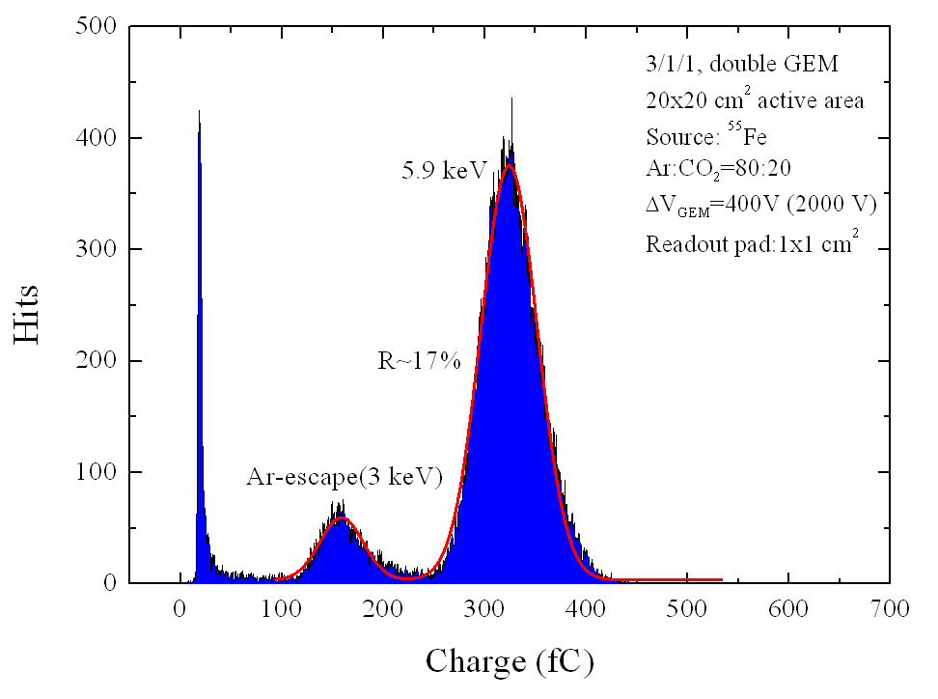
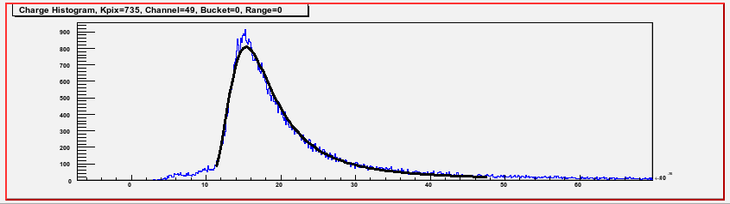
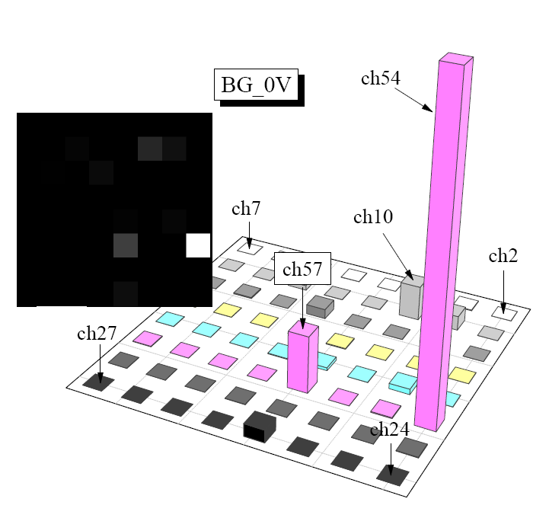
GEM+kPiX Fe⁵⁵ and Ru¹⁰⁶ Spectra
Fe⁵⁵
Ru¹⁰⁶
Good conformation to characteristic Minimum Ionizing Landau fit

Slide 9
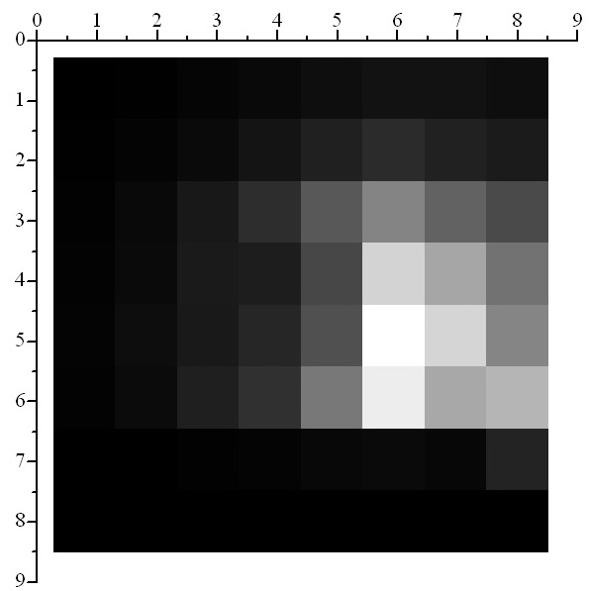
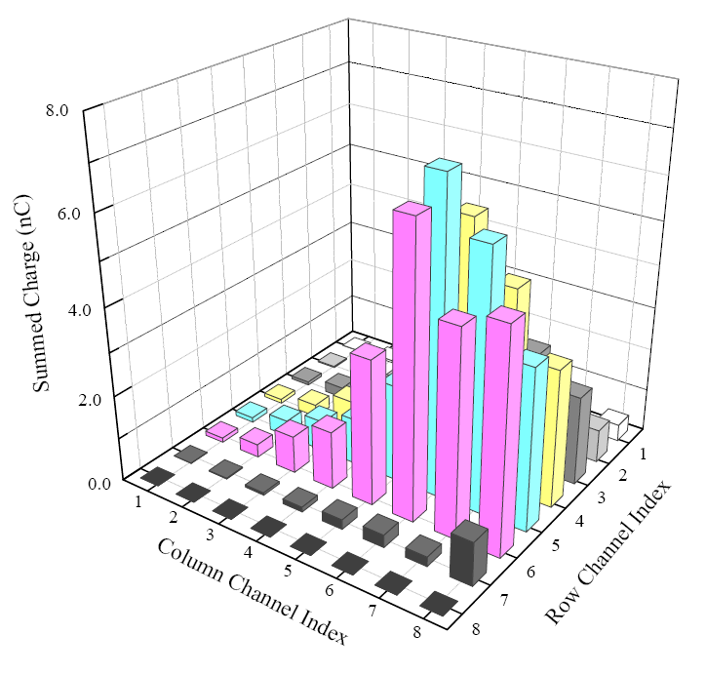
Charge Weighted Lego for Fe55
Inactive area
(HV not applied)
HV=1960 V, Self Trigger Th=1.8 V= 14fC

Slide 10
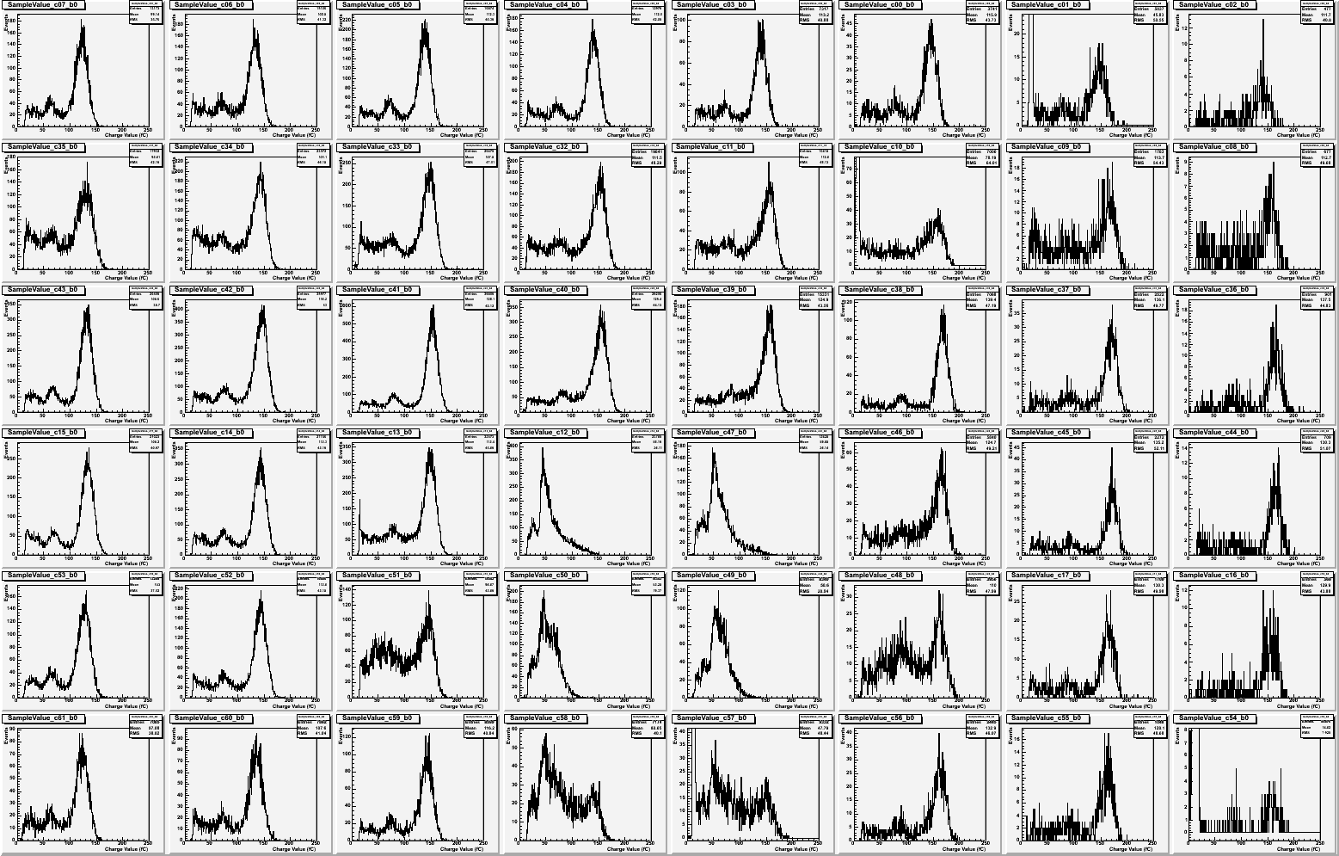
Histogram Map for Fe55
HV=1960 V, Self Trigger Th=1.8 V= 14fC

Slide 11
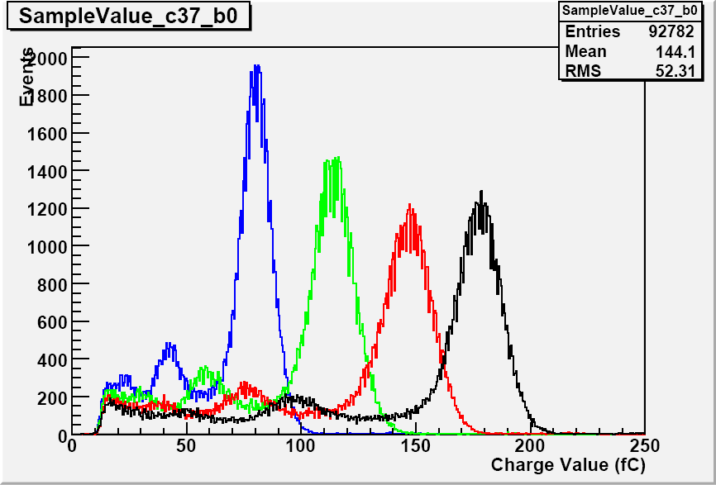
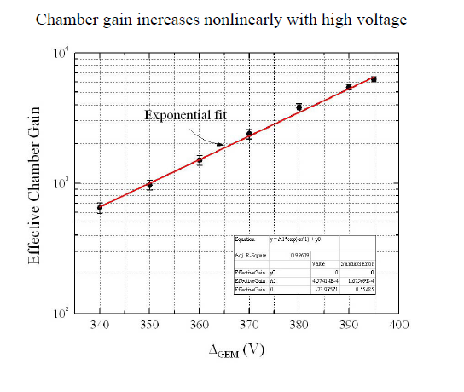
Gain vs HV
1860V
Typical operating point: Gain ~6000
1900V
1930V
1960V

Slide 12
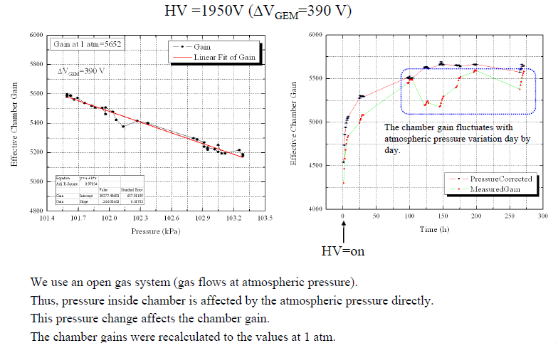
Pressure Dependence of Gain

Slide 13
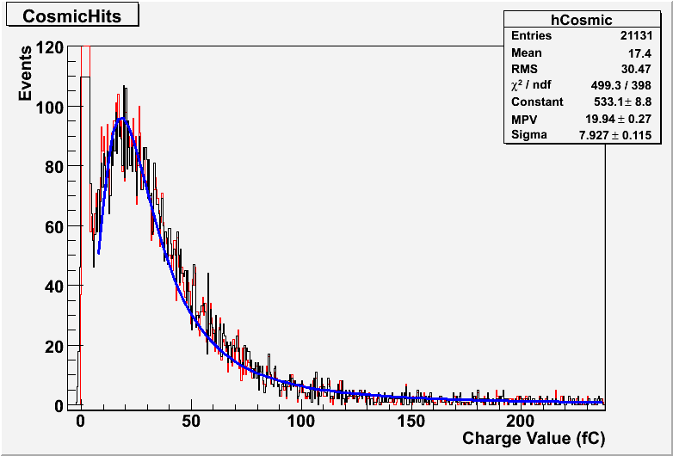
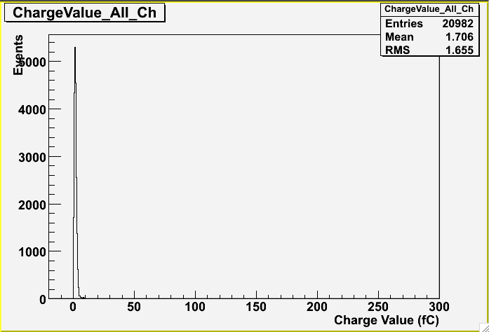
Cosmic Ray Data with External Trigger – kPiX
Noise spectrum

Slide 14
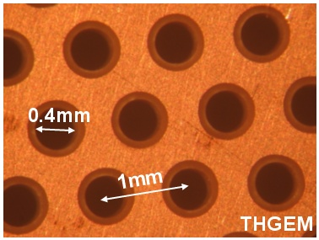
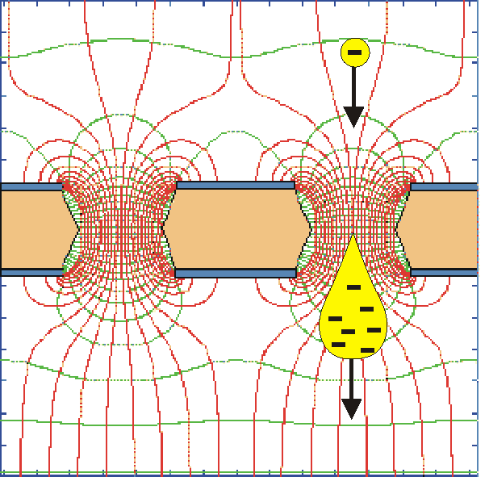
Thick Gas Electron Multiplier (THGEM)
~ 10-fold expanded GEM
drilled
THGEM
1e⁻ in
etched
E
10⁴- 10⁵ e⁻s out
Thickness 0.5-1mm
Double-THGEM: 10-100 higher gains
SIMPLE, ROBUST, LARGE-AREA
Intensive R&D
Many applications
PCB Based GEM ➔ Cost effective
0.5 – 1mm thick PCBs
Drilled 0.4mm holes with 1mm pitch
Expected to have higher gain per GEM
10cmx10cm tested, up to 30cmx30cm produced
THGEM Recent review
NIM A 598 (2009) 107
THGEM - A. Breskin et al

Slide 15
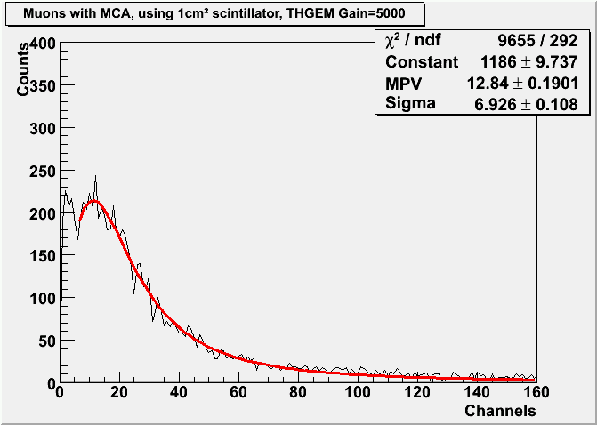
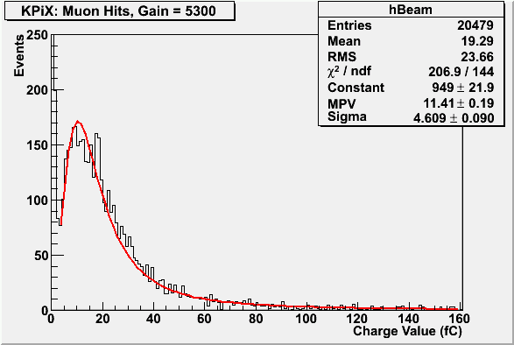
Muons w Double-THGEM
KPIX or Q-preamp/MCA
2-THGEM BEAM TESTS with Q-preamp/MCA
August 2010
3.4 mm
drift
Here we had:
0.5mmholes/1mm space
MIP
First Q-preamp spectrum with muons.
Double-THGEM, Ne/5%CH4; Average gain 5000
Trigger: large scint + ~1cm2 scint
e⁻
2-THGEM BEAM TESTS with KPIX
1x1 cm pad electrode
THGEM
3.4 mm
drift
KPIX or Q-preamp/MCA
First kpix spectrum with muons.
Double-THGEM, Ne/5%CH4; Average gain 5300
Trigger: large scint + ~1cm2 scint
THGEM - A. Breskin et al

Slide 16
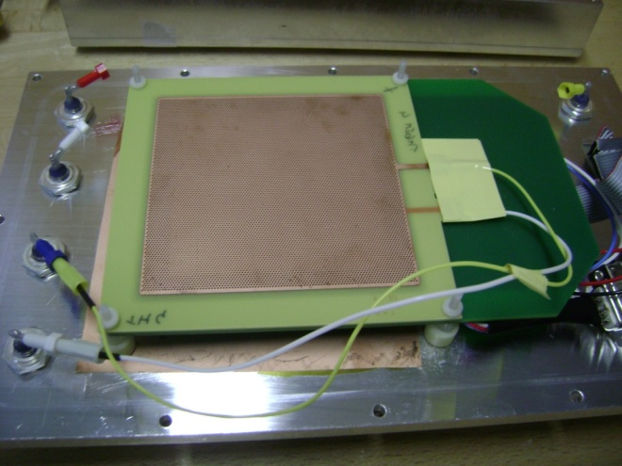
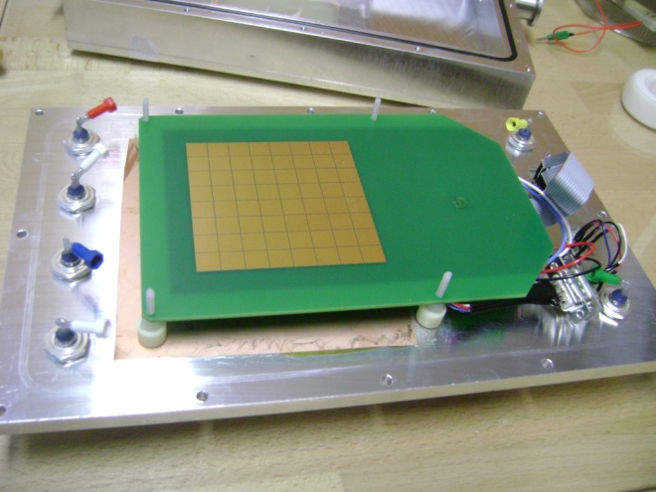
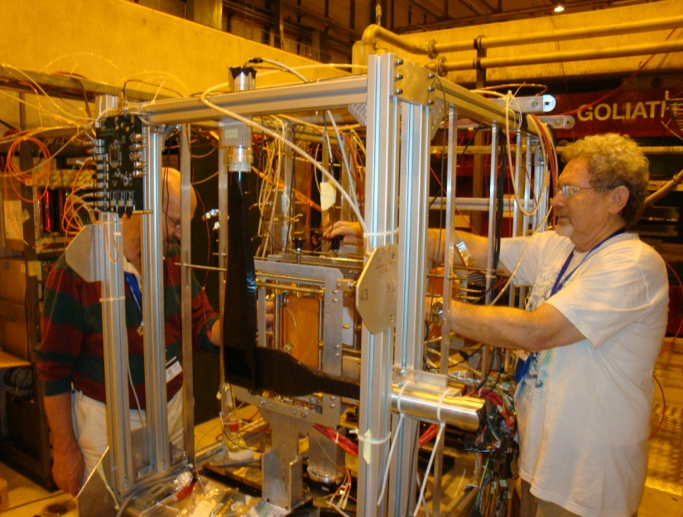
CERN TGEM test-beam detector
64 pads electrode
with KPiX behind
10x10 cm2 THGEM
Installation
at CERN
THGEM - A. Breskin et al

Slide 17
20 August 2010: Single-THGEM with muons
muons
August 2010
Single THGEM 10x10cm
Thickness: 0.4 mm
Particles: muons
Gas: Ne/5%CH₄
Drift gap: 3 mm
Charge preamp/MCA
0.5 cm² trigger
Efficiency: ~95%
ε~96%
THGEM - A. Breskin et al

Slide 18
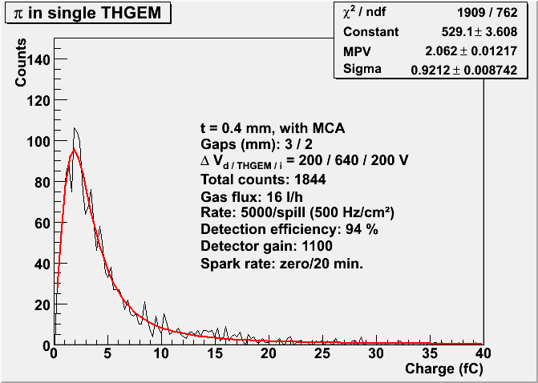
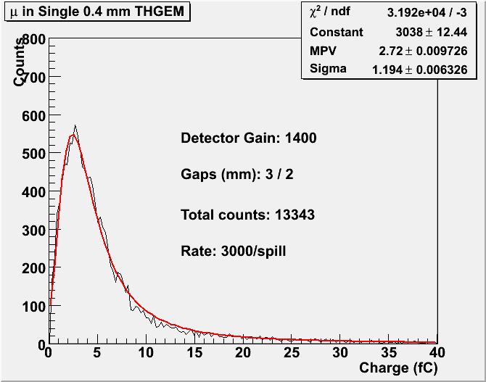
Single-THGEM/3mm drift gap
PIONS
MUONS
Measured very low discharge rates even with pions
THGEM - A. Breskin et al

Slide 19
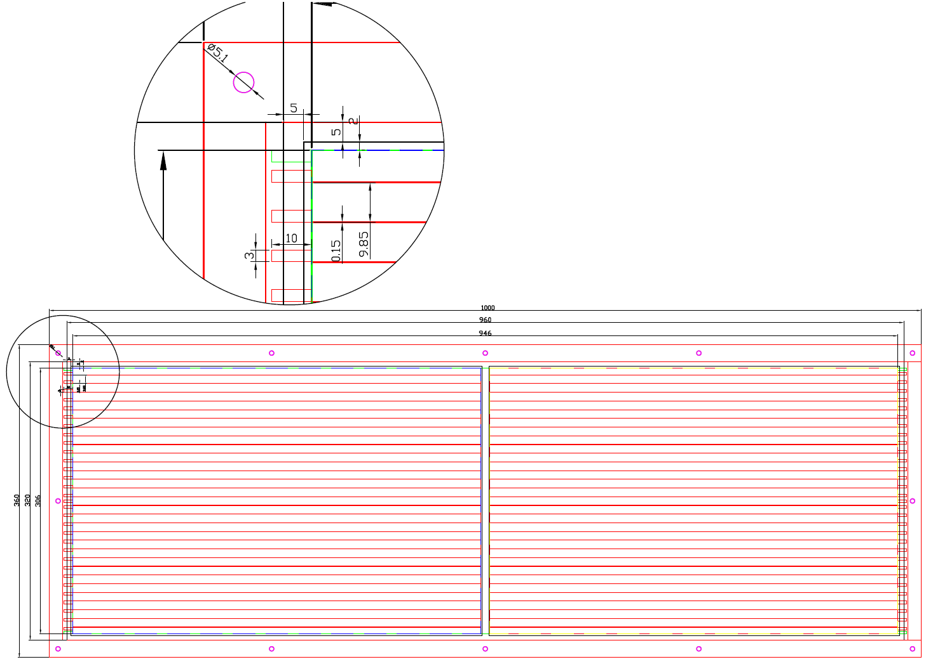
33cmx100cm GEM Foil Design
Designed to work with DCAL boards
Active area 468x306 mm²
Number of HV sectors = 32x2=64
HV sector dimension= 9.9x479.95 mm²
Sept. 24, 2010
GEM DHCAL, J. Yu

Slide 20
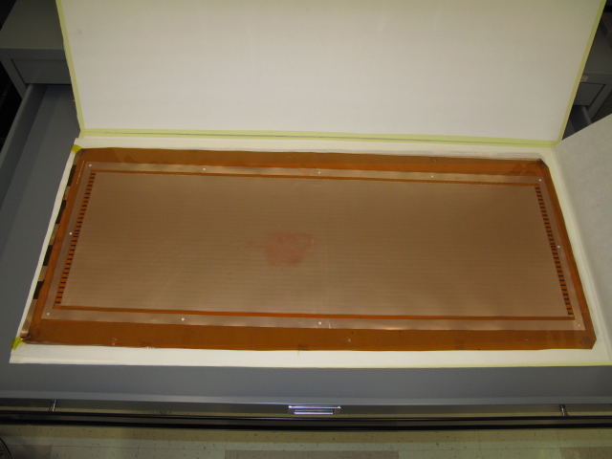
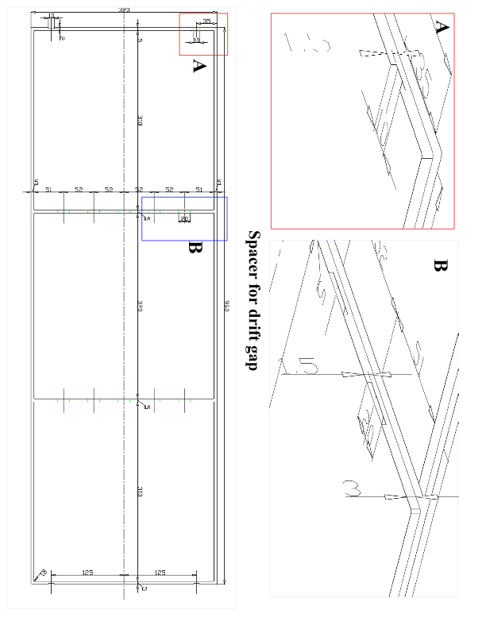
33cmx100cm Large Area GEM
First 5 of 33cmx100cm GEM foils delivered early July, 2010
Design for Large Area GEM detector frames
Sept. 24, 2010
GEM DHCAL, J. Yu

Slide 21
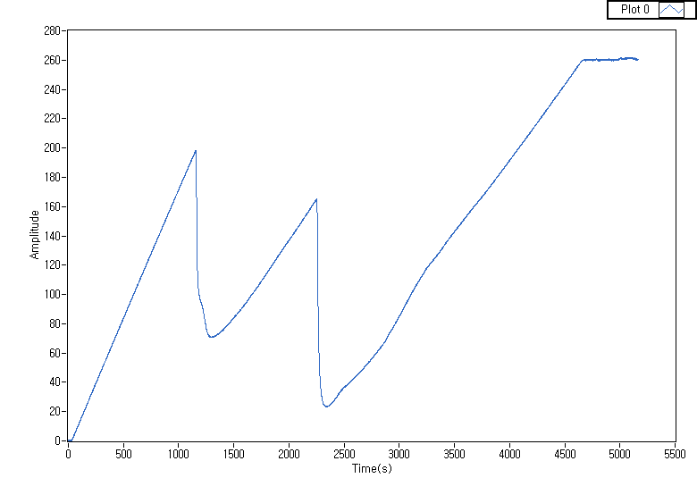
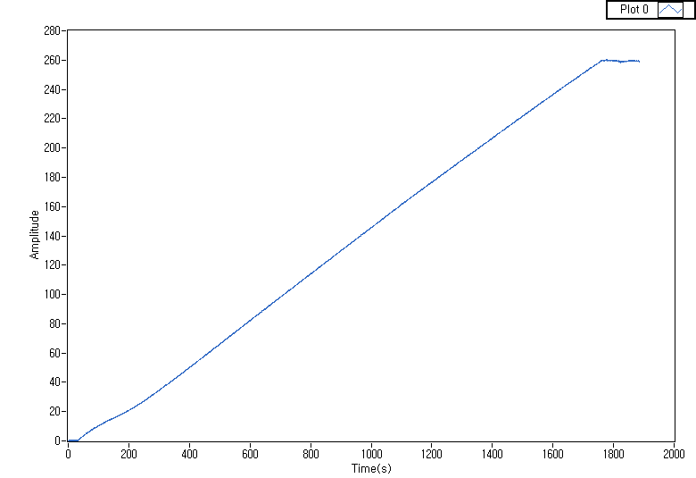
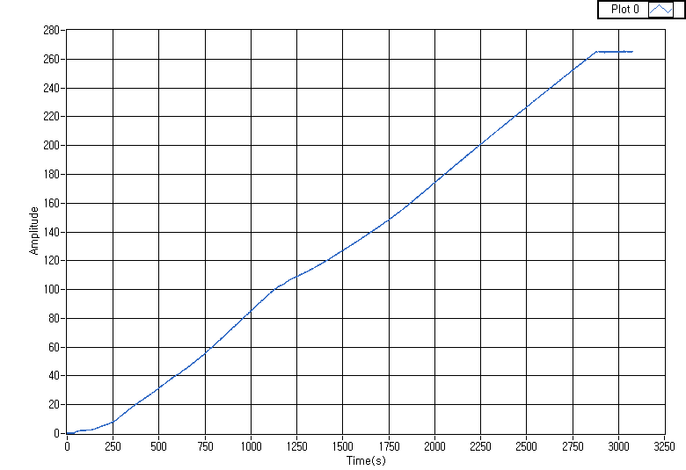
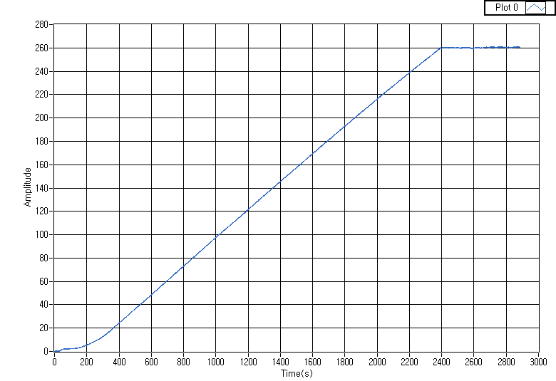
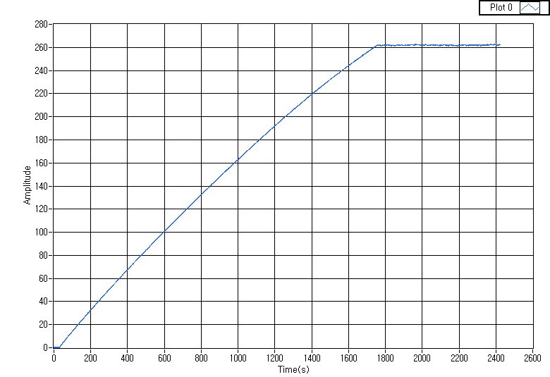
Temporal Behavior of Strips
Strip #4 - Trial 1
Strip #4 – Trial 2
Strip #9 –trial 1
Strip #9 – trial 2
Strip #9 – trial 3
Sept. 24, 2010
GEM DHCAL, J. Yu

Slide 22
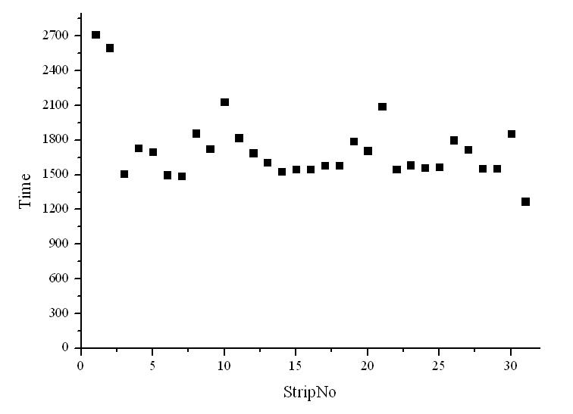
Times to reach full charge saturation
Indication of general health of each strip
Most of them reaches full charge up in 30min
Two strips took 15min longer
Resistance of each strip is over 260GOhms!!
Sept. 24, 2010
GEM DHCAL, J. Yu

Slide 23
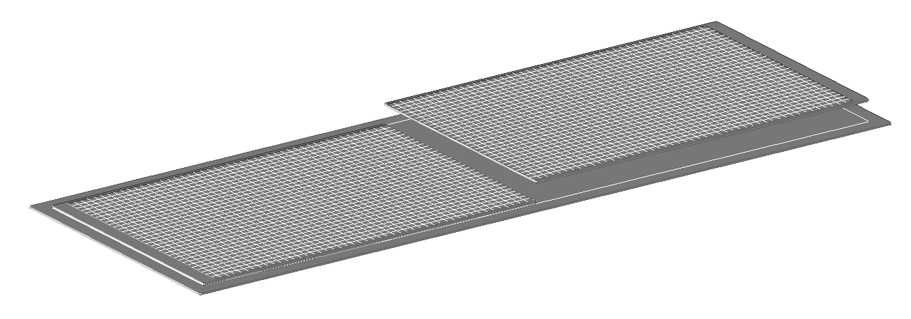
33cmx100cm DHCAL Unit Chamber Construction
Readout Board
320x500 mm²
1000 mm
Base steel plate, t=2 mm
320 mm
Readout boards are part of the gas volume!! How do we mate these together with minimal dead area?
2mm steel strong-back + thin cathode layer
1cm thick support from G10 spacers
3mm
1mm
We might be able to avoid this dead zone by gluing the two boards directly together!!
1mm
1mm pad board
2mm FE board
1mm assister strong back

Slide 24
UTA’s 33cm x 100cm DHCAL Unit Chamber
Glue the boards directly on their edges??

Slide 25
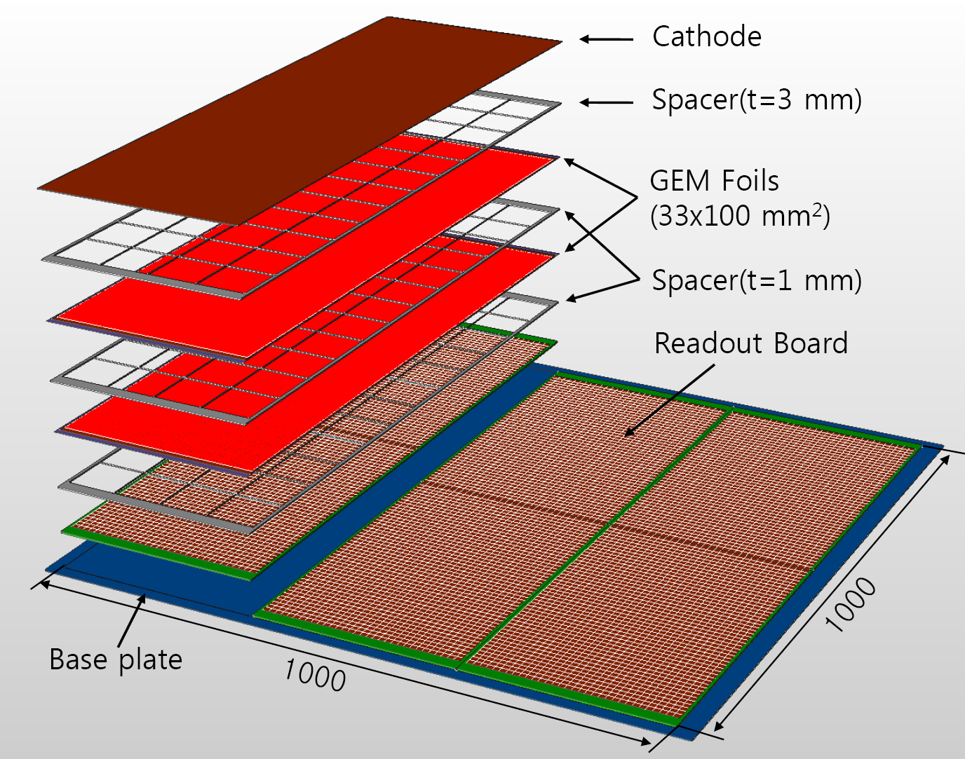
UTA’s 100cmx100cm Digital Hadron Calorimeter Plane
(32x96 mm²)
100cm
(32x96 mm²)
32cm
100cm
96 ~ 97cm
100cm

Slide 26
GEM DHCAL Plans
Phase I ➔ Completion of 30cm x 30cm characterization
  Mid 2010 – Early 2011: using one to three planes of 30cm x 30cm double GEM chamber with 64 channel KPiX7 and DCAL chips
  Oct. 2010: Joint Test with THGEM/KPiX at CERN (Using RD51 setup)
Phase II ➔ 33cm x 100cm unit chamber construction and characterization
  Early 2011 – late 2011 at FTBF: Using available KPiX chips (V9?) and DCAL chips
Phase III ➔ 100cm x 100cm plane GEM DHCAL performances in the CALICE stack
  Late 2011 – Late 2012 at Fermilab’s FTBF or CERN
  Five 100cm x 100cm planes inserted into existing CALICE calorimeter stack and run with either Si/W or Sci/W ECALs, and RPC or other technology planes in the remaining HCAL

Slide 27
Summary
Steady progress has been made reading out 30cmx30cm GEM prototype chambers with 64 channel KPiX v7 chips
  Observed clean characteristic peaks from Fe⁵⁵ and Ru¹⁰⁶ sources as well as cosmic ray muons
  Getting ready to beam test these chambers
  Higher channel count (512 channel) KPiX V9 chips available
  Pressure dependence measured and data corrected
TGEM made a quantum jump and had a beam test at CERN
  Will have another one in Oct. 2010 ➔ RD51 setup
33cmx100cm unit chamber construction proceeding
  First 5 foils of 33cmx100cm delivered and one HV tested
Mechanical design being worked out for constructing 33cmx100cm unit chambers and 1mx1m planes for DHCAL testing

