Slide 1
Improved resolution of Questar-based optical inspection system
Mingqi Ge and Genfa Wu
Aug 30, 2010

Slide 2
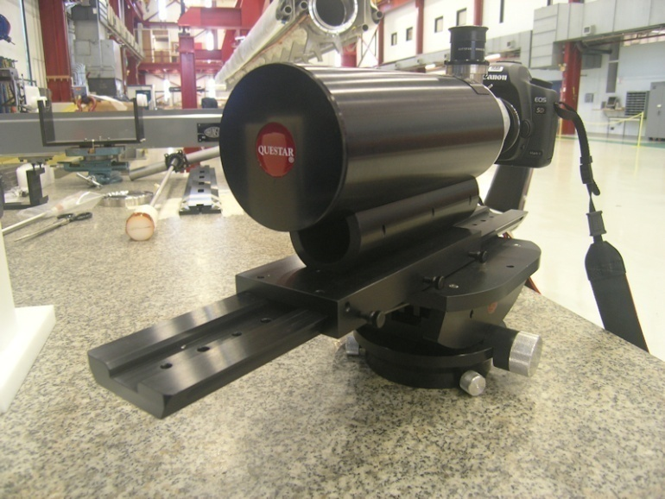
Optical inspection technique at Fermilab
Kyoto system:
1.3GHz 9-cell cavity
1.3GHz single-cell cavity
Questar system:
1.3GHz 9-cell dressed cavity
1.3GHz single-cell cavity
3.9GHz 9-cell cavity
3.9GHz single-cell cavity
1.3GHz Traveling wave cavity
Spoke cavity
650MHz SRF cavity
Kyoto optical inspection system
Questar inspection system

Slide 3
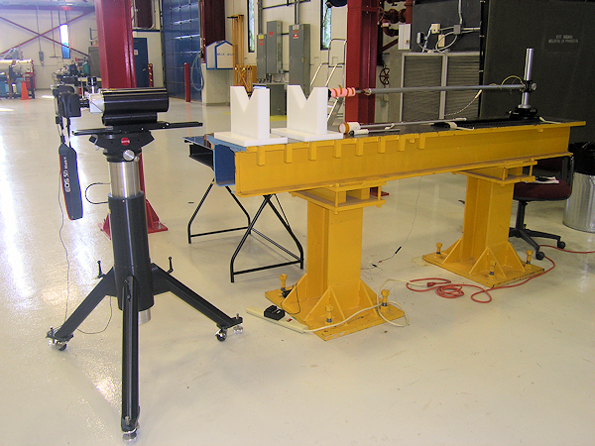
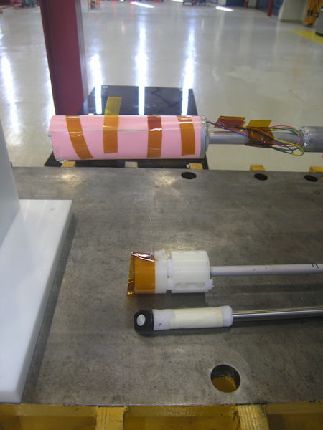
Questar system

Slide 4
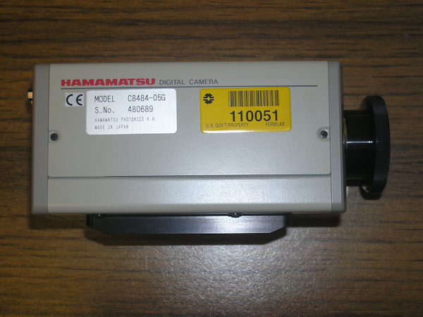
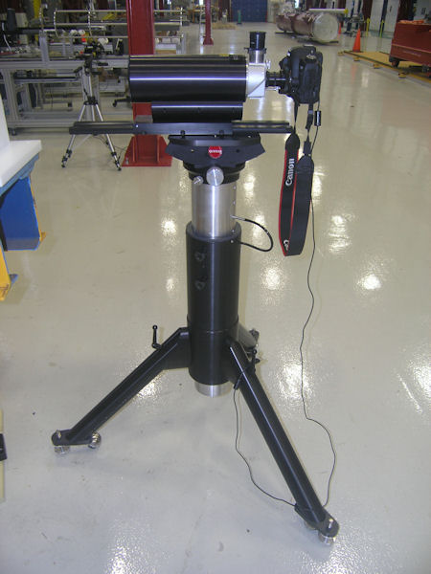
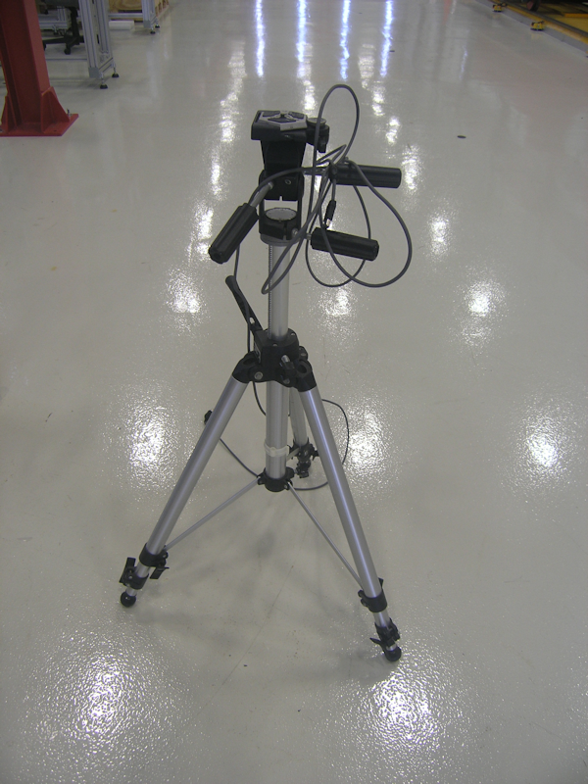
What’s new
New digital camera: Canon EOS 5D mark II (21 Mpixel, ISO: 50 - 25600 expansion, 1080p HD video)
Stronger floor stand: Heavy duty.
Before
Now

Slide 5
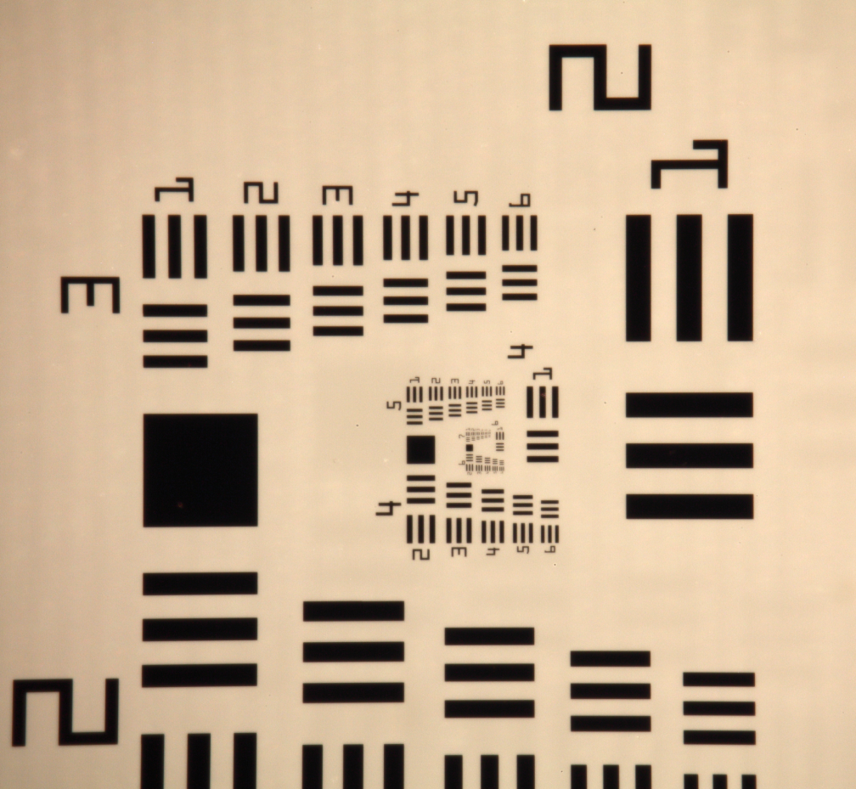
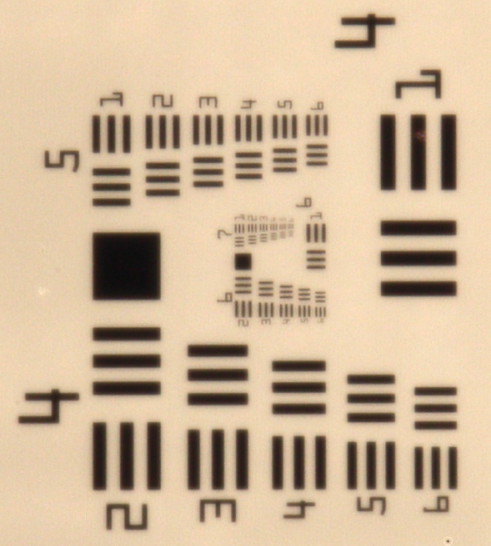
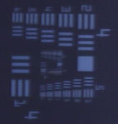

Resolution comparison between Kyoto and Questar system
100% cropped image from center
Kyoto system
Questar system
 | Resolution (lp/mm)
Questar | 181
Kyoto | 32

Slide 6
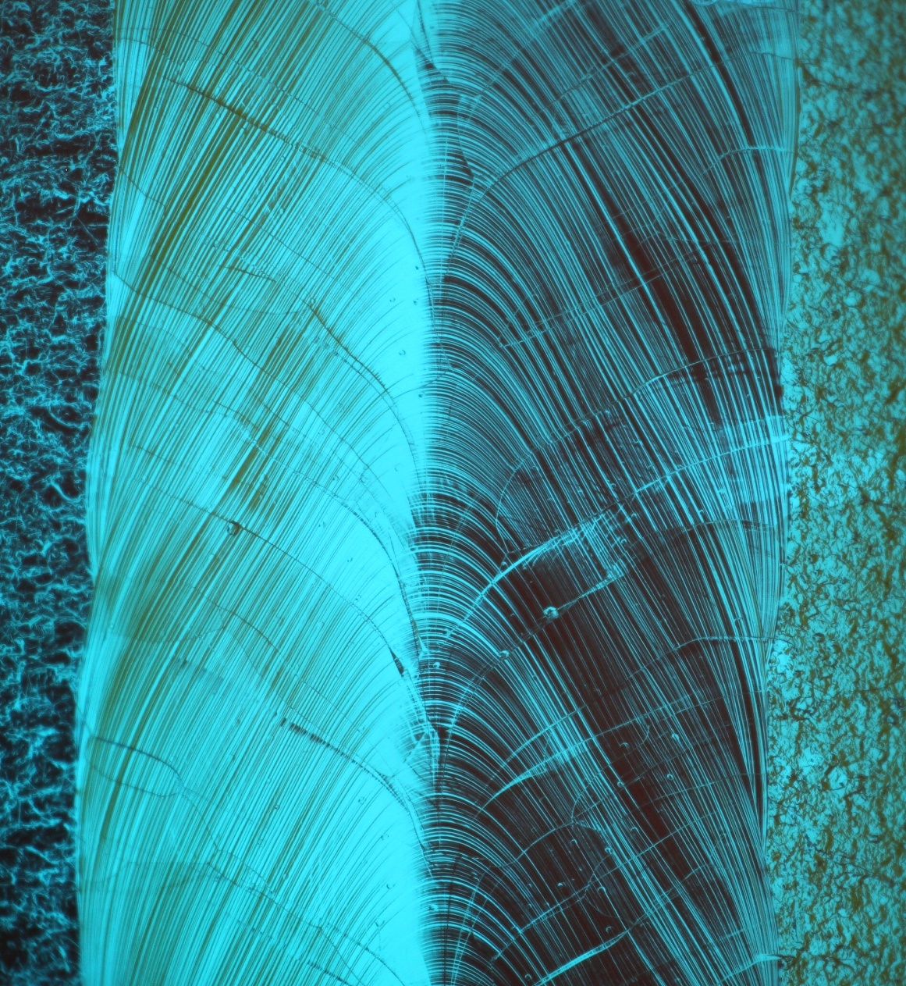
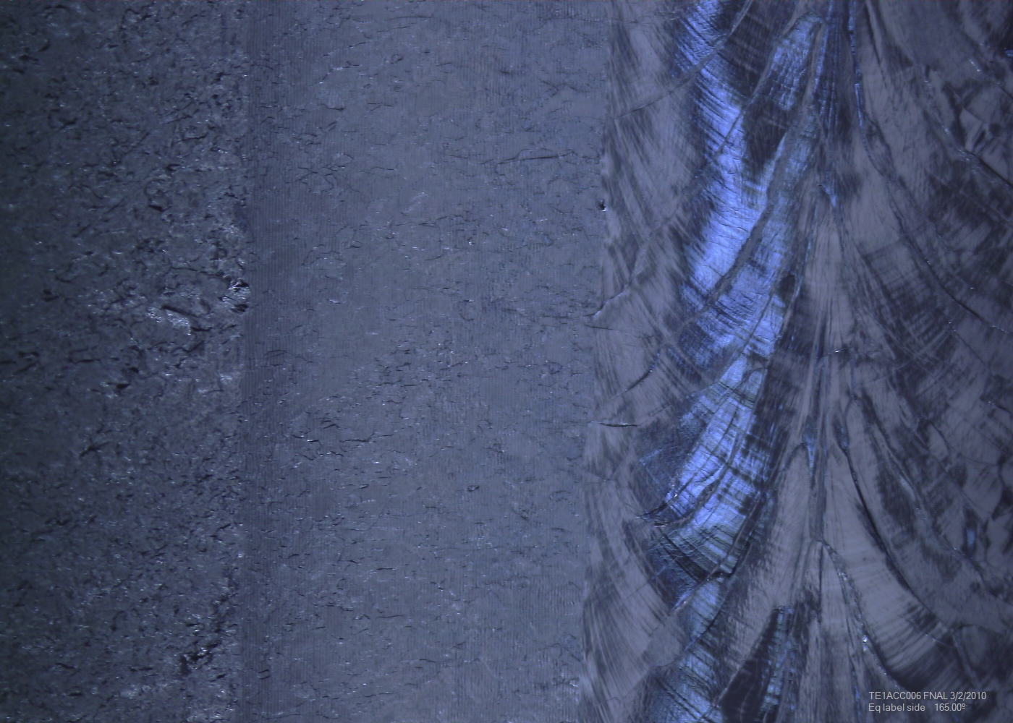
Cavity images comparison
Questar system
Kyoto system

Slide 7
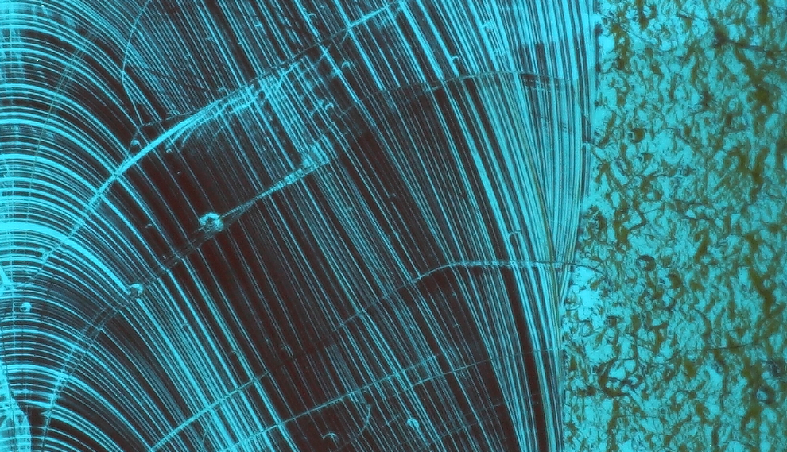
100% image

Slide 8
Future works
To improve lighting.
To build automatically moving stages.

