Slide 1
Asian Physics and Software meeting
Akiya Miyamoto
KEK
3-September-2010

Slide 2
Comparison of Lum. Spectrum
Lum spectrum generator.
Tim’s version: Using GunieaPig. Used for Whizard event generation. Both Energy spread and Beamstrahlung are included. Fortran95
BSGEN: Based on a fit to CAIN lum spectrum. Only beamstrahlung and energy spread can be given at generation time C++ & ROOT
Beam parameters
SB2009 500 wTF
SB2009 350 wTF
RDR_250(BSGEN) and Tim’s 250 GeV spectrum ( used for LOI)
Lum spectrum are generated by two programs and various spectrum are compared.
Generated events: 5M events

Slide 3
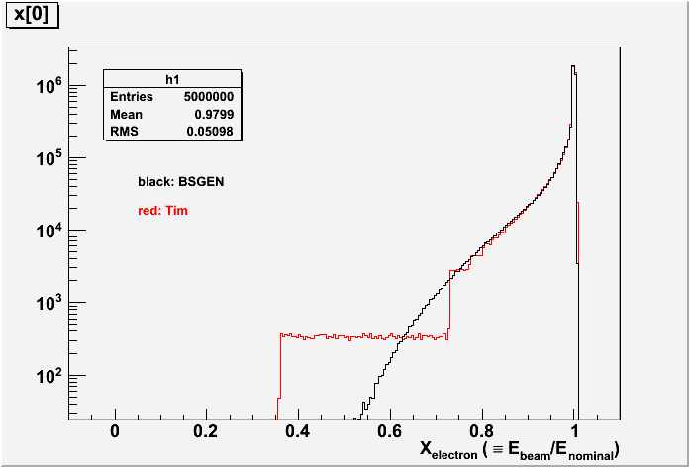
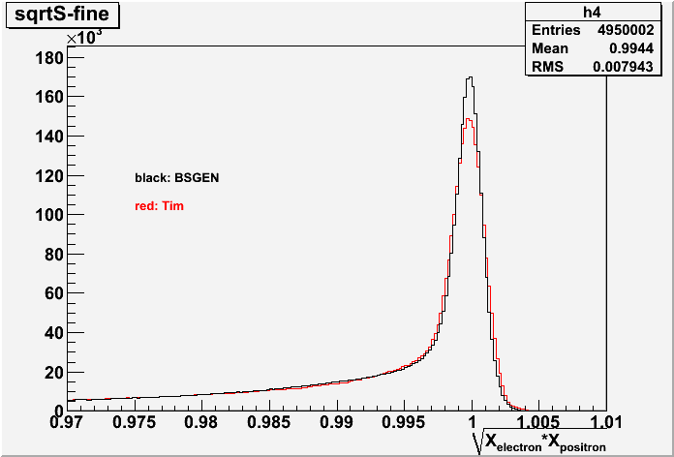
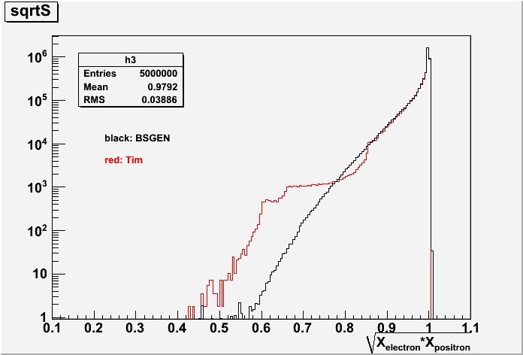
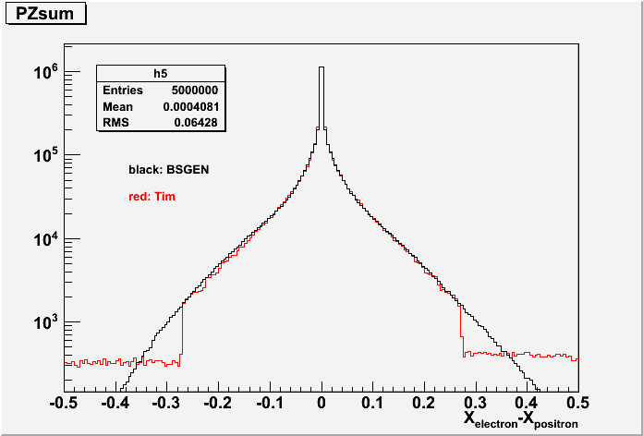
SB2009_500_wTF
Normalized e- energy
Normalized CM energy
Black: BSGEN
Red: Tim
Black: BSGEN
Red: Tim
Normalized CM energy
Normalized Pz
Black: BSGEN
Red: Tim
Black: BSGEN
Red: Tim

Slide 4
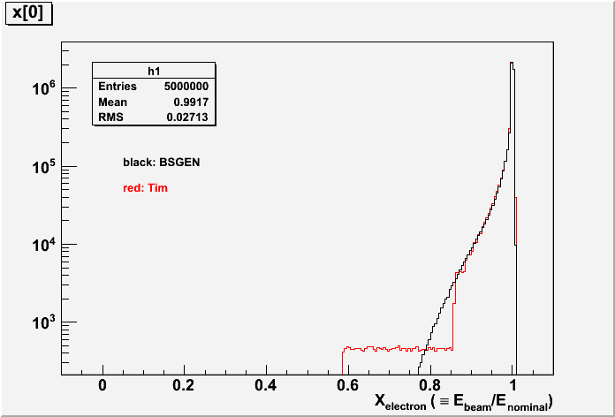
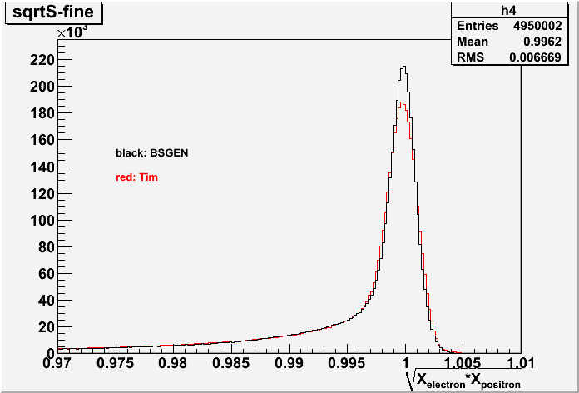
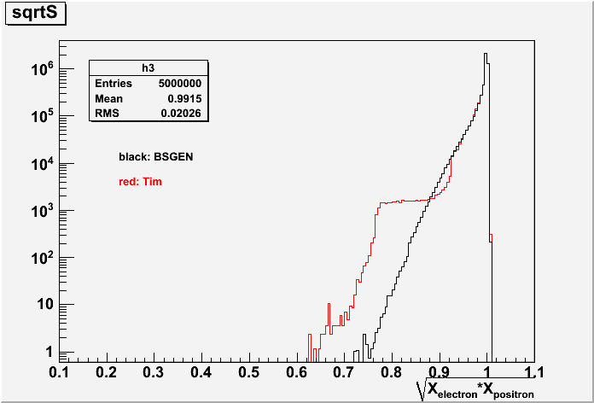
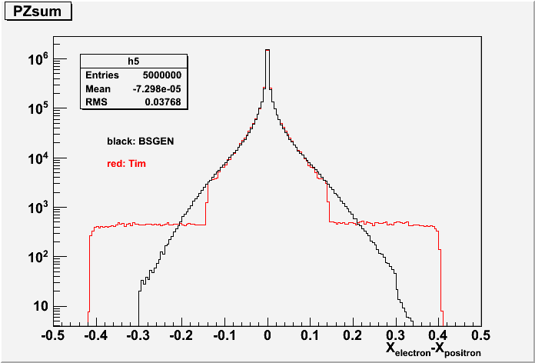
SB2009_350_wTF
Normalized e- energy
Normalized CM energy
Black: BSGEN
Red: Tim
Black: BSGEN
Red: Tim
Normalized CM energy
Normalized Pz
Black: BSGEN
Red: Tim
Black: BSGEN
Red: Tim

Slide 5
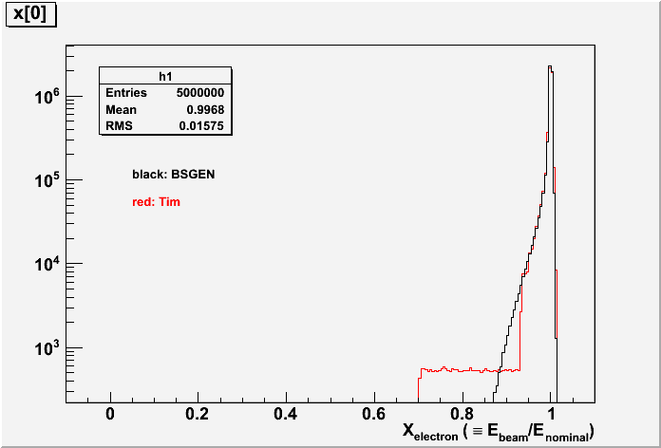
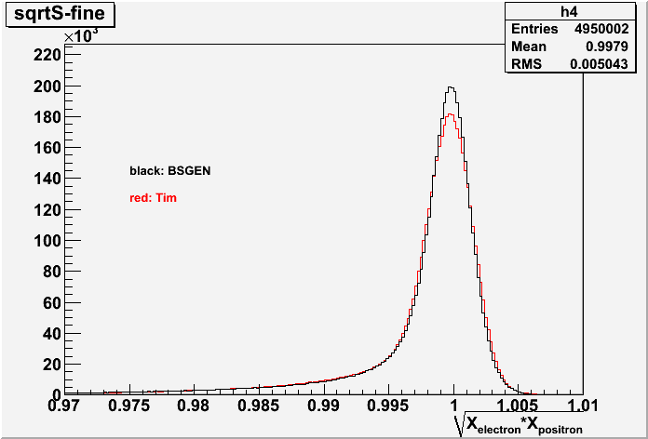
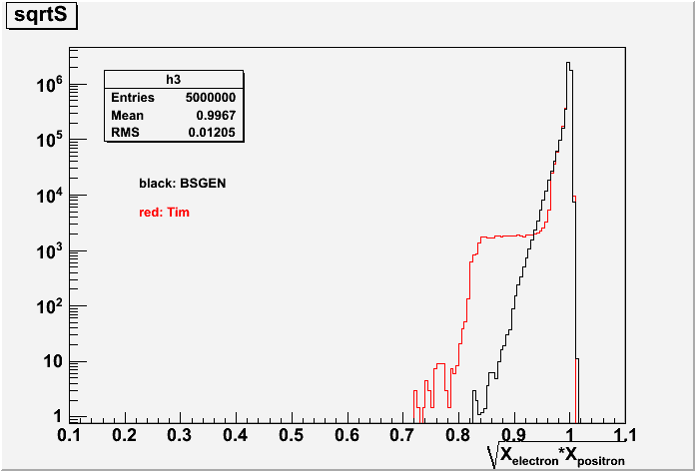
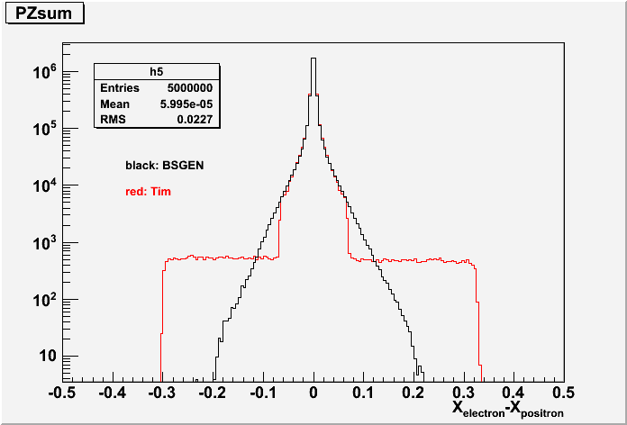
RDR_250
Normalized e- energy
Normalized CM energy
Black: BSGEN
Red: Tim
Black: BSGEN
Red: Tim
Normalized CM energy
Normalized Pz
Black: BSGEN
Red: Tim
Black: BSGEN
Red: Tim

Slide 6
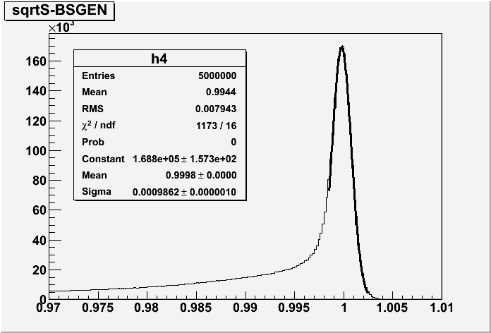
Energy spread
Fit by a single Gaussian. Fit range: 0.9985 to 1.0025
Fit Example: SB2009_500_wTF, BSGEN spectrum

Slide 7
Gaus fit summary
 | RDR_250 | SB2009_350_wTF | SB2009_500_wTF
σ(e⁻) | 0.272 | 0.281 | 0.207
σ(e⁺) | 0.18 | 0.093 | 0.065
σ(Average) | 0.163 | 0.119 | 0.108
σ(BSGEN) | 0.1528 | 0.110 | 0.0986
σ(Tim) | 0.1735 | 0.126 | 0.116
*) value in %

Slide 8
Summary of Lum comparison
Tim’s lumi function and BSGEN produce similar spectrum
In the region of large beamstrahlung, Tim’s spectrum is not smooth shape. Probably because of low statistics.
Initial beam energy spread: BSGEN produces narrower and Tim’s function produce wider spectrum. In principle, BSGEN could change run parameter to produce similar width as Tim’s or those estimated by naive formula.
BSGEN seems to produce slightly unbalanced Pz spectrum. Cause is not understood yet.

Slide 9
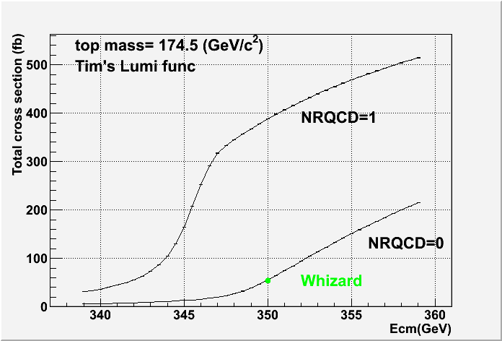
ttbar at 350 GeV
Physsim generator was modified to use Tim’s Lumi function, and total cross section of e+e- → ttbar at 350 GeV was calculated with QCD effect on(NRQCD=1) and off(NRQCD=0). QCD effect enhances total cross section by about factor 8.
Whizard calculation: Cross section of bbcssc was divided by branching ratio to get total cross section

Slide 10
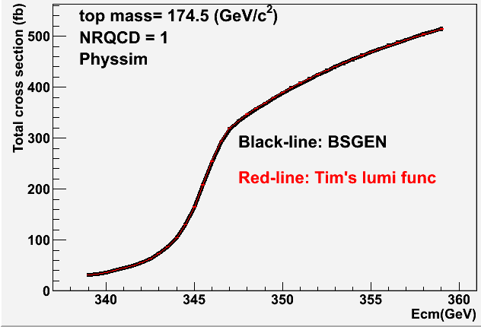
Lum spectrum dependance
Difference between two lum. function is 1% or less

Slide 11
Physsim cross sections
with QCD effect
 | σ(e⁻_{L}e⁺_{R}) | σ(e⁻_{R}e⁺_{L})
bbqqqq | 505.52 | 200.47
bbeνqq | 162.74 | 64.26
bbμνqq |  | 64.14
bbτνqq | 162.06 | 64.38
bbeνeν | 13.16 | 5.15
bbeνμν | 26.23 | 10.38
bbeντν | 26.28 | 10.34
bbμνμν | 13.05 | 5.11
bbμντν | 26.08 | 10.27
bbτντν | 12.96 | 5.18
( in fb unit )

Slide 12
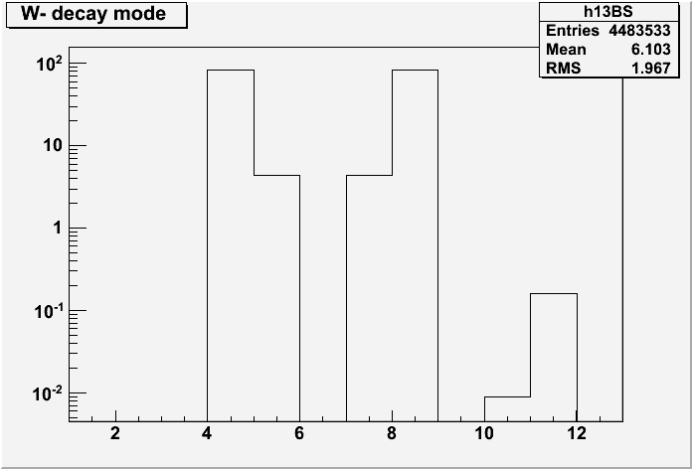
Decay mode of tt->bbqqqq
ud
us
cd
cs
ub
cb

Slide 13
Beam Pol. Asymmetry
 |  | Whizard | Phssim(w/o QCD) |  | Physsim(w/ QCD)
σ(e⁻_{L}e⁺_{R}→tt →bbqqqq) | fb | 74.44 | 72.82±0.05 |  | 506.5±0.5
σ(e⁻_{R}e⁺_{L}→tt→bbqqqq) | fb | 24.88 | 28.39±0.02 |  | 200.4±0.2
Apol |  | 0.499 | 0.439 |  | 0.433
1/α_{QED} |  | 1/132 | 1/128
sinθ_{W} |  | 0.22225
Mz | GeV/c² | 91.1882
M_{W} | GeV/c² | 80.419

