Slide 1
Status of MC samples (progress since early July)
ILD Optimization meeting
Akiya Miyamoto
KEK
8-September-2010

Slide 2
sb2009 350 GeV samples
Generator: Whizard 1.40
Beam parameter: sb2009_350_wTF
Generator information is available at http://wiki.kek.jp/display/~miyamoto/ILC+Common+Generator+Samples
Mokka/Marlin: ilcsoft-v01-06, ILD_00
Location of DST samples
lfn:/grid/ilc/users/miyamoto/CDS/reconstructed/ILD_00/CMS_350
lfn:/grid/ilc/users/miyamoto/CDS/reconstructed-100619/ILD_00/CMS_350 ( 1 DST file corresponds to 3~6 Mokka files )

Slide 3
Processes and statistics
Higgs processes nnH, llH, qqH : about 500fb-1 for each processes
SM processes:
qqqq
ννqq
lνqq
lνlν
llll
eeffff
~50 fb-1. See summary.txt
Need to produce more, if higher statistics are necessary

Slide 4
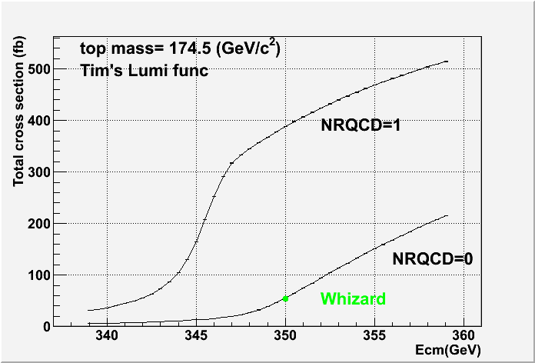
ttbar at 350 GeV
Whizard : No QCD enhancement
Physsim: developed by Keisuke, Sumino, using Helas ME calculator, including QCD effect (NRQCD=1) and KM. Hadronize by Pythia 6.416, tauola 2.5
QCD effect enhances the total cross section by about factor 8. Apol inconsistent
Stdhep files by Physsim will be prepared soon. Then produce DST
σ (tt →2b4q) | Whiz. (fb) | Phssim (w/o QCD) (fb)
σ(e⁻_{L}e⁺_{R}) | 74.44 | 72.82±0.05
σ(e⁻_{R}e⁺_{L}) | 24.88 | 28.39±0.02
Apol | 0.499 | 0.439
sb2009_350_wTF
sinθ_{W}=0.22225

Slide 5
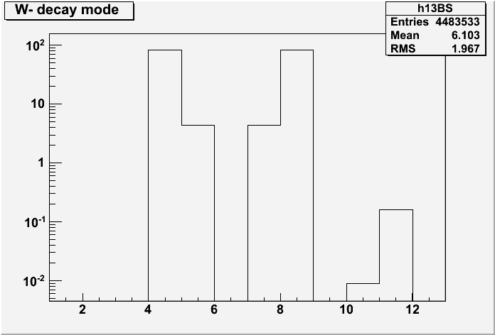
Classification of ttbar final states
ttbar final states will be categorized to following 10 states.
bbqqqq final states contain several quark flavors.
 | σ(e⁻_{L}e⁺_{R}) | σ(e⁻_{R}e⁺_{L})
bbqqqq | 505.52 | 200.47
bbeνqq | 162.74 | 64.26
bbμνqq | 162.81 | 64.14
bbτνqq | 162.06 | 64.38
bbeνeν | 13.16 | 5.15
bbeνμν | 26.23 | 10.38
bbeντν | 26.28 | 10.34
bbμνμν | 13.05 | 5.11
bbμντν | 26.08 | 10.27
bbτντν | 12.96 | 5.18
ud
us
cd
cs
ub
cb
( in fb unit)

Slide 6
Samples for DBD studies
GDE released new beam parameters in August. For DBD studies ?
 | 200 | 250 | 350 | 500 | 1000
Rate (Hz) | 10 | 10(5) | 5 | 5 | 4
Δp/p(e-)(%) | 0.22 | 0.22(0.220) | 0.22(0.218) | 0.21(0.207) | 0.11
Δp/p(e+)(%) | 0.17 | 0.14(0.130) | 0.10(0.093) | 0.07(0.065) | 0.04
β_{x}*(mm) | 16 | 12(21) | 15 | 11 | 30
σ_{x}*(mm) | 904 | 700(927) | 662 | 474 | 554
σ_{y}*(mm), wTF | 6.0 | 5.3(6.4) | 4.5(5.0) | 3.8 | 2.7
L(x10³⁴cm⁻²s⁻¹),wTF | 0.5 | 0.8(0.27) | 1.0 | 2.0 | 2.8^{[2]}
[1]parameters different from sb2009 are listed. Values in ( ) are SB2009 values.
[2] Luminosity without traveling focus.
Possible plan to Whizard sample productions
with Whizard 1.95, revised interface to tauoka, newer hadronization
Update of code in progress
Question: Do we need another energy points, ex. 230 GeV ?

