Slide 1
BAW-2
Low Beam Power
Undulator Source Relocation
Assumptions and questions needing work before BAW-2
Ewan Paterson
Nick Walker
AD&I WebEx Meeting 15.09.10

Slide 2
Low P Questions
1312 bunches with 2x10*10 per bunch up to 500 GeV?
Low energies use 5 + 5Hz mode or new undulator? The latter is knew but has many benefits both technical and cost!
Have parameters for all energies?? What about 5Hz and shorter period undulator? Or 1TeV with only 1312 bunches?
Assume 2 X 3.2 km DR’s in tunnel designed for
3 rings? Or is it 4? Need answer to whether a single E- ring can handle 2625 bunches and have 3ns kickers?
Operation at all energies uses TF and multipart Q1?
1 Tev needs discussion and work! Separate upgrades in energy or luminosity or consider only one combined?
Do we have a satisfactory E-DR design for 10Hz including modulated high power RF system which could share a tunnel with 2 E+ rings?

Slide 3
Low P Questions
1312 bunches with 2x10*10 per bunch up to 500 GeV?
  Our focus is now on the agreed Ecm values of
    200 GeV
    230 GeV – recently requested (to be added to tables)
    250 GeV
    350 GeV
    500 GeV
  Our goal (Working Assumption) is to provide a constant (positron) bunch charge across this region
    unlike 2009 December proposal
  This is still assuming the e+ source to be located at the end of the electron Main Linac
    as part of the central campus integration / consolidation
  For the 200, 230 and 250 GeV parameter sets, this will require adoption of
    10Hz alternate pulsing scheme
    Adjustment (optimisation) of undulator parameters
    Possible high field / short wavelength undulator (Nb₃Sn technology → R&D)
  Incremental cost estimation requires review before January BAW
    currently 1.9% RDR TPC (mostly DR)
Notes:
Does 230 replace 200?

Slide 4
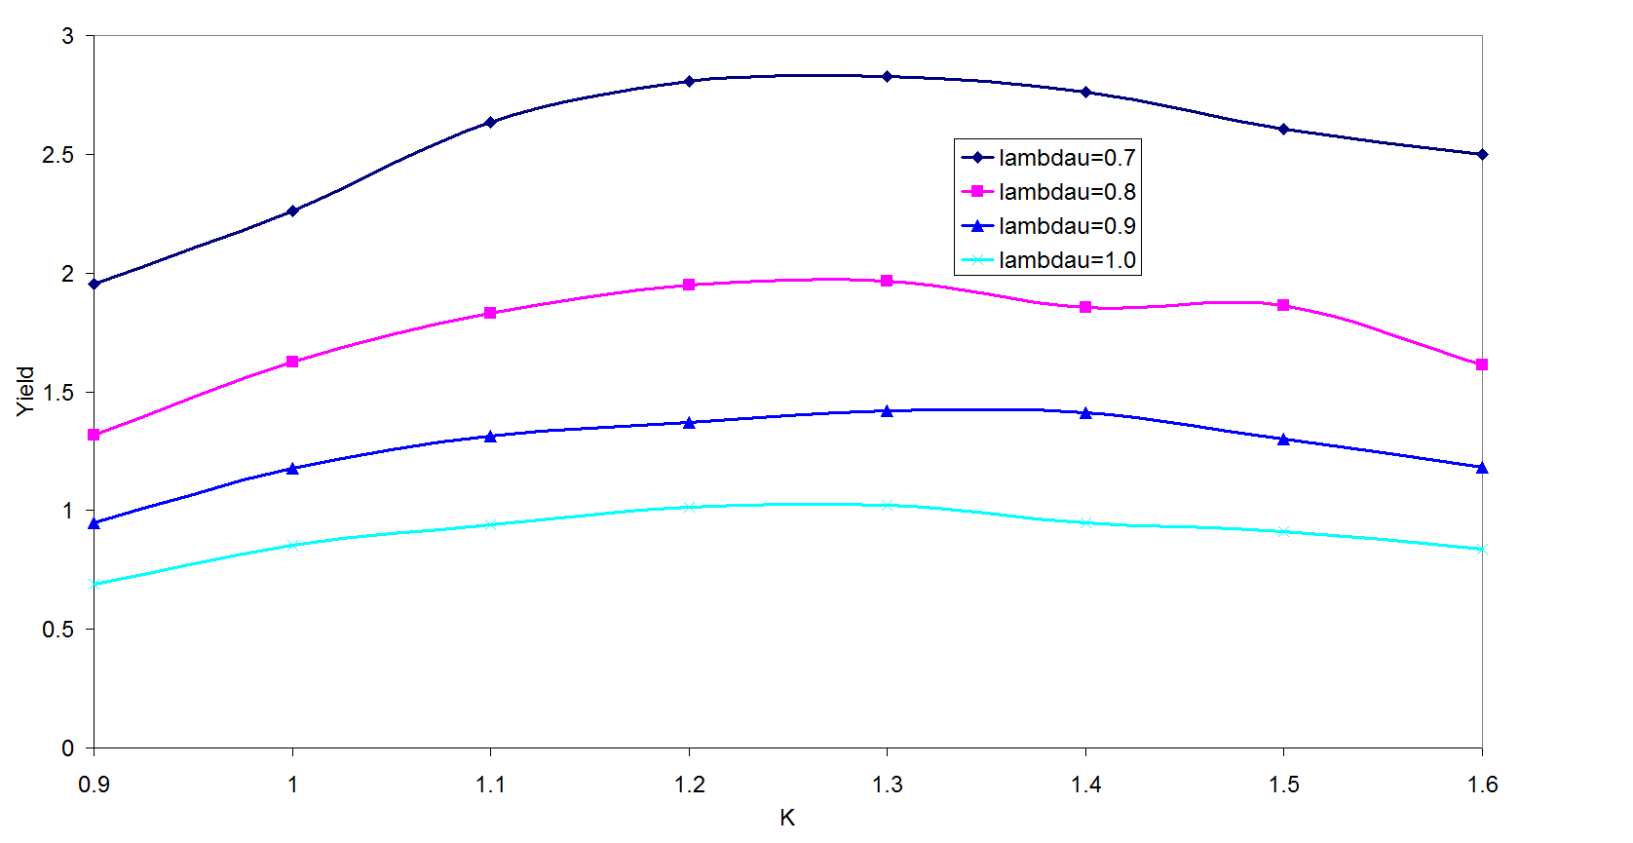
Low P Questions
Low energies use 5 + 5Hz mode or new undulator? The latter is knew but has many benefits both technical and cost!
  Already briefly mentioned in previous slide.
  Goal is to produce undulator capable of producing a yield of 1.5 at 100 GeV beam energy (200 GeV CM).
  No need for 10Hz operation to produce positrons BUT
  10Hz concept could be used to effectively double the luminosity at low Ecm (no 50% DR duty cycle problem) interesting concept! But stll needs short damping T
Most likely parameter region
9mm pitch probably the minimum
Proof of principle R&D required (STFC)
Possible (attractive) alternative
  but too immature right now
Need possible (realistic) parameters
(not the only example in machine of solutions still requiring R&D)
100GeV drive beam (Wei Gai, ANL)

Slide 5
Low P Questions
Have parameters for all energies??
What about 5Hz and shorter period undulator?
  To first order will impact energy spread and possible reduce bunch charge (tbc)
  We can produce alternative parameter sets (across range) when undulator parameters are settled.
  But given risk in very novel technology, should we propose this as our TDR baseline?
Or 1TeV with only 1312 bunches?
  1312 bunches would be a conservative approach, if we assume the reduction in L
  Parameter set with TF has already been requested; linked to the question above?
    if we believe it works for the current 500 GeV parameters, why will it not work for 1TeV?
  Current TeV parameter set assumed beam power upgrade, either already before upgrade, or as part of the TeV upgrade (see later question)
  TeV parameter set is “far reaching”. We can be aggressively optimistic and accept a high-risk at this time
    We will understand the performance and limitations of our machine much better when we finally begin to plan the energy upgrade
  To do: produce additional parameter sets
    note possible combinations will generate several new sets
      and possible confusion and much work!
After first round of discussion, publish guidelines defining limited subset of parameters to be studied for BAW-2

Slide 6
Low P Questions
Parameter sets accounting:
  6 centre-of-mass energies (incl. 1TeV upgrade)
  With or without Travelling Focus (x2=12!)
  With or without beam-power ‘upgrade’ (x2=24!!)
  Various other ‘scenarios’ (x2=48!!!)
  (e.g. positron source, say two options)
Clearly some “management” required here!

Slide 7
Low P Questions
Assume 2 X 3.2 km DR’s in tunnel designed for 3 rings? Or is it 4? Need answer to whether a single E- ring can handle 2625 bunches and have 3ns kickers?
  Working assumption is design for 3 rings in a single 3.2km tunnel and initially install 2
  Space for third ring can be consider as (a) risk mitigation if design luminosity is not achieved, (b) possible lumi upgrade path, if original goal performance is achieved.
  we assume that doubling the current in the e- ring is acceptable (needs study of collective effects – on-going), and that the DR kicker is available by that time,
  and that a doubling of the e+ current is constrained due to e-cloud (risk mitigation)
Notes:
Can this be agreed to at this ADI meeting?

Slide 8
Low P Questions
Operation at all energies uses TF and multipart Q1?
  Partly covered in previous answers
  If we believe these options to be feasible, then there is no reason to assume they cannot be applied across the board
  Acknowledged risk in TF is why we have produced parameter sets without using it (lower luminosity); these should be considered as more conservative options.
  Risk in new Q1 configuration still requires qualification
    note this solution is specific to Low Ecm running

Slide 9
Low P Questions
1 Tev needs discussion and work! Separate upgrades in energy or luminosity or consider only one combined?
  A focused study of the energy upgrade is still to do and is planned for 2011
    leading to white paper (input to TDR)
  The parameter sets can be aggressive but should be treated cautiously
    Upgrade will be after several years of operation and experience
  Upgrading the beam power (lumi) can be treated separately
    (see later)
  However, when it happens is an open question. Current TeV parameter set assumes it happens, but says nothing about when
    at the latest as part of the energy upgrade
  Note we have already proposed to generate a TeV parameter set(s) based on the reduce bunch number
    i.e. no beam-power upgrade

Slide 10
Low P Questions
Do we have a satisfactory E-DR design for 10Hz including modulated high power RF system which could share a tunnel with 2 E+ standard rings?
  Not at this time
  Requires study and ideas on how best to approach this problem
  Producing one (or more) cost-effective schemes for the RF should be a priority goal for this year (and before the January BAW)
Action item for Geneva Workshop!

Slide 11
Beam Power Upgrade
AAP/PAC – allow path back to 2600 bunches as
  risk mitigation or
  possible lumi upgrade
Need to understand the scope of this statement (for costing)
  Already WA is to leave room for second e+ DR
  CFS support for additional RF power?
    different scope for KCS, DRFS, RDR HLRF Tech.
Needs some guidelines for this discussion
  e.g. include additional CFS upfront

Slide 12
Other Issues (Studies)
Travelling Focus requires more study (AAP)
  simulation work
  Understanding better the tolerances / stability
    requirements for feedbacks etc.
  Particle tracking (not just Guinea Pig)
  Understanding how to tune-up the TF by adjusting the crab cavities
    relationship / dependence on other FF tuning
Consolidation of parameter tables
  cross-check numbers (add GUINEAPIG simulations)
  Fill in existing gaps (missing numbers)
  Add additional parameter sets (identified in this talk)
  Begin to add machine sub-system detailed parameter tables
    consisted with IP parameters
Feasibility of Final Doublet concept?
  R&D plan?
Resources!

Slide 13
Summary of Action Items
Consolidation of formal Ecm parameter sets (NW, JMP, AS + P&D)
  clearly not all permutations!
  will define scope of studies
  Add GP numbers to tables
RF Solution(s) for 50% duty cycle in e+ DR (S. Guiducci et al)
Further simulation studies of Travelling Focus operation and performance
(K. Kubo et al)
Parameter sets (ranges) for undulator source (J. Clarke et al)
  particular for ‘gray zone’ (200-300 GeV) operation
  include FC (as well as QWT)
  Initial estimates of Nb₃Sn-based solution
Consolidate HLRF parameters / requirements for reduced nb solutions
  this must include an assessment of supporting the proposed gradient spread from BAW-1
Refinement of cost increments (PMs and PHG)
  Re-analysis of cost of supporting 10Hz operation
  DR RF configuration (update) and incl. of 50% duty cycle solution
  Consolidate cost impact for reduced HLRF solutions (KCS, DRFS, RDR HLRF Tech.)
Notes:
CFS is missing here!

Slide 14
Straw-man Schedule (TBC)
What | When | Topics
AD&I webex | 13.10.10 | Formal parameters consolidation (scope)
Geneva Workshop | 19-22.10.10 | DR RF solution; Undulator parameters; ML HLRF parameters; DR e-cloud recommendation; cost increment review
AD&I webex | 10.11.10 | TF simulations; P&D studies status
AD&I webex | 08.12.10 | Discussion of upgrade/risk mitigation scenarios (including cost impact). CFS status.
AD&I webex | 05.01.11 | Final review of parameters and cost. Preparation for BAW (programme, proposal drafts etc.)
BAW-II | 18-21.01.11 | Too late!
Clearly subject to change as we move forward

