Slide 1
ILC-BAW1
Summary and Recommendations
Akira Yamamoto, Marc Ross and
Nick Walker
GDE Project Managers
Reported at BAW1, held at KEK, Sept. 10, 2010

Slide 2
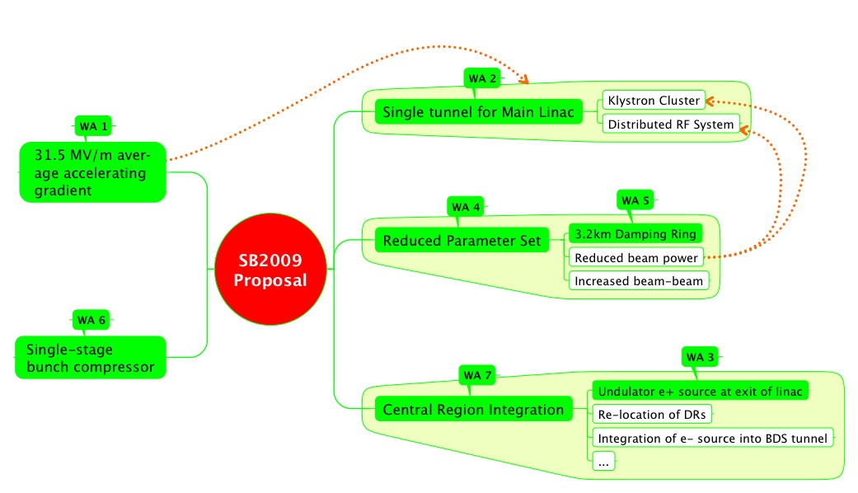
SB2009 Themes
N Walker

Slide 3
Global Plan for SCRF R&D
Year | 07 | 2008 |  | 2009 |  | 2010 |  | 2011 | 2012
Phase | TDP-1 |  |  |  |  |  | TDP-2
Cavity Gradient in v. test to reach 35 MV/m | → Process Yield 50% |  |  |  |  |  | → Production Yield 90%
Cavity-string to reach 31.5 MV/m, with one-cryomodule |  | Global effort for string assembly and test (DESY, FNAL, INFN, KEK)
System Test with beam acceleration |  |  | FLASH (DESY) , NML (FNAL) STF2 (KEK, extend beyond 2012)
Preparation for Industrialization |  |  |  |  | Production Technology R&D

Slide 4
Baseline Assessment WorkShops
Baseline Assessment Workshops
  Face to face meetings
  Open to all stakeholders
  Plenary
 | When | Where | What
WAB 1 | Sept. 7-10, 2010 | KEK | Accelerating Gradient Single Tunnel (HLRF)
WAB 2 | Jan 18-21, 2011 | SLAC | Reduced RF power e+ source location

Slide 5
BAW1 Objectives and Goals
Assess technical proposal in SB2009
Confirm R&D Plan required and Goal in TDP-2
Discuss Impact across system interfaces, cost, and schedule,
Discuss toward consensus in GDE and Physics/Detector groups to prepare for TLCC.

Slide 6
Subjects discussed in Sessions
Date | Main Theme | Tasks
Sept. 7 | Introduction HLRF-KCS: Design and R&D RDR: Technical | Make the workshop tasks clear Process for the reality including cost Feasibility as a backup solution
Sept. 8 | DRFS: Design and R&D LLRF/Control Discussions | Process for the reality including cost R&F operation margin for cavity/accelerator Recommendation
Sept. 9 | Cavity Gradient: R&D Discussions | Strategy for cavity gradient improvement Short-term and long-term strategy to be clear
Sept. 10 | ML Accelerator Gradient Discussions | Accelerator gradient including spread, Appropriate balance of gradient in cavity/cryomodule/accelerator, and Adequate margin in accelerator operation Recommendation

Slide 7
Time-Table / Agenda (Sept. 7) updated: August 27
Day | Am/pm | Subject | Chair/presenter
9/7 |  | Single Tunnel ML Design and HLRF -1 | S. Fukuda / C. Nantista
 | 9:0 0 90 min | Opening and Introduction Opening address Report from AAP BAW1 objectives and goals | Chair: S. Yamaguchi A. Suzuki (KEK-DG) E. Elsen A. Yamamoto (GDE-PM)
 | 10:45 90 min | Single tunnel CF design and HLRF design Single tunnel CF design status (1 hour) General HLRF design in SB2009 (30 min) | Chair: T. Shidara - A. Enomoto S. Fukuda
 | 13:30 120 min | HLRF KCS KCS design and R&D status (45 min) Demonstration of feasibility (45 min) | Chair: S. Fukuda C. Nantista C. Adolphsen
 | 15:45 105 min | HLRF – EU XFEL and RDR - Introduction (20 min) Experience from XFEL (1 hour) RDR configuration (as backup) (10 min) Discussion (15 min) | Chair: N. Walker M. Ross W. Bialowons S. Fukuda ALL

Slide 8
Time-Table / Agenda (Sept. 8)
Day | Am/pm | Subject | Convener/presenter
9/8 |  | Single Tunnel ML Design and HLRF -2 | S. Fukuda / C. Nantista
 | 9:00 | DRFS DRFS design and R&D status Installation strategy (1 hour total) | Chair: C. Nantista S. Fukuda S. Fukuda
 | 10:45 | HLRF and LLRF LLRF requirements/issues for KCS 30 LLRF requirements/issues for DRFS 30 Requirements from Beam Dynamics 30 | Chair: T. Shidara C. Adolphsen S. Michizono K. Kubo
 | 13:30 | Operational consideration Sorting cavities in relation with HLRF 30 Gradient and RF Power Overhead 30 | Chair: C. Adolphsen S. Noguchi J. Cawardine
 | 15:45 | Discussions and Recommendations General discussions and questions Summary and recommendations | Chair: A. Yamamoto TBD ALL

Slide 9
Single Tunnel Proposal: intro 1
The proposal to go to a single tunnel solution for the Main Linac technical systems remains essential that outlined in the SB2009 report.
The primary motivation was and remains a reduction in project cost due to the removal of the service tunnel for the Main Linac.
The original proposal was based on the adoption of two novel schemes for the HLRF:
  KCS
  DRFS
KCS has been identified as a preferred solutions for ‘flat land’ sites where surface access (buildings) is not restricted
DRFS has been identified as being preferred solutions for mountainous region where surface access (buildings) is severely limited.
Having both R&D programmes in parallel can be considered as risk-mitigation against one or other of them failiing.
It is acknowledged that both these schemes require R&D
  Programmes are detailed in the R&D Plan Release 5
At the time of submission in December 2009, the two primary obstacles to adoption of a single tunnel were identified as
  Safety egress
  Operations & Availability

Slide 10
In FY11: Also extend pipe system to 80 m and add bend prototype
5.0 MW
Resonant Line
back-shorted tap-in
80 m of WC1890
350 MW
In FY12: Use resonant ring to test ‘final design’ bends and tap-in/off
Resonant Ring
5.0 MW
phase shifter
directional coupler
160 m of WC1890
tap-off
tap-in
350 MW

Slide 11
Task and R & D schedule of DRFS in KEK
R&D study is easy since the DRFS system is not large.
Task force team of DRFS starts and try to solve the problems of DRFS.
Prototype RF unit is manufactured in FY09
Further R&D required for the DRFS RF system is continued from FY09. Three year R&D budget was approved.
Permanent magnet, high voltage SW
and IGBT will be studied intensively.
Prototype will be evaluated in the S1
global test (2 Klystron DRFS)
And then installed in the buncher
section of STF-II aiming for the realistic
operation.
More large scale of DRFS (4~5 Klystron
DRFS) is planed for STF-II in KEK.
l
S1-Global Plan

Slide 12
Single Tunnel Proposal: intro 2
Both these issues were addressed during the 2009 and the successful results reported in the SB2009 proposal.
  The conclusions of these studies were later accepted by both AAP and PAC
The remaining identified issues were with the technical feasibility and cost of the HLRF solutions upon which the single-tunnel proposal was based.
Two components to successful adoption were identified
  Definition of acceptance criteria for TD Phase R&D for successful demonstration of one or more of the novel proposed schemes
  Inclusion in the designs of a risk-mitigation strategy, whereby a fall-back to the RDR HLRF Technical Solution (in a single-tunnel) could be adopted, should the associated R&D not be considered successful.
The remainder of these slides deals with these two additional points

Slide 13
RDR HLRF Tech. Solution 1
Two scenarios have been cursorily studied for support of an RDR-like HLRF solution in a single-tunnel
  10MW MBK + (Marx) Modulator in the tunnel
  XFEL-like solution with modulators (low-voltage) accessible in cryo refrigeration builds/caverns, with long pulsed cables feeding 10MW MBKs (via a pulse transformer) in the tunnel.
Both are considered technically feasible.
For 1, early investigations show the tunnel diameter would need to increase to 6.5m
  This represents an estimated 10% increase in cost/unit tunnel length (~0.5% TPC) considered acceptable.
  Current availability* simulations (cf SB2009 proposal) suggest an additional ~5% linac overhead (~2.5% TPC)
For 2:
  additional space for modulators in halls/caverns is required.
  Cost of 3000 km of pulsed cable will be required.
  Re-design of tunnel cross-section needed to accommodate cables.
  Current availability* simulations (cf SB2009 proposal) suggest an additional ~2.5% linac overhead (~1.3% TPC)
* see later comments on availability

Slide 14
3D of RDR single tunnel plan ( Bouncer Modulator)-(1)
Cross Sectional View
6.5m
Cryomodule is installed on the floor to avoid the vibration problem which
possibly affects to the beam instability.
RF Power distribution system are under the passage in the middle of the tunnel.

Slide 15
RDR HLRF Tech. Solution 2
It is proposed that these RDR-like single-tunnel solutions be carried forward in parallel, to enough detail to support a cost estimate (incremental)
This estimate – together with the scope of the necessary re-design work to adopt one of the scenarios, will be factored into the TDR Risk Assessment
The main R&D and AD&I effort will continue to pursue the preferred baseline solutions for KCS and DRFS.
In order to reduce the number of scenarios to be developed, we propose to phase out one of these RDR-like options within the next six-months
* see later comments on availability

Slide 16
Time-Table / Agenda (Sept. 9)
Day | Am/pm | Subject | Convener/presenter
9/9 |  | Cavity: Gradient R&D and ML Cavity Gradient | R. Geng/A. Yamamoto
 | 9:00 | Introduction and Current Status Technical address for the 2nd part of WS Overview from RDR to R&D Plan 5 Progress of cavity gradient data-base/yield | Chair: M. Ross A. Yamamoto R. Geng C. Ginsburg
 | 10:45 | R&D Status and further R&D specification Fabrication, testing, & acceptance for XFEL/HG R&D expected in cooperation w/ vendors R&D w/ a pilot plant w/ vendor participation | Chair: K. Yokoya - E. Elsen M. Champion H. Hayano
 | 13:30 | Short-tem R&D and Specification Field emission and R&D strategy Gradient, Spread, Q0, Radiation: R&D specification, standardization | Chair: C. Pagani H. Hayano R. Geng
 | 15:45 | Long-term R&D ACD subjects and goals Seamless/hydro-forming, Large Grain, Cavity shape variation, VEP, Thin Film, Further R&D toward TEV/ML Discussions for Cavity R&D and Recommendations | Chair: A. Yamamoto - R. Rongli to lead discussions

Slide 17
Time-Table / Agenda (Sept. 10)
Day | Am/pm | Subject | Convener/presenter
9/10 |  | ILC accelerator gradient and operational margin | A. Yamamoto and J. Kerby
 | 9:00 | Gradients from VTS to Operation Introduction: Overview on ILC gradient specification at each testing / operation step Terminology definition Operational results from VT/HTS/CM tests in data base Operational results from STF VT/CM tests at KEK | Chair: H. Hayano - A. Yamamoto - M. Ross - C. Ginsburg - E. Kako
 | 10:30 | Operational margin Lorentz Force Detuning and Effects on op. margin Comments from LLRF and Beam Dynamics Comments onAcceerator Operation gradient margin | Chair: N. Toge E. Kako (K. Kubo/C. Michizono) N. Walker
 | 13:30 | Cost Impacts Reminder on cost effects List of systems / technical components affected by gradient specification change A plan to prepare for communication w/ industries | Chair: N. Walker P. Garbincius J. Kerby A. Yamamoto
 | 15:15 | General Discussion and recommendation General discussions Summary and recommendations | Chair: A. Yamamoto All
 | 17:00 | End

Slide 18
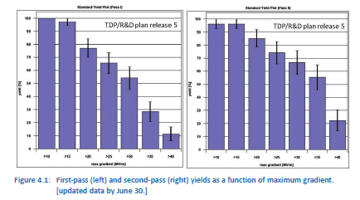
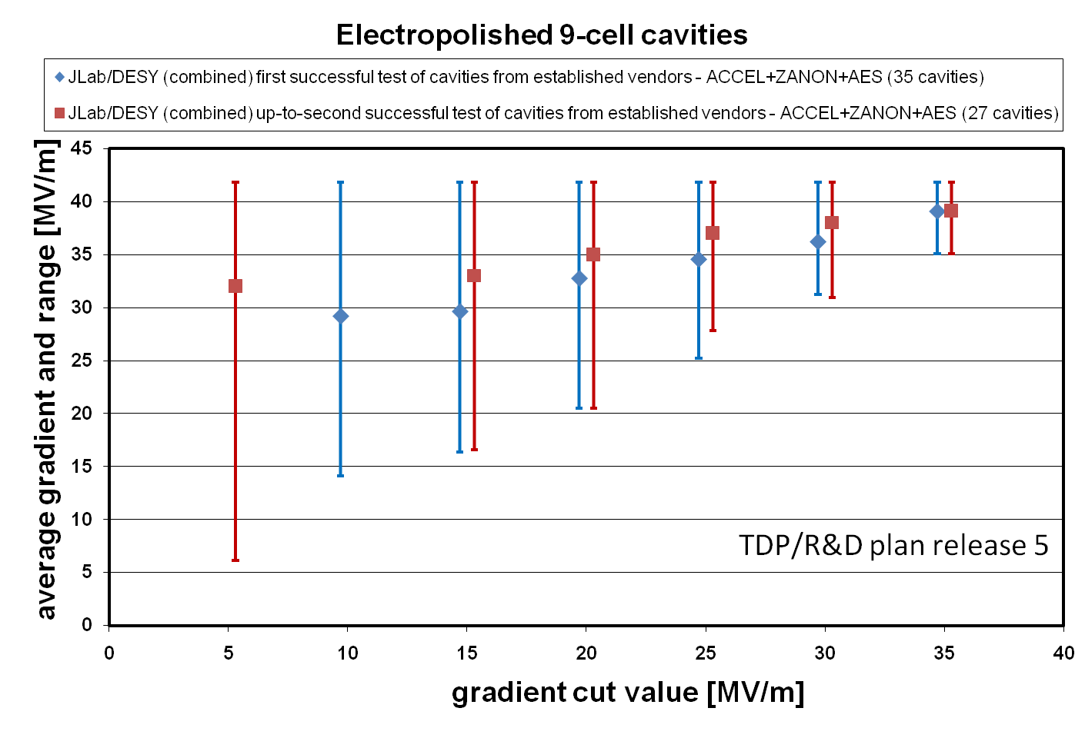
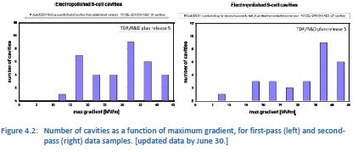
Cavity Gradient Progress
ILC-GDE Cavity Database Team Progress report
  C. Ginsburg et al.
  as of June 30, 2010

Slide 19
Gradient Spread and Standard Deviation
As of June 30, 2010
Average: ~ 36 MV/m at gradient cut at 25 MV/m
Standard deviation: ~ 5 MV/m gradient cut at 25 MV/m

Slide 20
Gradient Improvement Plan
Based on Recent Understanding due to Globally Coordinated S0 Program
Highest priority is to push yield up near 20 MV/m – the yield drop due to local (geometrical) defects near equator weld.
  Fab. QA/QC
  Mechanical polish prior to heavy EP
  Post-VT local targeted repair
  Seamless cavity
  Large-grain mat. From ingot slicing
  Fine grain mat. Optimization
Also high priority is to suppress field emission at high gradient (up to 42 MV/m) – and quantify its effect on cryogenic loss and dark current.
Remove local
defect (comp.)
and field emitter
Eliminate Local defect
(geo.) near equator weld

Slide 21
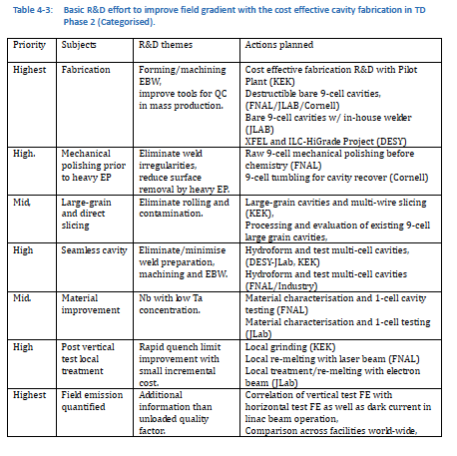
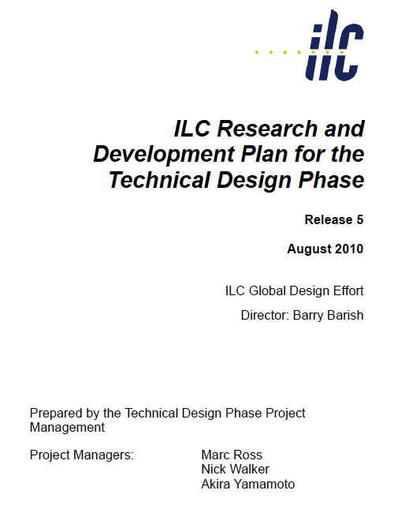
Basic R&D Efforts in TDP-2

Slide 22
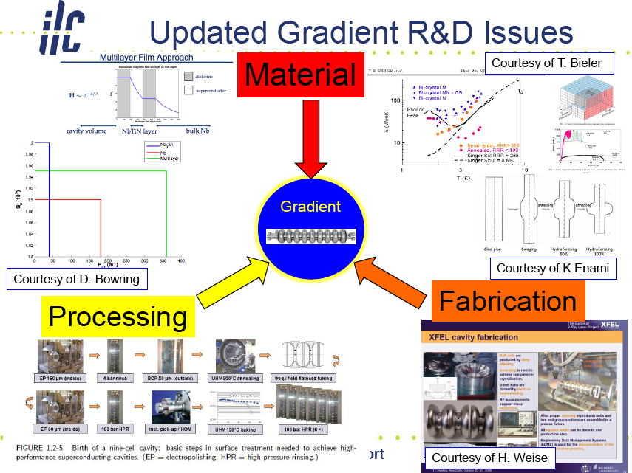
From R. Geng

Slide 23
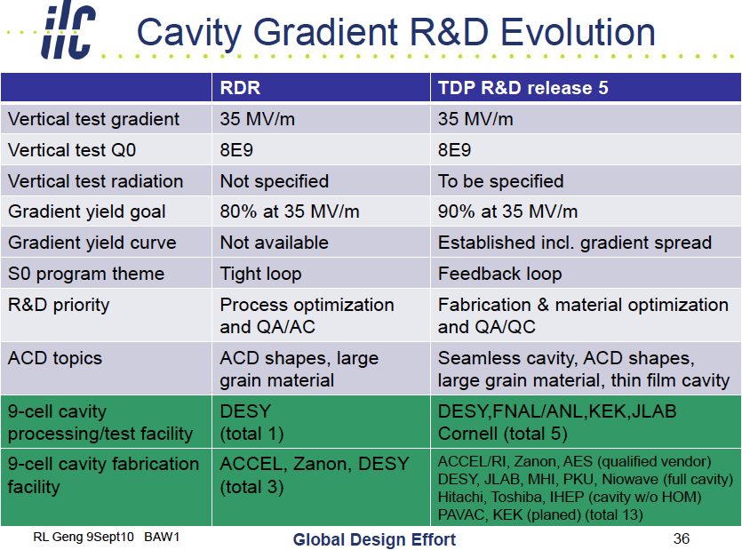
R. Geng

Slide 24
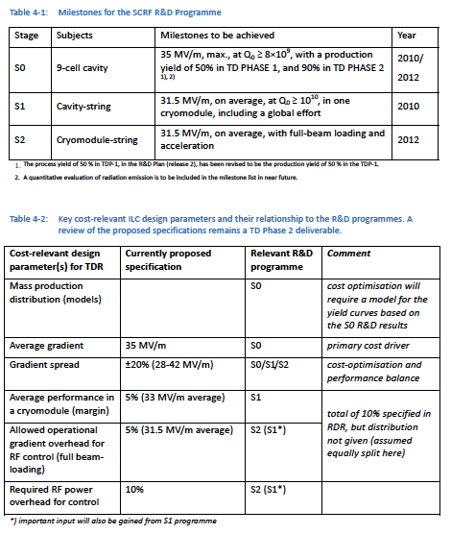
ILC ML Cavity Gradient
R&D Milestones and ML operational Specification

Slide 25
R&D Milestone
Technical R&D Plan (revised: Rel-5)
Stage | Subjects | Milestones to be achieved | Year
S0 | 9-cell cavity | 35 MV/m, max., at Q0 ≥ 8E9, with a production yield of 50% in TDP1, and 90% in TDP2 ^{1), 2)} | 2010/ 2012
S1 | Cavity-string | 31.5 MV/m, in average, at Q0 ≥ 1E10, in one cryomodule, including a global effort | 2010
S2 | Cryomodule-string | 31.5 MV/m, in average, with full-beam loading and acceleration | 2012

Slide 26
ILC Accelerator, Operational Gradient
Strategy for Average Accelerating Gradient in the ILC operation:
  Overview and scope of 'production yield' progress and expectations for TDP,
    including acceptable spread of the gradient needed to achieve the specified average gradient,
  Cavity
    Gradient, Q0, and Emitted Radiation in vertical test, including the spread and yield,
  Cryomodule
    Gradient, Cryogenic-load and Radiation, including the gradient spread and operational margin with nominal controls,
  ILC Accelerator
    Gradient, Cryogenic-load and Radiation, including the gradient spread and the operational margin with nominal controls
  Strategy for tuning and control,
    including feedback, control of ‘Lorentz force detuning’, tolerances and availability margin,
  Impact on other accelerator systems: CFS, HLRF, LLRF, Cryogenics, and overall costs.

Slide 27
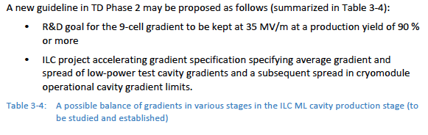
A possible balance in
ILC ML Accelerator Cavity Specification
Single 9-cell cavity gradient | String Cavity gradient in cryomodule w/o beam | String cryomodule gradient in accelerator with beam
35 MV/m, on average w/ spread above a threshold | 34 MV/m, on average (or to be further optimized) | 31.5 MV/m, on average (or to be further optimized)

Slide 28
Summary
HLRF/LLRF design with Single Tunnel layout
ML Accelerator Gradient

Slide 29
HLRF/LLRF Design with Single Tunnel
The main proposal is to go to a single tunnel solution for the Main Linac technical systems remains essential that outlined in the SB2009 report, and is based on the adoption of two novel schemes, requiring RD, for the HLRF in the single tunnel:
  KCS: preferred solutions for ‘flat land’ sites
  DRFS: preferred solutions for mountainous region
Two backup scenarios are proposed for supporting RDR-like HLRF solutions in a single-tunnel
  10MW MBK + (Marx) Modulator in the tunnel
  XFEL-like solution with modulators (low-voltage) accessible in cryo refrigeration builds/caverns, with long pulsed cables feeding 10MW MBKs, via a pulse transformer, in the tunnel.
Both are considered technically feasible, and no R&D program is proposed.
We propose to phase out one of these RDR-like options within the next six-months, in order to reduce the number of scenarios to be developed.
There are comments on the Original RDR HLRF solution with two tunnel to be a fall-back solution, although PM proposal to seek for the RDR-likeHLRF solution in the single tunnel to keep effective design work

Slide 30
ILC-ML SCRF Cavity Gradient Specifications proposed, based on R&D Effort and Milestone/Goals
Cost-relevant design parameter(s) for TDR | ML cavity gradient Specification | R&D Milestone | Relevant R&D Programme
Mass production distribution (models) |  |  | S0
9-cell Cavity Gradient in vertical test | 35 MV/m, average - Spread: 28 – 42 MV/m (+/- 20 % or less) | 35 MV/m at 90 % yield including 2nd pass, (eq. > 38 MV/m, average) | S0
Cryomodule Operational Gradient | 34 MV/m, average | 34 MV/m, average CM Obs. G. Limit = 3 % + ** | S1
ML Operational Gradient | 31.5 MV/m avg - Spread: 25 – 38 MV/m (+/- 20 % or less: TBD) | 31.5 MV/m, average Op. G lim = 1.5 MV/m** Cntrl margin = 3 %** | S2 (S1*)
Required RF power overhead for control | 10% (TBD) |  | S2 (S1*)
** as milestone for R&D

Slide 31
Accelerator Gradient
Common understanding and Recommendation
Observation
  Challenging operational margin in accelerator operation to be reliable enough for sufficient availability for physics run.
Our Strategy Proposed
  Provide two major guidelines
    R&D milestone: 35 MV/m with 90 % yield (eq. > 38 MV/m on average) , including 2nd pass,
    ILC ML Cavity specification: 35 MV/m on average with spread,
  Make our best effort with forward looking position to realize the accelerator operational gradient to be 31.5 MV/m, on average with reasonable gradient spread (< ~ +/-20 %). We require an additional HLRF power of 10 %.
  Keep cost containment concept, and prepare for the industrialization including cost and quality control.
  Ask physics/detector groups to share our observation and forward looking strategy

Slide 32
Acknowledgment on behalf of ILC-GDE Project Managers
Many thanks for all participants at KEK and through webex.
We would thank the LOC led by Seiya Yamaguchi and organized by Tetsuo Shidara, Tomiko Shirakata, Kazuko Toyomura, Nobuko Kobayashi, Kazuko Nagai, Emiko Kotaki, H. Hayano, Takayuki Saeki, and Araki Sake, for their much effort to bring the BAW1 successfully carried out.

Slide 33
backup

Slide 34
Higher Gradient Operation with
Better Electric Power Efficiency
Small Tuning Range
& Less DLD Effect
Cavity Grouping
with Over-Coupling

Slide 35
How should we do for Degraded Cavity ?
To Save other Good Cavities,
We should have
Tunability for RF Power & Coupling.

Slide 36
Highest Gradient Operation
Gradient
Quench Gradient
Feed-back Limit
( LLRF )
V-Sum Feed-back Margin
1 ~ 2 MV
Operating Gradient
Lorentz Detuning Compensation Error
Q_{L} = 3x10⁶, Δf = 50 Hz, ψ = 13°ーー→ ΔV = - 5 %
QL = 2.0x10⁶, Δf = 50 Hz, ψ = 8.7°→ ΔV = - 2.3 %
Time

Slide 37
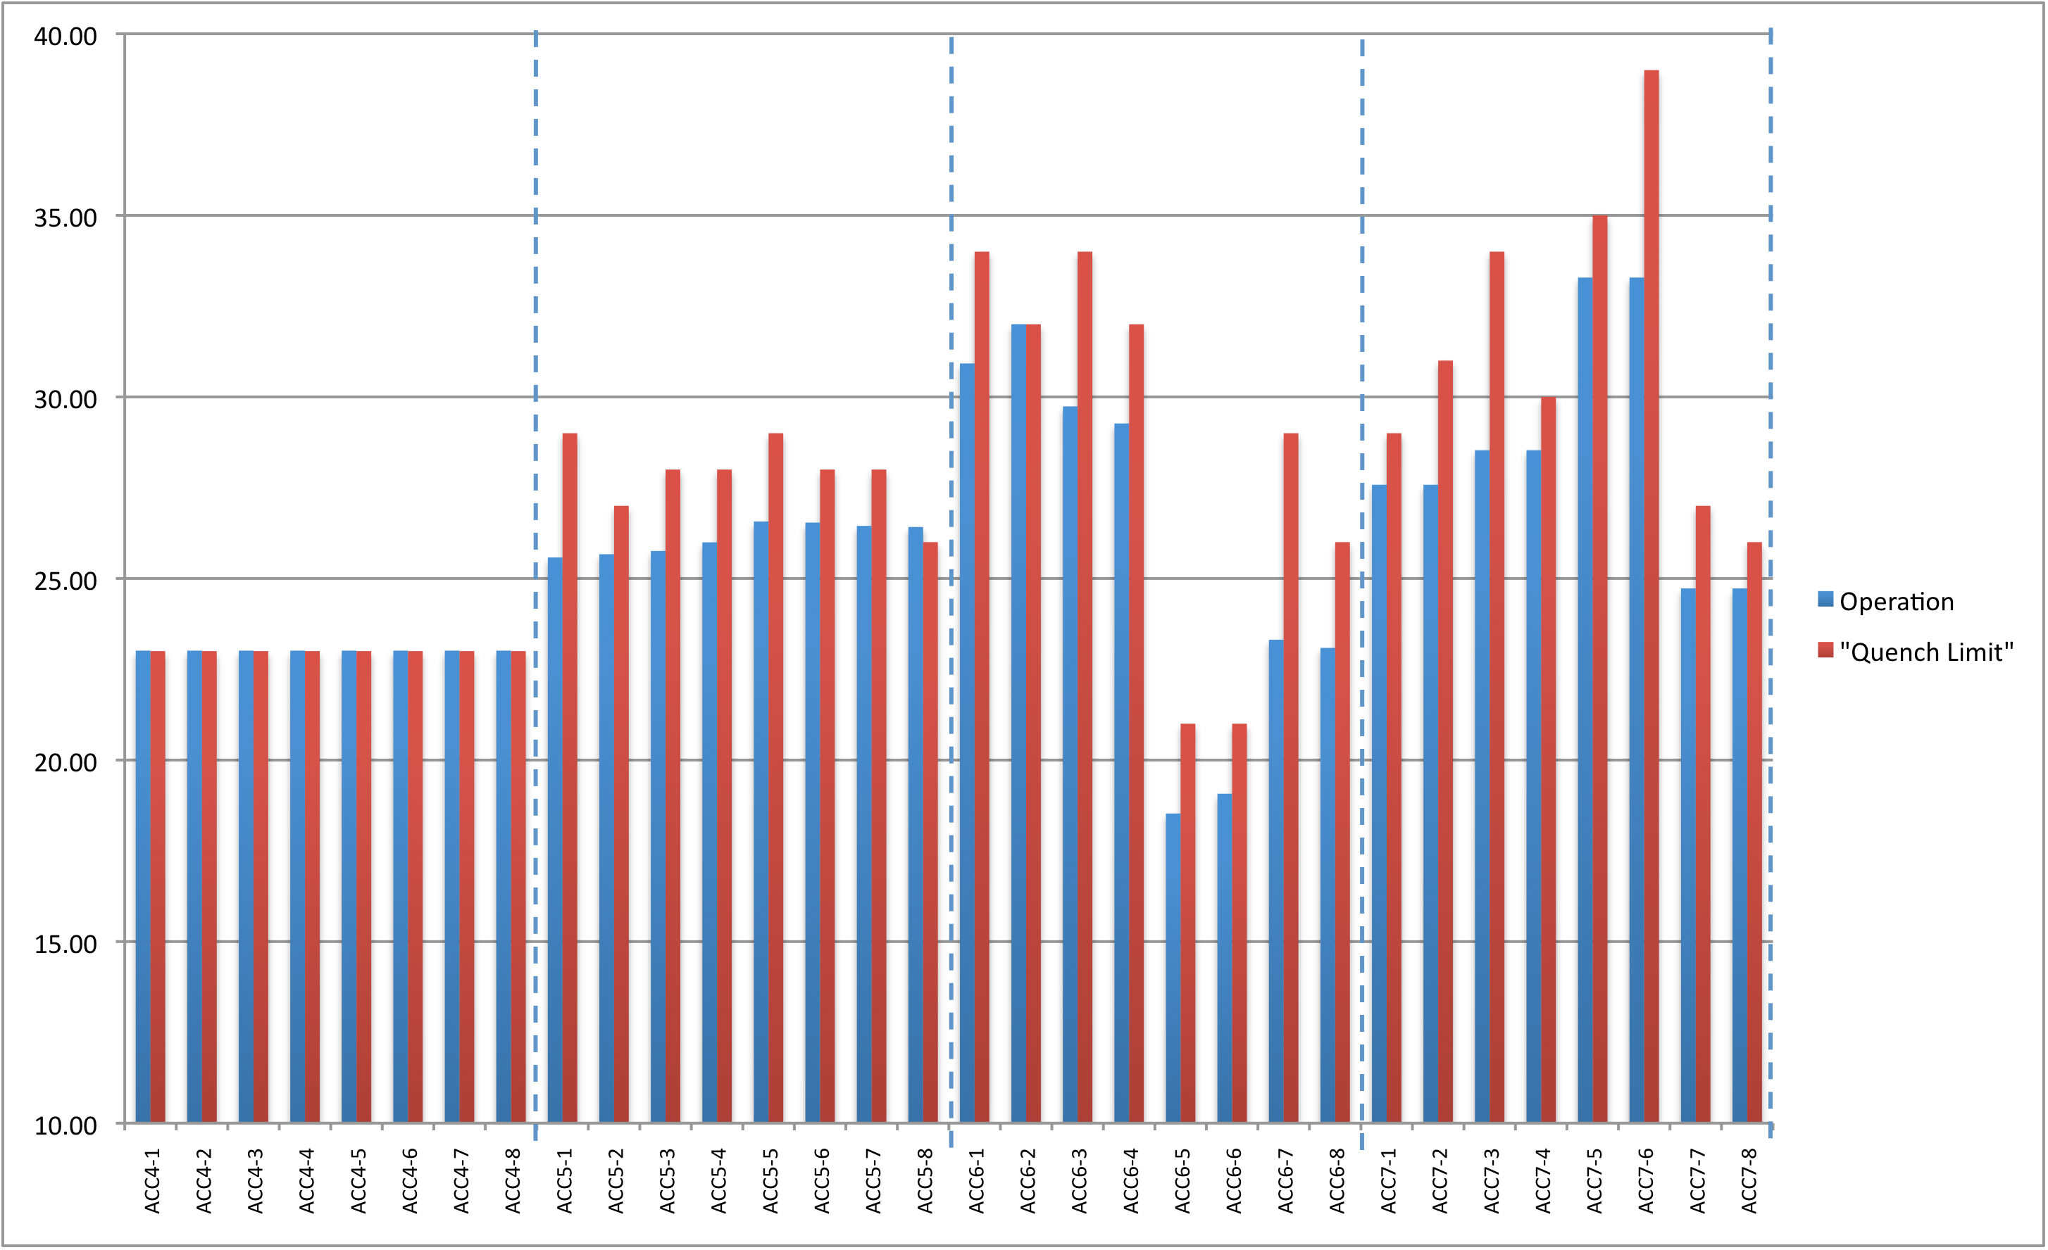
Ideally, all cavities reach their respective quench limits at the same forward power
4.6 MW klystron power (est.)
5.5 MW klystron power (est.)
23.0 MV/m
26.1 MV/m
25.7 MV/m
28.5 MV/m
ACC6 C2 will quench first (artifact of RF distribution forward power ratios)
Avg Emax:
23 MV/m
Avg Emax:
27.9 MV/m
Avg Emax:
28.6 MV/m
Avg Emax:
31.4 MV/m
Reality: errors in power ratios due to manufacturing tolerances of rf attenuators
(In this case: tolerances are of the order +/-0.1dB)

Slide 38
Summary from S. Michizono
 |  | RDR | DRFS (PkQl) | DRFS(Cavity grouping)
 | Operation gradient | Max. 33 MV/m | Average 31.5 MV/m | Max. 38 MV/m
 | RF source | 10 MW |  | 800 kW
 | Waveguide loss | 8% power | 2% power | 2% power
 | Static loss (Ql, Pk) | 2% power | 2% power | 2% power
 | Kly Hv ripple | 2.5% power | 2.5% power | 2.5% power
 | Microphonics | 2% power | 2% power | 2% power
 | Reflection | 0% power | 14% power | 0% power
 | Other LLRF margin | 10% power | 10% power | 5%~10% power
 | Ql tolerance |  | 3% (2) | 3% (2)
 | Pk tolerance |  | 0.2dB (2) | 0.2dB (2)
 | Detuning tolerance |  | 15Hz rms(3) | 20Hz rms (3)
 | Beam current offset |  | 2% rms (3)
RF power
Tolerance
LLRF overhead ~5%
Cavity gradient tilt (repetitive) ~5%
Pulse-to-pulse gradient fluctuation ~1%rms
We have to examine these numbers experimentally.
Tolerance should be discussed with cavity and HLRF group. If the tolerance is smaller, better gradient tilt would be possible.

Slide 39
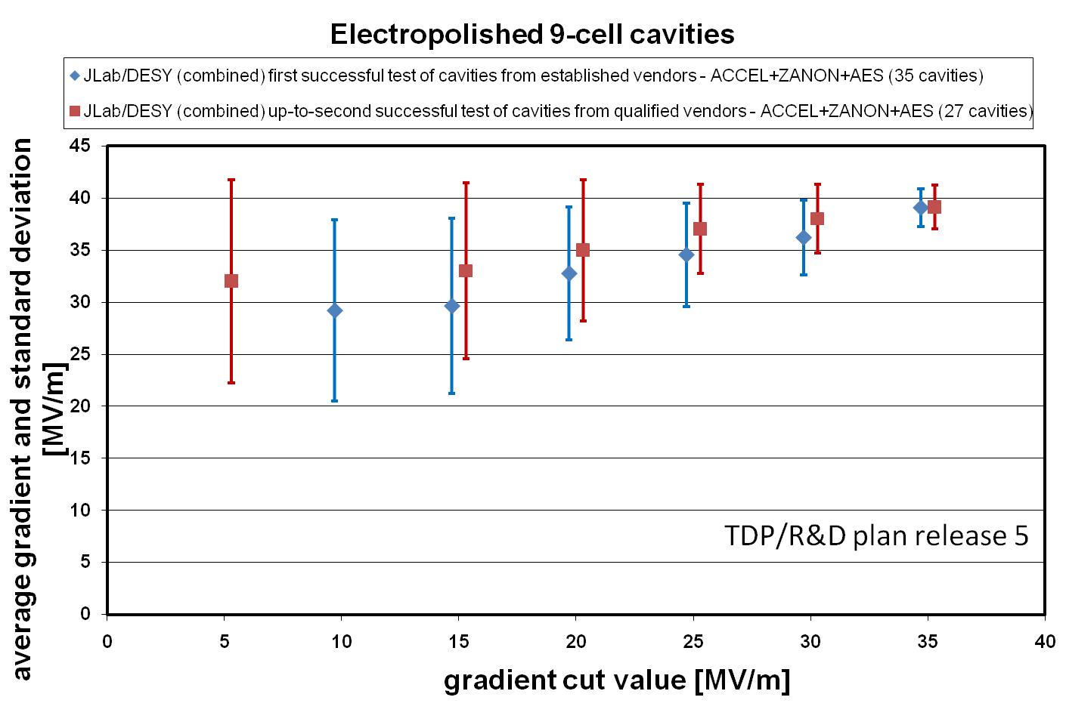
Gradient and Spread as of June, 2010

Slide 40
Highest Gradient Operation
From S. Nogichi
Gradient
Quench Gradient
Feed-back Limit
Operating Gradient
Feed-back
Beam Timing
One Cavity – One Klystron
Best Configuration
Time

Slide 41
Subjects to be further studied in
TDP-2
Further Studied in TDP-2
  How wide cavity gradient spread may be acceptable in balance of HLRF power source capacity and efficiency?
  How large operational margin required and adequate in cryomodule and accelerator operation?

