Slide 1
SRF Beam Test Facility at NML
Jerry Leibfritz
Sept. 13, 2010

Slide 2
Outline
NML Project Overview and Goals
Layout of Facility
Technical Progress
Schedule
Budget

Slide 3
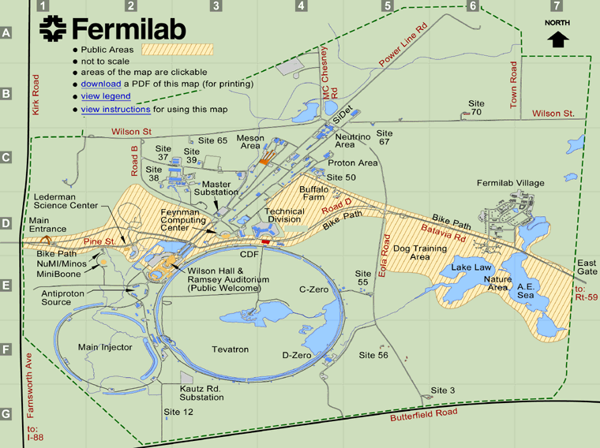
Location
New Muon Lab
3

Slide 4
NML Project Overview
Overall Goals
  Build an RF Unit Test Facility at the New Muon Lab (NML)
    ILC RF Unit = 3 cryomodules
    10-MW RF system
    Beam with ILC parameters (3.2 nC/bunch @3 MHz, Up to 3000 bunches @ 5Hz, 300-μm rms bunch length)
  Build Test facilities for Project-X cryomodules
Phase-1 (FY07 – FY10)
  Prepare facility for testing first cryomodule (CM1) without beam
    Infrastructure, RF power, cryogenics (Tevatron satellite refrigerators #1 & #2)
    Install first cryomodule (CM1) and Capture Cavity-2 (CC2), cooldown, and RF test

Slide 5
NML Project Overview
Phase-2 (FY10 - FY11)
  Prepare for first beam
    Civil construction to expand facility (capability for 2 RF units)
    Move parts from FNPL photo-injector to NML
    Install new gun, injector, test beamlines, beam dump
    Install/test second cryomodule (CM2)
Phase-3 (FY11 – FY14)
  Complete RF Unit
    Upgrade RF system to 10 MW, install third cryomodule (CM3)
    Commission new Cryogenic Plant
    Operate full RF Unit with beam
    Begin installation of 2nd RF Unit

Slide 6
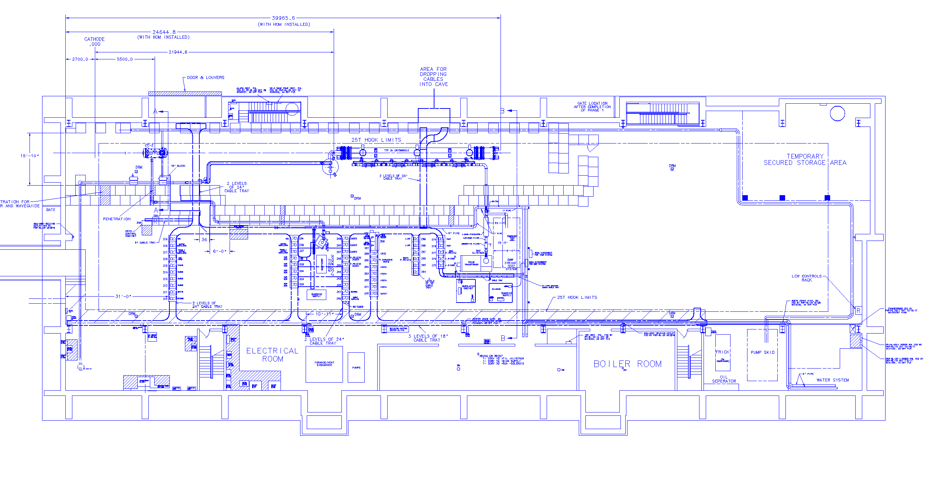
Phase-1 Layout of NML
Capture Cavity 2 (CC2)
Cryomodule-1 (CM1) (Type III+)
5 MW RF System for CM1
CC2 RF System
6

Slide 7
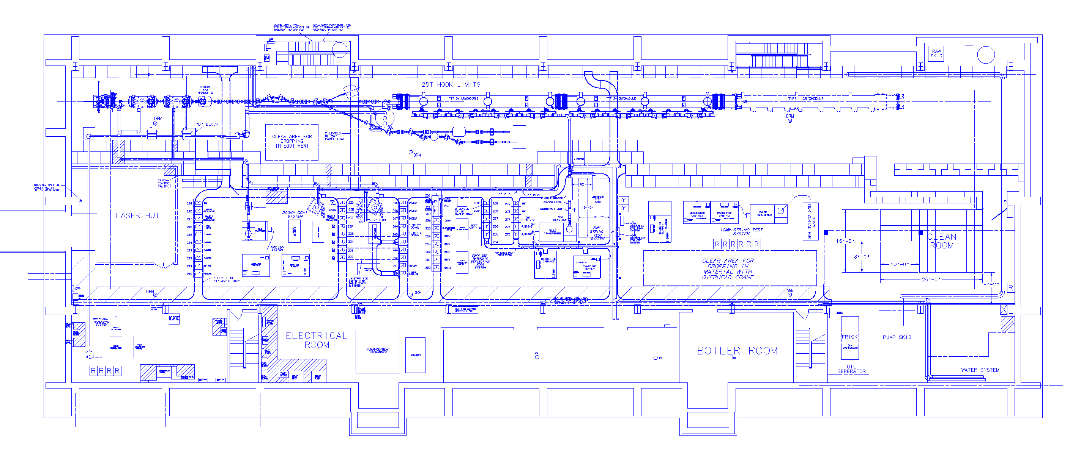
Phase 2/3 Layout of NML Building
Capture Cavity 1 (CC1)
Future 3.9/Crab Cavity Test Beamlines
Cryomodules
CC2
RF Gun
5MW RF System for Gun
CC1 & CC2 RF Systems
10MW RF System for Cryomodules
Future 10MW RF System
7

Slide 8
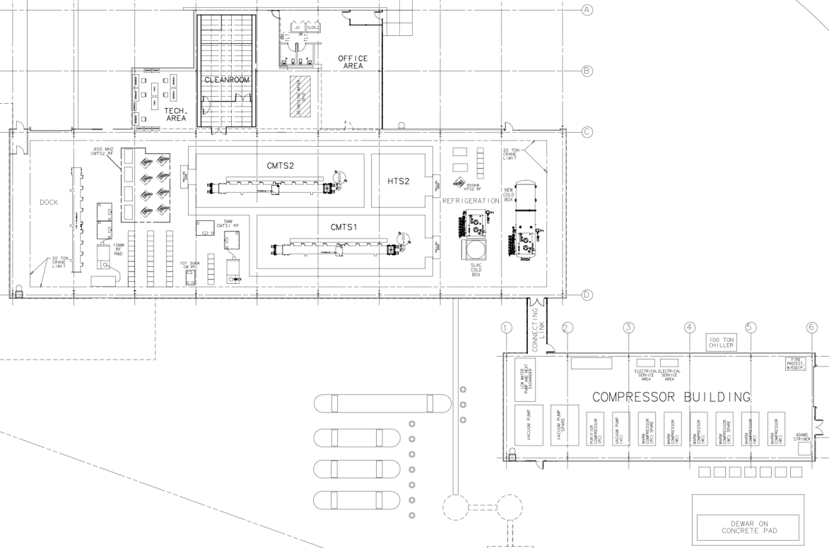
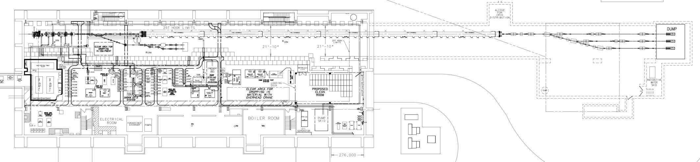
Expansion of NML Facility
New Cryoplant & CM Test Facility
(300 W Cryogenic Plant, Cryomodule Test Stands, RF Test Area, Vacuum Cleanroom)
Funded by ARRA
New Underground Tunnel Expansion
(Space for 6 Cryomodules (2 RF Units), AARD Test Beam Lines)
Existing NML Building

Slide 9
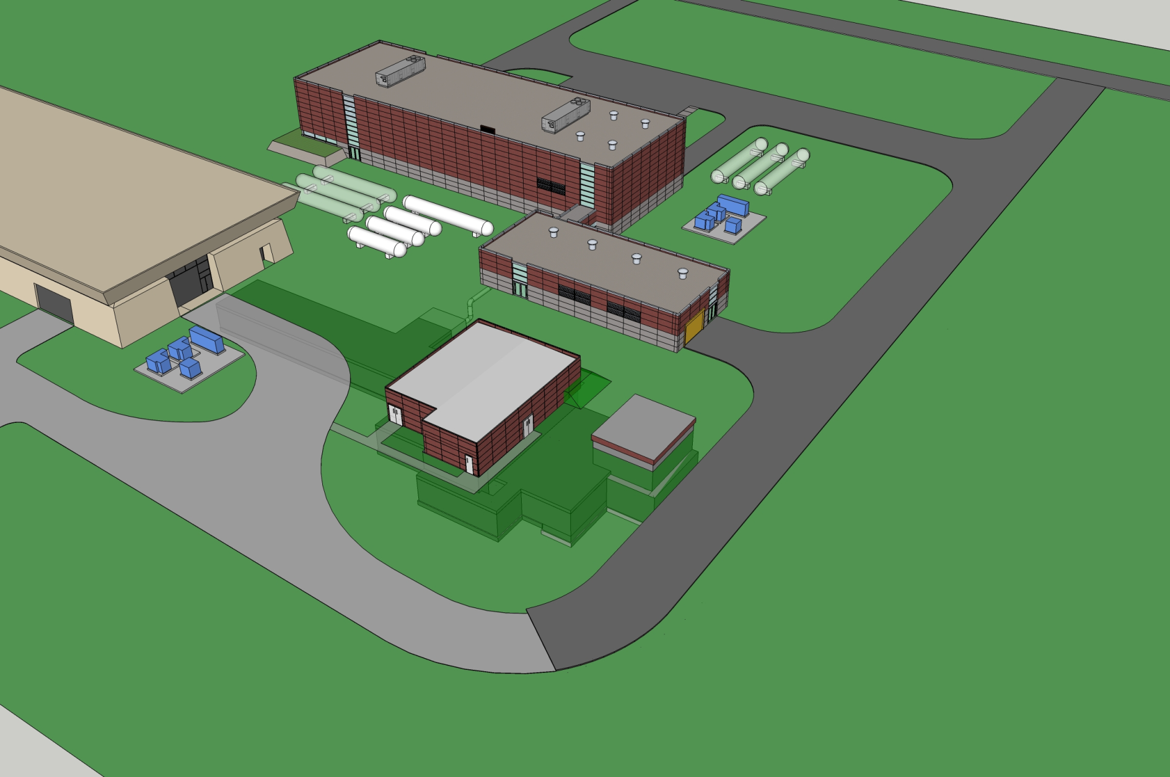
Future NML Complex

Slide 10
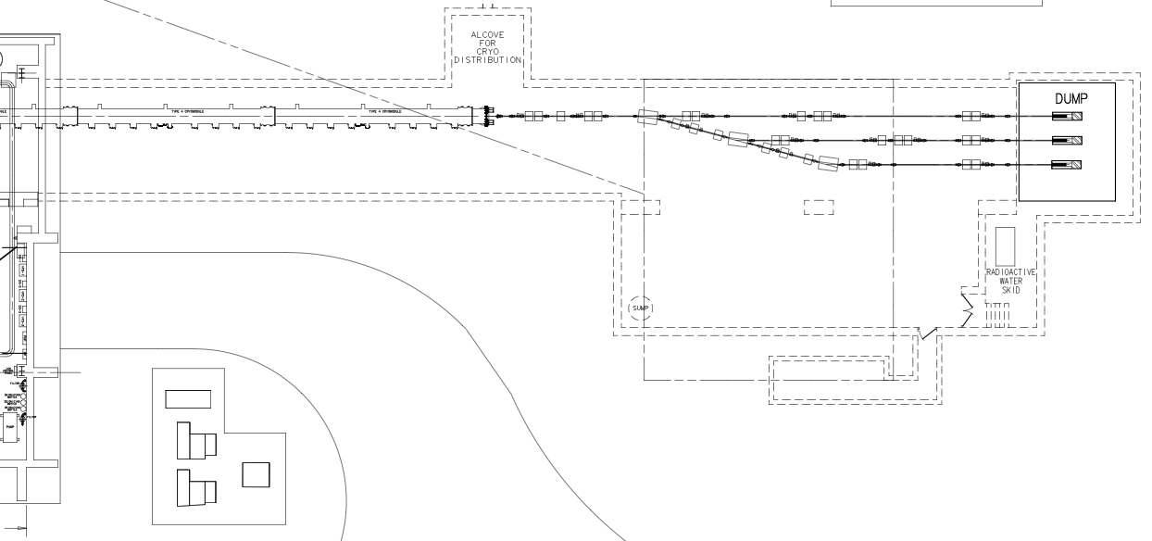
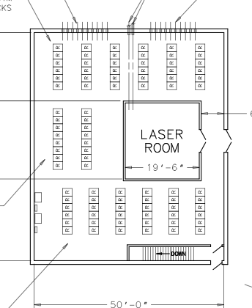
NML Expansion
Existing NML Building
Alcove for Cryoplant Tie-in
Test Beamlines/AARD Area
Beam Dump
CM5
CM6
Rack Room/Laser Lab
Construction Began 3/10

Slide 11
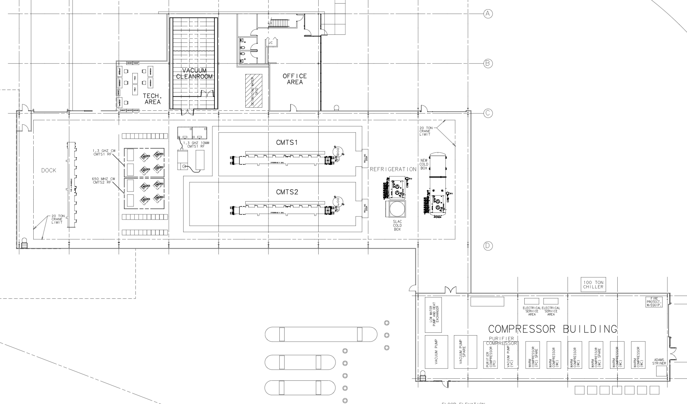
Cryomodule Test Facility (CMTF)
Vacuum Cleanroom &
Office Area
CMTF Building
RF Systems
(1.3 GHz, 650 MHz)
SLAC Refrigerator
ARRA Refrigerator
Compressor Building
Compressors
Vac. pump
LCW system
Air system
Test Stands
(1.3 GHz, 650MHz, Pulsed & CW)
- Construction Began 8/10

Slide 12
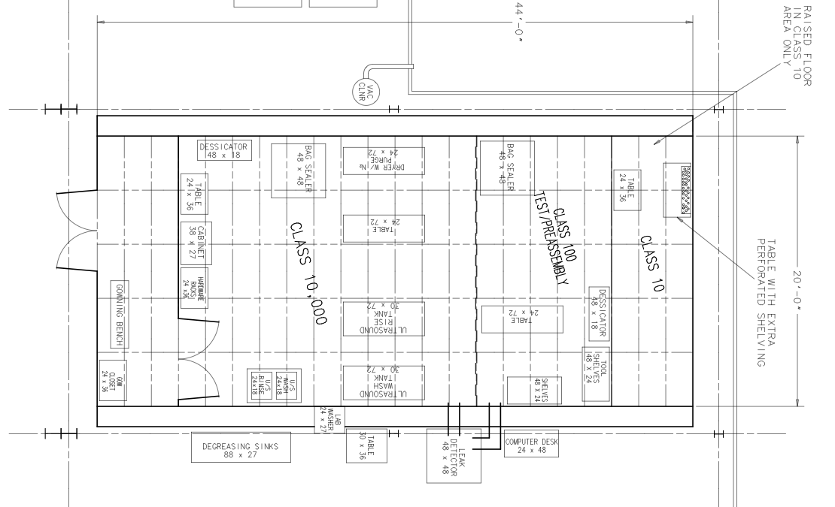
Vacuum Cleanroom

Slide 13
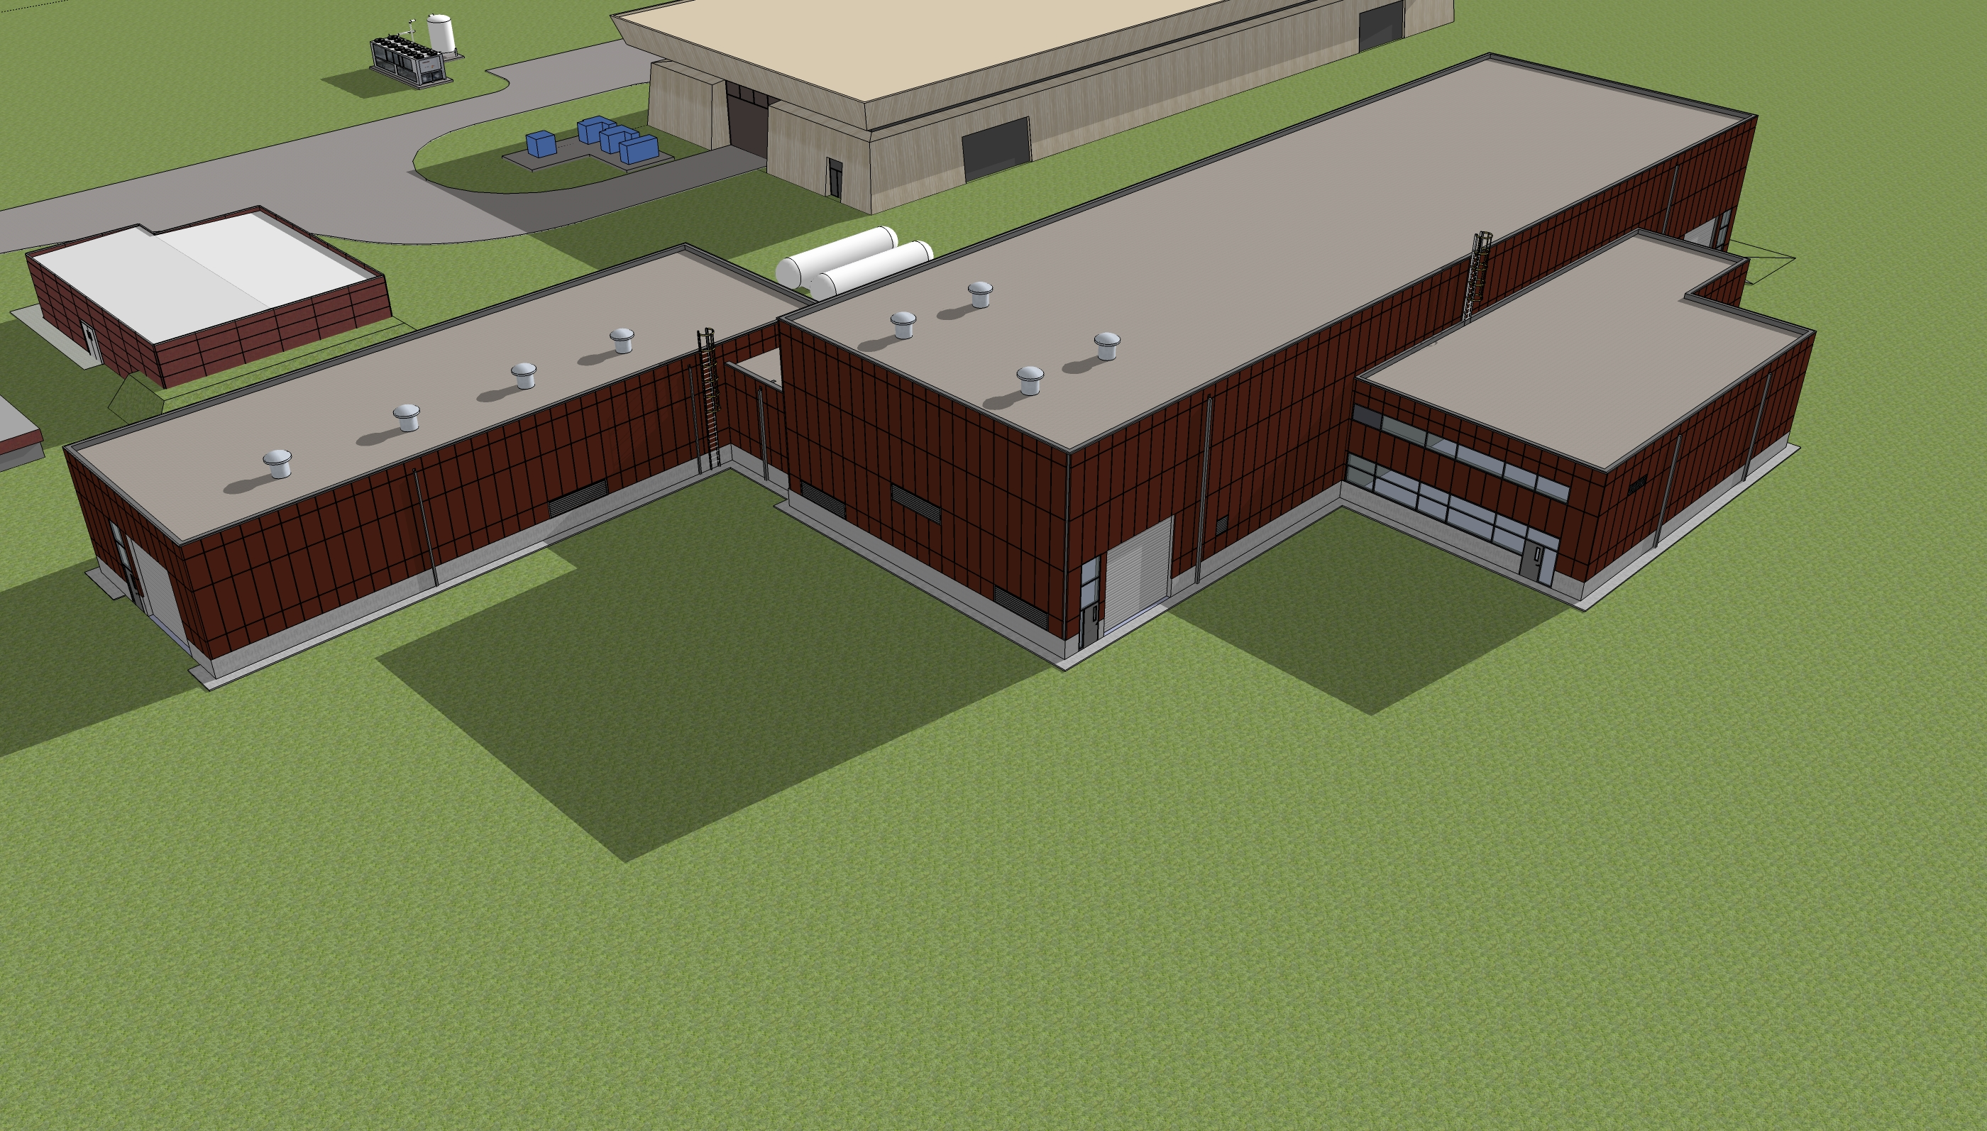
Future NML Complex

Slide 14
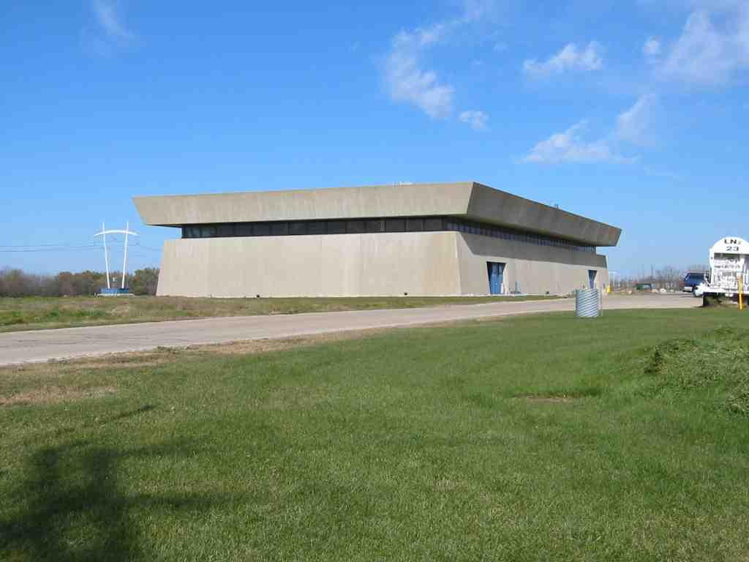
NML Technical Progress

Slide 15
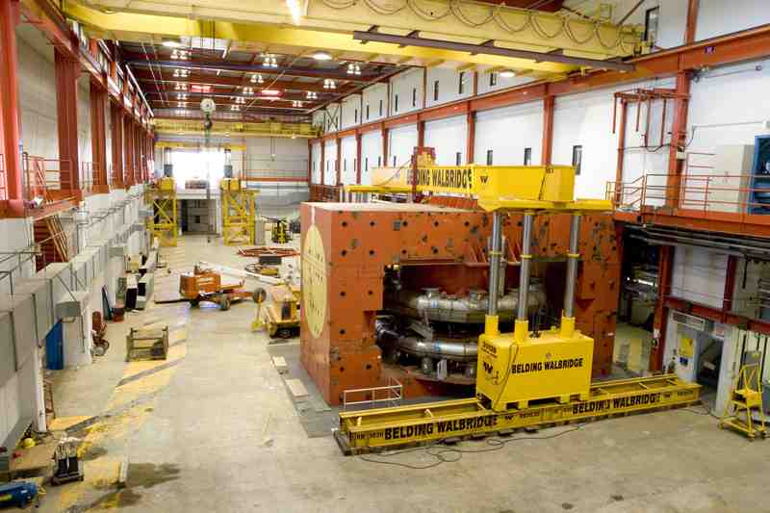
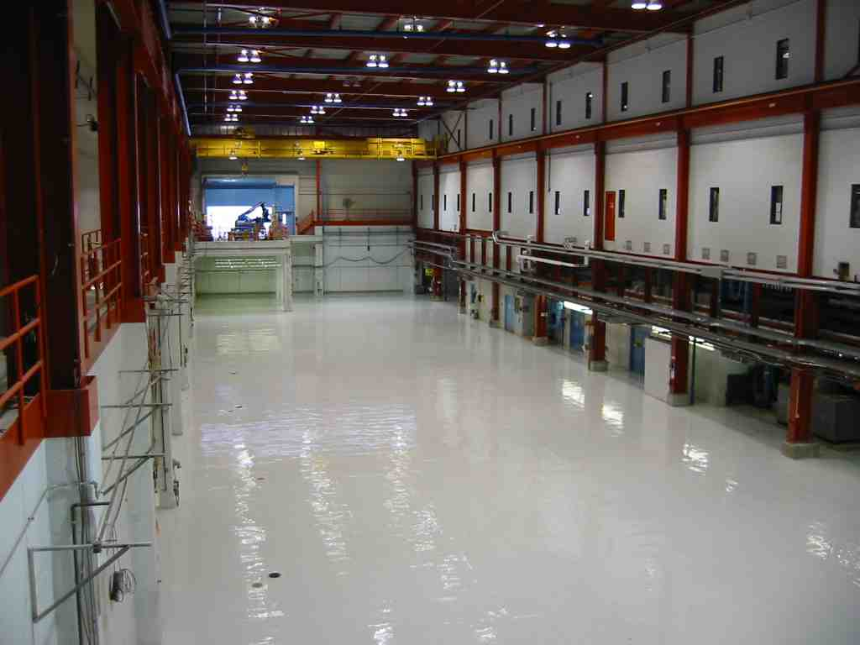
NML Infrastructure (FY07-08)
Completed Removal of Chicago Cyclotron Magnet
Prepared Building Infrastructure
  AC power, network cabling, piping, cable tray, air ducts
  Cleaned out building, epoxy coated floor, alignment network
  Cave for Phase-1 (~3/4 of full cave), electrical racks
  Reused existing equipment (tray, racks, piping, shield blocks, gas storage tanks, cryo heat exchangers & refrigerator components)
NML During Removal of Chicago Cyclotron Magnet(CCM) (September, 2006)
NML Facility after CCM Removal and Floor Painting (February, 2007)

Slide 16
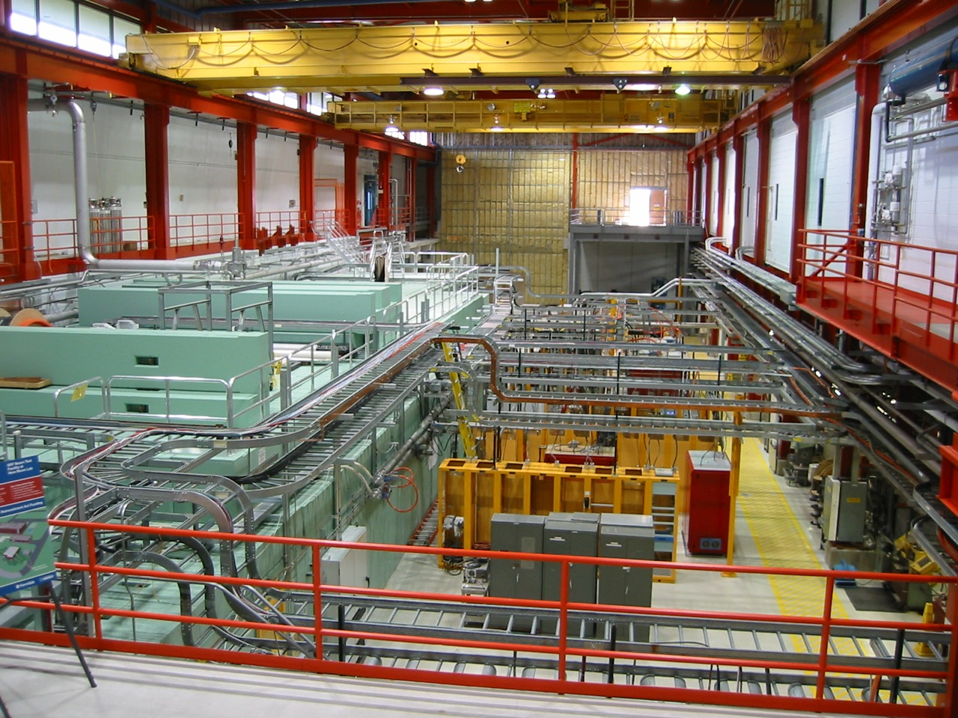
Recent Picture of NML Facility

Slide 17
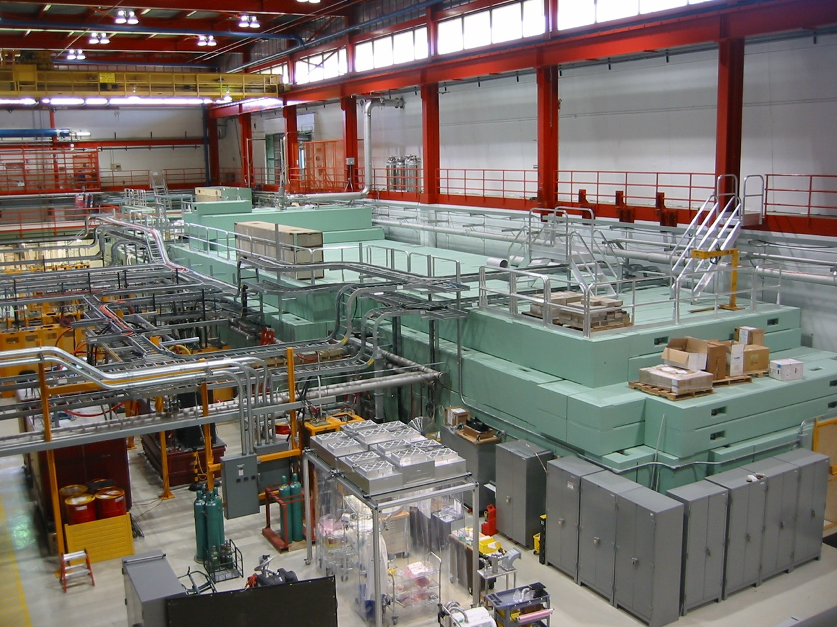
View From North

Slide 18
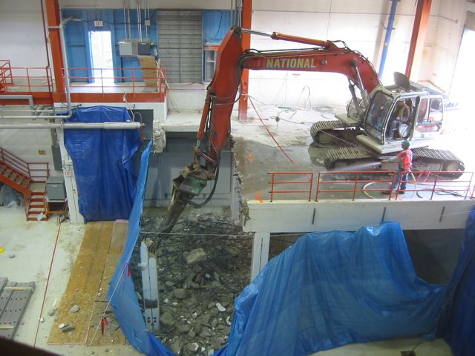
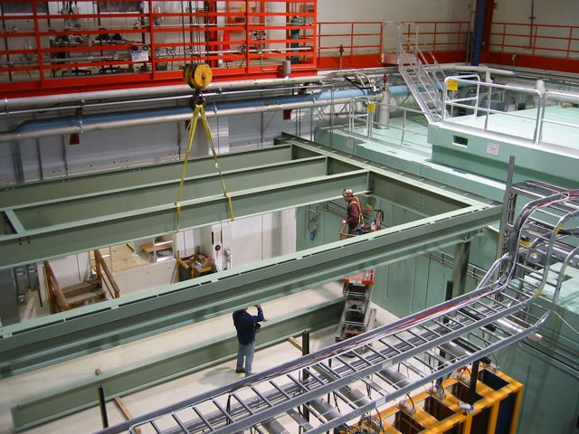
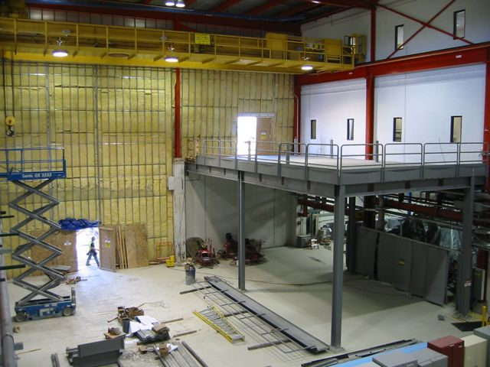
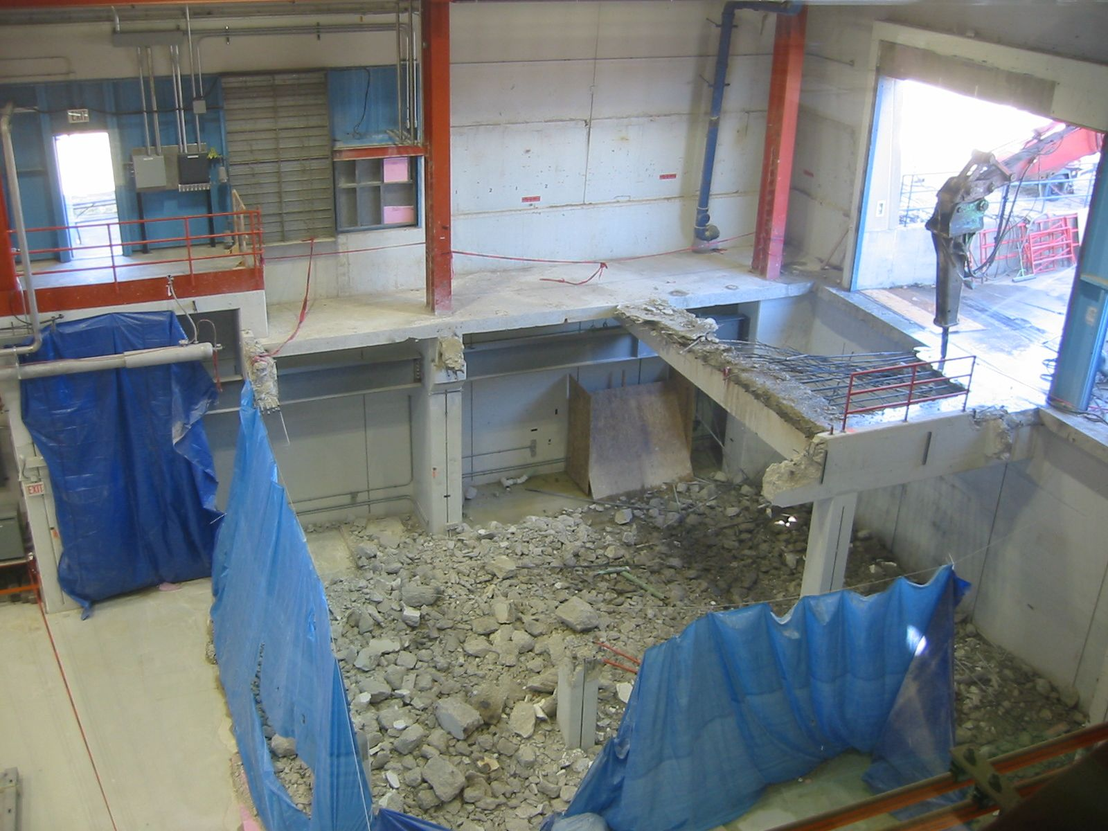
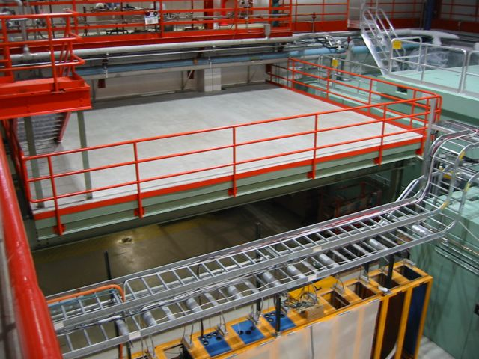
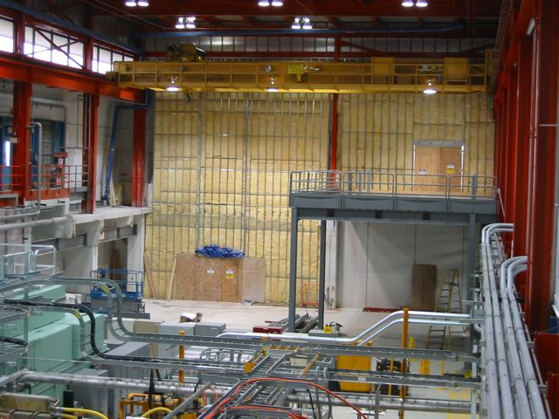
NML Expansion Construction
Loading Dock Demolition
Erection of Laser Deck
New Loading Dock

Slide 19
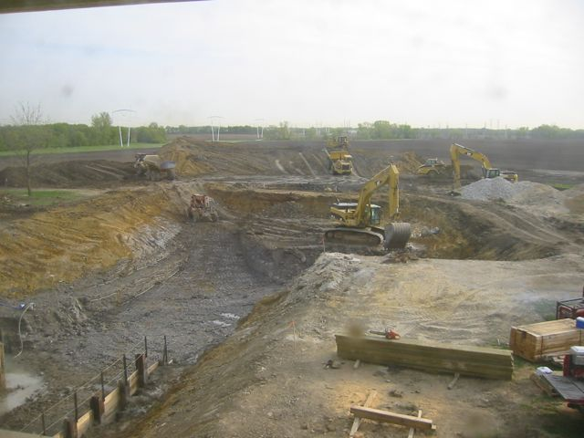
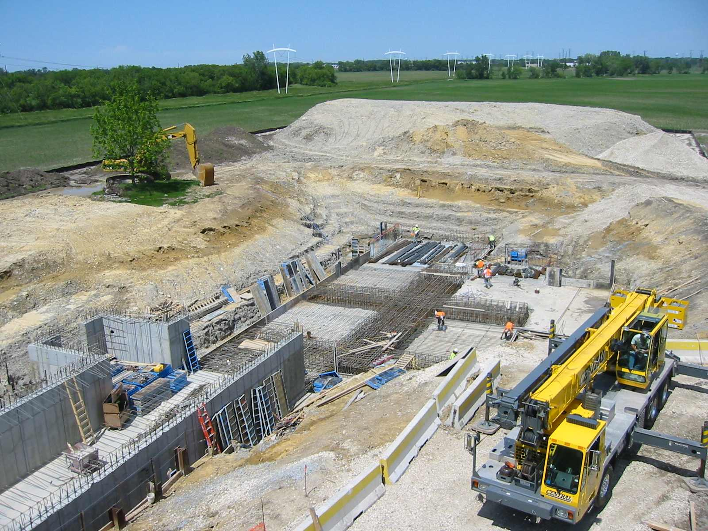
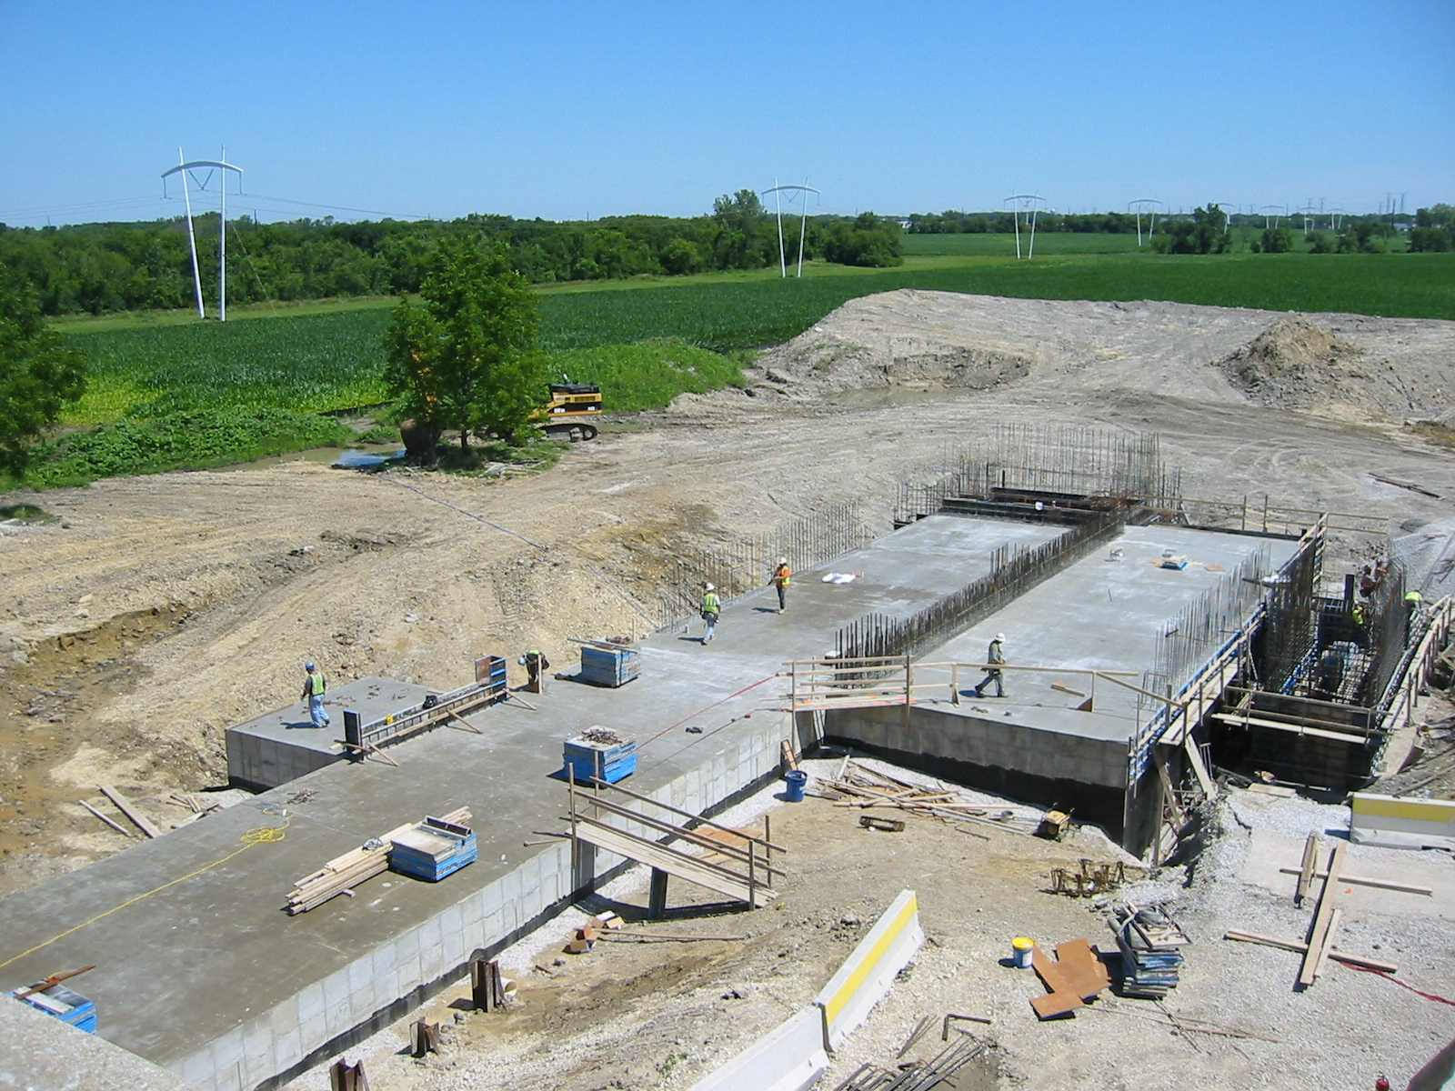
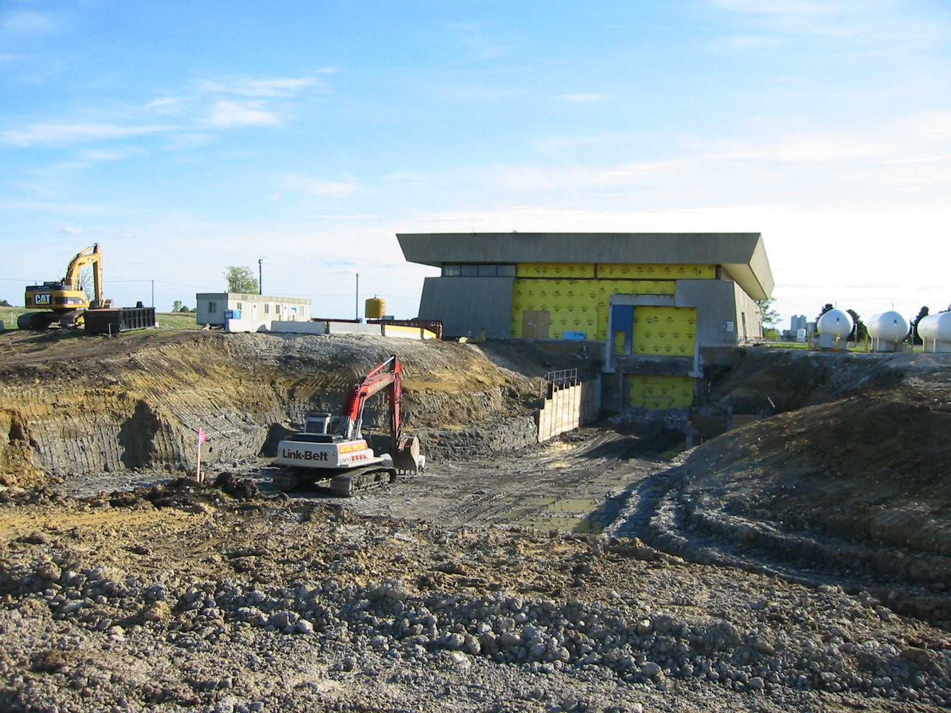
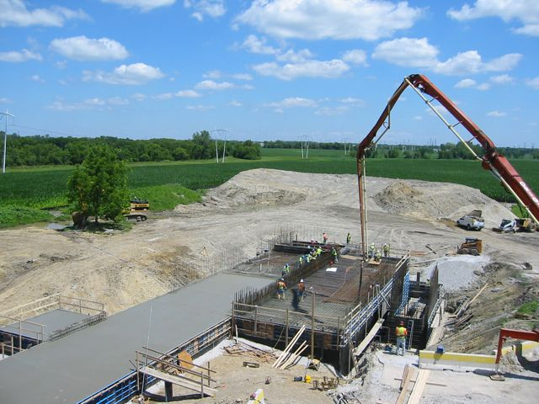
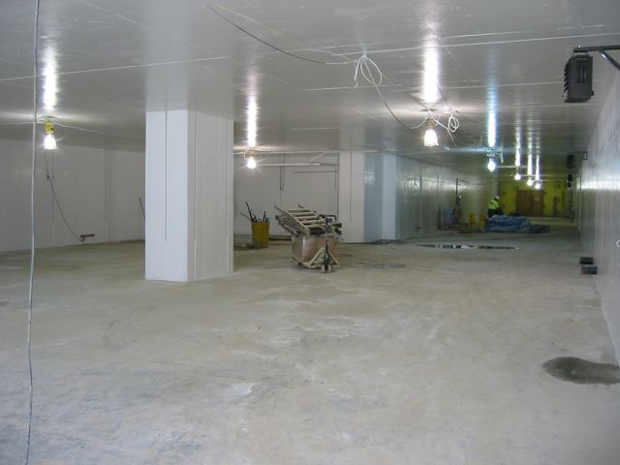
NML Expansion Construction
Digging Tunnel
Pouring Concrete
Finished Tunnel

Slide 20
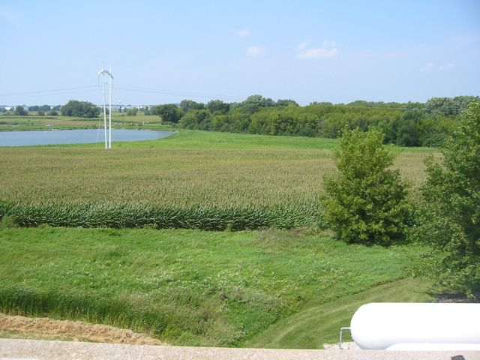
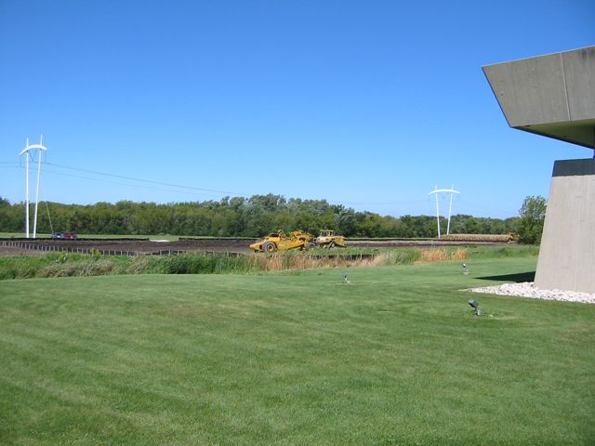
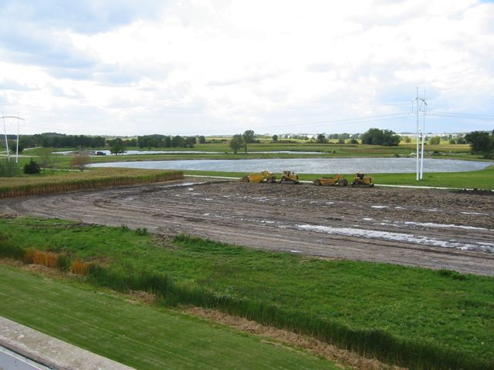
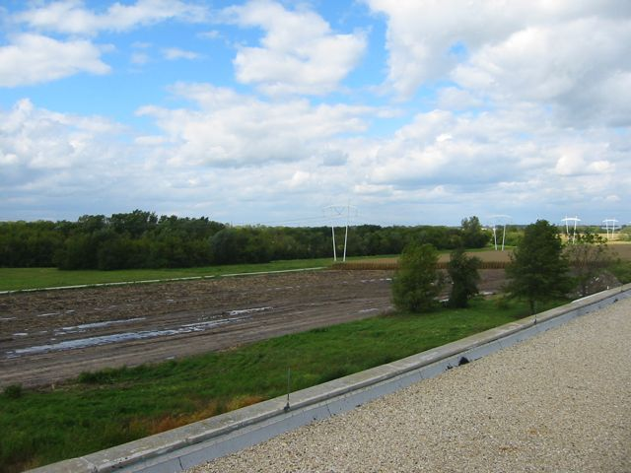
CMTF Construction

Slide 21
NML Cryogenic System
NML Cryogenic System Plan
  Start with two 625 W (4 K) Tevatron satellite Refrigerators and large vacuum pump ( ~ 60 W at 1.8 K)
  Move 1000 W (4 K) BABAR refrigerator from SLAC
  Add new 250 W (2 K) refrigerator
Status
  Installed Refrigerator room & helium storage tanks
  Tevatron Satellite Refrigerator #1 operational - 8/07
  Tevatron Satellite Refrigerator #2 operational – 4/10
  Distribution system - Feedbox, Feed Cap & End Cap installed
  Vacuum pump and Frick compressor
  Capture Cavity-2 (CC2) Cooled to 2K – 10/09
  Cryomodule-1 (CM1) Cool down to 2K – Fall 2010

Slide 22
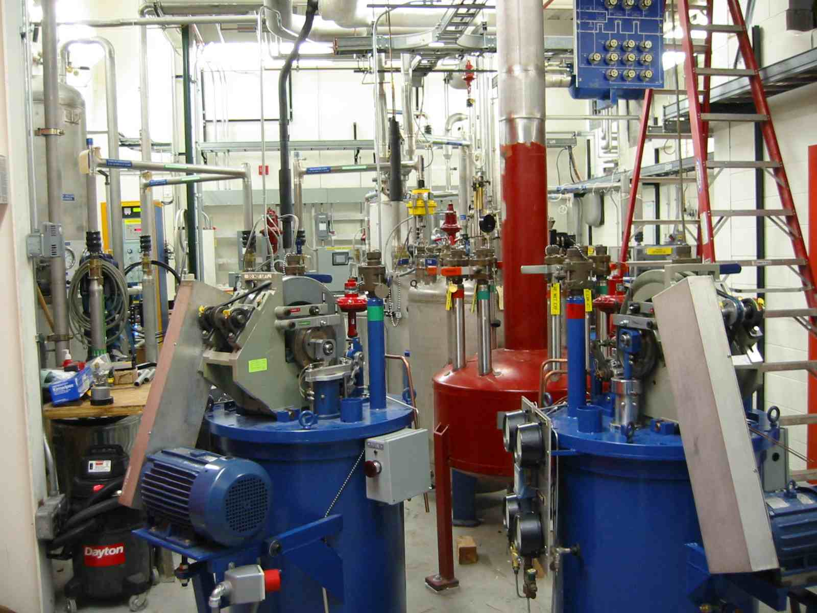
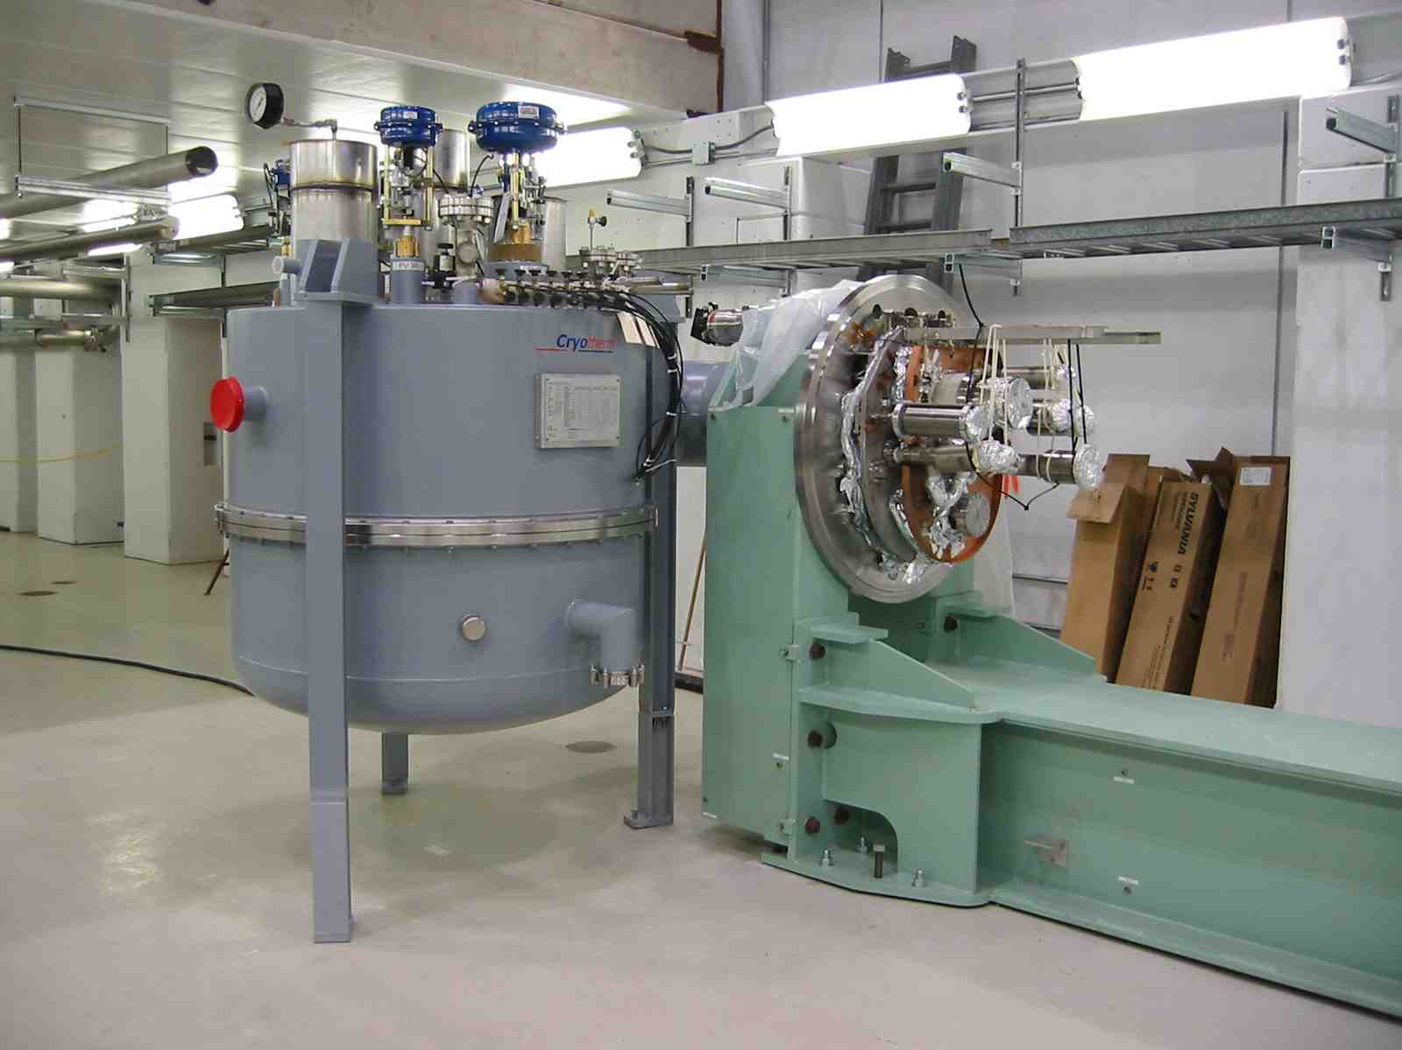
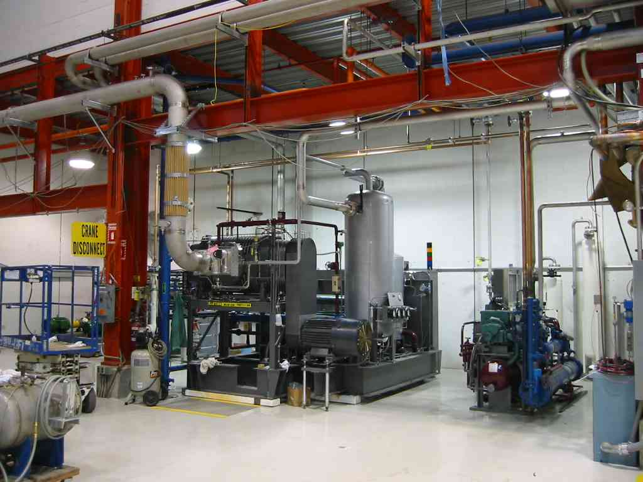
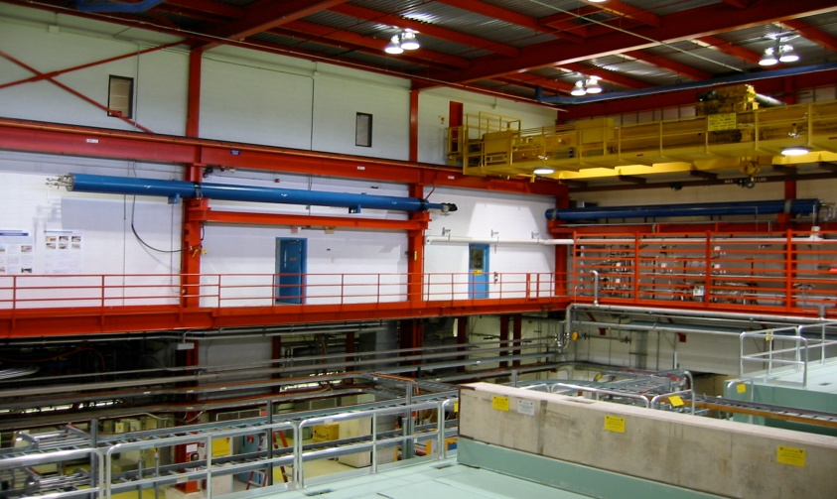
NML Cryogenic System
Refrigerator Room
Feedbox/Feedcap
Satellite Refrigerators
Cryo Vacuum Pump

Slide 23
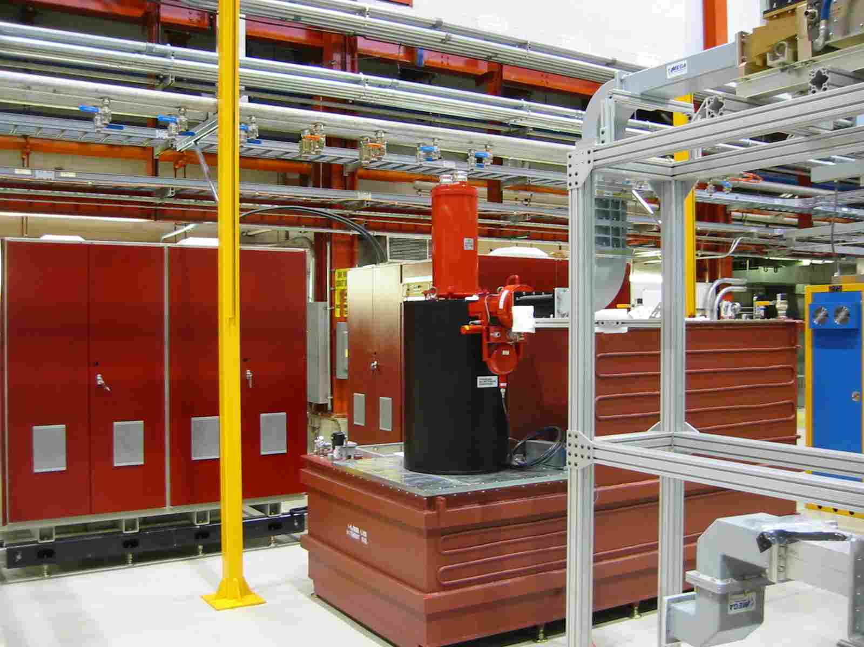
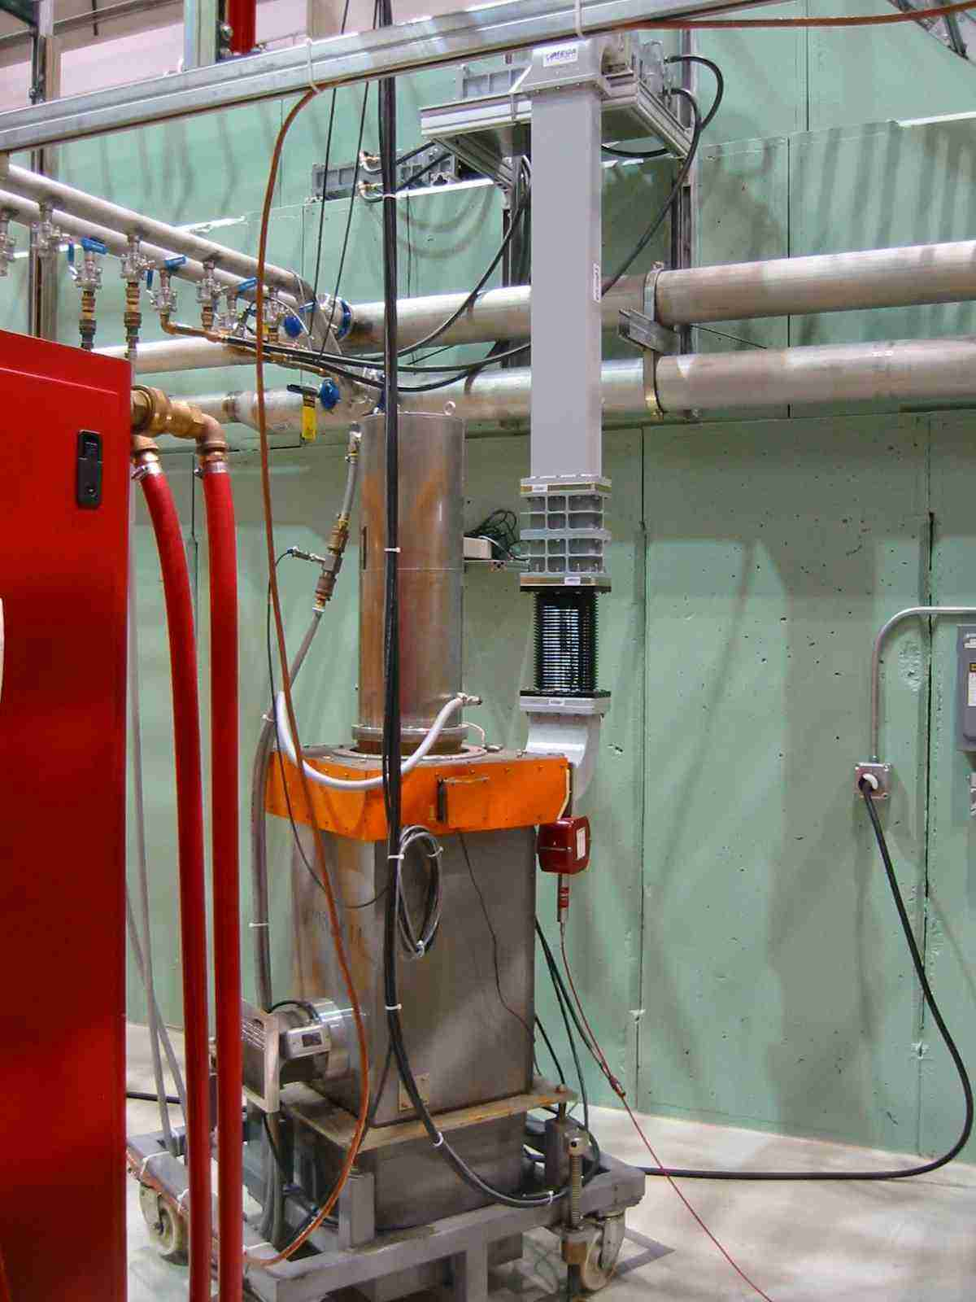
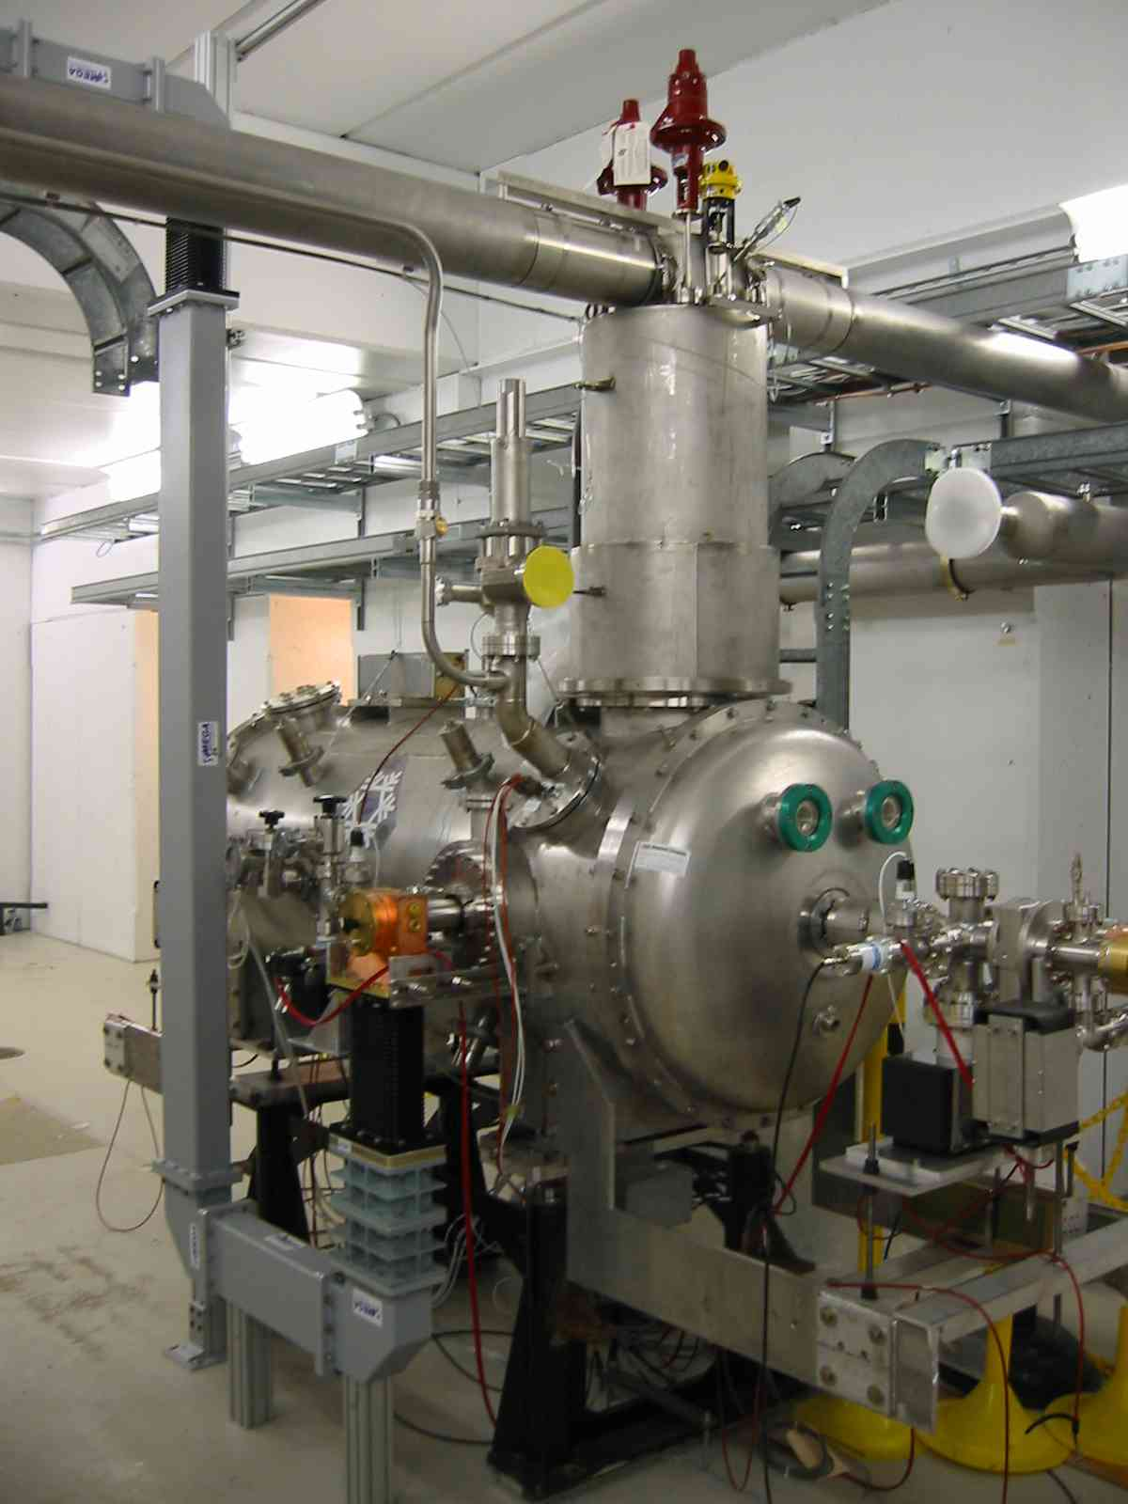
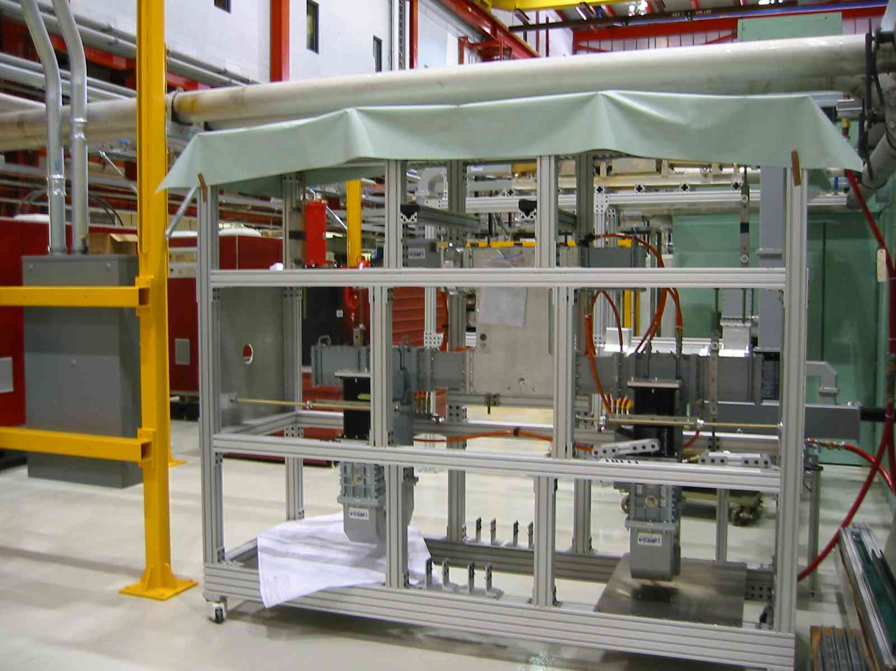
NML RF Systems
5 MW RF
Waveguide (SLAC)
300 KW RF
CC2 RF
RF System
  5 MW for CM1
    Fully Operational
  300 KW for CC2
    Fully Operational
  Distribution
    CM1 distribution from SLAC (in-house)

Slide 24
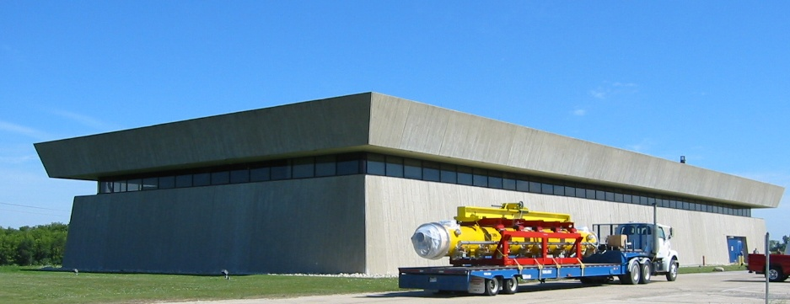
CM1 moving to NML

Slide 25
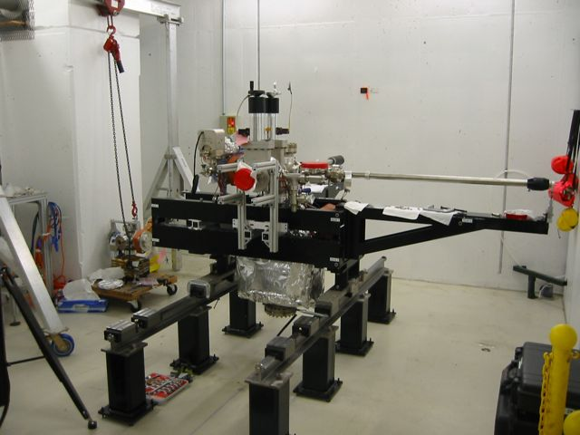
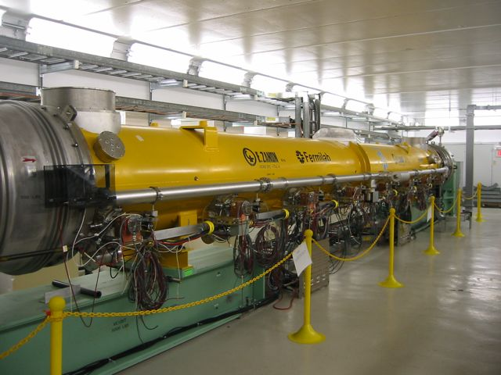
NML Accelerator
Injector
  Detailed Lattice designed
  New gun system being installed
    Collaboration with DESY, KEK & INFN
  CC2 (single 9-cell cavity) operational - 10/09
Accelerator
  CM1 installed, aligned, and under vacuum
  Cable pulls & cryo interconnects
Test Beamline
  Beamline layout complete
  Beam Absorber analysis complete

Slide 26
CC2 Operation At NML
Moved from MDB to NML – 2/09
Installation complete (vacuum, cryo., alignment) – 6/09
First warm RF powering – 6/09
Coupler conditioning complete – 7/09
CC2 operated at 2 Kelvin – 10/09
24 MV/m gradient (limited by Coupler PM Tube trips) – 2/10
  Similar to performance in MDB
Studies of Low Level RF system and tuner, microphonics and Lorentz Force Detuning Compensation

Slide 27
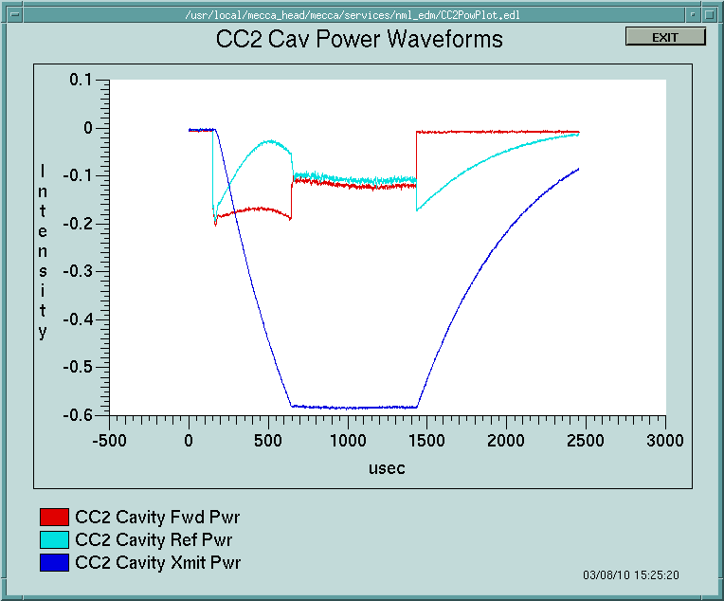
CC2 Operations at NML
Regulated operation
  LLRF feedback and feedforward enabled
  1.3 ms pulse width
  5 Hz
  20 MV/m
  Limitation is Coupler

Slide 28
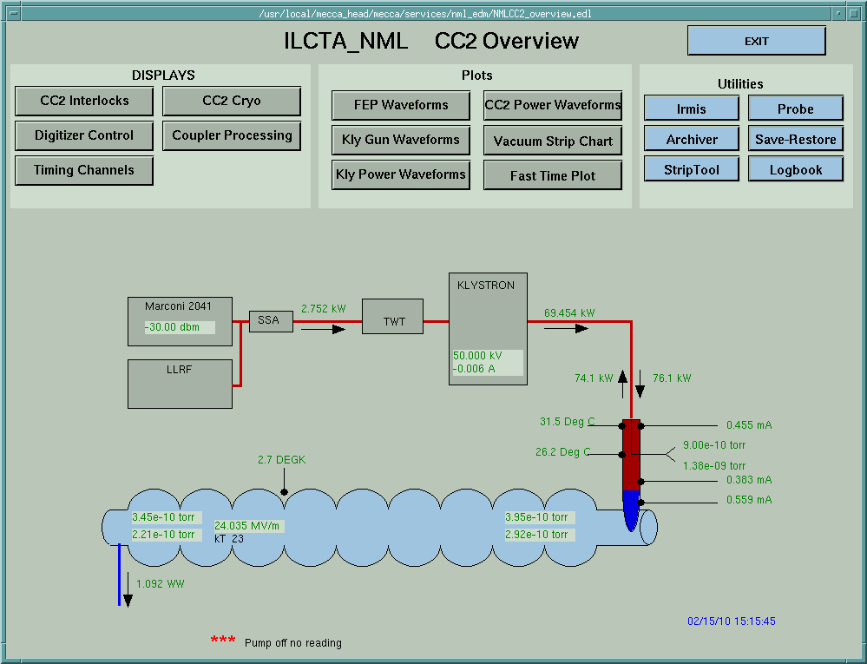
CC2 Performance at NML
Peak gradient - 24 MV/m
Limited by Coupler activity
Q_{L} = 2.92 X 10⁶
Similar performance as at MDB previously

Slide 29
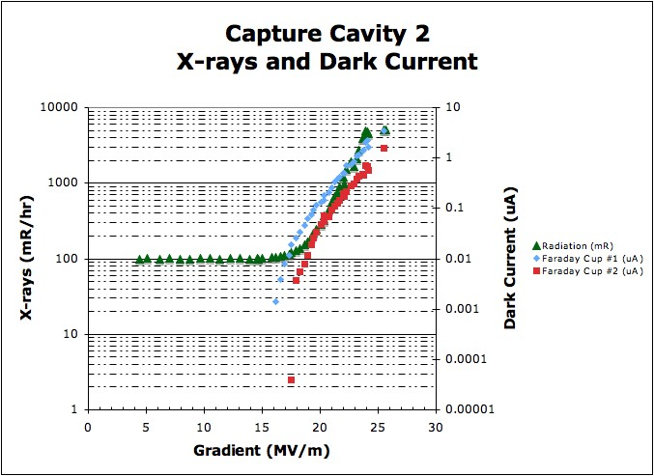
CC2 Performance at NML
Onset of field emission ~16 MV/m
Similar threshold for dark current
Largest amplitude at Coupler end

Slide 30

CM1 Testing
Our first goal is to understand the performance of cavities in CM1 compared to HTS tests at DESY
  We want to verify our assembly techniques in CAF
Note that the dressed cavities provided by DESY for CM1 are NOT 35 MV/M cavities
  We do not expect to meet the S1 goal of 31.5 MV/M
  Average of Chechia tests is 23.5 MV/M
  Anything close to this number will be a great success
It would be useful to understand what other tests might be useful for ILC with CM1

Slide 31
CM1 Test Plan
Virtually identical to DESY run plan for XFEL modules (courtesy of Dennis Kostin) and Fermilab experience at HTS and CC2
TEST PROCEDURE:
  1. RF Cable Calibration 
  2. Technical Interlock / Sensor checkout 
  3. RF source / Waveguides / LLRF 
  4. Warm Input RF Coupler Conditioning - in progress, 3/8 complete
  5. Cooldown to 2K
  6. Cavity Spectra measurements
  7. Cavity Tuners Test and Tuning
  8. Coupler Q_{load} measurement
  9. Set Cavities On Resonance
  10. Cold Input RF Coupler and Cavity Conditioning
  11. Module Performance Measurement
  12. Single Cavity Measurements
  13. Cryo system performance test (if needed).

Slide 32
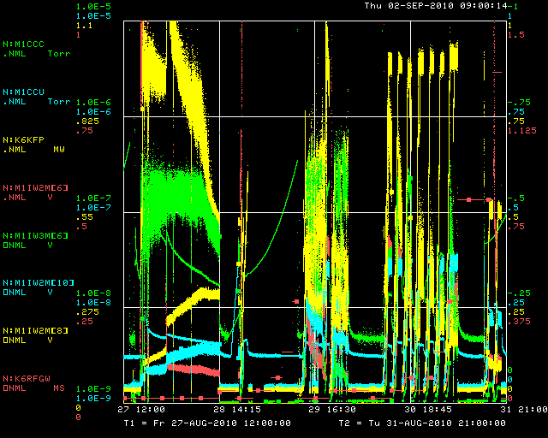
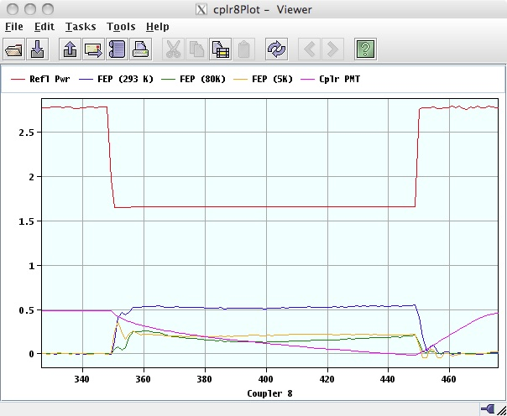
CM1 Test Plan
RF system is demonstrated good to ~3MW @ 2Hz, 1300 ms pulse
Warm coupler conditioning
  up to 1 MW for short (up to 400 us pulses)
  600 kW for 800, 1300 us pulses
  Using DESY results as the guide
Conditioning
Sequence
for #6
FEP, PMT
response
during #8
conditioning

Slide 33
NML Auxiliary Systems
• Vacuum System
  Low-particulate vacuum cart built and tested
    Leak detectors, RGA’s, pumps, gauges, controls
  (4) portable cleanrooms built (capable of achieving Class-10)
  CM1 cavity string, and coupler systems under vacuum (10⁻⁹ Torr)
Water Cooling System (LCW)
  System design complete
  New pumps and heat exchanger installed
  Temporary skid (for Phase-1) operational
Safety Systems
  Radiation, ODH, Interlock, and Safety Assessment documentation complete

Slide 34
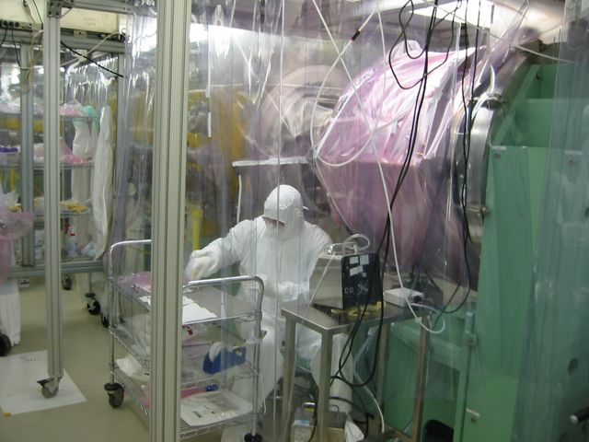
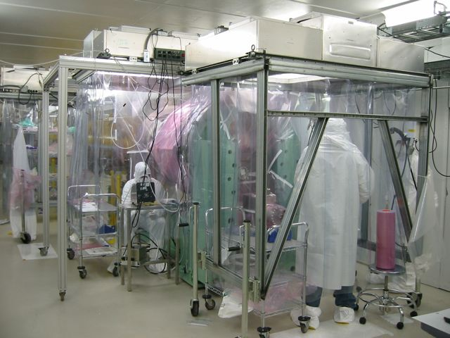




NML CM1 Vacuum Work

Slide 35




NML Auxiliary Systems
CC2 Installed
Cryomodule Interconnects
Vacuum Cart
Water System

Slide 36



NML Controls/Instrumentation
Before
After
Controls
  Control Room finished and operational
  Modified (upgraded) ACNET control system in use
Instrumentation
  Wire Position Monitors for CM1 tested and installed in Endcaps
  Faraday Cups assembled
  RF protection/interlock system complete
  Beamline Instrumentation prototypes being
  Testing at A0 Photo Injector

Slide 37
NML Schedule/Milestones
Phase-1 Cryogenic System Operational (August 2007)
Delivery of First Cryomodule to NML (August 2008)
Begin Civil Construction of NML Expansion (March 2010)
Warm RF Testing of First Cryomodule (July 2010)
Begin Construction of CMTF Building (August 2010)
First Cryomodule Ready for Cooldown (Fall 2010)
Cold RF Testing of First Cryomodule (Fall 2010)
Delivery of 2nd Cryomodule to NML (S1) (2011)
Install Injector & Test Beam Lines (2011)
First Beam (2012)
New Cryoplant Installation/Operation (2013-14)
RF unit test with beam (S2) (2014)

Slide 38
NML Budget
SRF (18.2) - FY10 $1,917k
Beamline/Facility Equipment (ARRA) $10,765k
  FY10-FY11 (~ 60% obligated)
Expansion Construction (ARRA GPP) $4,900k
  80% complete
CMTF Construction (ARRA GPP) $7,100k
  Began 8/10
Cryoplant Purchase (ARRA MIE) $9,348k
  Place Order 9/10
RF Equipment for CMTF (ARRA) $2,910k
  (~ 70% Obligated)
Total $36,940k

Slide 39
Integrated SRF Plan (Cryomodules)
Page 39

