Slide 1
SCRF Monthly WebEx Meeting
Sept. 22, 2010
Agenda
Report from PMs (15 min.)
  BAW-1 report and proposal for TLCC
  Preparation for the industrialization
  Interim report
General Report from GLs (15 min.)
Special Discussions (30 min.)
  Comments from P. G
  ILC-CLIC Workshop Agenda

Slide 2
General Schedule related to SCRF
Sept. 8-10: BAW-1 (completed)
Oct. 18 – 22: IWLC-2010 at CERN
Oct. 20: Next SCRF WebEx during IWLC
            S1-Global Interim report and further plan
Oct. 31: Due date for Interium Report Draft
Nov. 11-12: ILC-PAC at Oregon
Jan. 18 – 21: BAW-2, SLAC
Jan. 31 - : (TTC)

Slide 3
ILC-BAW1
Summary and Recommendations
Akira Yamamoto, Marc Ross and
Nick Walker
GDE Project Managers
Reported at BAW1, held at KEK, Sept. 10, 2010

Slide 4
Baseline Assessment WorkShops
Baseline Assessment Workshops
  Face to face meetings
  Open to all stakeholders
  Plenary
 | When | Where | What
WAB 1 | Sept. 7-10, 2010 | KEK | Accelerating Gradient Single Tunnel (HLRF)
WAB 2 | Jan 18-21, 2011 | SLAC | Reduced RF power e+ source location

Slide 5
Subjects discussed in Sessions
Date | Main Theme | Tasks
Sept. 7 | Introduction HLRF-KCS: Design and R&D RDR-backup: Technical | Make the workshop tasks clear Process for the reality including cost Feasibility as a backup solution
Sept. 8 | DRFS: Design and R&D LLRF/Control Discussions | Process for the reality including cost R&F operation margin for cavity/accelerator Recommendation
Sept. 9 | Cavity Gradient: R&D Discussions | Strategy for cavity gradient improvement Short-term and long-term strategy to be clear
Sept. 10 | ML Accelerator Gradient Discussions | Accelerator gradient including spread, Appropriate balance of gradient in cavity/cryomodule/accelerator, and Adequate margin in accelerator operation Recommendation

Slide 6
Time-Table / Agenda (Sept. 7) updated: August 27
Day | Am/pm | Subject | Chair/presenter
9/7 |  | Single Tunnel ML Design and HLRF -1 | S. Fukuda / C. Nantista
 | 9:0 0 90 min | Opening and Introduction Opening address Report from AAP BAW1 objectives and goals | Chair: S. Yamaguchi A. Suzuki (KEK-DG) E. Elsen A. Yamamoto (GDE-PM)
 | 10:45 90 min | Single tunnel CF design and HLRF design Single tunnel CF design status (1 hour) General HLRF design in SB2009 (30 min) | Chair: T. Shidara - A. Enomoto S. Fukuda
 | 13:30 120 min | HLRF KCS KCS design and R&D status (45 min) Demonstration of feasibility (45 min) | Chair: S. Fukuda C. Nantista C. Adolphsen
 | 15:45 105 min | HLRF – EU XFEL and RDR - Introduction (20 min) Experience from XFEL (1 hour) RDR configuration (as backup) (10 min) Discussion (15 min) | Chair: N. Walker M. Ross W. Bialowons S. Fukuda ALL

Slide 7
Time-Table / Agenda (Sept. 8)
Day | Am/pm | Subject | Convener/presenter
9/8 |  | Single Tunnel ML Design and HLRF -2 | S. Fukuda / C. Nantista
 | 9:00 | DRFS DRFS design and R&D status Installation strategy (1 hour total) | Chair: C. Nantista S. Fukuda S. Fukuda
 | 10:45 | HLRF and LLRF LLRF requirements/issues for KCS 30 LLRF requirements/issues for DRFS 30 Requirements from Beam Dynamics 30 | Chair: T. Shidara C. Adolphsen S. Michizono K. Kubo
 | 13:30 | Operational consideration Sorting cavities in relation with HLRF 30 Gradient and RF Power Overhead 30 | Chair: C. Adolphsen S. Noguchi J. Cawardine
 | 15:45 | Discussions and Recommendations General discussions and questions Summary and recommendations | Chair: A. Yamamoto TBD ALL

Slide 8
Time-Table / Agenda (Sept. 9)
Day | Am/pm | Subject | Convener/presenter
9/9 |  | Cavity: Gradient R&D and ML Cavity Gradient | R. Geng/A. Yamamoto
 | 9:00 | Introduction and Current Status Technical address for the 2nd part of WS Overview from RDR to R&D Plan 5 Progress of cavity gradient data-base/yield | Chair: M. Ross A. Yamamoto R. Geng C. Ginsburg
 | 10:45 | R&D Status and further R&D specification Fabrication, testing, & acceptance for XFEL/HG R&D expected in cooperation w/ vendors R&D w/ a pilot plant w/ vendor participation | Chair: K. Yokoya - E. Elsen M. Champion H. Hayano
 | 13:30 | Short-tem R&D and Specification Field emission and R&D strategy Gradient, Spread, Q0, Radiation: R&D specification, standardization | Chair: C. Pagani H. Hayano R. Geng
 | 15:45 | Long-term R&D ACD subjects and goals Seamless/hydro-forming, Large Grain, Cavity shape variation, VEP, Thin Film, Further R&D toward TEV/ML Discussions for Cavity R&D and Recommendations | Chair: A. Yamamoto - R. Rongli to lead discussions

Slide 9
Time-Table / Agenda (Sept. 10)
Day | Am/pm | Subject | Convener/presenter
9/10 |  | ILC accelerator gradient and operational margin | A. Yamamoto and J. Kerby
 | 9:00 | Gradients from VTS to Operation Introduction: Overview on ILC gradient specification at each testing / operation step Terminology definition Operational results from VT/HTS/CM tests in data base Operational results from STF VT/CM tests at KEK | Chair: H. Hayano - A. Yamamoto - M. Ross - C. Ginsburg - E. Kako
 | 10:30 | Operational margin Lorentz Force Detuning and Effects on op. margin Comments from LLRF and Beam Dynamics Comments onAcceerator Operation gradient margin | Chair: N. Toge E. Kako (K. Kubo/C. Michizono) N. Walker
 | 13:30 | Cost Impacts Reminder on cost effects List of systems / technical components affected by gradient specification change A plan to prepare for communication w/ industries | Chair: N. Walker P. Garbincius J. Kerby A. Yamamoto
 | 15:15 | General Discussion and recommendation General discussions Summary and recommendations | Chair: A. Yamamoto All
 | 17:00 | End

Slide 10
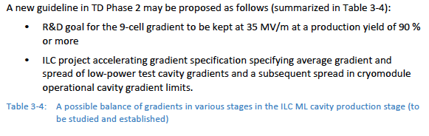
A possible balance in
ILC ML Accelerator Cavity Specification
Single 9-cell cavity gradient | String Cavity gradient in cryomodule w/o beam | String cryomodule gradient in accelerator with beam
35 MV/m, on average w/ spread above a threshold | 34 MV/m, on average (or to be further optimized) | 31.5 MV/m, on average (or to be further optimized)

Slide 11
Summary and Proposal for
Top Change Control Panel
HLRF/LLRF design with Single Tunnel layout
ML Accelerator Gradient

Slide 12
HLRF/LLRF Design with Single Tunnel
The main proposal is to go to a single tunnel solution for the Main Linac technical systems remains essential that outlined in the SB2009 report, and is based on the adoption of two novel schemes, requiring RD, for the HLRF in the single tunnel:
  KCS: preferred solutions for ‘flat land’ sites
  DRFS: preferred solutions for mountainous region
Two backup scenarios are proposed for supporting RDR-like HLRF solutions in a single-tunnel
  10MW MBK + (Marx) Modulator in the tunnel
  XFEL-like solution with modulators (low-voltage) accessible in cryo refrigeration builds/caverns, with long pulsed cables feeding 10MW MBKs, via a pulse transformer, in the tunnel.
Both are considered technically feasible, and no R&D program is proposed.
We propose to phase out one of these RDR-like options within the next six-months, in order to reduce the number of scenarios to be developed.

Slide 13
Accelerator Gradient
Common understanding and Recommendation
Observation
  Challenging operational margin in accelerator operation to be reliable enough for sufficient availability for physics run.
Our Strategy Proposed
  Provide two major guidelines
    R&D milestone: 35 MV/m with 90 % yield (eq. > 38 MV/m on average) , including 2nd pass,
    ILC ML Cavity specification: 35 MV/m on average with spread,
  Make our best effort with forward looking position to realize the accelerator operational gradient to be 31.5 MV/m, on average with reasonable gradient spread (< ~ +/-20 %). We require an additional HLRF power of 10 %.
  Keep cost containment concept, and prepare for the industrialization including cost and quality control.
  Ask physics/detector groups to share our observation and forward looking strategy

Slide 14
ILC-ML SCRF Cavity Gradient Specifications proposed, based on R&D Efforts and Goals
Cost-relevant design parameter(s) for TDR | ML cavity gradient Specification | Cavity R&D goal | Relevant R&D Programme
9-cell Cavity Gradient in vertical test | 35 MV/m, average - Spread: 28 – 42 MV/m (+/- 20 % or less) | 35 MV/m at 90 % yield including 2nd pass, (eq. ≥ 38 MV/m, average) | S0
Cryomodule Operational Gradient | 34 MV/m, average | 34 MV/m, average CM Obs. G. Limit = 3 % + ** | S1
ML Operational Gradient | 31.5 MV/m avg - Spread: 25 – 38 MV/m (+/- 20 % or less: TBD) | 31.5 MV/m, average Op. G lim = 1.5 MV/m** Cntrl margin = 3 %** | S2 (S1*)
Required RF power overhead for control | 10 % to be reserved in operation at 38 MV/m |  | S2 (S1*)
** as milestone for R&D

Slide 15
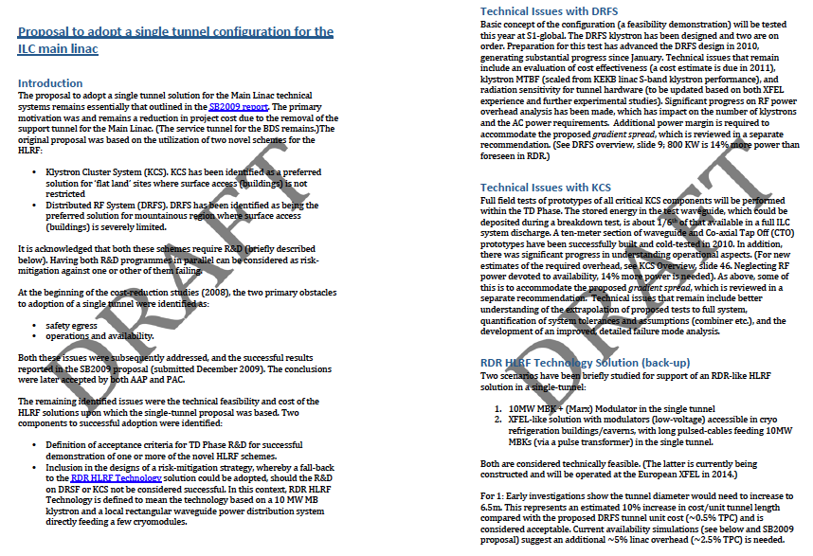
Proposal to adopt a single tunnel configuration for the ILC-ML

Slide 16
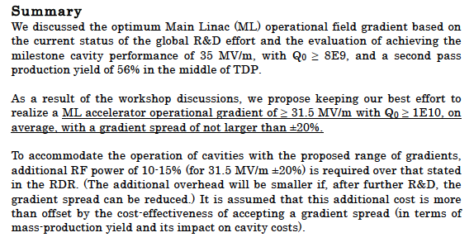
ML Accelerator Gradient
Summary of Discussions and Proposal

Slide 17
Preparation for IWLC at CERN
Discussions on
  Cavity Industrialization

Slide 18
Global Plan for SCRF R&D
Year | 07 | 2008 |  | 2009 |  | 2010 |  | 2011 | 2012
Phase | TDP-1 |  |  |  |  |  | TDP-2
Cavity Gradient in v. test to reach 35 MV/m | → Yield 50% |  |  |  |  |  | → Yield 90%
Cavity-string to reach 31.5 MV/m, with one-cryomodule |  | Global effort for string assembly and test (DESY, FNAL, INFN, KEK)
System Test with beam acceleration |  |  | FLASH (DESY) , NML (FNAL) STF2 (KEK, test start in 2013)
Preparation for Industrialization |  |  |  |  | Production Technology R&D
Communication with industry: | 2009: 1st step: Visit Venders (2009) 2010: 2nd step: Organize Workshop (2010) ~ 2011: (Plan) 3rd step: Issue specification & receive response

Slide 19
Two approaches proposed for Communication with Industry
A standard approach
  Prepare for preliminary specifications including
    design parameters, plug-compatible interfaces, process of the fabrication : (process specification: not built-print, and not functional specification).
  Send the specification to possible vender and
    Receive their response without commercial contract
      Within standard process for call-for-tenders
Alternate approach
  Prepare for specific specification for the industrial models in details
  Make contract to study the models to
    receive best cost effective way of manufacturing including factory layout and working models ,

Slide 20
Plan to prepare for Further Communications/Interactions with Industry, under discussion
Period | Action Items | purpose
Oct. 20 or 21 | Discuss ‘cavity and CM specification’ during the CERN meeting (IWLC-2010) | Prepare for specification and industrialization model
Oct. 25-26(am) | Learn E-XFEL cavity specification with visiting DESY | Prepare for specification and industrialization model
TBD | Learn E-XFEL cryomodule assembly specification in communication with CEA-Saclay (/DESY/INFN) | Prepare for specification and industrialization model
Nov. 11-12 | Present our preparation plan for industrialization | Get a review by PAC.
Jan. | Distribute ‘specification’ to possible venders | Explain common specification
April/May | Receive 1st responses from venders | (no contract)
June ? | Receive | (with contract with limited companies)
~ Dec. | Prepare for cost-estimate update for TDR

Slide 21
Interim Report
First meeting editing team today
  Tech. Editor Board (TEB) + communicators
  TEB: Elsen, Harrison, Ross, Walker, Yamamoto, Yokoya
Outline agreed upon
  approximate page counts
  principle authors
Principle TEB contacts for sections identified
Workflow discussed (needs refinement)
Milestones agreed-upon (next slide)
Next steps
  Iterate authoring guidelines with communicators
  send email to principle authors
  Set-up ILC-EMS workspace

Slide 22
Schedule
5.11.10 First drafts from authors
17.12.10 Editing cycle complete
28.01.11 FINAL DRAFT Available
25.02.11 FINAL REPORT finished
EC sign-off; send to printer
19.03.11 ALCPG – PUBLISH!
6 weeks
4 working weeks
4 weeks
3 weeks
Notes:
Producing document layout etc. How long?

Slide 23
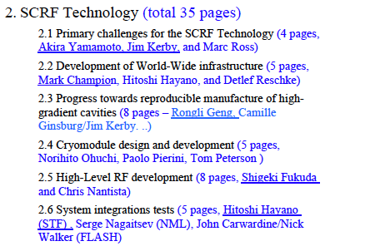
SCRF Technology: Anticipated Subsection Authors/Contributors
Individual communication is to be made soon

Slide 24
TDP: Interim Report

Slide 25
Reports from Group Leaders
Cavity R&D : R. Geng
Cavity Integration: H. Hayano
Cryomodule: N. Ohuchi
Cryogenics: T. Peterson
HLRF: S. Fukuda and C. Nantista
ML Integration: C. Adolphsen

Slide 26
Special Discussions
Update cost estimating information
  P. Garbincius
International Workshop on Linear Collider (IWLC-2010), SCRF Parallel Session Agenda
  H. Hayano, C. Pagani, and C. Adolphsen

Slide 27
cost info needed for BAW-1 proposals & BAW-2 please give complete info, not just incremental bits!
CFS: specify diameter of tunnel KCS and for XFEL-like => klystron in tunnel w/ modulator in accessible location
PMs: 1% or 10% RF overheads for cavity gradient spread? includes both HLRF & LLRF. Energy margin for reliability?
Shigeki: latest estimate of unit costs (& quantities) for DRFS – scaling of cost of klystron & modulator w Power? P^{α}
Chris & Chris: latest estimate of unit costs (& quantities) for Klystron Cluster pipe & CTOs. Cost of wave-guide valves. How does cost of klystron scale with power? P^{α}
Carwardine: how does cost of LLRF scale with power? P^{α}
Susanna: complete tech spreadsheets for 3.2 km DR for full power, low power, 10 Hz (twice duty factor – RF impact)
PHG: do 10 MW modulators work for e- Source at 10 Hz?

Slide 28
IWLC-2010 General Plan and Subjects to be discussed
 | Oct. 18 | 19 | 20-SCRF | 21-SCRF | 22
8:30 – 10:00 |  | Plenary | Industrialization (specification) | Long-term R&D | Acc. Plenary WG summary
10:30 – 12:30 |  | Plenary | Industrialization (process/model) | Long-term R&D | Acc. Plenary WG Summary
14:00 – 15:30 | Plenary | Acc. Plenary | S1-Global (interim rep.) | Cavity fundamental (breakdown, radiation … ) | Plenary
16:00 – 18:00 | Plenary | Acc. Plenary | S1-Global or Joint session w/ CFS | Linac instr. or Joint session w/ NC Linac tech. | Plenary
Main Issues: 1) SB2009 to Top Level Change Control: Single tunneling
2) S1-Global: Interim review and further plan
3) Preparation for PAC, November: preparation for industrialization

Slide 29
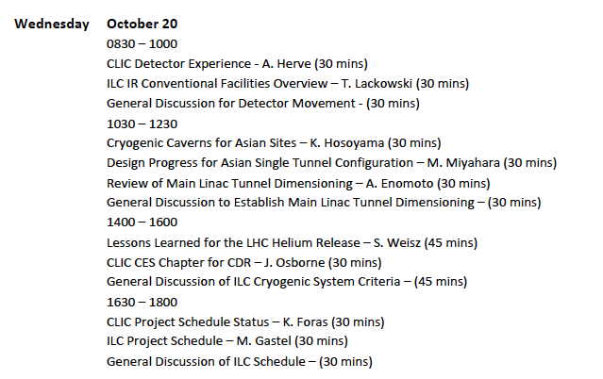
Seek for a joint session with CFS
Discussion required: ML tunneling dimensioning

