Slide 1
Investigation of large grain cavity surfaces
M. Ge¹, G. Wu¹, P. Kneisel², K. Zhao³
^{1.} Fermilab ^{2.} Jefferson Lab ^{3.} Peking University
Replicas of cavity RF surface of a large grain 1-cell cavity were made. The cavity topology and surface roughness were compared to other 1-cell cavities. Field enhancement of grain boundaries will be analyzed and discussed.

Slide 2
Outlines
Fermilab surface replica technique
Large grain cavity surface optical inspection
Cavity replica results
Large grain cavity surface compared to other cavities
Summary

Slide 3
Fermilab Cavity diagnostics – Surface replica
To reveal the 3-D profile of geometric defects and to establish the mechanism of local quench at the defects.
To assess surface preparation effectiveness by extracting surface roughness
Resolution in micron detail ( to resolve features~ <100µm in diameter; <10µm in depth).
Pouring silicone in and peeling it out from deep 9-cell cavity.
No degradation for RF performance.
M Ge, G Wu, D Burk, J Ozelis, E Harms, D Sergatskov, D Hicks, and L D Cooley,
Routine characterization of 3-D profiles of SRF cavity defects using replica techniques,
Manuscript to be submitted to Journal of Superconducting Science and Technology.

Slide 4
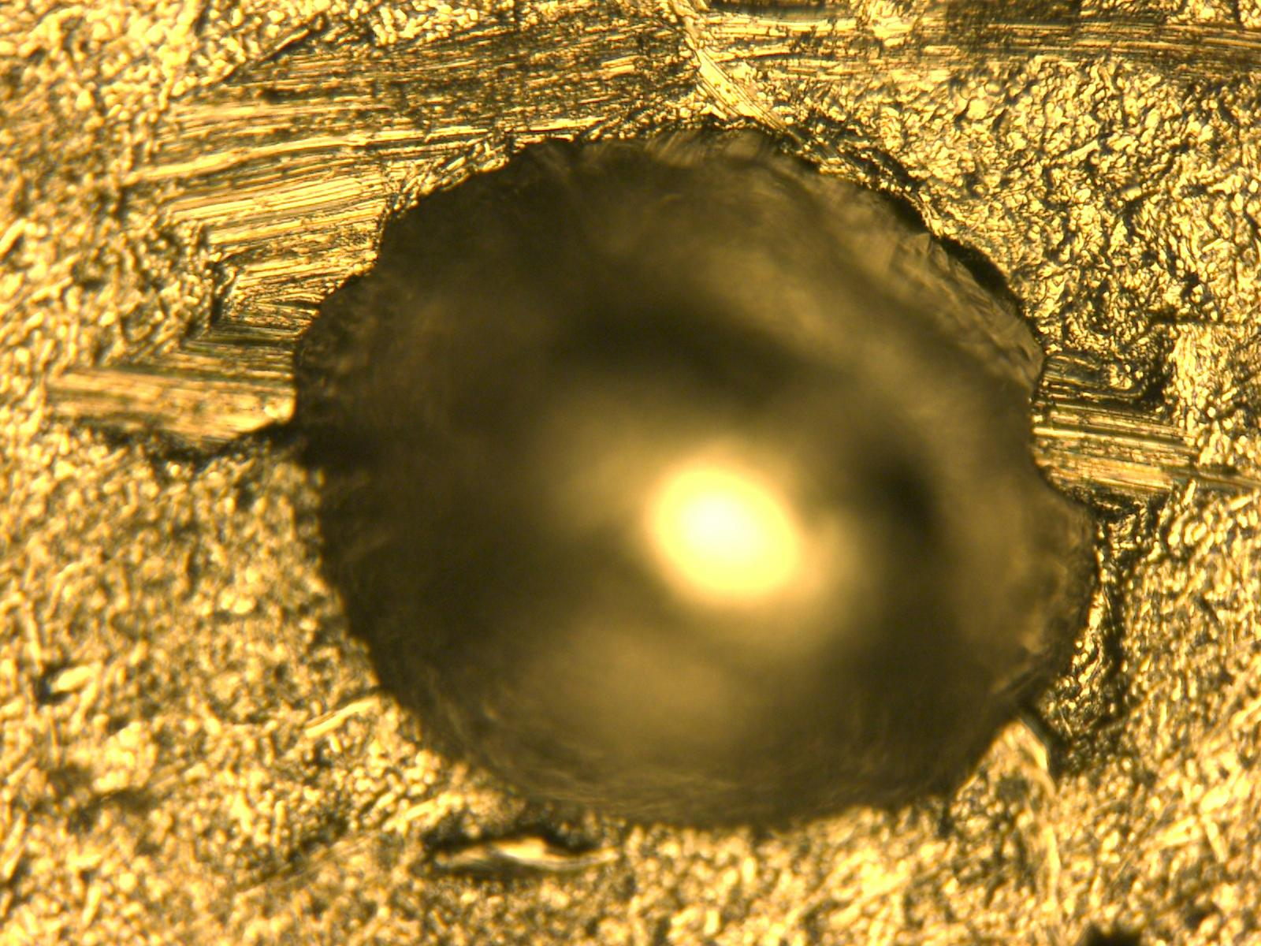
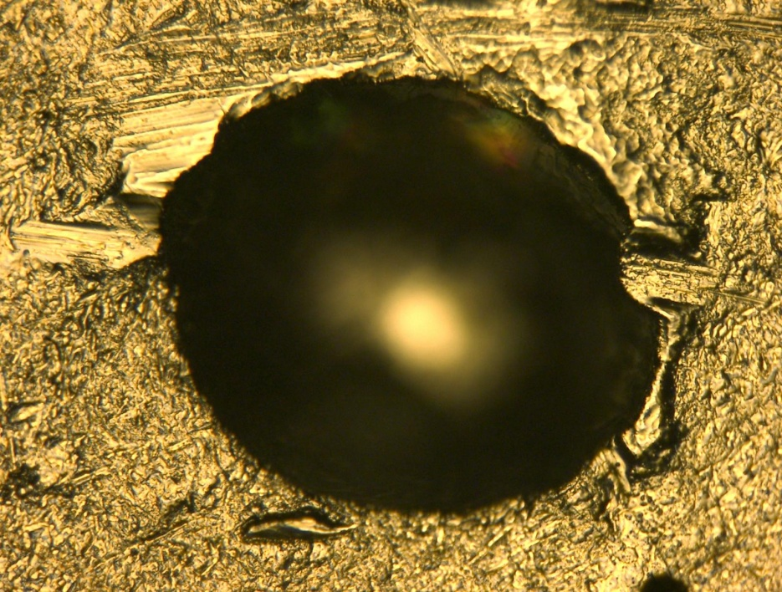
Surface replica - resolution
A man-made pit 125µm deep, 300µm in diameter
Pit replica
profile of a pit on the Nb coupon
profile of pit’s replica
Overall, 1 µm detail can be replicated
M Ge, G Wu, D Burk, J Ozelis, E Harms, D Sergatskov, D Hicks, and L D Cooley,
Routine characterization of 3-D profiles of SRF cavity defects using replica techniques. Manuscript to be submitted to Journal of Super. Sci. and Tech.

Slide 5
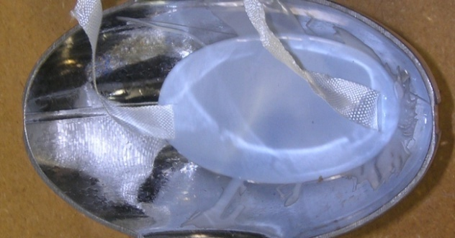
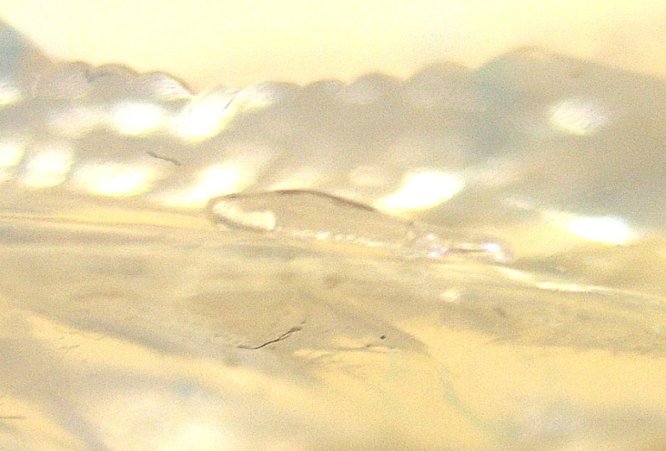
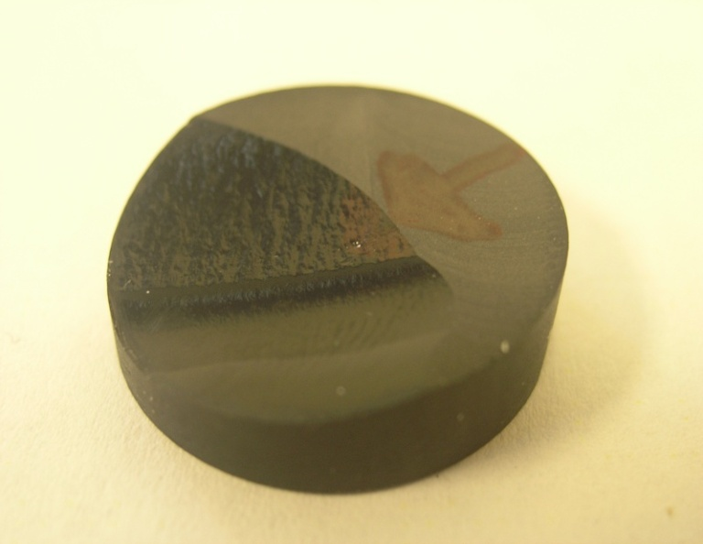
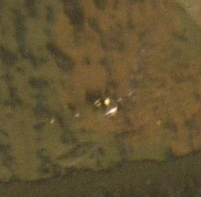
Surface replica – extraction and surface scan
String
Silicone
Feature on silicone
Silicone pouring into an open half cell with a string embedded
Visually indentify the features
Epoxy casting on silicone
Feature’s 3D shape by profilometer scanning

Slide 6
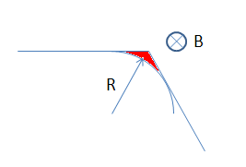
A discussion about surface detail
As magnetic field at the edge of the defect approaches the thermal critical magnetic field, the magnetic flux then enters the corner area deeper, depending on the field enhancement factor.
At this time, the defect can be divided into one lossy corner and a remaining flux-free body.
The corner is in micron scale.
Surface replica resolution sufficient to characterize the RF surfaces
J. Knobloc, et al., “High Field Q Slope in Superconducting Cavities Due to Magnetic Field Enhancement at Grain Boundaries,” in Proc. of 9th Workshop on RF Superconductivity, Santa Fe, New Mexico,1999, pp. 77-91

Slide 7
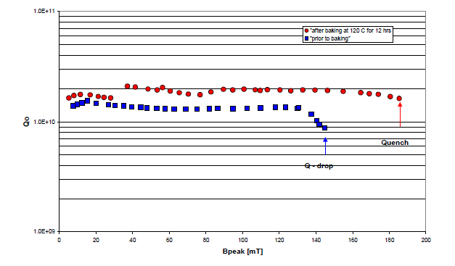
1-cell cavity: PKU-LG1
43 MV/m. 185 mT
NingXia large grain RRR niobium
Post purified
BCP only
Low temperature baking
Features found:
BCP stains
BCP etching pits
Weld Pits
Steep grain boundaries
P. Kneisel, “Progress on Large Grain and Single Grain Niobium – Ingots and Sheet and Review of Progress on Large Grain and Single Grain Niobium,” in Proc. of 13th Workshop on RF Superconductivity, Beijing, China, 2007.

Slide 8
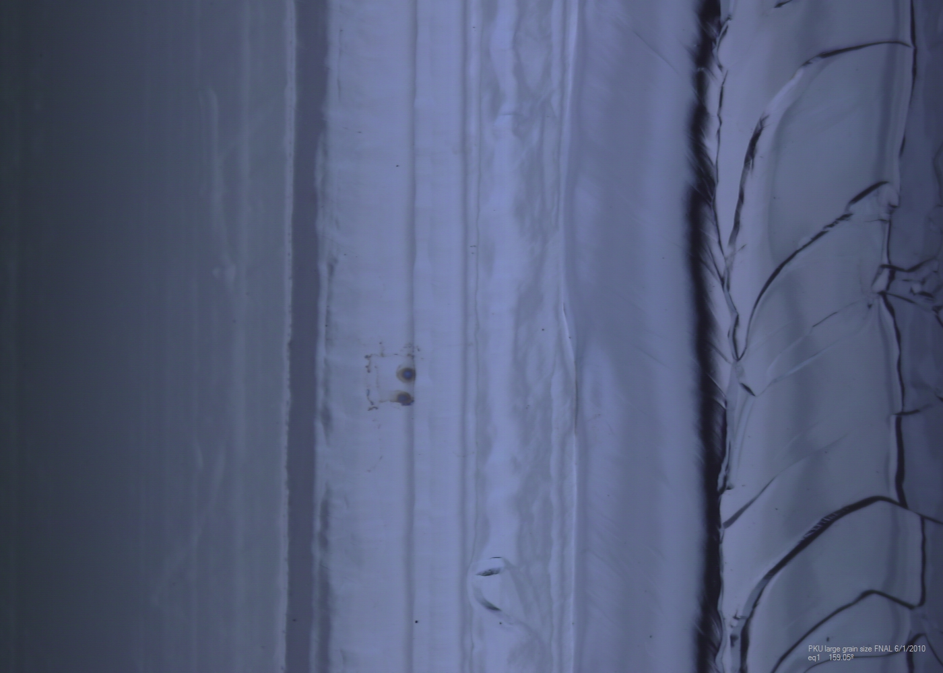
Optical features of PKU-LG1

Slide 9
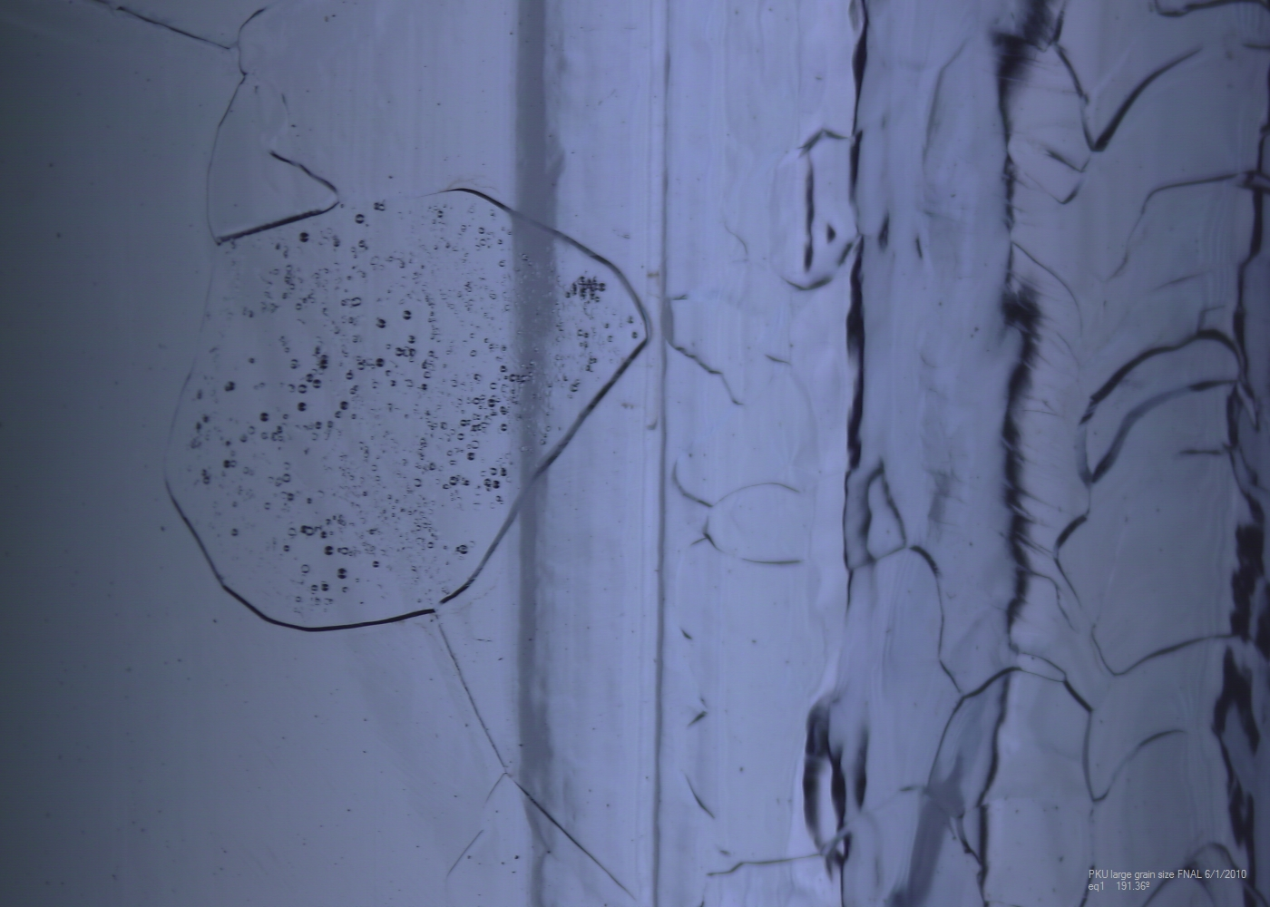
Optical features of PKU-LG1

Slide 10
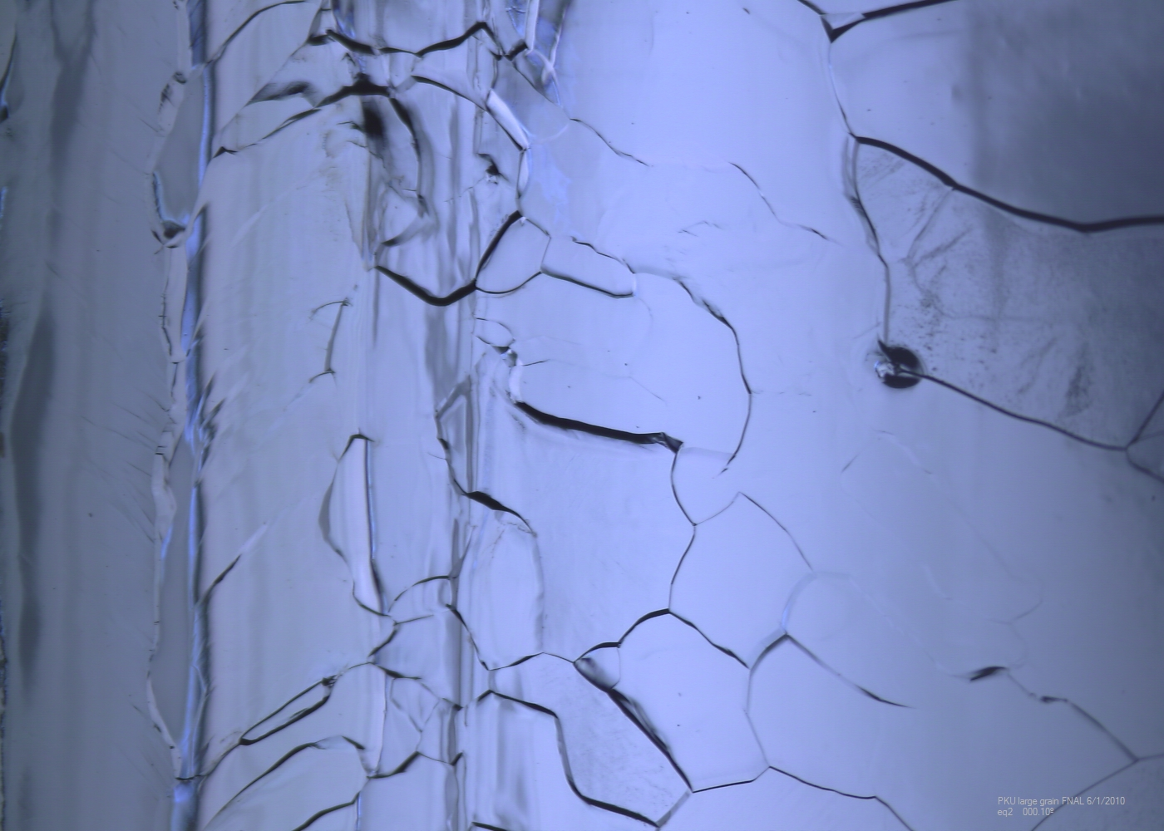
Optical features of PKU-LG1

Slide 11
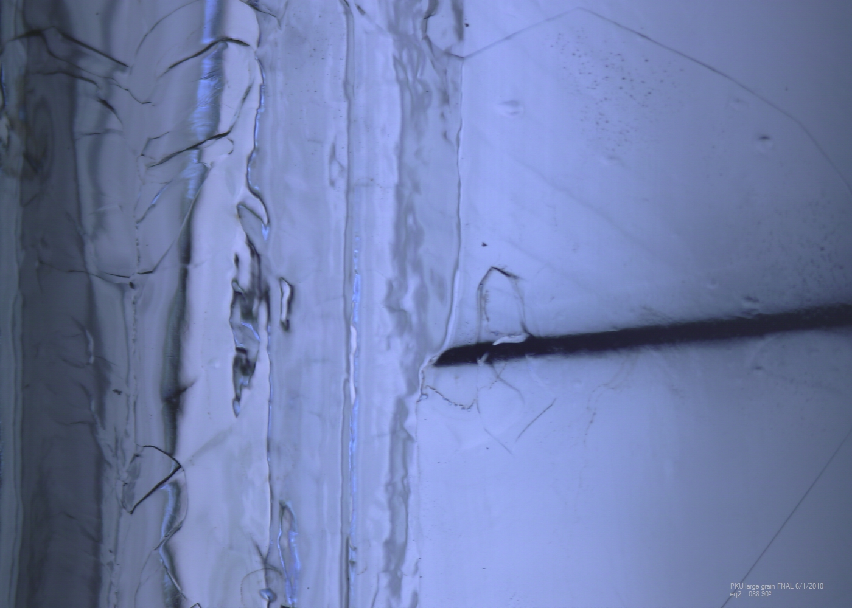
Optical features of PKU-LG1

Slide 12
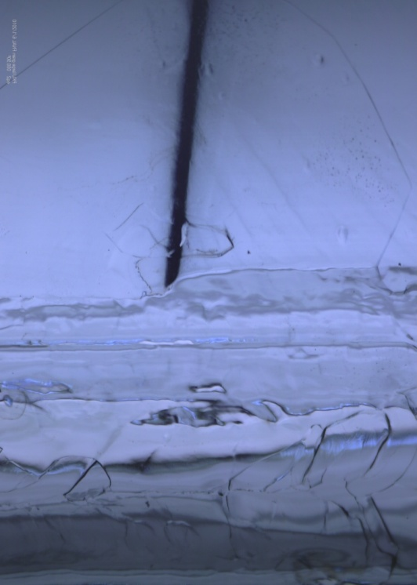
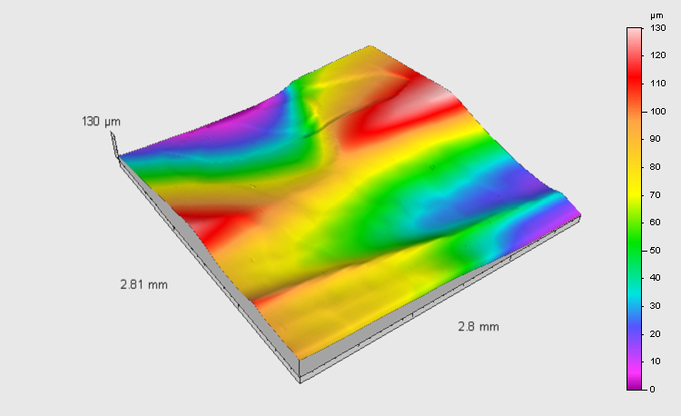
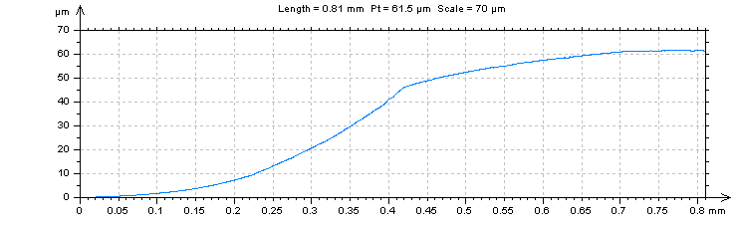
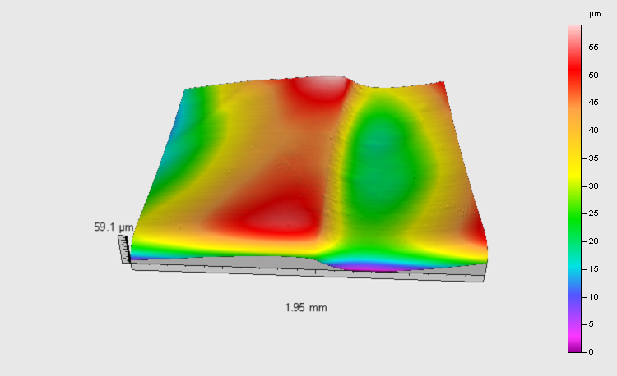
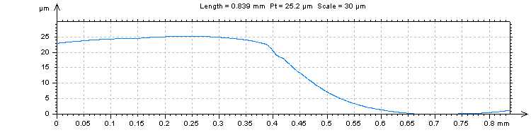
The measurement of grain boundary step
A-A’
B-B’
Joint of grain boundary
A-A’
Joint of grain boundary
Profile on A-A’
Welding seam
B-B’
Optical image of PKU-LG1
The height of step on A-A’: 60µm
The height of step on B-B’: 25µm
A result from surface scanning profilometer
Profile on B-B’
Notes:
Add results

Slide 13
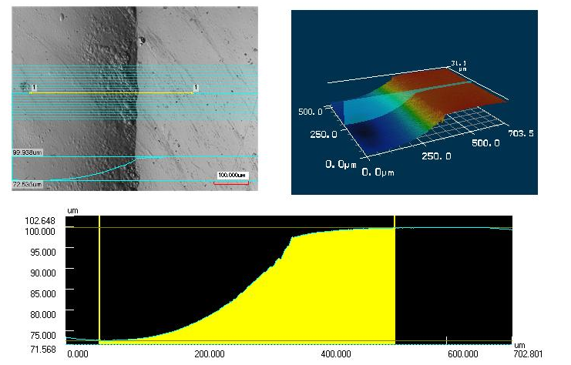
The measurement of grain boundary step
A result from confocal laser scanning microscope

Slide 14
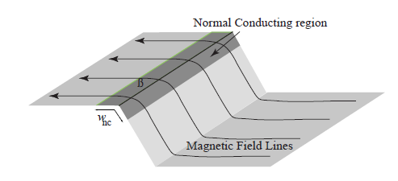
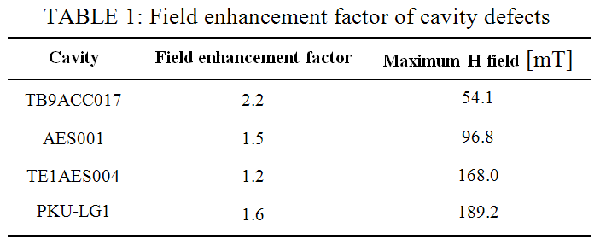
Field enhancement factor with step model
185
Magnetic field enhancement model suggested the features in this cavity cannot fully explain the cavity performance limitations.
Geometric topology serves only a secondary role in limiting cavity performances.

Slide 15
Cavity surface features comparison
Cavities have apparent geometric defects
  Bumps
  Pits
  Scratches
  Grain boundaries (Large grain)
Cavities have no visible defects
  Surface roughness in
  Weld seam
  Heat Affected Zone (HAZ)
  Normal area.
Cavities represent six categories
  Fine grain BCP
  Large grain BCP
  Single crystal BCP
  Fine grain light EP
  Fine grain heavy EP
  Fine grain Tumble polishing plus light EP

Slide 16
Cavity surface roughness
Welding seam
HAZ
Normal area
Brand new
TE1PAV001
(3 similar cavities)
Brand new
TE1ACC006
(2 similar)
PKU single crystal BCP‘d cavity
BCP'd 70µm
NR-6
(3 similar)
EP'd 40µm
TE1ACC005

Slide 17
Cavity surface roughness
Welding seam
HAZ
Normal area
EP'd 120µm
TE1ACC003
(8 similar)
EP'd 150µm
TB9ACC017
Tumbling
100-120µm
TE1ACC004
(4 similar)
PKU Large grain BCP‘d cavity

Slide 18
Surface roughness vs. Gradient
TESLA shape ,quenched but no obvious defects
Cavity performance becomes less dependent on the surface roughness as the maximum magnetic field reached a plateau

Slide 19
What we observed from quench studies
The defects can be divided as geometric imperfections or intrinsic to the material.
  Geometric imperfections played a secondary role in limiting cavity performance. The apparent defects are not necessarily harmful other than bearing the risk of trapping acidic water during processing.
  Standard processing can easily reduce the magnetic field enhancement and push the cavities to a higher gradient
In cavities that have no apparent material or geometric defects, the surface roughness is sufficiently good for both fine grain cavities with the standard EP process and for large grain cavities using the standard BCP process.
G. Wu, M. Ge, P. Kneisel, K. Zhao, L. Cooley, J. Ozelis, D. Sergatskov and C. Cooper, “Investigations of Surface Quality and SRF Cavity Performance”, manuscript submitted to IEEE transactions on Applied Superconductivity.

Slide 20
Conclusions
Large steep grain boundaries in large grain cavity are found that performance cannot be explained by magnetic field enhancement.
Surface roughness inside grains by BCP is comparable to modern electropolished cavities.

Slide 21
Extra slides

Slide 22
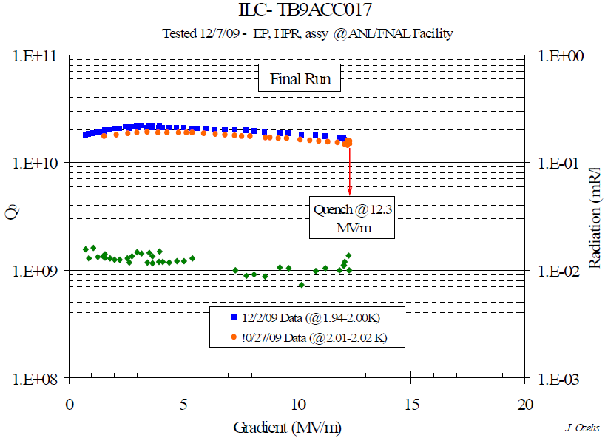
Surface defect limits cavity performance at low field
1.3GHz 9-cell cavity TB9ACC017
Y-Y’
X-X’
EB-Welding seam
X-X’
TB9ACC017 quenched at 12.3MV/m,
Pit was found at Cell #4 equator 180 deg region (quench location),
the pit is 150 µm deep and 200 µm wide on the top.
Y-Y’

Slide 23
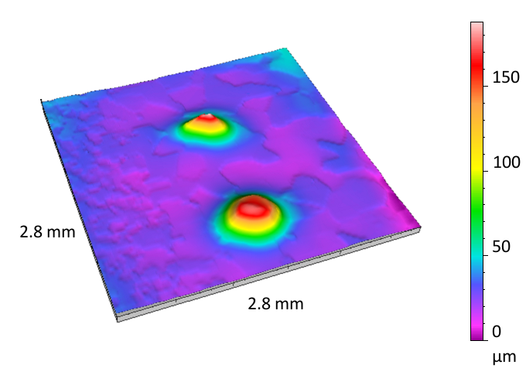
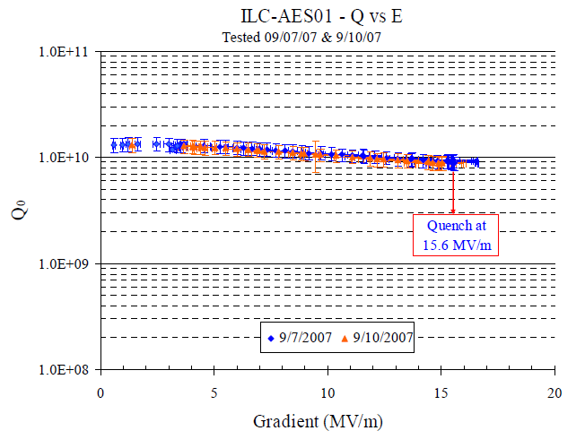
Surface defect limits cavity performance at low field
Spot (a)
Spot (b)
Spot A height 160µm, diameter 700µm on bottom
AES001 quenched at 15.6~21MV/m,
Twin peaks were found at Cell #3 equator 169 deg region
Spot B height 155µm, diameter 1000µm on bottom
Notes:
22MV/m curve?

Slide 24
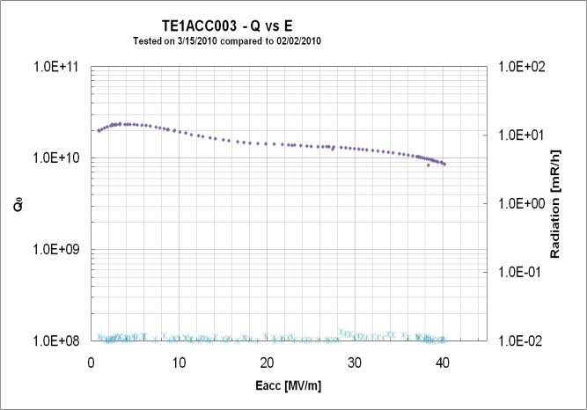
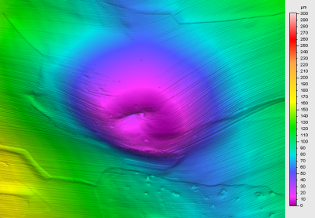
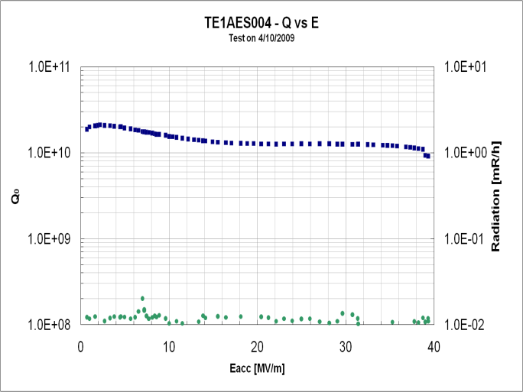
Surface defect limits cavity performance at high field
Equator
welding seam
HAZ
40.2 MV/m quenched at pit region
TE1ACC003
Diameter: 400µm,Depth: 60µm
Equator welding seam
TE1AES004
Diameter: 1300µm, Depth: 70µm
A 15µm high tiny bump in the center.
39MV/m quenched NOT at pit region

Slide 25
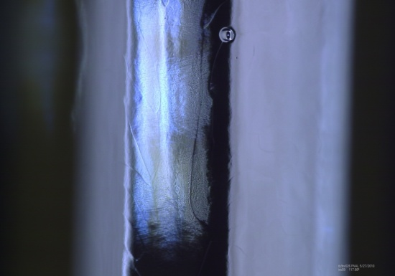
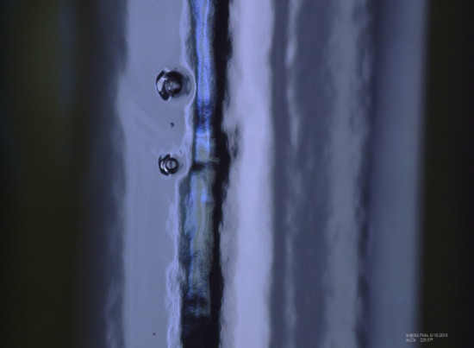
Reveal pits profile on iris region
Diameter: 400µm,Depth: 70µm
TB9RI026
Spot A
Spot A
Spot B
TB9jl002
Spot A: Diameter: 800µm,Depth: 180µm
Spot B
Spot B: Diameter: 550µm,Depth: 110µm
A 20µm deep crevice in center

Slide 26



Roughness comparison
Large grain BCP’d cavity
Eacc reached 43MV/m!
Fine grain EP’d cavity
Eacc reached 40MV/m!
Fine grain BCP’d cavity
Eacc reached 26MV/m!
 | Large grain BCP’d cavity | Fine grain EP’d cavity | Fine grain BCP’d cavity
Ra (µm) | 0.0516 | 0.053 | 0.257
Rz (µm) | 0.283 | 0.275 | 1.21
Rq (µm) | 0.0648 | 0.0665 | 0.333

Slide 27
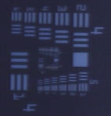
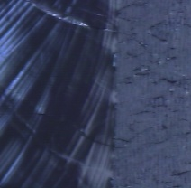
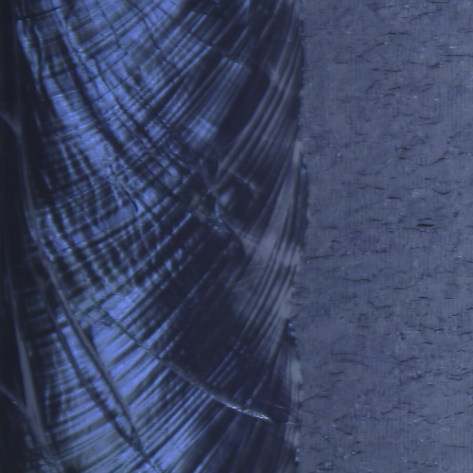
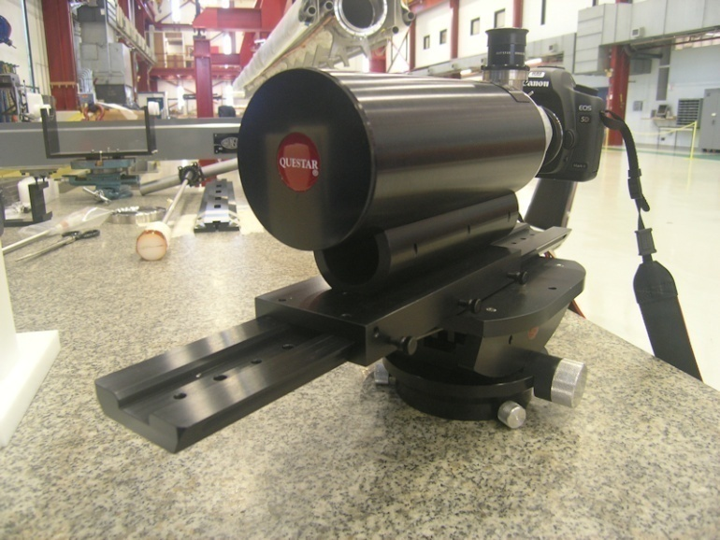
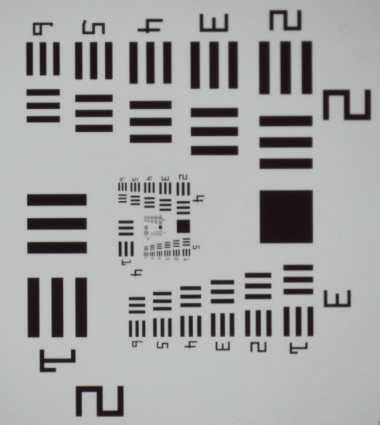
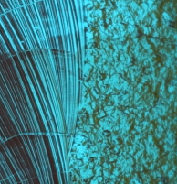
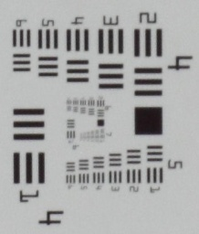
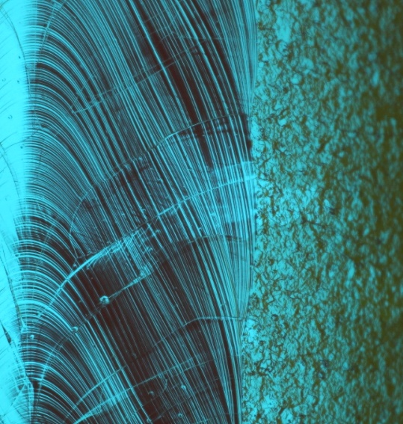
Fermilab Cavity diagnostics – optical inspection
 | Resolution (µm)
Questar | ~5
Kyoto/KEK | ~25
Kyoto/KEK: standard ILC cavities. Questar: All style cavities
Camera inspection system by Kyoto University/KEK
Image of TE1ACC006
Questar QM-1, first adopted at Cornell USAF-1951 seen by Questar
Image of 3C9FER001

