Slide 1
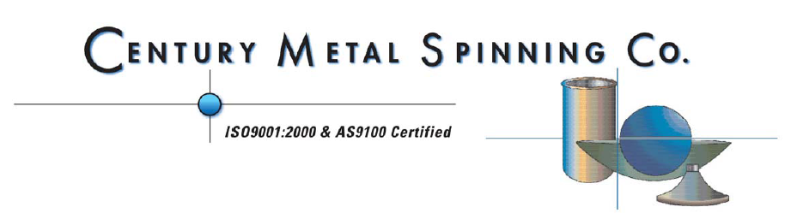
FNAL Visit to Century Metal Spinning
Current P.O. for:
2 - Titanium Helium Vessel Tubes (20” I.D. x 3/16” Wall x 14.5” Long)
2 - 650MHz β=0.9 Nb Beam Tubes (100mm I.D. x .125” Wall x 7.5” Long )
3 - Small Nb Beam Tubes (50mm I.D. x .125” Wall x 6.5” Long)

Slide 2
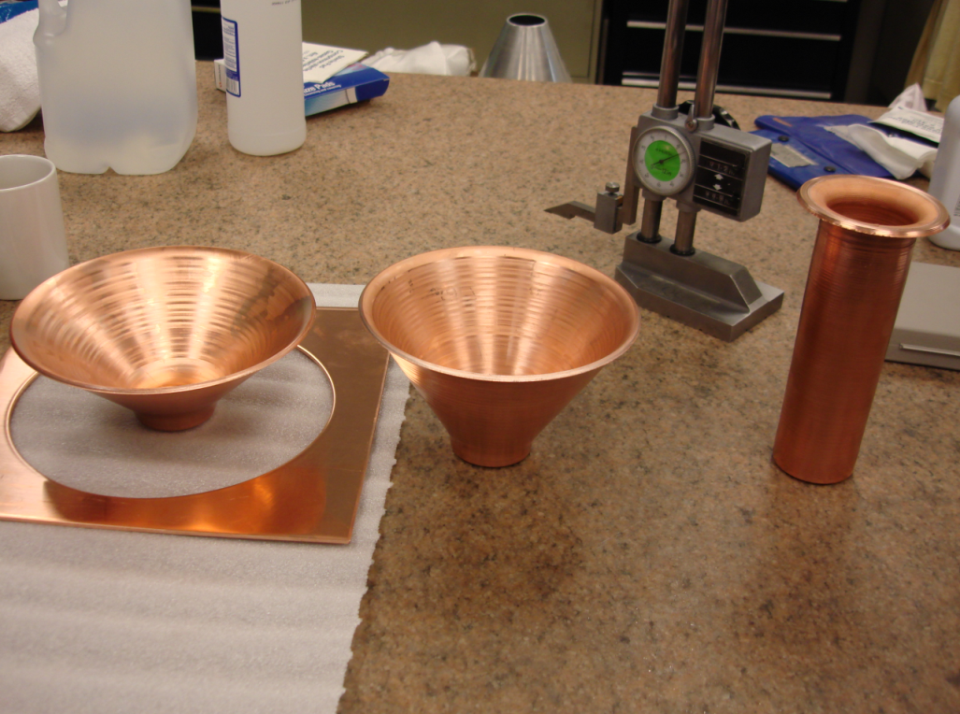
FNAL Visit to Century Metal Spinning
3- Stage Operation
45°, 60°, and 90° Die Set (Tool Steel)
Proof Sets Made From .125” Thick Copper

Slide 3
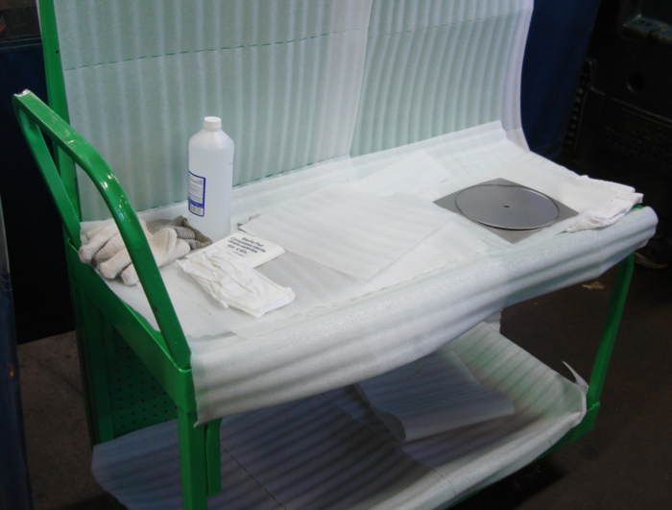
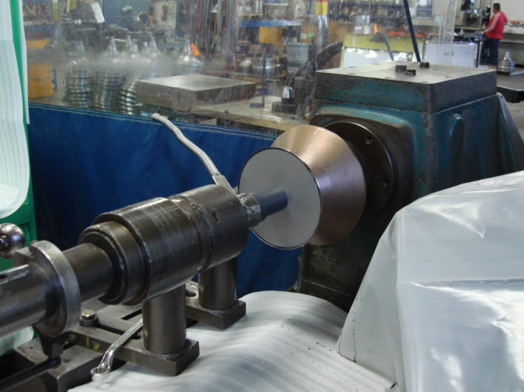
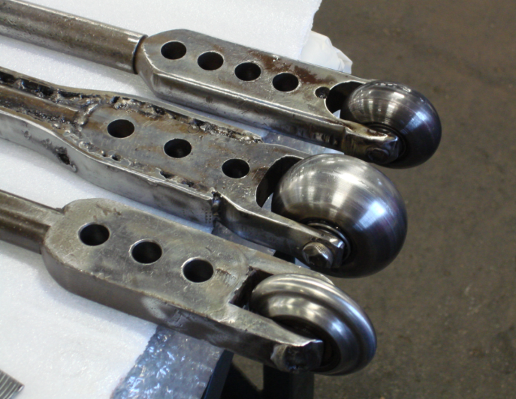
FNAL Visit to Century Metal Spinning
1st Stage
45° Die used
Niobium Cut to 8” Diameter, .125” Starting Stock
Baby Oil Used as Lubricant

Slide 4
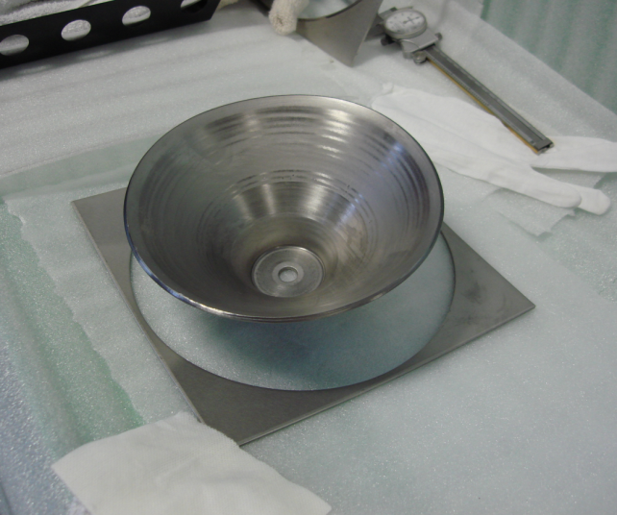
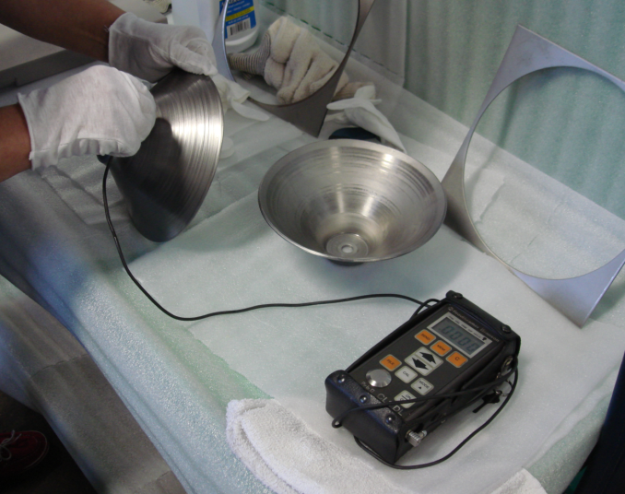
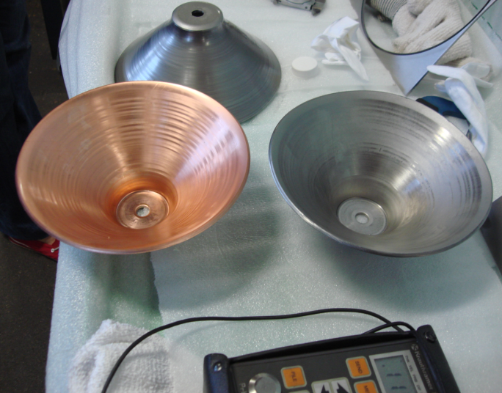
FNAL Visit to Century Metal Spinning
Thickness Measurements
Taken Between Each Stage
Immediate Feedback to Operator
Adjustments Made to Part

Slide 5
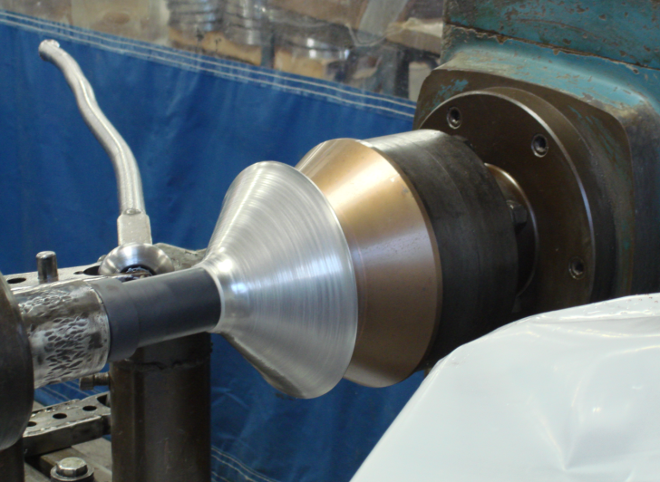
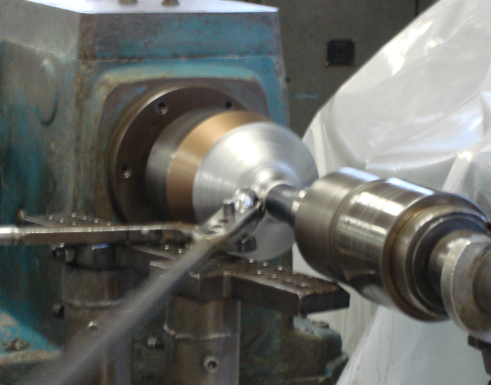
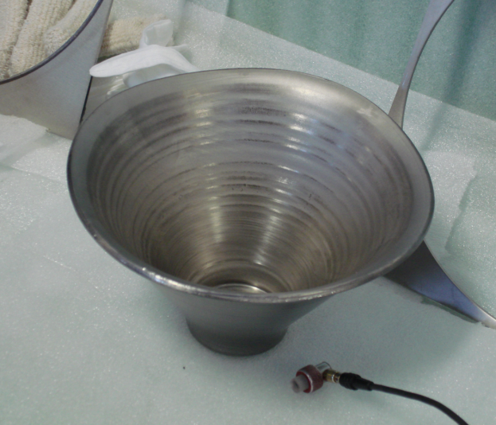
FNAL Visit to Century Metal Spinning
2nd Stage
60° Die used
Spinning Speed ~250-300 rpm Throughout Process
Baby Oil Used as Lubricant

Slide 6
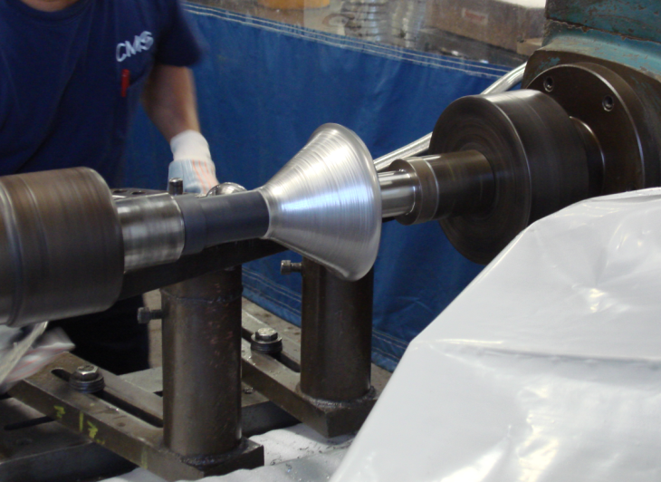
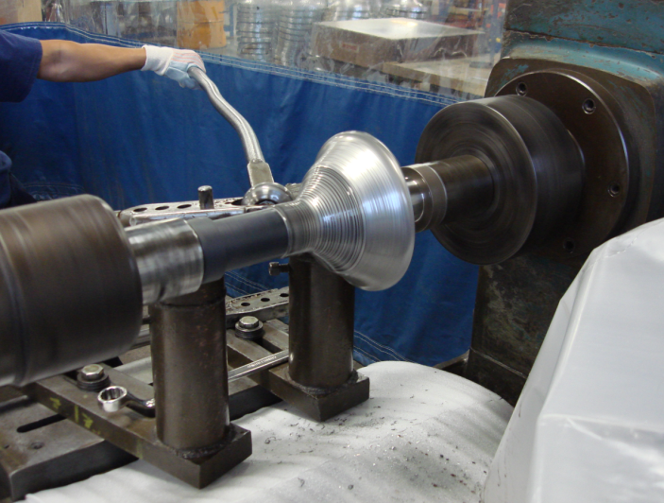
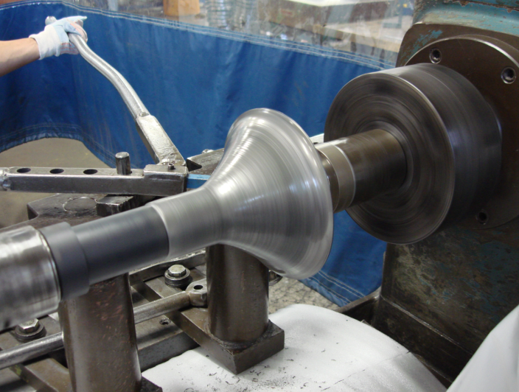
FNAL Visit to Century Metal Spinning
3rd and Final Stage
90° Die used
Longest Duration of the Process

Slide 7
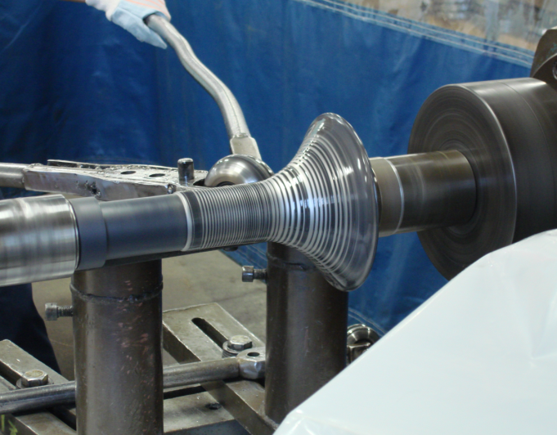
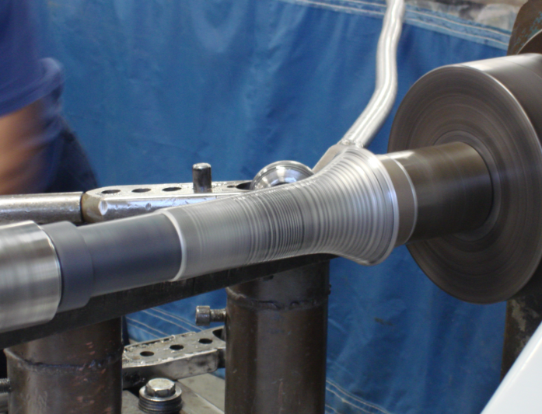
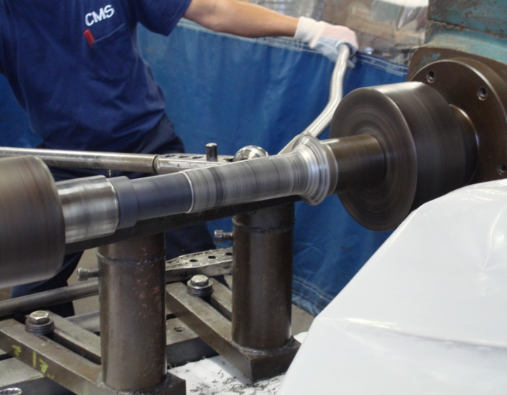
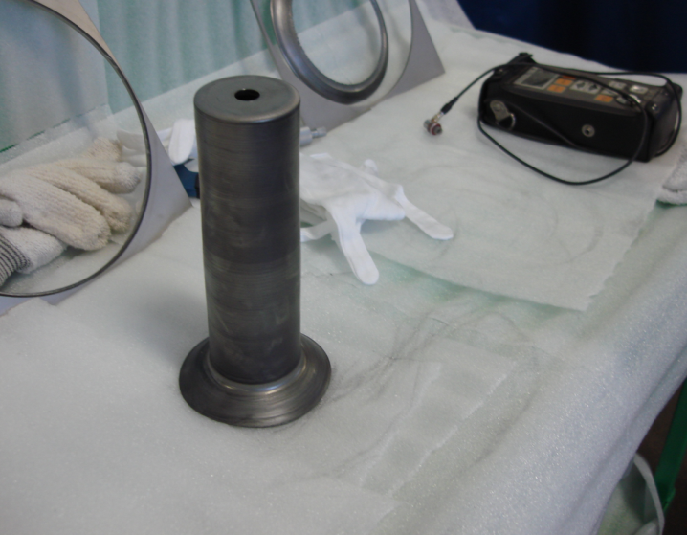
FNAL Visit to Century Metal Spinning

