Slide 1
S1-G Cryomodule Thermal Data

Slide 2
Accessing thermal data from the collaborative laboratories
Data files of S1-G cryomodule thermal condition
  Temperature sensors and strain gauges in the cryomodule
  Pressures, mass flow rates of He gas and LHe levels in 2K cold box
  Data sampling time= 1 minute
  Every day, the data file will be updated.
    June 7 ~ August 4, September 6 ~ End of this year.
  We will prepare the accessible directory on the KEK Website.

Slide 3
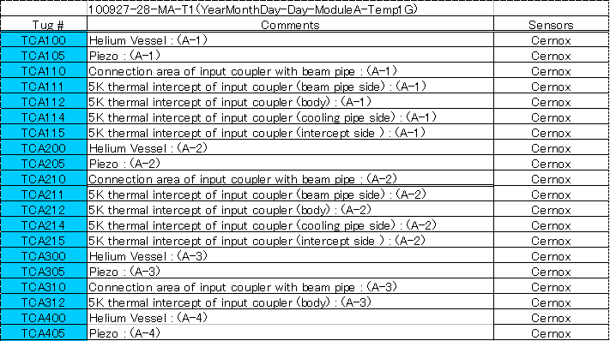
Data file
File Name/
Year-Month-Day-Day-Module A-Item
Item: T=Temperature, STG=strain gauge,
P-F-LD=pressure etc.

Slide 4
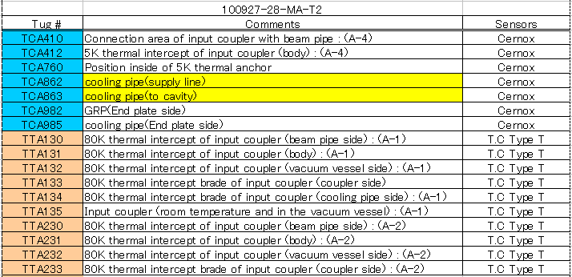
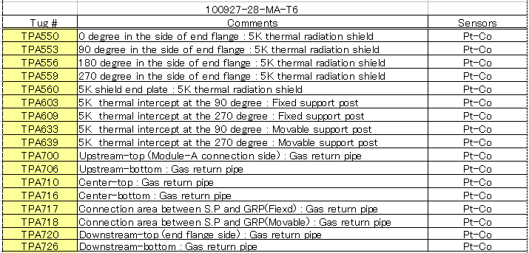
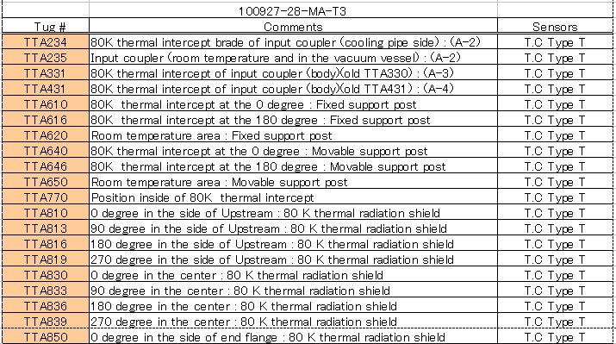
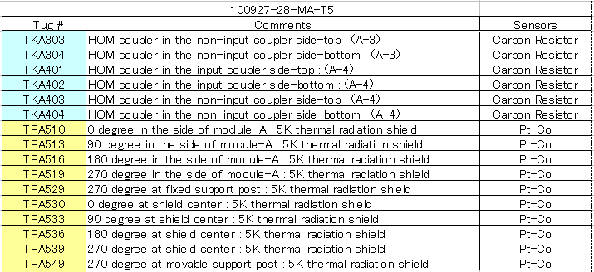
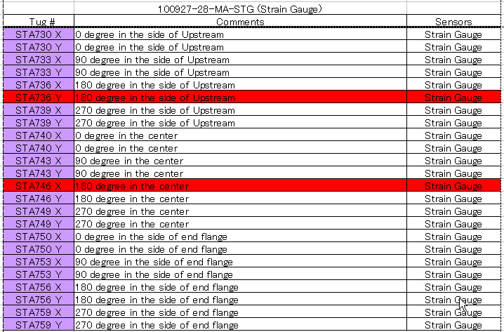
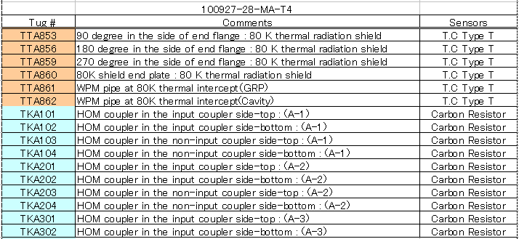

Slide 5
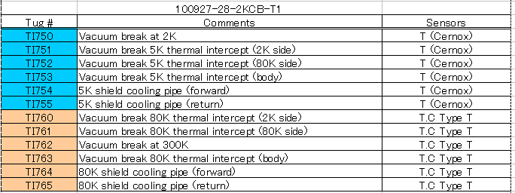
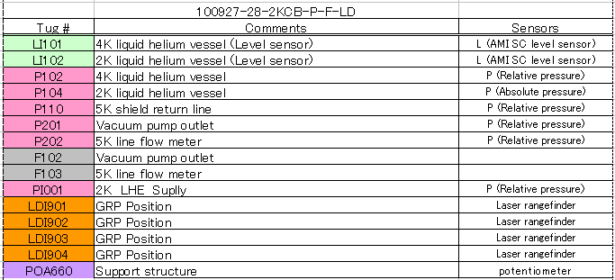
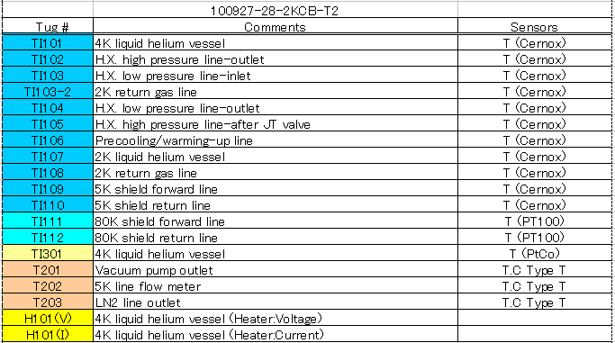
2 K Cold Box

