Slide 1
Status of 1.3-GHz Cavity Vacuum Furnace at IB-4
SRF Dev. Group Meeting
27 Sept 2010

Slide 2
Much good news…
Vendor visit last week
Assembly complete
Completed acceptance testing
  Vacuum pressure 1.2x10⁻⁸-torr
  Empty Chamber Bake-out 1000°C
  SS cylinder Bake-out 800°C
Completed FNAL training (7 engineers and technicians)

Slide 3
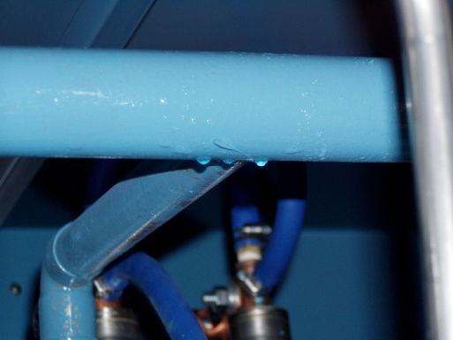
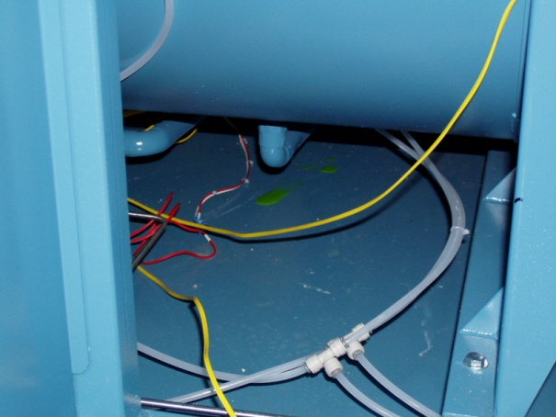
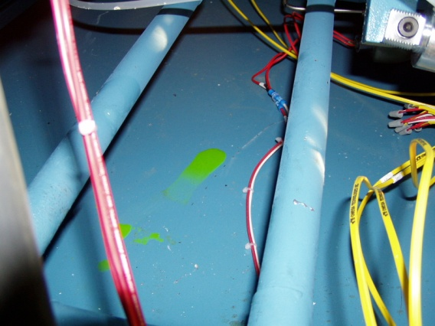
Some bad news…
Small leaks in inner water lines
Leak across inner seal of one of the gate valves leading to cryopump
Vendor visit to make repairs Wed-Fri this week

Slide 4
Next week
Repair to leak in outer water cooling line
Run at least one bake-out cycle to test the system
Prepare for ORC

