Slide 1
Micromegas analysis results
On behalf of those involved

Slide 2
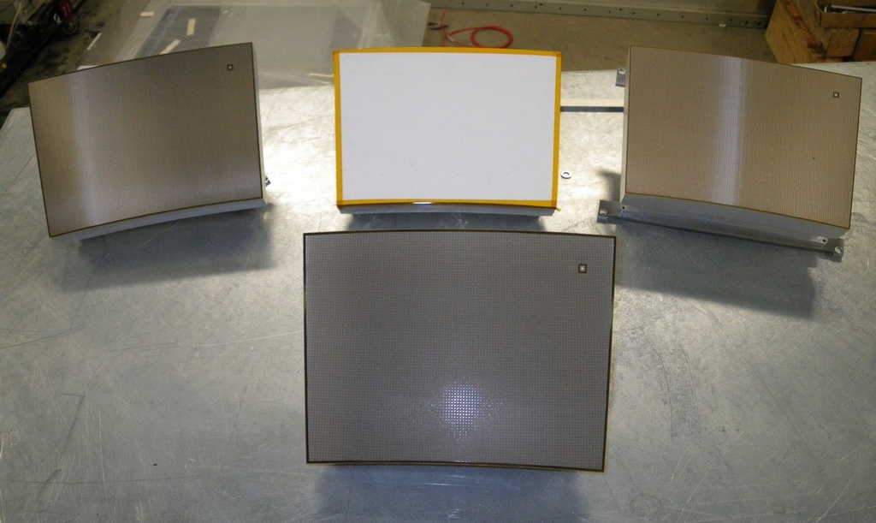
Micromegas Modules for TPC
2 Resistive Kapton
~3 MΩ/□
Resistive Kapton
~5 MΩ/□
Standard
Resistive ink
~3 MΩ/□
2

Slide 3
From December 2008 to July 2010, we tested one module at a time.
December 2009: tested modules 4 and 5 without magnetic field.
March 2010: tested modules 2 (ink) and 3 (kapton) with 1T magnetic field.
June-July 2010: taken data in a high intensity hadron beam at CERN.

Slide 4
Data analysis results (B=0T)
Drift Velocity in T2K gas compared to Magboltz simulations for
- P=1035 hPa
- T=19°C
- 35 ppm H₂0
( T2K gas: Ar:CF4:iso=95:3:2)
V_{drift} = 7.698 +- 0.040 cm/µs at E=230 V/cm
(Magboltz : 7.583+-0.025(gas comp.))
The difference is 1.5+-0.6 %
B=0 data : Drift velocity measurements

Slide 5
Data analysis results (B=0T)
Drift Velocity in T2K gas compared to Magboltz simulations for
- P=1035 hPa
- T=19°C
- 35 ppm H₂0
( T2K gas: Ar:CF4:iso=95:3:2)
Asian GEM preliminary results (WP114):
Vd = 7.557±0.001 [cm/μs]
Magboltz (v8.5) : Vd = 7.509±0.002 [cm/μs]
Temperature 290K
Pressure 1atm,
200ppm H2O
E field?
V_{drift} = 7.698 +- 0.040 cm/µs at E=230 V/cm
(Magboltz : 7.583+-0.025(gas comp.))
The difference is 1.5+-0.6 %
B=0 data : Drift velocity measurements

Slide 6
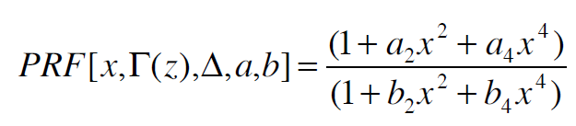
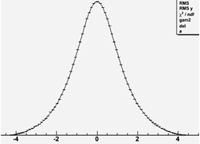
Data analysis results
PRF : Pad Response Function
a measure of signal size as a function of track position
relative to the pad
using pulse shape information to optimize the PRF
The PRF:
is not Gaussian.
can be characterized by its FWHM Γ(z) & base Width Δ(z).
Γ
Δ

Slide 7
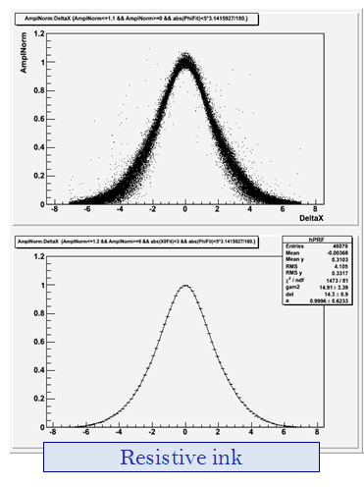
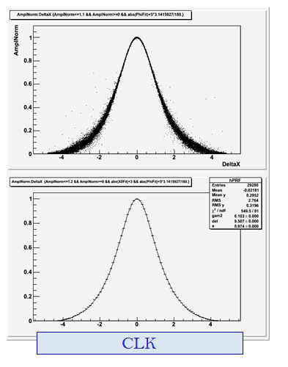
PRF(Pad Response Functions) fits, z ~ 5 cm
Data analysis results
Γ ~ 4 mm
Γ ~ 2.6 mm
δ ~ 14 mm
δ ~ 10 mm
B=1T data : comparison of resistive ink and Carbon-loaded Kapton

Slide 8
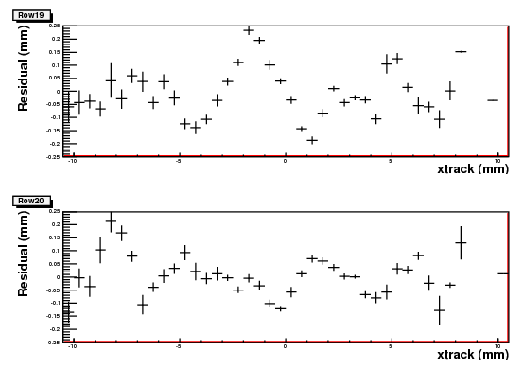
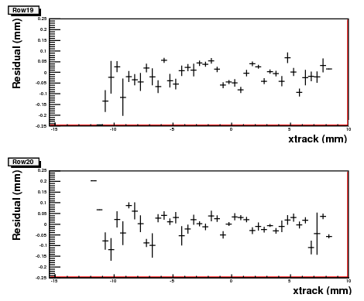
Bias (module ink)
±100µm
±100µm
Bias before
Bias after
Bias due to non-uniformity can be easily corrected.

Slide 9
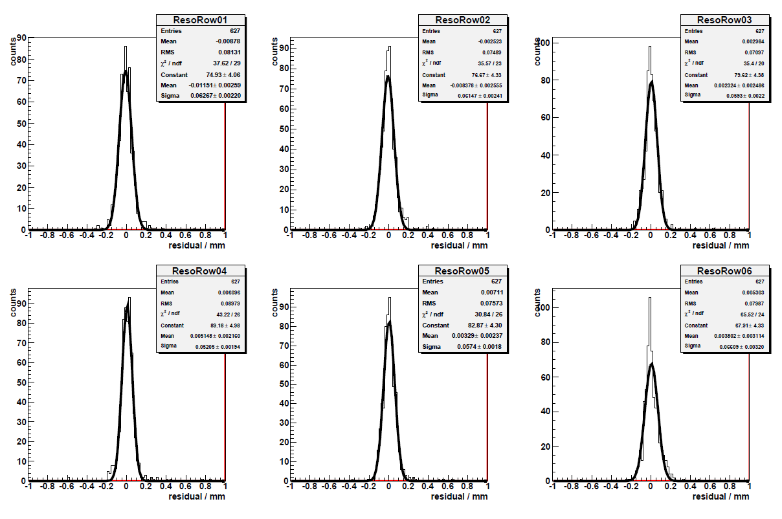
Data analysis results
Position residuals x_{row}-x_{track}

Slide 10
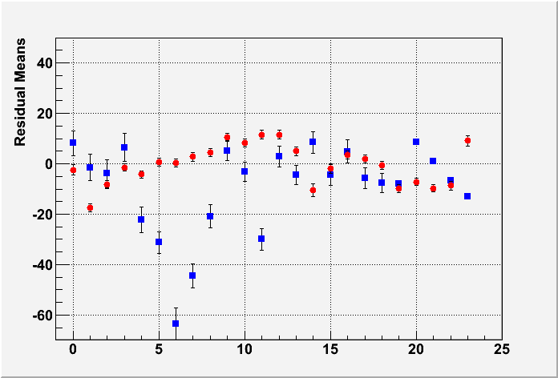
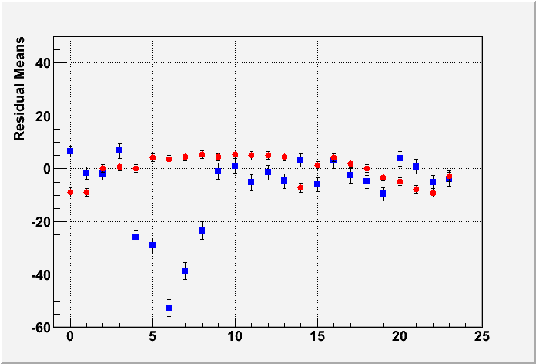
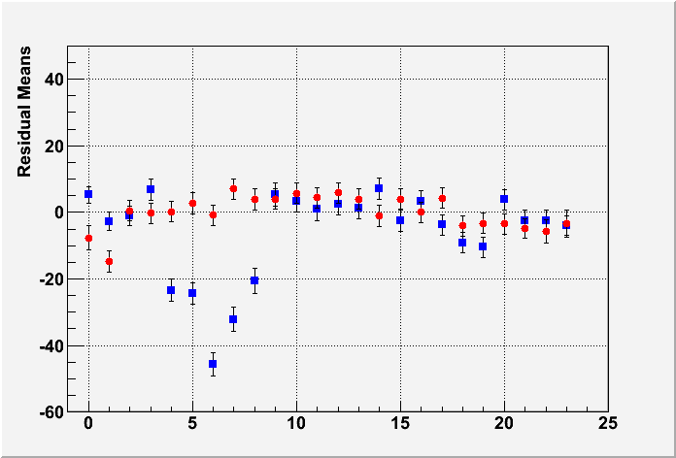
Uniformity
Z=5cm
MEAN RESIDUAL vs ROW number
Z-independent distortions
Distortions up to 50 microns for resistive paint
Rms 7 micron for CLP film
Z=35cm
Z=50cm

Slide 11
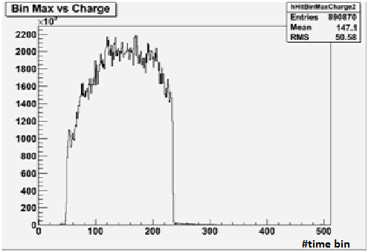
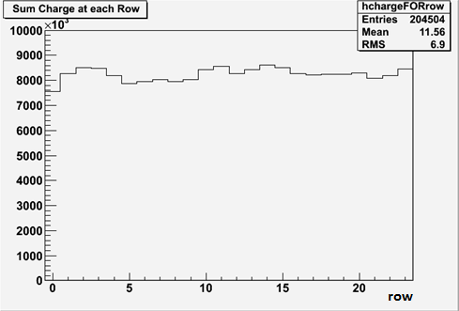
Uniformity (B = 0T)
Preliminary
Using cosmic-ray
Total charge by row using cosmic-ray events

Slide 12
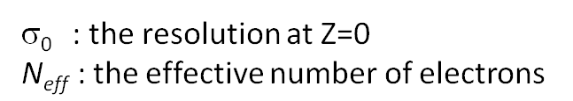
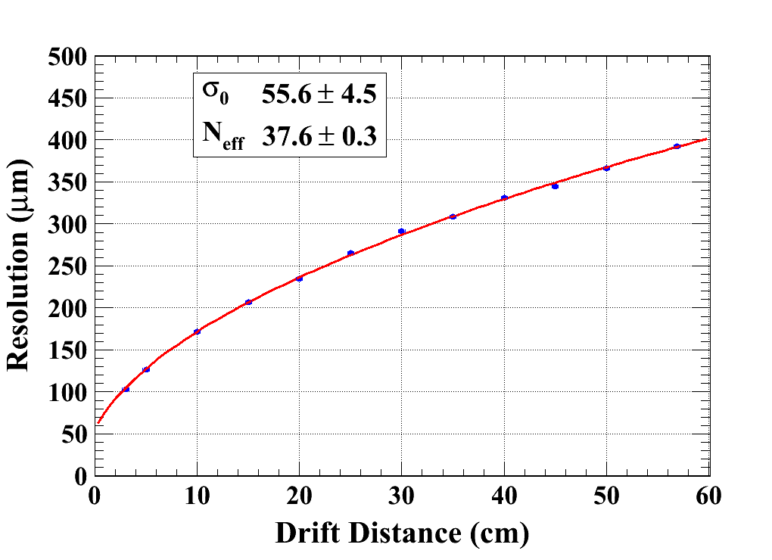

Data analysis results (B = 0T)
C_{d} = 315.1 µm/√cm (Magboltz)
Module 4
χ² : 10.6
Ndf: 10
Module 5
χ² : 13.9
Ndf: 10

Slide 13
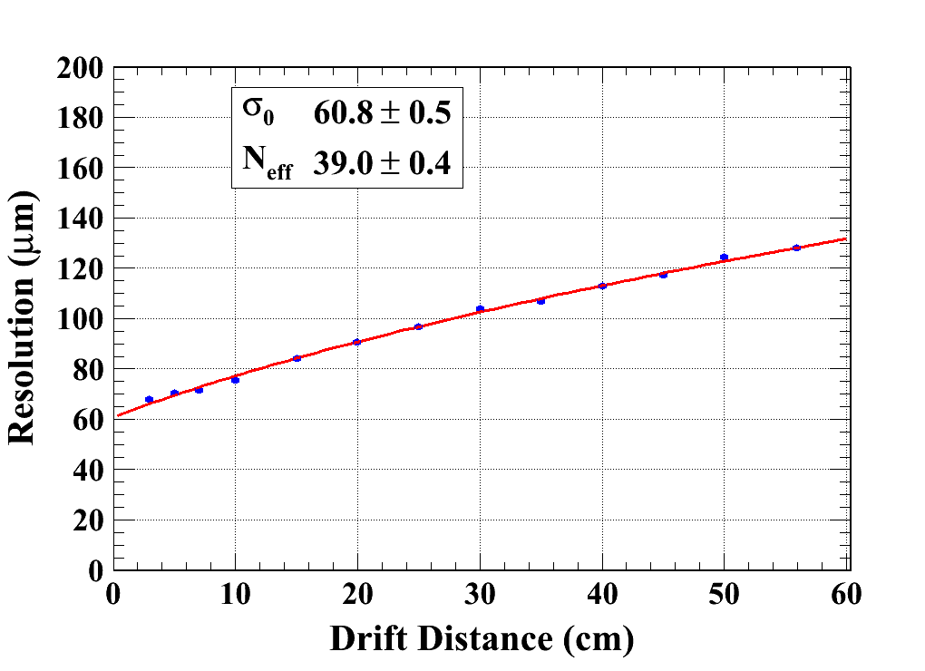
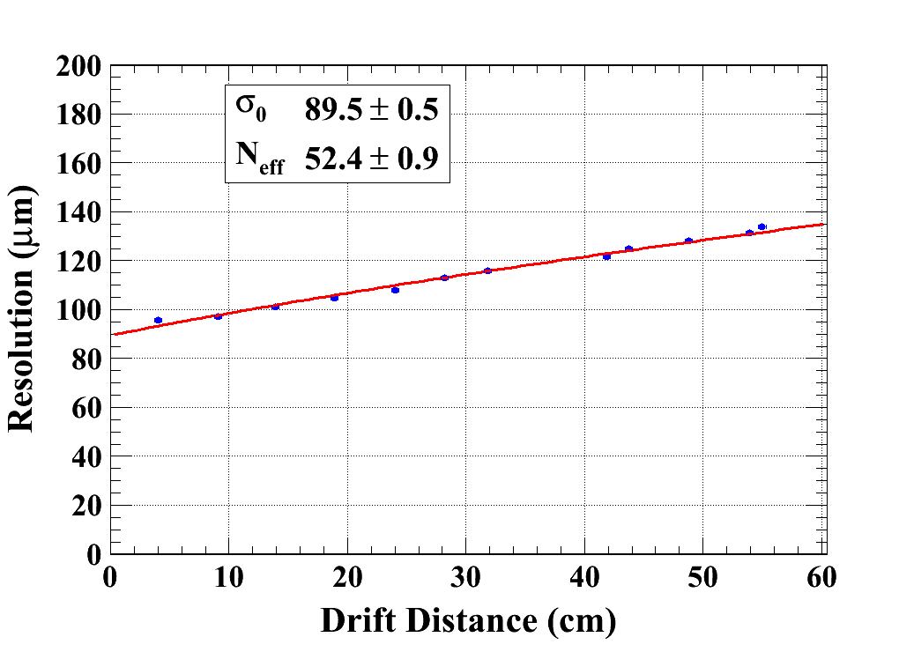
Data analysis results (B = 1T)
C_{d} = 94.2 µm/√cm (Magboltz)
Module_CLK
Module_INK
χ² : 29.1
Ndf: 11
χ² : 38.5
Ndf: 10

Slide 14
N_{eff} measurement with Micromegas
Averaging B=0T data and B=1T data (excluding ink module):
N_{eff} = 38.0±0.2(stat) ±0.8 (Cd syst)
σ₀= 59 ± 3 µm
Note that <1/N> = 47.1 from Heed for 5Gev electrons on 6.84 mm long pads.
<1/N> = 34.9 for 5.4 mm pads.

Slide 15
Data analysis results (B = 1T)
Resolution at z=5cm (µm)
V_{mesh} (V)
Dependence of resolution with data taking conditions

Slide 16
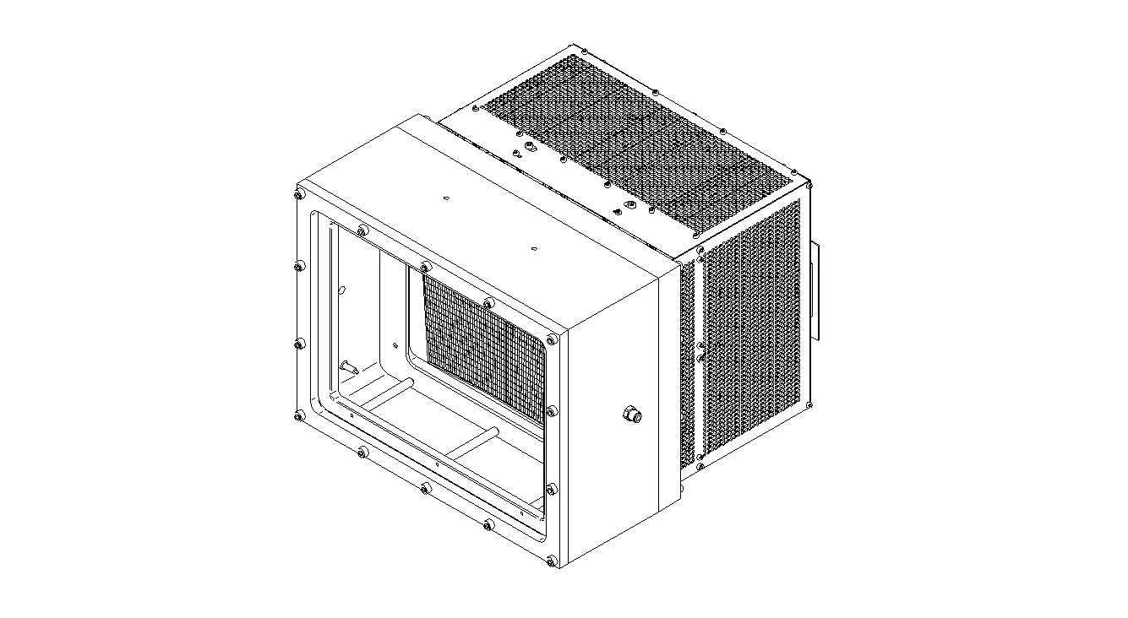
High intensities beam test
Total weight: ~20 kg
Radiation length: 40% (2×1.8 cm of aluminium)
B field
Top
27 cm
40 cm
Bottom
35cm
11 cm

Slide 17
Data were taken with muons mostly at 1 kHz and with hadrons at intensities up to 180 kHz (over a 5 cm x 1cm region) and 150 GeV energy.
drift length: 28.8 mm
electric field: 240 V/cm
Gas mixture: T2K gas
The mesh voltage was 380 V, which corresponds to a gas gain of 2500
The detector peformed perfectly normally, as usual
We also tested a new, faster and multimodule DAQ. We obtained read-out rates of 40 Hz.

Slide 18
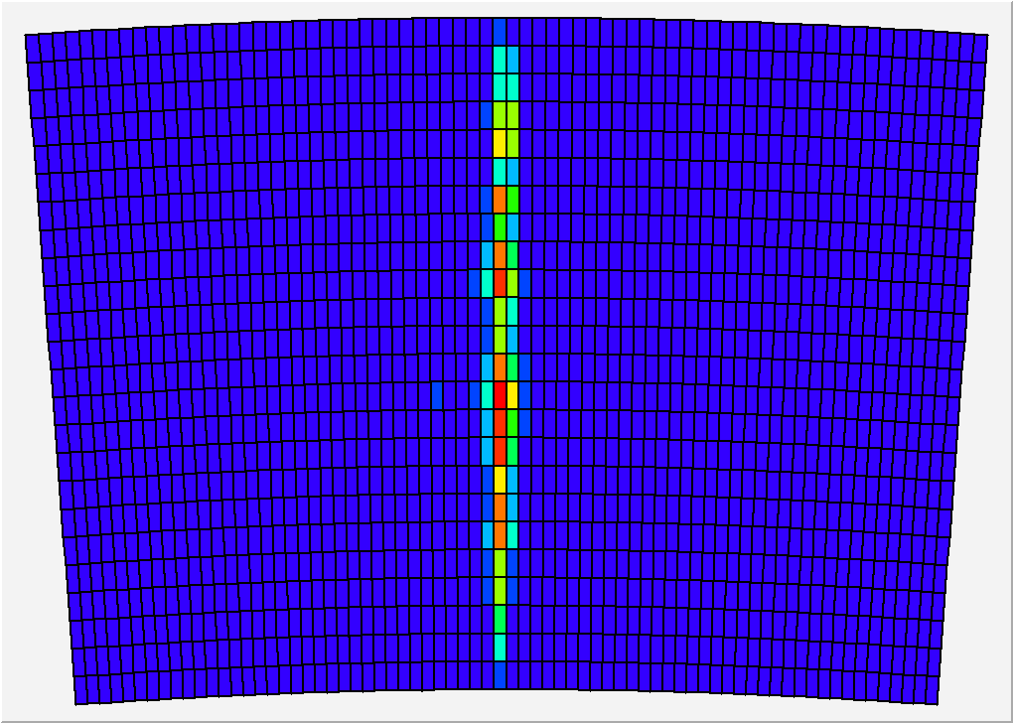

Slide 19
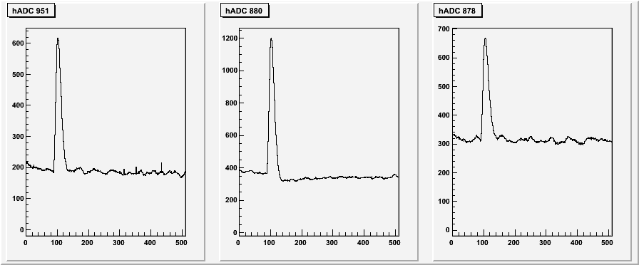
Pad signals at 180 kHz hadrons
High intensity data

Slide 20
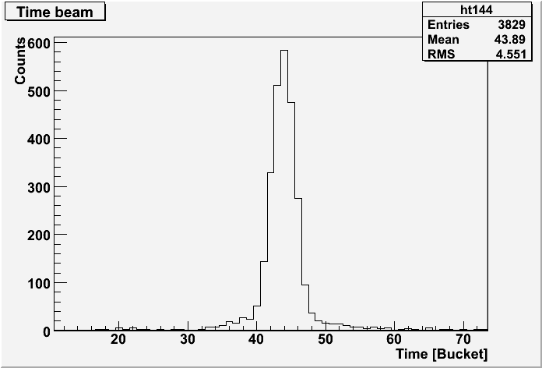
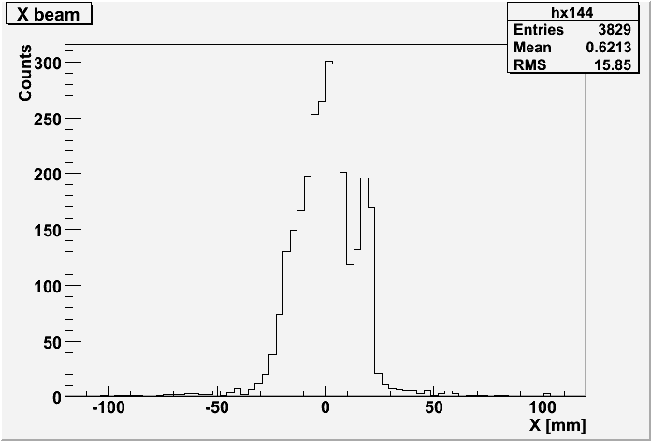
Beam profile (run 565, 14 kHz pions)
High intensity data

Slide 21
Thank you

