Slide 1
ILC CFS AND GLOBAL
SYSTEMS MEETING
CONVENTIONAL FACILITIES
AND SITING GROUP
Current Status of Area System Criteria
V. Kuchler

Slide 2
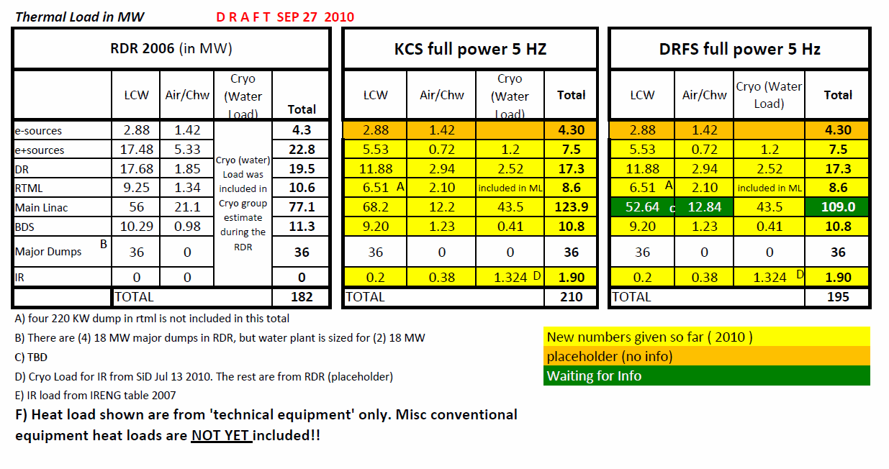

Slide 3
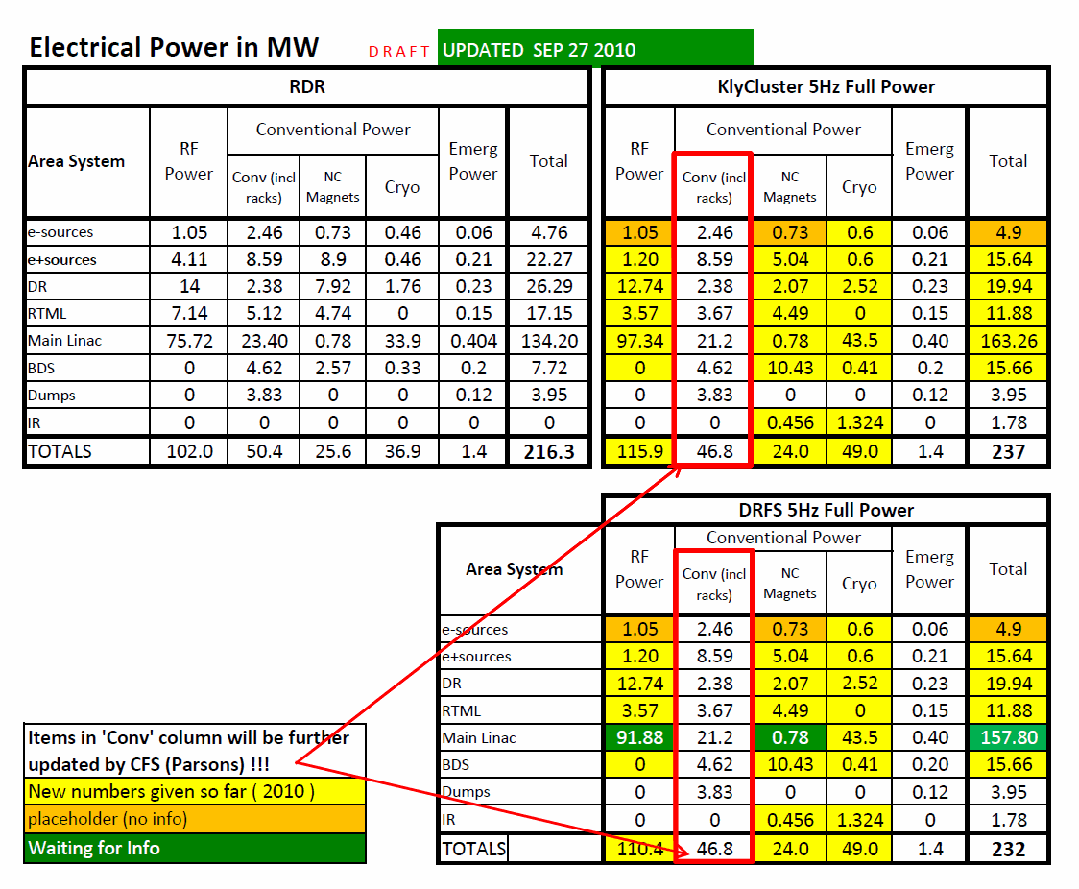

Slide 4
General Questions & Assumptions
What are the heat loads, electrical power, locations, load distributions to be used for each area system? Current load table is 90% complete. Waiting on updated DRFS number. e-source remains a placeholder. KCS ML number will be affected by additional RF due to overhead.
What are the SB2009 features we need to use?
DR circumference 3.2Km or 6.4 Km (use 3.2 Km)
DR low power or full power We have numbers for full power
Service tunnel only in central region and none in other area (Yes. There will also be small service cavern/tunnel in RTML)
Undulator in end of ML? (Yes)
Remove one RTML bunch compressor and give the previous RTML’s 24RFs to ML? (Yes)

Slide 5
General questions ..continuation
What’s the impact of the 10Hz operation option to the CFS heat load/power load? is 5Hz full power the same as 10Hz low power, with regard to power requirement? We currently have load numbers for 5Hz full power and we will use this based on the assumption that this will give the maximum heat load/power
What cryo load should we use? As placeholder we will use the RDR numbers with the addition of the IR cryo from the SiD table
The Cryo water cooling and most electrical was included with Cryo WBS in the RDR, should CFS include this in the TDR? Yes, CFS will include Cryo water cooling (cooling tower/related pump) and electrical power for the TDR phase

Slide 6
KCS related questions
What’s the total amount of Klystron (RF) needed for overhead; for undulator; and for reliability for KCS? How does this affect the KCS distribution between shaft? What are the proper distances between shafts? What are the number of RF units between shafts? How does the additional 24 RTML RFs affect the spacing between shaft? (Our current assumption for power accounting is based on latest slide from BAW, but with added 24 RTML, that is, 30 RF per KCS x 20 KCS + 24 RTML RF = 624 RF for ML.) Is the 24 (previous) RTML RF units, KCS or RDR style?
How much rack power are in the tunnel and in the surface. Our current number is 7 KW per RF in the tunnel (per email) and an assumption of 3 KW per RF on the surface
What Modulator should be used as basis for TDP, Marx or RDR style. Our current assumption is the RDR-style modulator

Slide 7
DRFS related questions
What’s the updated power load? Are the components characteristics (water delta T, maximum temperature etc) similar to the RDR table?
What’s the total amount of Klystron (RF) needed for overhead; for undulator; and for reliability for DRFS? How does this affect the KCS distribution between shaft? What are the proper distances between shafts? What are the numbers of RF between shafts? How does the additional 24 RTML RFs affect the spacing between shaft?
Should the power/heat load for the backup power supply/modulator be included in the power load tabulation, since they are “hot spare“ backup?
What’s the oil quantities for the DRFS equipment (and the oil characteristics or MSDS)
What are the physical dimensions of the DRFS equipment? & latest layout

Slide 8
BDS space temperature related questions
(The following are being communicated with Norbert, Deepa & Andre)
What portion of the BDS is the stringent temperature stability applicable? (from IP to 700m from IP) What 100m region should we select for the study? (we assumed the area where the RTML/e+ line goes to the DR)
Do the loads in central region vary? (critical to the BDS tight temperature stability)? Are the BDS components at constant load?
Is the 0.2 C temperature stability only required when the machine is running and not during startup, beam off and tuning conditioned?

Slide 9
Others
What are the equipment sizes in the damping ring? (Klystron, cryomodule, wiggler)
Is there any DR equipment with oil quantities? What’s the oil quantity? What’s the oil characteristics?
When can we freeze the information that we are given?

