Slide 1
PM Report
TLCC Process
BAW-1 status
Planning for BAW-2 (AD&I meetings etc.)
IWLC-10 planning and (ILC) focus
GDE “Interim Report” (working title)

Slide 2
TLCC Status: BAW-1
BAW-1 report given in 15th September AD&I meeting:
http://ilcagenda.linearcollider.org/getFile.py/access?contribId=7&resId=1&materialId=slides&confId=4789
BAW-1 proposals submitted to Director
Accelerating gradient, gradient spread
Single-tunnel + HLRF solutions (KCS, DRFS)
Both documents are ‘extensions’ of original SB2009 document
they do not replace it (or repeat it)
BB has formed Change Review Panel
together with EC.
Process should close by the time of ILCSC-PAC review (11-12 November)

Slide 3
TLCC Status BAW-2
BAW-2: SLAC January 18-21 2011
Two remaining SB2009 themes:
Reduced bunch number parameter set
Re-location of e+ source to end of e- linac
Expect large involvement from Physics & Detector community
Our primary stake-holders
Monthly AD&I meetings will focus on preparation for January BAW-2
13.10 Parameter sets (discussion & review)
10.11 Travelling focus simulations, Physics & Detector studies
08.12 Upgrade / risk-mitigation strategies, CFS impact
05.01 Preparation for workshop, programme review etc.
Considerable work to do
but resources are scarce
IWLC10 will provide an important venue to discuss BAW-2 related issues

Slide 4
ILWC10
Programme now finalised
difficult ‘marriage’ between ILC and CLIC requirements
For TLCC important aspect is communication with Physics & Detector groups
BAW-2 important focus (AS):
Damping Rings:
e-cloud
10Hz running – in particular 50% duty cycle for e+ ring
Positron Source
Consolidate parameters including low E_{cm} running
Parameters for high-field undulator (Nb₃Sn)
BDS/MDI
Propose novel FD solution (low Ecm running)
IP (beam-beam) parameters in general (within MDI)
Simulations / RTML
Completion of emittance budget document
Gradient tilt – further work?
GUINEA-PIG simulations (Travelling Focus)

Slide 5
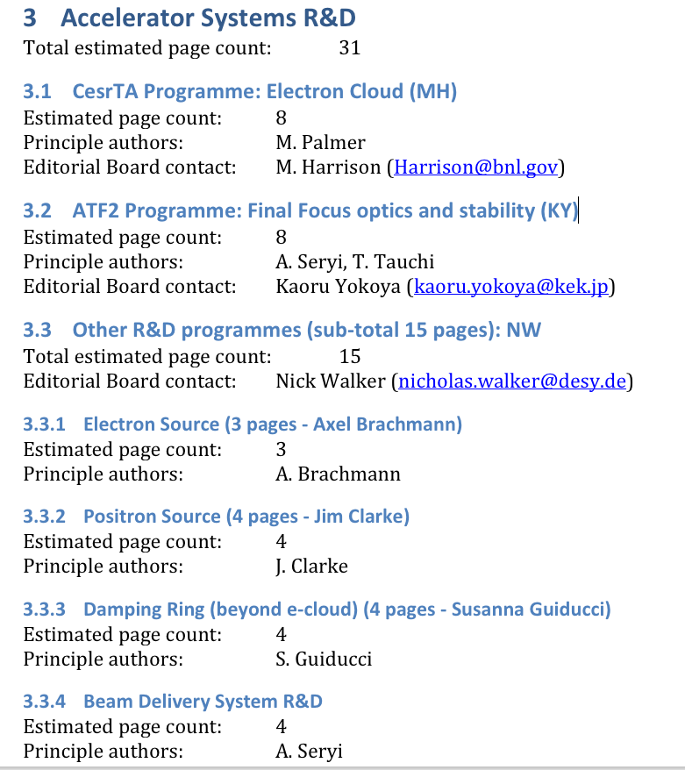
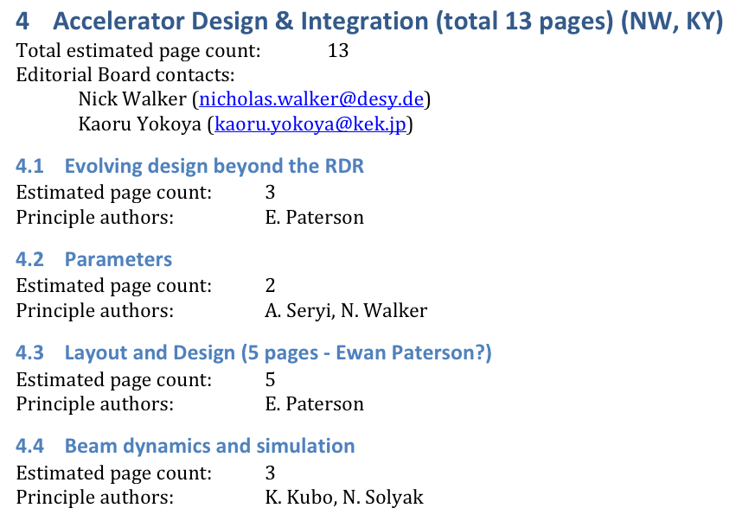
GDE Interim Report
First draft deadline: November 5

