Slide 1
EX-6 Shielding Block Preliminary Random Vibration Analysis
John Amann
Mechanical Engineer
SLAC MDI Group
10/07/10

Slide 2
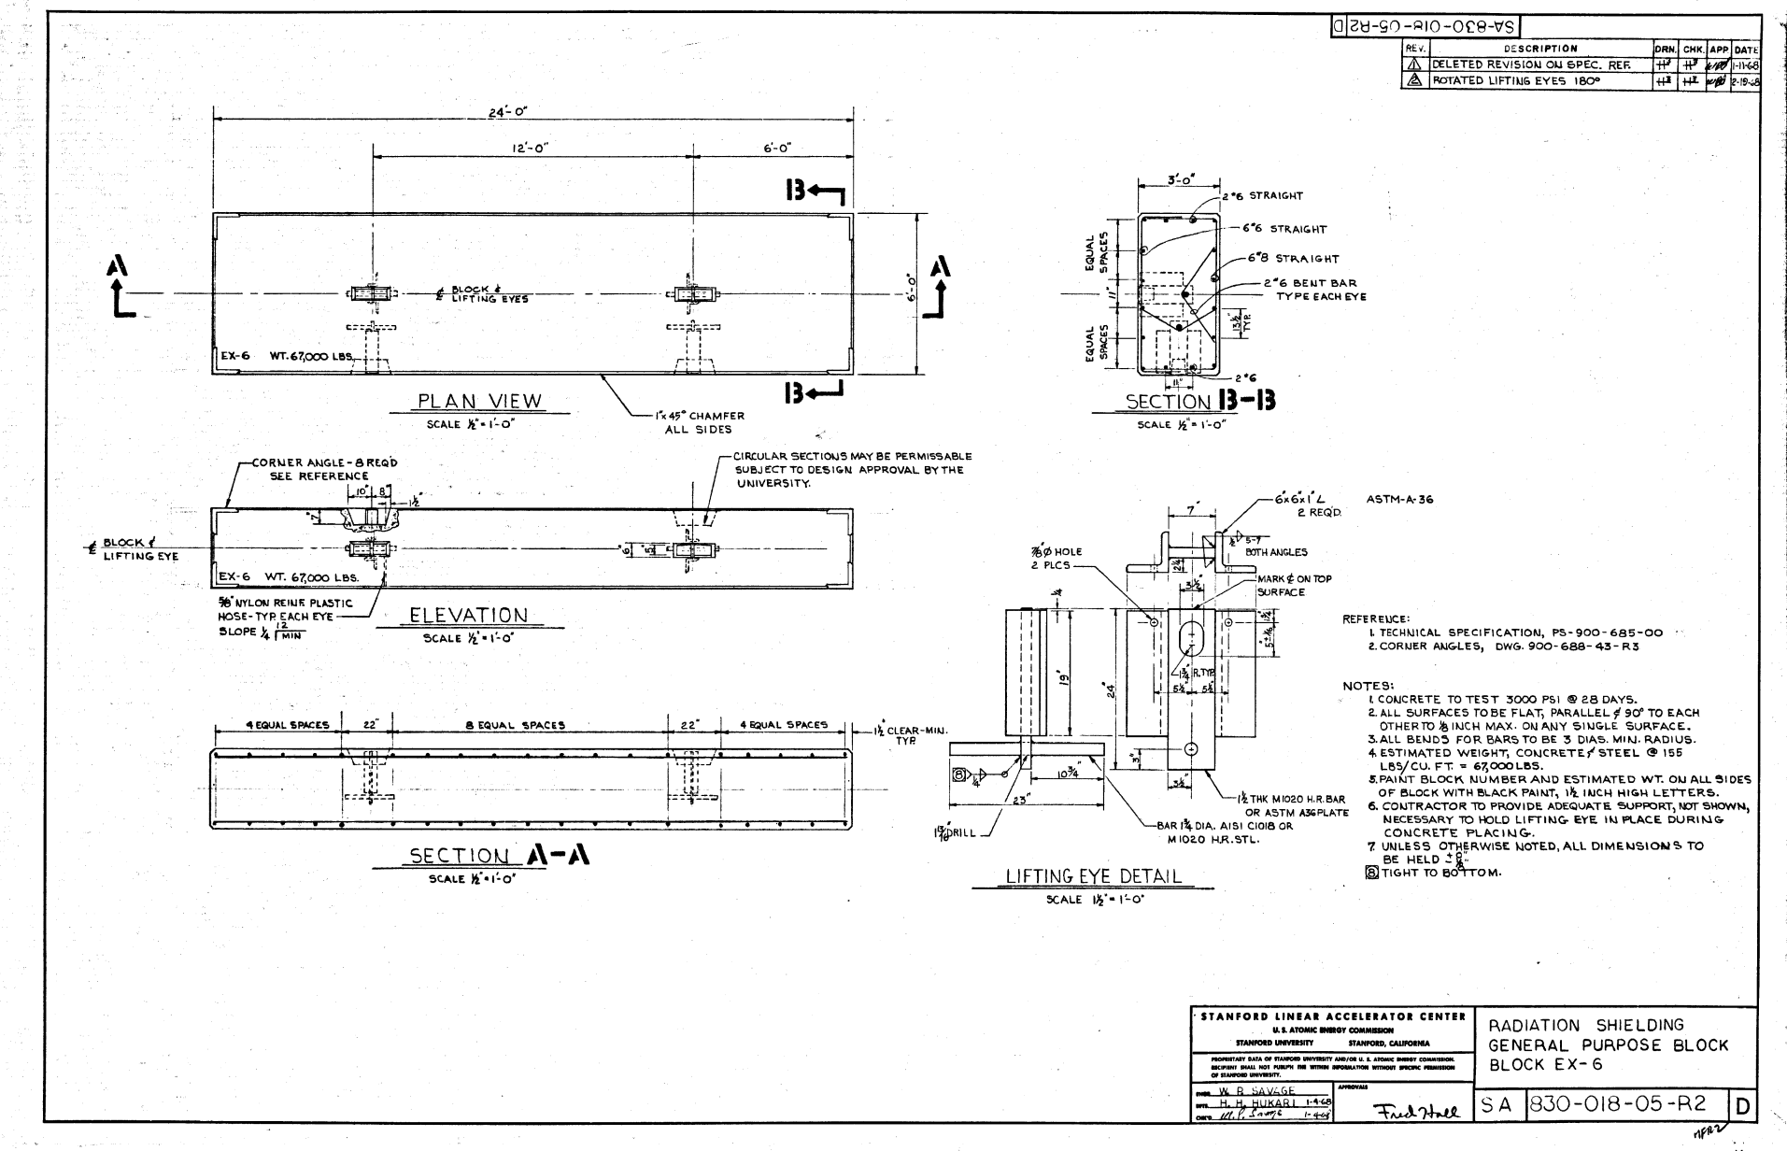
EX-6 Shielding Block

Slide 3
Model Parameters
Limitations of the model:
No damping – need to add.
No static pre-stress (deflection under gravity not included).
Fixed support at 2 lower edges - not realistic for the real world case we wish to measure.
PSD input is not real (was Hera spectrum, but units got mixed up).
Will fix all these things and model all 3 PSD input spectra from Marco in the next weeks.
Results are preliminary at this point.

Slide 4
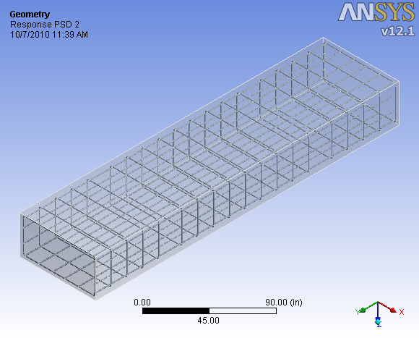
Solid Model for FEA

Slide 5
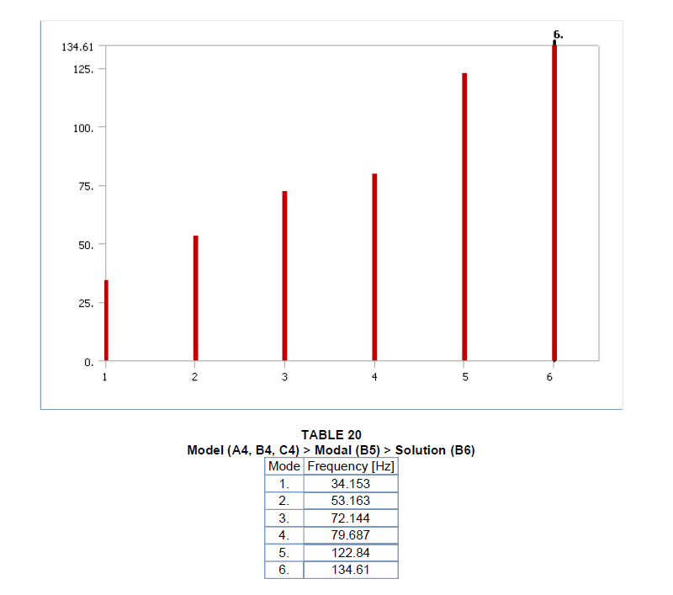
Modal Analysis Results

Slide 6
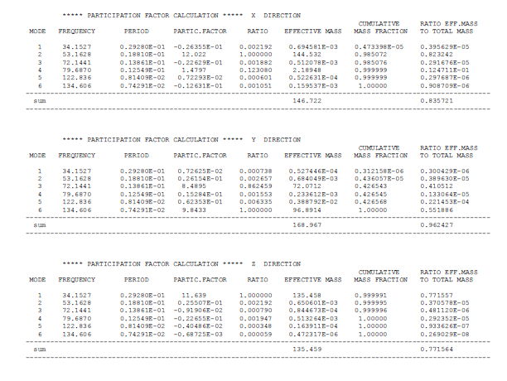

Slide 7
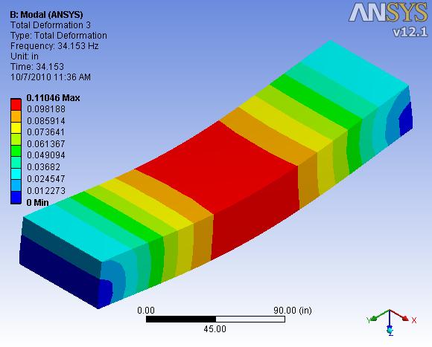
Mode 1

Slide 8
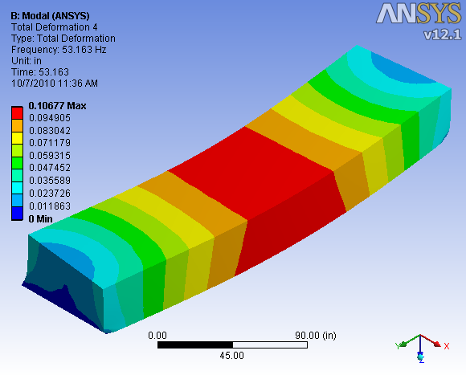
Mode 2

Slide 9
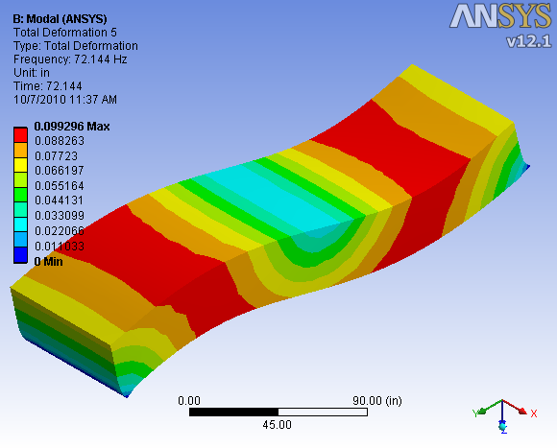
Mode 3

Slide 10
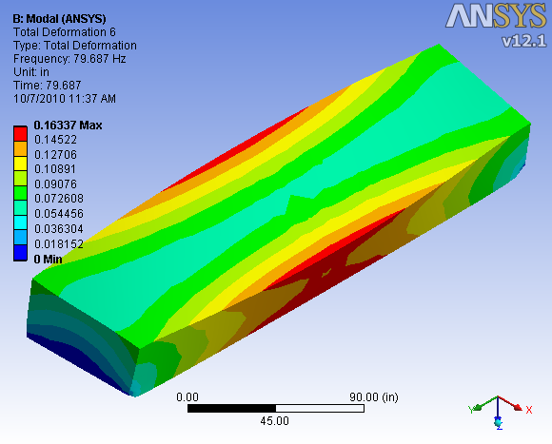
Mode 4

Slide 11
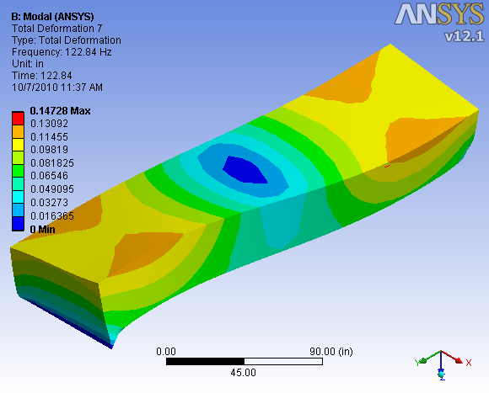
Mode 5

Slide 12
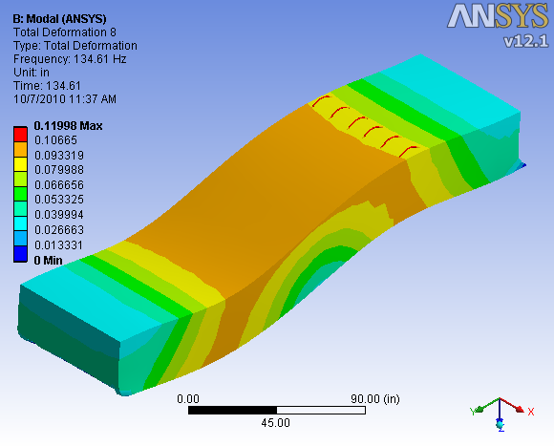
Mode 6

