Slide 1


LC TPC 2008-2010
PRC at DESY, Zeuthen
P. Colas for the LC TPC collaboration

Slide 2
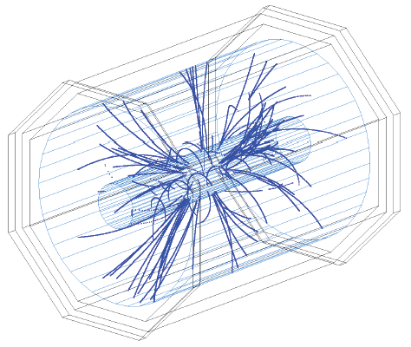
A TPC for the LC
Higgs recoil, jets
Continuous 3D tracking
High B required for vertex detector -> good for TPC
Wires have disadvantages at high B: ExB
Wires need to be tensioned
ILD concept

Slide 3
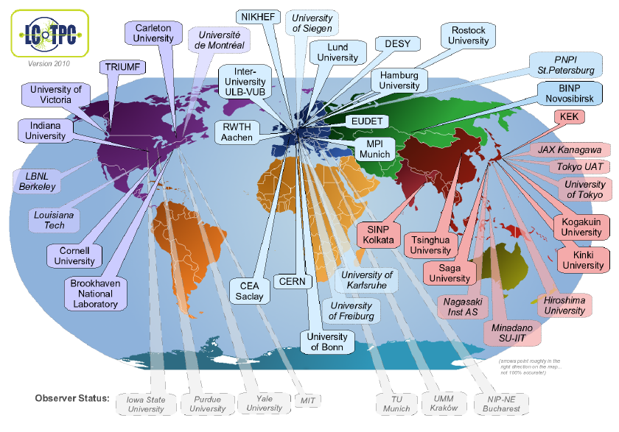
LC TPC gathers all the actors in R&D for a TPC at a LC
25/38 institutes from 12 countries have signed the MoU
7 institutes are observer.
Most world specialists of TPCs, MPGD, front-end electronics, cooling, etc… are members

Slide 4
After a decade of small prototype tests in various labs, all the member institutes joined their efforts and resources around the construction and exploitation of a beam test infrastructure in DESY, supported by the FP6 program EUDET.
LC TPC created a speaker’s bureau in 2009 and started a new working group for TPC engineering and integration.
Outline:
The EUDET infrastructure at DESY Hamburg
The prototypes
Results of operation in 2008-2010
Future

Slide 5
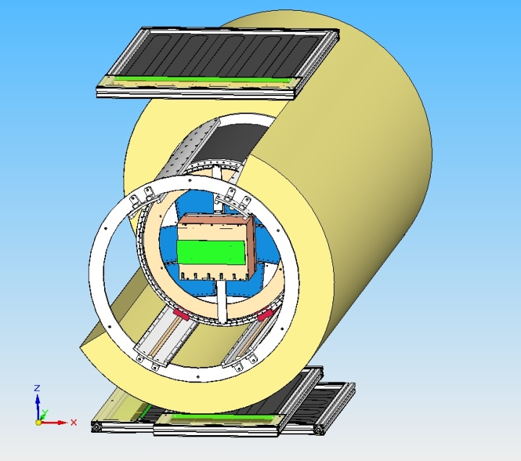
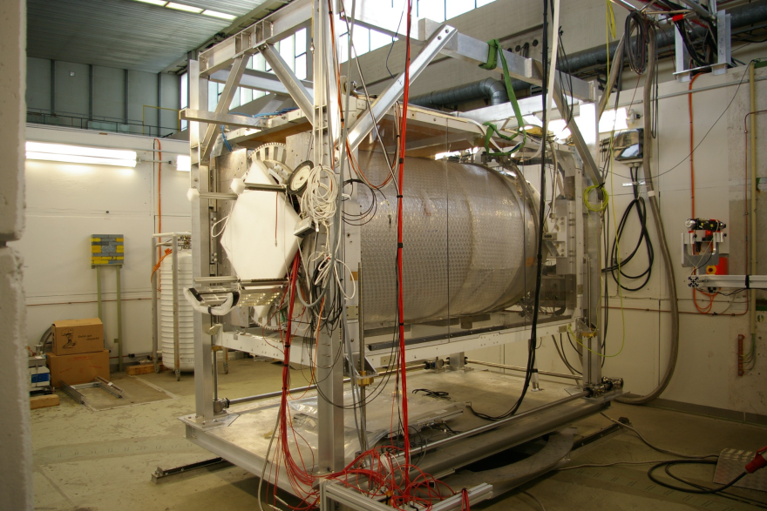
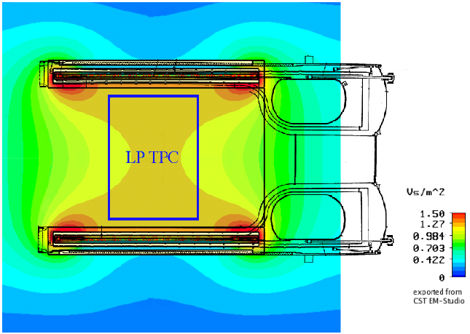
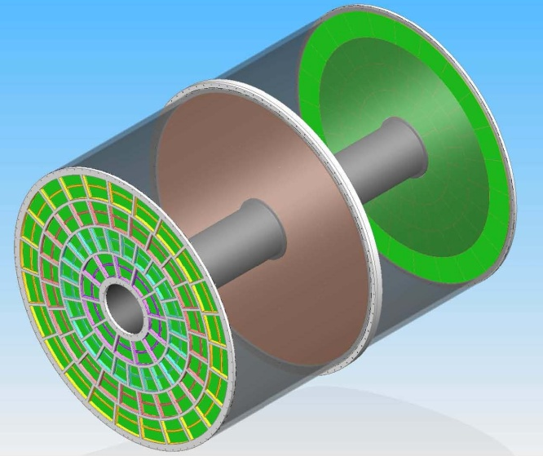
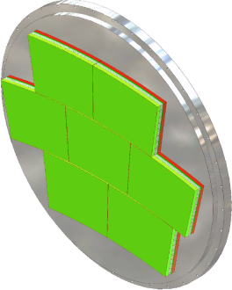
The EUDET facility at DESY Hamburg
PCMAG:
superconducting magnet, 1.2 T
e⁻ test beam @DESY
(1GeV/c<p<6GeV/c)
KEK
SiPM Cosmic
Trigger Setup
Moving frame
DESY
Saclay
LP : part of a
TPC endplate

Slide 6
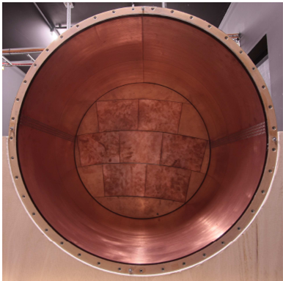
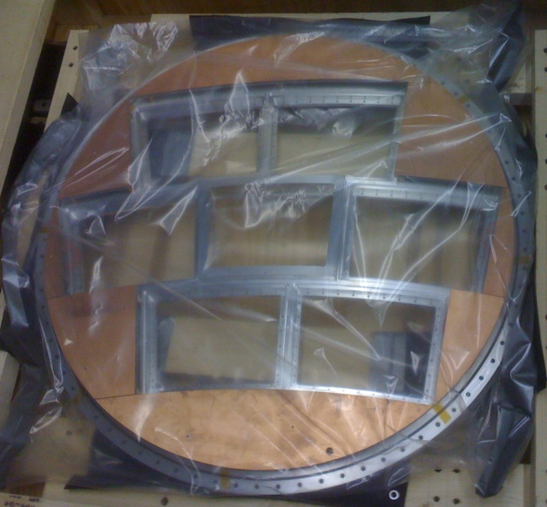
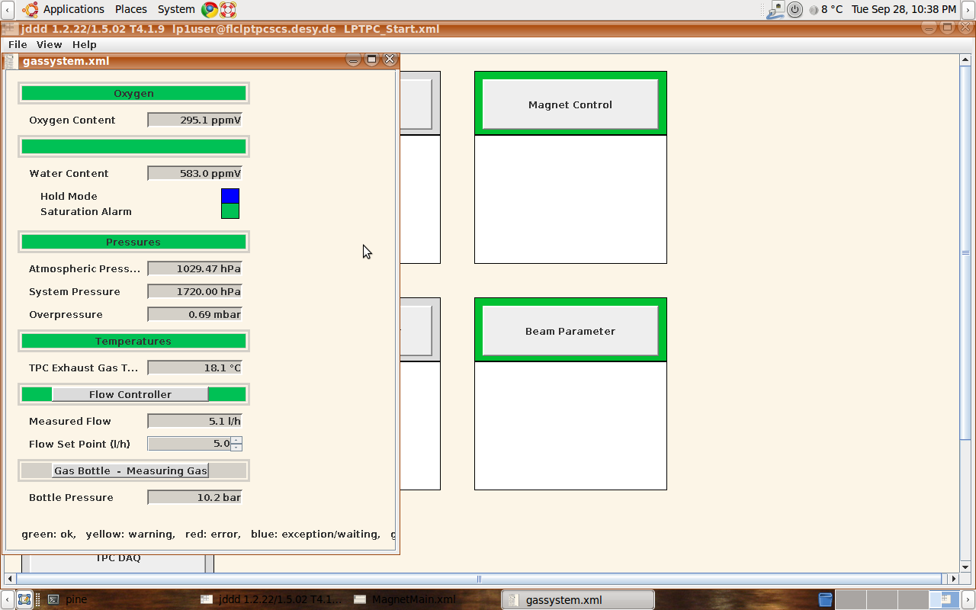
The Large Prototype
Field cage:
extrapolable to LC
L=61 cm, f=72 cm
1.2 X°
Endplate
DESY
Cornell
Gas system
DESY
HV system
Slow control:
T,P, O₂, H₂O
DESY
Laser calibration
U. Victoria
Sharing infrastructure:
- avoids duplication
- favours communication

Slide 7
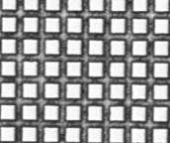
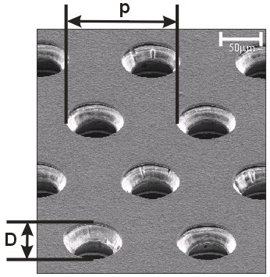
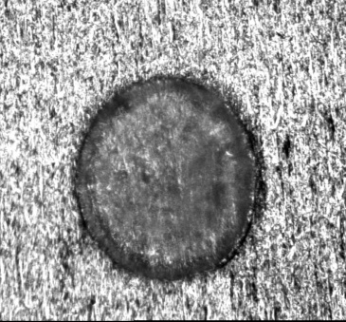
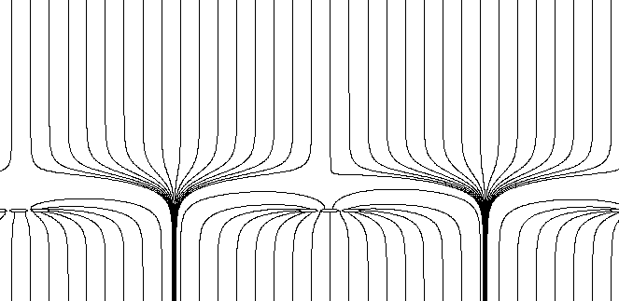
Micromegas
GEM
a micromesh supported by 50-100 μm - high insulating pillars. Multiplication takes place between the anode and the mesh
Two copper perforated foils separated by an insulator (50 μm). Multiplication takes place in the holes.
Usually used in 2 or 3 stages.
Very
S1
200 μm
S2

Slide 8
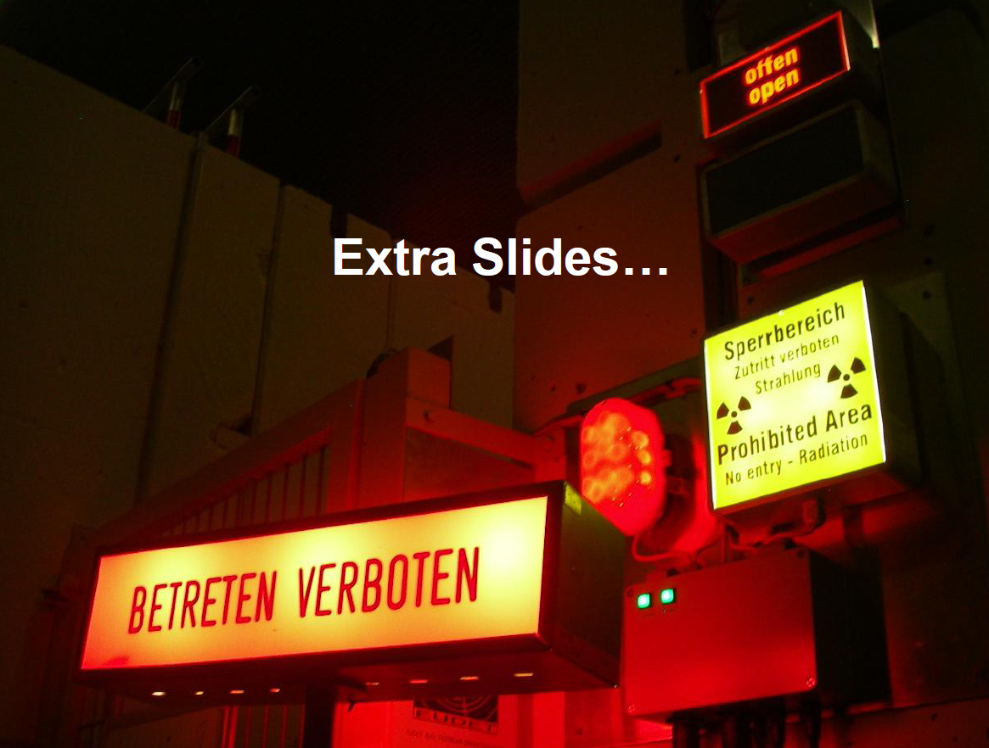
PLEASE ENTER…

Slide 9
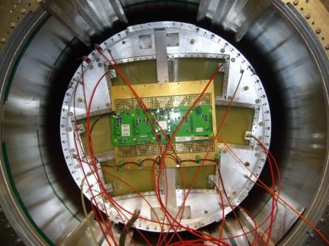
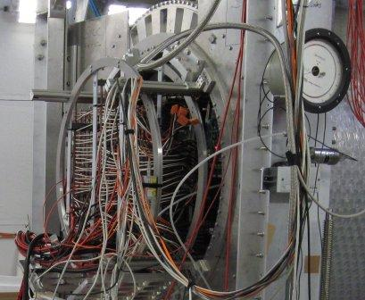
Beam tests at DESY
Micromegas
GEM
Read out by T2K AFTER-based electronics (Saclay)
Read out by ALTRO electronics (EUDET, Lund,CERN)
From October 2008 to September 2010 several GEM and Micromegas modules were tested in beam at the LP

Slide 10
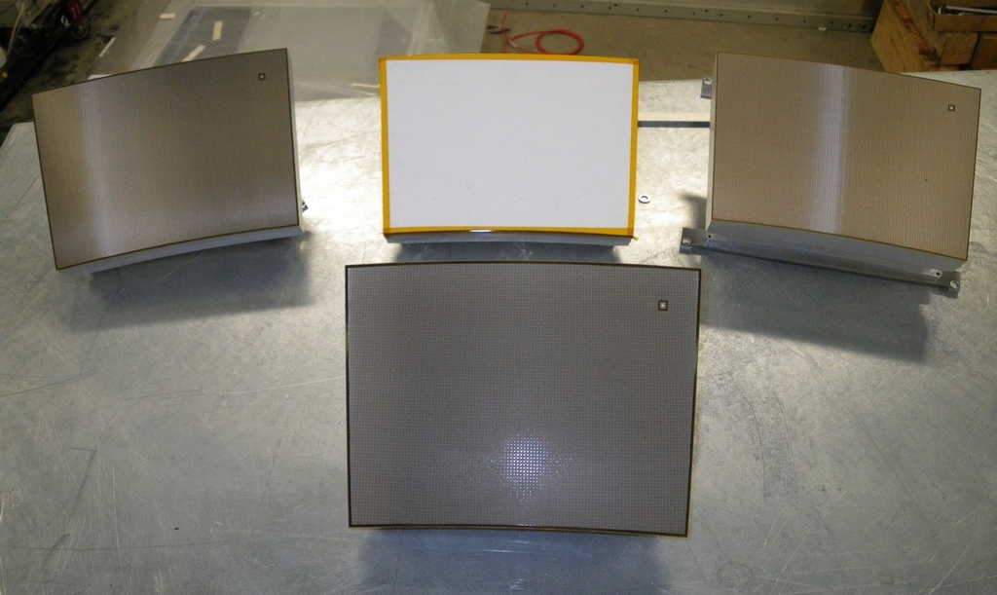
5 Micromegas Modules for TPC
Saclay
CERN
Carleton
2 Resistive Kapton
~3 MΩ/□
Resistive Kapton
~5 MΩ/□
Standard
Bulk Micromegas: pillars hold the mesh on the whole surface: no need for frame
Resistive bulk: continuous 2D RC network to spread the charge
Resistive ink
~3 MΩ/□
10

Slide 11
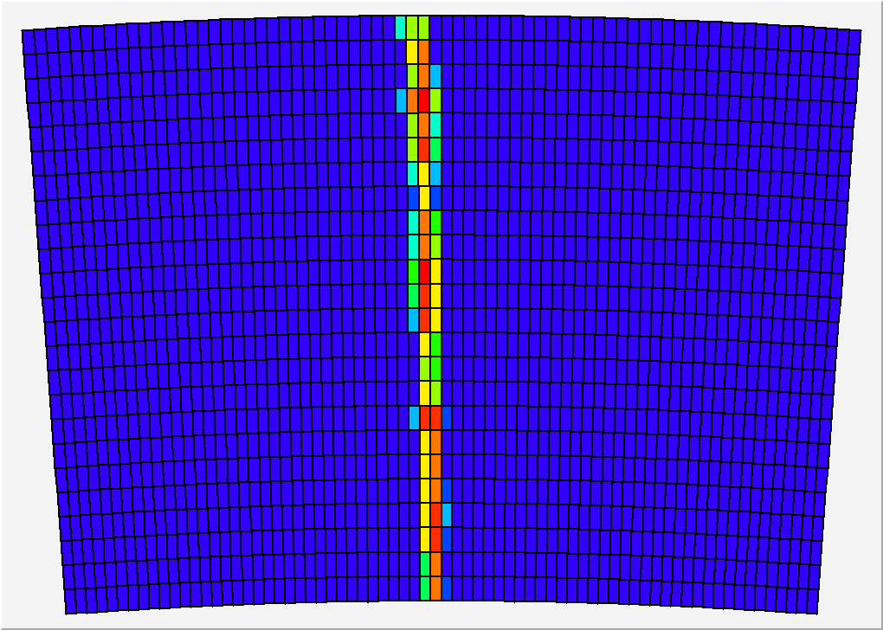
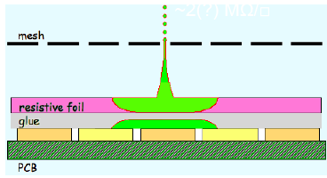
24 rows x 72 pads, 2.7-3.2 mm wide, 7 mm long

Slide 12
Asian GEM Modules for TPC
KEK
Tsinghua
Saga + other Japan Univ.
2-GEM (laser etched, with 100 µm gap, from SciEnergy, Japan), plus 1 gating grid (replaced by a field shaper in Sep. 2010 )
GEMs pegged down by the two arc-shaped stiffenders

Slide 13
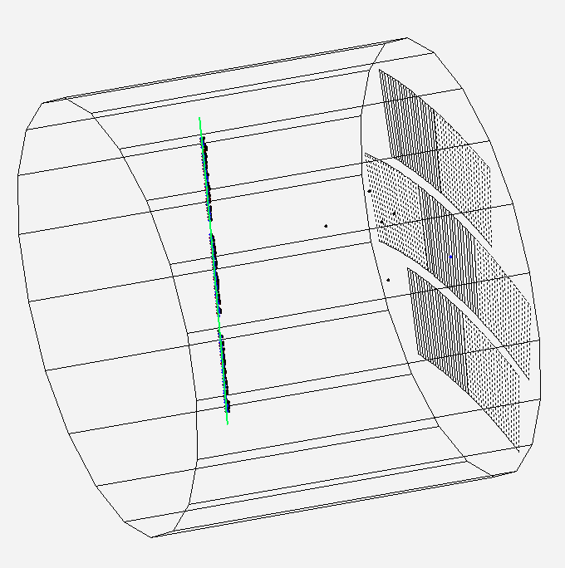
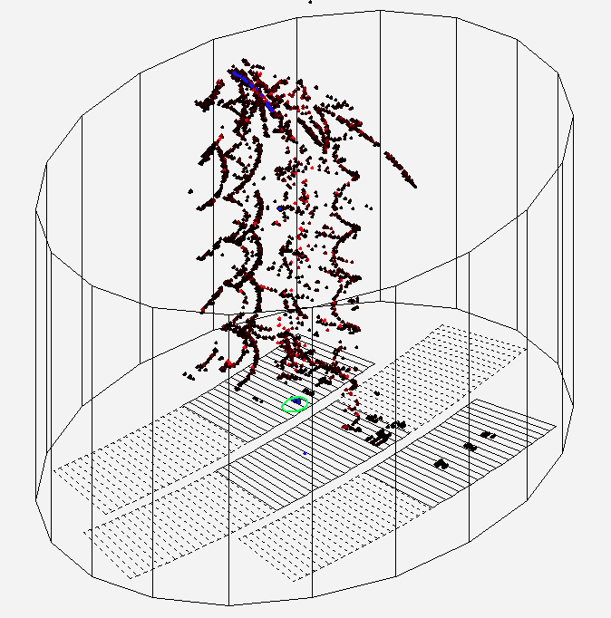
28 pad-rows of 176 -194 pads (pad size ~ 1.1 x 5.4 mm²
Total 5152 pads/modules
3 modules partially equipped (7616 channels)

Slide 14
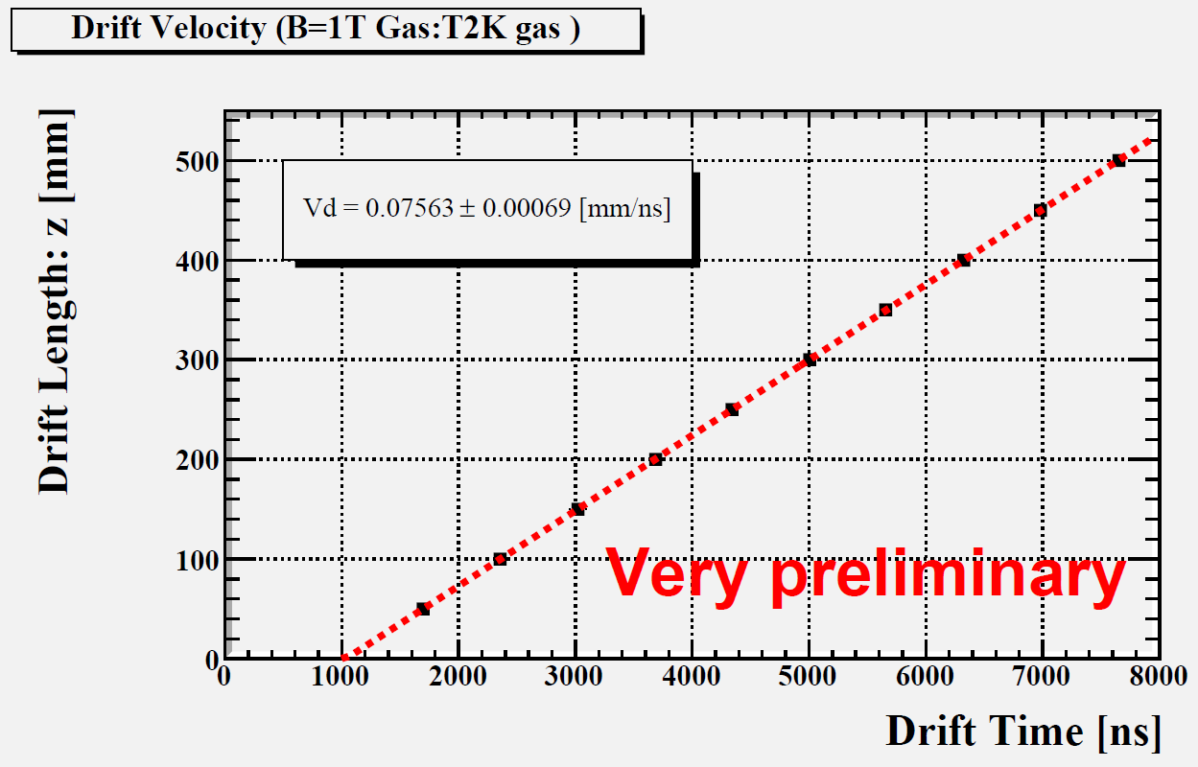
Drift velocity measurements
Both GEM and Micromegas used T2K gas (Ar:CF4:iso=95:3:2).
GEM
T2K Gas: B=1T
Micromegas, with P=1035 hPa, T=292 K, 35-50 ppm H₂0
V_{drift} = 7.698 +- 0.040 cm/µs at E=230 V/cm (Magboltz : 7.583+-0.025(gas comp.))
GEM, with P=1013 hPa, T=290 K, 200 ppm H₂0
V_{drift} = 7.563 +- 0.069 cm/µs at E=230 V/cm (Magboltz : 7.509+-0.024(gas comp.))

Slide 15
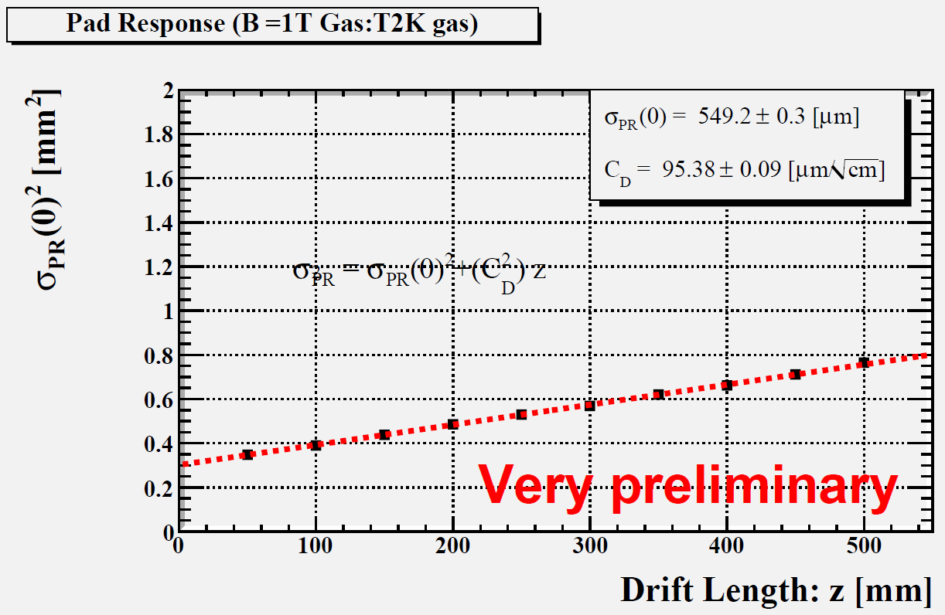
Velocity vs drift field with Micromegas
σ² (pad resp.) vs drift distance with GEM
C_{D} = 95.4±0.1 µm/√cm
Magboltz predicts 94.3

Slide 16
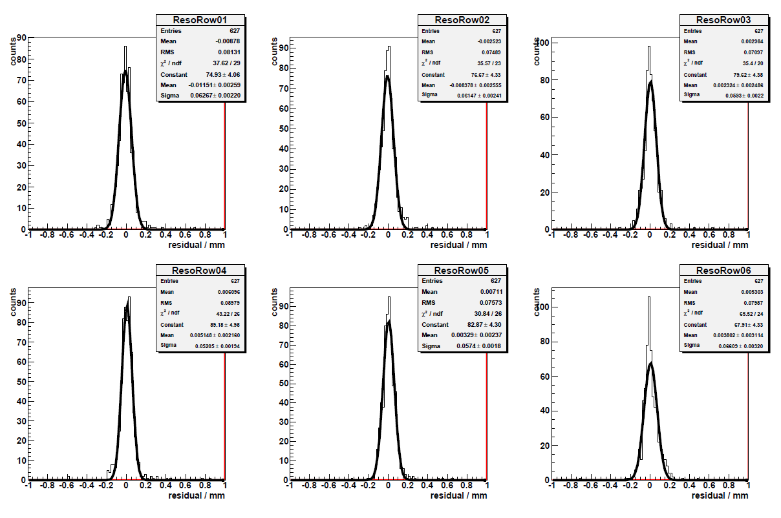
Micromegas residual distributions
Position residuals x_{row}-x_{track}

Slide 17
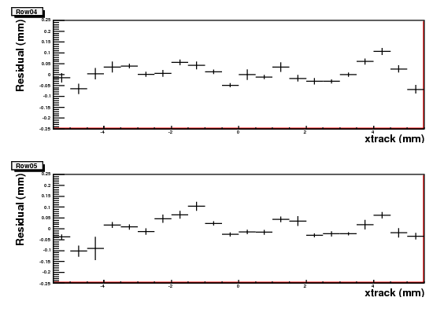
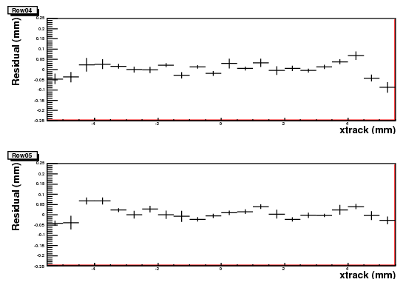
Bias inside a row vs track position
Bias before correction
Bias after correction
±50µm
±50µm
Bias after
Bias due to non-uniformity can be easily corrected.

Slide 18
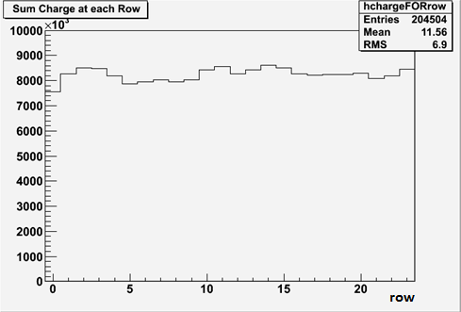
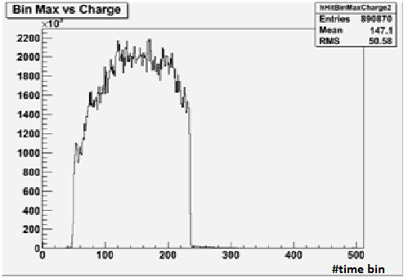
Uniformity (B = 0T)
from cosmic-ray tracks
Time of pulse max
Preliminary
Total charge by row using cosmic-ray events

Slide 19
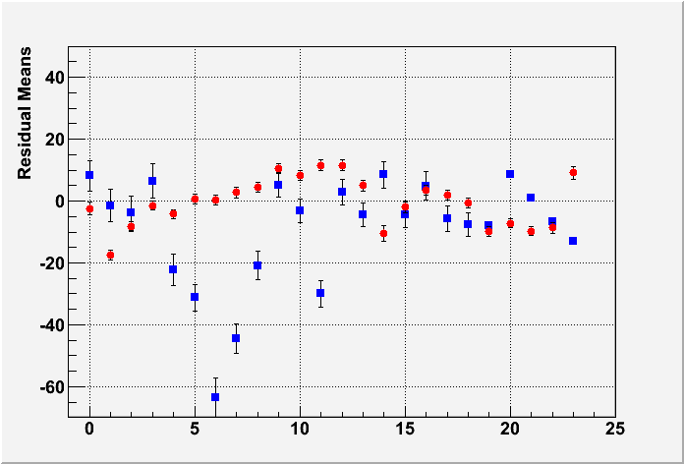
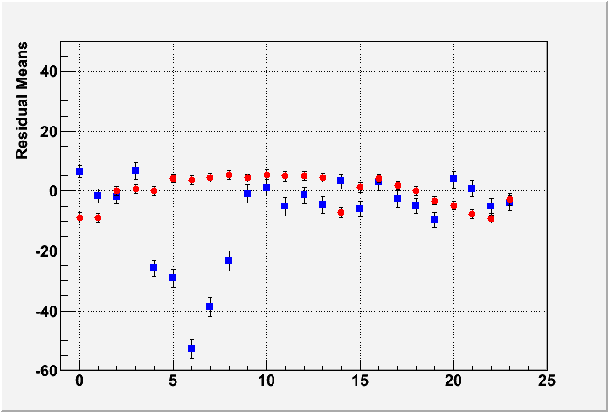
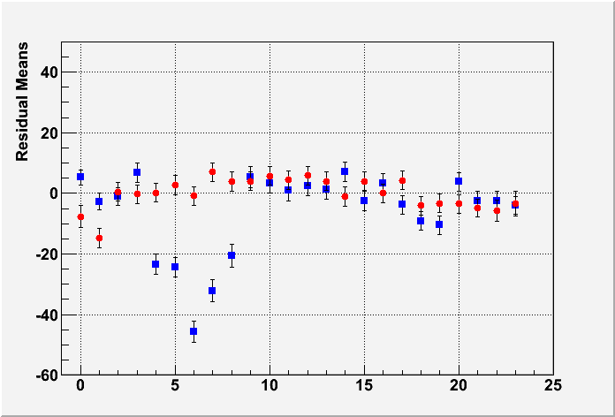
Uniformity
Z=5cm
MEAN RESIDUAL vs ROW number
Z-independent distortions
Distortions up to 50 microns for resistive ink (blue points)
Rms 7 microns for CLK film (red points)
Z=35cm
Z=50cm
Carbon loaded kapton is much more uniform than resistive ink

Slide 20
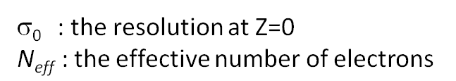
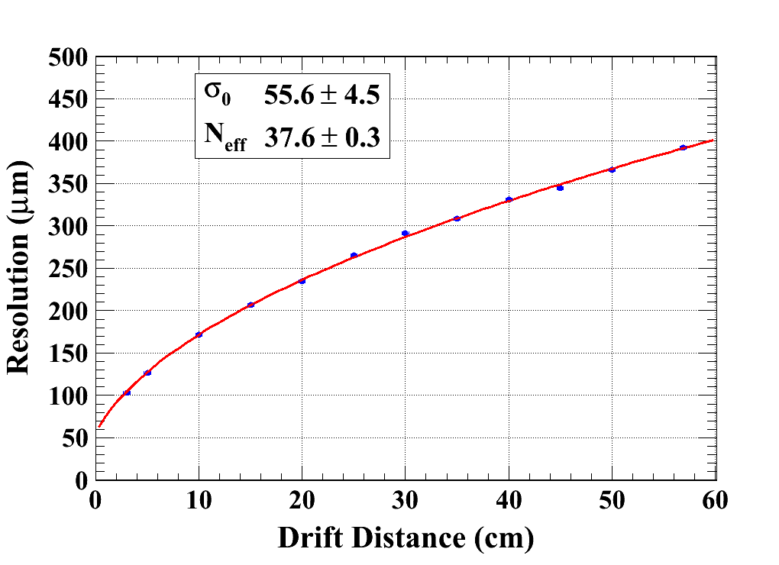
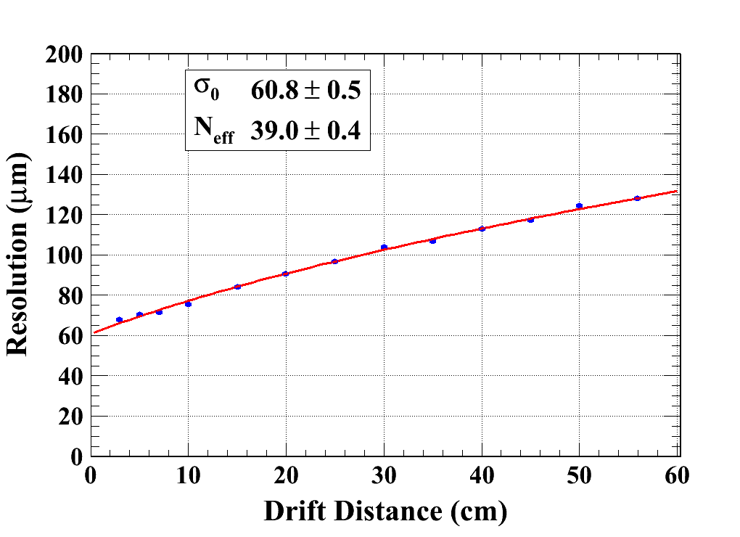
Micromegas results (B = 0T & 1T)
Carbon-loaded kapton resistive foil
B=0 T C_{d} = 315.1 µm/√cm (Magboltz)
B=1 T C_{d} = 94.2 µm/√cm (Magboltz)
χ²/Ndof = 10.6/10
χ²/Ndof = 29.1/11
Module 4
Module 3
Averaging B=0T data and B=1T data (excluding ink module):
N_{eff} = 38.0±0.2(stat) ±0.8 (Cd syst)
σ₀= 59 ± 3 µm
80 µm resolution at 2m in B=3.5 T !

Slide 21
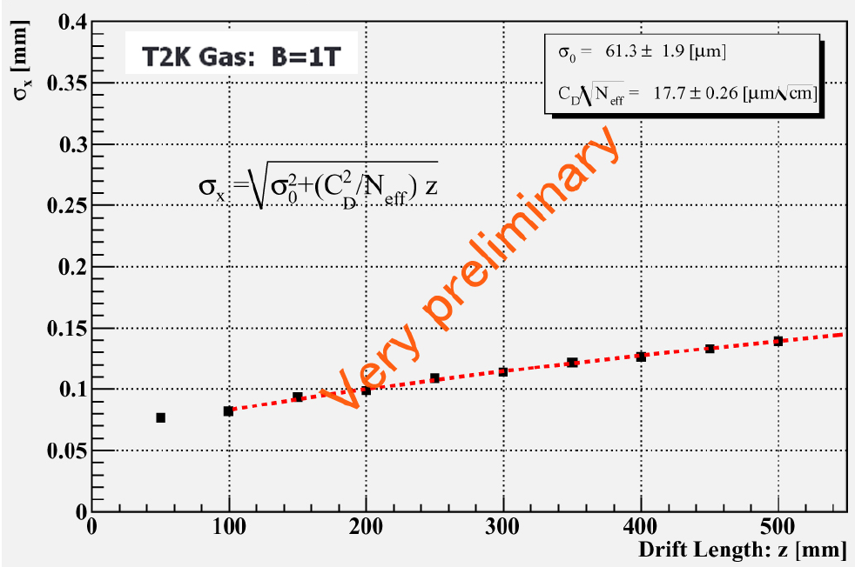
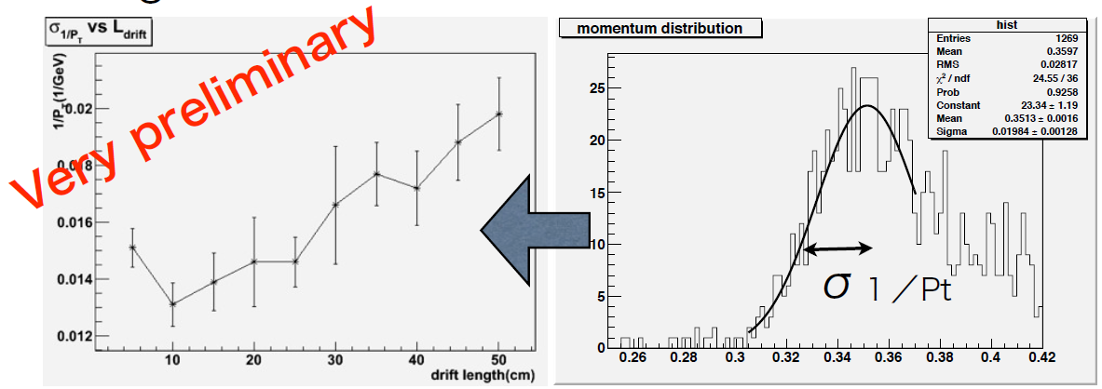
Resolution with GEMs
3 modules allow a momentum measurement :
1/P_{T} resolution extrapolated to z=0 obtained 0.083 GeV⁻¹ (expected 0.081 GeV⁻¹ )
Using MarlinTPC software

Slide 22
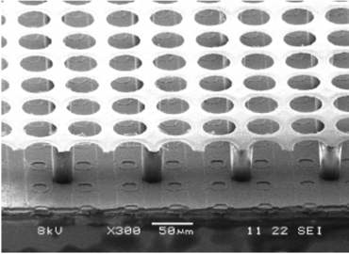
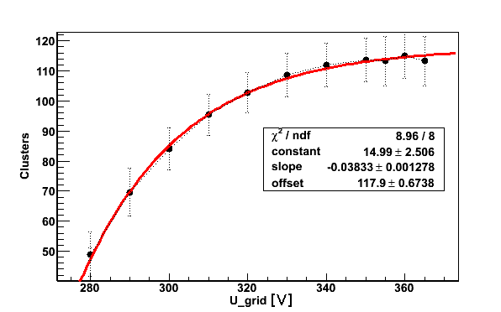
Micromegas+pixels, GridPix
Nikhef Saclay Bonn CERN
TimePix chip : 65 000 digital pixels (55 µm x 55 µm) with time and TOT measurement
Single electron capability
Octopuce : 8 chips bounded
on a LP panel.
Next steps within AIDA
e- content and width
of the escape peak
Single electron efficiency vs gain determined by counting electrons from a source, assuming some analytic form for avalanche fluctuations

Slide 23
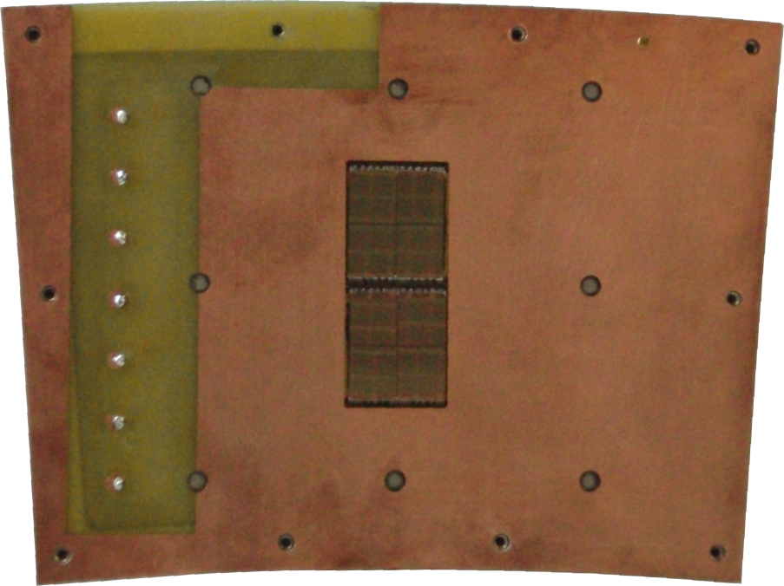
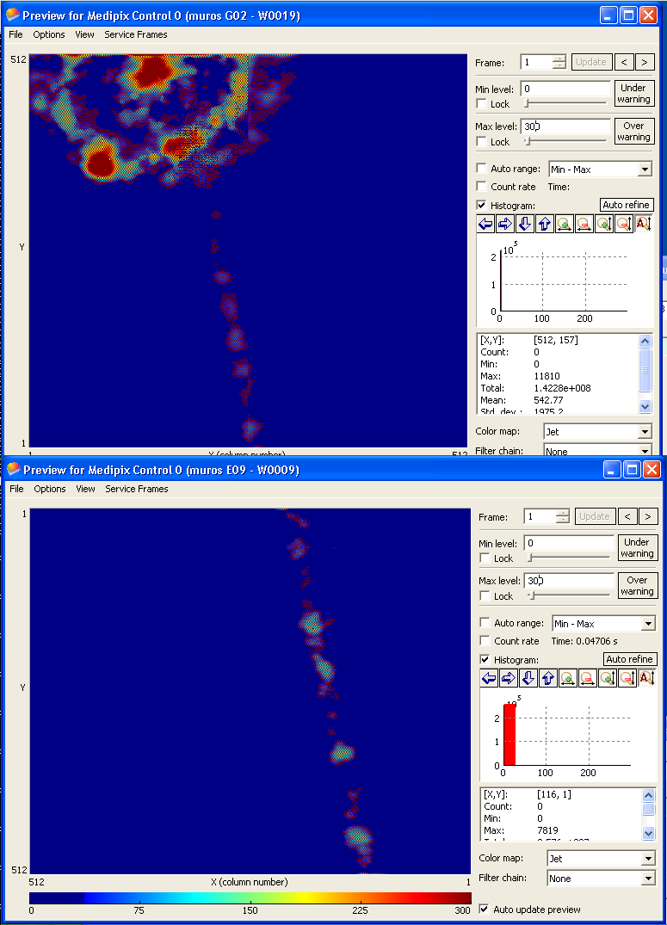
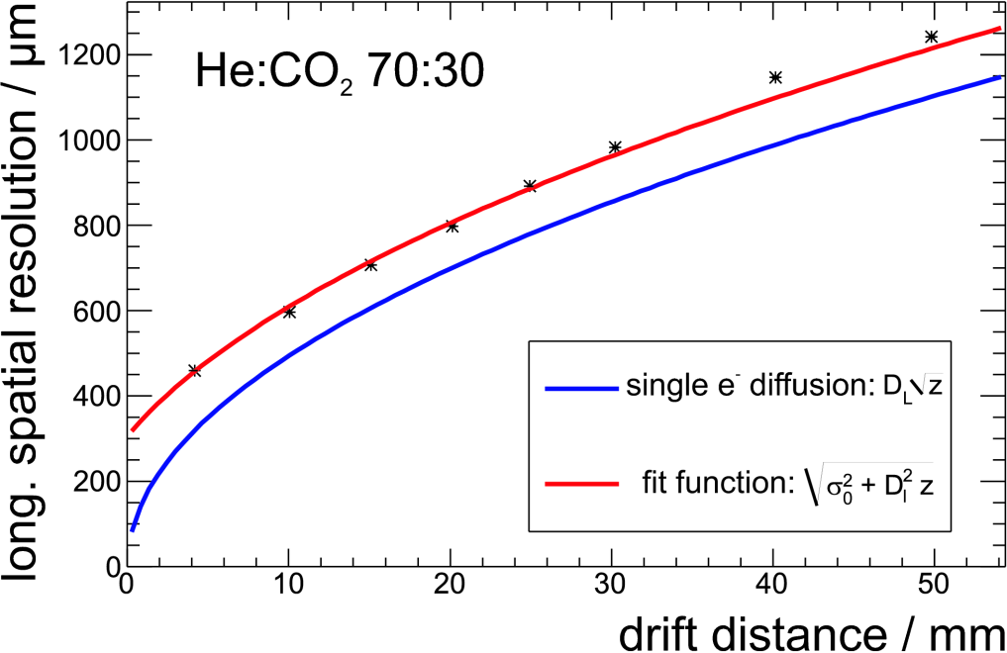
GEM + Pixels
2 TimePix quads topped by 3 GEMs
/cm

Slide 24
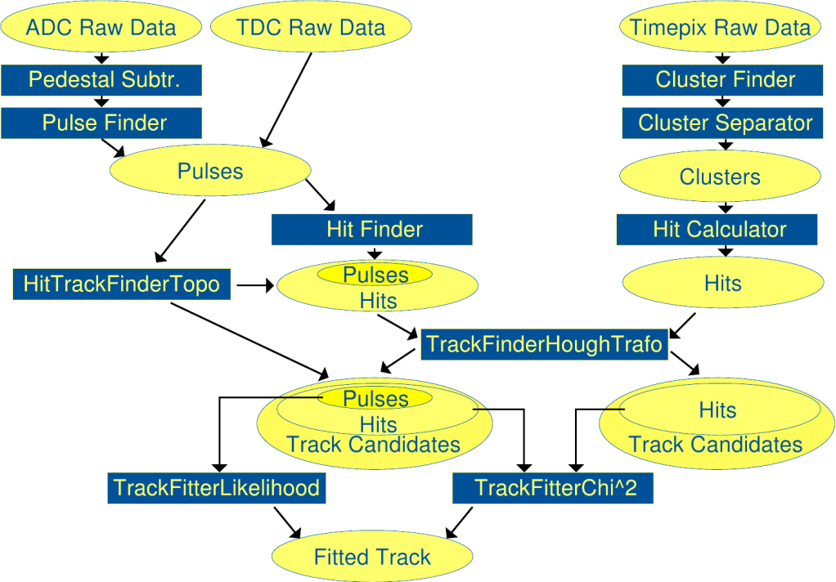
SOFTWARE
DESY, KEK, Bonn, Tsinghua, Victoria, Carleton…
LC TPC developped a common software for reconstruction and simulation of test data: MarlinTPC (based on the ILC software).
This provides input for ILD design and benchmark studies
It includes reconstruction up to hit level (treatment of charge-spreading by resistive anodes to come)
Packages are available for track finding and fitting (Kalman filter, Hough transform, χ² and likelihood)
Calibration and correction methods (alignment, inhomogeneous fields) tools are being set up with the ILD collaboration

Slide 25
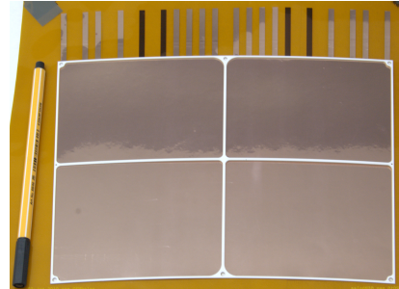
DESY GEM module
Present GEMs need improved flatness: a design with a thin ceramic support structure is under construction.
The GEMs are stretchless in this design, minimizing the dead space and flattening the gaps. This also allows to reach the dE/dx goal and provides robustness.
Previous studies with MediTPC showed that the ceramic grid (1 mm x 1 mm mullions) has a negligeable effect on single-point resolution.

Slide 26
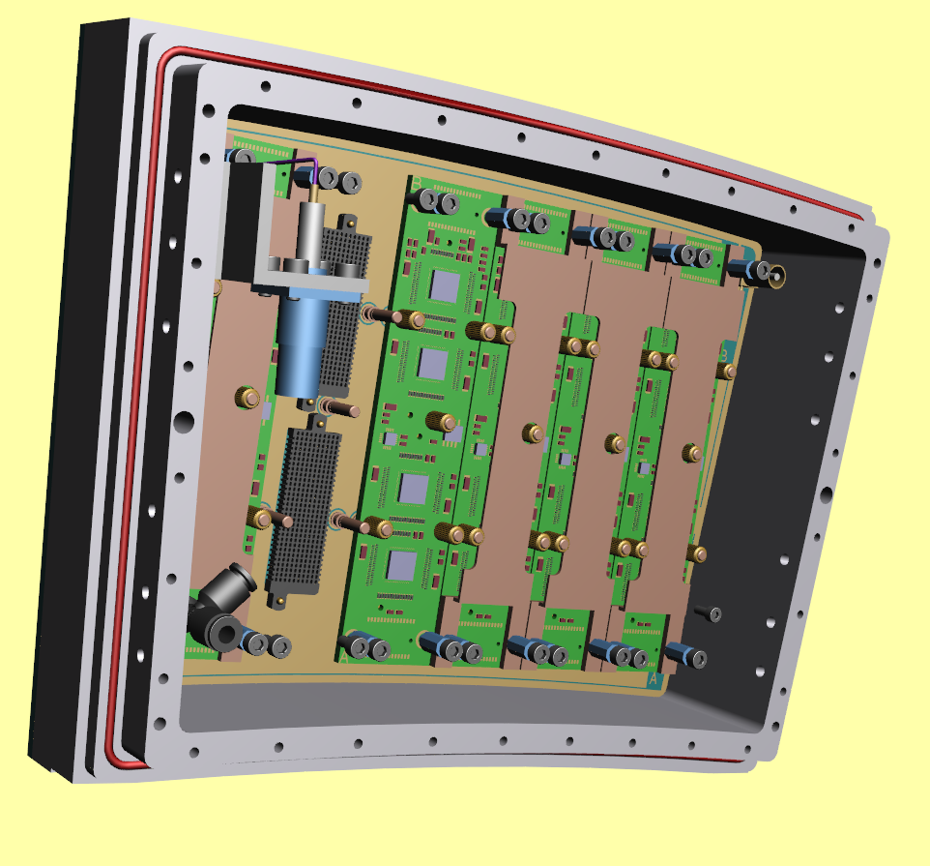
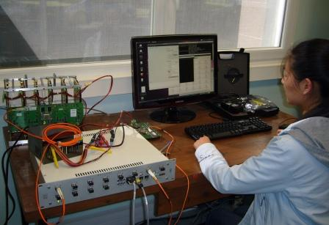
7-module electronics for Micromegas LP test
Effort to integrate the electronics flat behind the modules : cards with naked wire-bonded chips, special high density flat connectors, tailored protection
Expect noise reduction
Air cooling
“Power-pulsing ready”
Status: Backend and 2 prototype module cards operational, FECs under fabrication.
Saclay Carleton

Slide 27
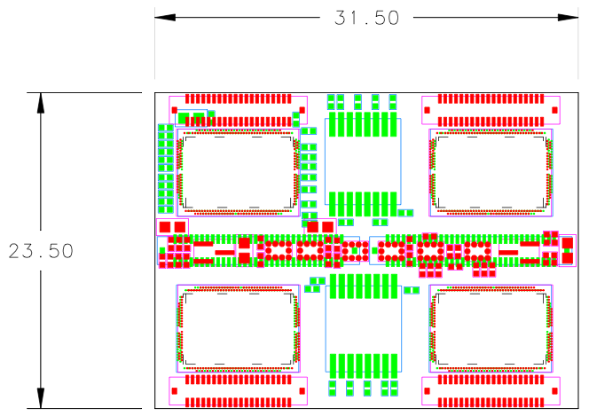
S-Altro electronics
Until now used PCA16 preamp and ALTRO filter+ADC
Full chain new S-ALTRO16 chip prototype submitted
Will be mounted on Multi-Channel Modules
Towards new chip 64 channels
CO2 Cooling and power pulsing foreseen

Slide 28
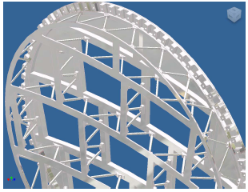
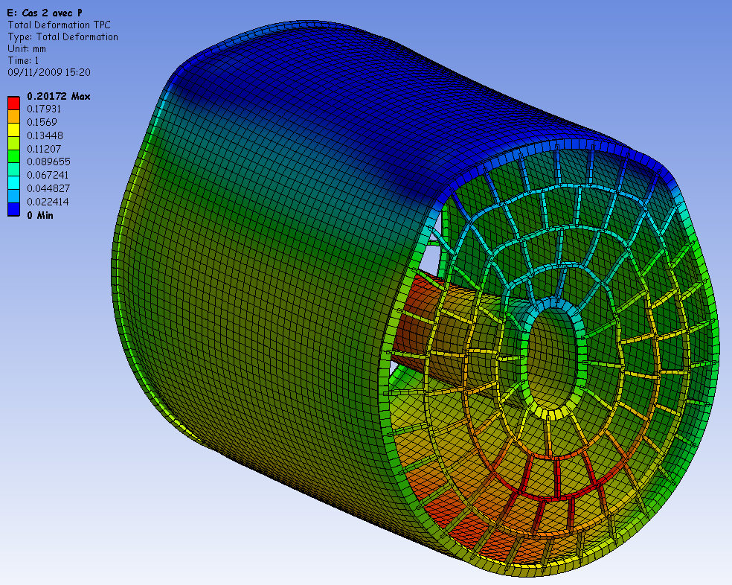
Mechanical engineered design
New Endplate under study at Cornell: hybrid Al (for surfaces) and composite (for rigidity)
Mechanical studies within AIDA (DESY-Saclay)

Slide 29
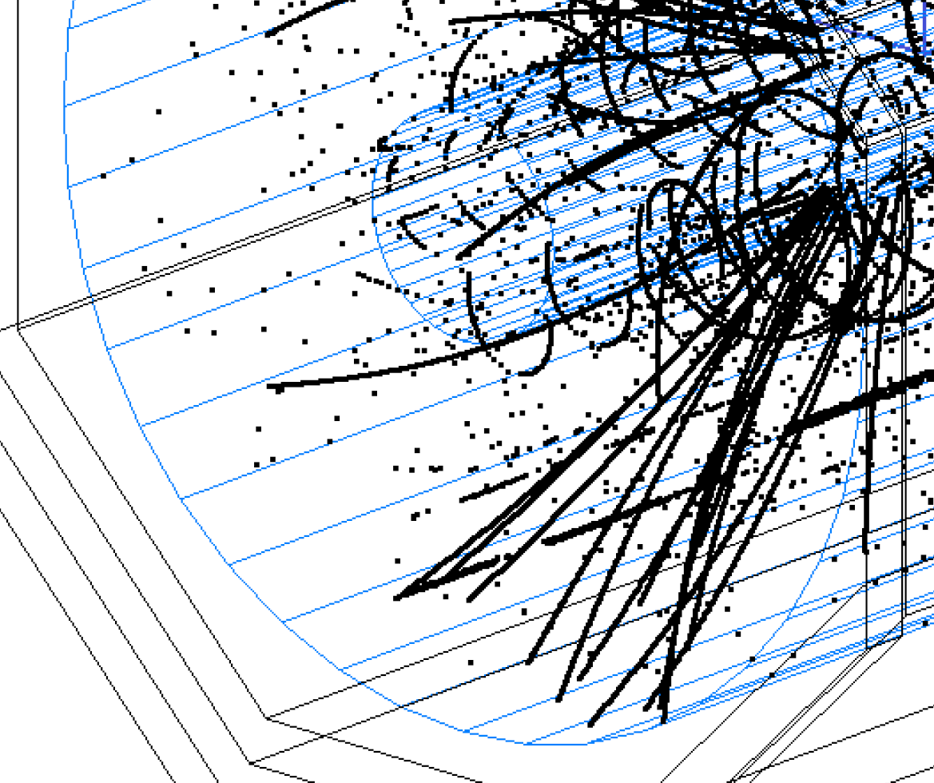
Space charge
Mainly due to micro-curlers and X rays
Study of effects of primary ionisation (curlers and ‘snow’) have started
Also effect of the ‘ion disk’ flowing back in the drift volume at each train crossing will be assessed

Slide 30
Towards the Detailed Baseline
The next milestone of LC TPC is to converge towards a Detailed Baseline Document answering all the open questions
New endplate and field cage designs with reduced material budget
S-ALTRO 16 chip in production
Cooling and power pulsing will be tested
Software developments towards corrections for space charge and field inhomogeneity
TimePix 2 and its readout

Slide 31
BACK-UP SLIDES

Slide 32


Data analysis results
PRF : Pad Response Function
a measure of signal size as a function of track position relative to the centre of the pad
The PRF:
is not Gaussian.
can be characterized by its FWHM Γ(z) & base Width Δ(z), plus another shape parameter.
Γ
Δ

Slide 33


PRF(Pad Response Functions) fits, z ~ 5 cm
Data analysis results
Γ ~ 4 mm
Γ ~ 2.6 mm
δ ~ 14 mm
δ ~ 10 mm
B=1T data : comparison of resistive ink and Carbon-loaded Kapton

Slide 34
N_{eff} measurement with Micromegas
Averaging B=0T data and B=1T data (excluding ink module):
N_{eff} = 38.0±0.2(stat) ±0.8 (Cd syst)
σ₀= 59 ± 3 µm
Note that 1/<1/N> = 47.1 from Heed for 5 Gev electrons on 6.84 mm long pads.
This demonstrates that gain fluctuations are not exponential (Neff would be 23) but smaller.
1/<1/N> = 34.9 for 5.4 mm pads (GEM case).

Slide 35

Distortions with GEMs
z=50cm
z= 5cm
Very preliminary
E=230[V/cm]
Due to wrong HV setting
E=230[V/cm]
E~200[V/cm]
Dummy modules
Or
Termination
plates
Dummy modules
or
Termination
plates

