Slide 1
JLab Update
RG
ILC Cavity Group Meeting
November 9, 2010

Slide 2
Facilities
Facilities resumed after 2-week down in late August.
Some field emission issues in September. Several suspected causes identified – but no strong final correlation. Situation seems to have recovered now.
CEBAF 12 GeV upgrade cavities started EP processing and RF test and dominate work EP machine, HPR machine and class-10 assembly area.

Slide 3
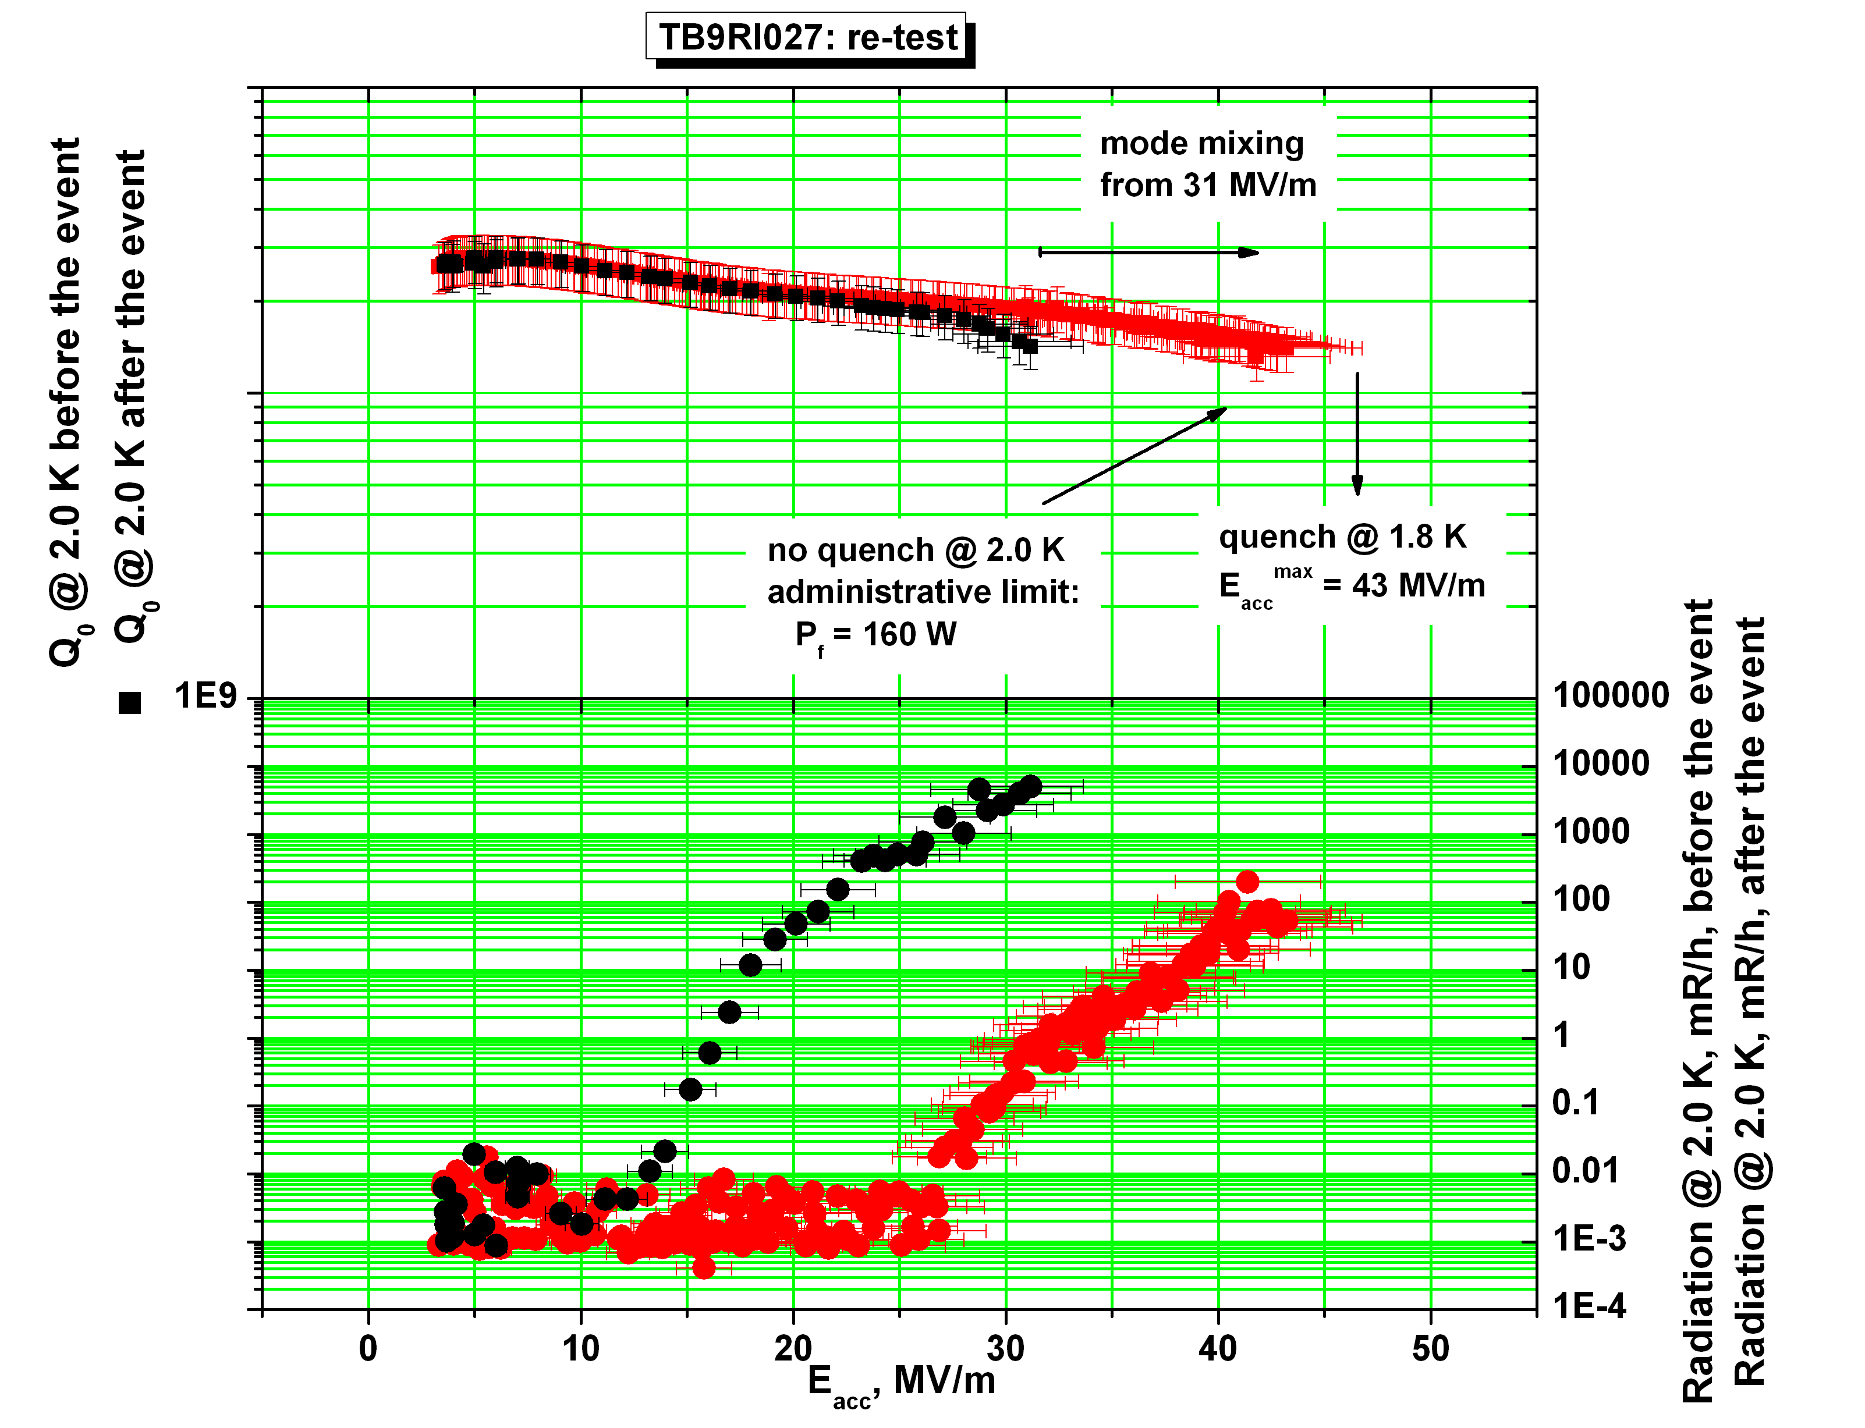
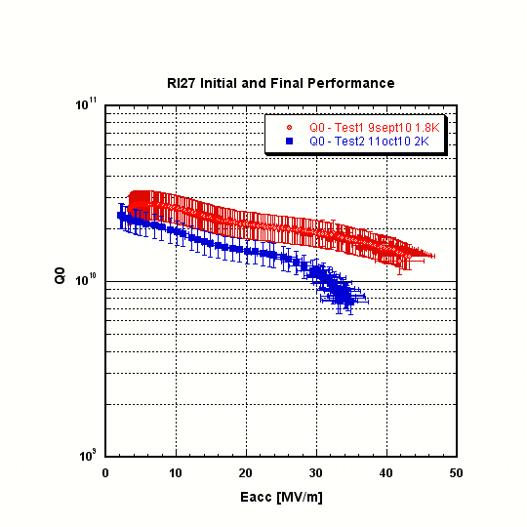
TB9RI27
RI27 1st test 43 MV/m quench limited, < 500 mR/h X-ray at highest field, mode mixing observed at > 31 MV/m. 2nd sound predicted quench in center cell. Re-test after warm up and fixed thermometry installation – event at > 41 MV/m followed by FE turn on and limited to 31 MV/m.
RI27 re-test after re-HPR 3X (partial dis-assm), performance recovered somewhat and meets ILC vertical test spec. still strong FE limited. Pi-mode frequency at 2K under vacuum 1299.824 MHz (target 1299.700); Pi mode FF 97.7% prior to final EP.
Cavity already shipped back to FNAL.

Slide 4
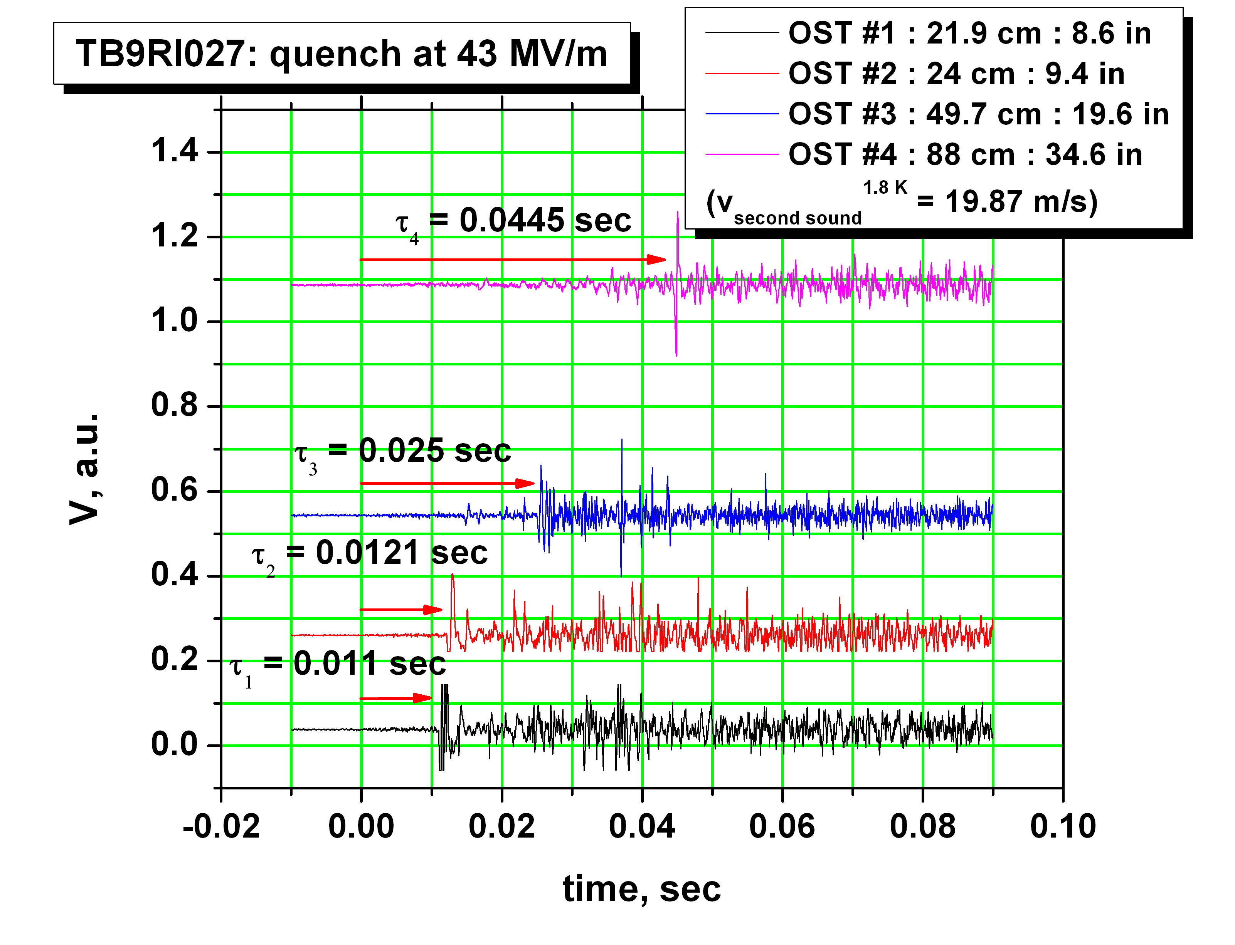
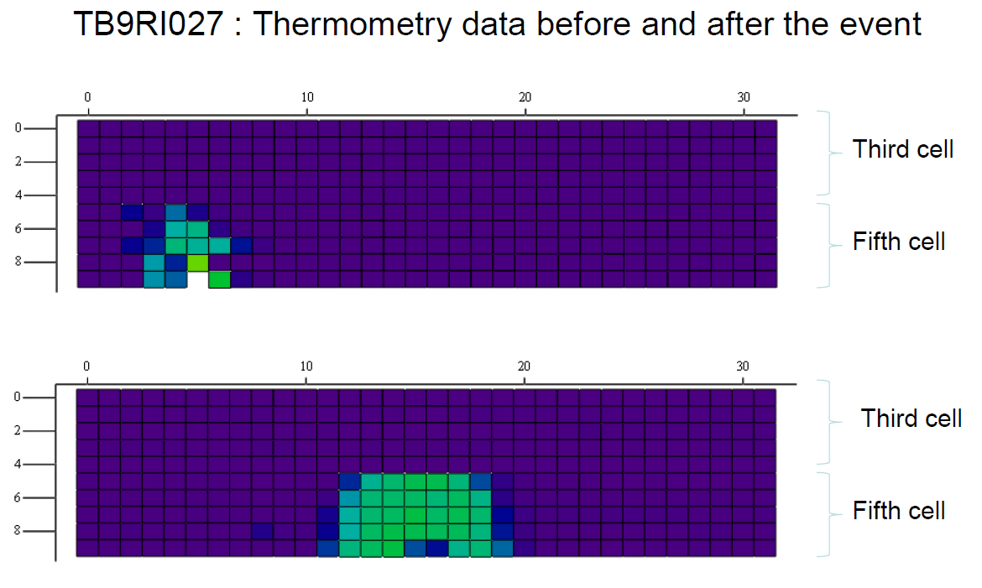
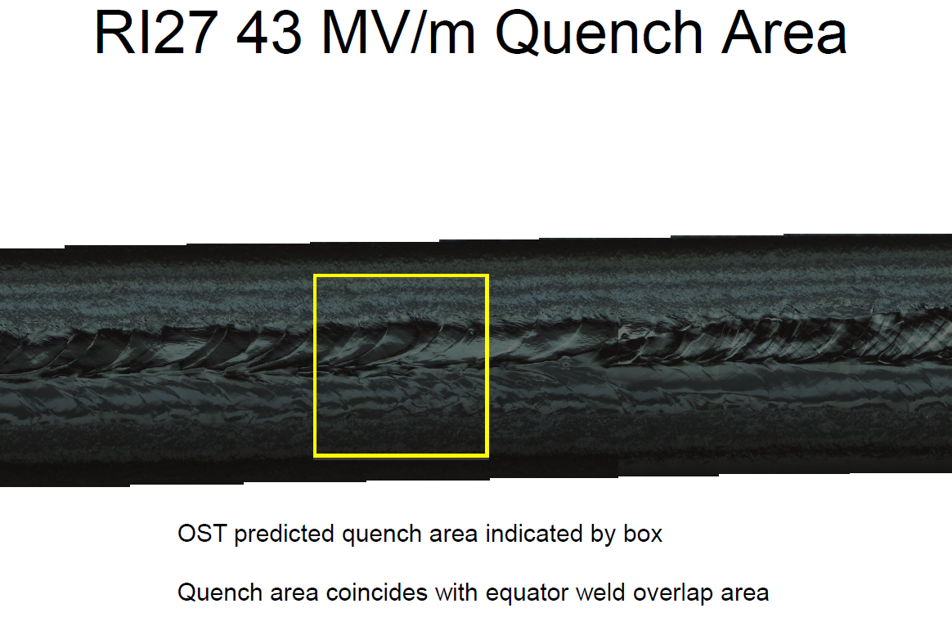

Slide 5
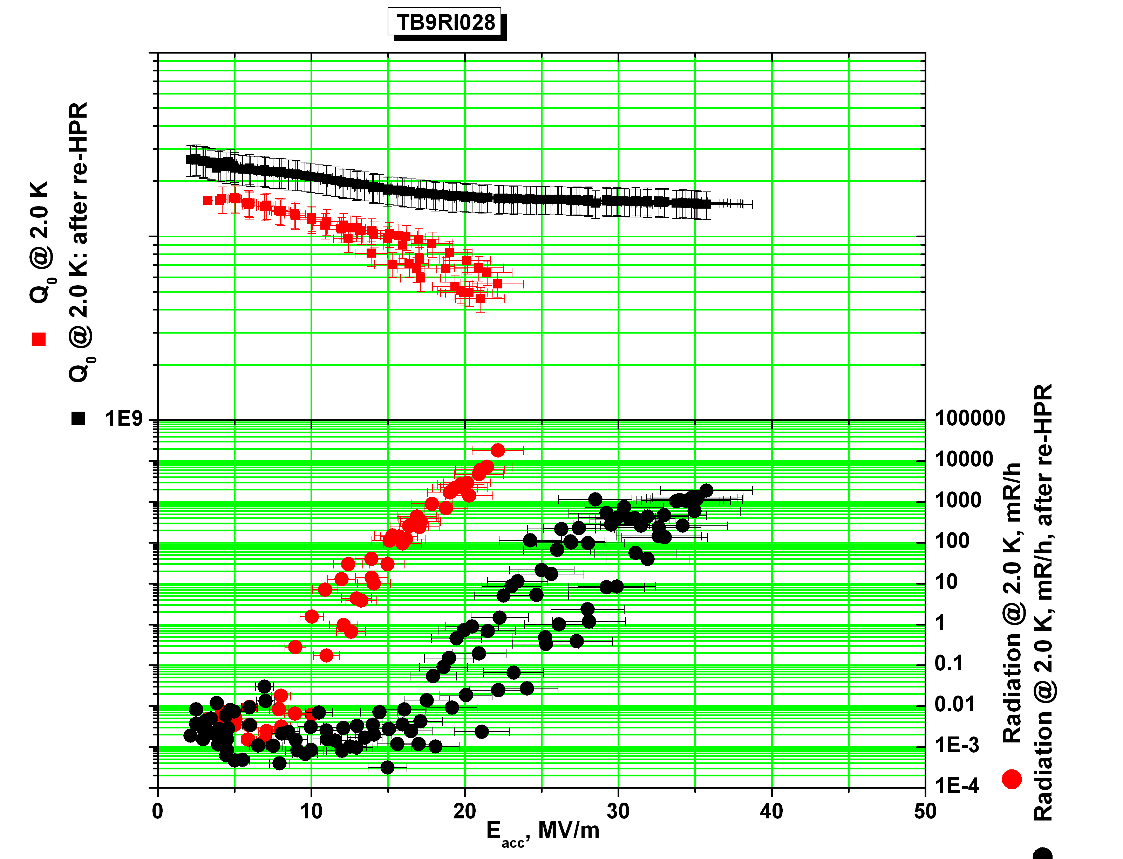
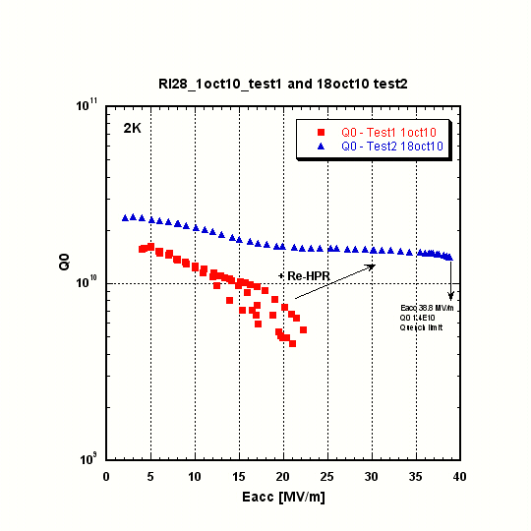
TB9RI28
Initial power rise
After re-HPR
Two EP runs necessary for needed bulk removal (due to removal meter issue).
First RF test 22 MV/m, limited by strong field emission (amid temporary field emission issue related to facility).
RI28 re-test after re-HPR 6x (complete dis-assm with hardware swap), successful FE reduction, some FE at initial power rise, almost no FE at final power rise, 38.8 MV/m at Q0 1.4E10, limited by quench. Pi mode freq 2K under vacuum 1299.854 MHz; Pi mode FF 96.5% prior to final EP.
Cavity already shipped back to FNAL.
final power rise
After re-HPR

Slide 6
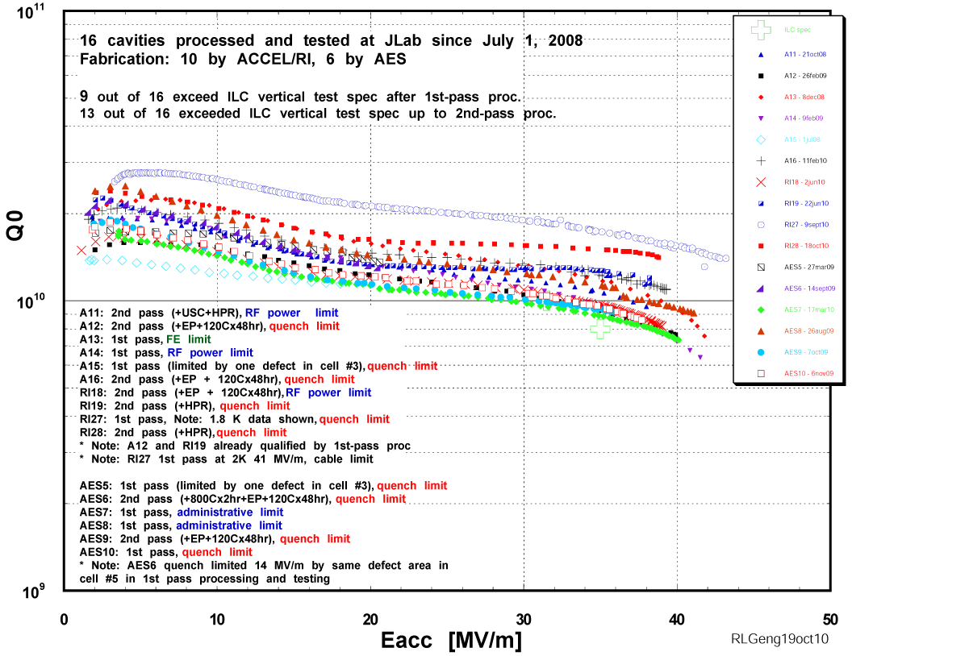

Slide 7
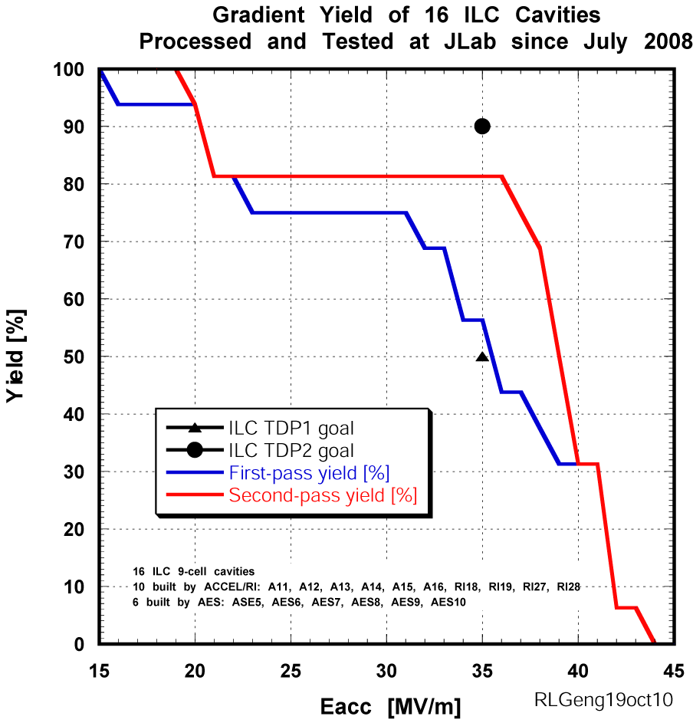
Gradient yield curve
ACCEL/RI and AES cavities without bias

Slide 8
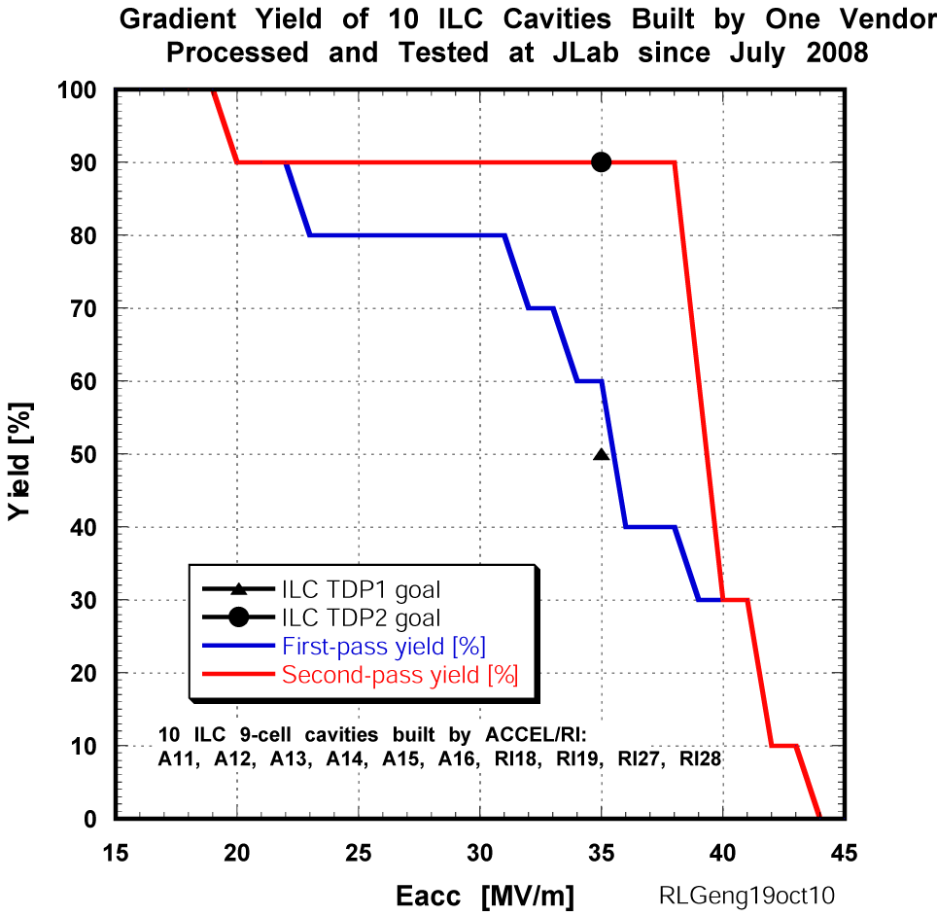
An example of 90% yield at 35 MV/m w/ Q0 >= 8E9
ACCEL/RI cavities without bias

Slide 9
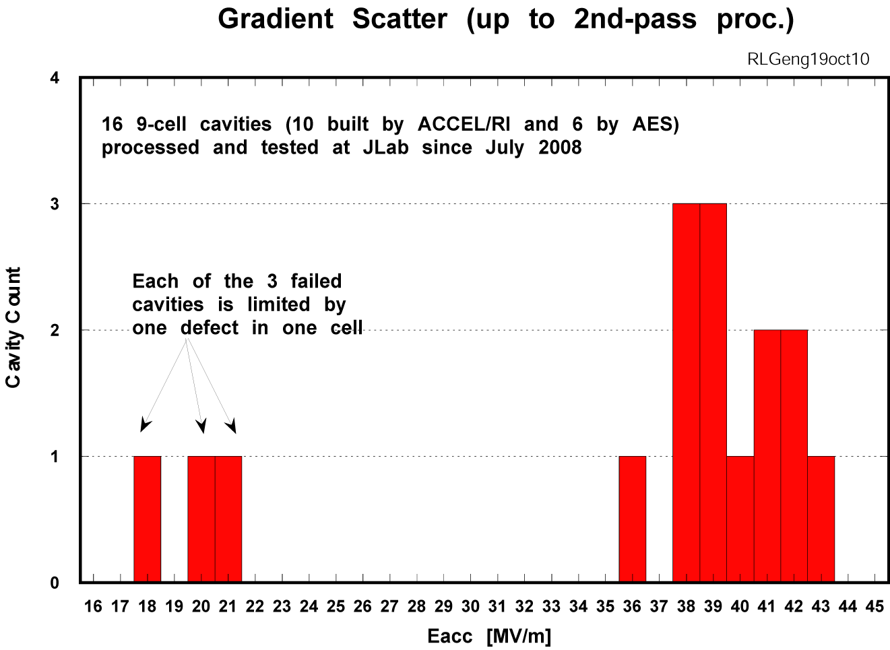



Hpk 160-180 mT

Slide 10
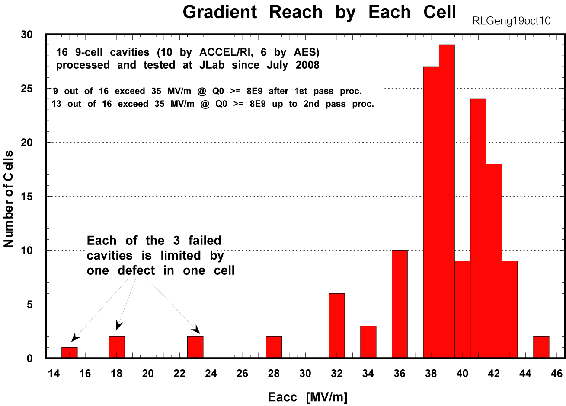
Hpk 160-180 mT

Slide 11
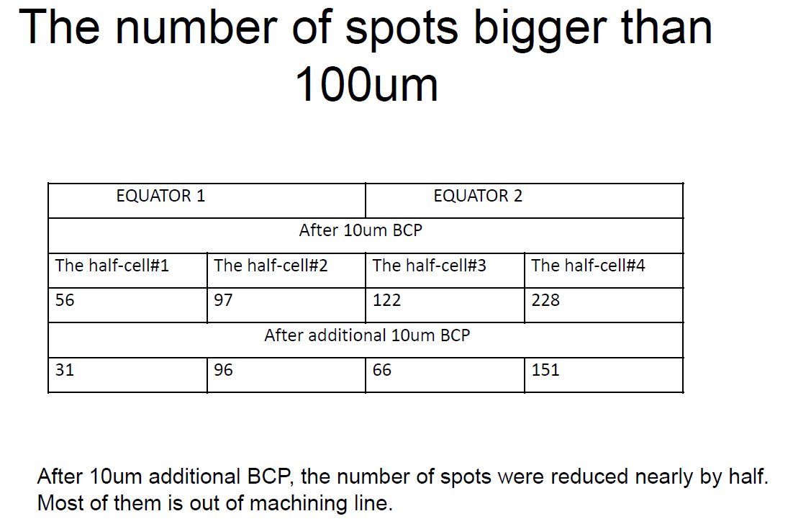
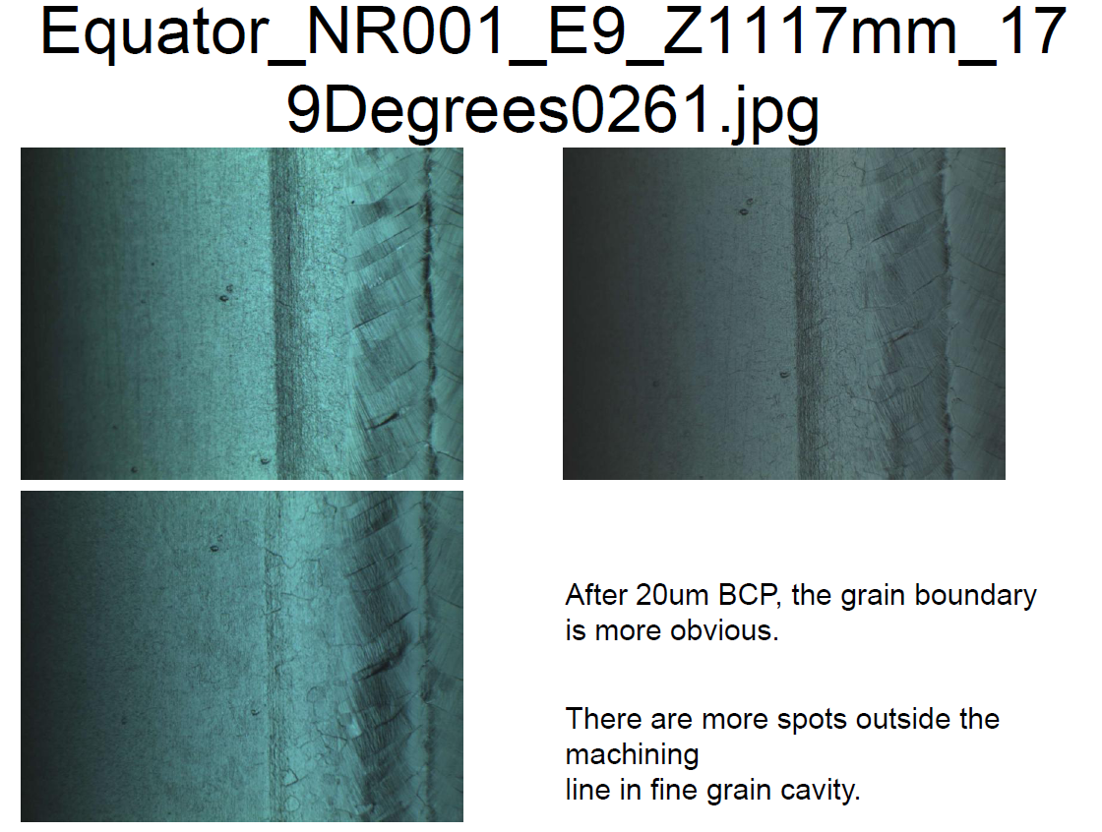
TB9NR001
Initial 10 um BCP not sufficient for removal of identified defect; additional 10 um BCP with cavity orientation flipped.
Continued reduction in defect density.
Heavy EP 26oct10 stopped at 80 um removal due to slow removal rate.
Furnace heat treated at 800C for 2 hr and frequency and FF tuned.
Final EP of 50 um and first HPR 5nov10; final HPR on going; RF test soon.

Slide 12
Other Cavities
JLAB LG#1 worked started since coming back from KEK for local grinding and EP. Field flatness tuned, HPR, clean room assm, 120Cx48hr, RF test this week.
ICHIRO7 beam tube defects removed by local mechanical polish, field flatness tuned to 96%, light EP scheduled this week.
AES6 local re-melt with electron beam under preparation.
MHI#8 en route from KEK for cross-region exchange.

