Slide 1
2010.11.09: Hayano
Cavity status; recent KEK activities
(1) MHI-010, MHI-011,MHI_A ; 9 cell cavities field measurements
MHI-010: 3rd VT 20MV/m @ Q0=1.1E10 Sep 02,2010
MHI-011: 3rd VT 18MV/m @ Q0=0.17E10 Sep 09,2010
MHI_A: 1st VT 29MV/m @ Q0=1.1E10 Oct 28,2010
(2) KEK-FNAL collaboration; on RI-026 and AES-001
These cavities were borrowed for the tuning machine commissioning, and
local grinding studies.
The local grinding were done for these cavities.
AES001 was used for the tuning machine commissioning. (RI-026 was not.)
(3) DESY-FNAL-KEK collaboration; on tuning machine
The start up of tuning machine at STF is on-going.
AES001 and Z-142 are used for this start up.

Slide 2
MHI-010
Quench at #1cell 330 degree
(Local grinding place)

Slide 3
MHI-011
Field emission turned on.

Slide 4
MHI-A
Quench at #8cell 180 degree

Slide 5
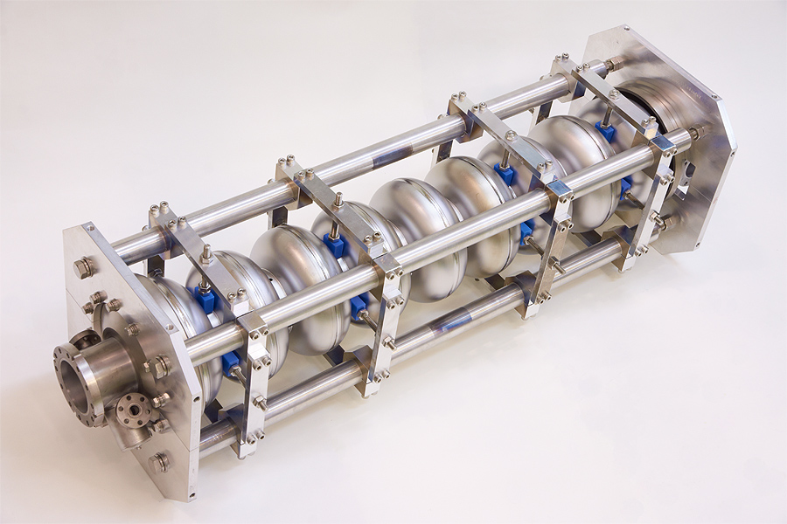
MHI-A cavity
Deep drawing of HOM cup,
Laser beam welding,
more smooth EBW seam

Slide 6
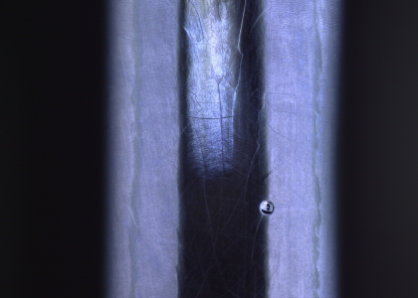
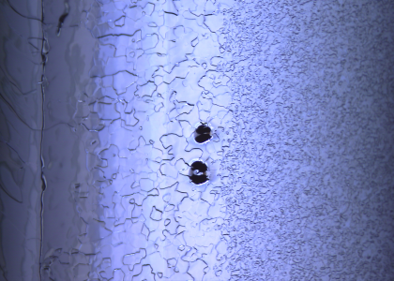
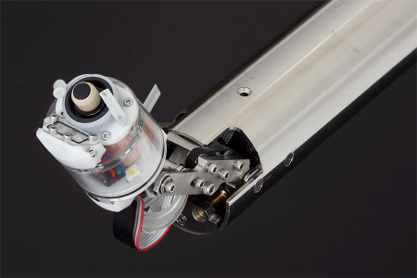
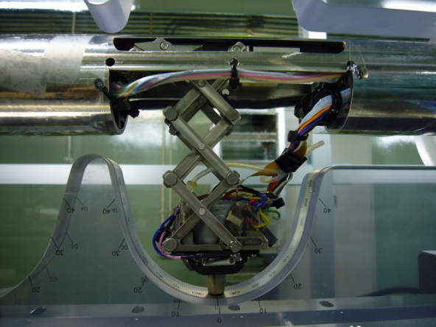
mechanical grinding of two FNAL cavities; Ken Watanabe
(19MV/m, field emission )
(22MV/m, quench)
TB9RI 026: 8-9 iris, t = 107 deg. Pit-type
AES-001: 3-cell equator, t = 169 deg. Bump type
EBW seam at Equator
Twins
To 9-cell equator
Grinder #3 used for grind at Iris.
Grinder #1 used for grind at Equator

Slide 7
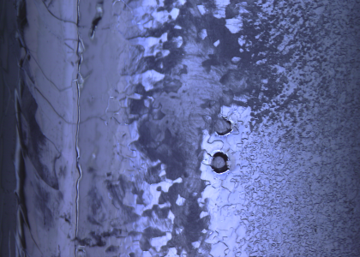
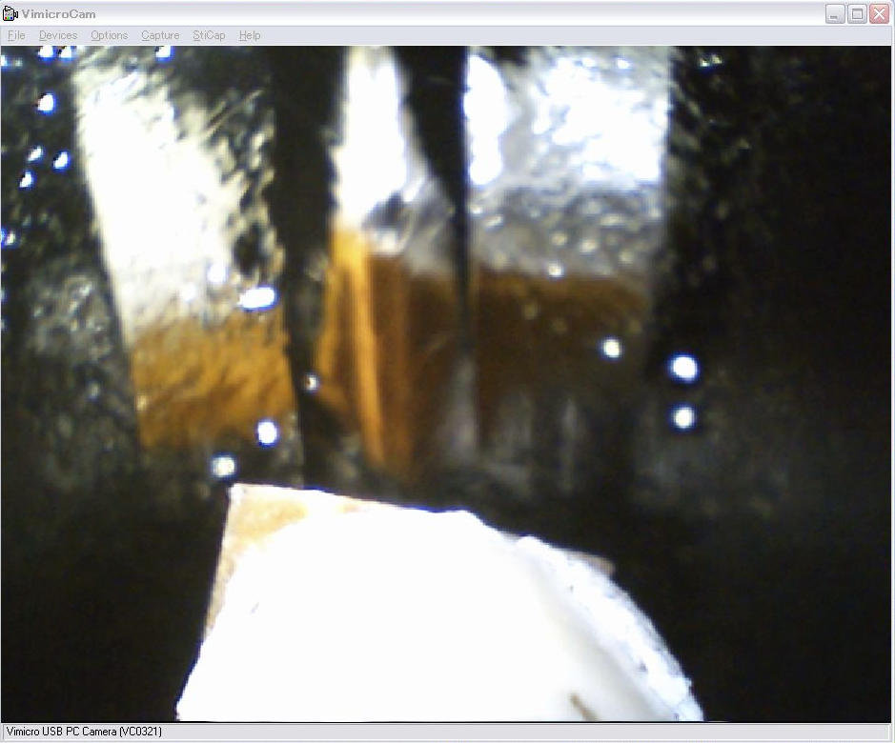
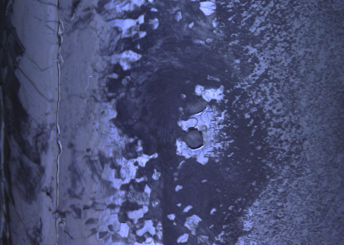
AES-001 : Grinding (1)
Initial
After (1) : grinding
Grinder CCD camera image
After (2) : grinding

Slide 8
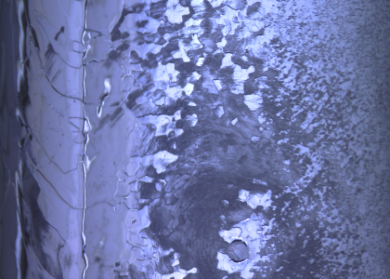
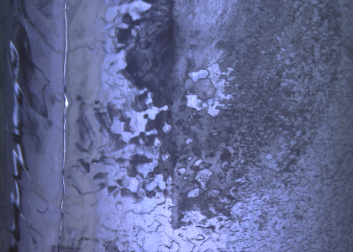
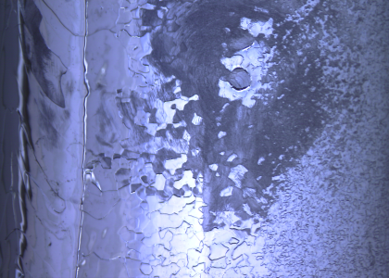
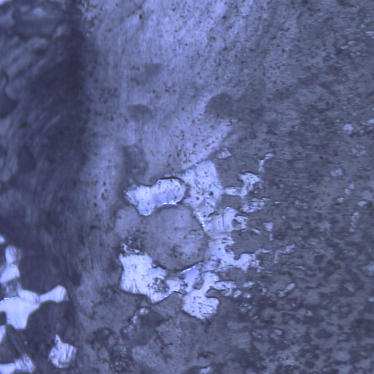
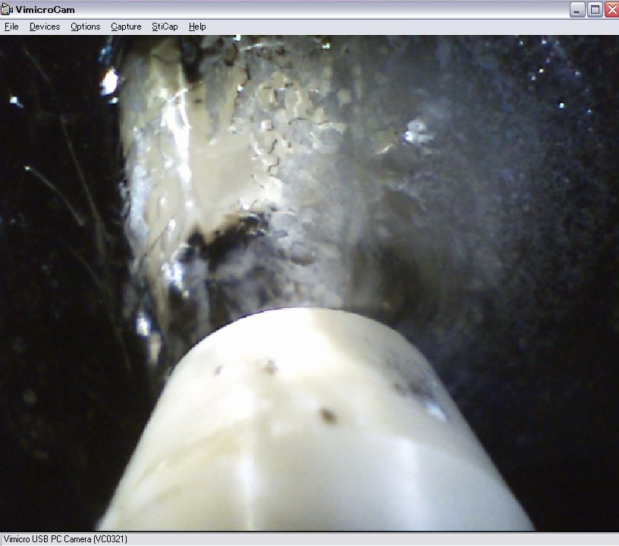
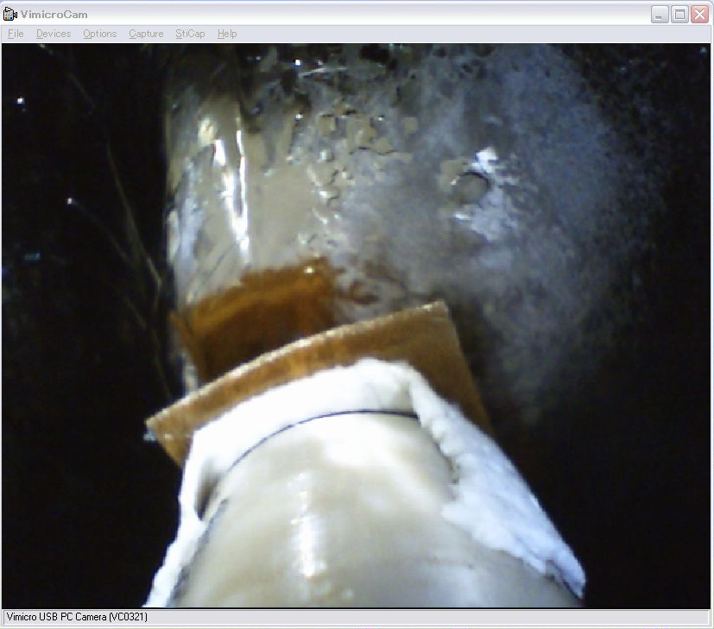
AES-001 : Grinding (2)
After (4) : grinding
After (3) : grinding
5 mm x 5 mm
Two bumps were removed completely.

Slide 9
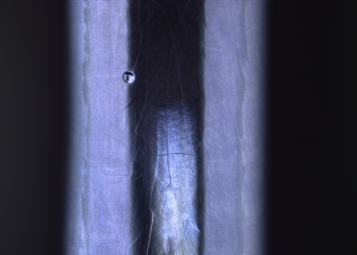
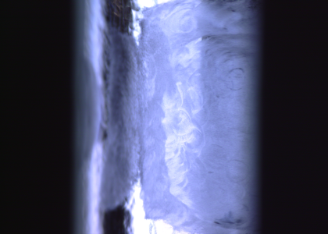
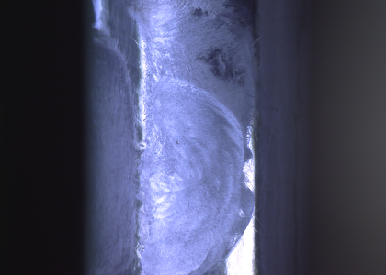
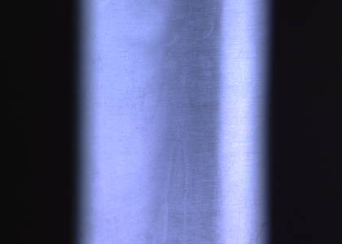
TB9RI 026 : Grinding (1)
Initial
After (4) : Grinding
To 9-cell equator
After (2) : Grinding
After (5) : polishing

