Slide 1
Cavity Test Results : TB9AES002 & TB9NR002
TB9AES002 (aka AES002) : dressed cavity that received light EP, after limited in 3 vertical tests to 20MV/m (hard quench)
TB9NR002 : first cavity fabricated by Niowave/Roarke to be processed/tested
27th ILC Cavity Grp Mtg. 11/9/2010 J.Ozelis

Slide 2
Early FE onset (9 MV/m), processed away. FE returned at 18MV/m. Limited by FE-induced quench at 27.3MV/m. LF Q₀ 1.9 x 10¹⁰ (“hump”), strong Q₀ drop due to FE loading at 20MV/m. Improvement from previous 19.8MV/m (hard) quench limit, but FE much worse, and overall Q₀ is lower (LF and HF).

Slide 3
First N/R cavity to be tested. Full processing at FNAL/ANL. Quench limited to 28.5 MV/m (with Q₀ there 1.2 x 10¹⁰). Also good LF Q₀ (2.1 x 10¹⁰), no FE. At 1.8K, Q₀ improves by 30-40% (typical).

Slide 4
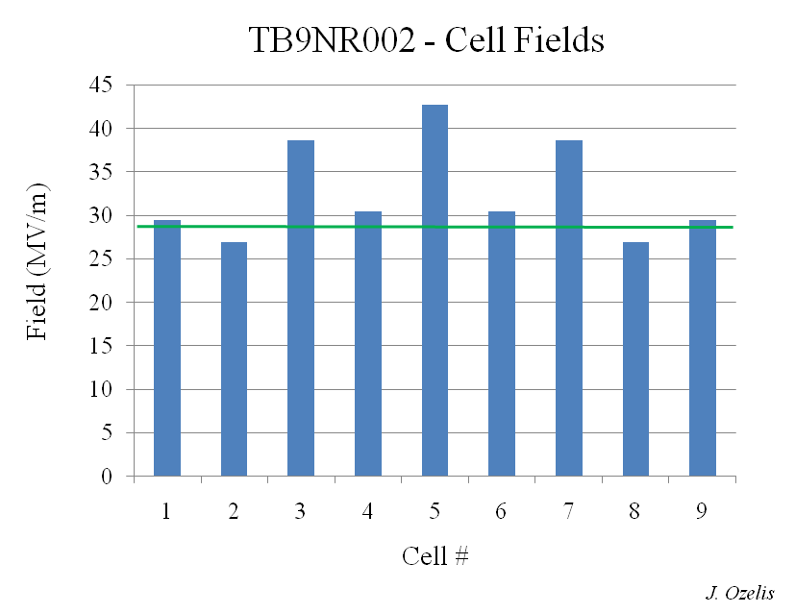
Mode meas & OST data indicate cell #2 as limiting cell. Others do better : 30– 43MV/m. Recent re-tests w/ thermometry and optimized placement of OST’s indicate cells 1 and 2 are limiting performance at the 28-29 MV/m level.

Slide 5
Residual surface resistance ~7nΩ.

