Slide 1
PM Introduction & Report
TLCC process: BAW-1 status
TLCC process: preparation for BAW-2
ILCSC PAC meeting – Eugene, Oregon
Design documentation (ILC-EDMS)
Interim Report

Slide 2
TLCC Process: BAW-1
Proposals:
adoption of ±20% gradient spread in ML
single-tunnel solution for ML
KCS
DRFS
RDR HLRF Technology Option (back-up)
Change Review Panel:
Barish (Chair), Garbincius, Himel, Asiri, Büßer, Jie Gao, Yokoya
PMs received request for some clarification
responded as of yesterday
May not be resolved before PAC meeting (next week)
original plan

Slide 3
TLCC Process – Prep. for BAW-2
BAW-2 SLAC, Jan. 18-21
Themes:
Re-location of e+ source to end of e- linac
Reduced bunch number parameter set
Physics parameters and low-Ecm running the underlying theme
Much more relevance for AS
very much an integrated activity, unlike BAW-1 themes
Focus of AD&I webex meetings

Slide 4
BAW-2 Issues
some studies just starting
IWLC10 – solutions exist
Working with Physics & Detector groups as part of the TLCC process
Generally positive responses being heard

Slide 5
Preparing for BAW-2: AD&I meetings
10.11.10: Next week AD&I meeting
Parameters updates (formal parameters table)
Physics and detector studies status
Tentative detailed programme for BAW-2
8.12.10: Upgrade/risk-mitigation scenarios
mostly CFS related
5.01.11: Review of parameters, cost, BAW-2 programme
Open workshop – everybody welcome
no parallel sessions
larger attendance expected than for KEK BAW
Registration page available (very) soon.

Slide 6
ILCSC PAC review
Uni. Oregon, Eugene 11-12.11
last review: 19-20 May Valencia
Accelerator & Detector overview
more management level
Agenda and talks publically accessible on ILCAgenda:
http://ilcagenda.linearcollider.org/conferenceOtherViews.py?view=standard&confId=4680

Slide 7
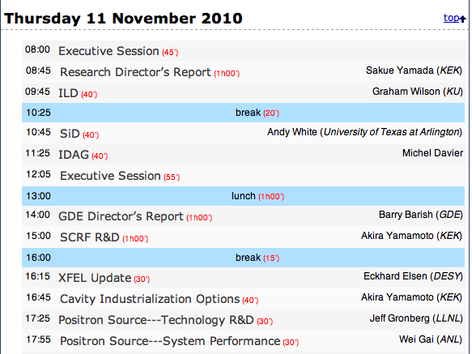
Agenda

Slide 8
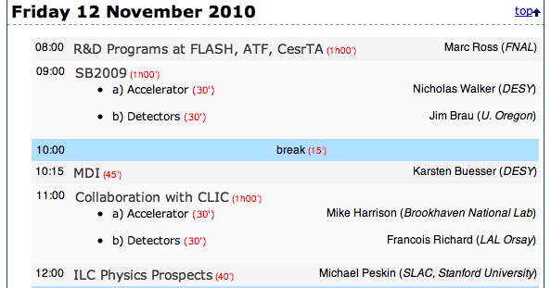
Agenda

Slide 9
Design Documentation
Beginning the process of producing the TDR
All design-related documents must be uploaded to ILC-EDMS
ILC-EDMS group (@DESY) will be primarily responsible for maintaining the database
documents zsar
Plan to work systematically through each AS TAG and ‘harvest’ important design documents
lattice files
specifications / parameters tables
drawings and sketches
technical documents supporting design choices
…
Have started with the Damping Ring group
Goal is to have initial ‘sweep’ complete by ALCPG (March 2011)

Slide 10
Interim Report
Deadline for draft section submissions in This Friday November 5
AS responsibilities:
Section 3.1 CesrTA – Palmer
Section 3.2 ATF2 – Tauchi, Seryi
Section 3.3.1 e- source – Brachmann
Section 3.3.2 e+ source – Clarke
Section 3.3.3 Damping Ring – Guiducci
Section 3.3.4 BDS – Seryi
Section 4.4 Beam Dynamics & Simulation – Kubo, Solyak
Please pay attention to author guidelines distributed

