Slide 1
Accelerator Operational Gradient Margin The challenge! (and some personal observations)
Nick Walker
TTF 9mA Meeting 2.11.10

Slide 2
Two margins to consider
Accelerating gradient margin
margin to measured quench limit
margin for operational control
RF power overhead
in support of gradient spread (reduced η_{RF→beam})
additional overhead for LLRF control
Will only discuss the first of these in this talk
primary cost driver

Slide 3
Why are we discussing this?
Cost of 1% accelerating ~34 MILCU gradient:
Cost of 1% additional ~10 MILCU RF power:
Gradient is cost premium, trade against RF power
rationale for adoption of ‘gradient spread’

Slide 4
Operational Gradient
Historically (Snowmass 2007) assumed a ~10% de-rating from Vertical Test (35 MV/m CW) to operational gradient (31.5 MV/m pulsed)
This margin included
de-rating allowed for cryomodule fabrication
control headroom (margin for LLRF feedback)
(division was not specified)
Our primary goal is to construct an accelerator with an average accelerating gradient of 31.5 MV/m
primary cost driver

Slide 5
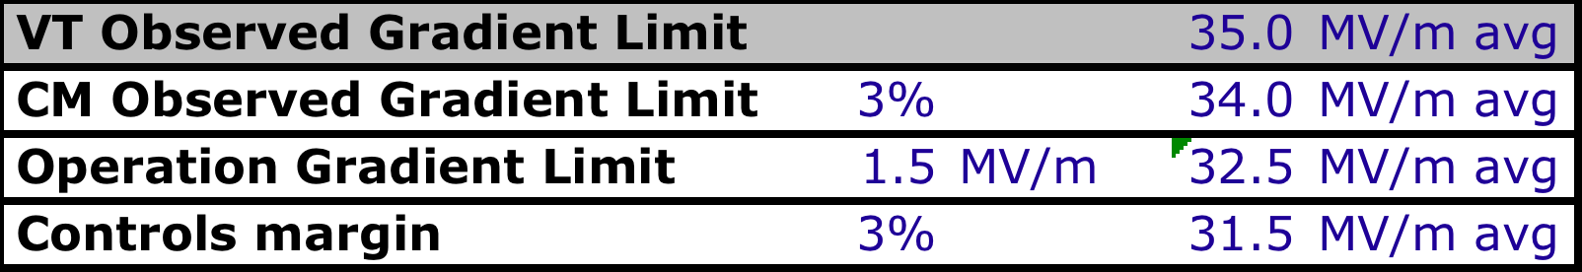
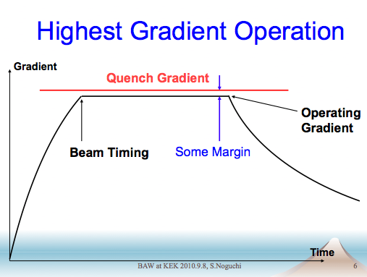
Dividing up the Pie
Noguchi-san

Slide 6
Dividing up the Pie
Data from FLASH modules
Notes:
Spread way too large. Ramifications for sorting schemes etc.

Slide 7
Dividing up the Pie
gradient “slopes” within 3%
1% change in gradient
ΔP_{for}/P_{for} 2%
ΔQ_{ext}/Q_{ext} 2%
ΔI_{b}/I_{b} 1%
Δf 15 Hz
Controls Issues
calibration!
Major R&D challenge (but impossible?)

Slide 8
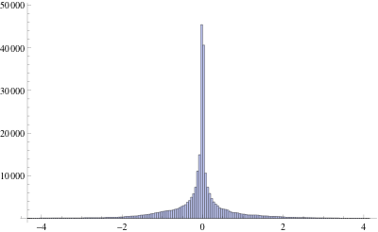
Beam Dynamics Constraint
time-dependent transverse kicks from misaligned cavities
3% pk to pk is 1% RMS
Already at specified tolerance
Kicks to do not give gaussian distribution
RMS a poor measure of performance (?) (possible overestimate)
Attempt to get control levels first, then fix remaining effect (if necessary) with additional feedback in linac
distribution of random kicks from one RF unit

Slide 9
Note on TDP2 R&D Goal
So far we have discussed proposed baseline design parameters for the ILC
The S0 R&D goal for TDP2 remains ≥35 MV/m with a production yield of 90%
low-power cw VT
This infers <G> > 35 MV/m
closer to ~38 MV/m but depends on distribution
Notes:
If this is achieved, this could allow more overhead in the machine. But it could also be used to reduce the linac length (cost!).

Slide 10
Pushing the Envelope!
ILC is a 200-500 GeV machine
100-500 GeV if we include running at the Z
60%
80%
100GeV
200 GeV
500 GeV
Ecm

Slide 11
Pushing the Envelope!
ILC is a 200-500 GeV machine
100-500 GeV if we include running at the Z
60%
We are discussing this ‘zone’
80%
100GeV
200 GeV
500 GeV
Ecm

Slide 12
Pushing the Envelope!
Unacceptable?
Compromise?
Too expensive?
1
Performance “Guarantee”
500 GeV
Ecm

Slide 13
Comments on Gradient Spread
Current proposal assumes ≤ ±20% in limiting gradient in cavities
25.2 ≤ G_{a} ≤ 37.8 MV/m
Length of linac dictated by <G_{a}> = 31.5 MV/m
Assumed is a HLRF system than can support such a gradient spread
For max. energy operation
For E_{cm} ≤ 400 GeV – we can run all cavities at equal gradient

Slide 14
In Conclusion
Focus R&D Plans are needed to give us more confidence
goals are “aggressive” but not impossible
Thinking “out-of-the-box” may be required
Two primary areas need attention
Gradient yield
VT → CM (difficult because statistics are poor)
S2 for LLRF control margins
FLASH 9mA test and S1g, more simulation work
Longer term: STF2 and NML

Slide 15
In Conclusion
Focus R&D Plans are needed to give us more confidence
goals are “aggressive” but not impossible
Thinking “out-of-the-box” may be required
Two primary areas need attention
Gradient yield
VT → CM (difficult because statistics are poor)
S2 for LLRF control margins
FLASH 9mA test and S1g, more simulation work
Longer term: STF2 and NML
This groups contribution

