Slide 1
ILC CFS AND GLOBAL
SYSTEMS MEETING
CONVENTIONAL FACILITIES
AND SITING GROUP
IWLC10 Review CFS Summary
V. Kuchler

Slide 2
Outline
Review of CFS Budget Status
Progress at IWLC 2010
Mount Blanc Tunnel Tour
Agenda for DESY Visit

Slide 3
CFS International Budget
Americas Region Budget for FY11 Will Continue Through 2012
Post 2012 CFS Budget Will Be Reduced
Asian Region Budget Does Not Include AAA Effort
European Region is Focused on CLIC

Slide 4
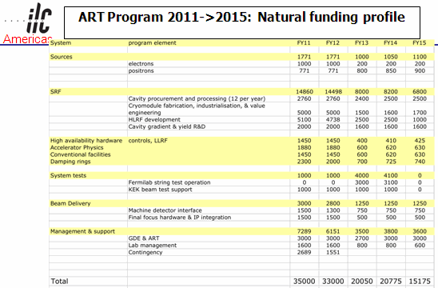
Americas Region Resources

Slide 5
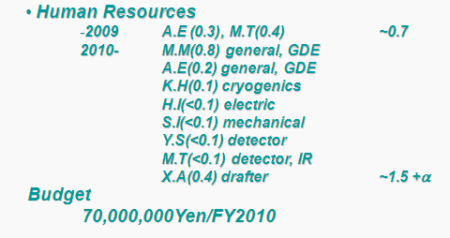
Asian Region Resources

Slide 6
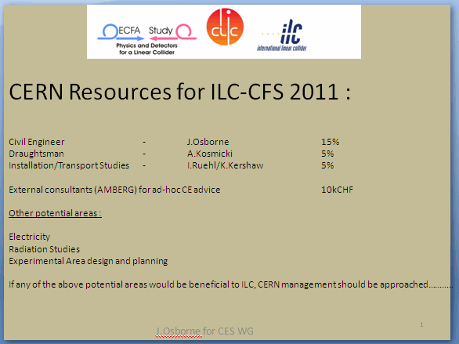
European Region Resources

Slide 7
IWLC 2010 Parallel Session w/RF Group
Main Goal Was to Establish Dimensions for Cryomodule Placement in the Tunnel
Atsushi Presented the DRFS Configuration
Klystron Cluster Configuration Will Also Use the Dimensions Agreed Upon

Slide 8
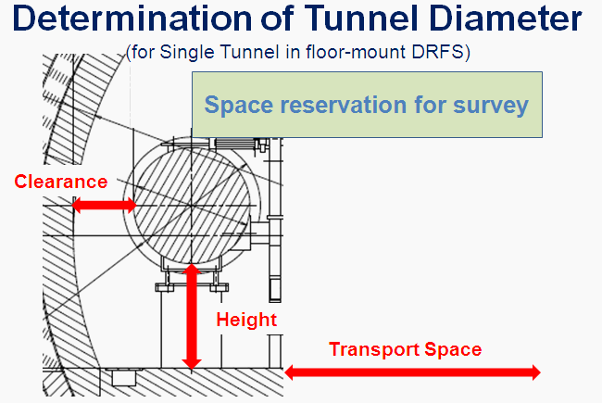
IWLC10 Parallel Sessions

Slide 9
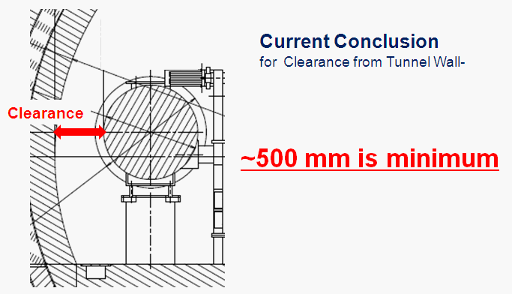
IWLC10 Parallel Sessions

Slide 10
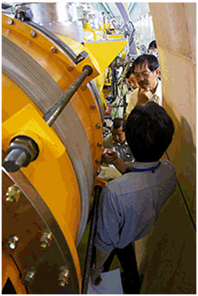
IWLC10 Parallel Sessions

Slide 11
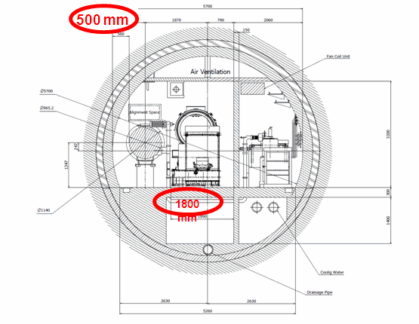

Slide 12
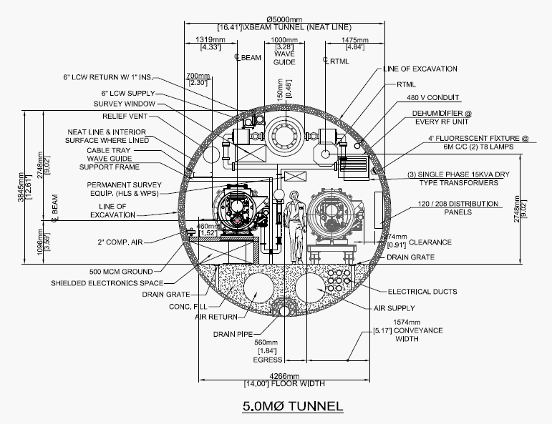
Americas Region KCS

Slide 13
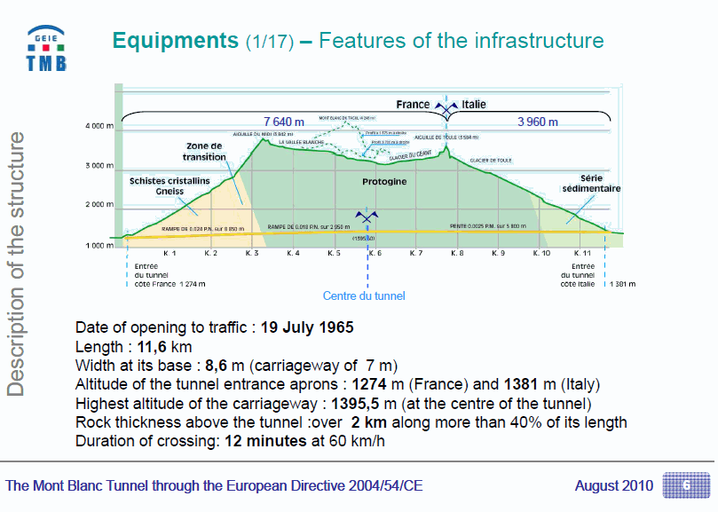

Slide 14
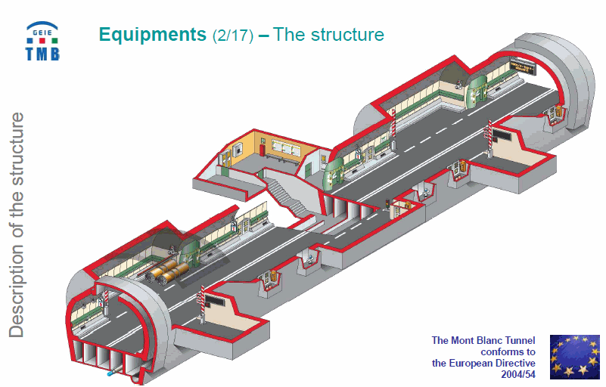

Slide 15
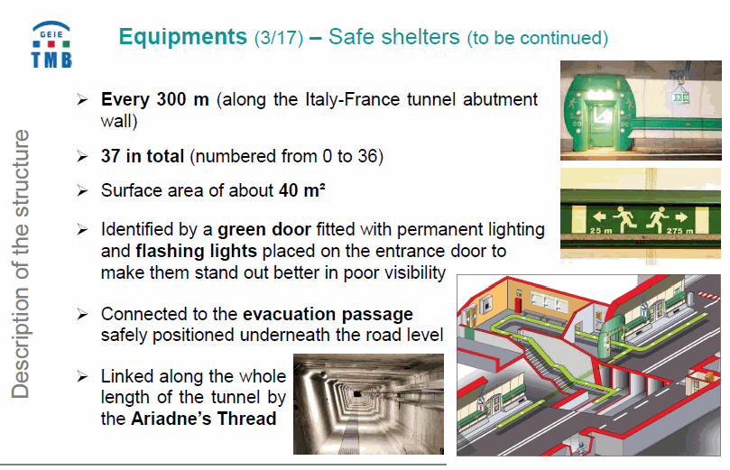

Slide 16
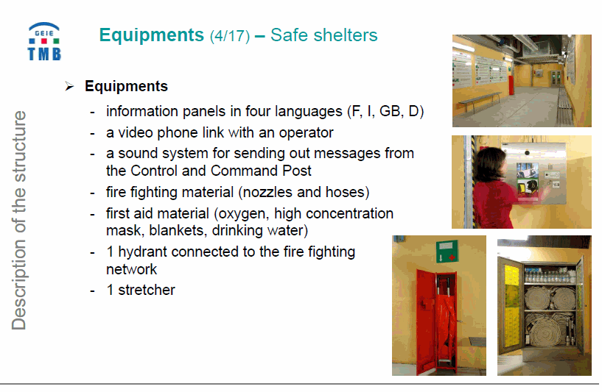

Slide 17
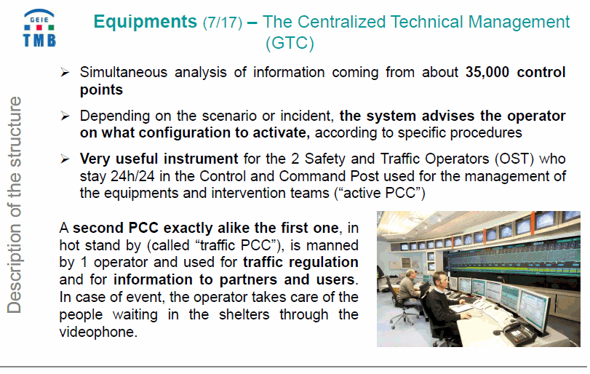

Slide 18
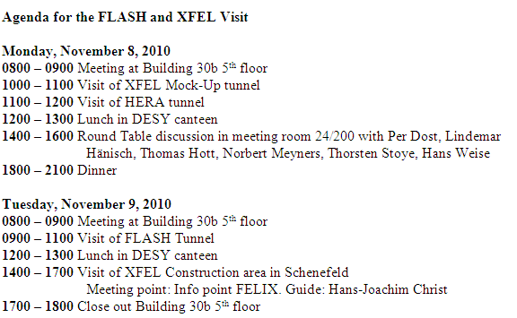
DESY Visit Agenda

