Slide 1

Pions in the SiW ECAL using FNAL 2008 data (CAN-025)
Philippe Doublet
Roman Pöschl
François Richard
CALICE Analysis Meeting, November 8th, 2010

Slide 2
Introduction
Interactions of pions in the SiW ECAL
Aim to use granularity and energy deposition to classify interactions
And have a look at differences between models in physics lists
CAN paper v2 submitted, now finalising answers to the questions of the EB

Slide 3
Data samples
We study and compare interactions of pions (π⁻) with E = 2, 4, 6, 8 and 10 GeV
TB data were recorded at FNAL in 2008 and reconstructed (v0409)
MC data are simulated + digitised for 5 physics lists : QGSP_BERT, FTFP_BERT, LHEP, QGS_BIC and QGSP_BIC (Geant4 9.2)
Calice soft v02-00 is used for both TB and MC data

Slide 4
Outline
The SiW ECAL (in 2008)
The test beam at FNAL (May & July 2008)
MC simulations
Finding the interaction point
Classification and optimisation
Observables
Ongoing work
Conclusions
Important slides for today’s meeting topic

Slide 5
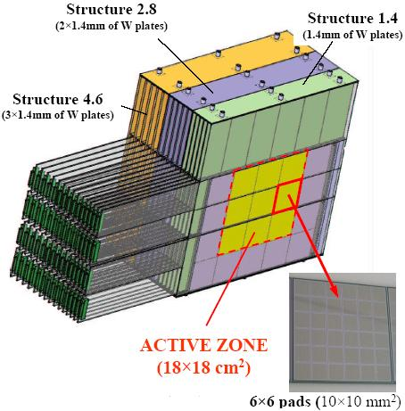
The SiW ECAL in 2008
Fully equipped ECAL
3 x 3 wafers of 6 x 6 pads
Sensors = Si pixels of 1 cm x 1 cm → tracking possibilities
Absorber = W
30 layers in 3 different stacks :
  1.4 mm of W
  2.8 mm
  3.6 mm
≈ 24 X₀ ≈ 1 λ_{I} ≈ half of the hadrons interact inside the ECAL volume
9 Si wafers
Picture of the fully equiped SiW ECAL

Slide 6
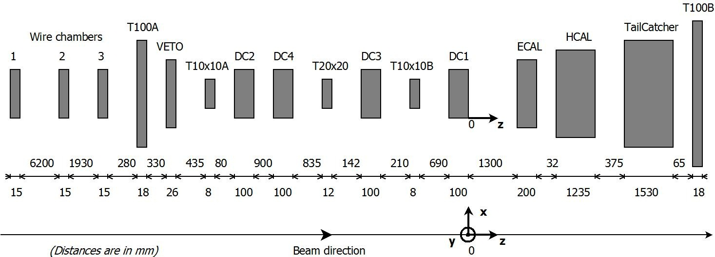
Test beam at FNAL in 2008
Beamline at FNAL
3 CALICE calorimeters installed : SiW ECAL, Analogue HCAL, TailCatcher (TCMT)
Triggers : scintillators, Cherenkov counters
Muon cuts added on the basis of simulated muons :
< 0.6% remaining
Ask for only one primary track found with the MipFinder
Events left :
E (GeV) | 2 | 4 | 6 | 8 | 10
N evts | 212942 | 126222 | 73590 | 233820 | 454714

Slide 7
Monte Carlo simulations
For comparisons, different physics lists were simulated in Geant4 9.2
QGSP BERT is used as reference for optimisation
E (GeV) | 2 | 4 | 6 | 8 | 10
QGSP BERT | BERT |  |  |  | BERT + LEP
QGS BIC | LEP (+ BIC for secondaries < 1.2 GeV)
QGSP BIC | LEP
LHEP | LEP
FTFP BERT | BERT |  | FTFP
Content of the physics lists for pions

Slide 8
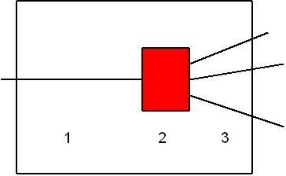
A look at interactions of hadrons
Picture of a generic interaction in the calorimeters :
  A primary track enters the detector (« MipFinder »)
  The interaction occurs
  Secondaries emerge from the interaction zone

Slide 9
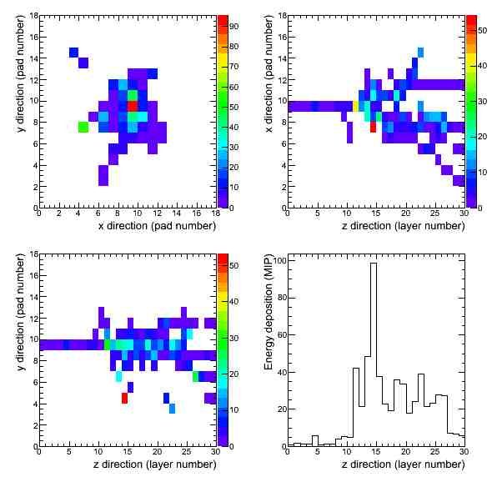

Visual examples (1/2)
2D profiles of an event at 10 GeV in the SiW ECAL
High energy deposition when the interaction starts
Interaction layer confirmed by visual inspection
Large number of secondaries created
Equation to be satisfied:
Ecut
TB data event at 10 GeV

Slide 10
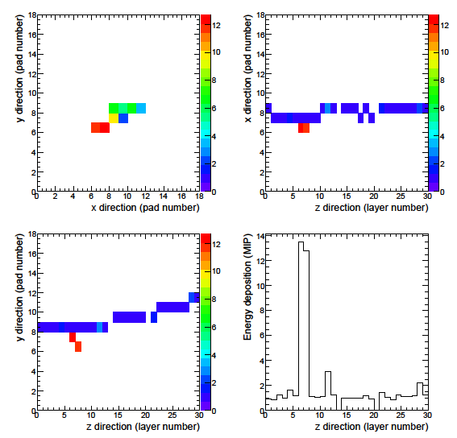

Visual examples (2/2)
Previous example not always valid, especially at low energies
Sometimes, slow increase in energy
Here, local energy deposition
Quantified by the relative increase in energy:
Secondary proton
(from MC)
MC event at 2 GeV

Slide 11
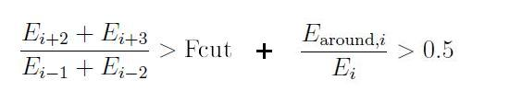
Classification
High energy deposition
→ « FireBall »
Increase continues + veto for backscattering
→ « FireBall »
Works here and meant for small energies
Event view of the « FireBall » type at 10 GeV

Slide 12
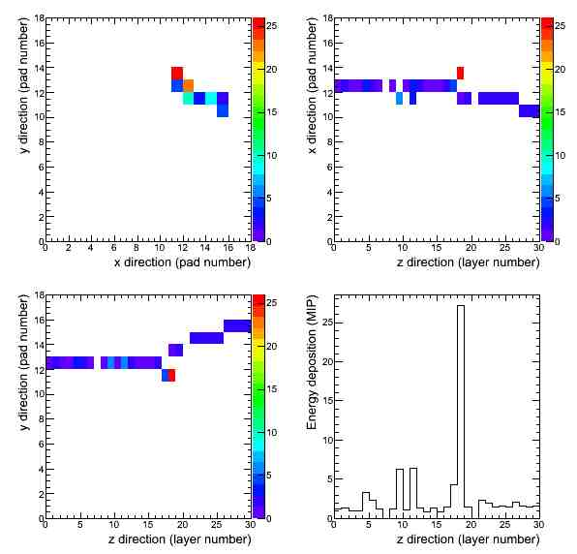

Classification
High energy deposition
→ « FireBall »
Increase continues + veto for backscattering → « FireBall »
Local increase → « Pointlike »
Remark : delta rays are naturally included in « Pointlike » but contribute less than 4%
Real TB data event at 2 GeV
Event view of the « Pointlike » type at 2 GeV

Slide 13
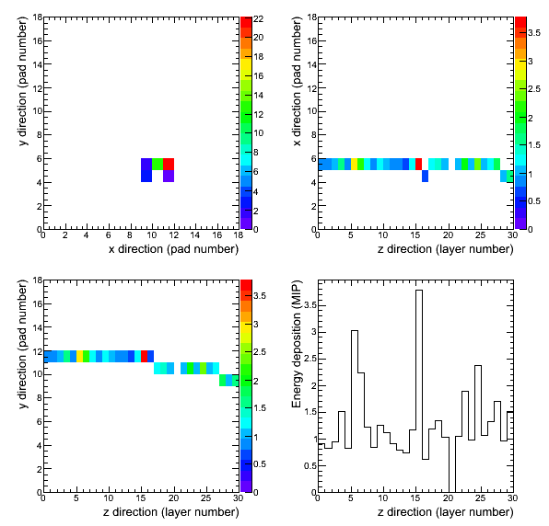
Classification
High energy deposition
→ « FireBall »
Increase continues + veto for backscattering → « FireBall »
Local increase → « Pointlike »
Others = non interacting
  « MIP »
  « Scattered »
Remark : delta rays are naturally included in « Pointlike » but contribute less than 4%
Real TB data event at 2 GeV
3 cm !
Event view of the « Scattered » type at 2 GeV

Slide 14
Optimisation
Cuts need to be optimised (not discussed today, see my talk at CASABLANCA)
After optimisation →
Choice was made to
merge all Fcut to one
single value for
simplicity
E (GeV) | Ecut | Fcut
2 | 3 | 4 → 6
4 | 8 | 5.5 → 6
6 | 10 | 6.5 → 6
8 | 13 | 7 → 6
10 | 10 | 6 → 6

Slide 15
Efficiencies after optimisation
The efficiency to find the true interaction layer within ±1 and 2 layers is the result of the optimisation.
It is compared with another method.
E (GeV) | η (±1) | η (±2) | η (3-4, ±2)
2 | 56 % | 67 % | 28 %
4 | 60 % | 73 % | 61 %
6 | 62 % | 76 % | 69 %
8 | 64 % | 78 % | 71 %
10 | 72 % | 84 % | 76 %

Slide 16
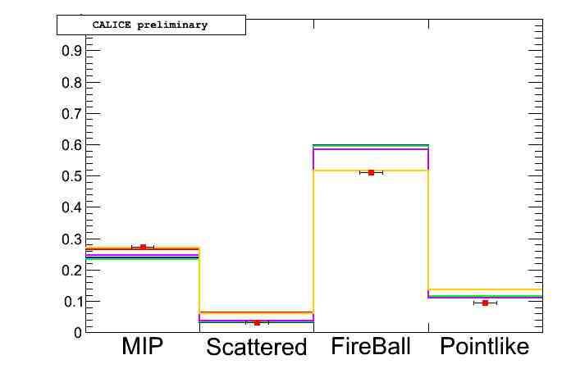
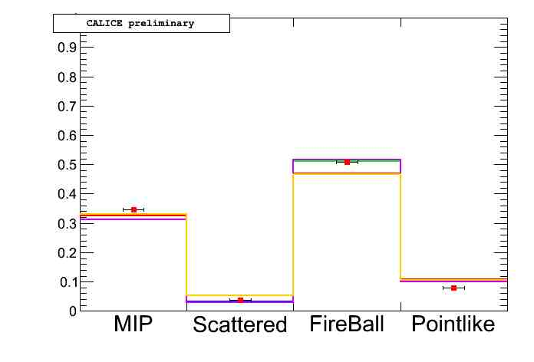
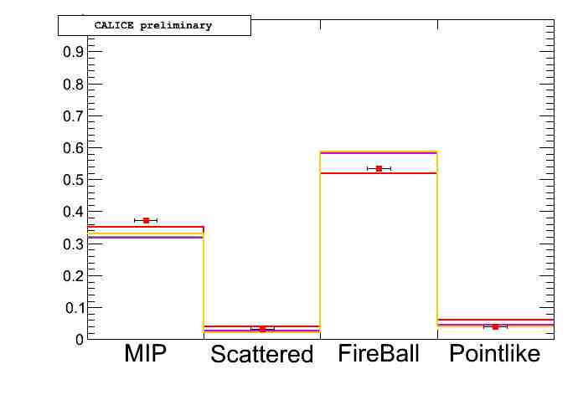
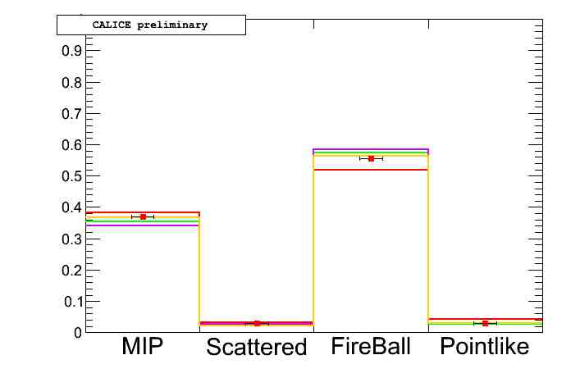
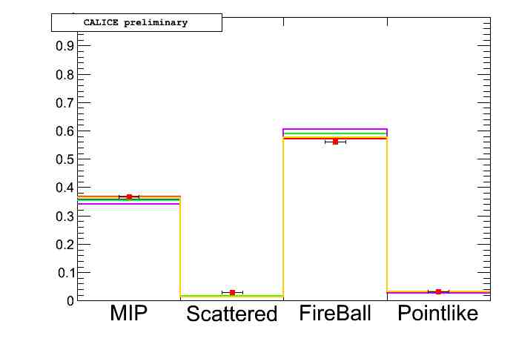
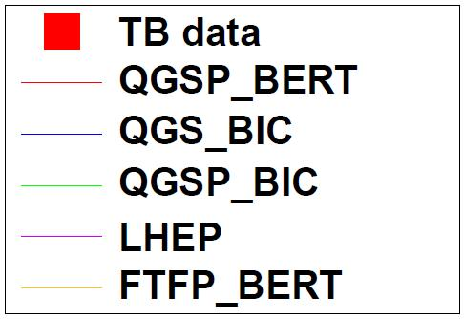
Rates of interactions
2 GeV
4 GeV
6 GeV
8 GeV
10 GeV
Small systematics with Ecut and Fcut in ±1
Interaction rates similar between physics lists

Slide 17
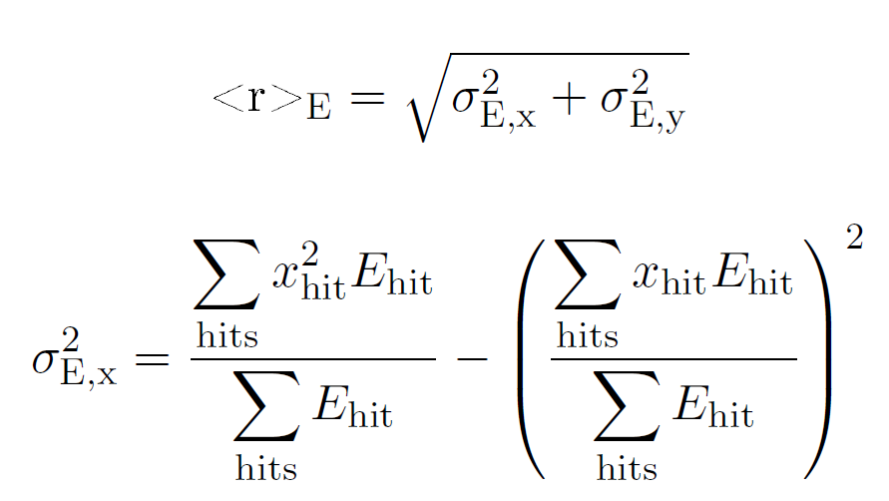
Observables
The following results are still under discussion with the EB
We compare TB data and MC using
  Rates of interactions (previous slide)
  Mean shower radius (rms of transverse profile)
  Longitudinal profile
  (as defined in the CALICE
  pions in the SiW ECAL paper)

Slide 18
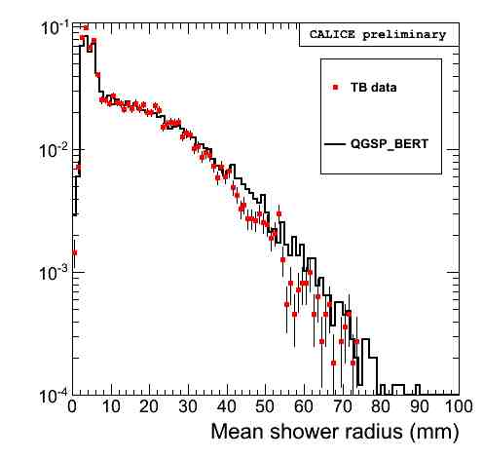
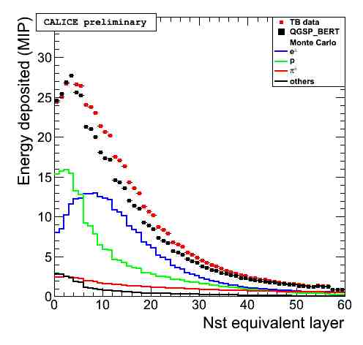
Examples
Mean shower profile (log)
Longitudinale profile
Example of data vs QGSP_BERT simulation at 2 GeV

Slide 19
Ongoing
Agreement with hadrons in SiW ECAL paper
Redoing style of the figures
Text improvement on comparison data – MC
Quantitative check of systematics of optimisation with physics lists
Write a new version of the note

Slide 20
Conclusions
Interactions of hadrons in the SiW ECAL at energies from 2 GeV to 10 GeV are found and classified into 4 kinds, using energy deposition and high granularity
Efficiencies to reconstruct the interaction layer within ± 2 layers are > 67 %
Still answering to the EB (good progress)
Hope for a validation before the end of the year

