Slide 1
What are the ‘STANDARD’
Baseline Parameters
UPDATE
AD&I Meeting
October 13, 2010
November 10, 2010

Slide 2
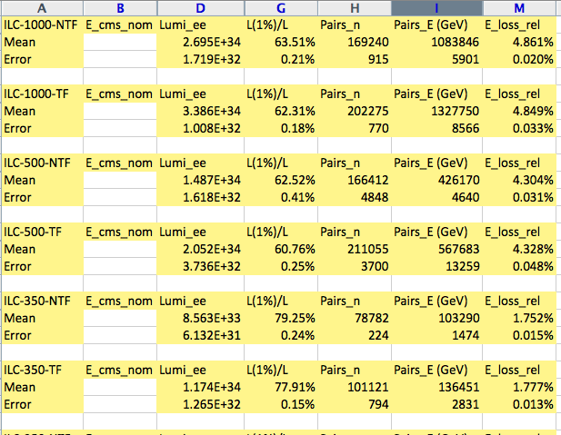
Systematic GP Runs by K. Büßer
Will make results available via ILC-EDMS
Update formal tables
GP input “acc.dat” also put into ILC-EDMS

Slide 3
An Attempt at Comparisons with the same Assumptions
Assume 2x 10^10 E+ at all energies, i.e. 10 Hz at 200 to 250 GeV or Higher yield source.
Assume ½ number of bunches, 1312, except at 1 TeV
Use travelling focus and what else?
200 250 350 500 1000 GeV
Lum Values from G-P 0.5 0.8 1.0 1.9 2.7
Dec 2009 & Sendai
New Oct 11, 2010 0.3 0.5 0.8 1.6 3.1
K. Büßer NO TF 0.47 0.71 0.86 1.5 2.7
K. Büßer TF 0.64 0.97 1.17 2.0 3.4

