Slide 1
Cavity Integration 11172010
H. Hayano

Slide 2
MHI-012 1st VT reaches 37.5MV/m

Slide 3
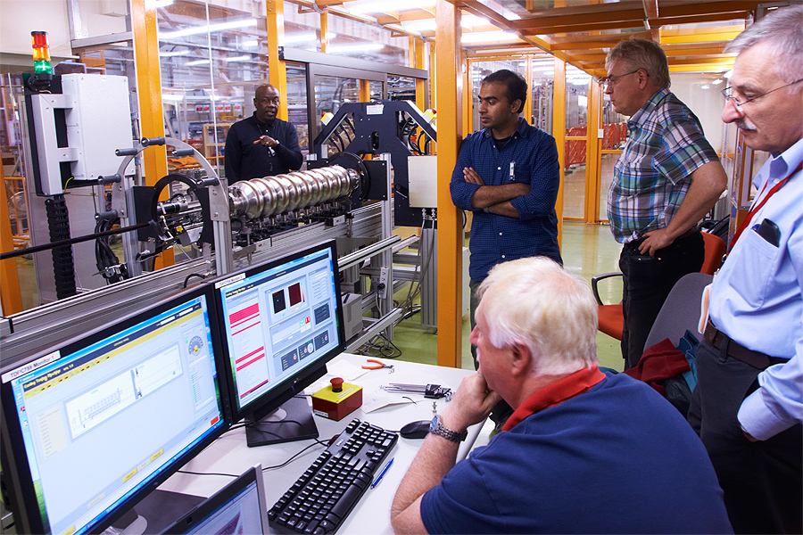
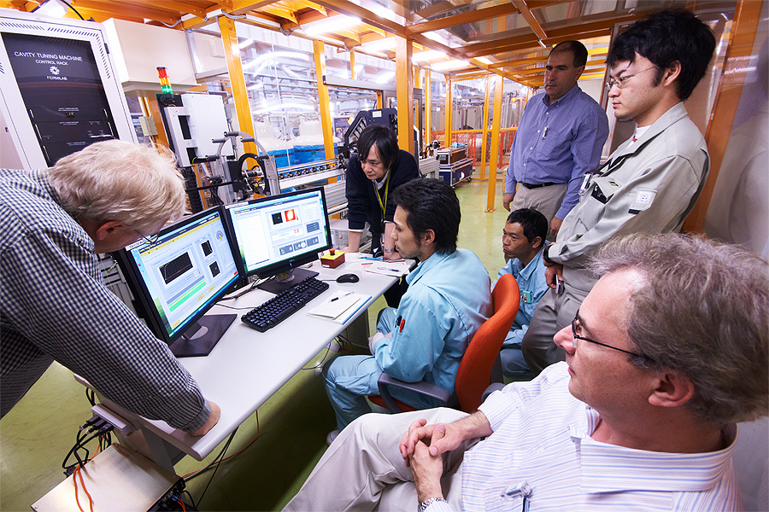
Tuning machine successful start-up at STF
DESY-FNAL-KEK collaboration
Training for KEK technician
FNAL team start-up

