Slide 1
SCRF Monthly WebEx Meeting
Nov. 17, 2010
Agenda
Report from PMs (15 min.)
  Director’s decision for the BAW1 proposal
  Report from ILC-PAC, Nov. 11 – 12, Eugene
  Preparation for the BAW-2 and other meetings
General Report from GLs (15 min.)
Special Discussions (30 min.)
  Progress and further plan for S1-Global test
  Progress in NML/CM1
  Interim report progress and editing

Slide 2
Schedule related to PM/SCRF
Oct. 18 – 22: IWLC-2010 at CERN
  Oct. 20 SCRF webex
Oct. 25: PM Visit DESY
Nov. 5: Due date for Interim report draft
Nov. 11-12: ILC-PAC at Oregon
Nov. 17: SCRF-webex, TODAY!
Dec. 9: PM Visit CEA/Saclay
Dec. 15: SCRF-webex,
Jan. 6-7: PM Visit JLab
Jan. 12: SCRF-webex
Jan. 18 – 21: BAW-2, SLAC
Feb. 28 – Mar. 3: TTC at INFN/Milano
March 18 – 22: GDE/ALCPG meeting, Univ. Oregon, Eugene,

Slide 3
TLCC Process
Baseline Assessment Workshops
  Face to face meetings
  Open to all stakeholders
  Plenary
Physics and detector input / representation mandatory
 | When | Where | What
BAW 1 | Sept. 7-10, 2010 | KEK | Accelerating Gradient Single Tunnel (HLRF)
BAW 2 | Jan 18-21, 2011 | SLAC | Reduced RF e+ source location
Global Design Effort
3
Notes:
3

Slide 4
A Proposal for Cavity Gradient Balance
- from our report in the previous PSC, May, 2010 -
Appropriate balance should be re-considered b/w
  R&D stage and Project stage
  Components and Accelerator System Operation
A new guideline toward TDP-2 and TDR
  R&D Goal for Cavity Gradient (unchanged) : 35 MV/m (@ 90 % yield)
  Guideline for System Engineering to be updated
    with allowing gradient spread
  G _{Cavity} > G _{Cryomodule} > G _{ILC-operation}
  <35 MV/m> : <33 MV/m> : <31.5 MV/m>
Our homework
  How much gradient spread to be allowed?
    To be optimized within 10 – 20 % in balance of RF distribution efficiency
  Can we justfy the above operational margins?
    ~ 5 % in Cavity (itself) operational margin in cryomodule operation
      To prevent excessive field/field-emission/cryogenics-load and quench
    ~ 5 % in LLRF/HLRF and beam tune-ability and operational margin or overhead
      We shall learn FLASH/NML/STF progress in TDP-2

Slide 5
Accelerator Gradient Balance
Summary
Two guidelines established
  R&D milestone:
    35 MV/m with 90 % yield (eq. > 38 MV/m on average) , including 2nd pass,
  ILC ML Cavity manufacturing specification:
    35 MV/m on average with spread (≤ +/- 20 %) ,
ILC-ML Accelerator Gradient (as baseline approved)
  to be kept at 31.5 MV/m on average
    With gradient spread (< ~ +/-20 %).
  additional HLRF capacity of 10~15 % required.

Slide 6
ILC-ML SCRF Cavity Gradient Specifications Update
Cost-relevant design parameters for TDR | ML cavity gradient Specification | R&D Milestone
9-cell Cavity Gradient in vertical test | 35 MV/m, average - Spread: 28 – 42 MV/m (+/- 20 % or less) | 35 MV/m at 90 % yield including 2nd pass, (eq. > 38 MV/m, average)
Cryomodule Operational Gradient | 34 MV/m, average | 34 MV/m, average CM Obs. G. Limit = 3 %
Accelerator Operational Gradient | 31.5 MV/m, average - Spread: 25 – 38 MV/m (+/- 20 % or less: TBD) | 31.5 MV/m, average Op. G lim = 1.5 MV/m Cntrl margin = 3 %**
Required RF power overhead for control | 10-15%

Slide 7
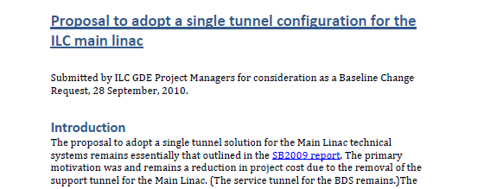
Proposals Received

Slide 8
Proposal Approved by Director
Global Design Effort
8
Notes:
8
PM goal: make this final step a formality supported via the BAW mechanisms.
8

Slide 9
Single Tunnel
High-Level RF Solution
Critical technical challenge for one-tunnel option is the high level RF distribution.
Two proposed solutions :
  Distributed RF Source (DRFS)
    Small 750kW klystrons/modulators in tunnel
    One klystron per four cavities
    ~1880 klystrons per linac
    Challenge is cost and reliability
  Klystron Cluster Scheme (KCS)
    RDR-like 10 MW Klystrons/modulators on surface
    Surface building & shafts every ~2 km
    Challenge is novel high-powered RF components (needs R&D)
  Backup: RDR-like single tunnel HLRF
9

Slide 10
Proposal Approved by Director
Global Design Effort
10
Notes:
10
PM goal: make this final step a formality supported via the BAW mechanisms.
10

Slide 11
SCRF Progress
A.Yamamoto, Marc Ross, and Nick Walker
ILC-GDE Project Managers
ILC-PAC, Eugene, Nov. 11, 2010

Slide 12
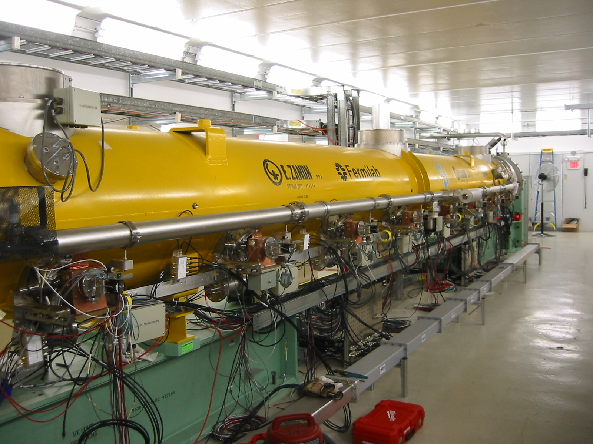
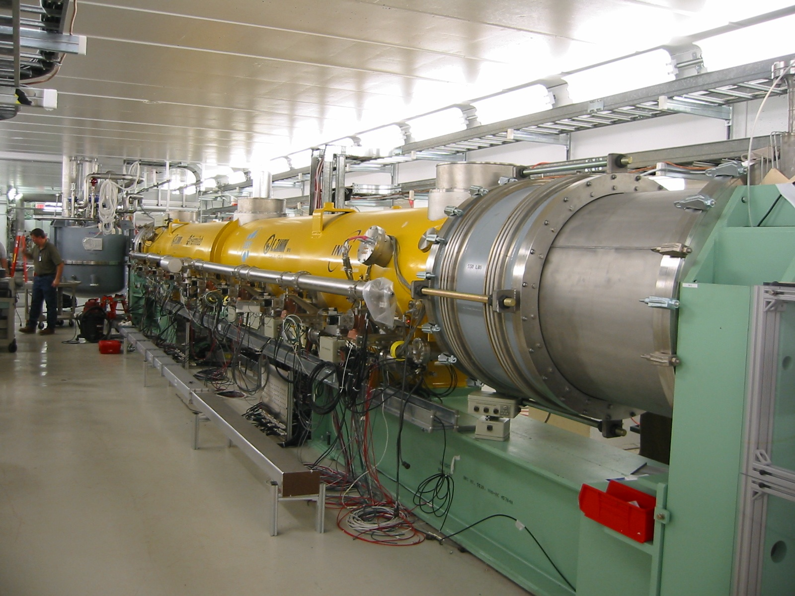
Topical Progress going on This Week!:
Fermilab: NML Cryomodule
NML-CM1 cryomodule in collaboration of
  Fermilab, DESY, INFN.
- Cool down is about starting, this week.

Slide 13
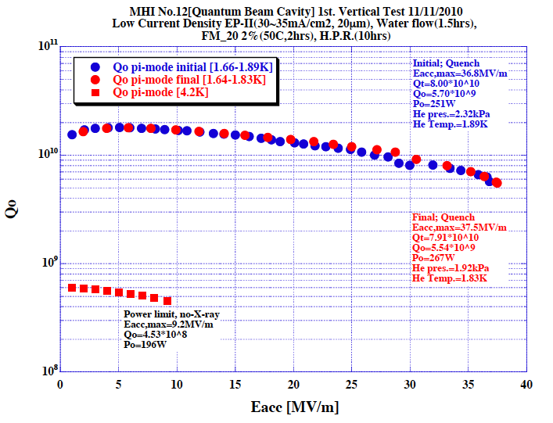
KEK: MHI-12 reached 37.5 MV/m in the 1st pass, TODAY!

Slide 14
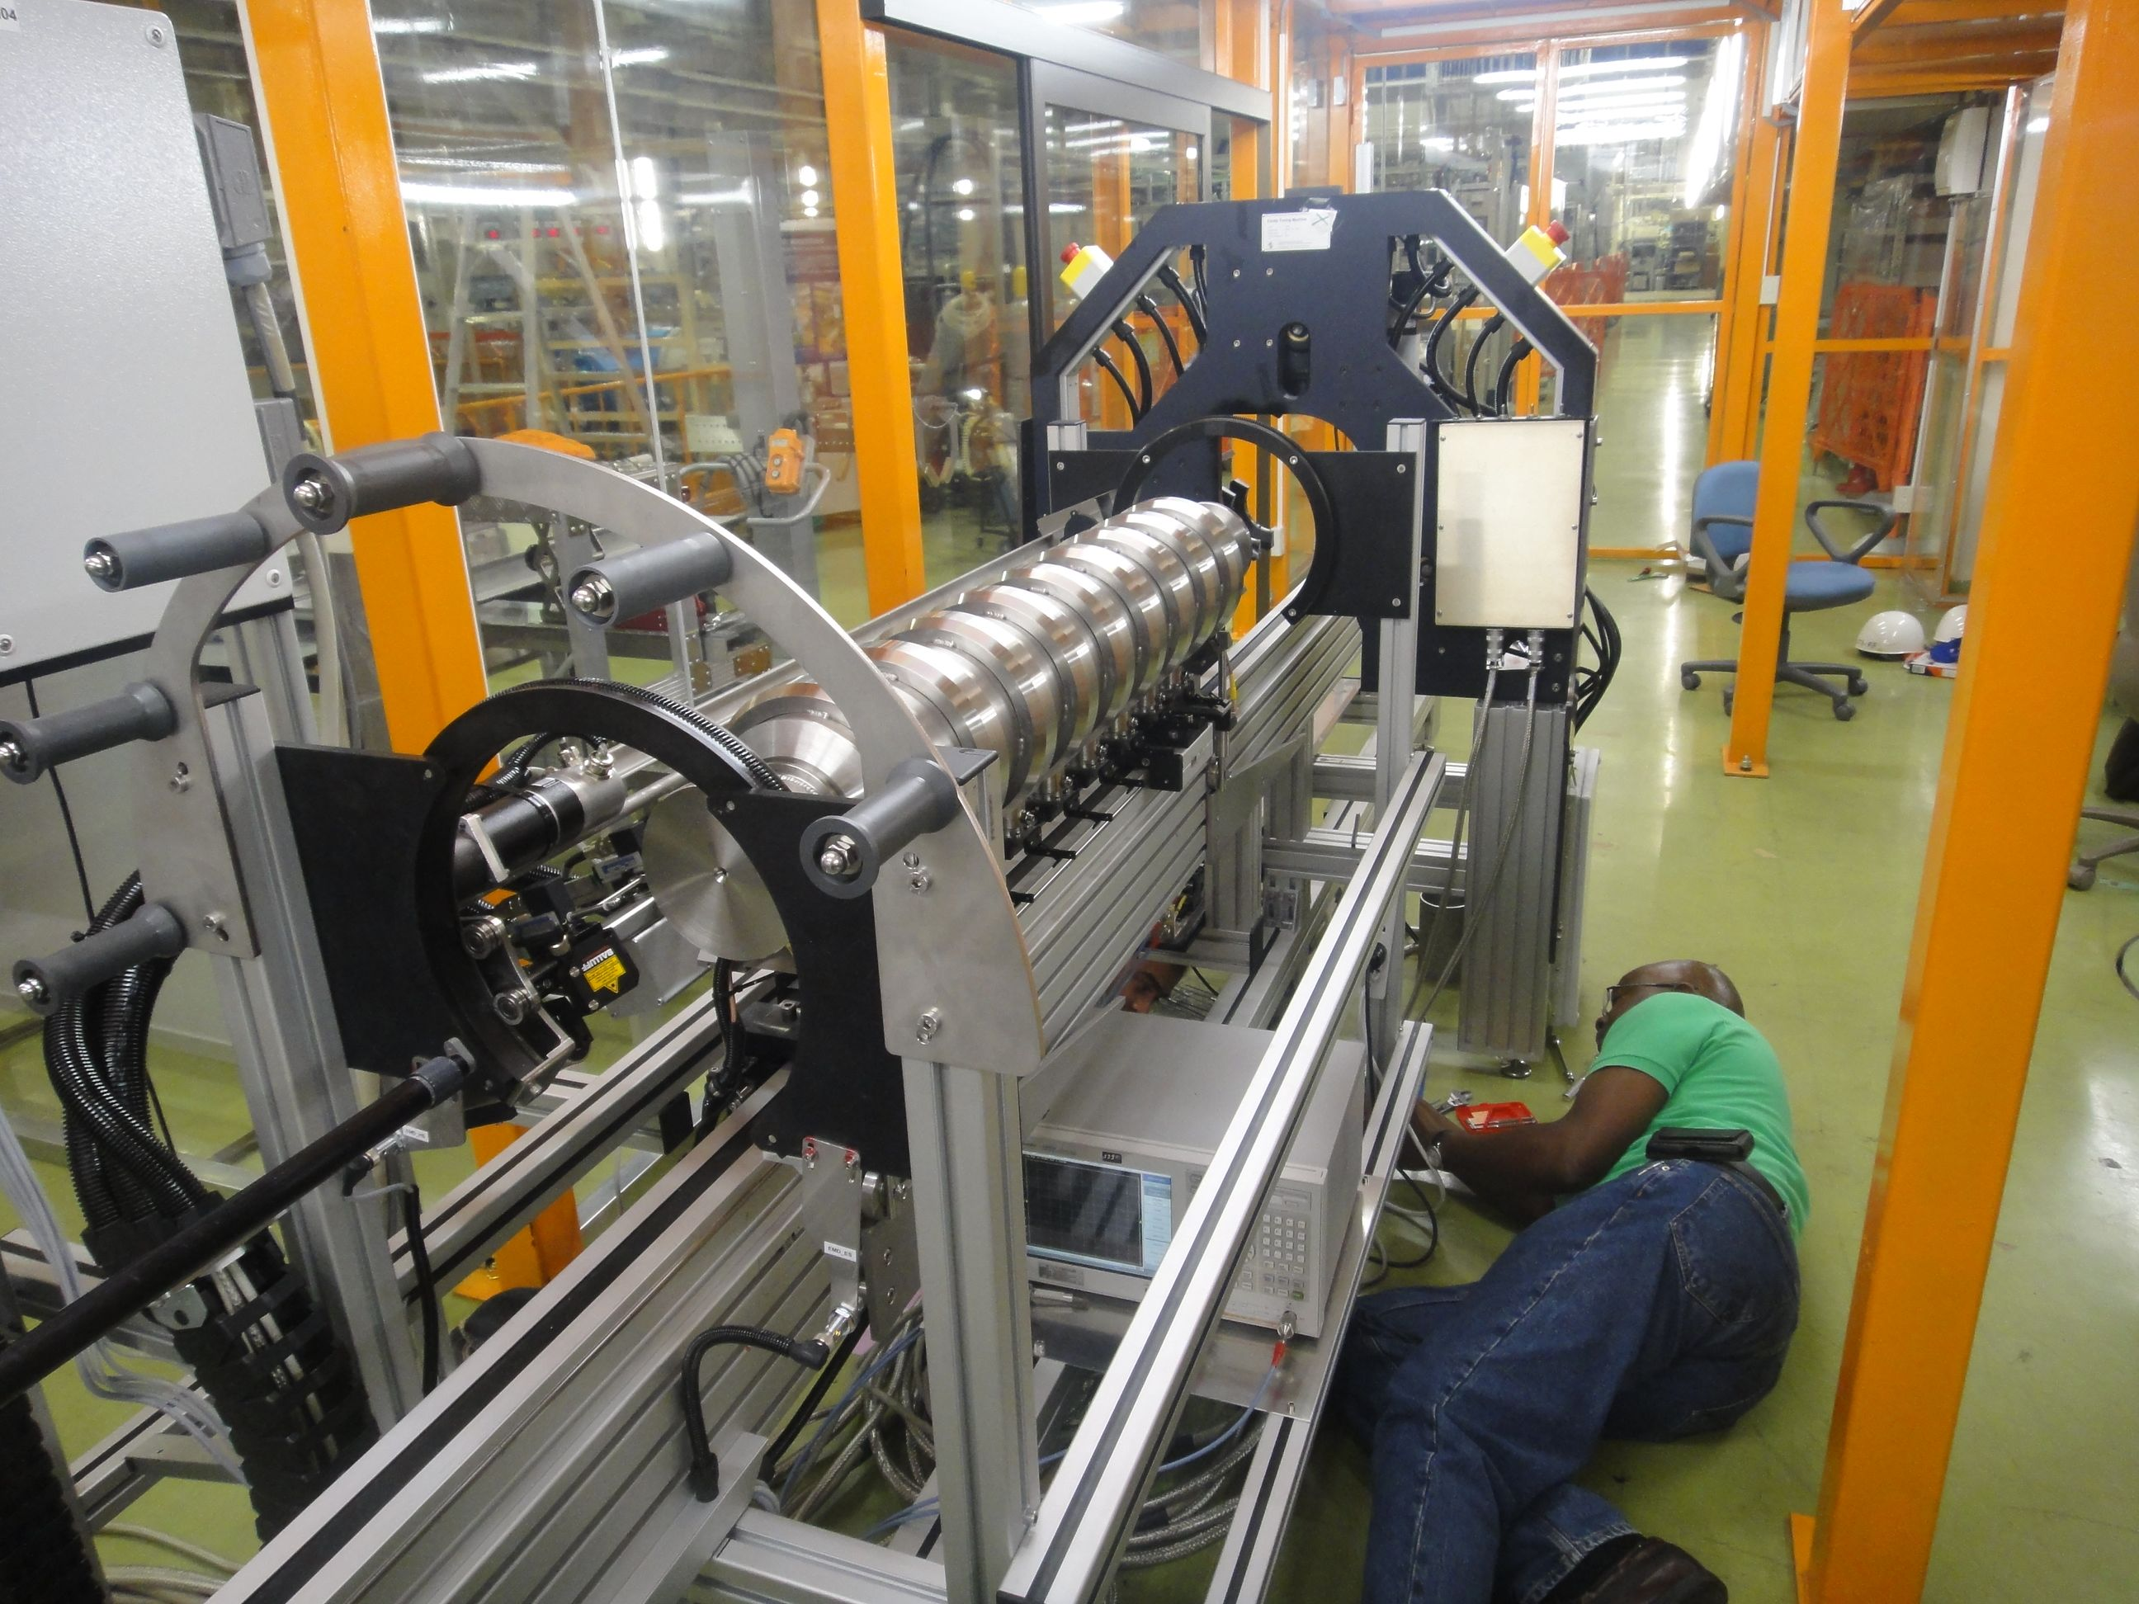
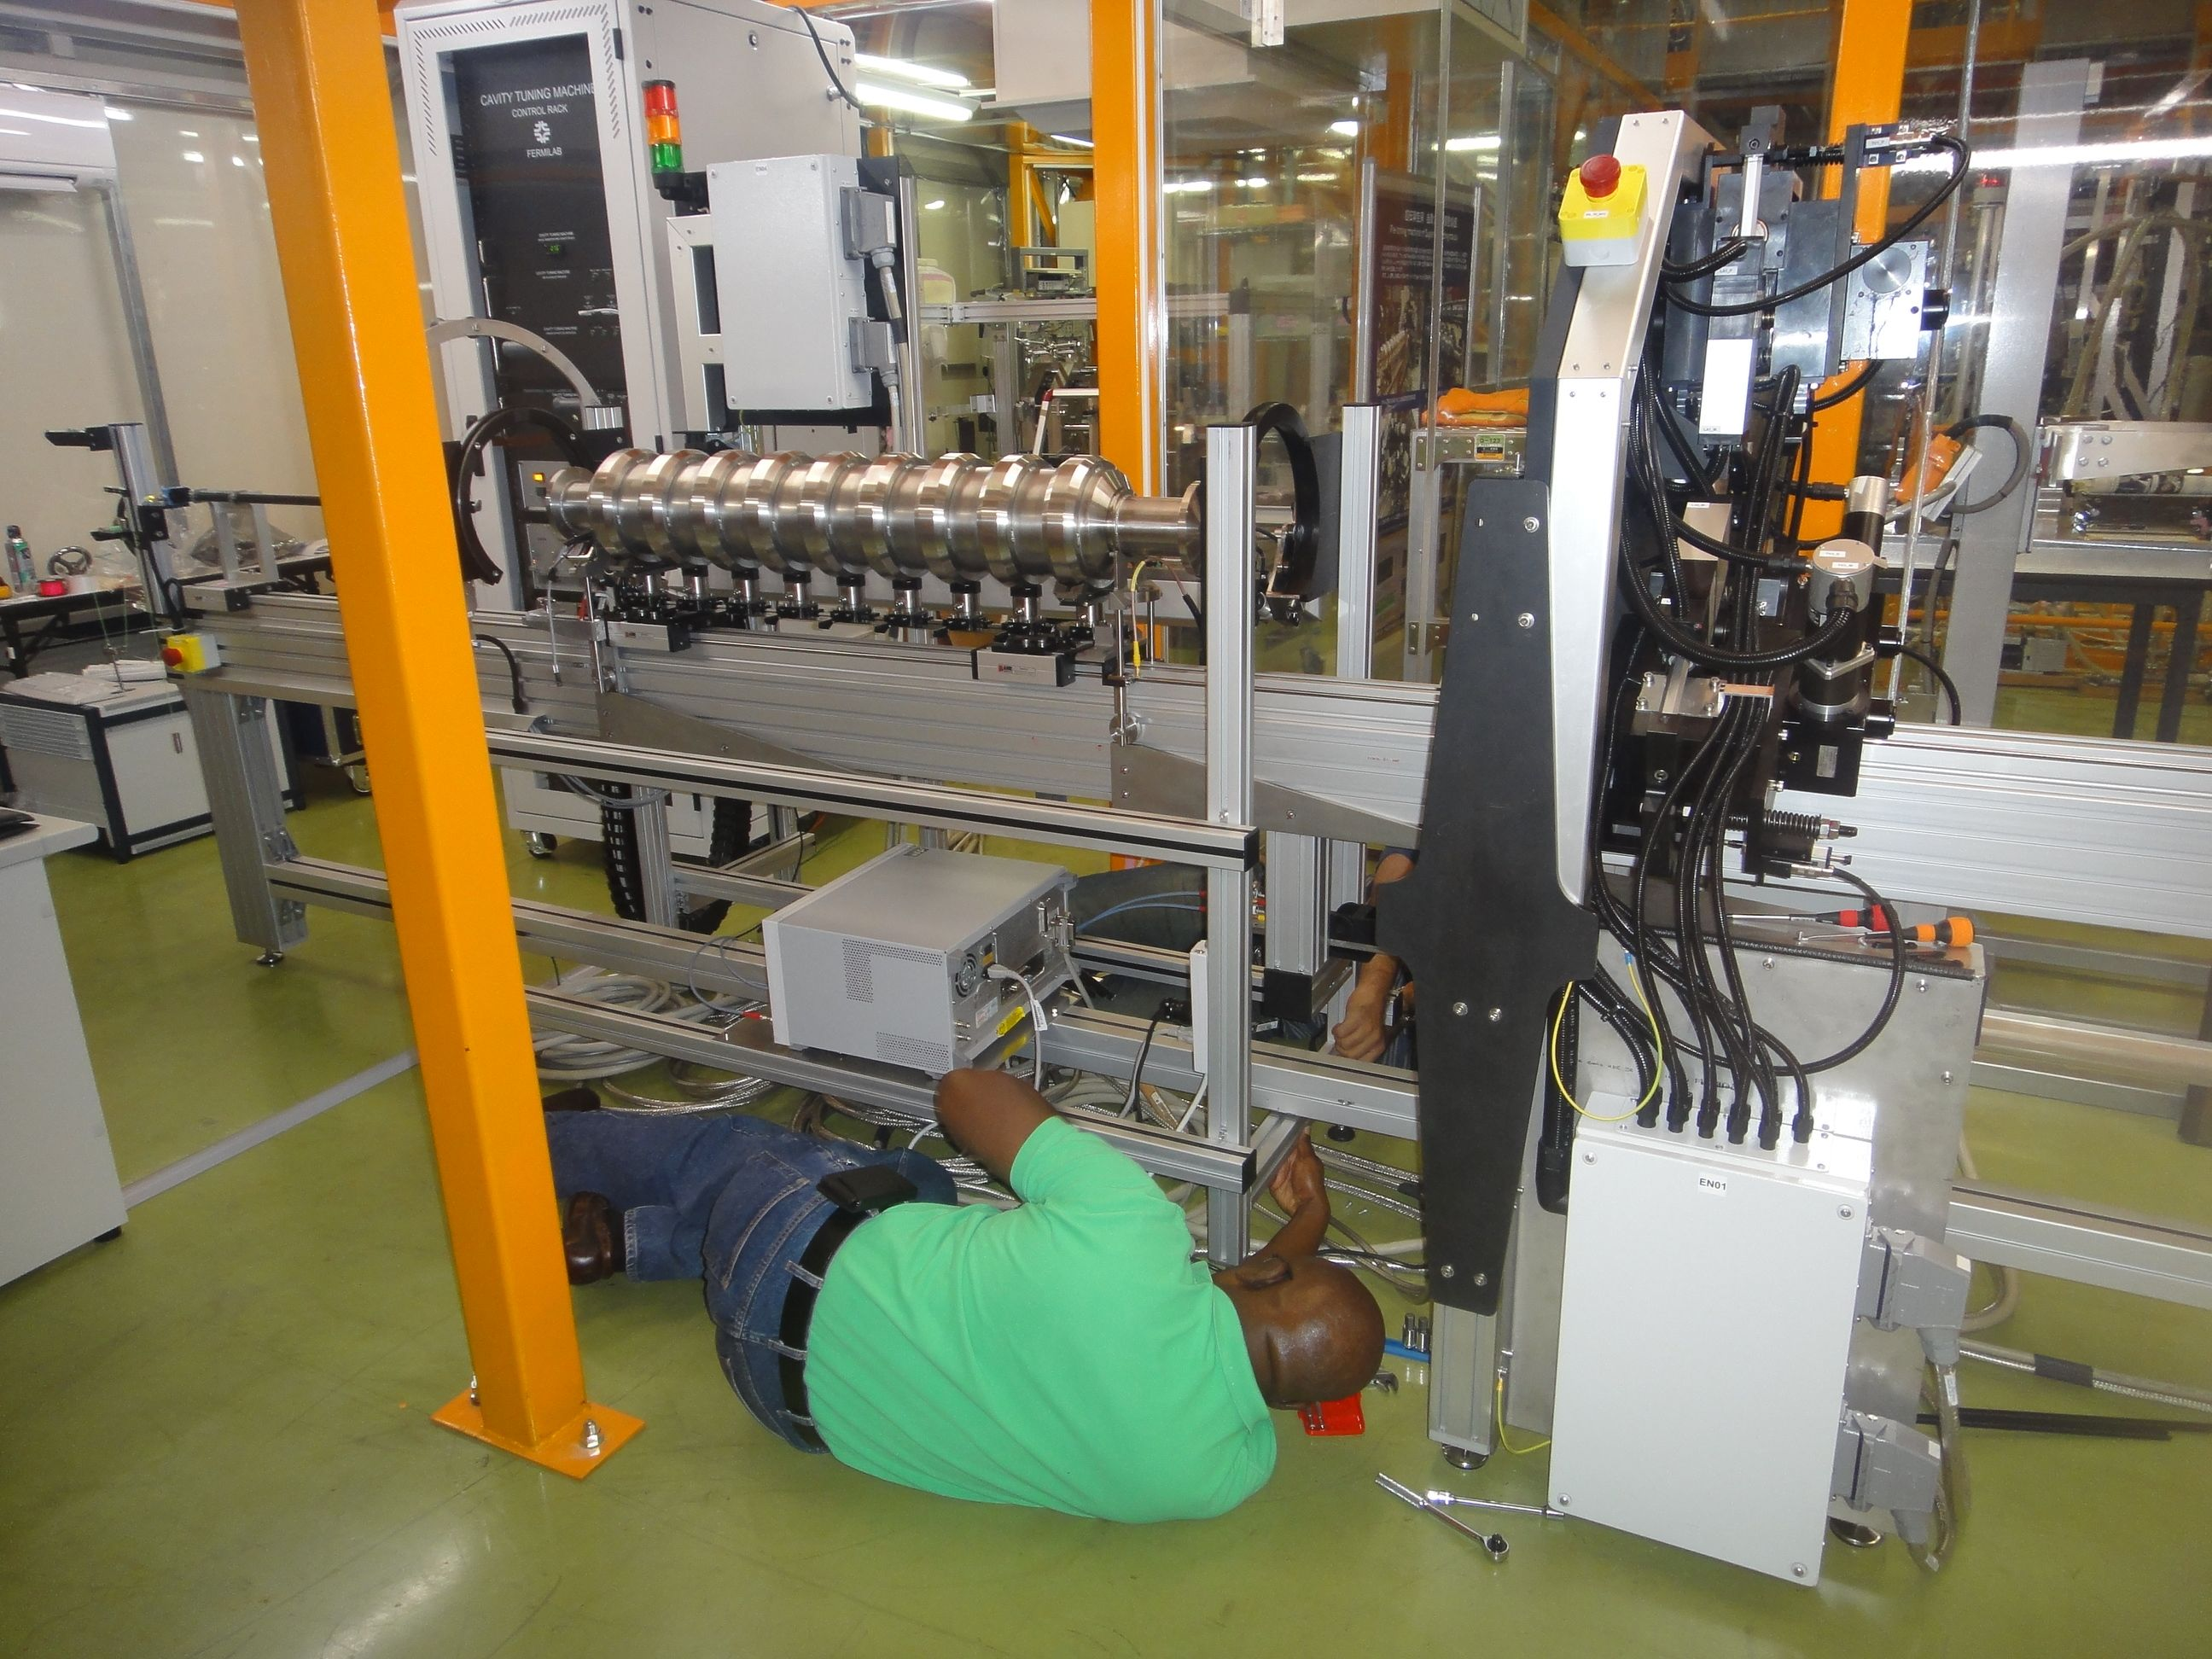
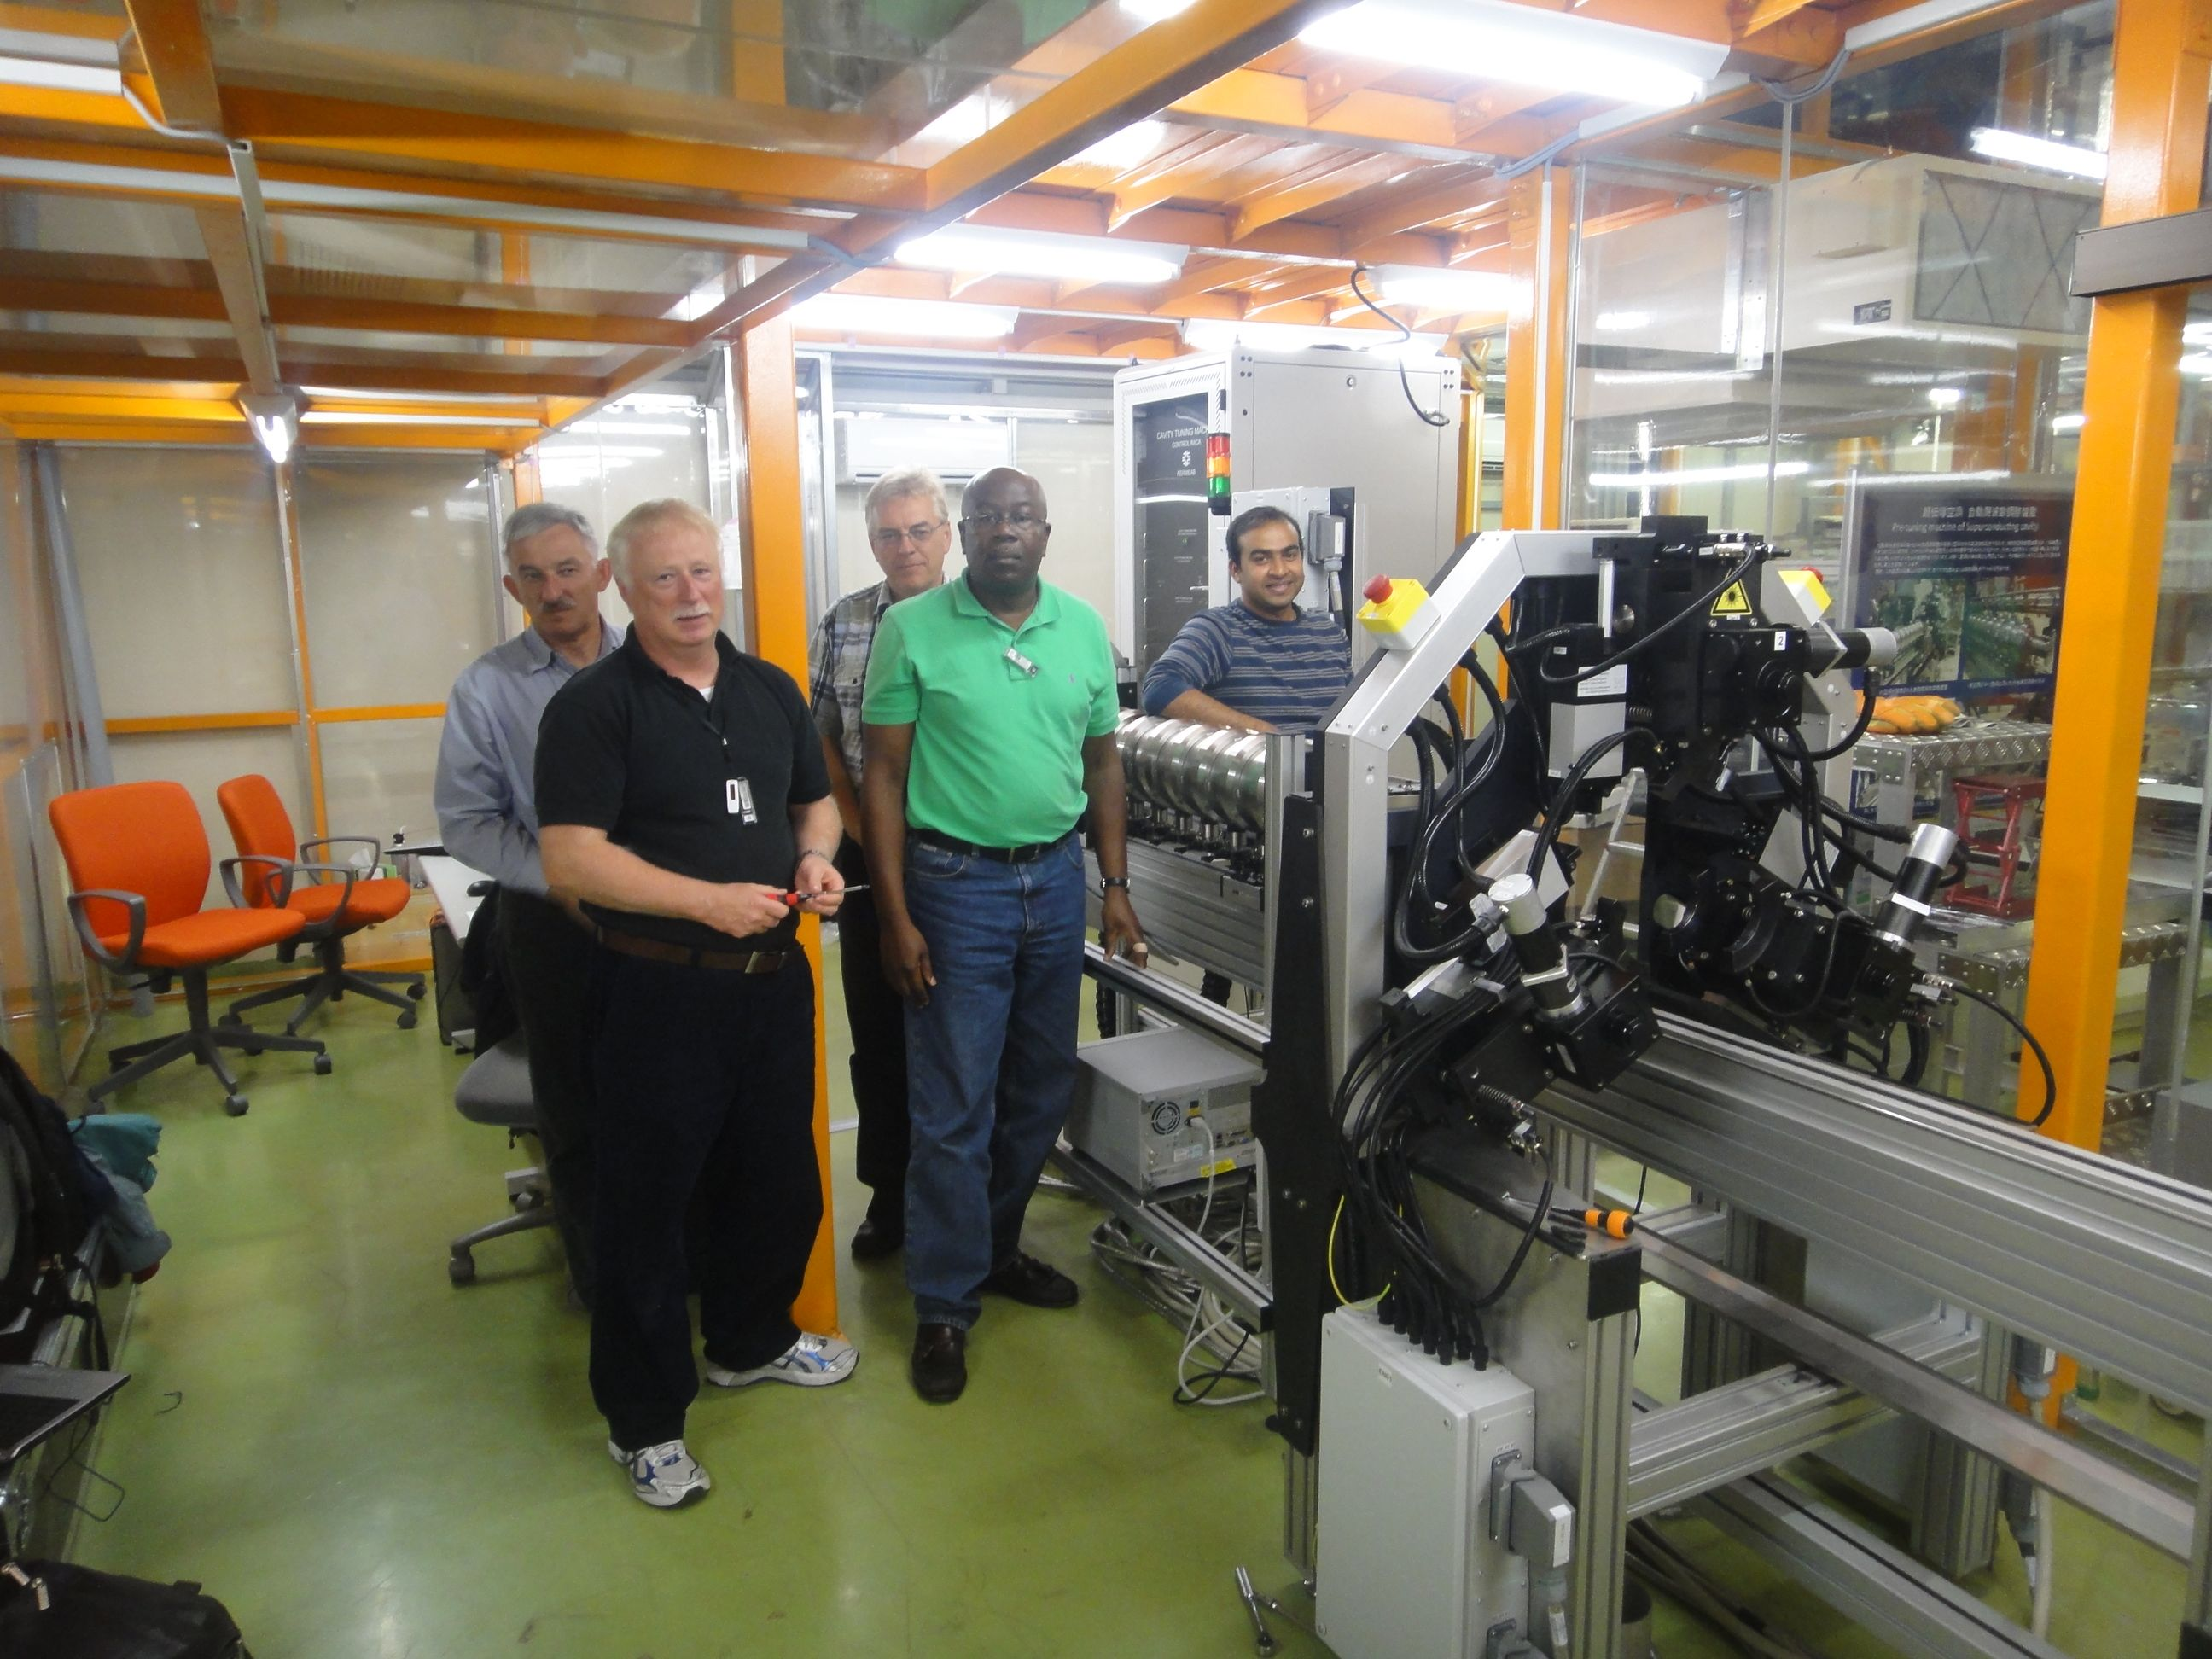
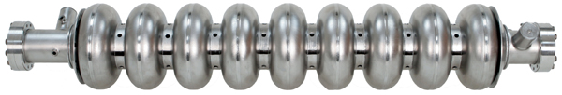
Topical Progress really going on ‘this week’
DESY-FNAL-KEK, Cooperative Work:
  Common tuning machines developed by DESY
  One being assembled by FNAL team at KEK

Slide 15
SCRF 9-Cell Cavity
Highlight: March ~ Oct., 2010
Americas:
Niowave-Roark-FNAL: 1st cavity reached 28.8 MV/m.
Jlab set an example of ~ 90% yield @ 35 MV/m (1 vendor & all process at JLab)
FNAL-KEK: Cavity locally repaired, G improved from 11 to 30 MV/m
Asia (hosted):
IHEP-KEK: 1st cavity (LL, large-grain, no-end) reached 20 MV/m,
PKU-JLab: Cavity (Tesla, fine-grain) reached 28 MV/m,
Hitachi-KEK: 1st cavity (Tesla-like, no-end) reached 35 MV/m
MHI-a-KEK: QB (Tesla-like w/ end-HOM: MHI- 12) reached 37 MV/m, TODAY !
MHI-KEK-S1-Global: cavity (Tesla-like) reached > 35 (40) MV/m
Europe:
E-XFEL / HG-FP7: 600 cavity production order placed (2 vendors)

Slide 16
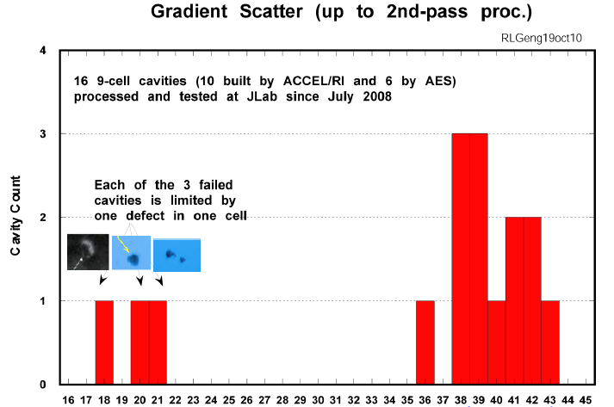
90 % Yield at 35 MV/m achieved with one vendor and JLab Process/Test
R. Geng
9/10 A CCEL/RI cavity exceeded 35 MV/m
ACCEL/RI
AES
AES
35 MV/m
22 MV/m
AES

Slide 17
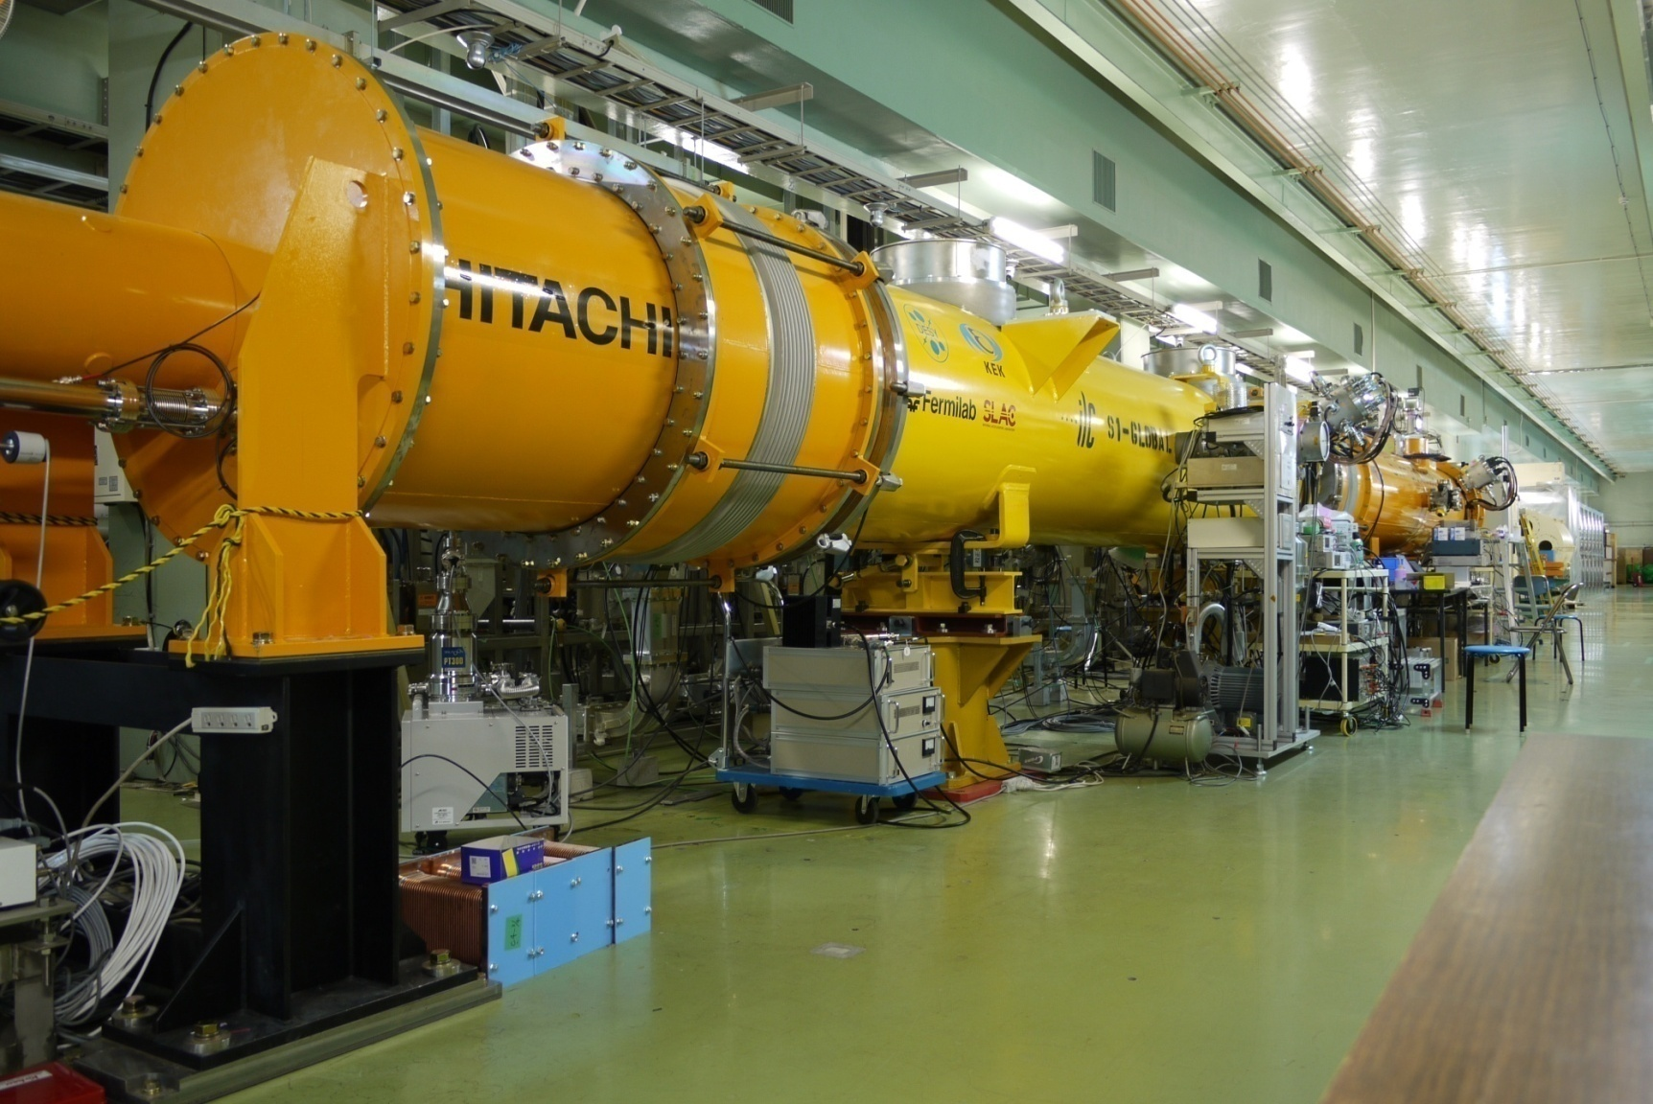
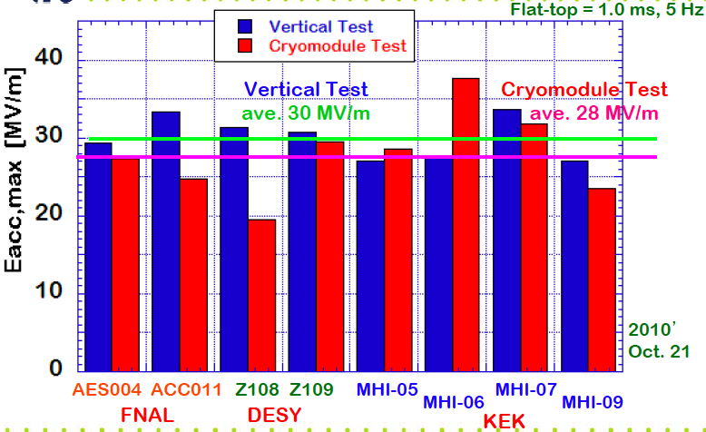
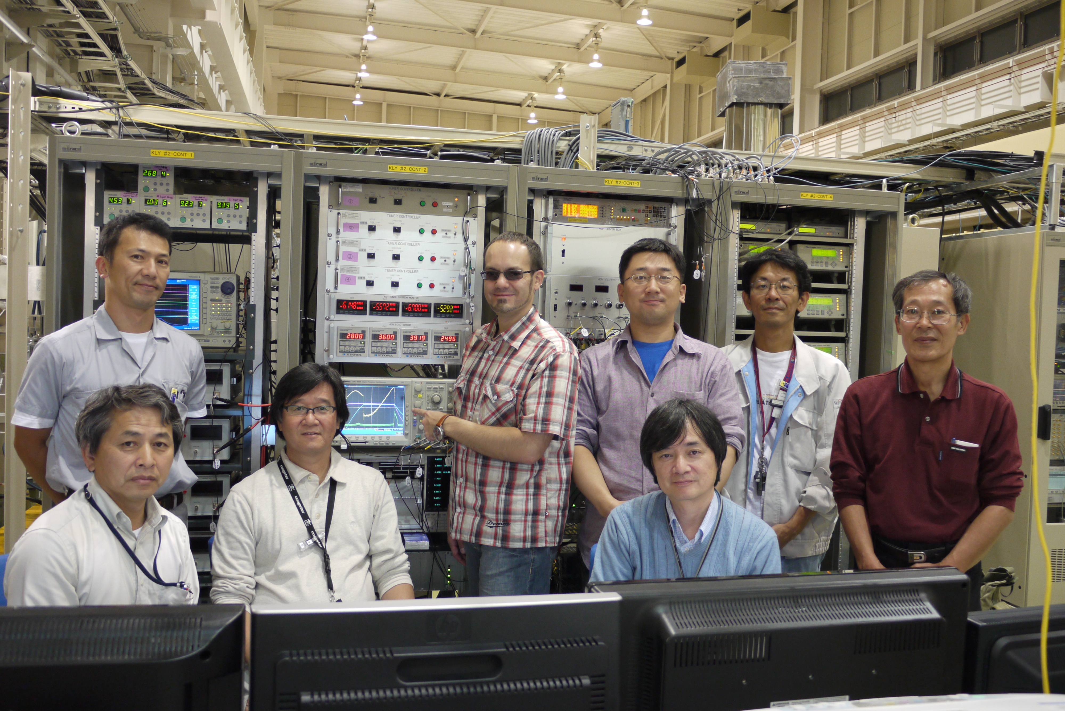
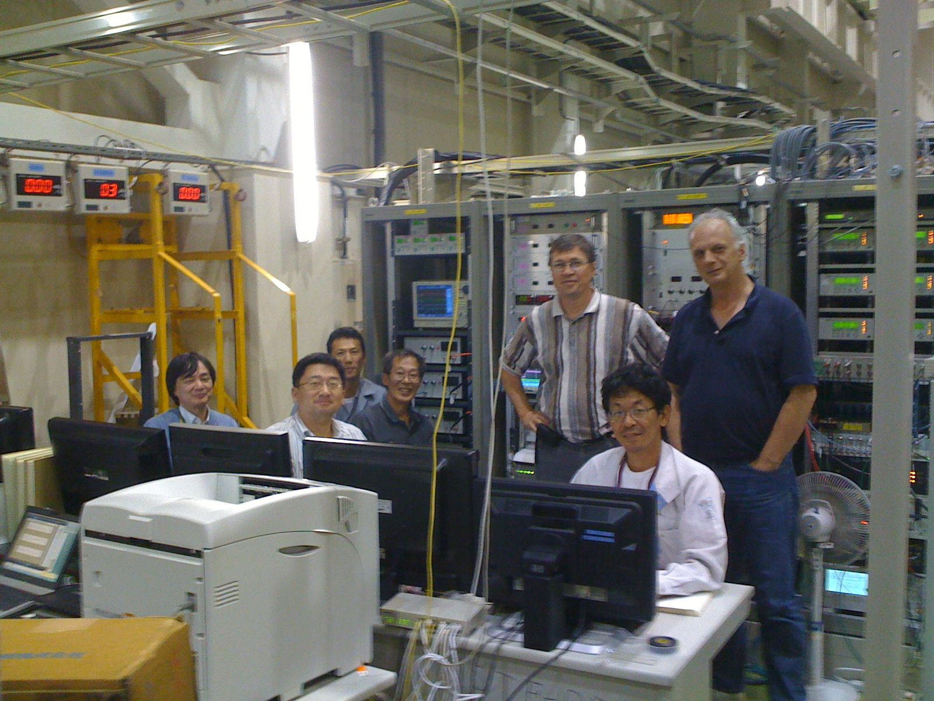
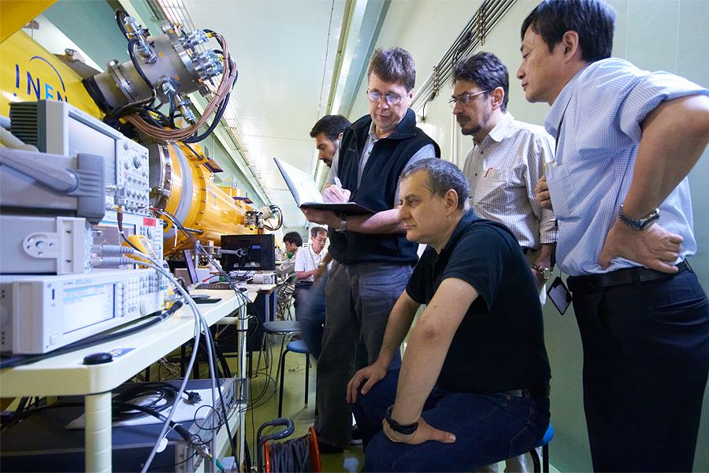
S1-Global Cryomodule Test in Progress
DESY, FNAL, INFN, KEK, SLAC cooperation and IHEP participation
Vertical cavity test
• CW low power test
reached:
< 30 MV/m >
S1-Global cryomodule
• 1ms, 5 Hz pulse
Individual test reaching:
< 28 MV/m＞
{as of Oct. 22, 2010}
Notes:
777
888
17
777
888
17
777
17
888

Slide 18
Cryomodule Gradient Spread Observed at DESY and KEK, as of Nov. 2010
D. Kostin & E. Kako
PXFEL-1 PXFEL-2 PFEL-3
FLASH:
  3 PXFEL cryomodules
ILC-TDP:
  S1-Global cryomodule
S1-Global

Slide 19
Average Gradient Observed in Cavity/Cryomodule Tests at DESY and KEK
Project: Cryomodule | XFEL: PXEL-1 | XFEL: PXFEL-2 | XFEL: PXFEL-3 | ILC-TDP: S1-Global |  | ILC: Spec.
9-Cell Cavity Vertical Test (CW-mode) | < 36 > | < 31 > | < 30 > | < 30 > |  | < 35 >
Cryomodule Test (10 or 5 Hz) | < 32 > | < 30 > | < 25 > | < 28 > |  | < 34 >
G. degradation VT→CMT, % | ~10 % | ~ 4 % | ~15 % | ~ 7 % |  | ≤ 3 %
Accelerator Operation (10 or 5 Hz) | < 30 > used in FLASH (ACC7) | N/A | N/A | N/A |  | < 31.5 >

Slide 20
Summary
Cavity gradient R&D
  R&D milestone:
    35 MV/m at Q0 > 8x10E9, > 50 % yield achieved in TDP-1, 2010,
    35 MV/m, w/ > 90 % yield (eq. > 38 MV/m av.) anticipated in TDP-2.
  ML Acc. Gradient baseline: 31.5 MV/m with the spread ≤ +- 20 %
Cryomodule Performace
  S1-global module, achieving the av. gradient 28 MV/m
    in balance of the vertical test w/ 30 MV/m
  Cryomodule performance is conern,
    the drop of the gradient to be understood and improved,
Preparation for the SCRF Industrialization
  To be discussed in the next report.

Slide 21
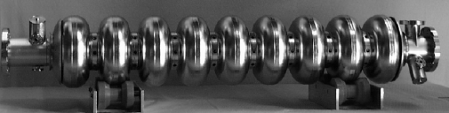
Preparing for Industrialization of
ILC SCRF Cavity and Cryomodule
Akira Yamamoto, Marc Ross, and Nick Walker
ILC-GDE, Project Managers
To be presented at ILC-PAC, Eugene, Nov., 11, 2010

Slide 22
Outline
Introduction
  What was advised by the 4th ILC-PAC?
  ILC -SCRF cost effective production
Strategy for Preparing Industrialization
  Learn Experience
  Laboratory’s (own) effort
  Communication with industry
Preparing Plan and Process
  Call for response w/ ILC preliminary specifications
  Integrate information from laboratories and industry
  Establish the ILC SCRF industrialization model and cost estimate

Slide 23
Preparing for ILC SCRF Industrialization
Learn from previous efforts and on-going programs:
  Study of the TESLA project (1990’s)
    Assuming to manage ~ 20,000 cavities
  R&D progress in past 10 years
    Varied industrialization efforts
  On-going Industrialization in the XFEL Project
Develop Industrialization Model
  Need to adapt various governance models and in kind contribution models from multiple regions, countries, and laboratories,
  Make our own effort to seek for the best cost-effective production technology and approach
    An example: A pilot-plant effort at KEK
  Communicate with industry and laboratories to seek for cost-effective manufacturing and quality control

Slide 24
Next Step for Preparing Industrialization
Plan for 2010-2011:
  Extend our own effort for industrialization at laboratories,
  Prepare for “ILC Cavity/cryomodule Specification” and
  Ask responses/advices from cavity/cryomodule vendors
Boundary Conditions assumed:
  Plug-compatible, build-print, specification
    Including design parameter, interfaces, manufacturing process,
    Requirement on quality control, and minimum acceptance critera
  Possible mass-production model
    Scale of production: 4,000 ~ 8,000 (25 ~ 50 %, for example)
      Possible industrial collaboration (grouping etc.. )
    Scale of production period: 2 + 5~6 years
      pre-series + main production period, assuming ≥ 2 x EXFEL construction period

Slide 25
Guideline for Industrialization Study
Global industrial market expected for
  Sub-Components purchasing, w/ estaliblished tech.
    supplied by manufacturers with no strong constraints for regional/national balance
  Industrial competition encouraged for
    Healthy competition in bidding, and cooperation in manufacturing process with risk mitigation,
    Keeping control of cost and schedule,
Laboratory responsibility required for
  Assembly/integration/test work,
    With system engineering with intellectual interest,
    Facility hosted by laboratories for benefit of further development and applications in each region/countries

Slide 26
Possible Models of Industrialization
Possible work sharing | Commercially supplied, relying on market | Region/ Laboratory responsible | Notes, constraint
# of participants | 1: possible , ≥ 2: desired | ≥2: most likely
Cavity:
Nb and raw material | Yes
Main cell, He-Jacke | Yes with care |  | High Pressure Code
End-group, HOM etc. | Yes
Input Coupler, Tuner | Yes
Surface Process | Yes /Possible | Yes/Possible
Integration |  | Most Likely | High Pressure Code
Cavity Perform.. Test |  | Most Likely | Lab should be responsible
Cryomodule:
Vacuum vessel | Yes
C.M. component | Yes with care |  | High P. code
Cavity-CM Assembly |  | ≥2: Most likely 1: special case
Cryomodule test |  | Most likely | Lab should be responsible

Slide 27
Industry and Laboratory Cooperation
 | Main Cavity/Process | Coupler | Tuner (currently) | Process, Vertical Test, Integration
EU | RI, Zanon | Thales, RI | {INFN}/TBD | DESY, Saclay
AMS | AES, Niowave, PAVAC | CPI | TBD | FNAL, JLab, Cornell,
AS | MHI, Hitachi, Toshiba | Toshiba-ET | MHI/TBD | KEK
Possible share of responsibility:
  Sub-component : manufactured by industry
  Integration: hosted by Lab, and worked by industry
  Test: hosted and worked by Lab.

Slide 28
An Industrialization Model
Industry-based Cavity Production
  Manufactured by companies,
    shared fraction of ½ or smaller (50 % ~ 12.5 %)
  According to ‘built-print specification’ , satisfying
    Minimum acceptance criteria and inspections, such as mechanical, surface, pressure, leak-tight, RF characteristics, so on,
    Specific process such as EBW, EP, heat-treatment,
  Delivery from industry to laboratories with no inspection for the gradient performance
Laboratory-based Cavity Performance Test
  Collaborating laboratories should be responsible for the cavity gradient performance,
    As a deliverable in collaboration between / among laboratories,
  Multiple laboratories’ collaboration are natural.
  Delivery from laboratory to (host) laboratory with performance tested,

Slide 29
An Industrialization Model and Responsibility
Laboratory: A
aboratory : …
Laboratory: B
ILC
host-laboratory
Laboratory: E
Performance specification / MOU
Laboratory: C
Laboratory : D
Responsible for gradient test
Built-print specification/ Contract
Lab: responsible for gradient
Industry: responsible manufacturing
Manufacturer / industry

Slide 30
Summary of Responsibility to seek cost-effective cavity/crymodule manufacturing
ILC Hosting laboratory and Collaborating Lab.
  ‘Gradient and performance’ should be within an agreements,
ILC Hosting-lab / Participating-Lab and Vendor
  Manufacturing should be contracted according to
    Plug-compatible, built-print specification with minimum acceptance criteria to be well established,
    ‘Gradient performance should not be asked in contract,

Slide 31
Plan for Industrial Communication
Period | Occasion | Action Items
Oct. 20 | IWLC-10: GDE SCRF | Discuss ‘cavity and CM specification’ and industrial model, and study plan
Oct. 25-26 | Visit DESY | Learn E-XFEL cavity and cryomodule specification and procurement
Nov. 11-12 | ILC-PAC | Report the study plan / preparation plan for industry
Dec. 9 | Visit Saclay | Learn E-XFEL cryomodule assembly contract: Hosted by Saclay lab., and contracted by companies
Jan. |  | Complete the technical specification, and Distribute it to possible vendors
April/May |  | Receive responses from vendor
Oct. |  | Complete new cost estimate

Slide 32
TLCC Process
Baseline Assessment Workshops
  Face to face meetings
  Open to all stakeholders
  Plenary
Physics and detector input / representation mandatory
 | When | Where | What
BAW 1 | Sept. 7-10, 2010 | KEK | Accelerating Gradient Single Tunnel (HLRF)
BAW 2 | Jan 18-21, 2011 | SLAC | Reduced RF e+ source location
Global Design Effort
32
Notes:
32

Slide 33
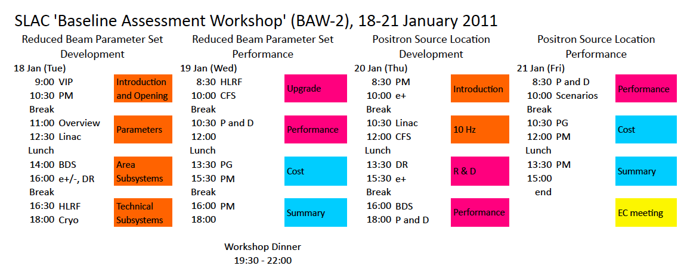
BAW-2 Plan
Subjects to be discussed for SCRF
  HLRF response to LE 10 Hz operation.

Slide 34

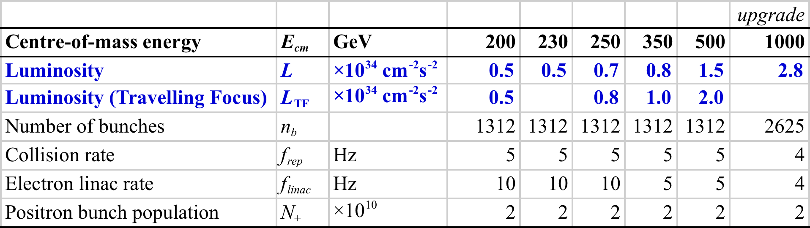
BAW-2 Themes
Reduction of # bunches (2625 → 1312)
  Reduced beam power → reduced RF
  Smaller damping rings (6.4 km → 3.2 km)
  Regain luminosity via strong focusing at IP
Re-location of e+ source to end on Main Linac
  Better integration (central campus) – higher overhead (at 500 GeV running) ⇒ reduced risk
  Issues of running for Ecm < 300 GeV
10 Hz alternate pulse mode
Notes:
Need to again emphasise that these two issues are separate, but because both have a direct impact on the luminosity, they have been confused in the past.
In particular the e+ source, where the original reported drop in L by factor 3 was assumed to be entirely due to the source re-location.
Stress also that these detailed studies of Ecm<500 GeV were never made for RDR. Assumption of gamma-scaling was naïve and incorrect (IR collimation depth).

