Slide 1
S1-Global status 11172010
H. Hayano, E. Kako, N. Ohuchi, S. Fukuda, S. Michizono, H. Nakai
and S1-G team

Slide 2
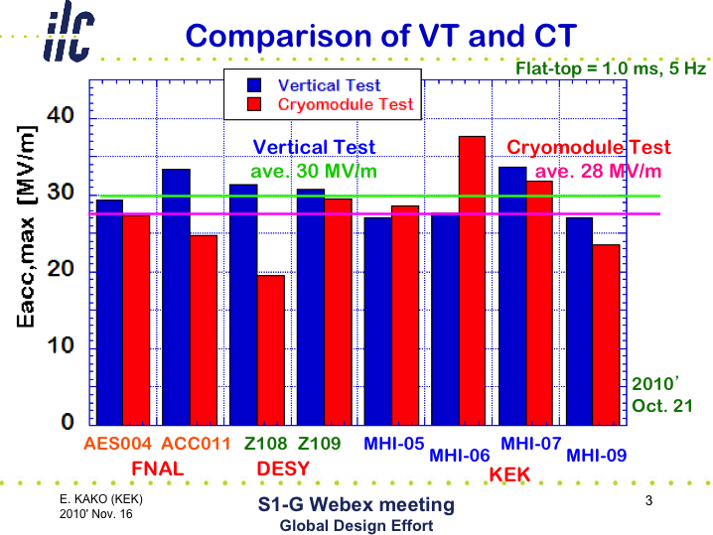
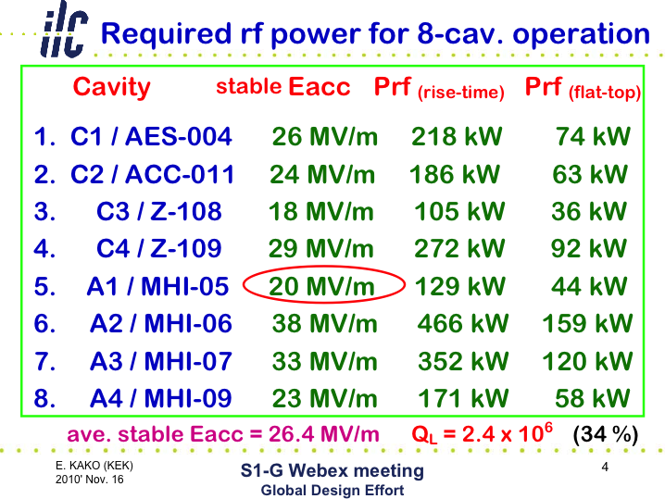
Cavity gradient status
Last week, arc & vacuum trip happened around coupler warm side,
Much rf power was put by accident.
Then field reduced from 28 to 20MV/m.
RF process is required.

Slide 3
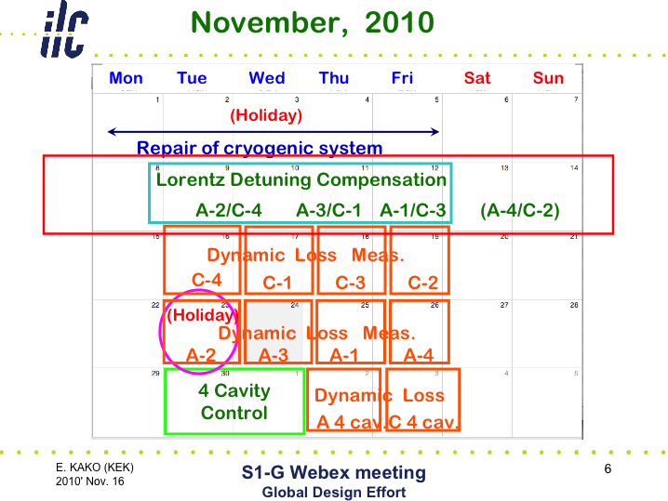
Vector sum operation date
4 cavities vector-sum operation
8 cavities vector-sum operation

Slide 4
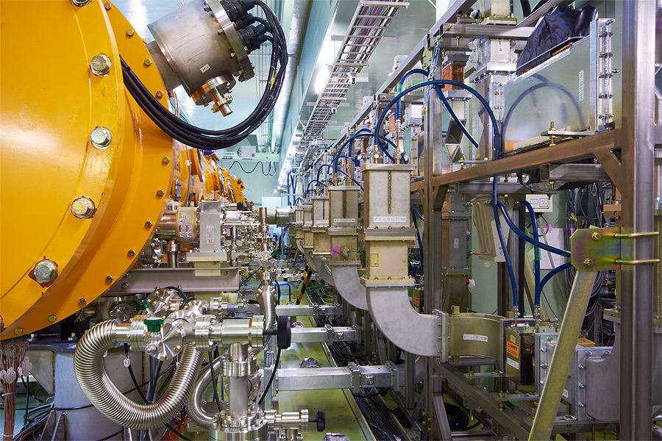
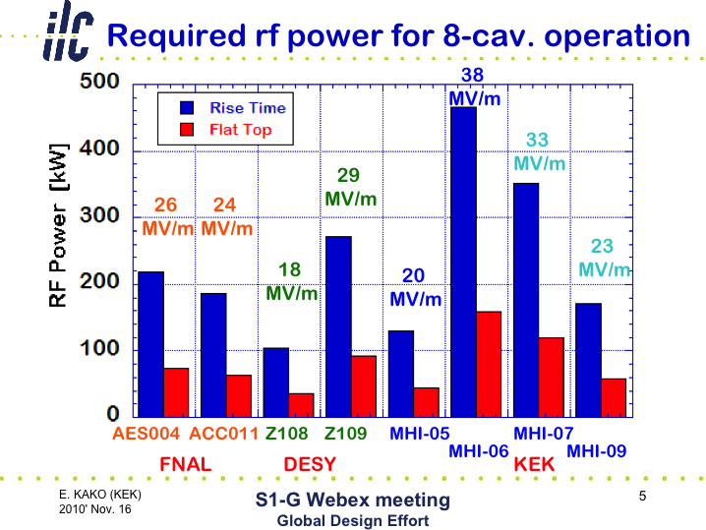
Power divide ratio
Motor driven tunable hybrid

Slide 5
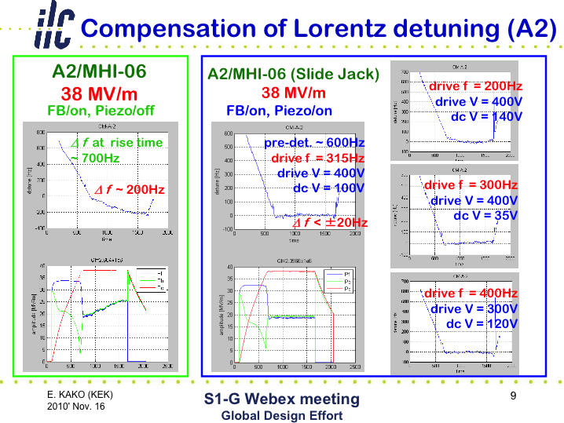
Example of LFD compensation by Piezo pulsing

Slide 6
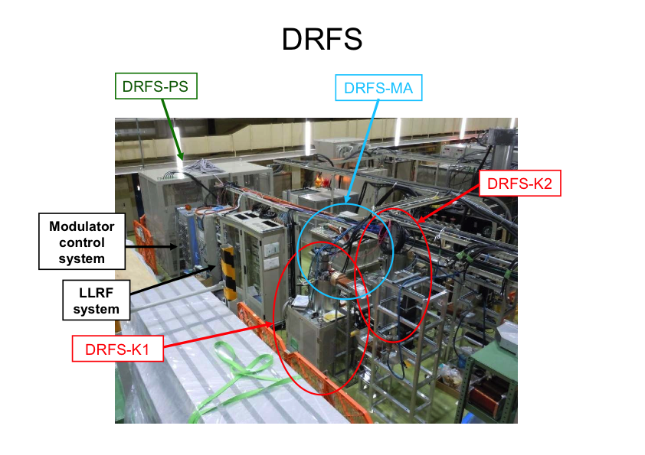
Two DRFS Klystrons Test at surface (1)

Slide 7
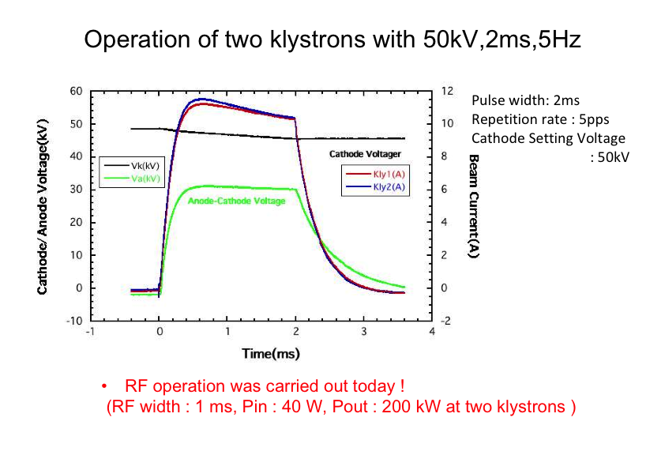
Two DRFS Klystrons Test at surface (2)
As of Nov.16, 2010

Slide 8
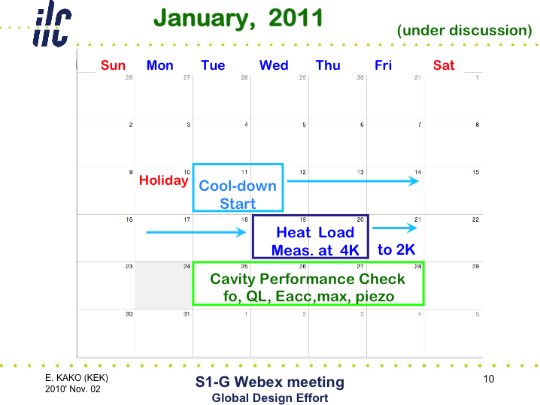
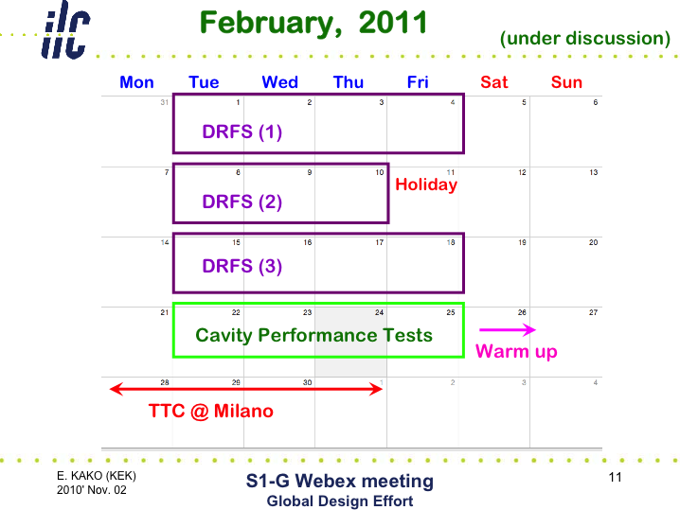
DRFS Test to drive cavities
3 weeks in Feb. 2011 are scheduled, but still under discussion.

