Slide 1
NML/CM1 Status
Jim Kerby (Fermilab)
on behalf of the NML/CM1 team
(particular thanks to Jerry Leibfritz)

Slide 2
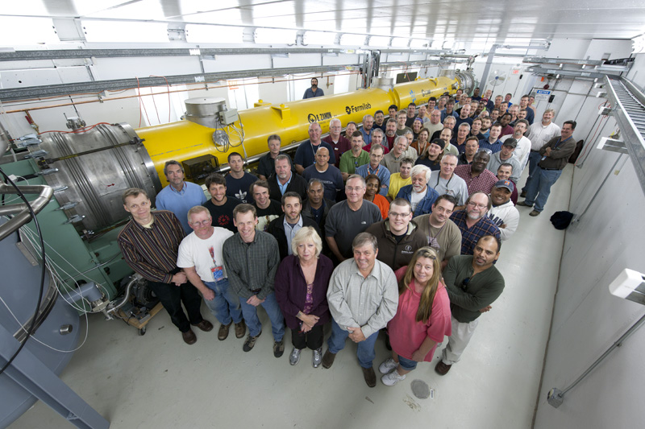

Slide 3
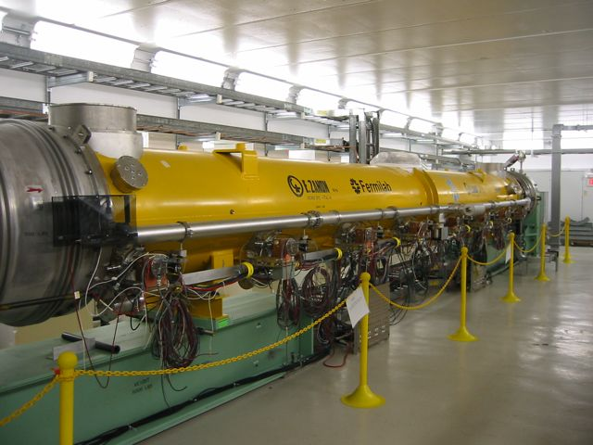
NML Accelerator - CM1
Cryomodule-1
Installed
Aligned
Under Vacuum
Warm RF Conditioning Complete
Cryogenic Interconnects Complete
Ready for Cooldown

Slide 4

Cryomodule 1 (DESY kit)
Our first goal is to understand the performance of cavities in CM1 compared to HTS tests at DESY
We want to verify our assembly techniques in CAF
Note that for CM1:
We do not expect to meet the S1 goal of 31.5 MV/M
Average of Chechia tests is 23.5 MV/M
Working to understand what other tests of CM1 might be useful for ILC

Slide 5
CM1 Test Plan
Virtually identical to DESY run plan for XFEL modules (courtesy of Dennis Kostin) and Fermilab experience at HTS and CC2
TEST PROCEDURE:
1. RF Cable Calibration done
2. Technical Interlock / Sensor checkout done
3. RF source / Waveguides / LLRF done
4. Warm Input RF Coupler Conditioning done
5. Cooldown to 2K (Nov.)
6. Cavity Spectra measurements
7. Cavity Tuners Test and Tuning
8. Coupler Q_{load} measurement
9. Set Cavities On Resonance
10. Cold Input RF Coupler and Cavity Conditioning
11. Single Cavity RF Measurements
12. RF Measurement of 8 Cavity Cryomodule
13. Cryo performance testing (non-ILC conditions)

Slide 6
CM2 Status
All parts in hand. TTF type III cold mass
U.S. processed cavities > 35 MV/m in VTS
Cavities dressed at FNAL
INFN provided blade tuners (receiving U.S. built tuners)
3 cavities qualified in HTS to 35 MV/m
1 backup cavity at 31 MV/m
4 more >35 MV/m cavities dressed and await HTS test
HTS test takes ~ 1 month, working to reduce this to 2-3 wks
1 more VTS tested >35MV/m
Expect to have all eight cavities qualified and CM2 constructed by ~ March 2011
ML-SCRF Webex

Slide 7
NML Schedule/Milestones
Phase-1 Cryogenic System Operational (August 2007)
Delivery of First Cryomodule to NML (August 2008)
Begin Civil Construction of NML Expansion (March 2010)
Warm RF Testing of First Cryomodule (July 2010)
Begin Construction of CMTF Building (August 2010)
First Cryomodule Ready for Cooldown (Nov. 2010)
Cold RF Testing of First Cryomodule (Dec. 2010)
Delivery of 2nd Cryomodule to NML (S1) (2011)
Install Injector & Test Beam Lines (2011)
First Beam (2012)
New Cryoplant Installation/Operation (2013-14)
RF unit test with beam (S2) (2014)

Slide 8
