Slide 1
JSF update to correct error seen in ZHH spring.
- JSFHadronizer
correct Pythia error ( pythia6.416 )
JSFWriteStdHep
job exit if stack size in HepEvtCheckAndMod gets big.

Slide 2
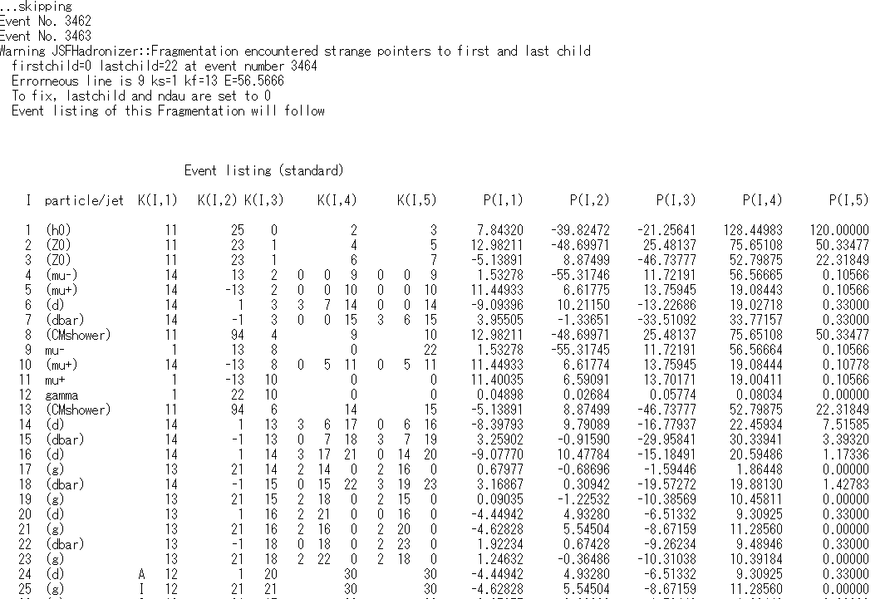
Pythia problem (6.416)
e+e- → ZZH→qqqqH
H decays by LUEXEC call
H→ZZ
pylist(2)
Z→dd
Z→μμ ◊ μμγ
13 events in total 20k ZZH

Slide 3
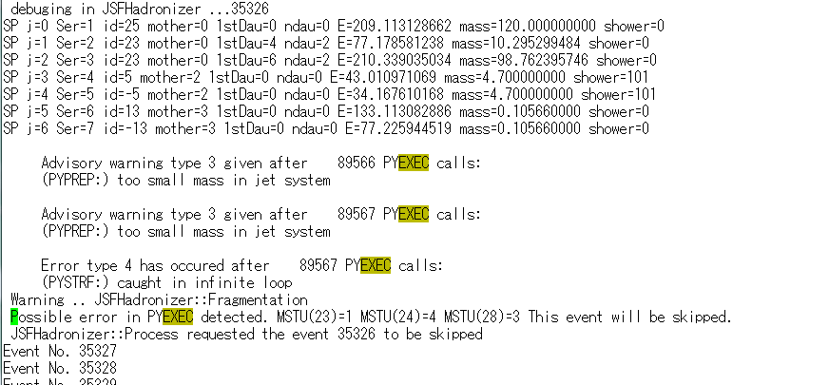
Another error in ZZH spring: Too small mass in jet system
JSF terminated immediately.
New JSF’s environment parameter was added.
JSFHadronizer.ExitOnError: 1 ( set 0 to skip the event )

