Slide 1

Status of top analysis at LAL
Philippe Doublet
Thibault Frisson
Roman Pöschl
François Richard

Slide 2
Observables
Measure of σ(tt), A_{LR} and A_{FB}
Using the LOI data samples (DSTs) : top produced at 500 GeV with 1000fb⁻¹
In the semileptonic decay mode :
tt→(bW)(bW)→(bqq)(blv)
Gives top charge
Allows reconstruction of the top quark

Slide 3
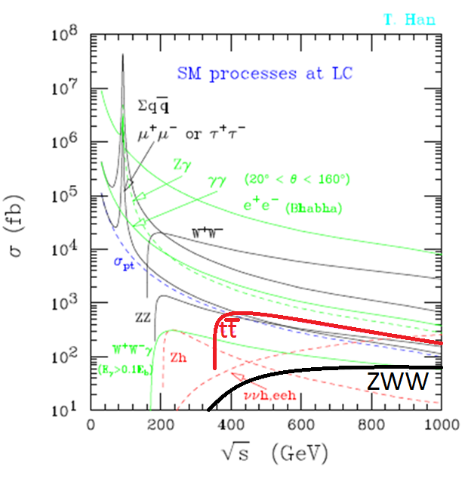
Top quark cross section
σ(tt) ≈ 600 fb
at 500 GeV
(≈ 180 fb for SL top into e and µ)
Backgrounds :
  ZWW (Z→bb) ≈ 8 fb, same topology
  τ channel not discussed here but not a problem
  Major background : full hadronic decay

Slide 4
Requirements
tt→bbqqlv (l=e,µ)
  Need at least 1 b jet (vertex)
  Find 1 lepton (tracking)
Method :
  Find a lepton
  Force 4 jets clustering
  Find at least 1 (or 2) b jets
  Form the top with one b jet + 2 non-b jets left,
  lepton charge gives the opposite sign of the top

Slide 5
Efficiencies and purities of the lepton
Particle | P « good » (W_{top}→lv) | P « bad » (mis-id) | Events found | Bad leptons
Muon | 92.6 % | 6.9 % | 93.0 % | 1.2 %
Electron | 87.7 % | 9.2 % | 88.8 % | 2.2 %
Tracking inefficiencies :
Muon = 94.4 % - 92.6 % = 1.8 % (|cos θ|>0.97)
Electron = 93.5 % - 87.7 % = 5.8 % (TPC disk,|cos θ|>0.97)

Slide 6
Efficiencies : angular and energetic
Effiencies under control :
  Tracking worse at large angles and in the TPC disk
  Leptons with small energies are suppressed by lepton selection (isolation cuts – see my talk at IWLC2010)

Slide 7
Cross-section and A_{LR}
σ = N/(εL), L = 500fb⁻¹
σ(tt→SL)_{unpol.} = 159.4 fb, Δσ/σ = 0.37% (stat.)
  Whizard : σ(tt→SL)_{unpol.} = 159.6 fb (-0.1%)
  P(e⁺e⁻)= (±30%, ±80%) → Δσ/σ = 0.28%/0.42% (stat.)
A_{LR} = 0.435, ΔA_{LR}/A_{LR} = 0.54% (stat.)
  A_{LR} = 0.37 expected… Whizard problem ?
  However, interest lies in relative uncertainty
  P(e⁺e⁻)= (±30%, ±80%) → ΔA_{LR}/A_{LR} = 0.69% (stat.)

Slide 8
Top reconstruction (new since IWLC2010)
Next steps applied on signal (not optimised)
Merge 2 least b-tagged jets → W
Combine 2 remaining jets (b’s) with W
Keep object (b₁W or b₂W) with mass closest to top and energy closest to beam energy

Slide 9
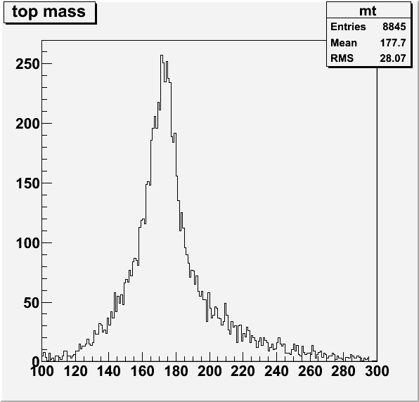
Top mass
Reconstructed top mass (raw = no optimisation, no kinematic fiting, …)
Just to give an idea :
  m_{top} = 177 GeV
  σ_{m} = 12 GeV
But :
  no background added
  indication of small combinatorial background
Need to understand why such large masses

Slide 10
Conclusion and prospects
To find a lepton (e,µ) in a semileptonic environment
efficiency > 88% , purity > 98%
Major backgrounds seem under control (ZWW and tt→bbqqτv)
Top full hadronic decays now seems to be the major background
→ should be killed by energy left after lepton removal
σ and A_{LR} can be known at 0.4% and 0.7% statistical uncertainty (systematics guaranteed small due to large purity)
First look at m_{top} (not our goal), may help to understand reconstruction problems
Next steps : do A_{FB} , add background and check purity (cut based analysis foreseen)

