Slide 1

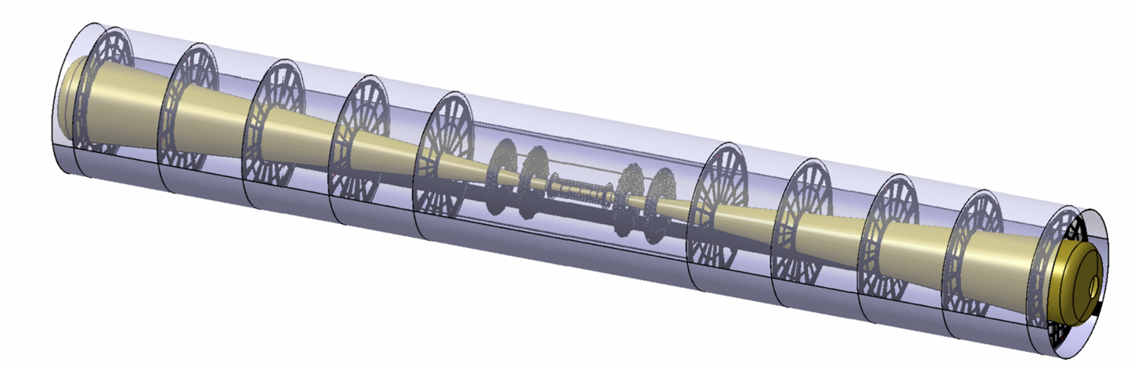

5th ILD Workshop
Orsay, 23rd -25th May 2011
Strip FTD Readiness for the DBD
D. Moya, J. Duarte, I. Vila, A. Ruiz - IFCA (CSIC-UC)
F. Arteche, C. Esteban - ITA

Slide 2
_Outline
FTD detector Integration.
Detailed design FTD (disk 3-7):
  Mechanics
  Power distribution system.
Software modeling.

Slide 3
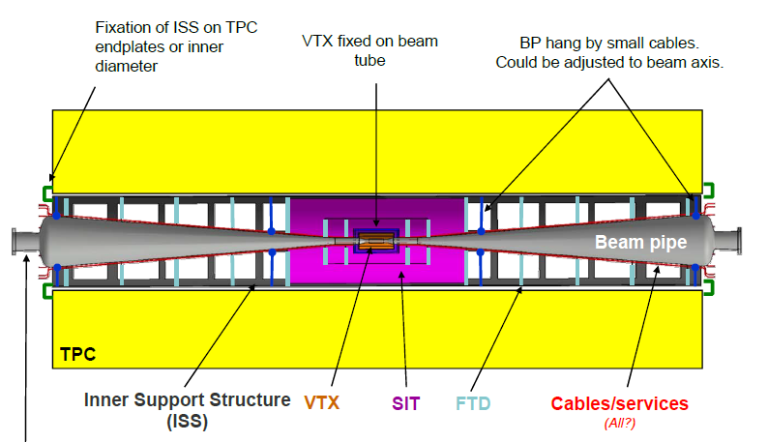
_Detector Integration
Integration of inner detectors: critical item.

Slide 4
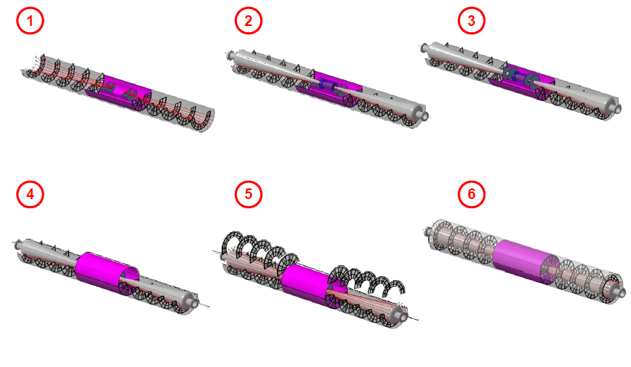
_Assembly procedure defined

Slide 5
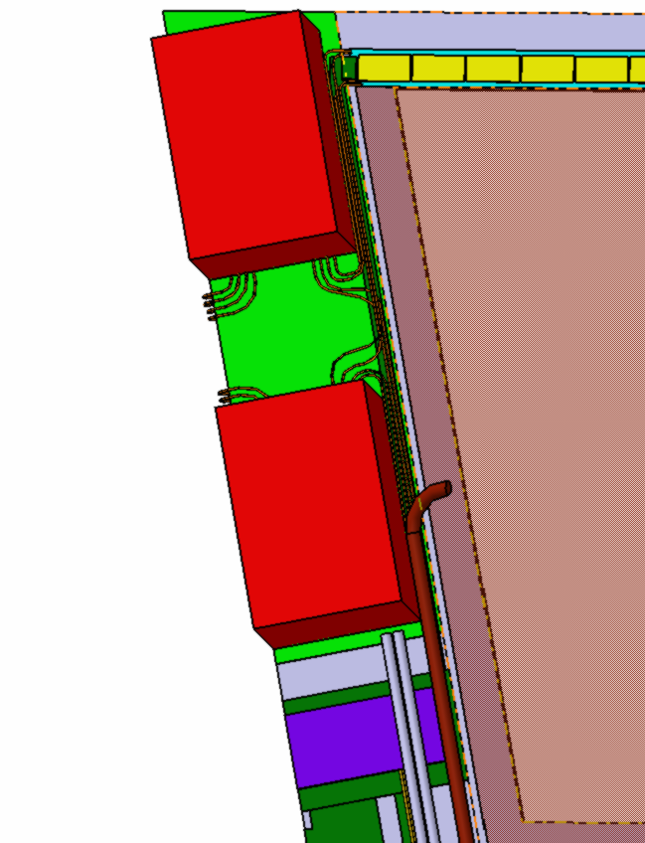
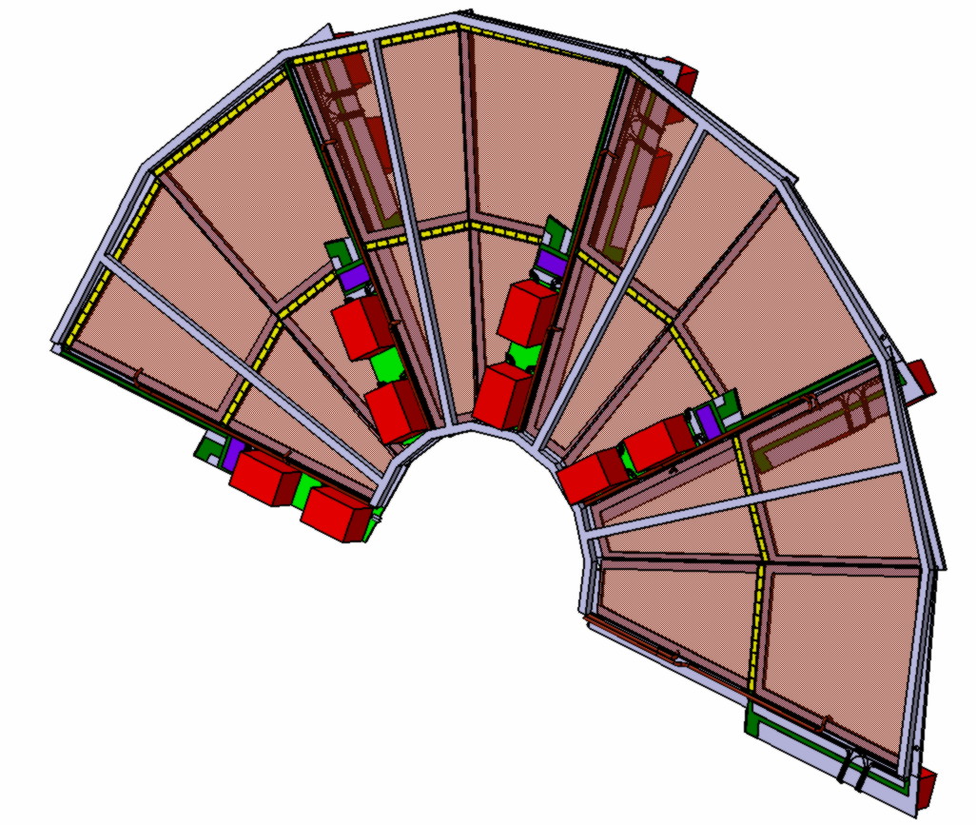
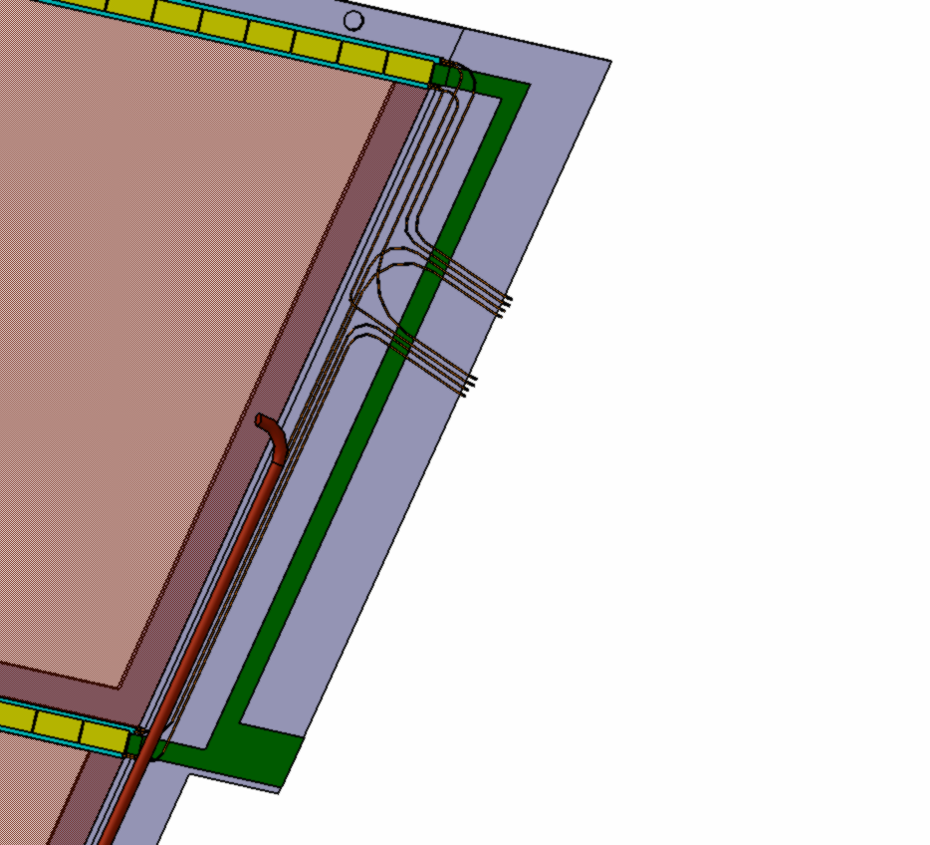
_Detailed mechanical designs
Including power distribution system, r/o electronics and cables and optical links.

Slide 6
_Power distribution system
Currents consumption of Strip – FTD
 | MIDDLE PITCH
FTD | FTD3 |  | FTD4 |  | FTD5 |  | FTD6 |  | FTD7
 | TOP | BOT | TOP | BOT | TOP | BOT | TOP | BOT | TOP | BOT
Nº STRIPS PER Module (2sensors) | 4096 | 2560 | 4096 | 2560 | 4608 | 3072 | 4608 | 3584 | 4608 | 3584
Chips per petal | 52 |  | 52 |  | 60 |  | 64 |  | 64
Optical links per petal | 1 |  | 1 |  | 1 |  | 1 |  | 1
I2.5 (A) per Petal | 2.56 |  | 2.56 |  | 2.8 |  | 2.92 |  | 2.92
I1.25 (A) per Petal | 1.18 |  | 1.18 |  | 1.34 |  | 1.42 |  | 1.42
I per petal | 3.74 |  | 3.74 |  | 4.14 |  | 4.34 |  | 4.34
I per disk | 59.84 |  | 59.84 |  | 66.24 |  | 69.44 |  | 69.44
TOTAL Mstrip- FTD Current |  |  | 649 A

Slide 7
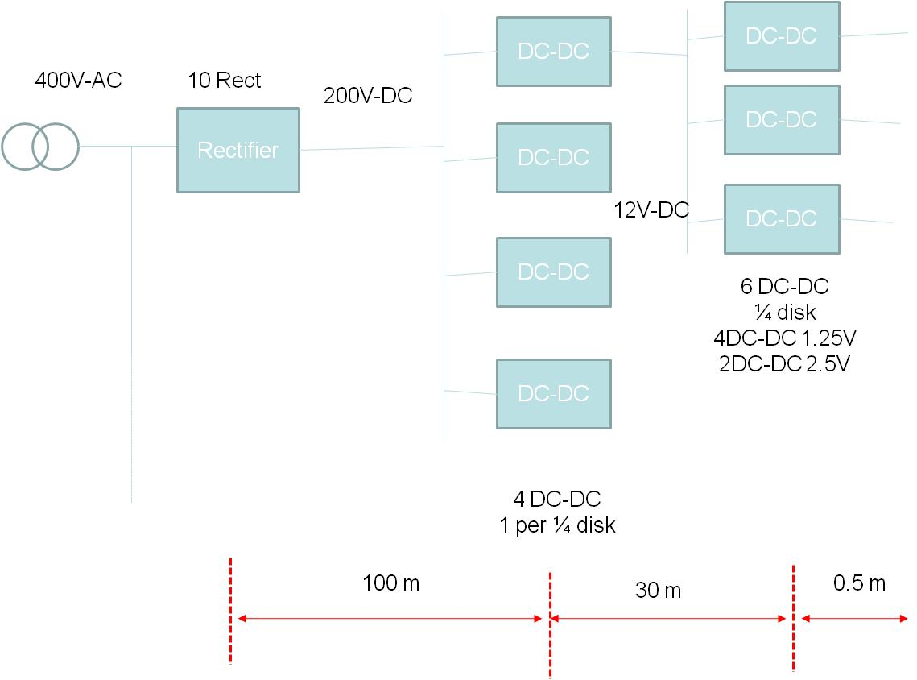
_Power supply topology

Slide 8
Software modeling of strip FTD
Implementation of the detailed detector geometry including cables and electronics in simulation.
Cooling (air-based cooling) it is not yet decided.
Digitization code not developed yet.

Slide 9
Summary
Significant improvement in terms of realistic hardware description for the strip FTD.
BUT simulation code still lacking a working digitizer (short of manpower).
Outside the scope of this talk other inner trackers pending issues:
  FTD disk 1 & 2 ( pixels)
  SIT ?

