Slide 1


OTR Monitors and Emittance Measurements
A. Faus-Golfe, J. Alabau, C. Blanch,
J.V. Civera, J.J. García Garrigós
IFIC (CSIC-UV)
D. McCormick, G. White,
J. Cruz, M. Woodley
SLAC
and
KEK team
Notes:
This talk try to summarize the work made in the multi-OTR system project during 2010 for all the people from IFIC and SLAC with the support from KEK team.

Slide 2
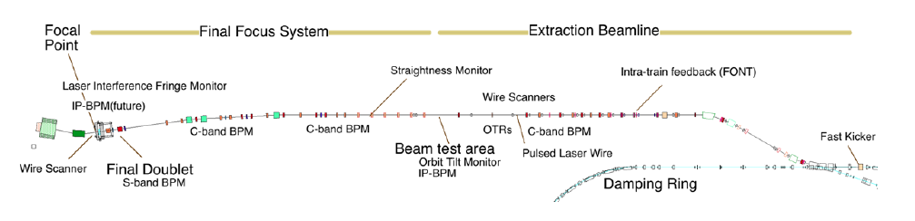
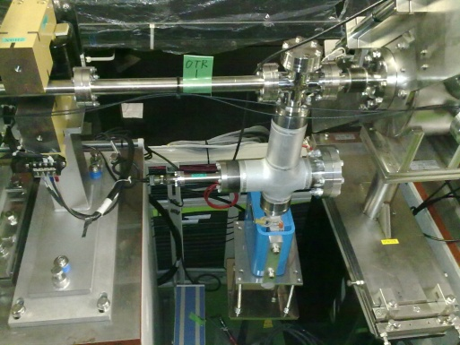
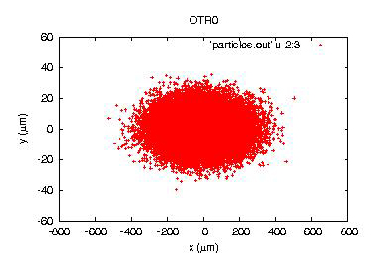
Multi-OTR System
Overview
  The multi-OTR system of 4 OTR monitor installed in the zero-dispersion part of EXT line
  Fast emittance measurements with high statistics
  Design based on existing OTR1X with improved features and we will get 2um resolution
  Installed near WS for comparison and confirmation of OTR as a beam emittance diagnostic device
OTR0
σx: 118 um
σy: 9 um
Notes:
The multi-OTR system is composed of 4 OTRs located in the diagnostic section of the EXT line of ATF2, close to the wire scanners location.
The design is based in the OTR1X with some improved featuresas compactness. The objective is to perform fast emitttance measurement with high statistics.

Slide 3
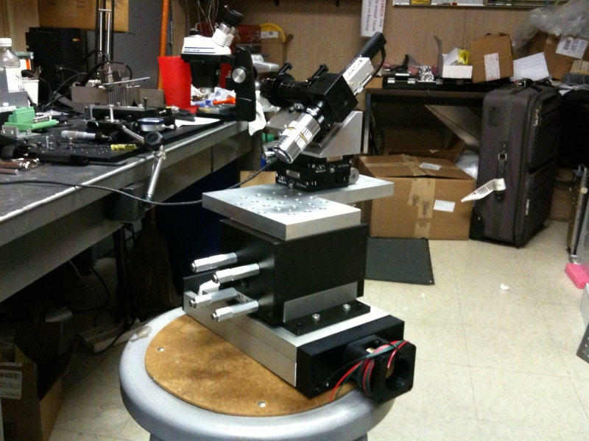
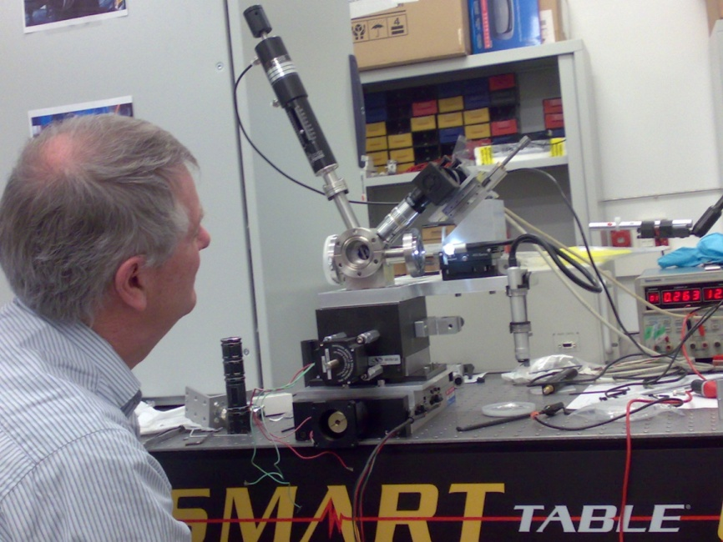
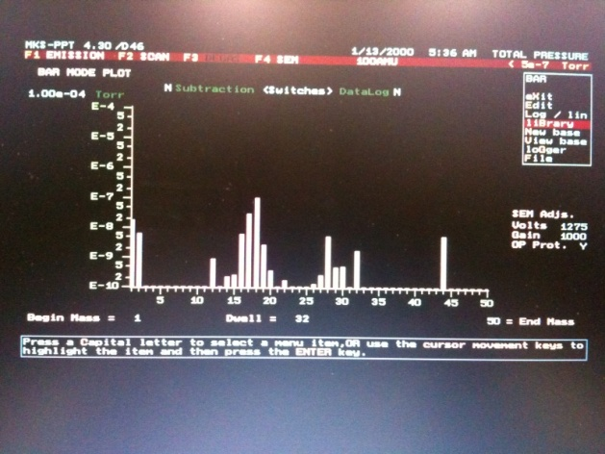
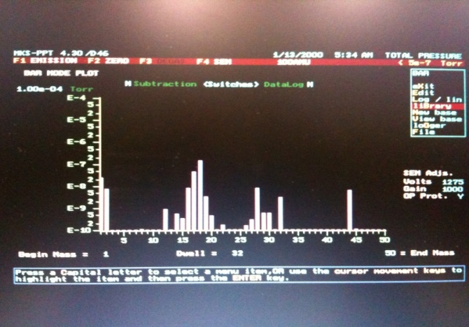
Multi-OTR System
February 2010: H/W Tests
Assembling and first tests at SLAC and IFIC labs after fabrication
Vacuum test made at SLAC
without OTR
with OTR
Notes:
February 2010 Doug visited the IFIC labs for assembling and first calibration tests.

Slide 4
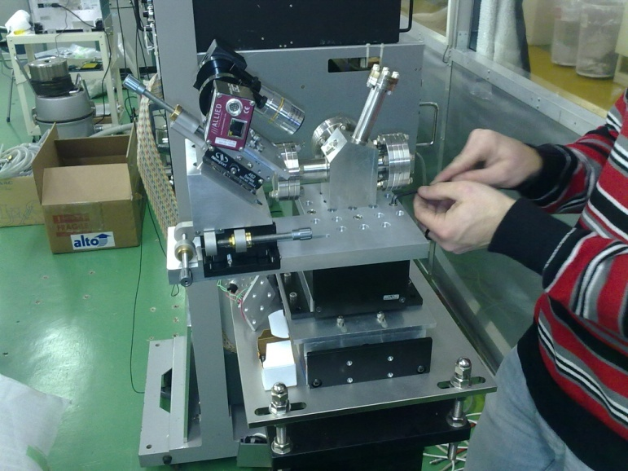
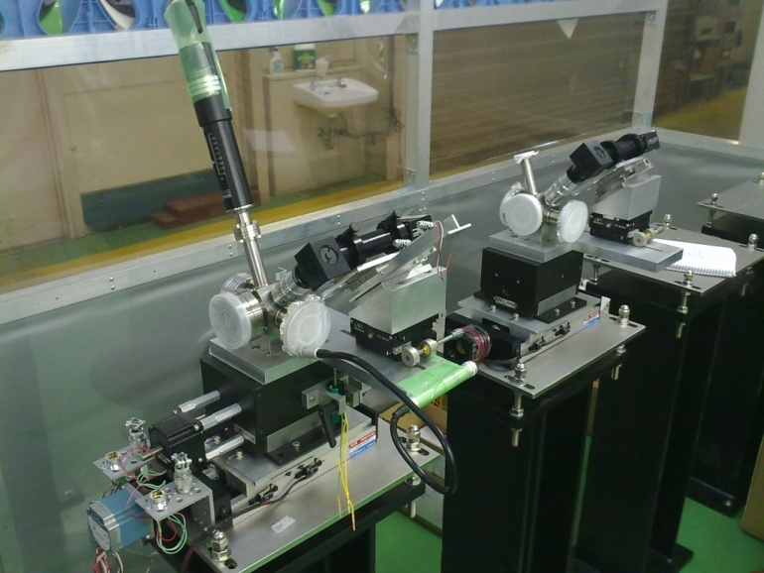
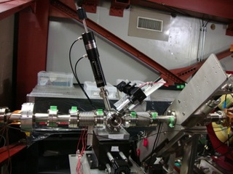
Multi-OTR System
April / May 2010: H/W Installation
April: All 4 OTRs were assembled at ATF clean room
May: All 4 OTRs installed in the EXT line
Notes:
The OTRS were send it to KEK. On April we assembled the 4 OTRs in the ATF clean room and in May there were installed.

Slide 5
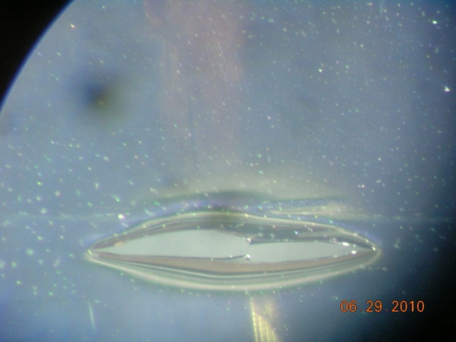
Multi-OTR System
June 2010: First Measurements
Exercise and calibration of vertical and horizontal movers and read-back potentiometers
Tests of 4 OTRs during beam time: beam seen but 3 targets (nitrocellulose coated aluminum)
were damaged (4x10⁹ e⁻ per pulse)
CCD Cameras suffer from radiation, some pixel are dead.
Damaged target
Notes:
In June we have made the first tests with movers that works very well but we have a problems with the target material that was by an error (nitrocellulose coated aluminum) instead of kapton. The material was not adequated and the targets were damaged. Furthermore cameras are suffering from radiation and some pixel were dead.
We order new targets in kapton for the next run of measurements and we plan also to add a calibration system for illuminating the targets and some protection for the cameras.

Slide 6
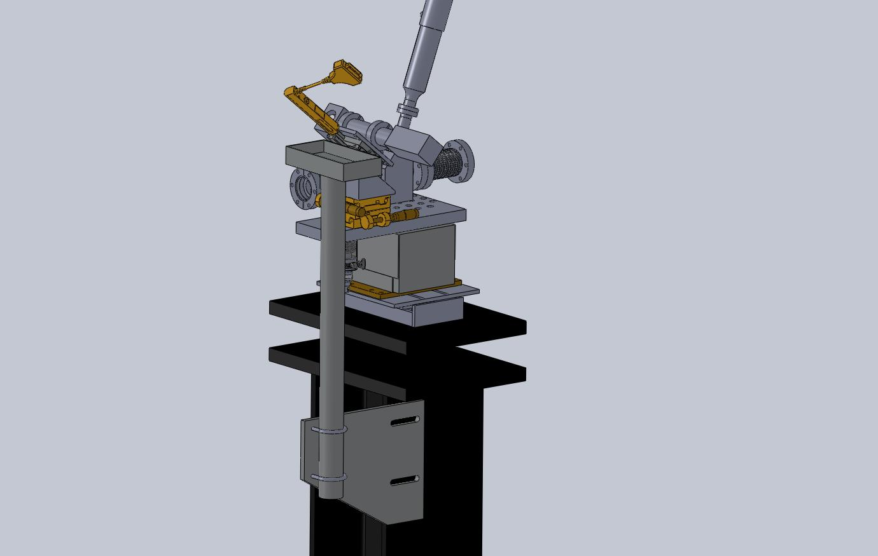
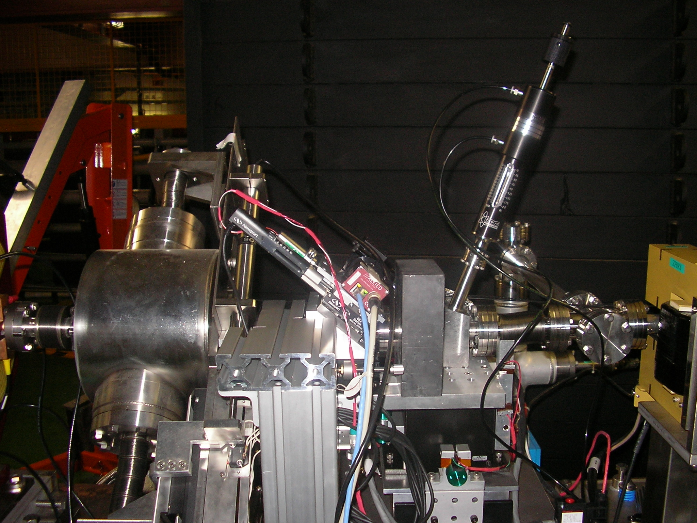
November 2010: Installation of cameras protection
Multi-OTR System
Lead blocks has been added to protect cameras from the radiation
Notes:
In November we installed a support for holding some lead blocks to protect the cameras from radiation

Slide 7
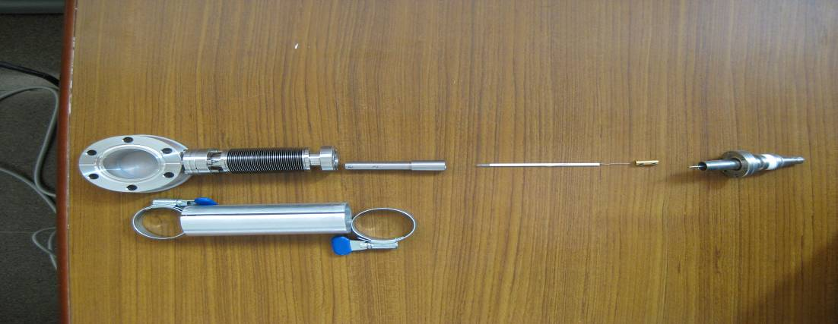
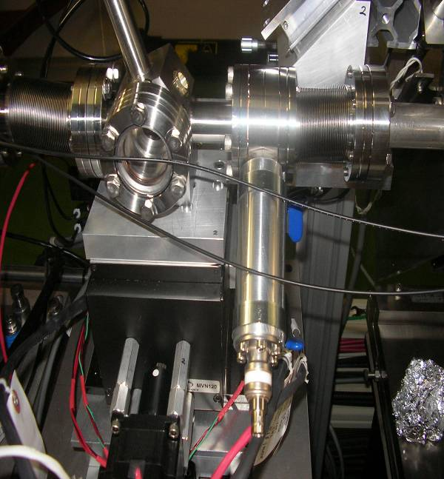
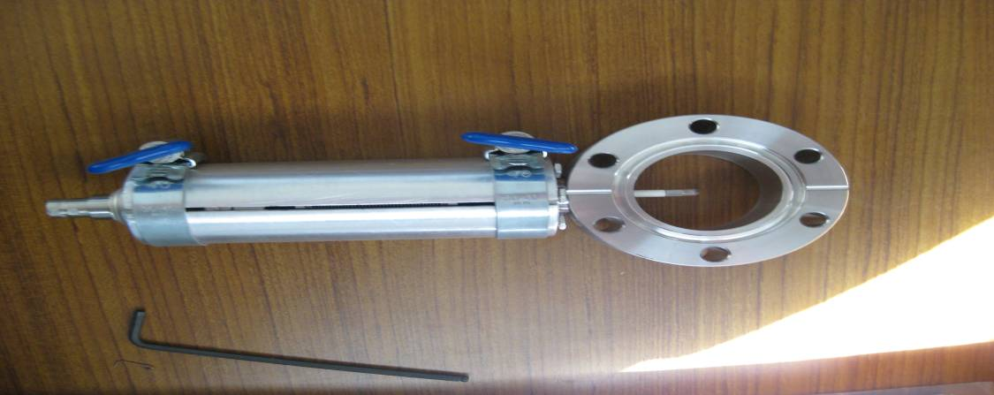
Multi-OTR System
November 2010: Installation of calibration setup
BNC feedthrough, copper connector, ceramic tube with bulb, SS tube (ceramic tube holder), bellow and flange with port.
Illuminators were installed to facilitate calibrating tasks by lighting the target from the beam direction
Aluminium tube and clamp to hold the bellow
Notes:
We also installed an illumination system to help us in the calibration by lighting the target with a bulb in the beam direction.

Slide 8
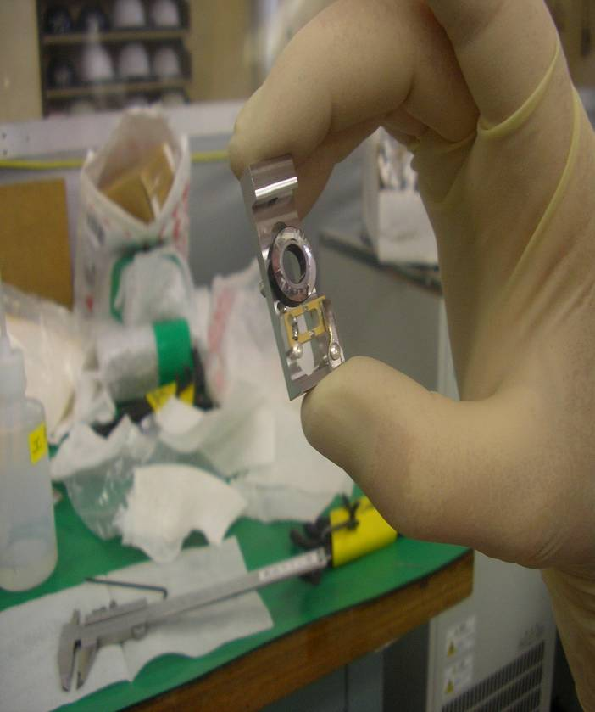
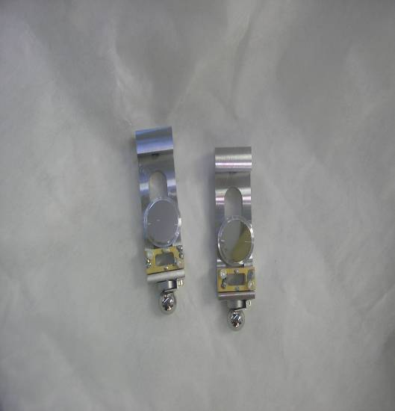
Multi-OTR System
November 2010: New targets installed and tested
Two new targets were installed, two made with aluminium and two with aluminized kapton. Besides, together with all them were installed the wire targets, made with 4 wire, one horizontal, one vertical and two tilted.
New targets could stand the beam currents for several minutes without being damaged
Notes:
The new targets were also installed and furthermore there was also a wire sytem in the bottom part

Slide 9
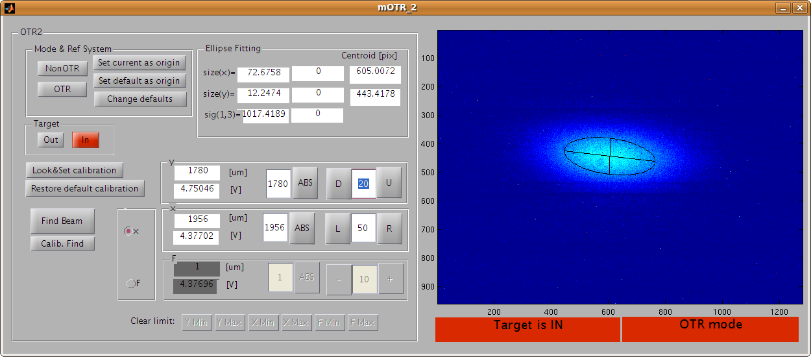
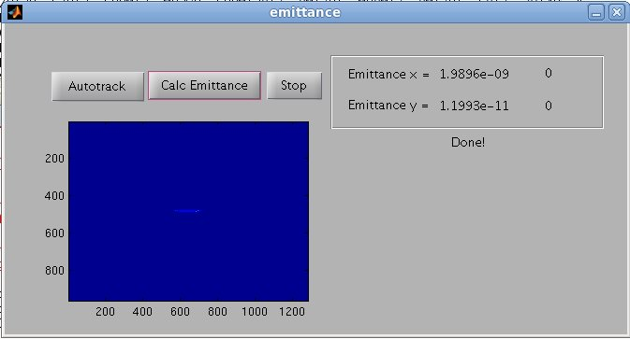
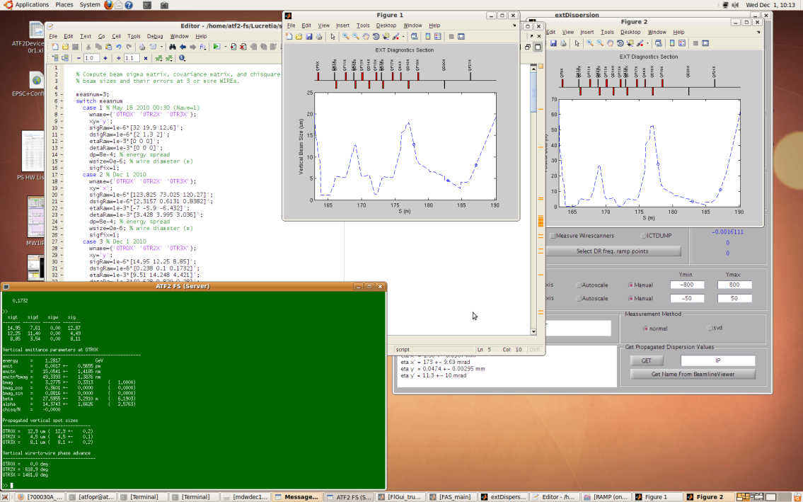
Multi-OTR System November 2010: First calibration of vertical scale and first
software test
First GUI tests and some initial calibrations using IPBSM were made.
Notes:
In November we made the first measurements and we start to test the software. We tested the OTRs one by one doing some calibration tests. Targets behave very well and the software is being developed.

Slide 10
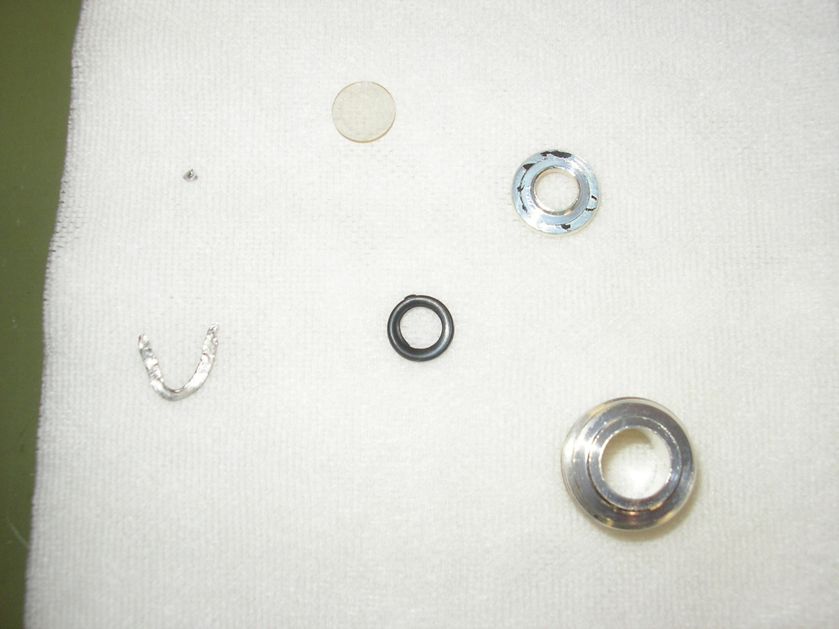
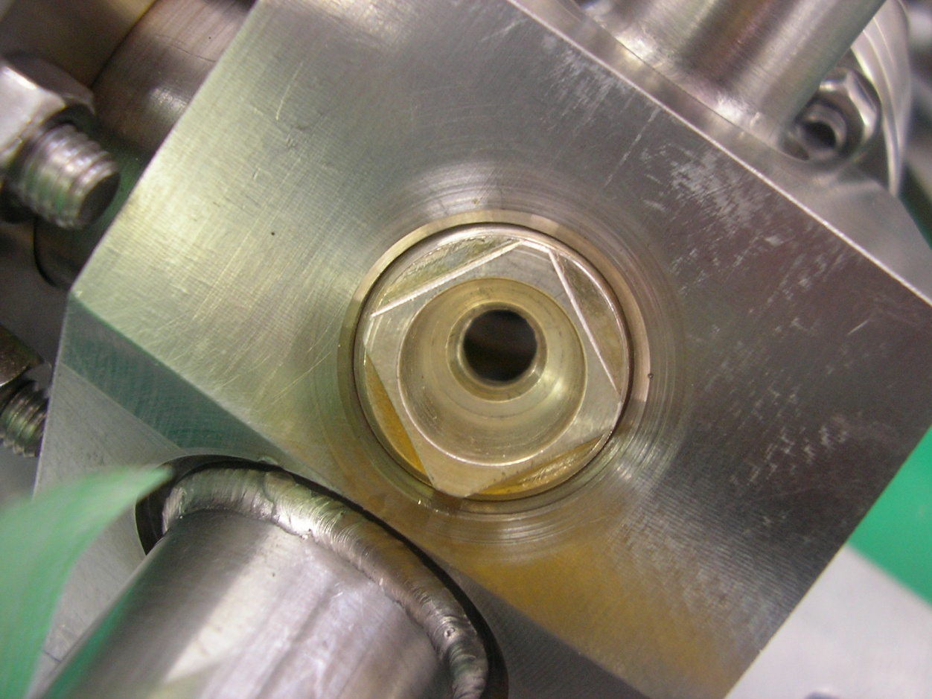
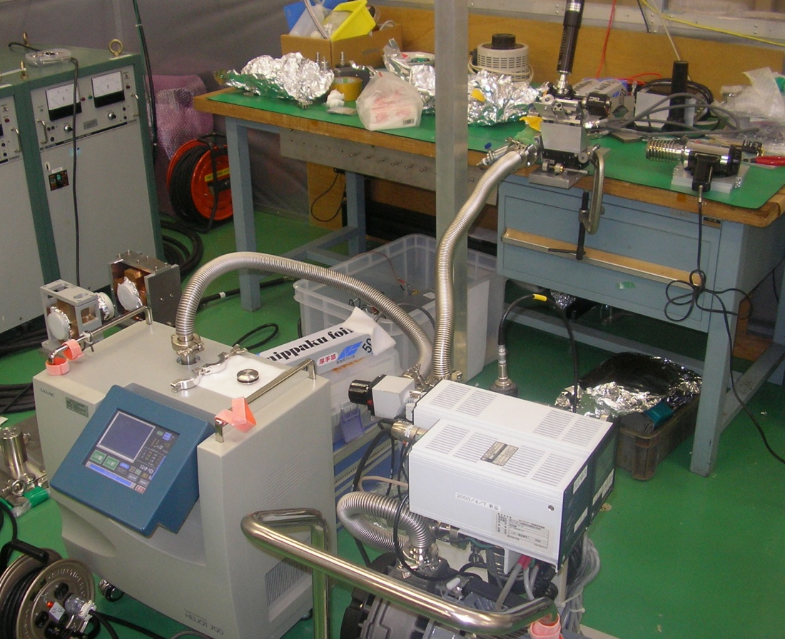
Multi-OTR System
December 2010: Vacuum leak repaired
Leak in the camera window
window
Thrust washer
O-ring
Nut
Old indium washer
Important vacuum leak in the camera window of OTR2 was repaired by changing the indium washer
OTR
Heat gun
Helium leak check
Vacuum pump
Notes:
In the last week of November a vacuum leak was detected in OTR2. It was repaired during the first week of December and we could continue with the measurements using all the OTRs.

Slide 11
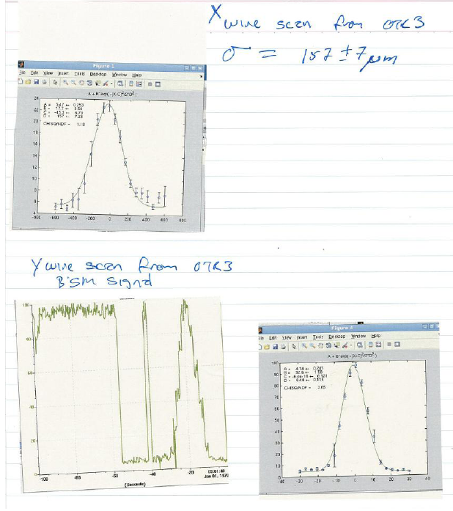
Multi-OTR System
December 2010: OTR Wire Scans
Scan wires vs. signal from IPBSM background detector.
Made to cross check wire scans with observed beam sizes. Numbers agree within fit errors.
Notes:
One of the first tests was the OTR wire scan versus the signal in the IPBSM (IP Beam Size Monitors). We could say that the numbers agree within the fit errors.

Slide 12
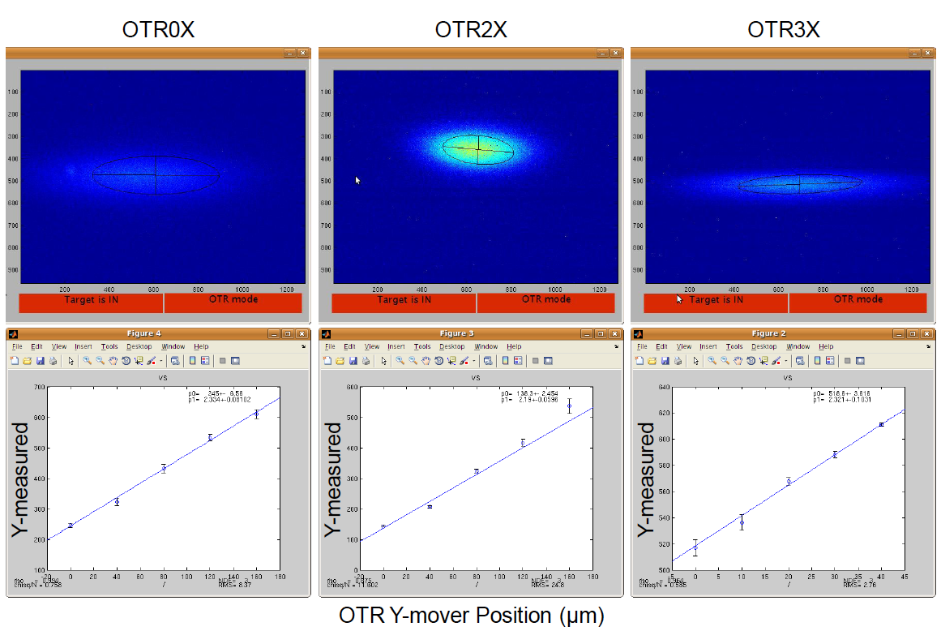
Multi-OTR System
December 2010: Vertical scale calibration
Vertical scale calibration done by scanning the vertical mover stage and recording the motion of the observed beam centroid. Thus the vertical calibration factor um/pixel is obtained.
Notes:
We perform the calibration for all the OTRs to get factor um versus pixel.

Slide 13
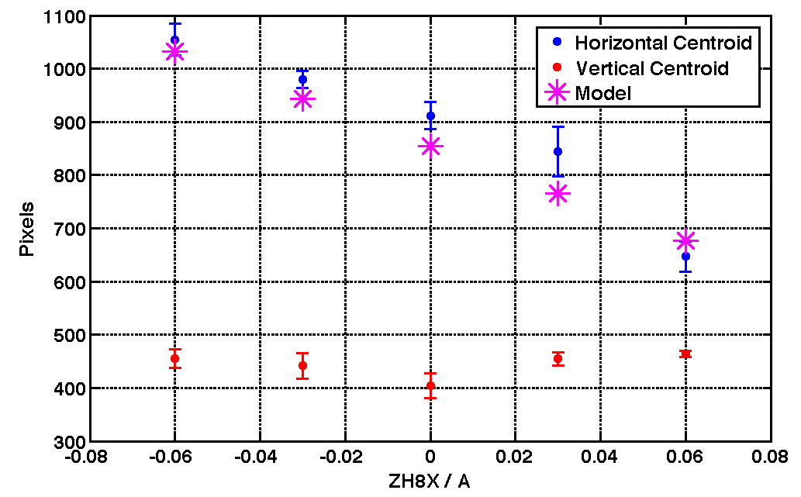
December 2010: OTR0x calibration test and roll alignment
Multi-OTR System
Calibration and roll alignment for OTR0X
To test the calibration an upstream corrector is scanned and the response in observed the OTR. To test roll alignment (of the OTR CCDs) we have to look for no motion in the opposite plane.
Notes:
We alos perform the calibration and roll alignment for OTR0.

Slide 14
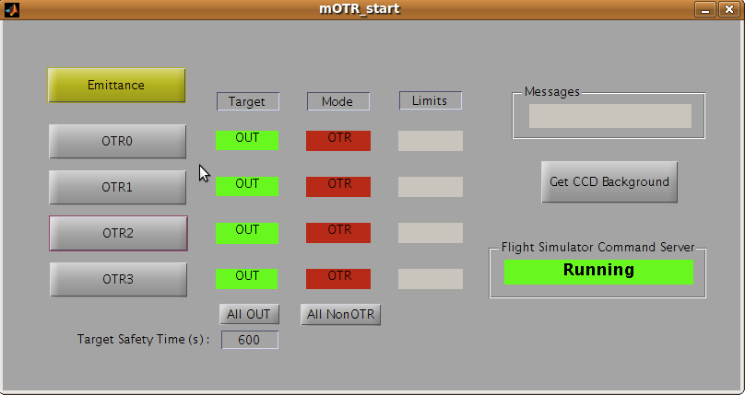
Multi-OTR System
December 2010: Software developments
New design of the OTR for ATF-ATF2
OTR sofware is an standalone compiled executable from Matlab.
Some functions like emittance calculation or beam finder need the Flight Simulator running.
OTR status reported and displayed on global ATF alarm panel showing OTR actuator status.
All useful data is stored in EPICS PVs and archived in the EPICS archival system.
Main start panel
Emittance calculation
(next slides)
Single OTR panel
(next slides)
Get CCD Background
Flight simulator Status
Some machine status
Some protection controls
Notes:
The software we have developed is standalone complied in Matlab. Some of the function needs of FS. In the main panel we have first the type of measurement you like to perform: beam size in one of the OTRs or an emittance measuremen using all the 4 OTRs. There is also displayed and ATF alarm panel and a OTR status. All the data is stocked via EPICs.
14

Slide 15
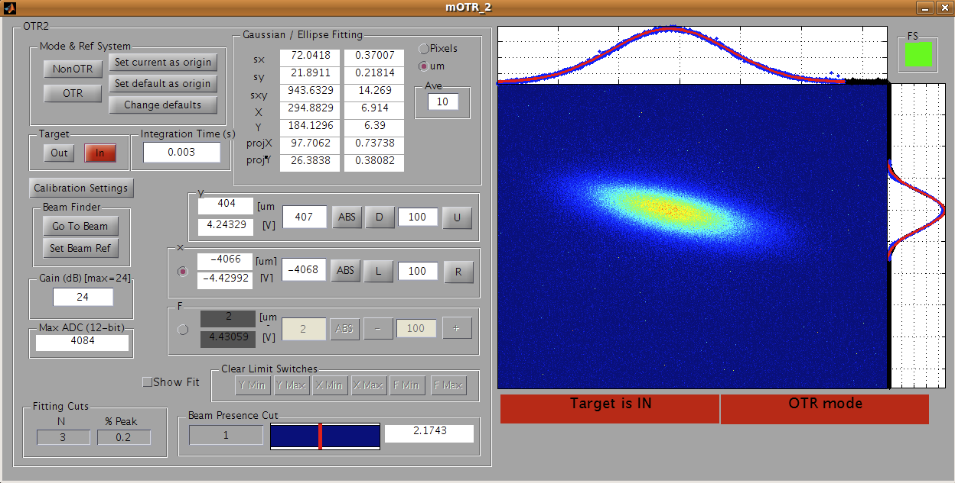
December 2010: Software development
Multi-OTR System
Single OTR panel
Working mode &
Reference system
Target control
Calibrations
Beam finder
CCD Gain
Position & movement of the movers
Limit switches status
Machine status
Ellipse fitting and analysis
CCD image and beam fitting
Notes:
The single OTR panel, uses only one of the OTRs we could perform the measurement of the beam size in the selected OTR. The errors are averaged over ten measurements. In the panel there is also all the complementary information we need as the position of the movers limits, target control….

Slide 16
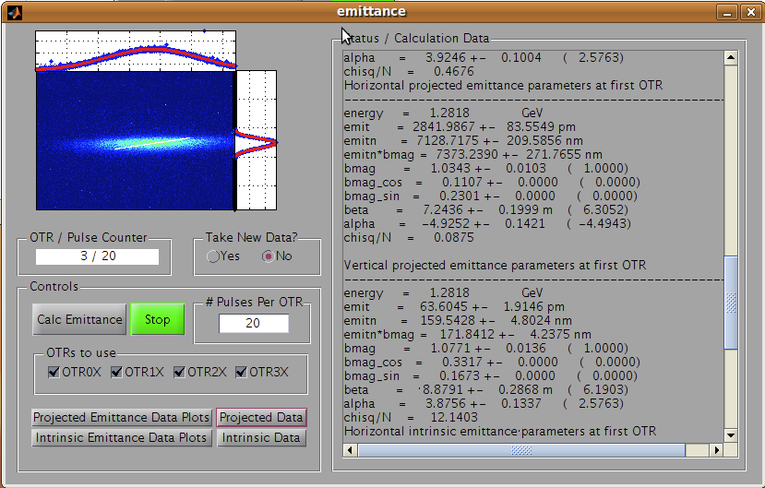
Multi-OTR System
December 2010: Software development
New design of the OTR for ATF-ATF2
Emittance panel
Current OTR info
Start/stop emittance procedure
Number of OTR to be used
Data analysis and plots
Calculation data
Notes:
The emittance panel, perfors the measurement of the emittance using the number of OTRs we like by means of the 2D formalism.
16

Slide 17
December 2010: 2D Emittance reconstruction algorithm
Multi-OTR System
WS
0
WS
1
WS
2
WS
3
WS
4
OTR
0
OTR
1
OTR
2
OTR
3
20°
28°
46°
Δψ
8.5
7.2
11.4
7.3
σ (μm)
R⁰¹
R⁰²
R⁰³

Slide 18
December 2010: 2D Emittance reconstruction algorithm
Multi-OTR System
Measure projected OTR beam sizes σ_{n} and their rms errors δσ_{n} (n=0,1,2,3)
    Gaussian fits to projections
    statistical rms of measured beam size over N pulses at each OTR
    correct measured beam sizes for known dispersion (quadrature subtraction)
Solve 3-parameter linear least-squares problem Ax = b using all data
    parameters: σ₃₃, σ₄₃, and σ₄₄ at OTR0 (first one)
    use rms errors and A matrix to compute covariance matrix (T)
Compute Emittance, Twiss, BMAG, etc. from fitted parameters
    use ∇f and covariance matrix to estimate errors
Implemented in Flight Simulator
    R-matrices from extant EXT model
    propagated dispersion values at OTRs from extDispersion package
    σ_{n} and δσ_{n} at OTRs from OTR emittance measurement package via EPICS (x and y simultaneously)
    emittance, Twiss, BMAG, etc. computed and displayed (coupling not included)
    graphics for measured/fitted/projected beam sizes and Twiss parameters

Slide 19
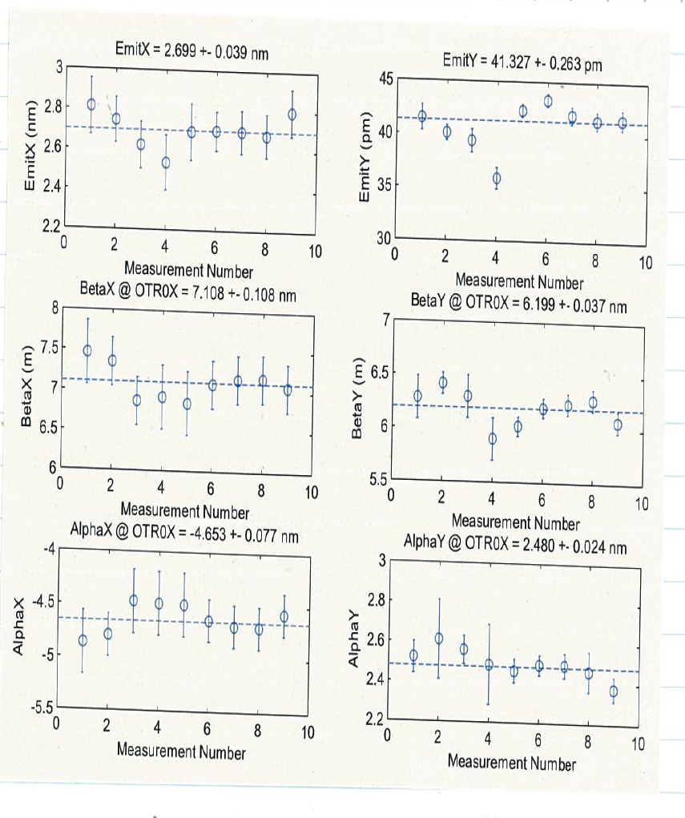
Multi-OTR System
December 2010: Stability Measurement
New design of the OTR for ATF-ATF2
Notes:
19

Slide 20
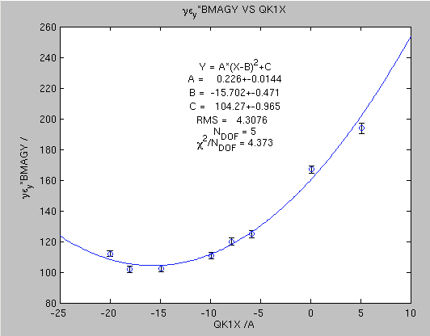
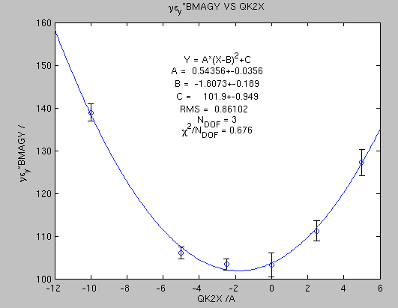
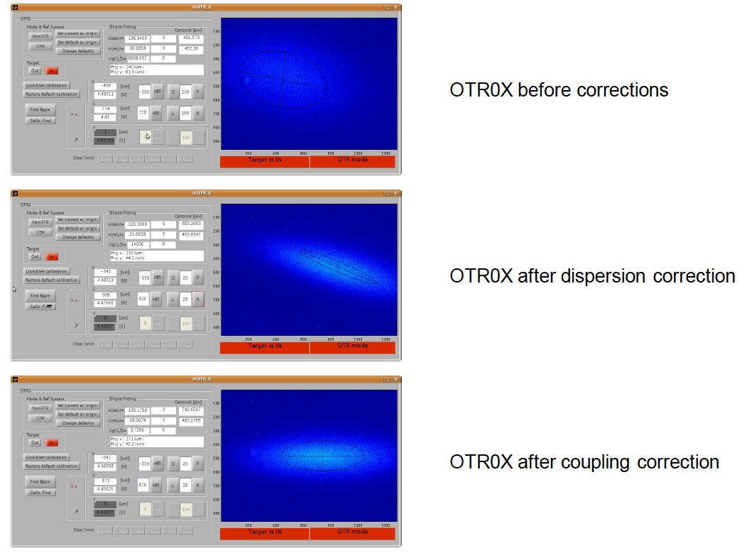
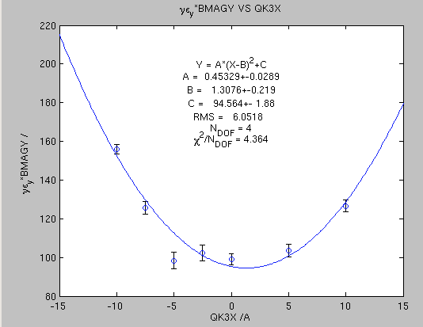
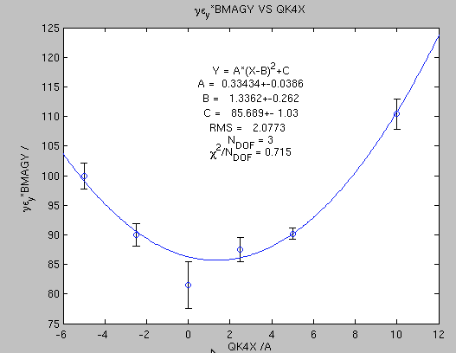
Multi-OTR System
December 2010: Coupling Correction
New design of the OTR for ATF-ATF2
Coupling correction in the EXT achieved by scanning each of the 4 EXT skew quads. For each scan the quantity (vertical normalised emittance)*BMAGY is plotted and taken the optimal from a parabolic fit.
Notes:
20

Slide 21
Multi-OTR System
To do list
New design of the OTR for ATF-ATF2
Get the Beam finder working.
-Work required on Flight Simulator online orbit fitting
-Work required on OTR software implementation
Finish test calibration and roll for OTR1-3X (no roll means all OTRs in the same coordinate frame and can use ellipse fit tilt with other measurements for the 4D emittance measurement)
4D intrinsic emittance calculation.
-Algorithm development, flight simulator calculation and OTR software
implementation.
Install a LAN controllable power strip in-tunnel and build in power cycle controls into the OTR software (CCD cameras can be put into a mode of operation unresponsive to the OTR software and needs to be reset by power cycling the cameras being the power supplies in-tunnel)
Notes:
21

Slide 22
Multi-OTR System
To do list
New design of the OTR for ATF-ATF2
Provide the capability of doing automated scans from the emittance GUI
(e.g. Automate the scan QK*X and plot versus emit*BMAG to search the minimum).
Install switchable de-magnifier lens (?)
Documentation (user’s guide started)
Systematic Measurement campaign during 2011
Notes:
22

Slide 23
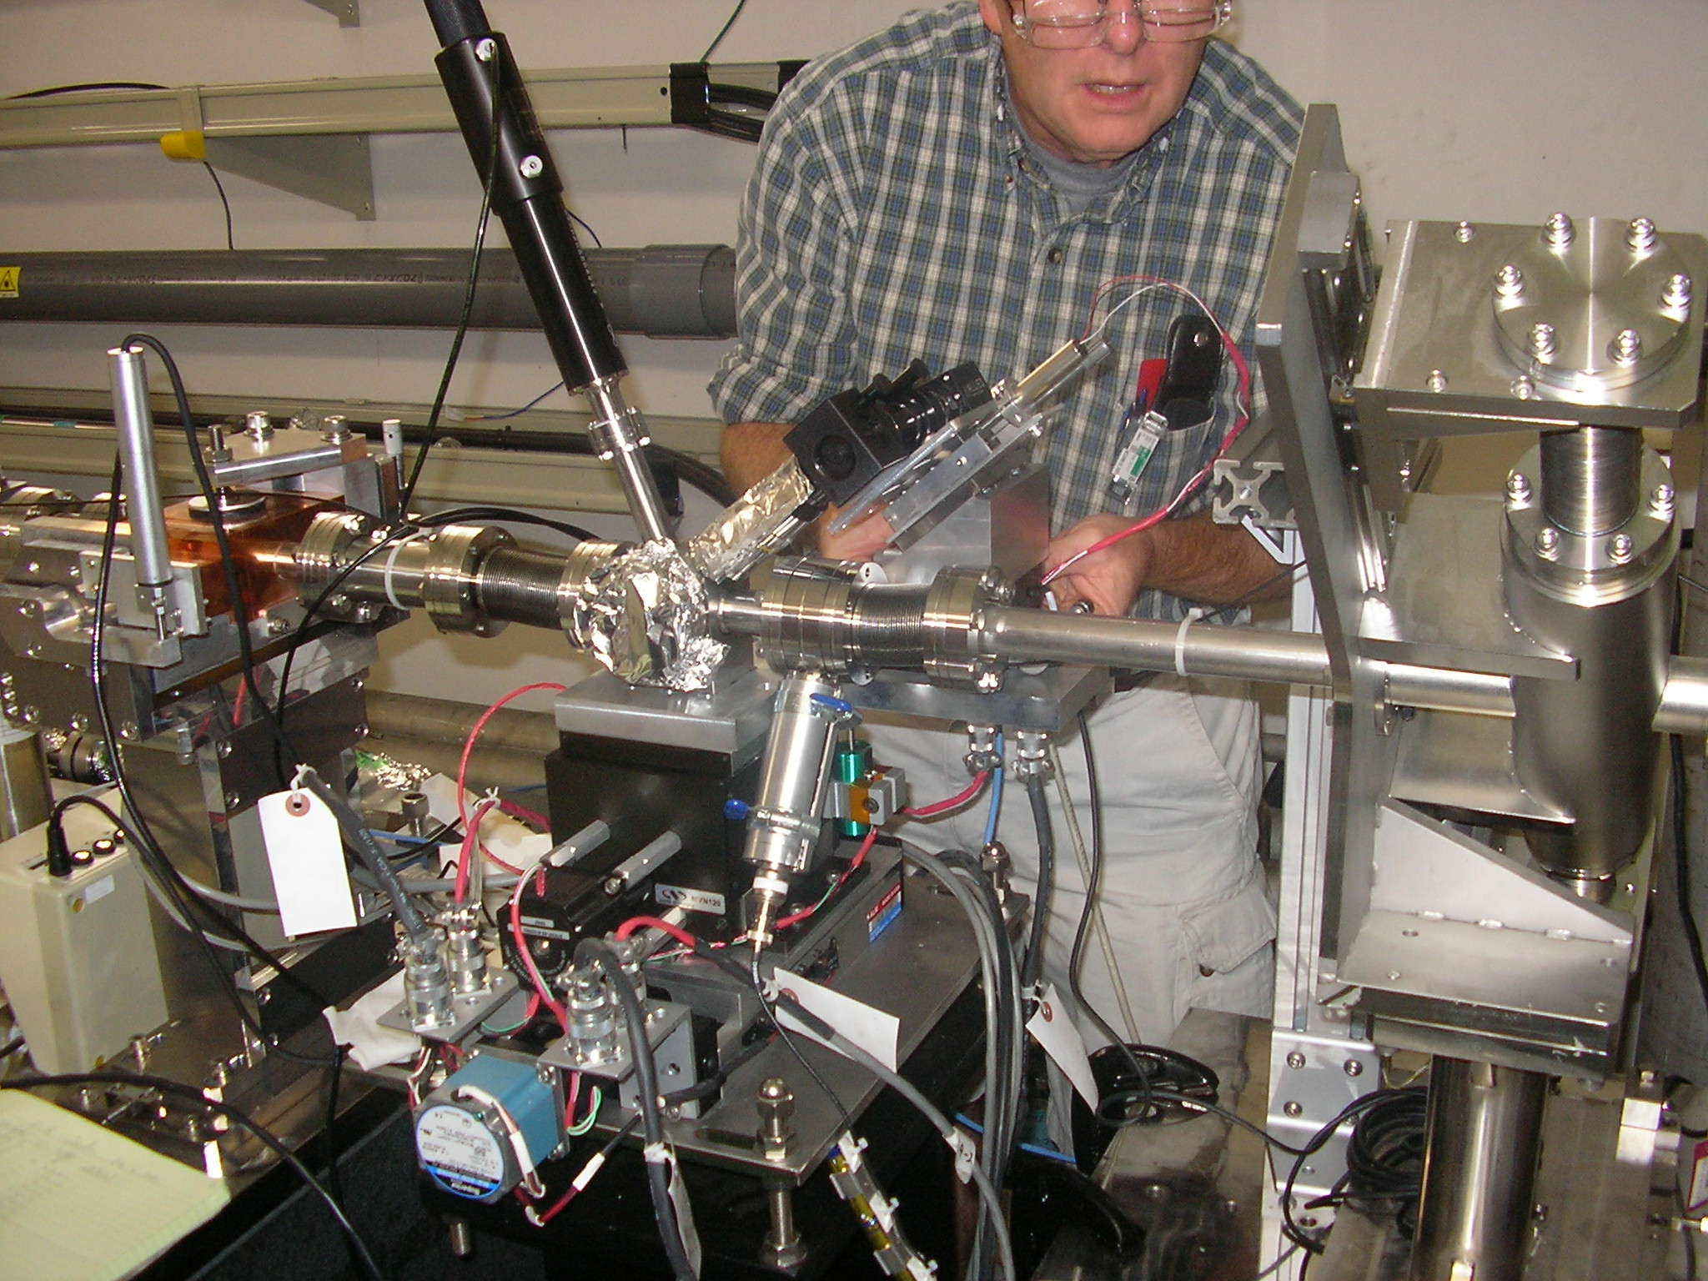
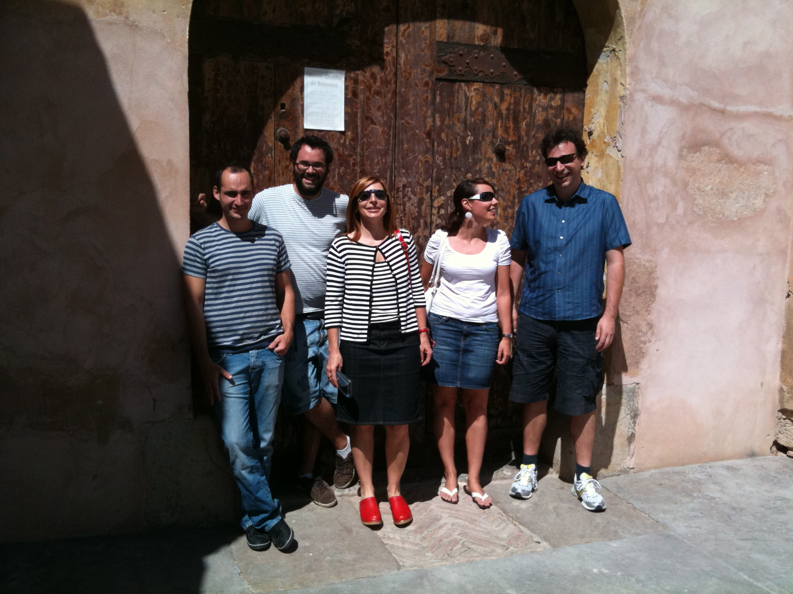
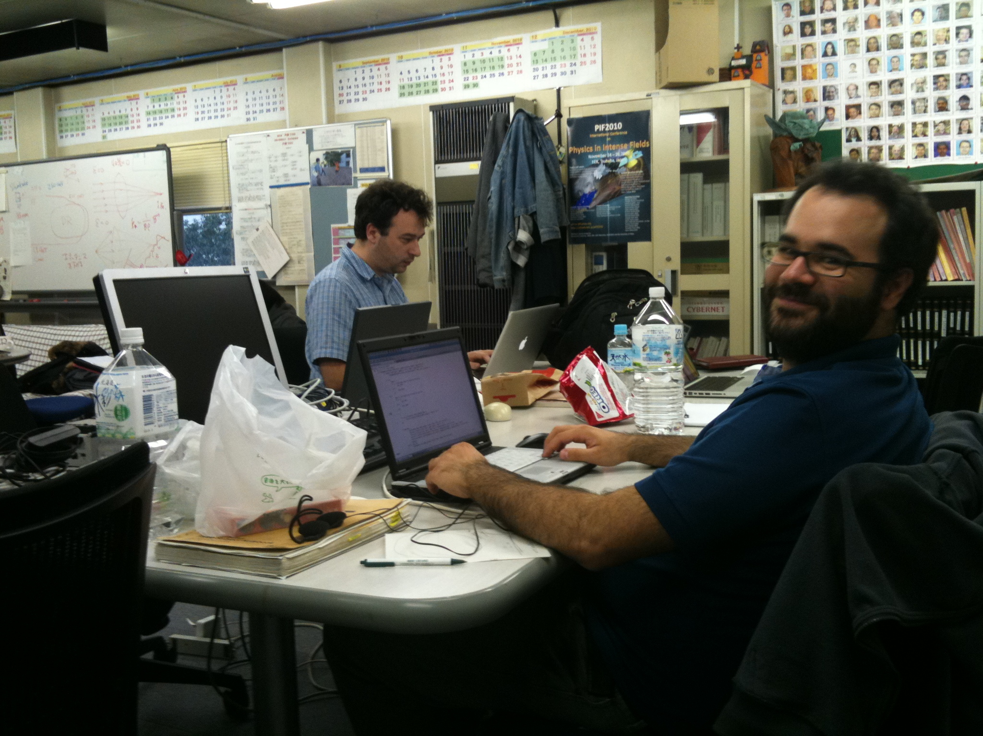
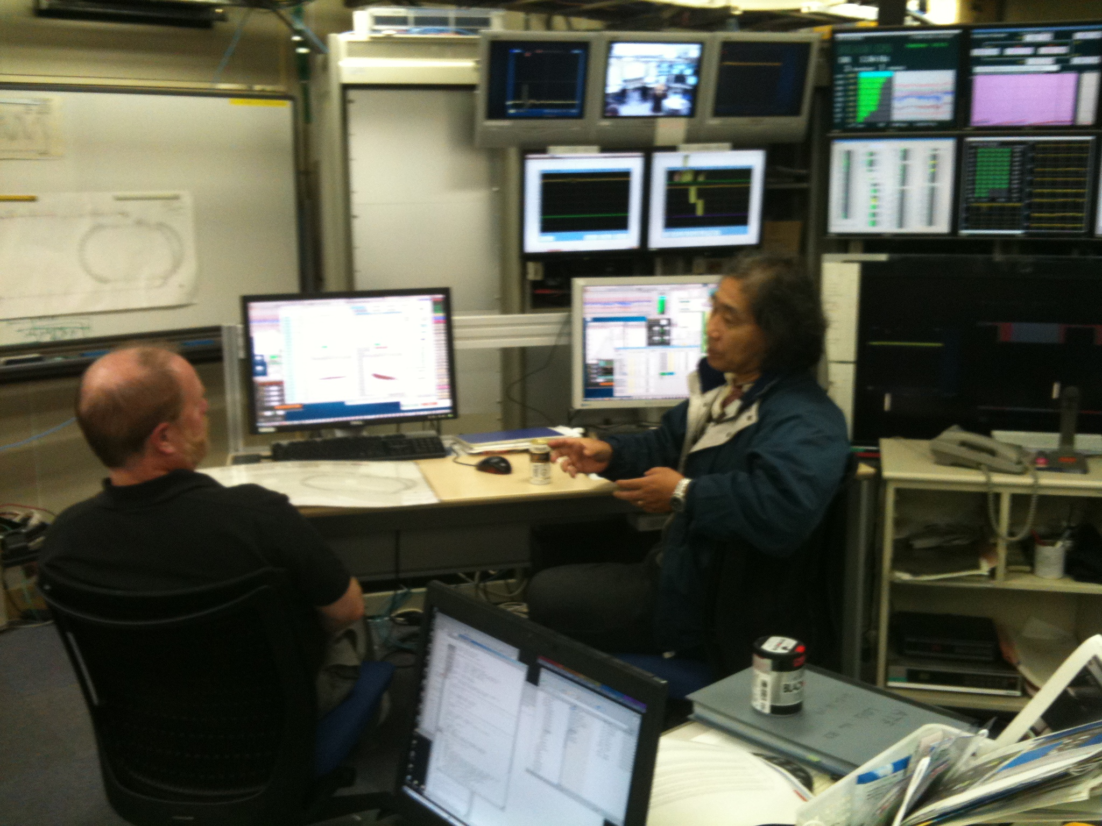
Thanks for your attention

