Slide 1
DR Firmware Update
Glenn Christian
19 November 2010

Slide 3
Working correctly – Bunch1

Slide 4
Working correctly – Bunch2

Slide 5
Working correctly – Bunch3

Slide 6
Turn Counter

Slide 8
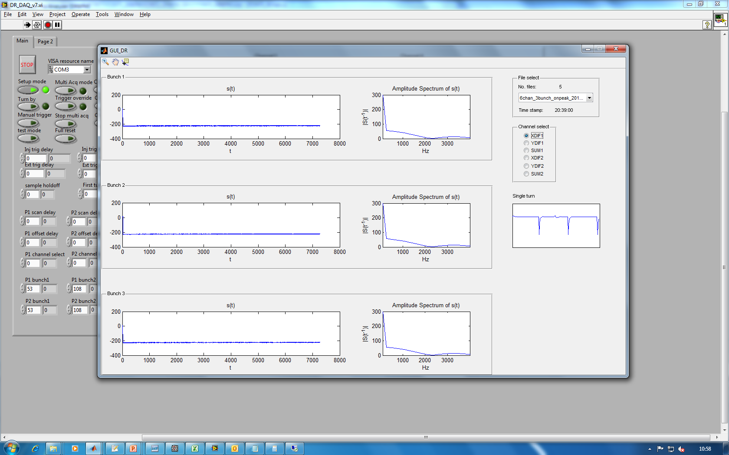
6 channel, 3 bunch

