Slide 1
Air Film Transporters (air casters)
John Amann
ILC MDI
12/02/10

Slide 2
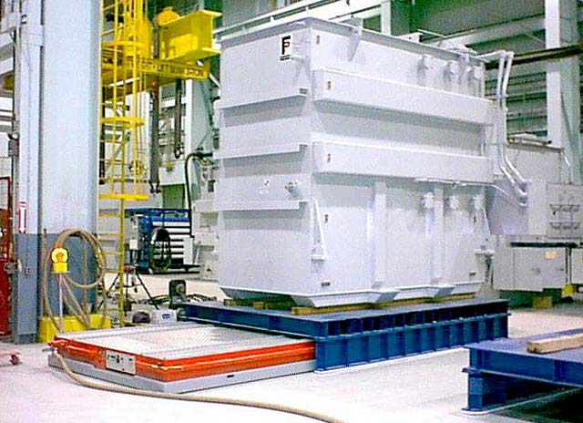

Slide 3
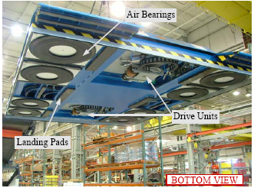

Slide 4
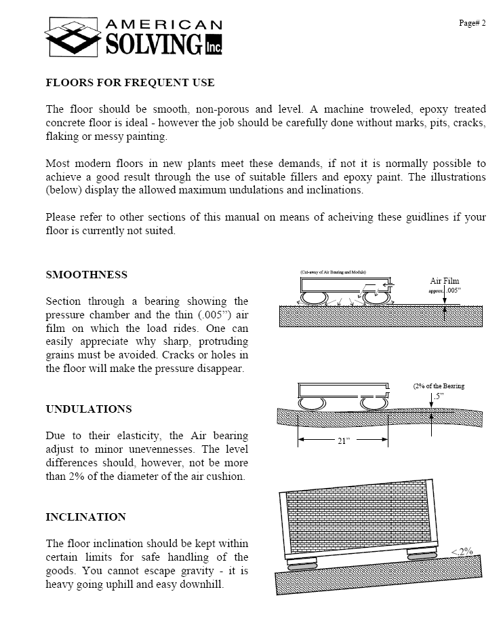

Slide 5
