Slide 1
ILC CFS AND GLOBAL
SYSTEMS MEETING
CONVENTIONAL FACILITIES
AND SITING GROUP
CPDG Response and
Preparation for BAW-2
V. Kuchler

Slide 2
CPDG Response
A. Suzuki has Requested Specifications and Comments from the CFS Group with Respect to the Site Selection Criteria Matrix in the CPDG
Some of the Items Listed in the Matrix have not Yet Been Addressed and Will be Different for Each of the Sample Sites and the Specific Sites Currently Being Considered in Japan
Nevertheless the CFS Group is Preparing a Draft Response to the Request for Each Region to be Completed by the First Week of December
CFS Will Review the Result and Try to Refine the Response to be as Complete as Possible by the End of December, However it is Likely that Definite Answers to all of the items May Still not be Available

Slide 3
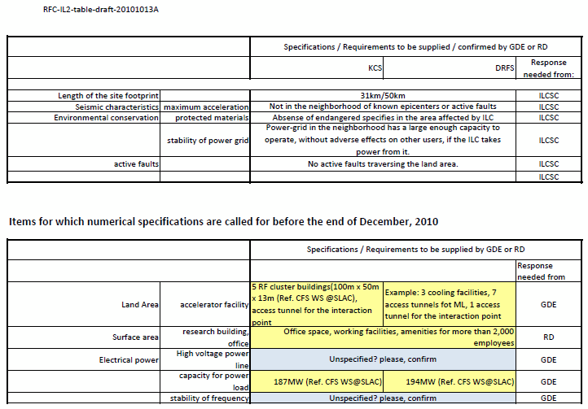
CPDG Site Selection Matrix

Slide 4
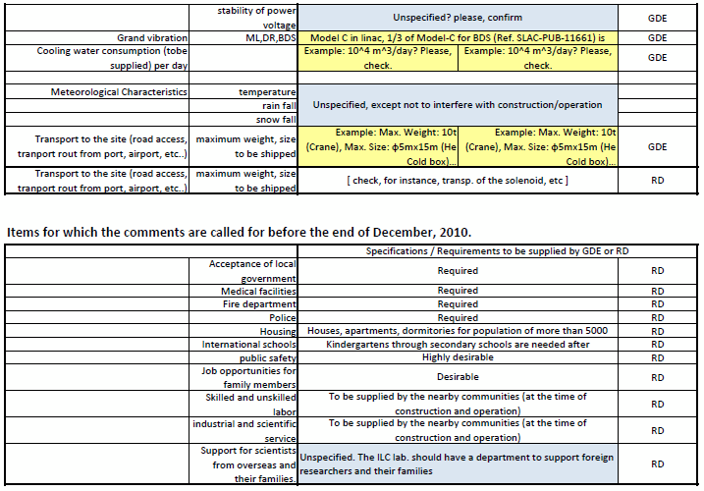
CPDG Site Selection Matrix

Slide 5
BAW-2 - Low Power to Full Power
The CFS Group has Worked with the Area Systems for Over a Year and a Half to Establish Full Power Heat Load and Power Requirements (They are Still Changing)
CFS Continues to Work to Develop Low Power Criteria, but Definitive Criteria is Still Not Finalized
Consequently the CFS Group will Pursue Preparation for BAW-2 Based on the Following Assumptions:
The Main Linacs and the Damping Ring will be Affected by the Low Power Option
The e- and e+ Sources, RTML and BDS will Use the Same Criteria as the RDR
Low Power Criteria for the Damping Ring has been Established
Low Power Criteria for the Main Linacs will be Set at 60% of RDR Criteria Unless Specifically Established Prior to BAW-2
CFS Only has Data for the Klystron Cluster RF Alternative at This Time

Slide 6
KCS Low Power to Full Power
We Will Evaluate the Major CFS Cost Drivers, Civil Construction (Surface and Underground Facilities), Process Water Cooling and Electrical Distribution
At This Time, Results are Preliminary
Some Refinement will be Developed Prior to BAW-2 Including Cost Information
All Considerations Assume a Reasonable Path Back to the Full Power Option
Civil Construction
Fundamental Reduction to Low Power is the Size of the Klystron Cluster Buildings
At Each Main Linac Shaft, KCS Surface Building Size Would be Reduced by 40%
Cryogenic Building Requirements will Remain the Same or Could Slightly Increase (T Peterson)

Slide 7
KCS Low Power to Full Power cont.
Process Water Cooling
Reductions Can be Made in the Number of Cooling Towers, Heat Exchangers, Pump Sizes and Distribution Piping Size
Main Piping Headers and the Remainder of the System Would Remain Unchanged from the RDR
Electrical Distribution
Electrical Distribution is Reduced to the Surface Klystron Cluster Buildings in Direct Proportion to the Reduction in Building Size
Main High and Medium Voltage Equipment and Cabling Will Remain as Initially Installed Capital Equipment
Damping Ring Distribution Made See Reduction, But Information is Still Being Developed

Slide 8
Summary
CFS Will Provide a Response to A. Suzuki’s Request
The Response May Not Be Complete, But it will Reflect the Information that We Have to Date
Consultants that will Work on Mechanical and Electrical Design will be Given Criteria for Full Power and Later Can Develop an Adjusted Design for Low Power
CFS will Continue to Work on the Low Power Option Criteria and Design in Preparation for BAW-2

