Slide 1
Dynamic Loss Measurement
Dynamic Loss measurements were performed on C-4, C-1, A-3 and A-2.
 | C-4 Z109 Nov. 16, 17 | C-1 AES004 Nov. 18, 19 | A-3 MHI07 Nov. 23 | A-2 MHI06 Nov. 24 | A-2 MHI06 Nov. 25
Measured Gradient | 28 MV/m | 25.2 MV/m | 32.3 MV/m | 38 MV/m | 32 MV/m
Dynamic Loss | 0.84 W | 1.44 W | 2.77 W | 4.76 W | 2.55 W
Detuned Loss | 0.09 W | 0.18 W | 0.73 W | 1.84 W | 1.22 W
Dynamic Loss at Cavity | 0.75 W | 1.26 W | 2.04 W | 2.92 W | 1.33 W
Q₀ | 8.8E9 | 4.3E9 | 4.3E9 | 4.2E9 | 6.5E9
Detuned 4 cavities dynamic Loss measurement at 32 MV/m.
Measurements of heat loss for DESY and KEK input couplers.
Measurement for DESY input couplers was performed at Nov. 26.
Measurement for KEK input couplers is scheduled at Nov. 30.

Slide 2
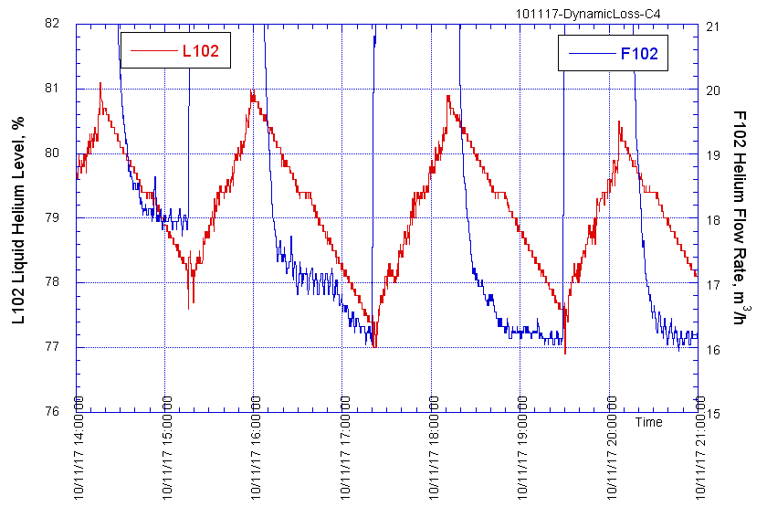
C4 Dynamic Loss Measurement
28MV/m
No RF
Static Loss Meas.
Detuned
28MV/m
Static Loss Meas.
Static Loss Meas.

Slide 3
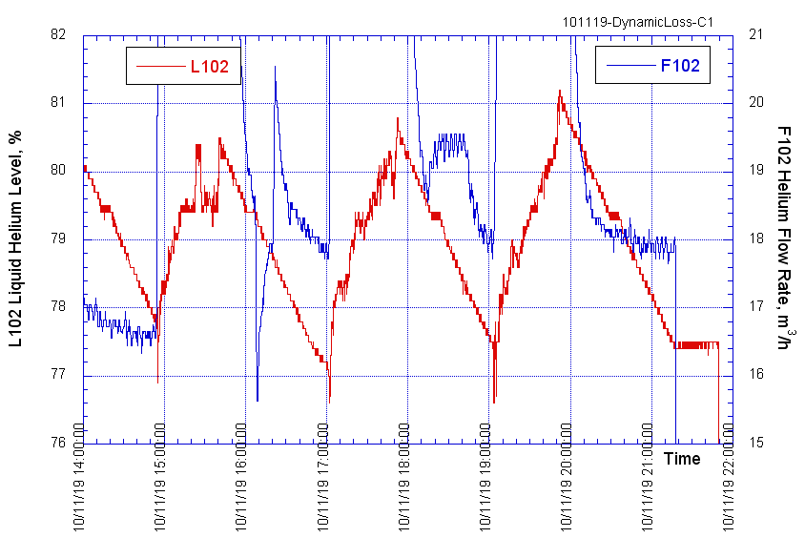
C1 Dynamic Loss Measurement
25.2MV/m
Static Loss Meas.
Static Loss Meas.
Detuned
25.2 MV/m

Slide 4
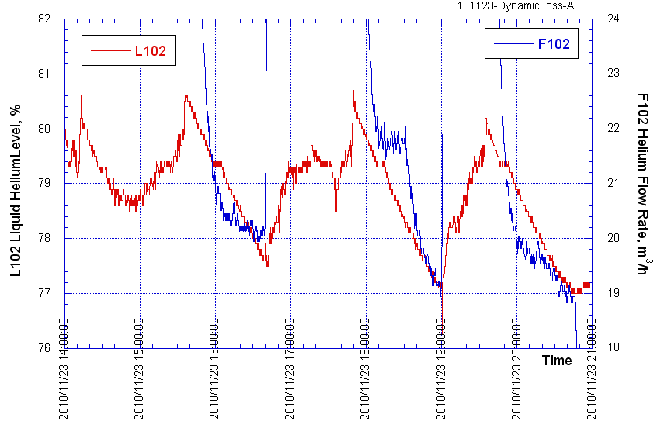
A3 Dynamic Loss Measurement
32.3 MV/m
Static Loss Meas.
Detuned
32.3 MV/m
No RF
Static Loss Meas.

Slide 5
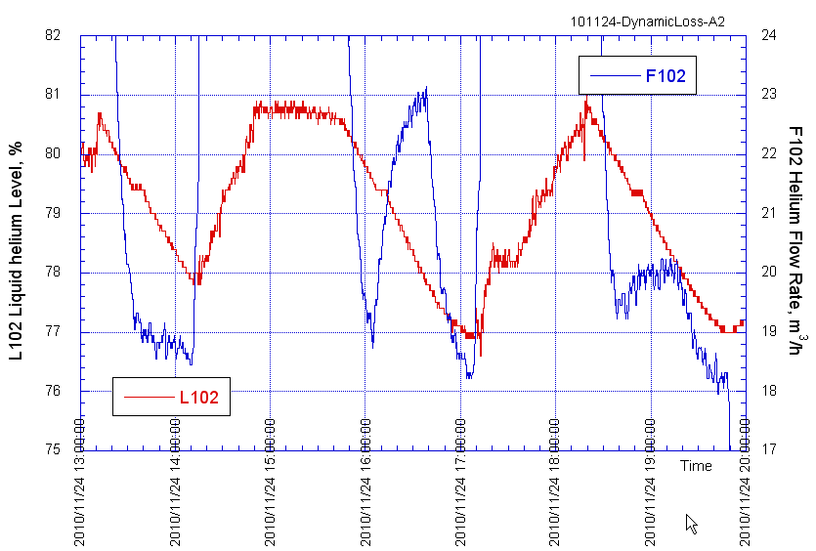
A2 Dynamic Loss Measurement
Detuned
38 MV/m
38 MV/m
Static Loss Meas.
Static Loss Meas.

Slide 6
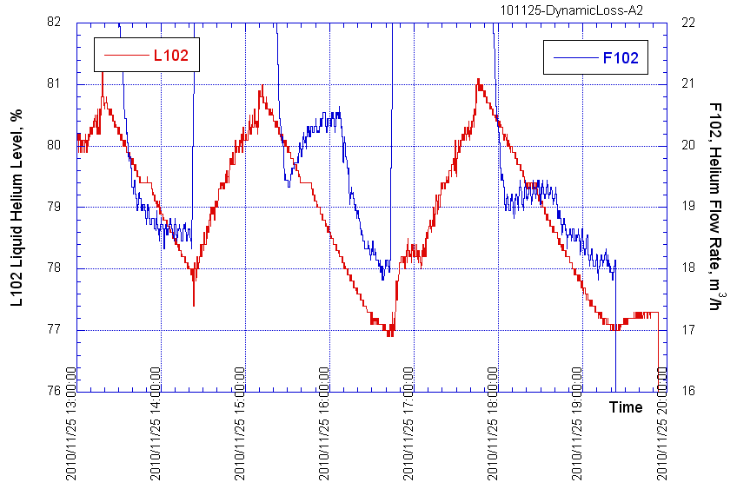
A2 Dynamic Loss Measurement
32 MV/m
Detuned
32 MV/m
Static Loss Meas.
Static Loss Meas.

Slide 7
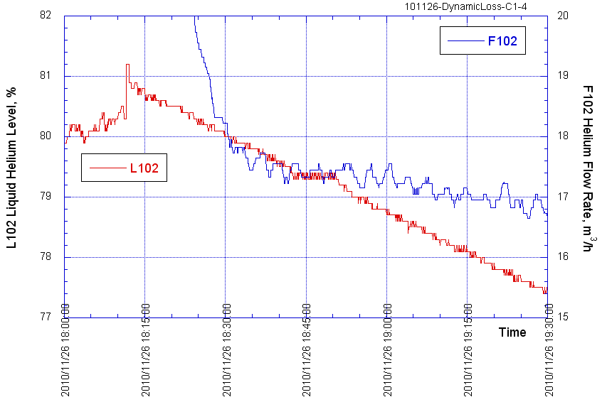
Detuned four cavities (FNAL/DESY)
Detuned 32 MV/m
17.4 m³/h
16.9 m³/h
Static Loss Meas.
Δm= 17.4－16.9 = 0.5 m³/h (= 0.5W)

