Slide 1
PM Introduction & Report
TLCC process: BAW-1 resolution
TLCC process: BAW-2 status
ILCSC PAC meeting – Eugene, Oregon
Interim Report
ALCPG
News from SCRF/CFS&G (optional)
AOB

Slide 2
TLCC Process: BAW-1 Resolution
Proposals:
adoption of ±20% gradient spread in ML
single-tunnel solution for ML
KCS; DRFS; RDR HLRF Technology Option (back-up)
Both proposals formally accepted by Director
After consultation with Change Review Panel
Caveats attached to both, documented in EDMS
(See next slide)
Comments reflect the discussions had by Director/CRP
Email send to AD&I mailing list
Director’s corner to follow

Slide 3
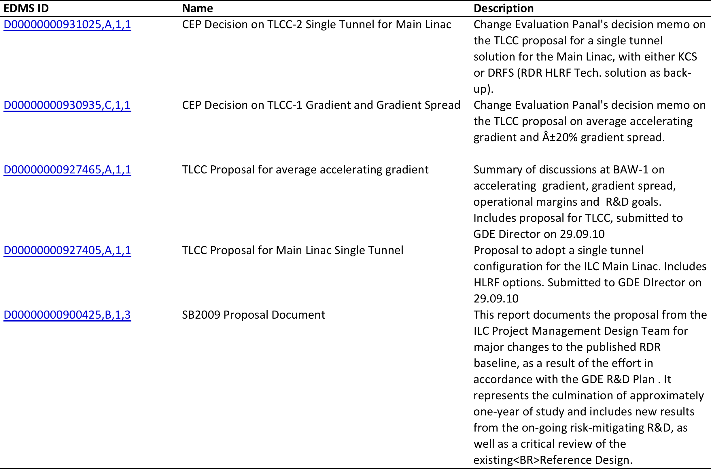
EDMS BAW-1 Documentation
ILC-EDMS Direct Syntax
Any world-accessible ILC-EDMS document can be accessed using the following syntax:
http://ilc-edmsdirect.desy.de/ilc-edmsdirect/document.jsp?edmsid=*nnnnnn
where nnnnnn is the ID number (e.g. for D00000000900425,B,1,3 use 900425).

Slide 4
TLCC Process –BAW-2 status
BAW-2 SLAC, Jan. 18-21
Themes:
Re-location of e+ source to end of e- linac
Reduced bunch number parameter set
Physics parameters and low-Ecm running the underlying theme
To date 47 registered participants
expect ~70
Tentative detailed programme almost complete
(next slide)
Final version to be posted end of this week

Slide 5
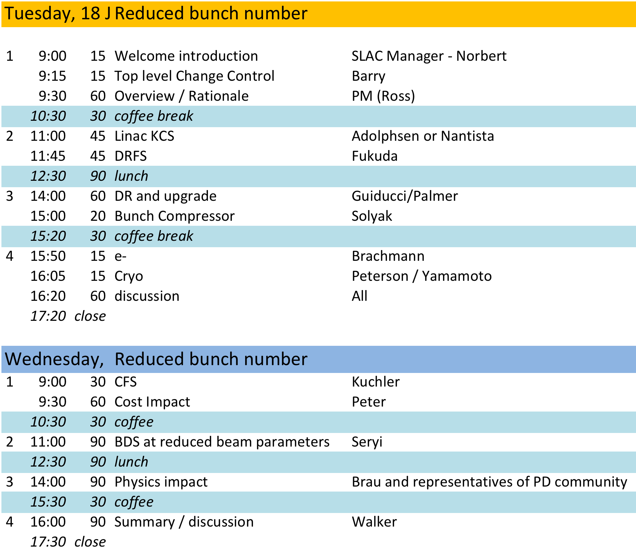
Reduced Bunch Number
NOT FINAL!

Slide 6
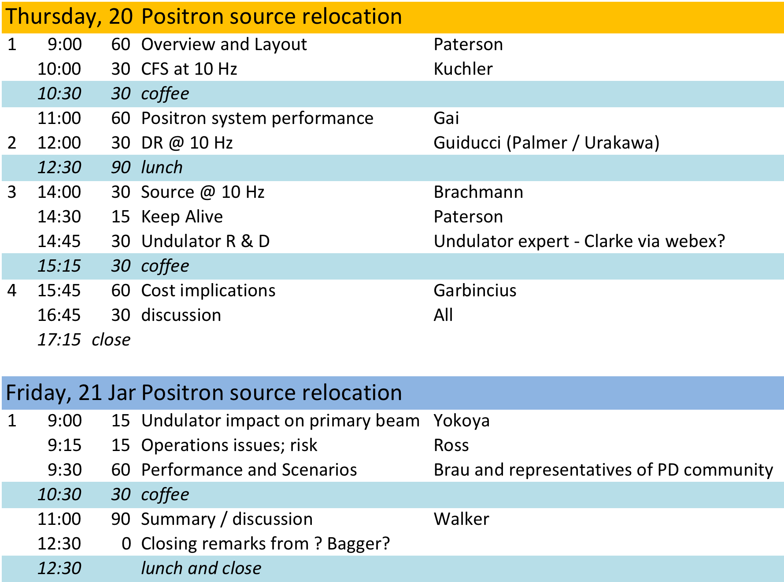
Positron Source Relocation
NOT FINAL!

Slide 7
AD&I Meeting 8.12.2010
CFS Issues
Scope of CFS reduction
Scenarios for restoration of beam power
Configuration constraint
Two many combinations of parameters to realistically consider
Damping Ring: 6.4 vs 3.2km
HLRF: DRFS/KCS/RDR Tech. (I_{beam} = 9mA, 6mA, 4.5mA)
10Hz scenario for low E_{cm} runnning
…
Need to focus on subset for BAW work
Will make separation out of changes difficult
Especially incremental cost analysis

Slide 8
ILCSC PAC review 11-12.11.10
Agenda and talks:
http://ilcagenda.linearcollider.org/conferenceOtherViews.py?view=standard&confId=4680
Michael Peskin’s talk was interesting – in it he explicitly referred to a higher energy for ILC. This is his last slide:
“The tight focus of the GDE on 500 GeV is a disadvantage in the debate over the
correct energy. The question will always be raised: Can we eventually go to
higher energies ?
The GDE and its PAC should discuss a vision for later, higher energy stages of
the ILC. This could play out over decades.
A model is the “site-filler” accelerator vision in the original proposal for
Fermilab. Mike Harrison discussed a staged approach to CLIC with ILC as the
first stage.
Another possible vision is a plasma wake-field accelerator (which could have
the same time structure) as an afterburner to ILC.“

Slide 9
PAC Closeout Notes (1)
1) The panel will strongly underline the fact that both Flash and Xfel are
adequate SRF linac demonstrators. Another such demonstrator is not necessary.
2) It is essential that the core team be maintained post-2012. To keep the
effort from diverging.
3) The committee was really impressed with SRF R&D progress. The recent
results from JLab - 9 out of 10 testing successfully - is a tremendous
achievement. With these results we have made the 'proof of principle' of the
process; we now have to make it cheap.
4) The 9mA studies have made a further step forward. Having some time on
Flash is not a contentious issue.

Slide 10
PAC Closeout Notes (2)
5) The DR extraction kicker studies have proven successful. Now the ATF
team have to get the small beam size.
6) Cornell studies on e-cloud have been comprehensive and better than
studies done anywhere else. Before the work stops it is important to benchmark the modeling codes.
7) SB2009. PAC was impressed with ongoing HLRF R&D at Slac and Kek. There is clearly much better collaboration with the physics community.
8) SRF industrialization. We have to preempt the XFEL costs. We have to be
prepared to explain why the RF for ILC will not be just an extrapolation. LHC
magnets could have been 2x or more expensive. But it turned out much better. We should follow the LHC example. Namely - to ask for the minimum required effort for each part.
The PAC membership has ‘rotated’. Stuart Henderson, Hans Weise and Katsunobu Oide are new members.

Slide 11
ALCPG ‘11
Eugene, Oregon March 19-12, 2011
GDE Workshop (+ regional phys&det)
Standard format (plenary + usual parallel WGs)
GDE focus (highlights)
Planning for TDR
“Writing the TDR starts here!”
Six themes for the TDR
New (approved) baseline for TDR
Special topic: R&D towards ultra-high gradient
In conjunction with discussions on TeV upgrade
Status/planning for on-going R&D (standard)
Tentative agenda should be available soon.

Slide 12
Interim Report
Deadline for draft section submissions WAS Friday November 5
Time is getting very short
AS responsibilities:
Section 3.1 CesrTA – Palmer
Section 3.2 ATF2 – Tauchi, Seryi
Section 3.3.1 e- source – Brachmann
Section 3.3.2 e+ source – Clarke
Section 3.3.3 Damping Ring – Guiducci
Section 3.3.4 BDS – Seryi (iterating)
Section 4.4 Beam Dynamics & Simulation – Kubo, Solyak
Please pay attention to author guidelines distributed

